Slide 1
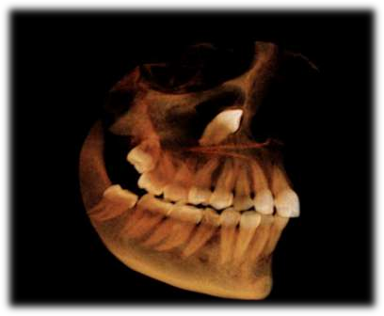

Slide 2

The third molar has been the most widely discussed tooth in the dental literature, and the debatable question “….. to extract or not to extract” seems set to run into the next century. - Faiez N. Hattab, JOMS, 57: 389-391 (1999)
Got their name „Wisdom teeth‟ from the age during which they erupt: 17 to 25. This is the age at which men and women become adults, and, presumably, wiser

Slide 3


According to WHO – An impacted teeth is any tooth that is prevented from reachimg its normal position in the mouth by tissue, bone or another tooth.
According to ARCHER – A tooth which is completely or partially unerupted and is positioned against another tooth, bone or soft tissue so that its further eruption is unlikely, described according to its anatomic position.
According to ANDERSON-An impacted tooth is a tooth which is prevented from completely erupting into a normal functional position due to lack of space, obstruction by another tooth or an abnormal eruption path.

Slide 4


IMPACTION
PRIMARY
RETENTION
SECONDARY
RETENTION
cessation of the eruption of a tooth caused by a clinically or radiographically detectable physical barrier in the eruption path or due to an abnormal position of the tooth.
If no physical barrier can be identified as an explanation for the cessation of eruption of a normally placed and developed tooth germ before emergence.
Cessation of eruption of a tooth after emergence without a physical barrier in the path of eruption or as a result of an abnormal position.

Slide 5
Primary retention is synonymous with
-unerupted teeth
-embedded teeth
 Caused by a disturbance in the dental follicle that fails to initiate the metabolic events responsible for bone resorption in the eruption trajectory.
Secondary retention is synonymous with
-submerged
-Halbretention
-reimpaction
-reinclusion
 Suggested causative factors include ankylosis ,Trauma, infection, disturbed local metabolism, and genetic factors
Raghoebar GM, Boering G, Vissink A, Stegenga B: Eruption disturbanees of permanent molars: a review. J Oral Pathol Med 1991; 20: 159-66.

Slide 6


Slide 7
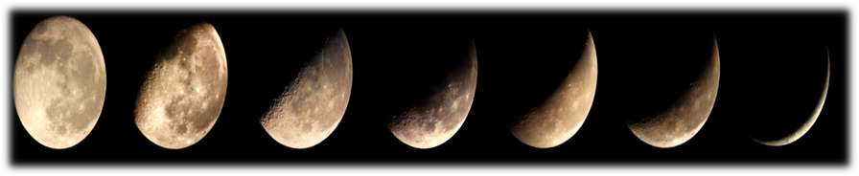
wisdom teeth many a times get impacted, exhibit extreme diminution in size and also show agenesis as a final step towards their ultimate disappearance from our dentition .
19.7%-25.9% third molars shows agenesis.
More common in females than males, in maxilla than in mandible and on right side than left.

Slide 8

 | Max.3rd molars | Man. 3rd molars | Max. & man. canines
First evidence of calcification | 7-9 yr | 8-10 yr | 4-6 months
Crown completion | 12-16 yr | 12-16 yr | 6 yr
Eruption | 17-21 yr | 17-21 yr | 11-13 yr
Root completion | 18-25 yr | 18-25 yr | 14-15 yr
If any tooth fails to erupt beyond 2 yrs of expected time, then it should be
considered unlikely to erupt.

Slide 9

By Durbeck
1) Orthodontic theory :Growth of the jaw and movement of teeth occurs in forward direction,so any thing that interfere with such moment will cause an impaction (small jaw-decreased space).
--Retardation of forward growth can be due to increased bone density which may be caused by
acute infections fevers
severe traumas
local inflammation of periodontal tissues
--Mouth breathing habit
--Early loss of deciduous teeth

Slide 10
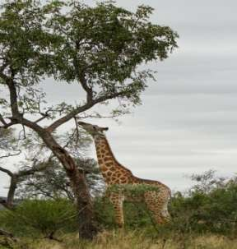
2) Phylogenic theory(nodine): use makes the organ develop better, disuse causes slow regression of organ.
Due to changing nutritional habits of our civilization, use of large powerful jaws have been practically eliminated. Thus, over centuries the mandible and maxilla decreased in size leaving insufficient room for third molars

Slide 11
3) Mendelian theory: Heredity is most common cause. The hereditary transmission of small jaws and large teeth from parents to siblings. This may be important etiological factor in the occurrence of impaction.
4)Pathological theory: Chronic infections affecting an individual may bring the condensation of osseous tissue further preventing the growth and development of the jaws.
5)Endocrinal theory: Increase or decrease in growth hormone secretion may affect the size of the jaws.
.

Slide 12

CAUSES OF IMPACTION
Archer has classified into local and systemic causes
Prenata l causes -Hereditary
Postnatal causes – Rickets, anaemia, tuberculosis,
congenital syphilis, malnutrition
Endocrinal disorders – Hypothyroidism, hypopituitarism, achondroplasia (Due to lack of osteoclastic activity)
Hereditary linked disorders – Down syndrome, Hurlers syndrome, Gardner’s syndrome, Aarskog syndrome, Zimmerman-Laband syndrome and Noonan’s syndrome, Osteopetrosis, Cleidocranial dysostosis, Cleft
palate.(Due to failure of overlying bone to resorb and to develop an eruption pathway)

Slide 13

Inadequate space in the dental arch for eruption – Crowding, supernumerary teeth
Inclination – Failure to upright from mesial inclination
Obstruction of tooth eruption – Irregularity in position & presence of an adjacent tooth , Density of the overlying & surrounding bone , Cysts & tumours, Odontomes, Supernumerary teeth
Nonabsorbing, over retained deciduous teeth Ankylosis of primary or permanent teeth Dilaceration of roots(trauma)
Ectopic position of tooth bud
Non absorbing alveolar bone

Slide 14

mandibular 3rd molars
maxillary 3rd molars
maxillary cuspid
mandibular bicuspids
Maxillary bicuspids
Mandibular canine
maxillary central and lateral incisors

Slide 15

1)Cystic like changes [radiolucent changes consistent with dentigerous cysts)
Internal resorption of the impacted tooth
Periodontal problems(periodontal ligament changes and alveolar bone loss)
Caries and/or resorption (tooth material loss on distal surface of second molar)
Stanley HR, Alattar M, Collett WK, Stringfellow HR Jr, Spiegel EH,Pathological sequelae of "neglected" impacted third molars. J Oral Pathol 1988:17: 113-117.

Slide 16

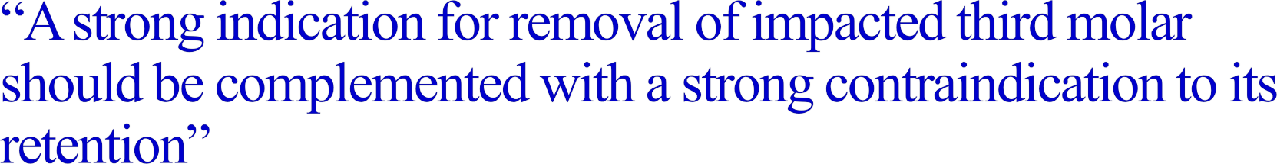




Slide 17
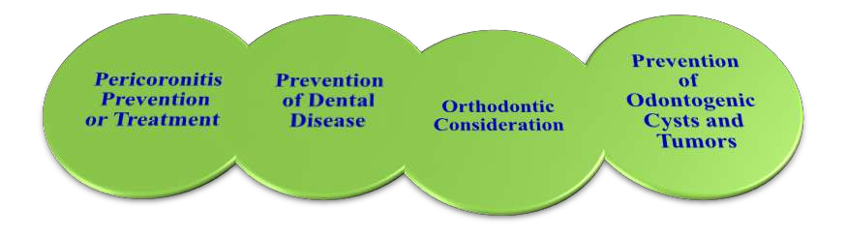
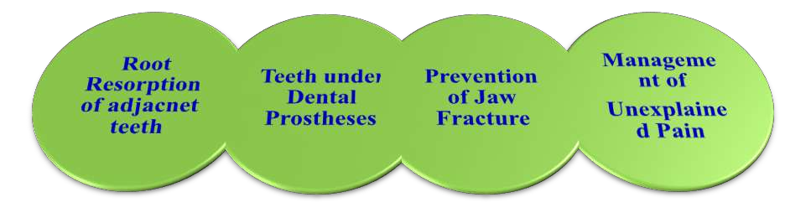

Slide 18

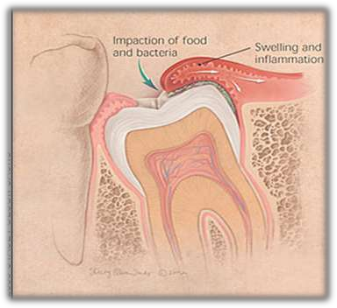
 Pericoronitis is an acute infection with accompanying inflammation of gingival and contiguous soft tissues around the crown of an incompletely erupted tooth.
Pericoronitis was found to be common in vertical (23.0%) followed by mesioangular (15.0%), distoangular(8.0%) and horizontal angulatio(3.0%).
Common in females than males
Streptococcus Viridans is the most common facultative isolate.
The predictivity of mandibular third molar position as a risk indicator for pericoronitis Kemal Yamalık & Süleyman Bozkaya
Clin Oral Invest (2008) 12:9–14

Slide 19
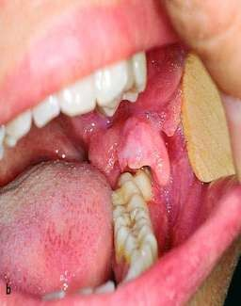
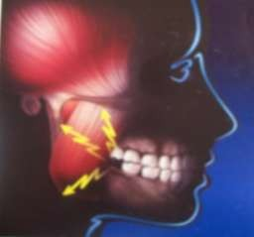
CLINICAL FEATURES
Markedly red, swollen suppurating lesion
Marked tenderness
Radiating pain to the ear, throat, and floor of the mouth.
Foul taste, and an inability to close the jaws.
Swelling of the cheek in the region of the angle of the jaw
and lymphadenitis.
Mandibular movement is limited (Trismus).
toxic systemic complications - fever, leukocytosis and
malaise.

Slide 20
COMPLICATIONS
 pericoronal abscess.
 spread posteriorly into the oropharyngeal area and medially to the base of the tongue, making swallowing difficult.
 Peritonsillar abscess formations, cellulities, Ludwig‟s Angina are infrequent
but potential sequel of acute pericoronitis.

Slide 21


 Mesioangular impactions were most commonly involved with caries
PERIODONTAL DISEASE
ROOT RESORPTION
Misaligned erupting teeth may resorb the roots of adjacent teeth just like succedaneous teeth resorb the roots of primary teeth during normal eruption.
PAIN OF UNEXPLAINED ORIGIN

Slide 22
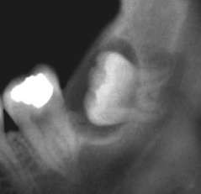
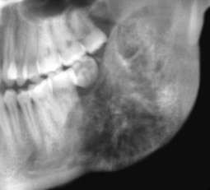


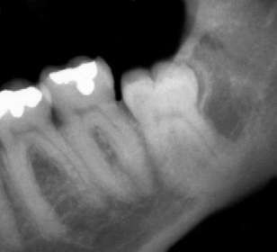
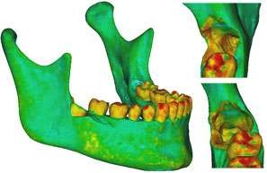
dentigerios cyst or keratocyst.
Ameloblastoma
PREVENTION OF PATHOLOGICAL MANDIBULAR FRACTURES
weakens the mandible by decreasing the cross sectional area of bone
change in the direction of the grain of bone
Patients with MTM are prone to angle # by 2.2 times
Impacted teeth in the line of #
Mandibular third molars as a risk factor for angle fractures: a retrospective study Rajkumar K · Ramen Sinha, Roy Chowdhury,Chattopadhyay PK J Maxillofac Oral Surg 8(3):237–240

Slide 23
 impacted tooth covered by only soft tissue or 1 or 2 mm of bone → Extract!
Facilitation of orthodontic treatment
Preparation for orthognathic surgery Systemic health considerations
Acts as foci of infection
Cardiac patients with heart valve disease or valve replacement
Organ transplant candidates
Autotransplantation
Trauma(Recurrent cheek bite)
Predisposes to premalignant and malignant diseases of oral mucosa

Slide 24
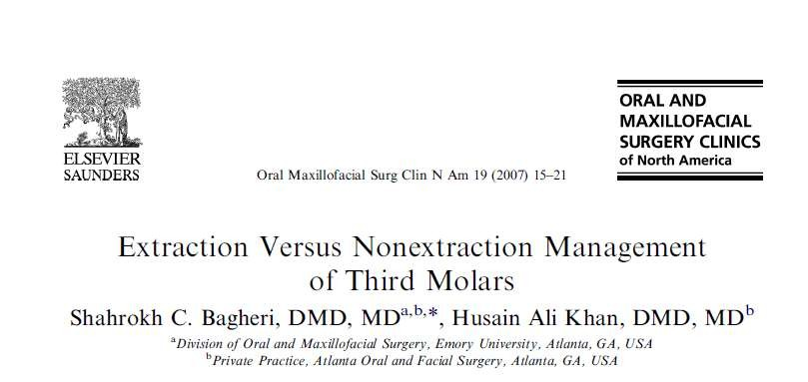
PROPHYLACTIC REMOVAL ?

Slide 25


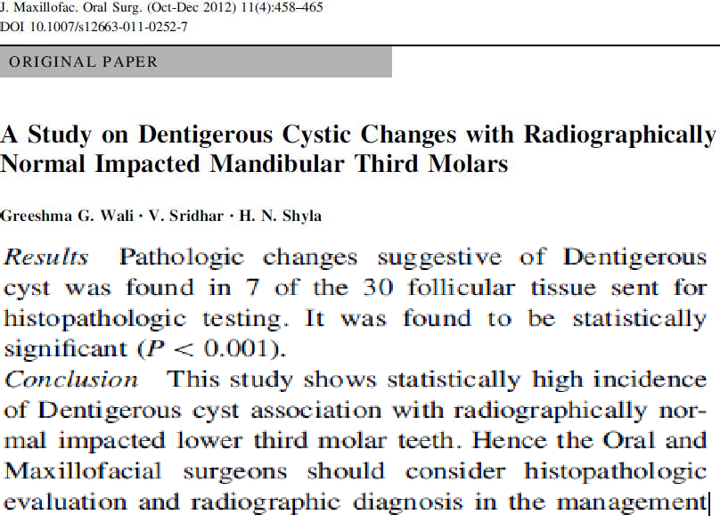

Slide 26
Glosser & Campbell - histologic abnormalities in soft tissue surrounding
impacted third molar teeth in the absence of radiographic signs of pathology.
Wagner and colleagues extraction of third molars in young adulthood would the incidence of mandibular angle fractures & pathologic fracture in older age.
Rakprasitikul - the incidence of ameloblastoma in association with the impacted third molar - <1%
Rionchardson and Dods concluded that most commonly the second molar attachment levels or periodontal depths either remain unchanged or improved after third molar extraction.
Zachrisson- a developing mandibular third molar with insufficient space can be one cause of late mandibular crowding.

Slide 27
oral bacteria associated with periodontal disease –have risk in coronary artery disease, stroke, renal vascular disease, diabetes, and obstetric complications
patients with periodontal attachment loss have increased levels of biochemical markers of inflammation compared with controls.
- AAOMS Third Molars Clinical Trials
Offenbacher and colleagues -periodontal disease and the risk of preterm delivery.
The incidence of nerve injuries is statistically associated with the age of the patient.The roots of the third molars are usually not fully formed until age 21.Subsequently, extraction of third molars in the teenage years is associated with a lower incidence of inferior alveolar nerve injury.
Greater regenerative capacity of younger adults is associated with a greater chance of recovery with nerve injuries

Slide 28


Iida and colleagues(2004) and Zhu and colleagues(2005) -reported a significant association between removal of impacted lower mandibular molars and mandibular condyle fractures.
Current publications report a significant variation from 0.5% to 5% injuries for the inferior alveolar nerve and 0.6% to 2% for the lingual nerve .If asymptomatic impacted mandibular third molars are found to bear no future oral or systemic health risks, it would be unnecessary to put a patient at risk for lingual or inferior alveolar nerve injury.
 economic restraints in socioeconomically poor populations

Slide 29
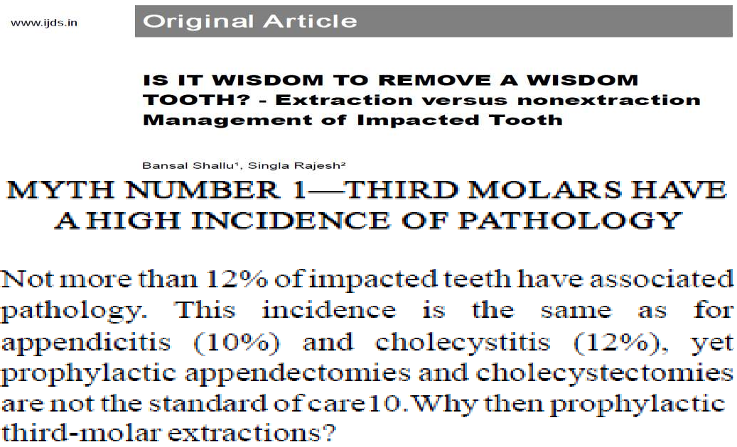

Slide 30
NICE(NATIONAL INSTITUTE FOR CLINICAL EXCELLENCE)
GUIDELINES ON EXTRACTION OF WISDOM TEETH(2000)
The practice of prophylactic removal of pathology-free impacted third
molars should be discontinued .
Surgical removal of impacted third molars should be limited to patients with evidence of pathology
The evidence suggests that a first episode of pericoronitis, unless particularly severe, should not be considered an indication for surgery. Second or subsequent episodes should be considered the appropriate indication for surgery.

Slide 31

Healing 
Longer recovery periods
Difficult - more densely calcified bone
Bone removal is more due to reduced PDL space
Extremes of Age -
Surgical Damage to adjacent Structures
If benefits  than complication, don‟t
extract
Compromised Medical Status
Prosthetic considerations – Can be used as abutment
Socioeconomic reasons

Slide 32



























GEORGE WINTER’S CLASSIFICATION
Based on the relationship of the long axis of the impacted tooth in relation to the long axis of the 2nd molar
Mesioangular – Most common type(43%) because mandibular third molars follow an mesial inclination while eruption, least difficult to remove but most damaging
Vertical Horizontal Distoangular
2nd most common type(38%)
- 3%
Most difficult to remove (6%)
Buccoangular Linguoangular Transverse Inverted
SIGNIFICANCE - Each type of impaction has some definite path of withdrawal of
the teeth.

Slide 33
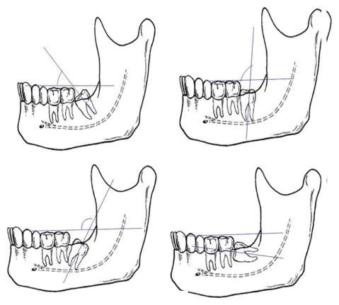
Mesial Vertical Distoangular Horizontal
Angle between 10̊ & 80̊ Angle between 80̊ & 100̊ Angle above 100̊
Angle between 350 ̊& 10̊
Incidence of cystic changes in impacted lower third molar Shridevi R Adaki, Yashodadevi BK, Sujatha S, N Santana, Rakesh N, Raghavendra Adaki

Slide 34
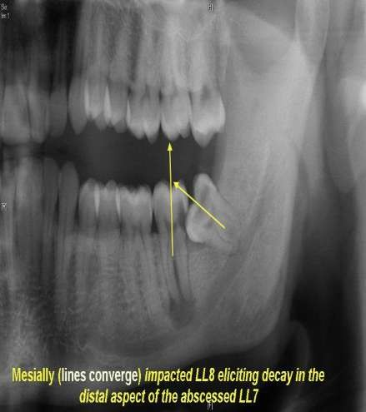
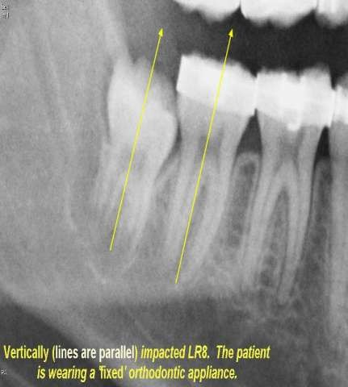
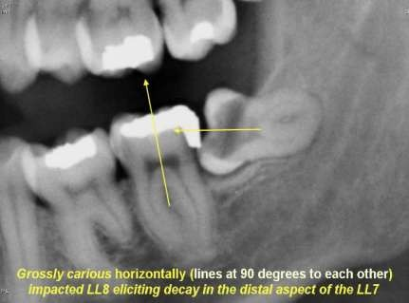
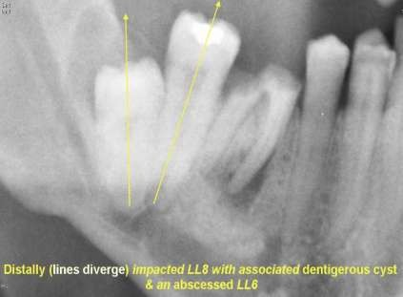

Slide 35
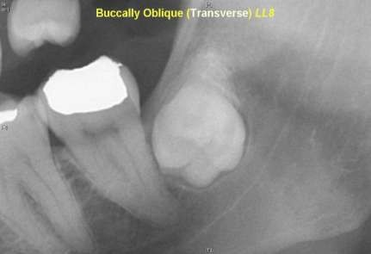
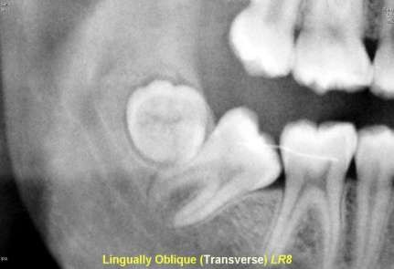
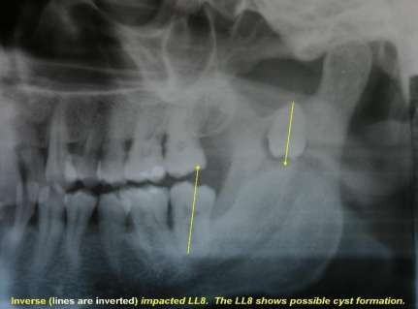
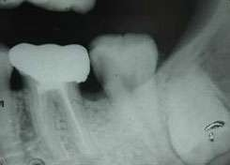

Slide 36
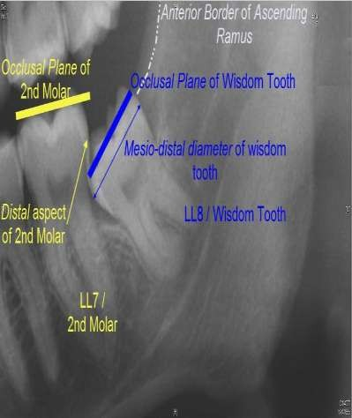
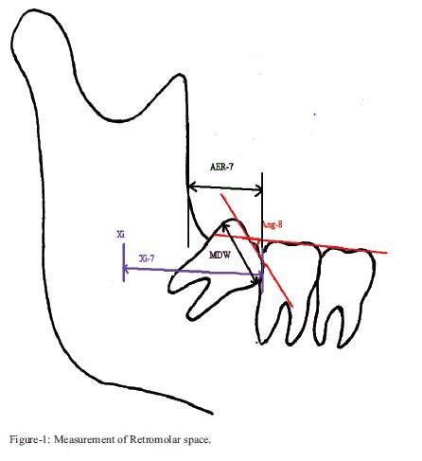
TERMS & MEASUREMENTS USED

Slide 37






Relation of the tooth to the ascending ramus of the mandible and to the
distal surface of the 2nd molar
Shows the anterioposterior relationship of the tooth to the arch and the amount of resistance offered by the bone of the ascending ramus that may influence the tooth removal
CLASS I
CLASS II – Most common CLASS III
Relative depth of the third molar in bone
Shows the superior inferior relationship of the tooth in relation to the
occlusal plane.
POSITION A
POSITION B – Most common POSITION C
3.WINTER‟S CLASSIFICATION

Slide 38
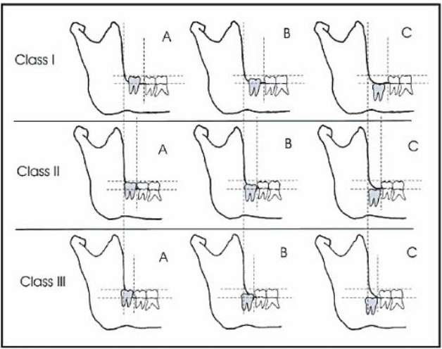

Slide 39


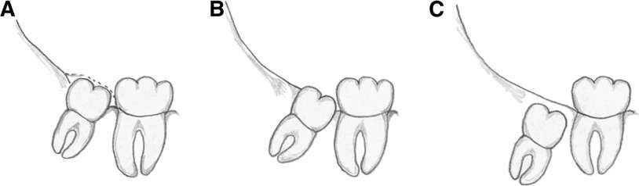
07220-Soft tissue impaction
07230-Partial bony impaction
Based on clinical and radiographic interpretation of the tissue overlying the impacted teeth
07240-Complete bony impaction
07241-Complete bony impaction with unusual surgical complications

Slide 40












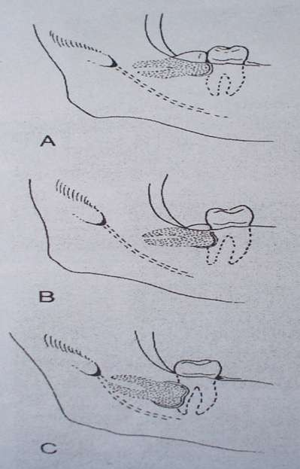
 Crown to crown
 Crown to cervix
 Crown to root

Slide 41
Killey & Kay’s Classification
a) Based on angulation and position:
(Same as Winter‟s classification)
b) Based on the state of eruption:
Completely erupted
Partially erupted
Unerupted
c) Based on roots:
Number of roots - Fused roots
  Two roots
  Multiple roots
2) Root pattern
Surgically favorable
Surgically unfavorable

Slide 42




 Compare the distance between the roots of 2nd & 3rd molars with that of 1st & 2nd

Slide 43


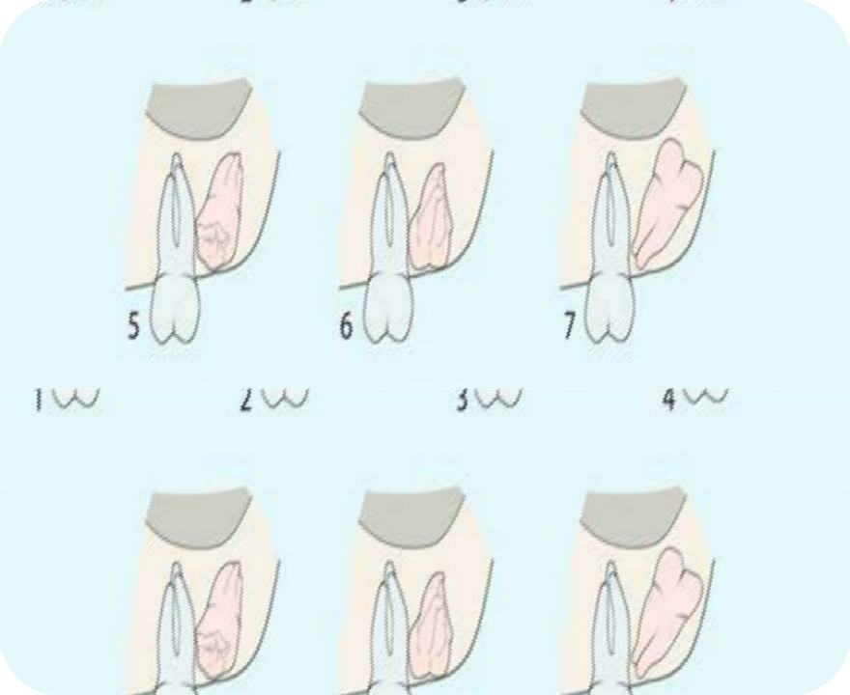
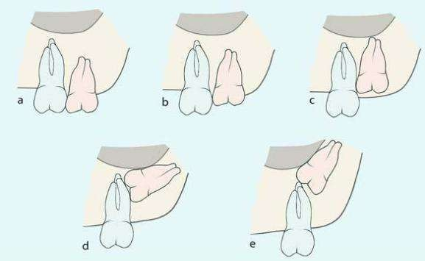

2.According to depth of impaction
1.According to angulation

Slide 44
3.The relationship of tooth to maxillary sinus :
a-sinus approximation (s.a) :
where no bone or very thin bone exist between the impacted teeth and floor of sinus.
b-no sinus approximation (n.s.a) :
where 2 mm or more of bone exist between the floor of sinus and impacted teeth.

Slide 45


Mandibular 3rd molar impaction than maxillary 3rd molar impaction.
In females than in males
Among mandibular 3rd molar, mesioangular.
Class II A- Obiechina et al.
Class II B- Blondeau et al. (canada) & Almendros-Marques et al.(spain)
Among maxillary 3rd molars
Vertical - Quek et al Mesioangular -Kruger et al.

Slide 46


 EXTRA ORAL:
Signs of swelling & redness of the cheek.
LN‟s - enlargment & tenderness.
Anesthesia or paraesthesia of lower lip.
INTRA ORAL:
  Mouth opening & any evidence of trismus
  State of eruption of tooth, signs of pericoronitis
  Condition of 1st & 2nd molars
  Space present b/w 2nd M & ascending ramus
  Elasticity of oral tissues
  Size of tongue

Slide 47


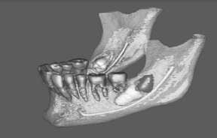
INTRA ORAL RADIOGRAPHS
  IOPA
  Occlusal
EXTRAORAL RADIOGRAPHS
  OPG
  Lateral cephalometric
DIGITAL IMAGING
  CT
  CBCT
LOCALIZATION TECHNIQUES:
-Buccal object rule (SLOB)
- Magnification
-CBCT(3D)

Slide 48
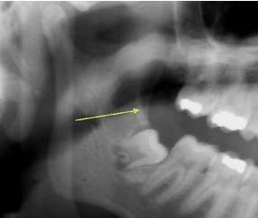
Type of impaction
Access - External oblique ridge
oblique & post.to third molars – good access
vertical & ant. to third molar – poor access
Position & depth (WAR lines)
Existing pathology
-Dental caries in II and III molars
-Periodontal problems
-Presence or absence of I molar
-Fused roots of II and III molars
-Any associated pathologies like cysts , odontomes.

Slide 49
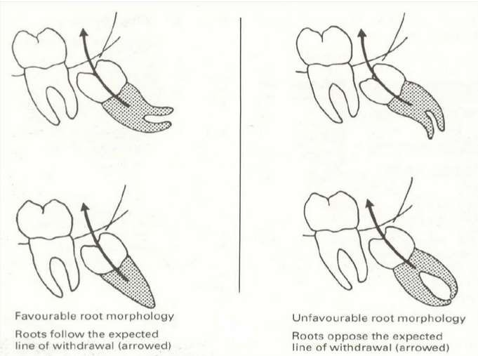
Assessing the buccal / lingual obliquity
Crown – sharp & well defined –Lingual obliquity -difficult Root apices - sharp & well defined -Buccal obliquity
Shape of the crown
Large square crown – difficult
Root pattern

Slide 50

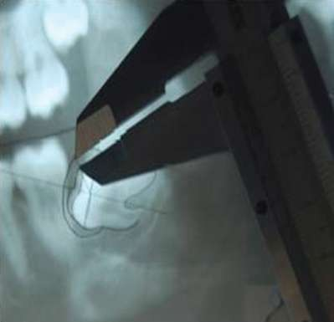
8. Path of withdrawal
9. Size of the follicular sac
FLAP DESIGN
AMOUNT OF BONE REMOVAL
TOOTH ELEVATION & SECTIONING
NATURAL PATH OF WITHDRA WAL
10. Texture of investing bone

Slide 51
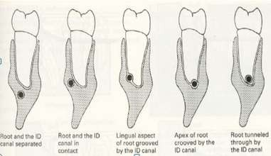
11.Relationship of Root to Canal
Related but not involving the canal
Separated
Adjacent
Superimposed

Slide 52
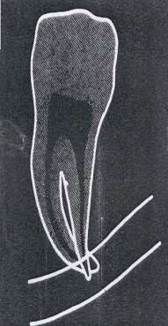
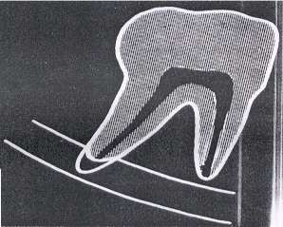
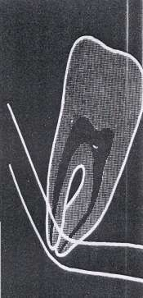
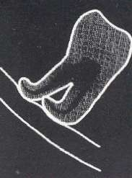
Related to changes in the roots
Calcification of inferior alveolar canal is completed before the roots of 3rd molar are formed. Thus growing roots may impinge upon the canal or get deflected. So blind elevation is not advisable.
Darkening of root
Dark and bifid root
Narrowing of root
Deflected root
DARKENING OF ROOT
DARK & BIFID APEX
NARROWING OF CANAL
DEFLECTION OF ROOT

Slide 53
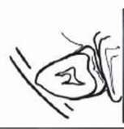
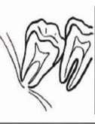
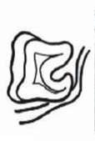
Related with changes in the canal
Interruption of lines
Converging canal
Diverted canal

Slide 54





(1) regardless of age, females had significantly shorter vertical distances from the IAN to the mesial and distal apices.
Females had shorter horizontal distances for total width of mandibular bone at mesial and distal apices.
the overall width of the mandibular bone decreased in both genders from the 3rd–6th decade of life.
Age- and Gender-related Differences in the Position of the Inferior Alveolar Nerve by Using Cone Beam Computed Tomography Jay D. Simonton, DDS, Bruno Azevedo, DDS, MS, William G. Schindler, DDS, MS,and Kenneth M. Hargreaves, DDS, PhD

Slide 55






Slide 56
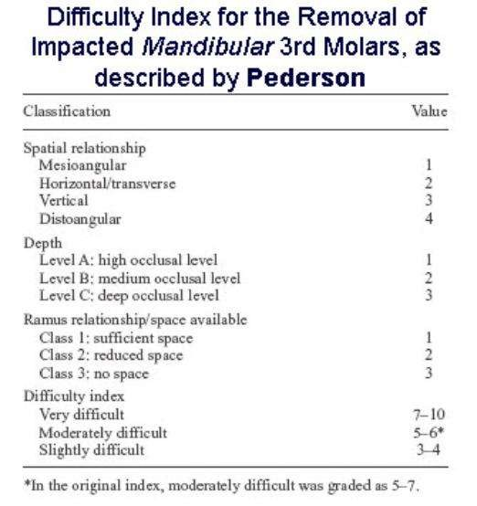

Slide 57
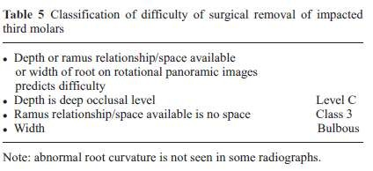
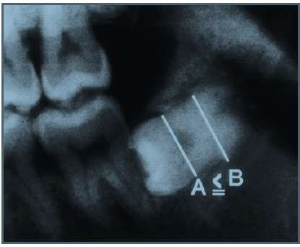
Scale of difficulty by YAUSA et al
Yuasa H, Kawai T, Sugiura M. Classiﬁcation of surgical difﬁculty in extracting impacted third molars. Br J Oral Maxillofac Surg 2002;40:26–31.

Slide 58







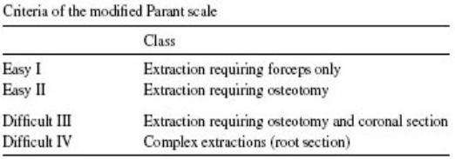

Slide 59

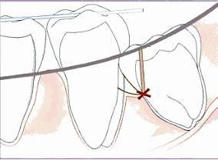
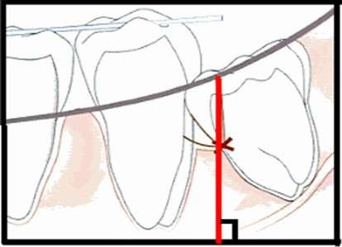
The red line when extended to the inferior
edge of the radiograph should meet at 90
Red line <5mm: extraction - easy, there after every 1mm increase in depth increases the difficulty three folds (Geoffrey Howe)& if it is >9mm then plan the surgery under GA or LA with sedation

Slide 60


Change of angulation of the film causes the ‘‘red-line’’ to change in length significantly. The red-line in B is shorter by ( 30 % )than in A with a 15 change in angulation of the film.
The ‘‘Red Line’’ Conundrum: A Concept Beyond Its Expiry Date? Sanjeev Kumar • Mahendra P. Reddy • Lokesh Chandra • Alok Bhatnagar : JMOS 02 aug 2013

Slide 61


Slide 62
1.WINTERS CLASSIFICTION
Horizontal Distoangular Mesioangular
2
3
1
Vertical 0
1-30mm 31-34mm
0
1
2.HEIGHT OF MANDIBLE
35-39mm 2
1 - 50
0
1
2
3
3.ANGULATION OF THIRD MOLAR 60
70
80
- 69
-79
- 89
90 + 4
Complex Favourable curvature Unfavourable curvature
1
2
3
4.ROOT SHAPE
Normal Possibly enlarged
Enlarged
0
1
2
5.FOLLICLE
6.PATH OF EXIT
Space available Distal cusp covered Mesial cusp covered Both cusp covered
0
1
2
3

Slide 63
Factors that Make Surgery Less Difficult
Mesio-angular impaction
Class 1 ramus
Class A depth
Roots 1/3 – 2/3 formed (present in the younger patient)
Fused conical roots
Wide periodontal ligament (present in the younger patient)
Elastic bone (present in the younger patient)
Separated from 2nd molar
Separated from IDN
Soft tissue impaction

Slide 64
Factors that Make Surgery More Difficult
Disto-angular impaction
Class 3 ramus
Class C depth
Long thin roots (present in the older patient)
Divergent curved roots
Narrow periodontal ligament (present in the older patient)
Dense, inelastic bone (present in the older patient)
Contact with 2nd molar
Close to IDN
Complete bony impaction

Slide 65
Patient factors predicting increased difficulty of third molar removal
Obesity
Dense bone
Large tongue
Strong gag reflex
Position of the inferior alvelolar canal
Advanced age
Superiorly positioned maxillary third molar
Fractious patient
Apical root of lower third molar in cortical bone
Uneven anesthetic
Atrophic mandible
Limited surgical access
Location of maxillary sinus
Third Molar Removal: An Overview of Indications,Imaging, Evaluation, and Assessment of Risk Robert D. Marciani, DMD

Slide 66



 Location: lower 3rd molar is situated at the distal end of the body of the mandible where it meets a relatively thin ramus.
Embedded b/w thick buccal alveolar bone buttressed by external oblique ridge & the narrow inner cortical plate.
Ramus offset by 20°-Distal incision should be curved towards buccal side.
Thick oblique ridge
Bone trajectories and grains

Slide 67


Most prevalent types of retromolar triangles,according to Suazo et al.,2007
A. Tapering form 9.16%; B. Drop form 10.83%; C. Triangular form 80%.

Slide 68

The prevalence of the RMF and RMC was 12.9%. Contents of the canal originates from mandibular neurovascular bundle before it enters tha mandibular canal
Neurovascular elements from the retromolar canal and foramen are distributed mainly in the tendon of the temporalis muscle, in buccinator muscle, in the region of the alveolar process and in the mandibular third molar, at its distal portion.
excessive bleeding or postoperative hematomas (Azaz & Lustmann, 1973) or the post- anesthesia of the area if the package was injured during a surgical procedure (Petruzzelli et al., 2003).

Slide 69


Muscles:
Vestibule is formed by the attachment of buccinator buccally and mylohyoid
lingually.
Along the anterior border of the ramus - tendinous insertion of temporalis Excessive stripping of these muscle will cause hematoma, pain and trismus.
Lingual pouch

Slide 70

Arteries
Facial artery & facial vein run in close approximation with lower 1st molar near the anterior border of masseter.
Mandibular vessels in retro molar triangle which supply temporalis tendon.
Hemorrhage can occur during surgical removal of impacted tooth if distal
incision is not taken laterally towards cheek.

Slide 71
By NORTJE et al.,1977
Type I: Bilaterally single high mandibular canals-single high canals either
touching or within 2 mm of the apices of 1st and 2nd permanent molars.
Type II: Bilaterally single intermediate canals-single canals not fulfilling the criteria for either high or low canals
Type III: Bilateral single low canals-single canals either touching or within 2mm of the cortical plate of the lower border of the mandible
Type IV: Variations including-asymmetry,duplications and absence of mandibular canals

Slide 72


BIFID & TRIFID MANDIBULAR CANALS
Most commonly occurs in females
During embryonic development, three separate canals fused to
form a single canal.Failure of this fusion results in bifid or trifid canals
–CHAVEZ LOMELI

Slide 73


Lingual nerve lies inferior and medial to the crest of the lingual plate of
mandible with a mean position of 2.28mm(+/-0.9) below the crest & 0.58mm(+/-0.9) Medial to crest-KIESSELBACH& CHAMBERLAIN
In 17% of cases it lies superior to the lingual plate

Slide 74



Slide 75



The scalpel is held with thumb, middle and ring finger while the index finger is placed on the upper edge to help guide the scalpel.
The scalpel should never be used in a "stabbing" motion especially while raising a flap.

Slide 76
Surgical Management
John Tomes (1849) – first to describe surgical access
Steps in surgical removal
  Anesthesia
  Incision and mucoperiosteal flap
  Removal of bone
  Tooth removal
  Wound debridement
  Arrest of haemorrhage
  Wound closure
  Postoperative follow-up

Slide 77


Mostly performed under LA
Indications of GA
When red line > 5mm
When more than two impacted teeth have to be removed at one time Emotional liability
Fear of pain & apprehension
Medical condition requiring alleviation of anxiety Lengthy procedure
Unco op. patient

Slide 78

Principles of flap design
Incisions should avoid anatomical structures, such as major nerves or blood vessels.
Incisions far enough away from the surgical area: The wound margins should rests on sound bone
The base of the flap should be wider than the apex to ensure adequate blood supply.
A firm pressure upon a sharp scalpel should be used so that both the mucosa and periosteal layers of the gingiva are incised down to bone

Slide 79
Incisions are made in one operation, as extensions.
Cut the soft tissues at right angles to the surface of underlying bone.
The MPF should be made large enough to provide for visibility, accessibility and adequate room for instrumentation.
The vertical releasing (relaxing) incision should be avoided if the horizontal incision will provide adequate access. This is because the vertical releasing cut
  reduces the blood supply to the flap
  and cause added discomfort
The vertical releasing incision, if needed, should be made at a line angle to maintain the integrity of the interdental papilla.
Schow(1974) –Extending flap beyond EOR increases the chances of dry socket formation

Slide 80



The incision having 3 parts
LIMB A: The anterior incision started from buccal sulcus approx. at the junction of posterior and middle third of 2nd molar, passes upwards extended upto the distobuccal angle of the 2nd molar at the gingival margin .
LIMB B:It was carried along the gingival crevise of third molar extending upto the middle of exposed distal surface of the tooth
LIMB C: Started from a point where intermediate gingival incision ended and was carried laterally towards cheek at mucosal depth.This arm should be about 2 cm long.

Slide 81

LIMB C - not to be extended too distally
Bleeding from buccal vessels & other arteries
Postoperative trismus – temporalis muscle damage
Herniation of buccal fat pad
Damage to lingual nerve (lingual extention)
 In case of unerupted tooth ,intermediate incision is not needed.The limb A is extended upto the middle of the distal surface of the 2nd molar
◻ Partly visible crown: de-epitheliazation

Slide 82


(Two cornered flaps )
Envelope flap
- Short Long
Triangular flaps
(Three cornered flaps)
L shaped flap Bayonet shaped flap Ward‟s incision
Modified ward‟s incision
Comma shaped incision S shaped incision Szmyd flap
Modified szmyd flap Berwick‟s tongue flap
Groove & Moore(1970)

Slide 83


ENVELOPE FLAP
 Incision is made horizontally along the crest of the ridge or in the buccal gingival crevice.
Has no vertical incision.
For shallow or superficial impactions
Advantages
Provides the broadest base and fully covers the resultant bony cavity.
There is little danger of violating any major anatomical landmarks.
During the procedure, the envelop flap can be
extended as needed; if still greater access is required

Slide 84

Ward’s incision
Modified ward’s incision

Slide 85






Suits only for buccal approach
2nd molar paramarginal Flap with vestibular extension
Vertical relieving incision is given at 45˚ angle to the long axis of the 2nd molar and runs straight anteriorly and downwards.
Bayonet – shaped flap
Distal limb
Mesial limb
Intermediate gingival incision

Slide 86



Designed by Nageshwar
Indications:
Total soft tissue impaction Advantages
No part of wound lies on resultant bone defect Less postoperative pain and swelling

Slide 87



Incision was made from the retromolar fossa across the external oblique ridge curving down through the attached mucoperiosteum to run along the reflection of the mucous membrane to the anterior border of the first permanent molar

Slide 88



SZMYD FLAP
MODIFIED SZMYD FLAP
A vertical incision line from the distofacial line angle of the second molar apically to the mucogingival line approximately 2 to 3 mm
 envelope flap with the incision beginning just medial to the external oblique ridge and extending to the middle of the
distal aspect of the second molar
 sulcular incision

Slide 89





Extende onto the buccal shelf of the mandible
Incision line did not lie over the bony defect created by the removal of the impacted teeth
Its base at the distolingual aspect of the second molar

Slide 90



A collar of tissue was preserved around the 2nd molar hence decreasing the pocket formation
A lingual extension of the incision allowed for exposure of the lingual
aspect as well

Slide 91


elevation and retraction of a lingual flap, and the placement of a retractor (Walters-type lingual retractor )
one can see more clearly where one is drilling, and the lingual nerve is protected

Slide 92




A periosteal elevator is used as a retractor for small flaps and the Minnesota or Austin retractors for large flaps.
Austin
Minnesota
Periosteal
elevator

Slide 93

Aim
1. To remove the bone obstructing the pathway for removal of the impacted tooth.
Types
By consecutive sweeping action of bur (in layers).
By chisel or osteotomy cut (in sections). How much bone has to be removed?
Bone should be removed till we reach below the height of contour, where we can apply the elevator.
Extensive bone removal can be minimized by tooth sectioning.
The surgeons should apply a handpiece load of approximately 300g and an irrigation rate of 15mL/mL to 24mL/min (Sharon et al Oral SUR oral Med Oral Pathol Oral Radiol Endod 1999)

Slide 94






-The chisel(Monobeveled) is a fine instrument for removing bone.
Osteotome is bibeveled.
Driven by hand, mallet or engine(impactor).
Bone Gauge
Unibeveld Chisel
Bibeveld Chisel
Mallet

Slide 95

BONE BURS
Ideal length of the bur used is 7mm & diameter of 1.5mm.
Available in many forms: crosscut fissure burs, tapered, or round.
Necklace or postage-stamp pattern

Slide 96


Moore & Gillbe’s Collar(BUCCAL GUTTERING) Technique
Conventional tech of using bur.
Rosehead round bur no.3 is used to create a gutter along the buccal side & distal aspect of tooth.
A point of elevation is created with bur.
Amount of bone sacrificed is less.
Can be used in old patient.
Convenient for patient.

Slide 97







Indicated for removal of unerupted third molars in the age groupof 9 to 16 years.
A modified S shaped incision is made from the retro molar fossa across external oblique ridge.
Such an incision leaves behind
5mmcuff of attached mucosa at the distobuccal
region of second molar.

Slide 98




Slide 99

Split Bone / Lingual Split Technique
Sir William Kelsey Fry(1933)
INCISION
VERTICAL STOP CUT
HORIZONTAL CUT
SPLIT OF DISTOLINGUAL BONE
REMOVAL OF BUCCAL
& DISTOLINGUAL BONE
ELEVATION
REMOVAL OF DISTOLINGUAL BONE
CLOSURE

Slide 100



 Rationale of tooth sectioning is to create a space into which impacted tooth can be displaced & thence removed.
Bone belongs to the patient and the tooth belongs to the surgeon
Indication:
Multi-rooted teeth with different lines of withdrawal
Tooth division may be done using a bur, an osteotome or tooth-splitting forceps (tooth shear forceps).

Slide 101

MESIOANGULAR IMPACTION
B. The distal aspect of the crown is then sectioned from tooth. Occasionally it is necessary to section the entire tooth into two portions rather than to section the distal portion of crown only
C . A small straight elevator is inserted into the purchase point on mesial aspect of 3rd molar, & the tooth is delivered with a rotational and level motion of elevator.
A. buccal and distal bone are removed to expose crown of
tooth to its cervical line.

Slide 102

HORIZONTAL IMPACTION
Removal of distal and buccal underlying bone
The crown is sectioned from the roots of the tooth and
is delivered from socket.
C, The roots are delivered together or independently with a Cryer elevator used with a rotational motion. Saperation of root into 2 parts - occasionally the purchase point is made in the root to allow the Cryer elevator to engage it.
D, The mesial root of the tooth is elevated in similar fashion

Slide 103

VERTICAL IMPACTION
A. When removing a vertical impaction, the bone on the occlusal, buccal, and distal aspects of the crown is removed, and the tooth is sectioned
into
mesial and distal portions.
B. The posterior aspect of the crown is elevated first
with a Cryer elevator inserted into a small purchase point in the distal portion of the tooth.
C. A small straight no. 301 elevator is then used to lift the mesial aspect of the tooth with a rotary
and levering motion.

Slide 104

DISTOANGULAR IMPACTION
Removal of mesial & distal boen. It is important to remember
that more distal bone must be taken off than for a vertical or mesioangular impaction.
The crown of the tooth is sectioned off with a bur and is
delivered with straight elevator
C, The purchase point is put into the remaining root portion of the tooth, and the roots are delivered by a Cryer elevator with a wheel and- axle
motion. If the roots diverge, it may be necessary in some cases to split them into independent portions

Slide 105



Triangular flap
Envelope flap

Slide 106


Slide 107


GUIDANCE THEORY
(Miller)
Canine erupts along the root of lateral incisors, which serve as a guide, and if the lateral incisor is absent or malformed, the canine will not erupt.

Slide 108

Genetic factors are primary origin of palatally displaced maxillary canine and include other possibly associated dental anomalies, such as missing or small lateral incisor
GENETIC THEORY

Slide 109








ETIOLOGY OF CANINE IMPACTION LOCALIZED CAUSES
Tooth size- arch length discrepancies
Failure of the primary canine root to resorb
Prolonged retention or early loss of primary canine
Ankylosis of permanent canine
Cyst or neoplasm

Slide 110







Dilaceration of the root
Absence of maxillary lateral
incisor
Variation in timing of lateral incisor root formation
Iatrogenic factors Idiopathic factors

Slide 111






SYSTEMIC
Endocrine deficiencies
Febrile diseases Irradiation

Slide 112






GENETIC
Heredity
Malposed tooth germ Presence of alveolar cleft

Slide 113


 Maxillary canine impaction occurs in approximately 2% of the population.
More common
In females than in males Maxillry than mandibular
Palatally placed than labially in maxilla Labially placed than lingual in mandible

Slide 114







Migration of neighbouring teeth and loss of arch length
Labial or lingual malpositioning of impacted tooth
Internal resorption or external root resorption of impacted or neighbouring tooth
Dentigerous cyst formation
Infection particularly with partial eruption
Referred pain

Slide 115


Class I: Palatally placed maxillary canines a)vertical,
Horizontal
Semivertical
Class II: Labialy placed maxillary canines a)vertical
Horizontal
Semivertical
Class III: Impacted cuspid located both in the palatal and labial bone.
Class IV: Impacted in the alveolar process between the incisors and first premolars
Class V:impacted cuspid that are present in an edentulous maxilla and may assume any of the previous three classes.

Slide 116

Labial Vertical Oblique Horizontal
Aberrant
At inferior border On the opposite side

Slide 117

Study model analysis
Amount of space available in dental arch for impacted canine is assessed in model.
Morphology of adjacent tooth
Gives clue of position of impacted tooth.
Contours of adjacent alveolar bone
Canine bulge present buccally or palatally.
Mobility of adjacent tooth
Root resorption.
Failure to palpate canine bulge in buccal vestibule by 10 years

Slide 118





Age of patient
General dental health and oral hygiene
General dental health and oral hygiene
Availability of space
Suitability of 1st premolar to replace a permanent canine
Radiographic position of canine
Patient motivation for orthodontic applainces
Presence of adequate width of attached gingiva

Slide 119

Involves
inspection,
palpation, and
radiographic evaluation
PARALLAX TECHNIQUE: Two radiographs taken at different horizontal angles
with the same vertical angle.
Locates canine positioned buccally or palatally to other teeth in the arch
Combinations used :
Two IOPA‟s taken at different horizontal angles(Clark,1909)
One maxillary anterior occlusal & one maxillary lateral occlusal (Southall &
Gravely,1989)
One IOPA & one maxillary anterior occlusal radiograph(vertical parallax,Rayne,1969)
One panoramic & one maxillary anterior occlusal radiograph(vertical parallax,Keur,1986)
SLOB rule- Same Lingual Opposite Buccal BOPS rule- Buccal Opposite Palatal Same BAMA rule- Buccal Always Moves Away
(or)
(or)

Slide 120


MAGNIFICATION:
Based on the principle of image size distortion.
For a given FSFD, objects further away from the film will be depicted more magnified than objects closer to the film.
CBCT:
Identify and locate the position of impacted canine accurately.
We can assess any damage to adjacent tooth roots and amount of bone surrounding each tooth.

Slide 121


1.Angulation of the canine long axis to the upper midline
Grade I: 0-15
Grade II: 16-30
Grade III: >31̊
2.Position of the canine apex relative to the adjacent teeth
Grade I: Above the region of the canine position Grade II: Above the first premolar region
Grade III: Above the upper second premolar region

Slide 122


3. Depth of impaction of canine relative to root of lateral incisor
Grade 1: Below the level of the cemento-enamel junction (CEJ).
Grade 2: Above the CEJ, but less than halfway up
the root.
Grade 3: More than half way up the root, but less than the full root length.
Grade 4: Above the full length of the root.
Mesiodistal position of the canine tip. Grade 1: No horizontal overlap
Grade 2: Less than half the root width
Grade 3: More than half, but less than the whole root
width
Grade 4: Complete overlap of root width or more.
Root resorption of adjacent incisor 6.Labio-palatal position of the canine crown

Slide 123
The management of impacted canine is a complex procedure requiring a multidisciplinary approach.
No treatment except monitoring
Interceptive removal of primary canine
Surgical removal of the impacted canine
Surgical exposure with orthodontic alignment
Autotransplantation of the canine

Slide 124

If the canine is in good position and without contact with the lateral incisor and first premolar.
If there is no evidence of pathology or root resorption of the adjacent teeth
The patient refuses treatment
If the impacted canine is severely displaced and remote from the anterior teeth and is difficult to remove or expose

Slide 125
 If the patient is between 10 and 13 years
The maxillary canine is not palpable
Localization confirms a palatal position
If the canine position does not improve over a 12-month period, alternative treatment is indicated.

Slide 126
If it is ankylosed and cannot be transplanted.
If it is undergoing external or internal root resorption.
If its root is severely dilacerated.
If the impaction is severe ,e.g., the canine is lodged between the roots of the central and lateral incisors.
If the occlusion is acceptable, with the first premolar in the position of the canine.
If there are pathologic changes (e.g., cystic formation, infection)
If the patient does not desire orthodontic treatment.

Slide 127


FLAP DESIGN:
canine is located buccally-
Angulated flap
canine is high & buccally –
Semilunar flap

Slide 128


 If the impacted canine is palatal
 If the both maxillary canines are impaced & planned to remove in single sitting
 positioned transversely in the alveolus
require mucoperiosteal flaps on the palatal and labial sides

Slide 129


Slide 130


3 methods
open surgical exposure
surgical exposure with packing and delayed bonding of the orthodontic bracket
surgical exposure and bonding of orthodontic bracket
intraoperatively
GOAL: Flap designs should preserve the band of attached gingiva (2-3 mm)and should guide tooth to erupt through its natural path of eruption

Slide 131


Labial impaction of upper canine
Initial orthodontic treatment was aimed at creating space in the maxillary arch with fixed appliance therapy.
Labial impaction
Surgical exposure and orthodontic traction.

Slide 132







Canine crown coronal to mucogingival junction
If the canine has correct inclination
  Adequate amount of keratinised gingiva is present
Excisional approach (Gingivectomy)
Canine crown apical to mucogingival junction
When an inadequate amount of KG is present
Apically positioned flap

Slide 133




Apically positioned flap

Slide 134







Flap is elevated
Indicated if tooth is impacted in the centre of the alveolus or more apically near the nasal spine
Attachment placed on impacted tooth
Ligature or chain placed over the
attachment to activate after a week
Raised flap is repositioned in its original location
Permit eruption of impacted
canine in normal direction

Slide 135




Crown is surgically exposed, an attachment is bonded during the exposure, flap is sutured back, leaving a twisted ligature wire passing through the mucosa to apply orthodontic traction.
CLOSED ERUPTION
OPEN WINDOW ERUPTION TECHNIQUE(Trap
door approach)
A flap is raised, bone covering crown is removed, small window or fenestration is made, orthodontic attachment is bonded and flap is sutured in to place.

Slide 136






Slide 137





Rubber bans
Ligature wire
Ballista springs
Elastic chains
TMA sectional arch wire
Eyelet attachment

Slide 138




Slide 139

Thorough debridement of the socket by Periapical curettage.
Smoothening of sharp bony margins by Bone file / burs.
Thorough irrigation of the socket Betadine solution + Saline .
Initial wound closure is achieved by placing 1stsuture just distal to 2ndmolar, sufficient number of sutures to get a proper closure.

Slide 140









the incidence of dry socket can be reduced significantly by using 0.2% chlorhexidne gluconate mouth rinse perioperatively (twice daily, 1 day before and 7 days after surgical extraction.

Slide 141


Intra Operative
During incision
  Injury to facial artery
  Injury to lingual nerve
  Hemorrhage – careful history
During bone removal
  Damage to second molar
  Slipping of bur into soft tissue & causing injury
  Extra oral/ mucosal burns
  Fracture of the mandible when using chisel & mallet
  Subcutaneous emphysema
During elevation or tooth removal
  Luxation of neighbouring tooth/ fractured restoration
  Soft tissue injury due to slipping of elevator
  Injury to inferior alveolar neurovascular bundle
  Fracture of mandible
  Forcing tooth root into submandibular space or inferior
alveolar nerve canal
  Breakage of instruments
  TMJ Dislocation – careful history

Slide 142
Post-operative Complications
Immediate
  Hemorrhage
  Pain
  Edema
  Drug reaction
Delayed
  Alveolitis
  Infection
  Trismus

Slide 143


Use good surgical technique, minimize trauma, avoid tears of flaps.
Most effective measure to achieve hemostatis is via moist gauze pressure over wound.
Application of topical thrombin on Gelfoam into socket and oversuturing.
Other hemostatics: oxidized cellulose (Oxycel or Surgicel), microfibriller collagen(Avitene).
Patients with acquired or congenital coagulopathy may need blood product
replacement.

Slide 144

0.6-5% of all the third molar surgeries are involved with nerve damages of which 0.2% are irreversible
IAN: immediate disturbance - 4-5% (1.3-7.8%) permanent disturbances - <1% (0-2.2%)
Lingual N: immediate - 0.2-22%
permanent - 0-2%
96% IAN injuries show spontaneous recovery within 9 months, better than lingual nerve which is about 87%
Beyond 2yrs recovery is unlikely

Slide 145



Slide 146




A method of removing the crown of a tooth but leaving the roots untouched, which may be intimately related with the inferior alveolar nerve, so that the possibility of nerve injury is reduced.
first proposed in 1984 by Ecuyer and Debien.
Also known as intentional partial odontoectomy, partial root removal and deliberate vital root retention
BASIS FOR CORONECTOMY
It is common practice for broken fragments of the root of vital teeth to be left in place and most heal uneventfully.
Renton et al.and Leung et al. (randomised clinical trial), Hatano et al. (case control study) and O‟Riordan (retrospective study) provided evidence that coronectomy decreases the risk of IDNI when compared to traditional extraction of MTMs

Slide 147




RADIOGRAPHIC SIGNS INDICATING PROXIMITY TO IAN
DEVIATION OF THE CANAL
PERIAPICAL RADIOLUCENT AREA
NARROWING OF THE CANAL
NARROWING OF ROOT

Slide 148



DARKENING OF ROOTS
CURVING OF ROOTS
LOSS OF LAMINA DURA OF CANAL

Slide 149


PROCEDURE
A Walters-type lingual retractor with appropriate periosteal elevators to retract the lingual flap.
A and B) Models show lingual retractor in place to demonstrate that the shape of the lingual retractor fits the lingual contours of the mandible.
The lip engages the
internal oblique ridge and prevents the retractor from passing too far inferiorly.

Slide 150

Coronectomy:A, cutting crown below cement-enamel junction (arrow); B, trimming cutted surface to less than 3 to 4 mm below alveolar crest.

Slide 151
FATE AFTER CORONECTOMY
Bone formation over the retained root fragment.
In all cases the root fragments move into a safer position with regard to the nerve and it can be envisaged that should removal become necessary the nerve would not then be at high risk.
Root migration is more in distoangular impactions and in older individuals
Dry socket can be treated in the conventional manner with irrigation and dressing, if it occurs.
There does not appear to be any need to treat the exposed pulp of the tooth.

Slide 152



PREOPERATIVELY
1 WEEK POSTOPERATIVELY
36 MONTHS POSTOPERATIVELY

Slide 153
CASES TO AVOID
Teeth with associated infection, particularly infection involving the root portion
Teeth that are mobile
Teeth that are horizontally impacted along the course of the inferior alveolar nerve
DRAWBACKS OF CORONECTOMY
Root walk out during surgery(FAILED CORONECTOMY)
deep periodontal pockets on the distal of the second molar,
delayed postoperative root migration with the possible need of a second procedure
postoperative pain
dry socket
infection

Slide 154
RESISTANCE TO THE ACCEPTANCE BECAUSE
concern about leaving a large section of root in the mandible.
Retained root may develop a radicular cyst leading to further surgery and
morbidity.
post-operative infections
root eruption leading to reoperation

Slide 155


BUT...

Slide 156

GOALS
To decrease the incidence of intraoperative root walkout.
To minimize the potential and/or preexisting periodontal pockets distal to the second molar
To decrease the risk of delayed root migration with the possible need for a second surgical procedure
PROCEDURE
An initial vertical cut with a #703 cross cut fissure carbide FG bur, 2.1mm diameter was made above the CEJ and oriented at a 20∘ angle to the distal root of the second molar

Slide 157


 After the removal of the first fragment, rest seats were created in the root portion at each of the subsequent steps
Clearance is achieved between 2nd
and 3rd molars.
A resorbable hydroxyapatite (HA) graft was placed into the bleeding site and no membrane was used.
23 month follow up showing healing

Slide 158



Slide 159


Postoperative radiograph after the right mandibular third molar was surgically sectioned. The space distal to the second molar would allow mesial migration of the impacted tooth.
Three months after odontectomy. The third molar moved mesially. However, the mesial root was still in contact with the alveolar canal. A second sectioning was required.

Slide 160


Postoperative radiograph after second sectioning of the right mandibular third molar. A pulpotomy has been performed.
More space was created distal to the right mandibular second Molar to allow further migration
Periapical radiograph obtained 2 months after second sectioning. At that time, the roots were away from the alveolar canal, and a riskless extraction could be scheduled.

Slide 161

ORTHODONTIC EXTRUSION
Risk of direct trauma to IAN is eliminated
A potential problem with this technique is soft tissue damage from impingement on the mucosa of the cheek and the gingva.
Difficult in working in this area because the action of the masseter muscle leads to cheek compression against the orthodontic appliances
no value in case of ankylosed teeth.
It is time consuming and not always successful

Slide 162



PERICORONAL OSTECTOMY
The removal of the overlying bone to allow for the tooth to erupt away from the IAN,
in cases of incomplete root formation in younger patients 14 to 18 years old

Slide 163
CAUSES
Excessive apical force during the use of elevators .
incorrect surgical technique.
Maxillary third molars have only a thin layer of bone posteriorly separating them from the infratemporal space and anteriorly separating them from the maxillary sinus.
In mandibular third molar, the thinness of the lingual cortical bone predisposes to displacement in a lingual direction.
Distolingual angulation of the tooth predisposes to the displacement.

Slide 164

TREATMENT RECOMMENDATIONS

Slide 165

DISPLACEMENT INTO MAXILLARY SINUS
patient complains of mild pain and heaviness in the left maxillary sinus area and the left maxillary sinus was tender on palpation. maxillary sinus was exposed through a Caldwell- Luc approach. The sinus was irrigated with sterile saline solution under pressure and the tooth was removed only by negative pressure of the suction pump

Slide 166

DISPLACEMENT INTO PTERYGOPALATINE FOSSA
classical maxillary third molar surgery flap design was performed
Upon the reflection of the flap the pathway of the displaced third molar has been
revealed as the posterior aspect of maxillary sinus area was open to site.
Extending through the posterior wall of maxillary sinus and with careful exploring the tooth was reached and exposed with a straight elevator.

Slide 167


DISPLACEMENT INTO BUCCAL SPACE
CT image of the case depicting the displaced tooth between the buccinator and masseter muscle in the buccal space..
3D CT image of the displaced maxillary third molar seen as localized obliquely in front of the anterior border of the ramus of the mandible in the buccopalatine direction.

Slide 168


Slide 169


DISPLACEMENT INTO LATERAL PHARYNGEAL SPACE
Panoramic radiograph showing displaced upper left third molar medial to mandibular ramus
Axial CT scan showing upper left third molar in lateral pharyngeal space.

Slide 170


Incision over glossopalatine arch.
The dotted line shows the bulge created by
the underlying tooth crown.
The tooth crown is visible after dissectio of the surrounding fibrous capsule.

Slide 171


Displacement into submandibular space
A lingual mucoperiosteal flap was raised in the 48 region after making an incision from the medial aspect of anterior border of the mandibular ramus and extending upto the lingual gingival sulcus of the mandibular right first premolar tooth.
Blunt dissection was carried out medial to the third molar socket to reach the mylohyoid muscle.
The tooth was located inferior to the muscle.

Slide 172



Displacement in pterygomandibular space

Slide 173


DEFINITION
“postoperative pain in and around the extraction site, which increases in severity at any time between 1 and 3 days after the extraction accompanied by a partially or totally disintegrated blood clot within the alveolar socket with or without halitosis.”
I.R. Blum: Contemporary views on dry socket (alveolar osteitis): a clinical appraisalof standardization, aetiopatho genesis and management: a critical review. Int. J. Oral Maxillofac. Surg. 2002; 31: 309–317

Slide 174
First described by CRAWFORD
SYNONYMS
alveolar osteitis(AO)
alveolitis
localized osteitis
alveolitis sicca dolorosa
localized alveolar osteitis
fibrinolytic alveolitis
septic socket
necrotic socket
alveolalgia

Slide 175

Mostly 1-3 days after extraction
Unlikely –before first operative day
Because the blood contains anti-plasmin that must be consumed before clot disintegration can take place.
The duration of AO varies depending on the severity of disease ,but it
usually ranges from 5-10 days
The incidence of alveolitis was 2.7 times greater among females than among males

Slide 176

The denuded alveolar bone ma be painful and tender
Some patients may also complain of intense continuous pain radiating to the ipsilateral ear, temporal region or the eye
Regional lymphadenopathy(occasionally)
Unpleasant taste(occasionally)
Trismus

Slide 177


 Multifactorial in origin
Suggested factors include
-Oral micro organisms(Trepanoma denticola)
-Difficulty and trauma during surgery
-Roots or bone fragments remaining in the wound
-Excessive irrigation or curettage of the alveolous after extraction
-Physical dislodgement of the clot
-Local blood perfusion and anaesthesia
-Oral contraceptives-estrogens, like pyrogens, will activate the fibrinolytic system indirectly
-Smoking

Slide 178


Previous experience of AO
Deeply impacted mandibular third molar (risk factor is directly proportional to increasing severity of impaction)
Poor oral hygiene of patient
Active or recent history of acute ulcerative gingivitis or pericoronitis associated with the tooth to be extracted
Smoking (especially >20 cigarettes per day)
Use of oral contraceptives
Immunocompromised individuals

Slide 179


BIRN FIBRINOLYTIC THEORY

Slide 180


Slide 181


Use of good quality current preoperative radiographs
Careful planning of the surgery
Use of good surgical principles
Extractions should be performed with minimum amount of trauma and maximum amount of care
Conﬁrm presence of blood clot subsequent to extraction (if absent, scrape alveolar walls gently)
Wherever possible preoperative oralhygiene measures to reduce plaque leve ls to a minimum should be instituted

Slide 182
Encourage the patient (again) to stop (or)limit smoking in the immediate postoperative period
Advise patient to avoid vigorous mouthrinsing for the ﬁrst 24 h post extracti on&to use gentle toothbrushing in theimmediate postoperative period
For patients taking oral contraceptives
extractions should ideally be performed during days 23 through 28 of the menstrual cycle
Comprehensive pre- and postoperative verbal instructions should be supplemented with written advice to ensure maximum compliance

Slide 183
 Antibacterial agents
 Antiseptic agents and lavage-
Chlorhexidine
Antifibrinolytic agents- Para hydroxybenzoic acid(PHBA)
Steroid anti-inflammatory agents- polylactic acid
Obtundant dressings
Clot supporting agents

Slide 184

Under block aneasthesia
The clot devoided socket is thoroughly curetted, both from the floor of the
socket as well as from the bony walls
The sharp margins were trimmed & rounded
Any foreign bodies if present were thoroughly removed
The detached gingival margins were also scraped
The desired medications and precautions

Slide 185








Many advantages Few disadvantages Stick to protocol Surer to have a good result……

Slide 186


Textbook of oral and maxillofacial surgery- NEELIMA MALIK
Textbook of oral and maxillofacial surgery- B SRINIVASAN
Oral and maxillofacial surgery - FONSECA volume I
Oral and maxillofacial surgery – LASKIN volume II
A Novel Surgical Approach to Impacted Mandibular Third Molars to Reduce the Risk of Paresthesia: A Case Series Luca Landi, DDS, CAGS, Paolo Francesco Manicone, DDS,Stefano Piccinelli, DDS,Alessandro Raia, DDS, and Roberto Raia, DDS

Slide 187
stanley hr, alattar m, collett wk, stringfellow hr jr, spiegel eh,
pathological sequelae of "neglected" impacted third molars. j oral pathol 1988:17: 113-117.
management of unerupted and impacted third molar teeth-SIGN
m. a. pogrel, j. s. lee, and d. f. muff, “coronectomy: a technique to protect the inferior alveolar nerve,” journal of oral and maxillofacial surgery, vol. 62, no. 12, pp. 1447–1452, 2004.
t. renton, m. hankins, c. sproate, and m. mcgurk, “a randomised controlled clinical trial to compare the incidence of injury to the inferior alveolar nerve as a result of coronectomy and removal ofmandibular thirdmolars,” british journal oforal and maxillofacial surgery, vol. 43, no. 1, pp. 7–12, 2005.
saravana kumar et al.,“study of comparison of flap designs - comma
incision versus standard incision in impacted third molar surgery”

Slide 188
h. kocaelli, h. a. balcioglu, t. l. erdem: displacement of a maxillary third molar into the buccal space: anatomical implications apropos of a case. int. j. oral maxillofac. surg. 2011; 40: 650–653.
extraction versus nonextraction management of third molars shahrokh c. bagheri, dmd, mda,b,husain ali khan, dmd, mdb
engelke, w.; beltrçn, v.; fuentes, r. & decco, o. endoscopically assisted root splitting (ears):ê method and first results. int. j. odontostomat., 6(3):313-316, 2012.
raghoebar gm, boering g, vissink a, stegenga b: eruption disturbanees of permanent molars: a review. j oral pathol med 1991; 20: 159-66.
management of the impacted canine and second molar pamela l. alberto, dmd clinics of north america
influence of radiographic position of ectopic canines on the duration of
orthodontic treatment padhraig s. fleminga; paul scotta; negan heidarib; andrew
t. Dibiasec
net sources

Slide 189

THANK YOU

