Slide 1
DISEASES OF SALIVARY GLAND
Dr Gopal Nagargoje
OMFS

Slide 2
Introduction
The salivary glands may be classified as major and minor glands. Major glands are paired glands.
They are: (i) Parotid (ii) Sub-mandibular and (iii) Sub-lingual glands.
Based on the type of secretion, the salivary glands may be grouped as: (i) Serous, (ii) Mucous and (iii) Mixed.

Slide 3
CLASSIFICATION
I. Developmental :
1. Aplasia 2. Atresia 3. Aberrancy
II. Salivary gland dysfunction:
1. Xerostomia 2. Sialorrhea
III. Obstructive diseases:
1. Sialolithiasis
III. Cysts:
1. Extravasation cysts
2. Retention cysts 3. Ranula
Iv. Inflammatory Enlargement of the gland
1. Viral: Mumps, coxsackie A, CMV, echovirus, influenza virus
2. Bacterial 3. Allergic
V. Non-inflammatory : Enlargement of the gland
1. Autoimmune: Sjögren’s syndrome and Mickulicz’s disease
2. Diabetes mellitus , HIV
3. Nutritional deficiency
IV. Tumours of salivary glands :
A. Benign tumours:
Pleomorphic adenoma
• Warthin’s tumour • Basal cell adenoma • Myoepithelioma • Canalicular adenoma • Ductal papilloma
B. Malignant tumours :
• Mucoepidermoid carcinoma
Adenoid cystic carcinoma
• Malignant pleomorphic adenoma

Slide 4
Developmental diseases of Salivary Gland
1. Aplasia—absence of the gland
2. Atresia—absence of the duct
3. Aberrancy—ectopic gland

Slide 5
II. Salivary gland dysfunction:
Sialorrhoea or Ptyalism
Excessive salivation
Minor sialorrhoea can be seen due to local irritation eg. aphthous ulcers or ill fitting Profuse salivation is seen in rabies, heavy metal poisoning or after certain medications like lithium and cholinergic agonists. Dentures, in cerebral palsy
Treatment- Anticholinergic medication (atropine)
Suggested Surgical Treatment
1. Submandibular gland resection.
2.Transposition of parotid duct.
3. Parotid duct ligation.

Slide 6
Xerostomia
This is a subjective sensation of a dry mouth
It affects women more than the men (Older)
Causes- Antihistamines, decongestants, antidepressants, antipsychotics, antihypertensives, anticholinergics are known to cause xerostomia.
Other causes of xerostomia are—salivary gland aplasia, ageing, excessive smoking, mouth breathing, local radiation therapy, Sjögren‘s syndrome, HIV infection, etc.
Clinically, dry mouth with foamy, thick, ropy saliva can be noticed. The tongue may have leathery appearance and fissures with atrophy of the filiform papillae. These patients are more prone for oral candidiasis, rampant caries
Treatment- maintainance of oral hygiene, use of sialagogues (pilocarpine)

Slide 7
Obstructive diseases:
Sialolithiasis
Sialolithiasis is the formation of sialolith (salivary calculi, salivary stone) in the salivary duct or the gland resulting in the obstruction of the salivary flow.
about 90% of the sialoliths form in the submandibular gland because the long, curved Wharton’s duct , the secretion of this gland is higher in calcium content , the position of the gland
The sialolith is yellowish white in color, single or multiple, may be round, ovoid or elongated having the size of 2 cms or more in diameter.
Contents- hydroxyapatite, octacalcium phosphate, P, ca, bacteria, epithelial cells

Slide 8
Clinical feature- pain and swelling during and after eating the food.
Management-
The smaller sialoliths, which are located peripherally near the ductal opening may be removed by manipulation.
Multiple stones or stones in the gland require the removal of the gland
Piezo electric shockwave lithotripsy to fragment the salivary stones.

Slide 9
CYSTS OF SALIVARY GLAND
The cysts of the salivary glands are known as “mucoceles.
Mucocele – It is a swelling due to the accumulation of saliva, as a result of obstruction or trauma to the salivary gland ducts.
Types :
1.Extravasation type 2. Retention type.
These two types differ in the pathogenesis. The extravasation type is the common one.

Slide 10
Pathogenesis of Mucocele
Extravasation cyst
Mucous retention cyst
Trauma (By bitting lip or by Forceps)
Minor Salivary gland
Extravasation of Mucin in connective tissue
Inflammation (PMN’s & Macrophages)
Granulation Tissue (Wall of Cyst)
Mucocele
No epithelial lining
Sialolith
Obstruction of duct of gland
Accumulation of saliva in duct
Dilatation of duct
Mucocele
Epithelial lining present

Slide 11
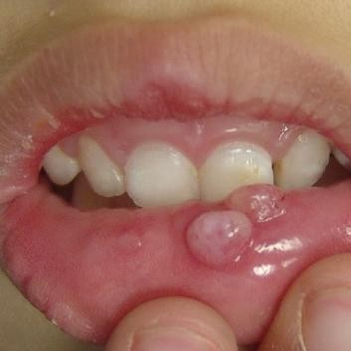
Clinical features
Mucoceles occur as painless swellings, which may be recurrent. (Some patients give the history of increase in size during mealtime).
The common sites of occurrences of mucoceles, the extravasation type, are the lower lip and tongue.
The retention type of mucocele occurs in palate, cheek, floor of the mouth and maxillary sinus.

Slide 12
The extravasation type occurs in 2nd decade and also in children. The retention type occurs in the middle aged persons.
The superficial mucoceles are the bluish translucent seen. They are fluctuant. Usually these cysts are 4 mm to 1 cm in size. The wall is very thin and they rupture easily.
The deep mucoceles are firm, well-circumscribed lesions and are present for longer period

Slide 13
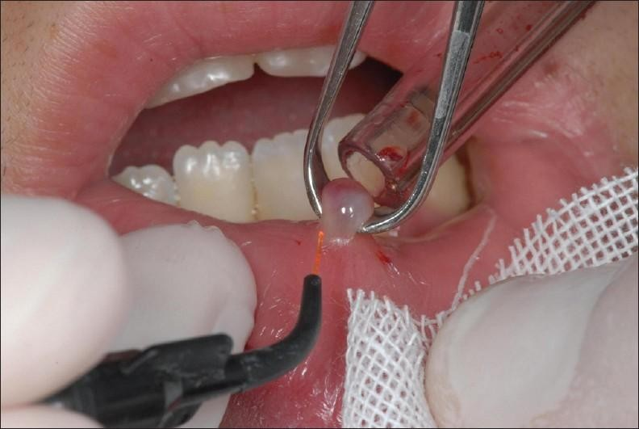
TREATMENT
Surgical excision is the primary treatment, particularly to prevent recurrence

Slide 14
TREATMENT
Aspiration of the fluid from the mucocele will
not provide long-term benefit
Intralesional injections of corticosteroids have been used successfully to treat mucoceles.

Slide 15
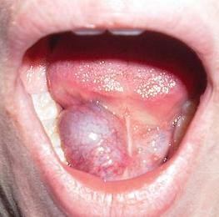
RANULA
It is a special type of mucocele, which occurs in the floor of the mouth.
Since the lesion appears like the belly of a frog, it is called ‘Ranula’. (Rana-frog)
Ranula is formed because of the trauma to sub-mandibular or sub-lingual ducts
This develops as a result of mucous extravasation.

Slide 16
It starts as a painless swelling on one side of the floor of the mouth. The swelling is fluctuant, and non-pitting on pressure.

Slide 17
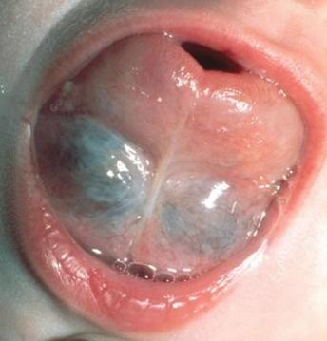
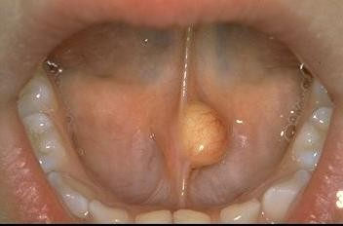
Superficial Ranulas can have a typical bluish hue
Deeply seated lesion - normal mucosa
Superficial Ranula
Deeply seated Ranula

Slide 18
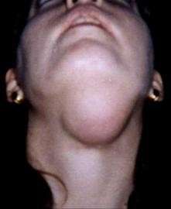
A rare variety, which herniates through the mylohyoid muscle resulting as the swelling of the neck is called “plunging ranula”.
This develops as a result of mucous extravasation.

Slide 19
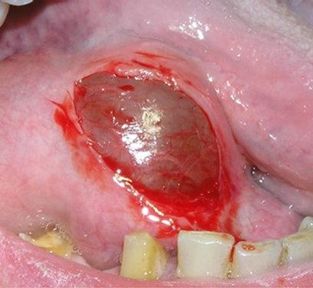
TREATMENT
Treatment of choice - surgical intervention
Marsupialization - unroofs the lesion is the initial treatment, especially for smaller lesions.
Postsurgical complications
  Recurrence
  sensory deficits of the tongue
  Damage to Wharton’s duct

Slide 20
TREATMENT
Frequency of recurrence is related to the surgical technique selected
  Marsupialization: 67%
  Ranula excision: 58%
  Sublingual gland excision: 1%
Due to this reason excision of the lesion and the gland should be considered
Intralesional injections of corticosteroids have been used successfully in the treatment of ranulas

Slide 21
Inflammatory Enlargement of the gland
(Sialadenitis)
Inflammation of the salivary glands is known as sialadenitis.
Types- Viral, Bacterial, Allergic
Viral Infections Mumps (epidemic parotitis) is the most common viral infection affecting the salivary glands.
Which is caused by a paramyxo virus.
It is an acute, contagious disease, usually affecting the parotid gland.
Occasionally, the submandibular or the sublingual glands may also be involved.

Slide 22
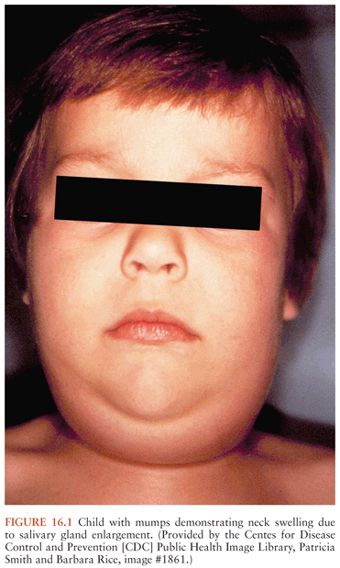
This disease is self-limiting one and not dangerous.
In these days, the number of cases are reduced, because of the use of the Mumps vaccine.
It is a disease of the childhood, but when it affects the adults, it leads to greater complications.
This disease has the incubation period of 2-3 weeks.

Slide 23
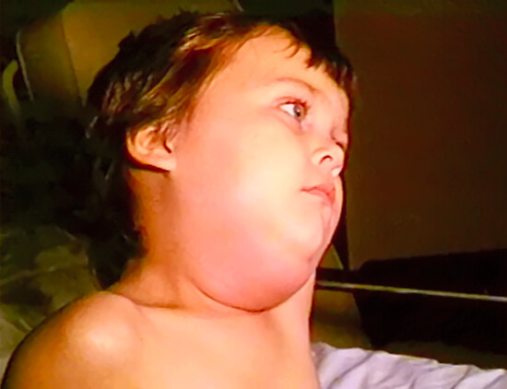
Clinical features
Initially, the patient may suffer from mild fever, headache, chills, vomiting, etc. followed by pain below the ear and sudden onset of firm, rubbery or elastic swelling of the salivary gland.
In viral parotitis, the glands of both the sides enlarge

Slide 24
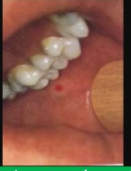
There is no suppuration and no pus discharge from Stenson’s duct upon pressure on the gland; however, the papilla may be puffy and red.
There is excruciating ear pain during mastication. Xerostomia, trismus, cervical lymphadenitis, tender glands, oedema of the overlying skin may also be present.

Slide 25
Management
It is self-limiting. Symptomatic relief can be given by antipyretics.
Antibiotics can be given to prevent the secondary infection.

Slide 26
IV. Tumours of salivary glands :
A. Benign tumours:
Pleomorphic adenoma
• Warthin’s tumour
• Basal cell adenoma
Myoepithelioma
• Canalicular adenoma
• Ductal papilloma

Slide 27
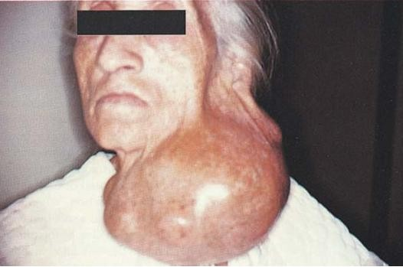
Pleomorphic Adenoma
Mixed tumor
A benign neoplasm consisting of cells exhibiting the ability to differentiate to epithelial cell (ductal & non ductal) and mesenchymal cell (chondroid, myxoid & osseous)
Pleomorphic adenoma constitutes more than 50% of all tumours and 90% of all the benign tumours of the salivary glands

Slide 28
Clinical features
Parotid gland – lower pole, superficially 90%
Minor Salivary gland 8%
- mostly palatal
F:M = 6:4
4th-6th decade of life – 43 yrs mean age
Also found in children

Slide 29
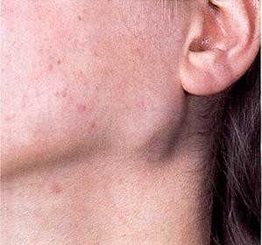
Clinical presentation
Small, painless, quiscent nodule – slowly increases in size, sometimes showing intermittent growth
Doesn’t fixes to deeper tissue – mobile on palpation
Skin never ulcerates, although size may reach a fantastic size and of several kilograms

Slide 30
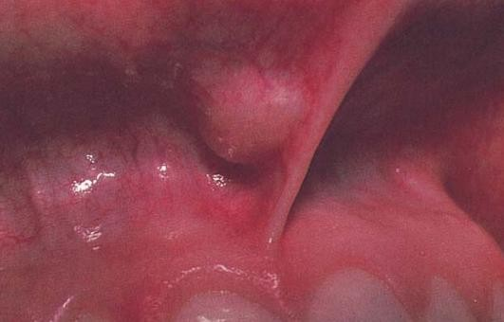
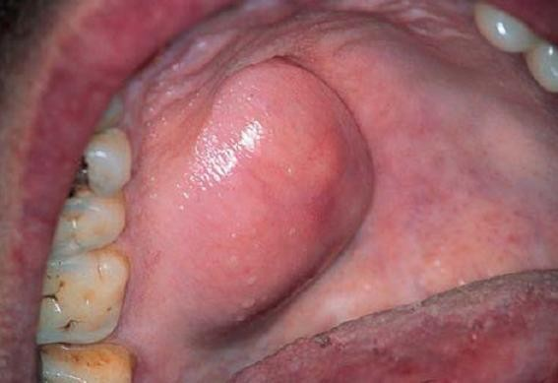
Clinical presentation
Pleomorphic adenoma of minor salivary gland of size >1-2 cm creates problem in mastication, talking and breathing
Palatal Pleomorphic adenoma may appear fixed to underlying bone but invasive

Slide 31
Treatment
Pleomorphic adenomas are treated by surgical excision, excision of the gland with the tumour is performed.
Irradiation is contraindicated as the tumour is radioresistant.

Slide 32
Diagnostic Imaging
(1) Conventional radiography,
(2) Sialography,
(3) Ultrasonography,
(4) Computerized tomography,
(5) Radionuclide imaging, and
(6) Magnetic resonance imaging (MRI).

Slide 33
SIALOGRAPHY
It is a specialized radiographic procedure performed for detection of disorders of the major salivary glands (usually parotid and submandibular glands.
The technique was first performed by Carpy in 1902, using mercury as the contrast agent
The technique is employed for examination of both parenchymal (acinar) and ductal abnormalities
It involves cannulation and filling with a radio-opaque/contrast agent to make them visible on a radiograph

Slide 34
Indications
a. Calculi or foreign bodies
b. Determination of the extent of destruction of salivary gland tissue
c. Detection of fistulae, diverticuli and strictures
d. Detection and diagnosis of recurrent swelling and inflammatory processes ‘
e. Demonstration of tumour; its size, location and origin
f. Selection of the site for biopsy
g. Outline the plane of facial nerve as a guide in planning a biopsy or a dissection

Slide 35
Contraindications
Patients with a known allergy or hypersensitivity to contrast media
Acute inflammation of the salivary glands
Patients scheduled for thyroid function tests in the immediate future.

Slide 36
Contrast Media
Lipid soluble or oil-based agents:
These agents contain 37% iodine e.g. Ethiadol.
Water soluble or water-based agents
These agents contain 28 to 38% iodine; e.g. Hypaque 50%, Hypaque M 75%, Renografin 60, 76% Sinografin, Isopaque, Triosil, and Dionosil

Slide 37
Technique
Identification of the location of duct orifices
Exploration of the duct with a lacrimal probe
Cannulation of the ducts:
Introduction of the radiographic dye: 0.76-1.0 ml for parotid gland, and 0.5-0.75 ml for submandibular gland.
Radiographic projections- Lateral View or Anteroposterior view

Slide 38
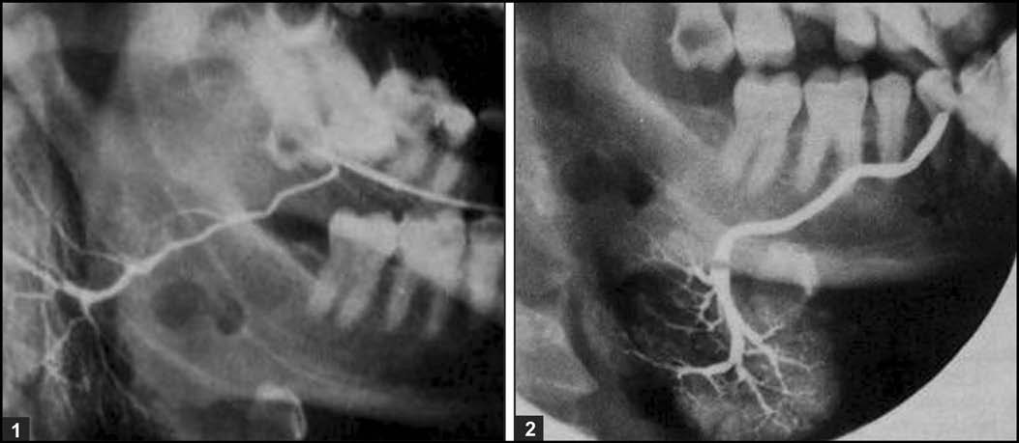
(1) Sialogram of normal parotid gland. (2) Sialogram of normal submandibular gland. Note the normal ductal branching pattern in both the sialograms

Slide 39
Observations
salivary calculi, stricture or other obstructions appear as radiolucent lesions.
In Sjögren’s syndrome, “Cherry - blossom” or “branchless fruit laiden tree” appearance
Tumours: “hand holding the ball” appearance.

