Slide 1
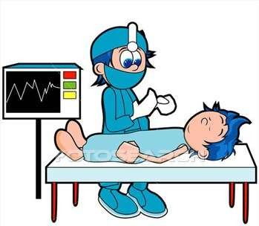
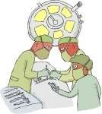
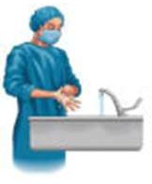
STERILIZATION ,DISINFECTION AND ASEPSIS

Slide 2
CONTENTS
Introduction
Historical Relevance
Terminologies
Methods Of Sterilization & Disinfection
Asepsis- Medical( Clinical) And Surgical Asepsis
Basics About OT Design
Operating Room Protocols
Principals Of Asepsis
Conclusion
References

Slide 3
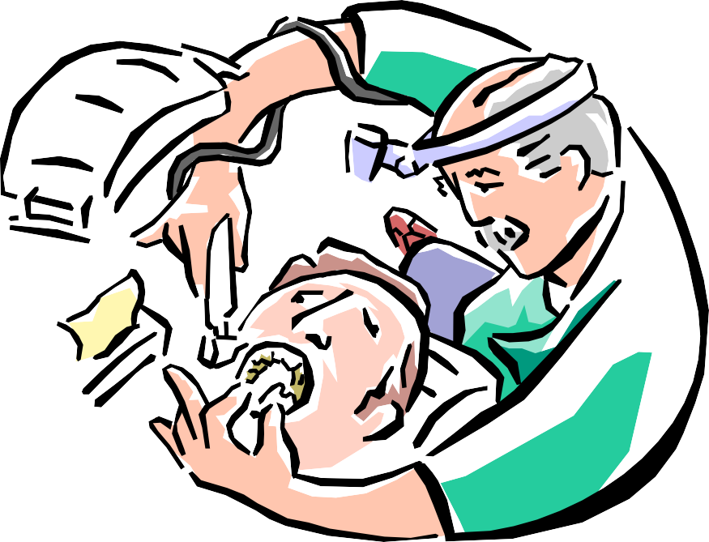


INTRUDING BODY’S LINE OF DEFENSE
During any operative procedure, we are breaching body’s line of
defense
Sterilization , Disinfection and Asepsis becomes important

Slide 4




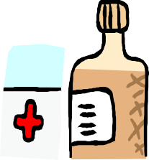



HISTORY OF INFECTIOUS DISEASE PREVENTION
3,000 BC – Egyptians use antiseptics such tar, resins and aromatics.
550 BC,In Greek Infantry men during war, pieces of clothing carried into a wound by a penetrating sword or spear point were more likely to cause infection.
460-377 BC Hippocratus used
wine or boiled water, for asepsis.

Slide 5
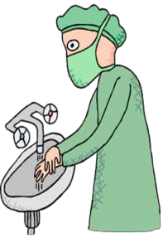
HOLMES AND SOMMELWEIS
The Hungerian Obstetrician Sir IGNAZ SOMMELWEIS & OLIVER HOLMES laid down general principles of asepsis
8
Made hand washing compulsory before any operative procedure

Slide 6
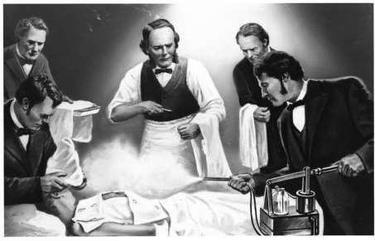
JOSEPH LISTER
Discovered how to use chemical antiseptics to control surgery related infections
Used antiseptics to disinfect surgical equipment and supplies
9

Slide 7

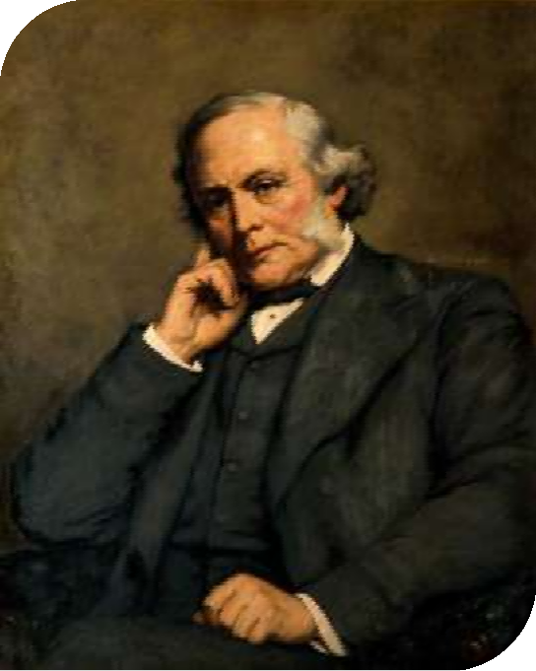
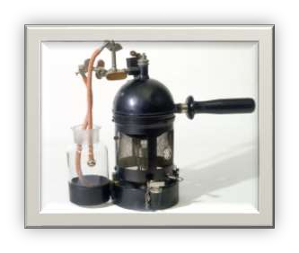
Lister began washing his hands before operating, and
wearing clean clothes.
Lister also sprayed the air with carbolic acid to kill airborne germs.
JOSEPH LISTER

Slide 8
TERMINOLOGIES

Slide 9
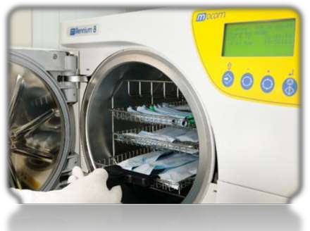
STERILIZATION
Process by which an article, surface and medium is freed of all microorganisms either in vegetative or spore state.

Slide 10
Disinfectant
A chemical used on nonvital objects to kill surface vegetative pathogenic organisms but not necessarily spore forms or viruses.
Antiseptic
A chemical that is applied to living tissues such as skin or mucous membrane to reduce the number of microorganisms present by inhibition of their activity.

Slide 11
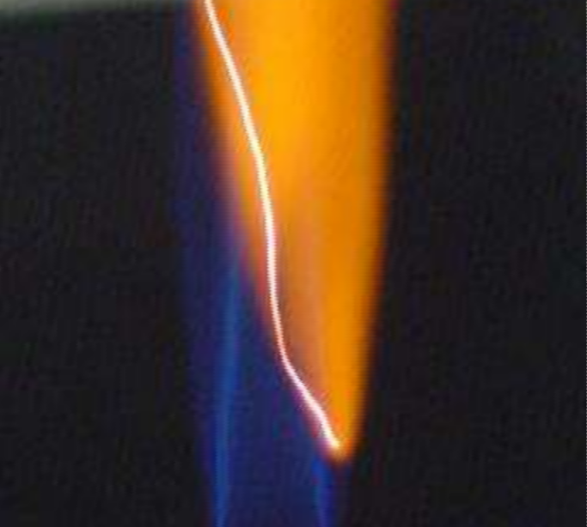
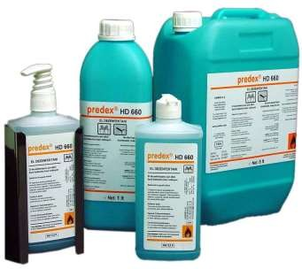
METHODS OF STERILIZATION
PHYSICAL AGENT
CHEMICAL AGENT

Slide 12
PHYSICAL AGENTS
1]SUNLIGHT
2]DRYING
3]DRY HEAT
4]MOIST HEAT
5]FILTRATION
6]RADIATION
7]ULTRASONIC & SONIC VIBRATIONS

Slide 13

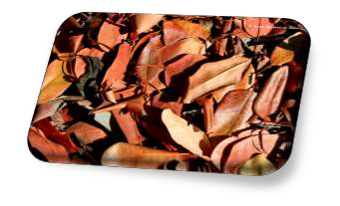
SUNLIGHT
---Possesses Bactericidal Activity
---Due to UV rays
DRYING
---Deleterious effect on many bacteria
---Unreliable
---Spores are unaffected

Slide 14
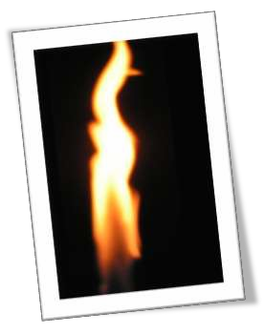
DRY HEAT
MECHANISM OF ACTION:-
--Protein Denaturation
--Oxidative damage
--Toxic effect of elevated level of electrolytes
ADVANTAGE -CAN BE EASILY EMPLOYED.
DISADVANTAGE -POOR PENETRATION POWER.

Slide 15
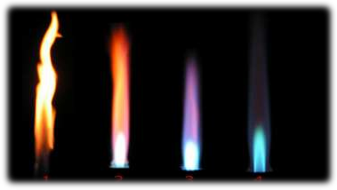
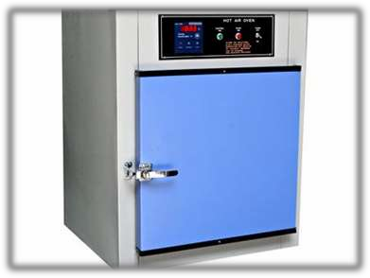
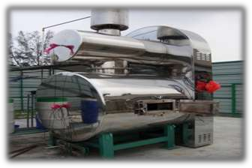
1]FLAMING
2]INCINERATION
3) Hot Air Oven

Slide 16
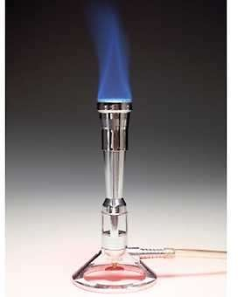
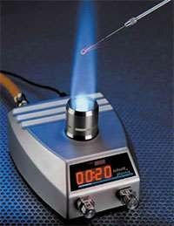
1) FLAMING
The articles are passed on the Bunsen flame. articles are made red hot
Articles Sterilized:
•
–
–
–
–
Inoculating loop of wires. Forceps.
Spatulas.
Mouths of culture tubes.

Slide 17
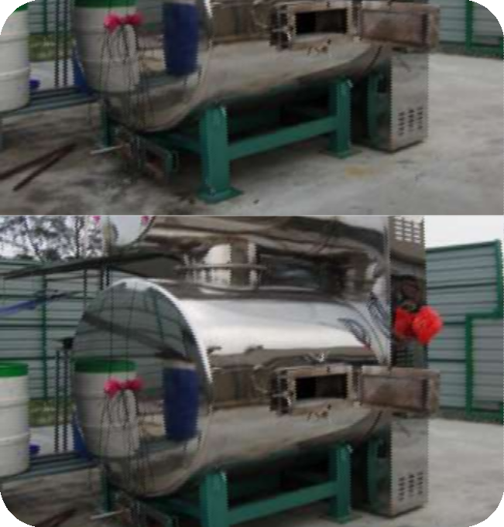

2)INCINERATION
Contaminated material in bulk is sterilized & disposed by burning in an incinerator.
Articles sterilized:
- surgical dressings
-disposable syringes
- contaminated lab
-animal carcass
-bedding.
materials

Slide 18
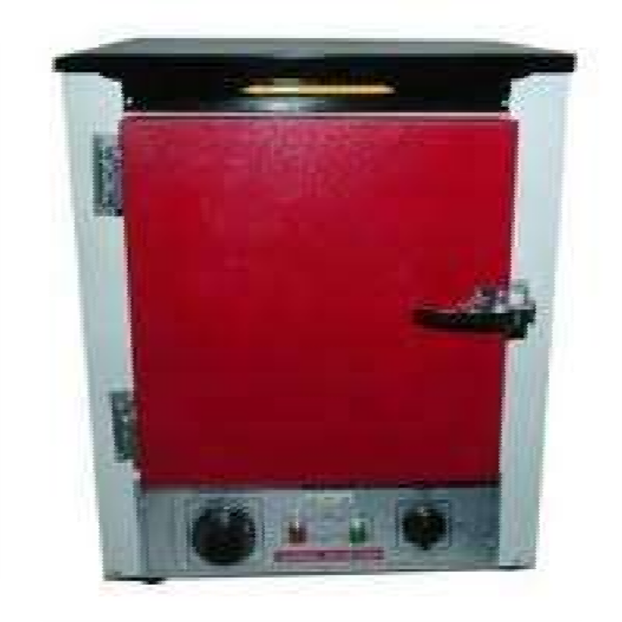

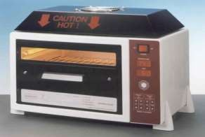
Louis Pasteur discovered in 1986
Compartments with perforated trays & fans
The temperature is
160c for 1 hour
Preserve sharp edges of cutting instruments
HOT AIR OVEN

Slide 19
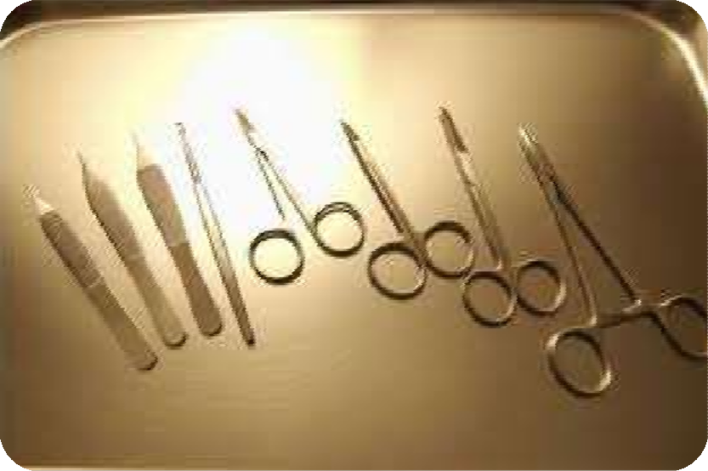

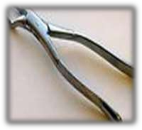

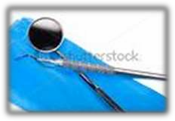
Articles to be sterilized:-
Scissors
Scalpels
Glass syringes
Swabs
Liquid paraffin
Dusting powder
Fats & Grease
Glassware
Forceps

Slide 20












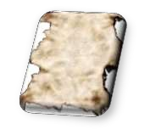
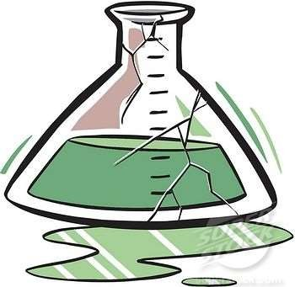
PRECAUTION TO BE OBSERVED WHEN USING
A HOT AIR OVEN:
Temp. should not exceed 180°c because glass ware kept inside for sterilization will get a smoky appearance & paper wrapper used to cover the articles will get charred.
The glassware kept inside should be totally dry or they will break.
No sudden cooling of the hot air oven.
No over loading of hot air oven.

Slide 21
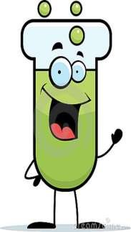
STERILISATION CONTROL
BROWNE’S TUBE use routinely.
Green color indicates proper sterilization
Nontoxigenic strains of CLOSTRIDIUM TETANI
Spores germination indicates improper sterilization

Slide 22
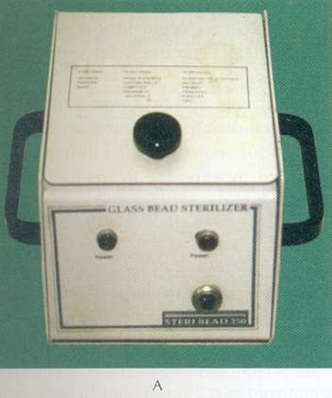
GLASS BEAD STERILISER
Heat transfer device
Glass beads & Salt
ARTICLES STERILISED:
Endodontic Files & Burs
Temperature is 220°C
Time is 10 sec.
Useful for chair side sterilization

Slide 23
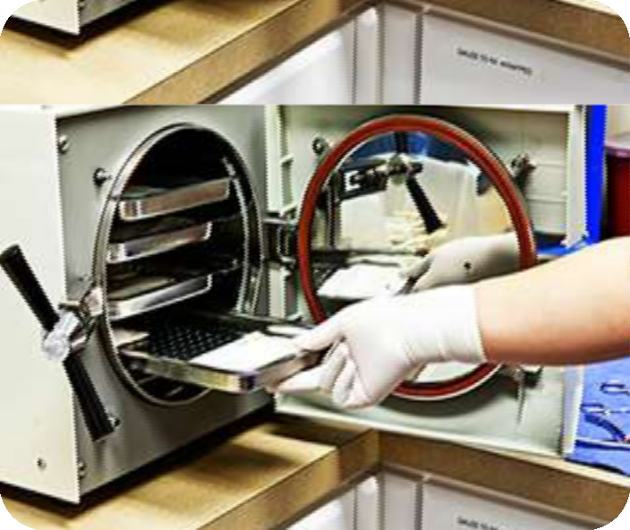

MOIST HEAT
MECHANISM OF ACTION:
-Denaturation of proteins
-Coagulation of proteins
TEMPERATURE BELOW 100°C
TEMPERATURE AT 100°C
TEMPERATURE ABOVE 100°C

Slide 24
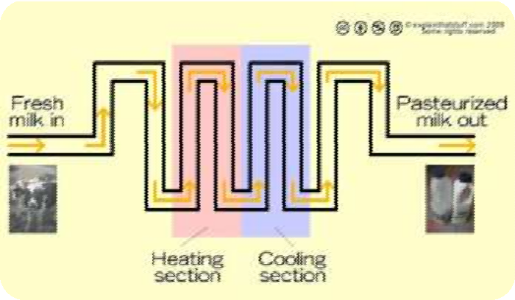

TEMPERATURE BELOW 100°C
a) Pasteurization
Holder’s process (63°C for 30 min)
Flash process (72°C for 15-20 sec)
Destroys - mycobacterium, salmonella & also Brucella.
Coxiella burnetii survive Holder method.

Slide 25
(b) Vaccines of non-sporing bacteria
Heat inactivated in special vaccine baths at 60°C for one hour.
(c) Lowenstein Jensen’s media, serum & other media which contain sugar & gelatin are sterilized in Inspissator at 80-85°C for ½ an hour on 3 successive days.- Inspissation

Slide 26
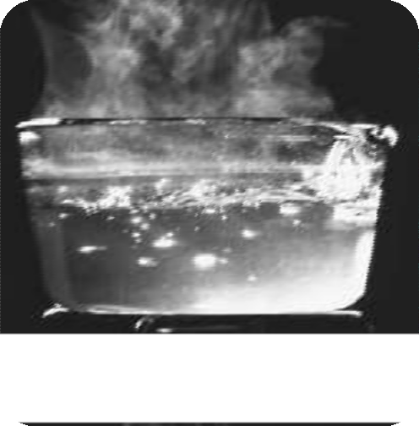

TEMPERATURE AT 100°C
(a)Boiling:
Vegetative Bacteria killed at 90-100°c
Time required is 10-30 min
Not effective for Sporing Bacteria
Sterilization promoted by use of 2% Na bicarbonate

Slide 27
(b) Tyndallisation –
For media containing sugar or gelatin exposure of steam at 100°c for 20 min for 3 successive days.

Slide 28
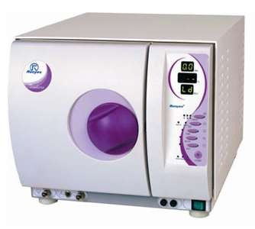
TEMPERATURE ABOVE 100°C
Steam under Pressure (AUTOCLAVE):
Principle: Water boils when
pressure equals to surrounding atmosphere.
Saturated steam has penetrative
power

Slide 29
AUTOCLAVE TIME
Temperature (ºCelcius) | Pressure (Lb) | Time (Minutes)
121 | 15 | 15
126 | 15 | 10
134 | 30 | 3

Slide 30
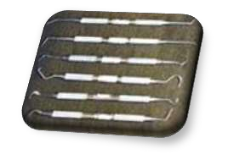
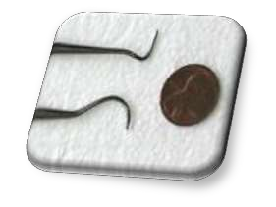
ARTICLES STERILISED:
Surgical Instruments
Lab equipments
Metallic syringes.
All culture media except media containing sugar & gelatin.

Slide 31
STERILISATION CONTROL
Spores of Bacillus stearothermophilus
Autoclave tapes
Agents use to avoid corrosive action of steam :
--Ammonia (Craford & Oldenburg)
--2% Na nitrite (Bertolotti & Hurst)
--Dicyclohexylammonium nitrate (ADT)

Slide 32
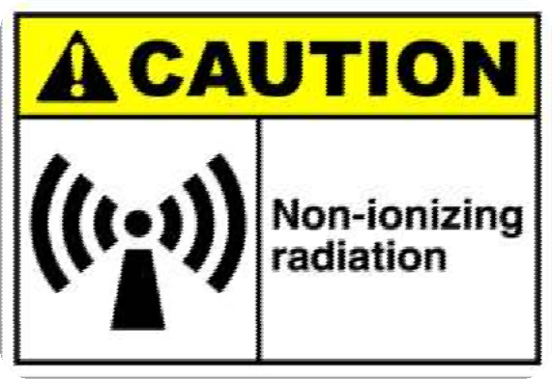



RADIATION
2 types
Non ionizing radiation.
Ionizing radiation.

Slide 33
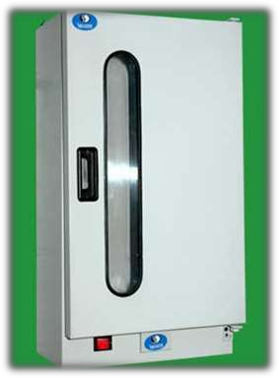
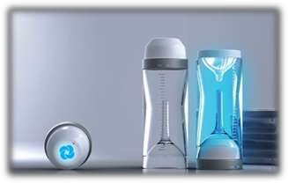
A) Non Ionizing radiation
U. V. rays:
•
Bring down the number of microorganism present in air.
Sterilization of Operation Theaters and biological safety cabinets.
•
Disadvantage: Low-penetrating power.
λ=240-280 nm

Slide 34
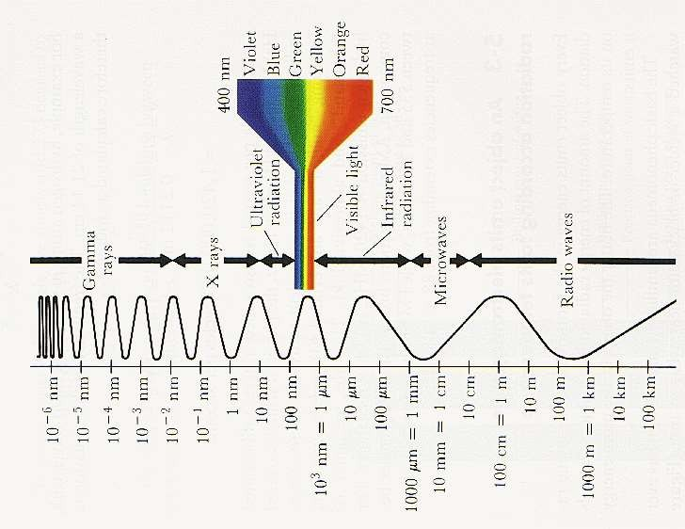
B) Ionizing Radiation:
‘X’- rays ,gamma rays, cosmic rays.
cold sterilization.
very high penetrating power.
lethal to DNA and other cell constituents
effective for heat labile items

Slide 35
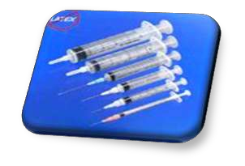
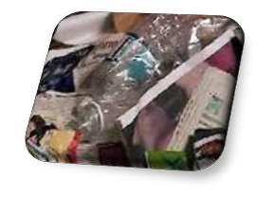
Articles sterilized:
Syringes
swabs
Catheters
Needles
Oils
Grease
Cannulas
Metal foils
Culture plates

Slide 36

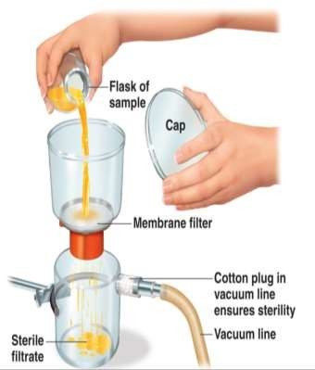
FILTRATION
•
•
Used to sterilize heat labile liquids like sera, sugar solutions.
Bacteria free filtrate of Virus
•
TYPES:
(a)Candles filters (b)Asbestos disc filters. (c)Sintered glass filters (d)Membrane filters.

Slide 37
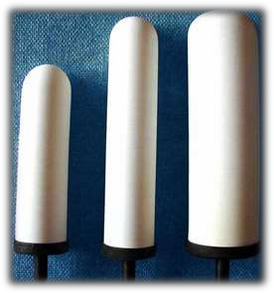
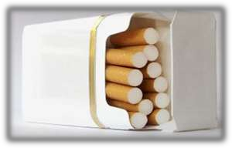
(a)Candle filters:
-- Use for purification of water
Types:
--Unglazed ceramic filters
--Diatomaceous earth fillers
(b)Asbestos filters:
--Disposable
--High adsorbing capacity
--Alkalinize filtered liquids
--Carcinogenic potential
-- e.g- Seitz &Sterimat filters

Slide 38
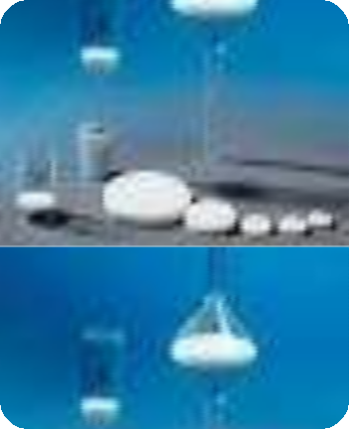

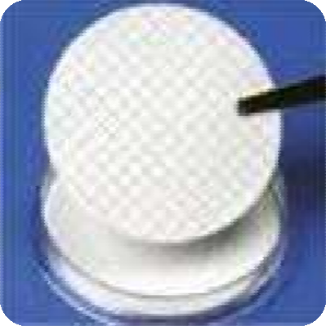

(c)Sintered glass filters:
--Heat fusing finely powdered glass particles
--Low absorptive
--Brittle & expensive
(d)Membrane filters:
--Made from Cellulose esters
--Pore diameter 0.22mm used widely
--Used in:
-- water purification
-- sterilization & sterility testing
-- preparation of solution for parental use

Slide 39
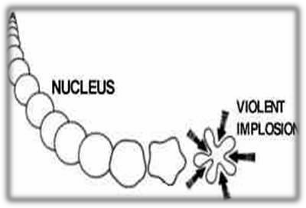
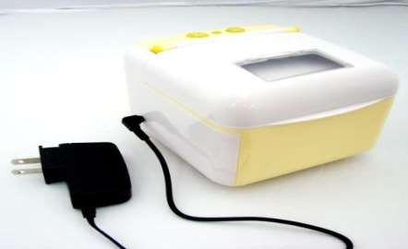
ULTRASONIC & SONIC VIBRATIONS
Ultrasonic cleaning depends upon cavitation, the rapid formation and violent collapse of minute bubbles or cavities in a cleaning liquid.

Slide 40
DENTAL EQUIPMENTS STERILISATION
EQUIPMENTS | METHOD OF STERILSATION
SURGICAL INSTRUMENTS | AUTOCLAVE
SHARP INSTRUMENTS | HOT AIR OVEN
OTHER MATERIALS | AUTOCLAVE
SYRINGES | IRRADIATION

Slide 41
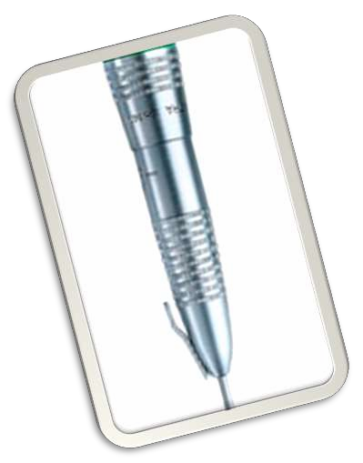
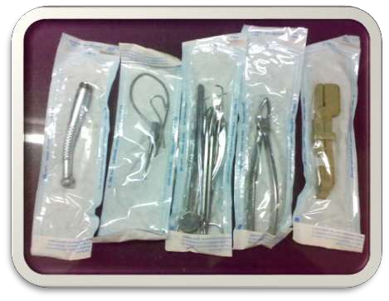
SURGICAL HAND PIECE STERILIZATION

Slide 42
SHOULD DO
Remove bur and disconnect handpiece from chair.
Wipe handpiece with alcohol.
Locate appropriate hole and spray lube for 2-3 seconds.
Attach handpiece to swivel unit and insert bur.
Run handpiece for 30 seconds to eliminate lube.
Wipe handpiece with alcohol.

Slide 43

SHOULD DO
Insert in autoclave bag…….paper on at least one side of bag.
Load in autoclave with cellophane side down.
Remove from autoclave immediately after all cycles are complete.
Always allow cooling to room temperature, paper side up.
Do not force cool with water or other means.

Slide 44
SHOULD NOT DO
Do not immerse hand piece in any solvent, cleaner or ultrasonic solution.
Do not clean hand piece in ultrasonic cleaners or dry heat sterilizers.
Do not exceed temperature of 135°C.
Do not use chemical disinfectants, when combined with heat of the autoclave, disinfectants may significantly reduce hand piece life
Do not use all cellophane bags

Slide 45
CHEMICAL AGENTS

Slide 46
CHEMICAL AGENTS
Alcohols
Aldehydes
Dyes
Halogens
Phenols
Gases
Surface active agents
Metallic salts

Slide 47


. The main modes of action are:
Protein coagulation.
Disruption of cell membrane
.
Removal of free sulphydryl groups
Substrate competition for enzyme.

Slide 48
IDEAL PROPERTIES OF AN ANTISEPTIC OR DISINFECTANT:
Wide spectrum of activity
Active in presence of organic matter.
Effective in acidic as well as alkaline media
Fast action.
High penetrating power.
Be stable.
Compatible with other antiseptic and disinfectants.
Should not corrode metals.

Slide 49

Should not cause local irritation .
Not interfere with healing.
Non toxic
Cheap and easily available.
Safe and easy to use.

Slide 50

ALCOHOLS
Isopropyl alcohol and ethyl alcohol
Used as skin antiseptics
Act by denaturing the protein
No action on spores
60% to 70% conc. is used
Methyl alcohol effective against fungal spores
It is toxic & inflammable

Slide 51

ALDEHYDES
Formaldehyde (formalin)
Glutraldehydes

Slide 52


1.Formaldehyde:
Bactericidal ,fungicidal & sporicidal.
10% formalin & 0.5% Na tetraborate use to sterilise clean
metal instruments.
Use:
Instruments & heat sensitive catheters
Fumigate wards, sick rooms , laboratories
Irritant & toxic when inhaled
Nullified by use of ammonia vapour

Slide 53


GLUTARALDEHYDE
Action similar to formaldehyde.
Effective against bacteria(tubercle bacilli) , Hepatitis B, C and HIV & fungi
It is less toxic and irritant to the eyes and skin than formaldehyde
Used for heat sensitive materials, rubber, plastic, metal instruments & porcelain

Slide 54


ARTICLES STERILISED:
Corrugated rubber anesthetic tubes
Face masks
Plastic endotracheal tubes
Metal instruments
Polythene tubing

Slide 55



BIGUANIDES
Chlorhexidine gluconate
0.5% in 70% alcohol or 4% detergent as an preoperative scrub
0.2% for suppression of plaque( mouthwash)

Slide 56

DYES
Aniline Dyes And Acridine Dyes
Skin & wound antiseptics
Bacteriostatic in high concentrations.

Slide 57

Aniline dyes in use are
brilliant green malachite green crystal violet.
More active against gram positive organisms
Lethal effect on bacteria is due to reaction with the acid groups in the bacterial cell

Slide 58

The Acridine Dyes
More Active Against Gram Positive Organism.
Proflavine Acriflavine Euflavine
They impair the DNA complexes of the organisms and thus destroy the reproductive capacity of the cell.
Eg.

Slide 59

HALOGENS
Iodine in aqueous and alcoholic solution is used widely as a skin disinfectant.
Bactericidal
Active against the tubercle bacteria and viruses.
Iodophores are more active than the aqueous or alcoholic solutions of iodine.

Slide 60
BETADINE-
Iodophore (povidone + iodine)
Povidone- surface active agent
“this agent should be kept out of fresh wound and should be kept only to scrub skin surface”
-Fonseca- vol 2, third edition
Fibroblast damage
1: 1000 – Not effective

Slide 61

Chlorine and its compounds are used as disinfectants in water supplies, swimming pools, food and dairy industries.
Chlorine is used as hypochlorites.
Bactericidal.
Wide spectrum of action against viruses.
The organic chloramines are used as antiseptics for dressing wounds.

Slide 62


PHENOLS
They are obtained by distillation of coal tar b/w 170°c to 270°c.
Precipitate proteins cell membrane damage
causing cell lysis releasing cell content.
Eg. Lysol and cresol .
They are not effective against spores .

Slide 63



GASES
Ethylene oxide
Highly penetrating gas
Highly inflammable.
Action is due to alkylation of the amino, carboxyl, hydroxyl, sulfhydryl groups in protein molecules

Slide 64

Mixing with carbon dioxide or nitrogen 10% eliminates explosive tendency
Mutagenic & carcinogenic
ARTICLES STERILISED:
--Heart-lung machine
--Respirators
--Sutures
--Dental equipments
--Glass,metal & paper surface

Slide 65

Formaldehyde gas
Fumigation of operation theatres and other rooms.
After sealing the windows and other outlets, formaldehyde gas is generated by adding 150 gms of KMNO4 to 280 ml formalin for every 1000cu. Ft of room volume.
Doors open after 48 hrs

Slide 66


BETAPROPIOLACTONE
More efficient for fumigation than formaldehyde
Very active against viruses
Has carcinogenic activity

Slide 67




SURFACE ACTVE AGENTS
Alter energy relationship at interface leads to reduction of interfacial tension
Classified as:
-Cationic
-Anionic
-Nonionic
-Amphoteric

Slide 68

Quaternary ammonium compounds (cationic) are bactericidal & active against gram positive organisms
Acetyl trimethyl ammonium bromide(cetavlon or cetrimide)
Benzalkonium chloride
Chlorhexidine + cetrimide

Slide 69

Anionic compounds like common soap have moderate action
Saturated fatty acid soaps- gram negative bacilli
Unsaturated fatty acid soaps - gram positive & neisseria group.
Amphoteric compounds are active against gram positive & negative organisms & some viruses but they are not in general use

Slide 70

METALLIC SALTS
Salts of heavy metals have germicidal action.
The salts of silver, copper, and mercury are used as disinfectants.
They are protein coagulants and have the capacity to
combine with free sulfhydryl groups of cell enzymes.
Copper salts are used as fungicides

Slide 71
TESTING OF DISINFECTANTS
RIEDAL WALKER TEST:
Suspension of typhoid bacilli added with phenol & disinfectant tested
CHICK MARTIN TEST:
Modified technique
Disinfectant act in presence of organic matter

Slide 72


ASEPSIS

Slide 73
ASEPSIS
Asepsis – condition in which pathogens are absent or controlled.
defined as any practice that helps reduce the number and spread of microorganisms.
Medical asepsis
defined as the complete removal of microorganisms and their spores from the surface of an object
Surgical asepsis

Slide 74


MEDICAL ASEPSIS
Clean technique - based on maintaining cleanliness to prevent spread of microorganisms
Keep office clean:
Reception room clean, well lit, and ventilate
Keep furniture in good repair
Strict “no food or drink” policy
d
81

Slide 75


MEDICAL ASEPSIS (CONT.)
Handwashing
Beginning of day
After breaks
Before and after each patient
Before and after handling equipment or specimens
After blowing your nose or coughing
82

Slide 76

SURGICAL ASEPSIS
Keep the surgical environment completely free of all microorganisms.
Sterile technique used for even minor operation or injections.
Object is either sterile or not sterile; if unsure then it is not sterile.
83

Slide 77
“IT HAS BEEN SAID THAT A FIRST CLASS SURGEON CAN WORK IN ANY PLACE AND IN ANY CLOTHES”

Slide 78


Slide 79
“Though aseptic surgery has been done in a tent, under a tree, or on a kitchen table, it is safer if it is done in a room which has been designed to preserve the sterility of the surgical field, to make surgical routines easier, and to prevent mistakes.”

Slide 80

OT DESIGN

Slide 81

THE THEATRE

Slide 82
THEATRE INTERIOR
Ideal theatre should have:
-Pressure release dampers
-Minimum fixtures , shelves
-Doors should be closed properly
-Windows should be sealed properly
-Flooring should have no gaps
-Painted surface should be finish
-Walls preferably rounded

Slide 83




Non adherent ,nonporous surfaces- OT WALL CLADINGS
Rounded corners

Slide 84



National Accreditation Board for Hospitals and Healthcare Providers
OT Size:
Occupancy:
Standard OT size of 20’ x 20’ x 10’ Standard occupancy of 5-8 persons
at any given point

Slide 85
VENTILATION
Proper ventilation will minimize risk of infection by:
-Filtration of supplied air
-Dilution of contaminated air
-Preventing entry of contaminated air from outside
TYPES:
(1) Conventional or Plenum type
(2)Laminar flow type

Slide 86


Laminar flow ventilation was first pioneered by Charnley
in the 1960s and 1970s
Laminar type use in modern operation theatres
AIR CHANGE RATE:
John Charnley
-Conventional maintains at rate of 20 air changes per hour
-Laminar maintains at rate of 300 air changes per hour

Slide 87

THE REVISED GUIDELINES FOR AIR CONDITIONING IN OPERATION THEATRES (NABH-2010)
I. Air Change Per Hour:
ƒMinimum total air changes should be 25
ƒThe fresh air component of the air change is required to be minimum 4 air changes out of total minimum 25 air changes.

Slide 88


II. Air Velocity: The vertical down flow of air coming out of the diffusers should be able to carry bacteria carrying particle load away from the operating table. The airflow needs to be unidirectional and downwards on the OT table.
AIR VELOCITY

Slide 89

III. Positive Pressure: There is a requirement to maintain positive pressure differential between OT and adjoining areas to prevent outside air entry into OT.
The minimum positive pressure recommended is 15 Pascal (0.05 inches of water)
POSITIVE PRESSURE

Slide 90

AIR QUALITY
Air Filtration: The air quality at the supply i.e. at grille level
should be Class 1000
Class 1000 means a cubic foot of air must have no more than 1000 particles
  HEPA filters
  EPA filters
  ULPA filters

Slide 91


TEMPERATURE & HUMIDITY
The temperature should be maintained at 21 +/- 3 °C inside the OT all the time
Corresponding relative humidity between 40 to 60% though the ideal is considered to be 55%.
Appropriate devices to monitor and display these conditions in the OT should be present

Slide 92
OPERATING ROOM PROTOCOLS

Slide 93

THE SURGICAL TEAM
Should be as small as possible . It consist:
Yourself the surgeon
Your assistant, when you need one
The scrub nurse responsible for the instruments
The circulating nurse to fletch and carrry
The anaesthetist

Slide 94



Slide 95

Preoperative showering with hexachlorophene has shown reduction in wound infection.
Short preoperative hospital stay reduces pathogenic bacteria on skin and nasal carrier state.

Slide 96


SHAVING THE SURGICAL AREA

Slide 97

PRE-OPERATIVE HAIR REMOVAL
Shaving a patient’s skin before surgery may raise the risk of an infection.
In its guidelines for preventing surgical site infections, the Centre for Disease Control recommends that hair should not be removed unless it will interfere with the operation.
When shaving is necessary, electrical clippers should be used.
Preferably immediately before surgery
Shaving with a razor blade causes microscopic nicks in the skin that can become bacterial breeding grounds.

Slide 98



PATIENT SKIN PREPARATION
Before the skin preparation of a patient is initiated, the skin should be free of gross contamination (i.e., dirt, soil, or any other debris)
The patient’s skin is prepared by applying an antiseptic in concentric circles, beginning in the area of the proposed incision and medial to lateral.
The prepared area should be large enough to extend the incision or create new incisions or drain sites

Slide 99
MATERIALS COMMONLY USED
The iodophors (e.g., povidone-iodine), alcohol- containing products, and chlorhexidine gluconate are the most commonly used agents.
Alcohol is readily available, inexpensive, and remains the most effective and rapid-acting skin antiseptic. Aqueous 70% to 92% alcohol solutions have germicidal activity

Slide 100






DRAPING THE PATIENT
Turban draping
Commercially available drapes

Slide 101


Once a drape has been positioned, it should not be repositioned.
The surgeon should maintain 12” away from the
O.R. table when performing the draping procedure
Surgeon should not reach across an undraped O.R. table in order to perform a draping procedure.
Non perforating towel clips should be used to keep
towels or drapes
  Beckhaus towel clip
  Pinchter type towel clip

Slide 102



Slide 103


PRE-OPERATIVE HAND SCRUB
Povidone-iodine and chlorhexidine gluconate are the current agents of choice
Recent studies suggest that scrubbing for at least 2 minutes is as effective as the traditional 10-minute scrub in reducing hand bacterial colony counts, but the optimum duration of scrubbing is not known

Slide 104
Dunphey & Way recommends 10 min for srubbing technique
Hexachlorophene compounds
Povidone iodine 7.5%
2.5% Chlorhexidine in 70% alcohol
In some comparisons of the two antiseptics when used as preoperative hand scrubs, chlorhexidine gluconate achieved greater reductions in skin microflora than did povidone-iodine and also had greater residual activity after a single application

Slide 105


Slide 106

Wet your hands, apply a little soap or forearms to 5cm above your
elbows for one complete minute

Slide 107



The first scrub of the day should include a thorough cleaning underneath fingernails usually with a brush.
After performing the surgical scrub, hands should be kept up and away from the body (elbows in flexed position) so that water runs from the tips of the fingers toward the elbows.
Sterile towels should be used for drying the hands and forearms before wearing sterile gown and gloves.

Slide 108
GOWNING

Slide 109



Gowning:
Hold the gown away from your body, high enough to be wel above floor
Allow it to drop open, put your arms into the ar
holes while keeping your arms extended
Then flex your elbows and abduct your arms
Wait for circulating nurse to help you
She will grasp the inner sides of the gown at each shoulder and pull them over your should
m
ers

Slide 110




GOWNING

Slide 111
GLOVING

Slide 112



GLOVING
Take hold of the turned cuff with right hand and glove left hand
Put the finger of your left hand under the cuff of the glove
Pull your right glove without touching your wrist

Slide 113








GLOVING

Slide 114


1. Only sterile items are used within the sterile field

Slide 115

2. Sterile persons are gowned and gloved
3. Tables are sterile only at table level
The edges and sides of the drape extending below table level are considered unsterile.

Slide 116

4. Sterile persons touch only sterile items or
areas
  The unsterile circulator does not directly contact the sterile field.
  Supplies are brought to sterile team members by the circulator, who opens the wrappers on sterile packages

Slide 117

 5. Unsterile persons avoid reaching over the
sterile field
The unsterile circulator never reaches over a sterile field to transfer sterile items.
The circulator holds only the lip of the bottle over the basin when pouring solution into a sterile basin in order to avoid reaching over the sterile area.
The scrub person sets basins or glasses to be filled at the edge of the sterile table.

Slide 118

6. The edges of anything that encloses sterile contents are considered unsterile
The inside of a wrapper is considered sterile to within 1 inch of the edges.
After a sterile bottle is opened, the contents are either used or discarded. The cap cannot be replaced without contaminating the pouring edges.
7. The sterile field is created as close as possible to the time of use
Sterile tables are set up just prior to the surgical procedure

Slide 119

8. Sterile areas are continuously kept in view
Sterile persons face sterile areas.
Sterility cannot by ensured without direct observation
Sterile persons keep well within the sterile area
  Sterile persons pass each other back to back at a 360-degree turn
  Sterile person faces a
sterile area to pass it.

Slide 120

10. Break of the integrity of microbial barriers results in contamination
Sterile packages are laid on dry surfaces only.
If a sterile package wrapped in absorbent material becomes damp or wet, it is discarded.
The package is considered unsterile if any part of it comes in contact with moisture.

Slide 121

IMPORTANT POINTS TO REMEMBER
The patient is the center of the sterile field.
Keep hands at waist level and in sight at all tim
Keep hands away from the face.
Never fold hands under arms.
Gowns are considered sterile in front from chest to level of sterile field, and the sleeves from above the elbow to cuffs. Gloves are sterile.
Sit only if sitting for entire procedure.
es.

Slide 122


Slide 123


Slide 124


Slide 125



CLASSIFICATION OF BIO-MEDICAL WASTE
Indian Journal of Forensic Medicine & Toxicology

Slide 126


HAZARDOUS WASTE MANAGEMENT
Hazardous waste products include:
Blood and blood products
Body fluids and tissue
Cultures
Vaccines
Sharps
Gloves
Specula
Inoculating loops
Paper product contaminated with body fluids

Slide 127


Slide 128
CONCLUSION
“STRICTLY FOLLOWING THE PROTOCOLS OF STERILISATION & DISINFECTION WILL RESULTS IN HIGH SUCCESS RATE and DECREASE IN SURGICAL INFECTIONS &
POSTOPERATIVE COMPLICATIONS ”

Slide 129


REFFERENCES
Anantnarayan-Textbook of Microbiology
LJ Peterson-Cotemporary Oral & Maxillofacial Surgery
Laskin-Textbook of Oral & Maxillofacial Surgery
NA Malik-Textbook of Oral & Maxillofacial Surgery
Fonseca-vol-2, edition 3

Slide 130

Take home message…….
“THERE IS NO COMPROMISE WITH STERILITY IT’S EITHER STERILE OR UNSTERILE.”

Slide 131


