Slide 1

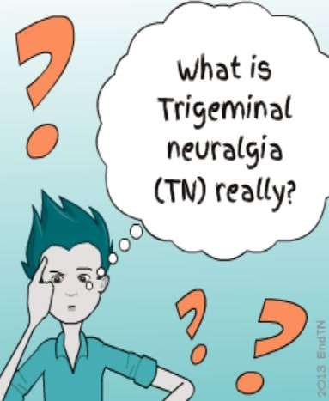
NEURALGIA

Slide 2

CONTENTS
 Introduction
 Definition
 Historical review of Trigeminal Neuralgia
 Classification
 Etio-pathogenesis
 General characteristics
 Clinical characteristics
 Diagnosis
 Treatment modalities
 Recent Advances

Slide 3
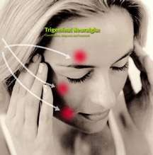
INTRODUCTION
Trigeminal neuralgia or tic douloureux is a neuropathic disorder of trigeminal nerve that causes episodes of intense pain in eyes, lips, scalp, forehead and jaws.
It has been labeled as suicide disease due to insignificant number of people taking their own life because they are unable to have their pain controlled by medication or surgery.

Slide 4
DEFINITIONS
(International association for study of pain; clinical journal of pain 2002)
Sudden,usually unilateral,severe brief stabbing recurrent pain in the distribution of one or more branches of Vth cranial nerve.
PETERSON:
It usually presents with sharp, electric shock like pain in the face or mouth. pain is intense, lasting for brief period of seconds to 1min.after which there is refractory period during which pain cannot be reinitiated for a period of time.

Slide 5


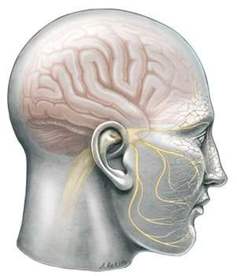



Synonyms
Tic Douloureux
Trifacial neuralgia
Fothergill’s disease

Slide 6
TIC
DOULOUREUX:
Tic douloureux
Painful jerking
It is a truly agonizing condition, in which the patient may clunch the hand over the face & experience severe, lancinating pain associated with spasmodic contractions of the facial muscles during attacks
– a feature that led to use of this term

Slide 7

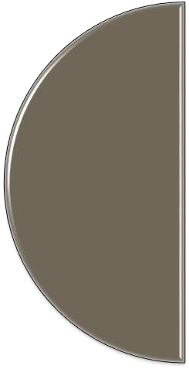

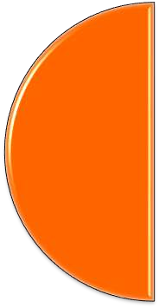

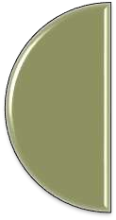



HISTORY
Aretaeus of Cappadocia –At the end of first century -1st clinical description of TN
1677 John Locke, gave the first full description with its treatment.
In 1756, Nicolaus Andre - tic douloureux
John Fothergill in 1773 published detailed description of TN

Slide 8
TYPES OF TRIGEMINAL
NEURALGIA :
 TYPICAL TRIGEMINAL NEURALGIA
 ATYPICAL TRIGEMINAL NEURALGIA
 PRE- TRIGEMINAL NEURALGIA
 MULTIPLE SCLEROSIS RELATED TRIGEMINAL NEURALGIA
 SECONDARY OR TUMOR RELATED TRIGEMINAL NEURALGIA
 TRIGEMINAL NEUROPATHY OR POST- TRAUMATIC TRIGEMINAL NEURALGIA
 FAILED TRIGEMINAL NEURALGIA

Slide 9
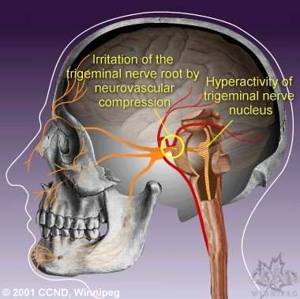
1. TYPICAL TRIGEMINAL NEURALGIA:
Most common form, previously termed CLASSICAL, IDIOPATHIC and ESSENTIAL TRIGEMINAL NEURALGIA.
Nearly all cases of typical trigeminal neuralgia are caused by blood vessel compressing the trigeminal nerve root.

Slide 10
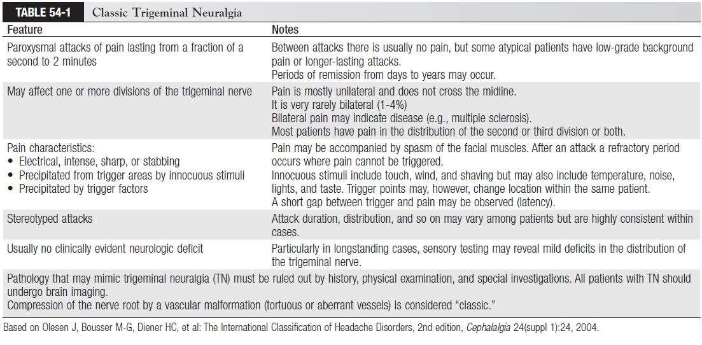

Slide 11
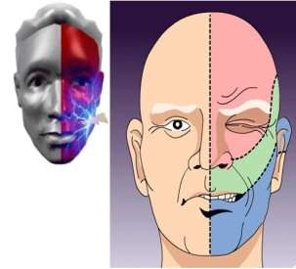
2. ATYPICAL TRIGEMINAL NEURALGIA:
 it is characterized by a unilateral, prominent constant and severe aching and burning pain superimposed upon otherwise typical symptom.
 Some believe that atypical trigeminal neuralgia is due to vascular compression upon specific part of the trigeminal nerve( the portio minor) while other theorize atypical trigeminal neuralgia as more severe progression of typical trigeminal neuralgia.

Slide 12

NEURALGIA:
PRE- TRIGEMINAL
MULTIPLE
FAILED TRIGEMINAL
- Days to years before
the first attack of TN pain, some sufferers experience odd sensations of pain,
( such as toothache) or discomfort
( parasthesia).
SCLEROSIS
NEURALGIA:
RELATED TN:
In certain cases,
symptoms of MS related TN are identical to typical TN. Bilateral TN is more commonly seen in people with MS. MS involves formation of demyelinating plaques within the brain.
all medications, surgical
procedures prove
ineffective in controlling
TN pain.Such individual
also suffer from
additional trigeminal
neuropathy as a result of
destructive intervention
they underwent.

Slide 13
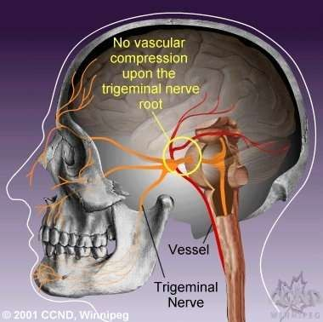
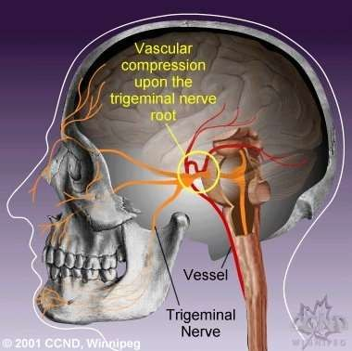
ETIOLOGY
Vascular factors

Slide 14
ETIOLOGY
Dental etiology(WESTRUM & BLACK 1976)
Infection
Multiple sclerosis(Olfson 1979)
Petrous ridge(basilar compression,Lee 1937)
Post traumatic neuralgia
Intracranial vascular abnormalities..
Viral etiology

Slide 15
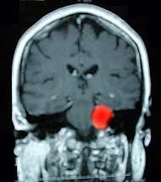
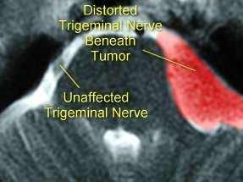
Intracranial tumors:

Slide 16

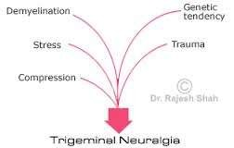
PATHOGENESIS:
Classically, TN has been related to a neurovascular compression in the prepontine cistern at the nerve root entry-zone due to an abnormal artery or vein, arteriovenous malformation, vestibular schwannoma, meningioma, epidermoid cyst, tuberculoma, various other cysts and tumors, aneurysm, vessels aggregation.

Slide 17
GENERAL
CHARACTERISTICS:
Incidence:
Age:
Sex:
Affliction for side:
Division of trigeminal nerve involvement:
8 : 1,00,000
5th – 6th decade of life Female > male ; 1.6 > 1.0 Right > left
V3 > V2 > V1

Slide 18
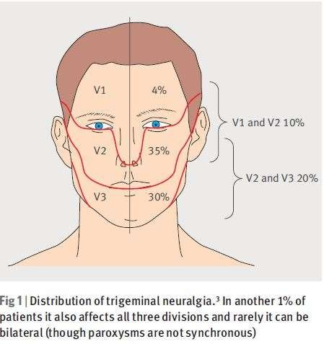

Slide 19







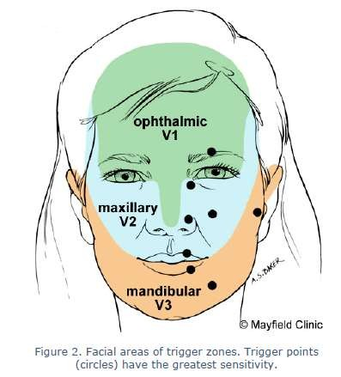
Trigger zones and trigger points
Trigger factors
V2- skin of upper lip, ala, cheeks & upper gums
washing the face
vibrations from walking
brushing teeth
V3- lower lip, teeth or gums of lower jaw
going out in cold wind
V1- supraorbital ridge of
shaving
affected side
applying make up

Slide 20
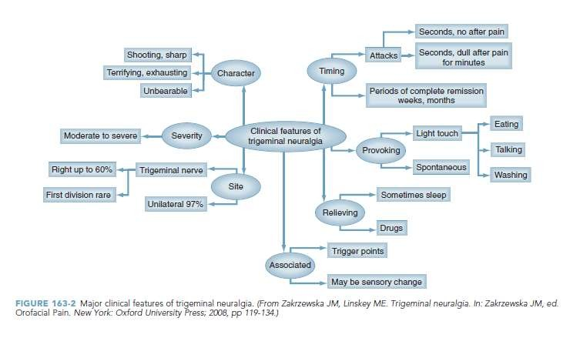

Slide 21
DIAGNOSIS

Slide 22

Well taken history
Classic clinical pattern
Diagnostic nerve blocks- 2% lignocaine without adrenaline
Response to treatment with carbamazepine – universal in TN.
MRI

Slide 23
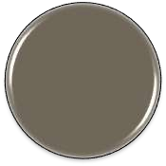
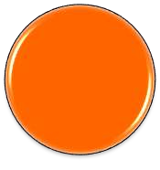
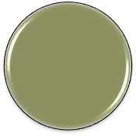
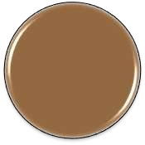

WHITE AND SWEET DIAGNOSTIC CRITERIA FOR
TRIGEMINAL NEURALGIA
Pain- provoked by light touch to trigger zones
Pain- confined to trigeminal distribution
Clinical sensory examination- normal
Pain- paroxysmal
Pain- unilateral

Slide 24
DIFFERENTIAL DIAGNOSIS

Slide 25
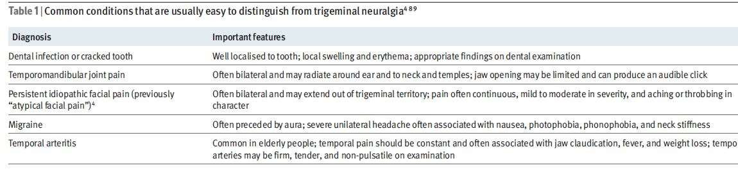

Slide 26


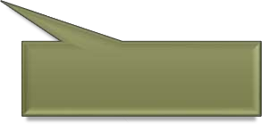




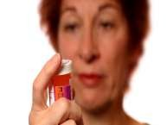
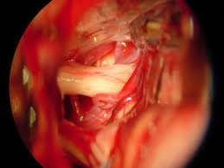
Treatment
Pharmacological
treatment
Surgical treatment

Slide 27

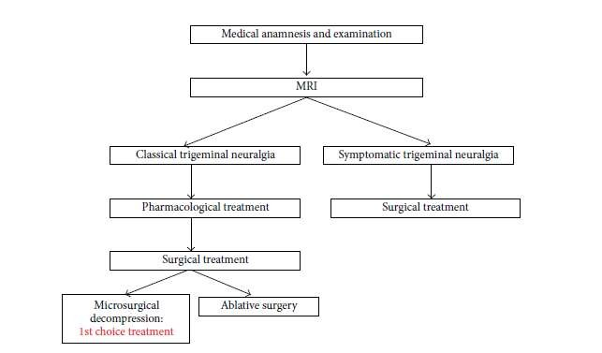

Slide 28
MEDICAL
 Based on current evidence, therapy with carbamazepine is initiated and patients are switched at the earliest opportunity to the controlled-release (CR) formulation, which has fewerside effects
 If carbamazepine causes troublesome side effects, reduce the dose and add baclofen.
 Alternatively oxcarbazepine or add on therapy either with lamotrigine or with phenytoin may be tried.
 In refractory cases gabapentin is probably the most promising drug.
 Pregabalin, topiramate or even the “older” anticonvulsants valproate and phenytoin may be tried in recalcitrant cases.

Slide 29
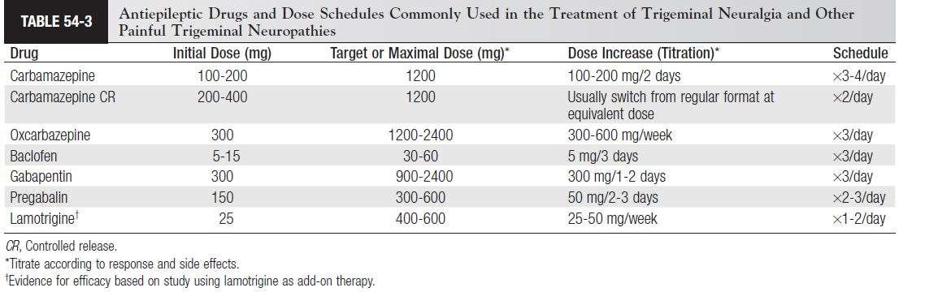
PHARMACOLOGIC TREATMENT

Slide 30
SURGERY
 Medically resistant patients who are physically able to withstand neurosurgery, particularly with typical CTN, are prime candidates for surgery
 The decision to opt for surgery is based on response to and side effects from medical treatment, the patient’s age and
profession, and the surgical facilities and expertise available.
 Surgery may be aimed peripherally at the affected nerve or centrally at the trigeminal ganglion or the posterior fossa

Slide 31
SURGICAL MANAGEMENT:
PERIPHERAL INJECTION:
It has been known that injection of destructive substance into peripheral branches of the trigeminal nerve, produces anaesthesia in the trigger zones or in areas of distribution of spontaneous pain.
(A) LONG ACTING ANAESTHETIC AGENTS:
Without adrenaline such as bupivacaine with or without corticosteroids may be injected at the most proximal possible nerve site.

Slide 32
0.5 – 2 ml of 95 % absolute alcohol can be used to
(B) ALCOHOL INJECTION:
block the peripheral branches of the trigeminal nerve. Aim is to destroy the nerve fibres.
It produces total numbness in the region of distribution of the nerve that was anaesthetized.
Complication:
Necrosis of the adjacent tissue Fibrosis
Alcohol induced neuritis

Slide 33
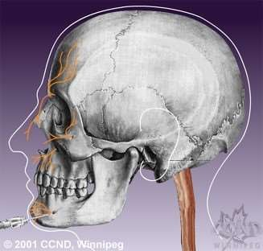
Oldest & most effective peripheral nerve destructive method
PERIPHERAL NEURECTOMY (NERVE AVULSION):
Can be repeated & relatively reliable technique.
It acts by interrupting the flow of a significant number of afferent impulses to central trigeminal apparatus.
Performed commonly on infraorbital, inferior alveolar,
mental and rarely lingual.
Disadvantage:
May produce
full anaesthesia deep hypoesthesia

Slide 34
(i) Conventional intraoral approach (ii)Braun’s transantral approach
INFRAORBITAL NEURECTOMY:
Conventional intraoral approach:
A ‘U’ - shaped Caldwell – Luc incision is made in the
upper buccal vestibule in the canine fossa region.
Mucoperiosteal flap is reflected superiorly to locate the infraorbital foramen.
Once the nerve is exposed, all the peripheral branches are held with the hemostat & avulsed from the skin surface intra orally.

Slide 35
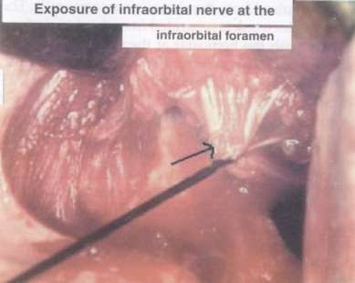
Then the entire trunk is separated from the skin surface is held with the hemostat at the exit point from the foramen & is removed by winding it around hemostat & pulling it out from the foramen.
Then it may be plugged with polyethylene plug.

Slide 36
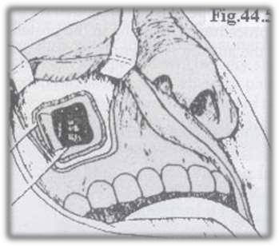
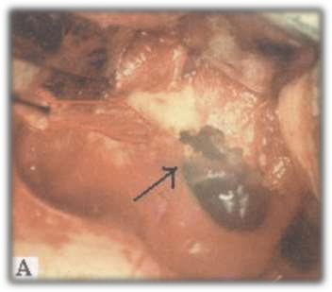
Braun’s trans antral approach:
An intra oral incision is made from the maxillary tuberosity to the midline in the maxillary vestibule.

Slide 37
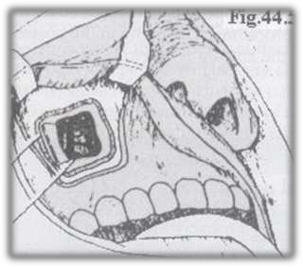
A 3 cm window is made in the antero – lateral wall of the maxillary sinus.
The descending palatine branch of the trigeminal nerve is identified & traced to the sphenopalatine ganglion.
The maxillary nerve is sectioned from the foramen rotundum to the inferior orbital fissure.
The antral mucoperiosteal flap in the vestibule is repositioned & sutured back.

Slide 38
INFERIOR ALVEOLAR NEURECTOMY:
Extra oral approach
Intra oral approach
The extra oral approach:
Done through Risdon’s incision
After reflection of masseter, a bony window is drilled in outer cortex & nerve is lifted with nerve hook & avulsed from its superior attachment & mental nerve is avulsed anteriorly through the same approach.

Slide 39
The intra oral approach:
Done via Dr Ginwalla’s incision
Incision is made along with the anterior border of ascending ramus, extending lingually & buccally & ending in a fork like an inverted Y.
Incision is then deepened on the medial aspect of ramus.
The temporalis & medial pterygoid muscles are split at their insertion & inferior alveolar nerve is located.

Slide 40
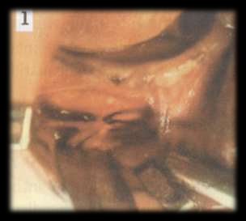
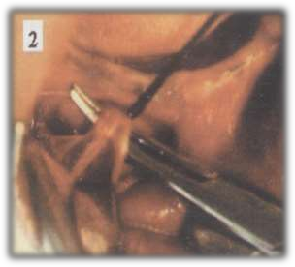
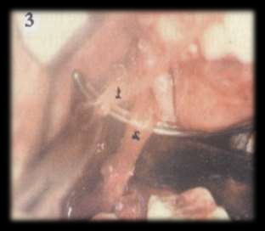

Slide 41
The nerve is ligated at two points in the most superior part visible & divided between the ligature.
The superior end is cauterized & the lower end is
held securely using a hemostat.
The mental nerve is also similarly ligated in two points close to the mental foramen & divided between two.
The remaining nerve is held at the inferior alveolar end & wound around the hemostat & excised from the canal.

Slide 42
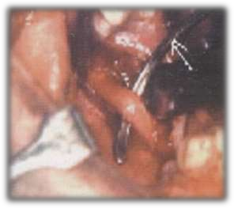
An incision is made in the anterior border of the ramus slightly towards the lingual side.
LINGUAL NEURECTOMY:
The lingual aspect is exposed & the lingual nerve identified in the third molar region just below the periosteum.
The nerve can be either avulsed or ligated, cut and the ends may
be cauterized.

Slide 43
CRYOTHERAPHY:
Barnard first used cryotheraphy in 1981 for the treatment of the trigeminal neuralgia.
After identifying the affected nerve , it is then exposed to the cryoprobe intraorally.
Direct application of cryotheraphy probe at temperatures colder than -60 C are known to produce Wallerian degeneration without destroying the nerve sheath itself.
Nerve is exposed for 2 min freeze followed by 5 min thaw cycle.
The freeze – thaw cycle is repeated at least 3 times.

Slide 44
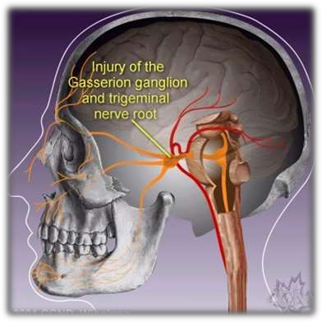
GASSERIAN GANGLION PROCEDURES:
PERCUTANEOUS RHIZOTOMY:
This is done on the Gasserian ganglion which involve either mechanically or chemically damaging parts of the trigeminal nerve.

Slide 45
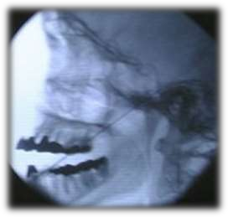
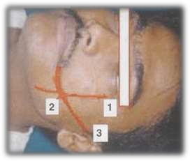
The foramen ovale is best visualize with the x – ray tube placed for a submentocortex position.
Technique of needle penetration:
Infiltration of the skin & cheek is done with local anaesthetic agent on the affected side.
Three points of Hartel are marked on the side of the face using marking ink.

Slide 46
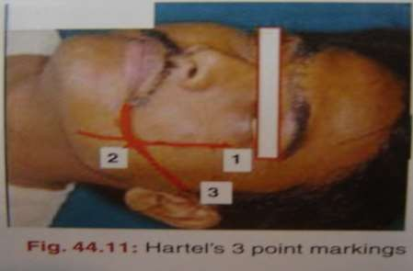
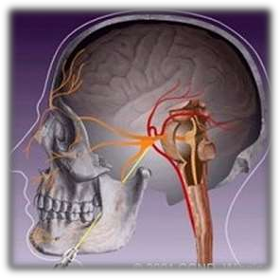
First point – a perpendicular line is drawn from the lateral orbital rim to the inferior border of the mandible.
Second point – marked at 15 mm lateral to the angle of the mouth on the perpendicular first line
Third point – marked at the level of TMJ 2.5 cm from the centre of the external auditory meatus.

Slide 47
It was first introduced by Kirschner (1931) & later modified by Sweet (1970).
(A) Controlled radiofrequency thermocoagulation:
Technique:
The patient is sedated with a short acting sedative and vital signs are monitored.
The electrode is inserted through the cheek under fluoroscopy into foramen ovale.
The patient is awakened briefly to accurately locate the position of the electrode.

Slide 48
Lesion production:
Thermal lesion of 30-90 sec. duration are made at 65 to
75 degree centigrade.
Power:
25 watt,voltage 40-45 volts.Current 120-140mA.
Temp. 65-75 degrees.
5mm bare tip electrode with 2mm diameter
Leison produced of 10*6mm within trigeminal ganglion root at temp. 75 degrees.

Slide 49
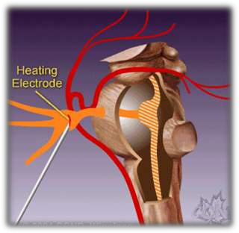
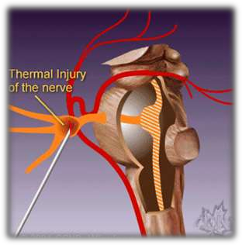
Indications
Ind
Toxicity of drugs
Failure of response to the other
modalities
Dependence on the drugs for life time.
Elderly patients
Medically compromised patients

Slide 50
Comparative low rate of recurrence
Advantages:
Zero mortality
Thermocoagulation preserves the motor function of the trigeminal nerve
Can avoid major surgical procedure
Disadvantage:
May cause
anaesthesia dolorosa loss of corneal reflex Meningitis (rarely)

Slide 51
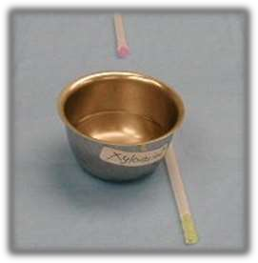
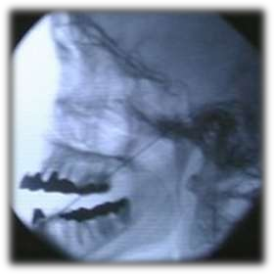
(B) Percutaneous glycerol rhizotomy:
Glycerol is a neurolytic alcohol which can be used to chemically destroy the nerve root.

Slide 52
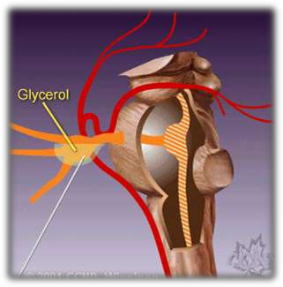
Simple technique
Advantages:
Lower incidence of anaesthesia dolorosa
Complication:
Post operative headache, nausea, vomiting
Meningitis
Post operative herpes simplex perioralis

Slide 53
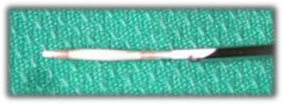
This is a mechanical means of destruction of the trigeminal nerve
introduced by Mullan & Lichtor in 1980.
(C) Percutaneous balloon compression:
Technique:
A no. 4 Fogarthy’s catheter is introduced with fluoroscopic guidance.
A 0.7 mm balloon is inflated for 1 – 2 minutes.

Slide 54
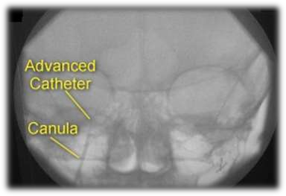
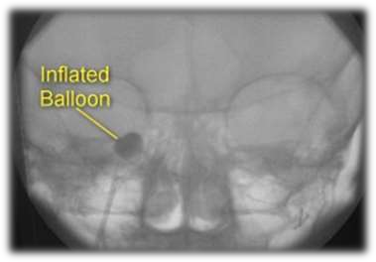
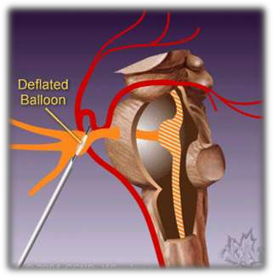


Slide 55

(A) Microvascular decompression of the trigeminal nerve sensory root:
OPEN PROCEDURES ( INTRACRANIAL PROCEDURES):
Procedure popularized in 1967 – 1976 by Jannetta.
Most commonly performed intra cranial open procedure.
The root is examined under the microscope

Slide 56



A compressing branch of the superior cerebellar artery will be seen medial to the nerve at the root entry zone.
Incision is made over the mastoid area

Slide 57


Then the trigeminal nerve is freed from the compressing
/ pulsating artery.
After freeing the nerve, the nerve is separated from the artery by placing a piece of Teflon between them.

Slide 58



Non absorbable insulating sponge may also be placed.

Slide 59



Slide 60



Slide 61


Slide 62


Slide 63


RECENT ADVANCES

Slide 64

RECENT ADVANCES

Slide 65
Conclusion
 Trigeminal Neuralgia has been an enigma to physicians for a long course of time. There have been various advances in the understanding of the pathogenesis of the disease per se and the treatment modalities.
 However various treatment modalities suggests
dissatisfaction with any one single procedure.
 Hence the golden rule still remains optimum scrutinisation and authentic diagnosis which is a key to the success of any treatment.

Slide 66

THANK
YOU…….

