Slide 1
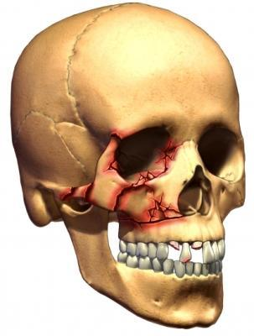
Zygomaticomaxillary Complex Fractures (ZMC Fracture)

Slide 2
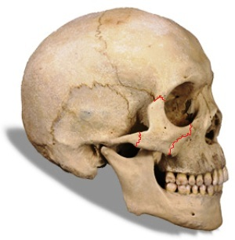
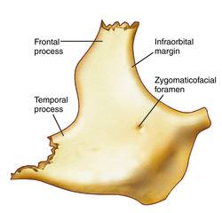
ANATOMY OF ZYGOMA BONE
Pyramid Shape of Zygoma
(Tetrapodal configuration)

Slide 3
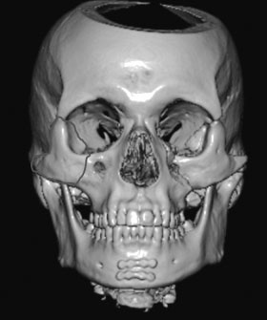

Slide 4
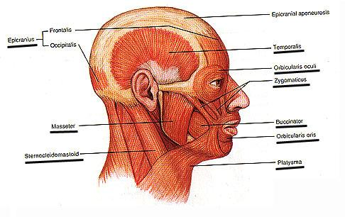
Muscle attachment

Slide 5
Introduction
Zygomatic fractures are common facial injuries, representing the second most in frequency after nasal fracture.
The high incidence of these fracture -the zygoma’s prominent position.
Male:female ratio - 4 : 1
Peak incidence - second and third decades of life
80% - motor vehicle accident.
The left zygoma is most commonly affected

Slide 6
DIFFERENT TERMINOLOGIES
Zygomatic fracture.
Malar fracture.
Zygomaticomaxillary complex fracture.
Zygomaticomaxillary compound fracture.
Zygomaticoorbital fracture.
Zygomatic complex fracture.
Trimalar fracture.
Tripod fracture (Ungley and Suggit, 1944).
Tetrapod fracture.
(FONSECA et al. FRACTURES OF ZYGOMATIC COMPLEX AND ARCH. ORAL & MAXILLOFACIAL TRAUMA: WB SAUNDERS. 3rd ed. Vol 1)

Slide 7
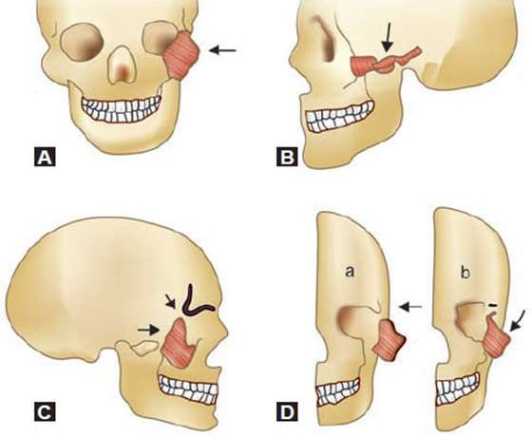
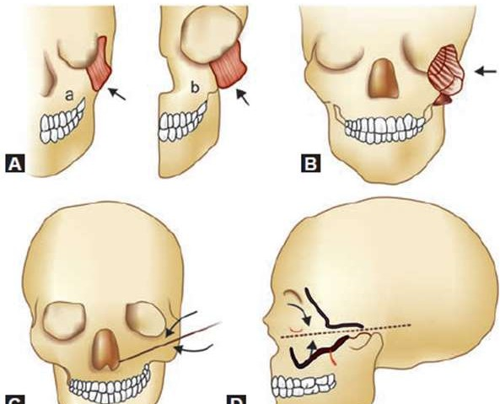
Classification
Knight & North
Group I fractures:
In these patients fracture lines in zygoma could be seen only in imaging. There is absolutely no displacement. These patients could ideally be managed conservatively by observation and by asking the patient to eat soft diet.
Group II fractures:
This group includes isolated fractures of the arch of zygoma. These patients present with trismus and cosmetic deformities.
Group III fractures:
This include unrotated fractures involving body of zygoma.
Group IV fractures:
This involves medially rotated fractures of body of zygoma

Slide 8
Group V fractures:
This involves laterally rotated fractures of body of zygoma. This type of fracture is very unstable and cannot be managed by closed reduction. Open reduction will have to be resorted to.
Group VI fractures:
This is complex fracture. It has multiple fracture lines over the body of zygoma. This condition is difficult to manage by closed reduction. Open reduction and microplate fixation is indicated in these patients. This type of fracture should not be managed by closed reduction alone because the presence of oedema / haematoma would mask the cosmetic deformity giving an impression that reduction has occurred. After reduction of oedema and followed by the action of masseter the fractured fragment may distract making the cosmetic deformity well noticeable

Slide 9
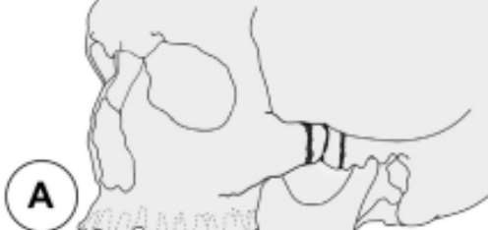
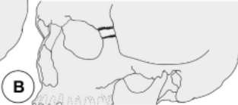
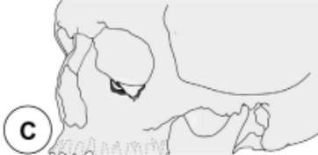
ZINGG etal classification (1992)
Type A: Incomplete zygomatic fracture. Isolated fractures involving only one zygomatic pillar:
Type A1: Isolated ZA fracture
Type A2: Lateral orbital wall fracture
Type A3: Infra orbital Rim fracture

Slide 10
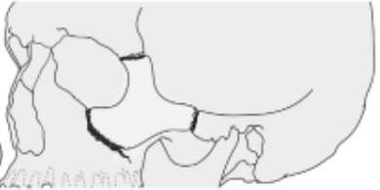
Type B: Complete monofragment zygomatic fracture (tetrapod fracture). All 4 pillars of the zygomatic bone are fractured

Slide 11
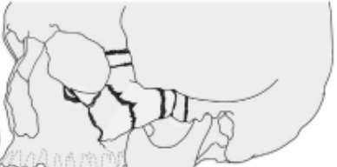
Type C: Multifragment zygomatic fracture. Same as type B, but with fragmentation, including the body of the zygoma

Slide 12
Manson's (1990) classification of fracture zygoma
1. Low energy injury
2. Medium energy injury
3. High energy injury

Slide 13
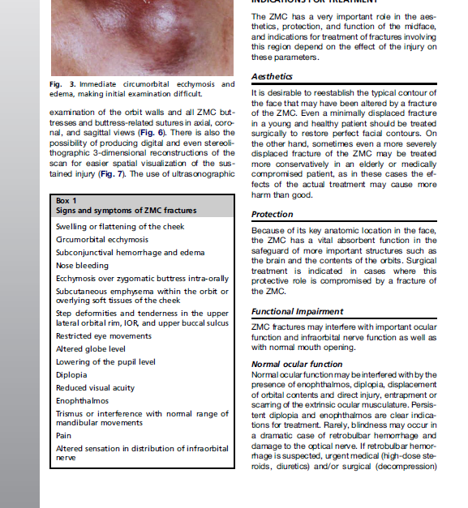
SIGNS AND SYMTOMS OF ZMC #

Slide 14
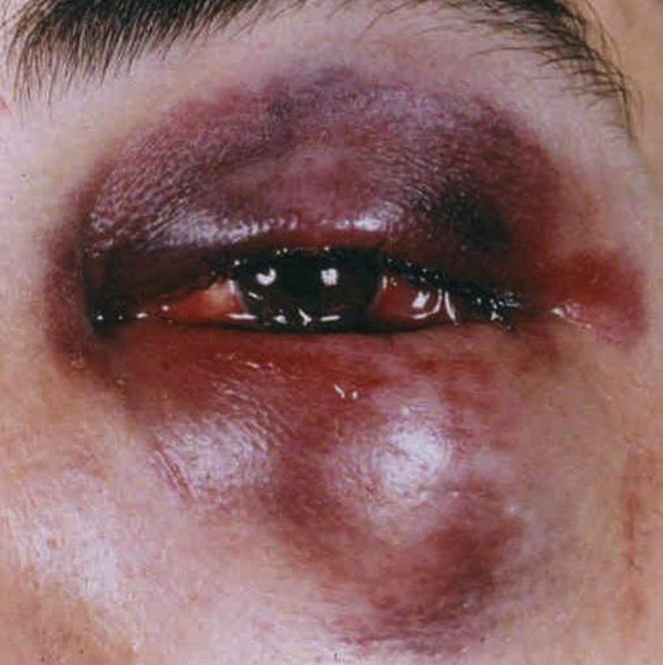
SIGNS AND SYMPTOMS
Periorbital ecchymosis and edema

Slide 15
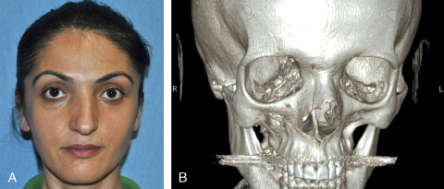
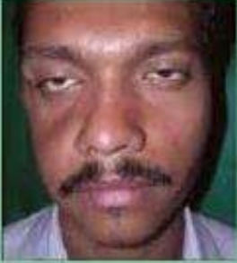
Flattening of malar prominence (70% to 86% cases, Larsen et al 1978 and Ellis et al 1985)

Slide 16
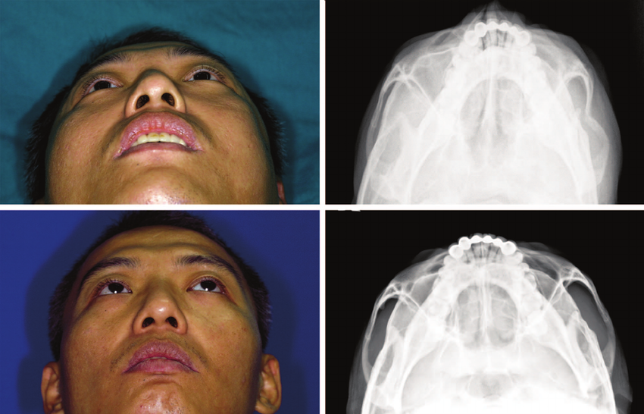
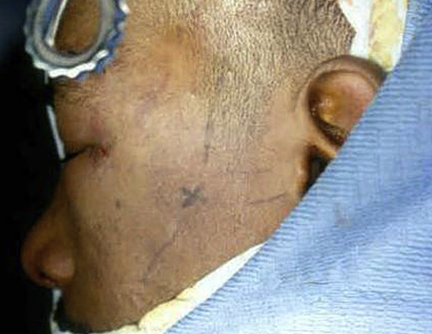
Flattening over the zygomatic arch

Slide 17
Pain

Slide 18
Ecchymosis of the maxillary buccal sulcus.

Slide 19
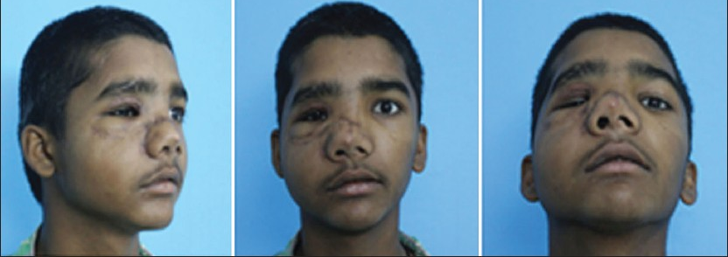
Deformity at the zygomatic buttress of the maxilla

Slide 20
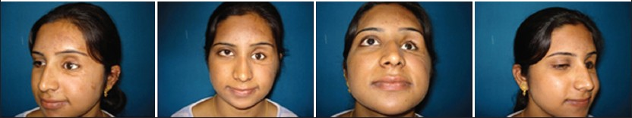
Deformity of the orbital margin

Slide 21
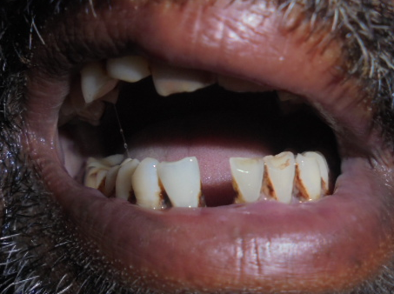
TRISMUS ( ONE-THIRD OF THE CASES AND 45 % CASES IN ARCH FRACTURES)

Slide 22
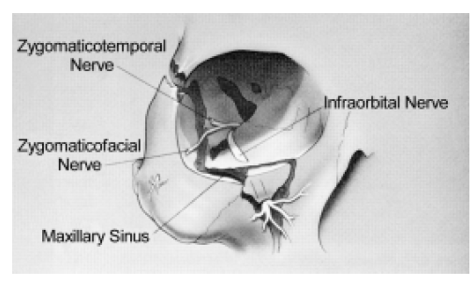
Abnormal nerve sensibility (50% to 90%)
(Larsen et al, 1978 and Ellis et al, 1985)

Slide 23
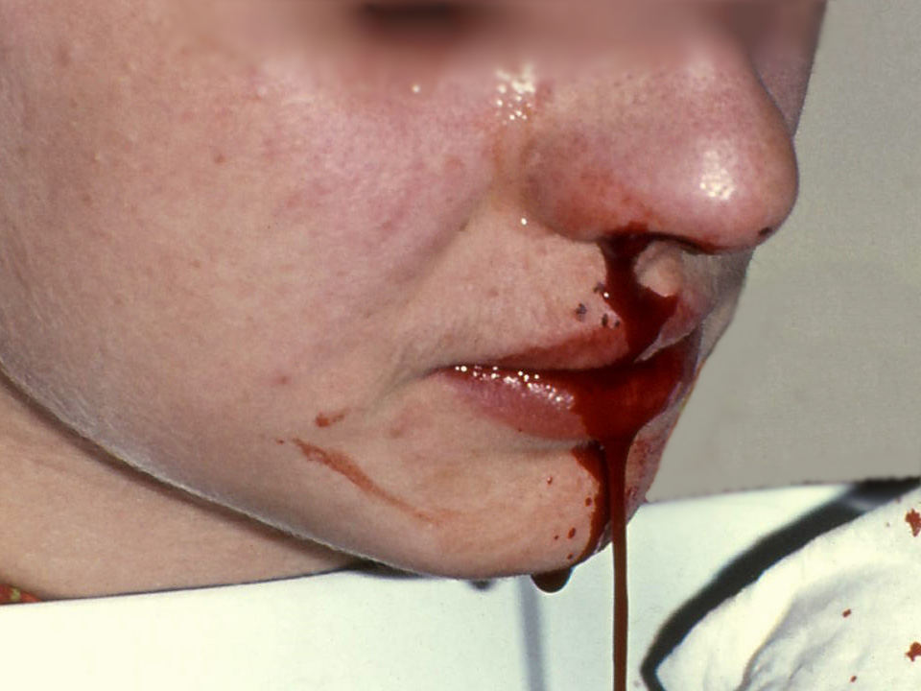
EPISTAXIS (30% to 50%)
(Weisenbaugh JM, 1970 and Ellis et al 1985)

Slide 24
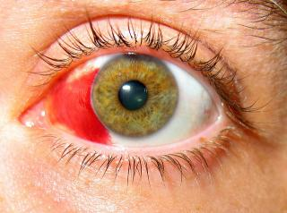
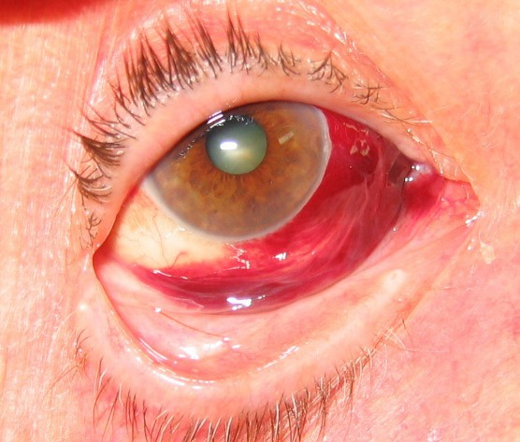
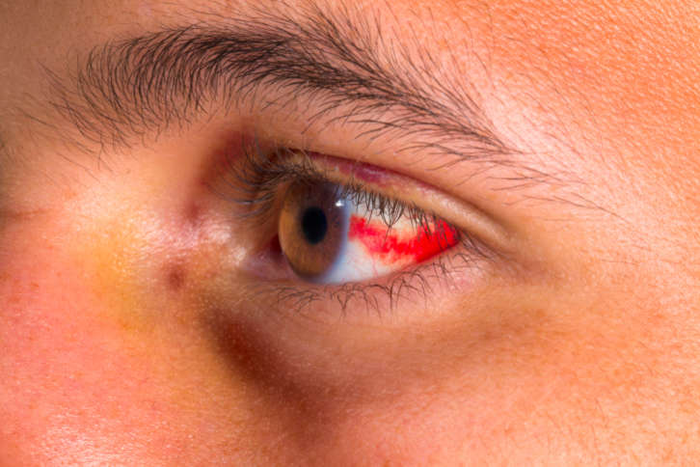
Subconjunctival ecchymoses (50% to 70%)
(Weisenbaugh JM, 1970 and Ellis et al 1985)

Slide 25
CREPITATION FROM AIR EMPHYSEMA (DISAPPEARS IN 2-4 DAYS SPONTANEOUSLY)

Slide 26
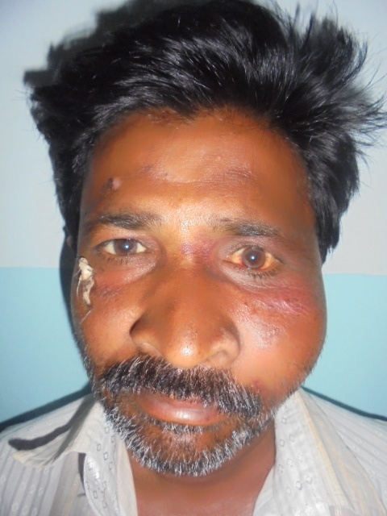
Displacement of the palpebral fissure

Slide 27

Diplopia

Slide 28
Superior Orbital Fissure Syndrome
Superior orbital fissure syndrome, also known as Rochon-Duvigneaud's syndrome, is a neurological disorder that results if the superior orbital fissure is fractured.
Involvement of the cranial nerves that pass through the superior orbital fissure may lead to diplopia, paralysis of extraocular muscles, exophthalmos, and ptosis.
Blindness or loss of vision indicates involvement of the orbital apex, which is more serious, requiring urgent surgical intervention.
Typically, if blindness is present with superior orbital syndrome, it is called orbital apex syndrome

Slide 29
IMAGING
CT scans allow detailed examination of the orbit walls and all ZMC buttresses and buttress-related sutures in axial, coronal, and sagittal views .
There is also the possibility of producing digital and even stereolithographic 3-dimensional reconstructions of the scan for easier spatial visualization of the sustained injury .
The use of ultrasonographic imaging in the diagnosis of craniofacial trauma is increasing.
A recent systematic review concluded that the use of diagnostic ultrasonography in maxillofacial fractures, especially fractures involving the nasal bone, orbital walls, anterior maxillary wall, and zygomatic complex, is justified on the grounds that the sensitivity and specificity of ultrasonography were considered generally comparable with those of CT. (Adeyemo et al. IJOMS 2011)

Slide 30
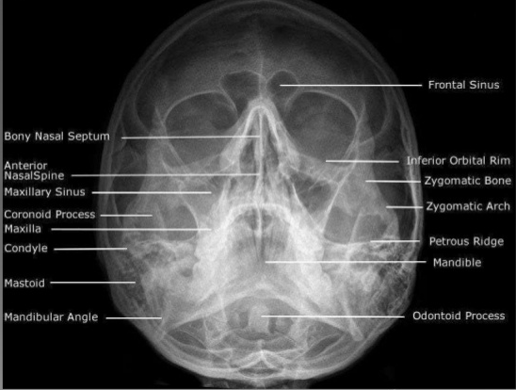
WATER’S PROJECTION

Slide 31
GENERAL PRINCIPLES OF TREATMENT
No treatment
Indirect reduction with,
a. No fixation
b. Temporary support
c. Direct fixation
d. Indirect fixation
Direct reduction and fixation

Slide 32
NO TREATMENT
Cases with a minimal degree of displacement, which following union, are considered unlikely to result any cosmetic deformity, disturbance of vision, persistent paraesthesia or impairment of mandibular movement.

Slide 33
INDIRECT REDUCTION
NO FIXATION:
Includes procedures which do not involve exposure of the fracture sites.
The principle is to disimpact and reduce the fracture by direct application of an instrument, through an indirect approach remote from the fracture line.

Slide 34
The techniques which have been developed for this operative approach, are based upon the introduction of an instrument through,
a. the temporal fossa,
b. the upper buccal sulcus (intraoral),
c. the cheek (percutaneous),
d. the nose (transantral)
e. the eyebrow (lateral brow)

Slide 35
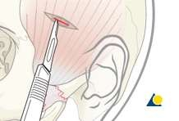
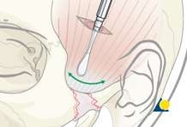
Temporal fossa approach:
This method was introduced by Gillies et al (1927) for elevation of the zygomatic arch. Incision of (2 cm in length), made 2.5 cm superior and anterior to the helix, within the hairline made above and parallel to the anterior branch of the temporal artery and dissection is carried down to the temporal fascia. This fascia is then incised to expose the temporalis muscle. An instrument is inserted deep to the temporalis fascia and superficial to the temporalis muscle
Using a Back- and- Forth Motion the instrument is advanced until it is medial to the depressed zygomatic arch.

Slide 36
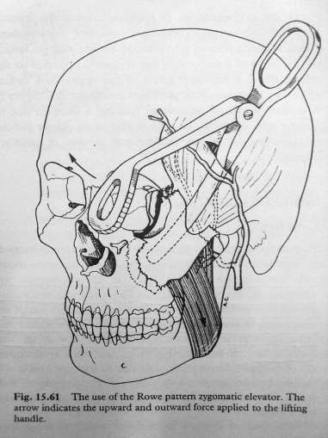
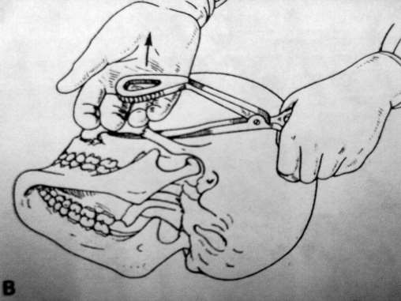
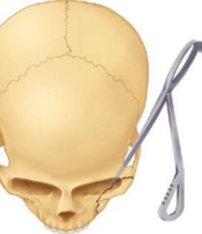
Firm Upward and outward force to the lifting
handle
Use of Rowe’s zygomatic elevator (1966)

Slide 37
Elevation from eye brow approach: (Dingman & Natwig 1964)
The advantage of this technique is that the fracture at the orbital rim is visualized directly.
The frontozygomatic area of the lateral orbital rim is exposed by the eyebrow incision.
The instrument is inserted to lift the zygoma anteriorly, laterally and superiorly.
Useful instruments for this purpose are – Dingman zygomatic elevator , urethral sound, or even large Kelly hemostat.

Slide 38
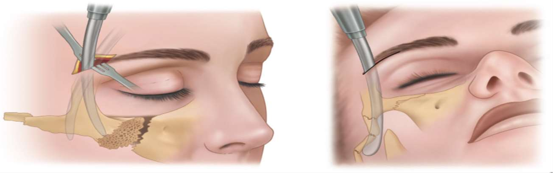
Dingman zygomatic elevator is placed along the temporal surface of zygoma for anterior , lateral and superior elevation

Slide 39
Upper buccal sulcus: (keen’s approach)
The advantages of this technique have been discussed by Balasubramaniam (1967) who considers that “less force is required by the intraoral approach than by the extraoral, because the force is exerted where it should be, i.e., more at the centre of the fractured fragment”.
Access is gained by an incision of about 1cm in length at the reflection of the upper buccal sulcus immediately behind the zygomatic buttress, so that a pointed curved elevator can be passed upwards supraperiosteally to contact the infratemporal surface of the zygomatic bone.
This enables upward ,forward and outward pressure to be exerted.

Slide 40
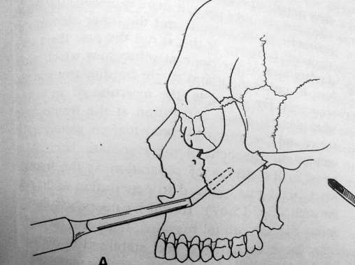
The elevator by Monks is suitable
for this purpose. (Taylor monk’s pattern)
A right angle retractor,bone hook, large Kelly Hemostat, simple dental extraction forceps and a Flat instrument –Seldin retractor to follow medial Surface of zyg arch and elevate it laterally.
Quinn in 1977 described a modification which is of value for medially displaced fractures of zygomatic arch.
This employs a lateral coronoid approach through an incision situated over the anterior border of ramus.

Slide 41
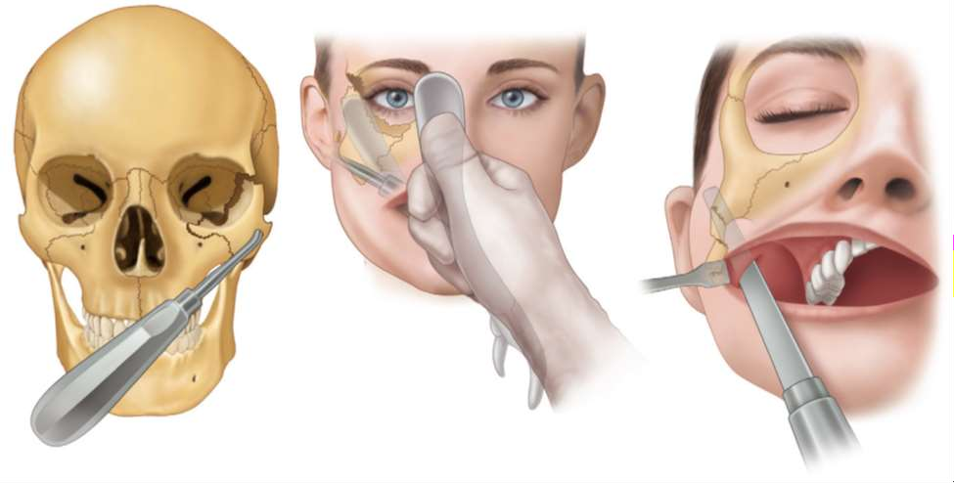
Intra oral approach to reduction of ZMC

Slide 42
Percutaneous approach: (Stroymeyer 1844)
Simplest of all because no soft tissue dissection is necessary.
Several instruments – bone hook , carroll –Girard screw( large bone screw ) for elevating zygomas.
This method consists of inserting a hook through the soft tissue of the malar area at a point just inferior and posterior to the prominence of the zygoma so that it engages the infratemporal aspect.
Poswillo advises that the exact location of the initial stab wound for insertion is found at the intersection of a perpendicular line dropped from the outer canthus of the eye and a horizontal line extended posteriorly from the alar margin of the nostril.

Slide 43
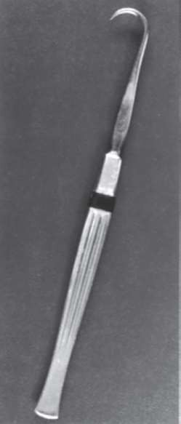
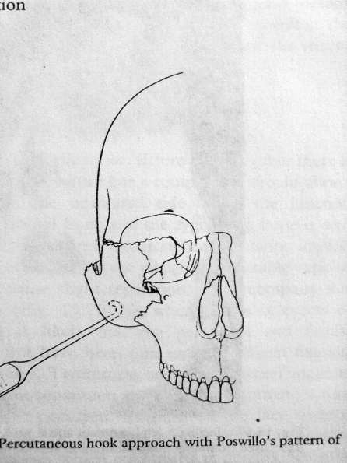
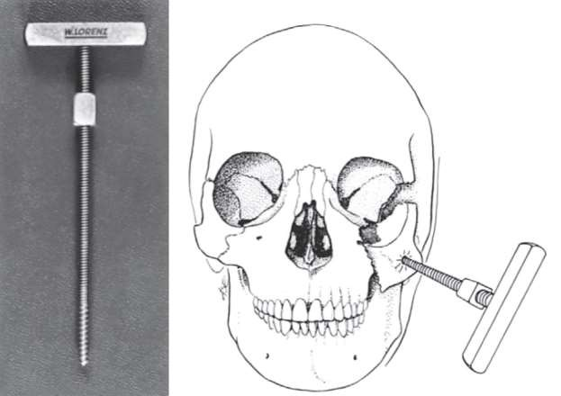
Carroll-Girard screw – elongated cork screw with a T bar handle and threads on its working end. This screw can be threaded into the body of zygoma following placement of hole
Adv – control ZMC position in all 3 planes of space.
Anterior and lateral traction with bone hook

Slide 44
Intranasal transantral approach: (Lothrop’s approach 1906)
Not common in use.
An opening is made into the antrum below the inferior meatus, and a curved urethral sound introduced and manipulated so that its tip lies on the antral aspect of the zygomatic bone. Firm outward and upward pressure is applied to reposition the bone.

Slide 45
ASSESSMENT OF REDUCTION
The success or failure of reduction will be obvious for those who have opened the fracture at three sites. If exposure at three sites has not been performed, the orbital margins are the areas that should be palpated first to determine reduction.
If reduction has been satisfactory, these margins will be smooth and continuous. This finding by itself, however, is inadequate verification . Although the zygomaticofrontal suture area provides the strongest pillar of the zygoma, it is one of the worst indicators of proper reduction of the entire complex, even when surgically exposed and evaluated directly.

Slide 46
One should also palpate in the maxillary vestibule. If there is any flatness still visible, then zygoma has not been properly elevated. If there is any doubt about proper reduction, exposure is mandatory. In this case, an incision in the maxillary vestibule offers excellent exposure of the zygomaticomaxillary buttress and the infraorbital rim.

Slide 47
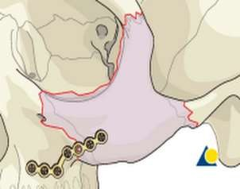
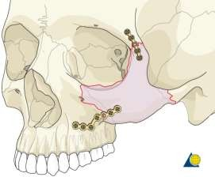
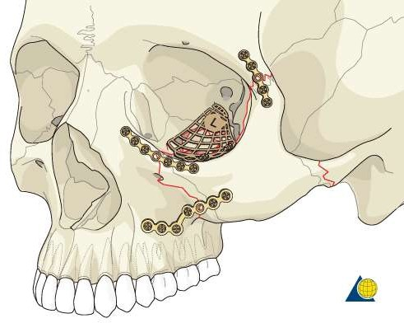
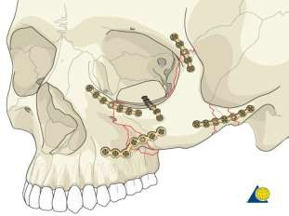
Fixation:
1 Point Fixation
2 Point fixation
3 point fixation
4 point fixation

Slide 48
One point fixation:
Indication:
Undisplaced fracture.
Simple non comminuted zygomatic complex fracture
Approach :
Zygomaticomaxillary buttress approached through maxillary vestibular approach.

Slide 49
Two point fixation:
Indication:
• Displaced fracture unstable after reduction
• Fracture at Frontozygomatic suture, Infraorbital rim and buttress.
Approach:
Exposure of frontozygomatic suture
A 2 point fixation using low profile plate at zygomaticomaxillary buttress or at the and FZ suture

Slide 50
Three point fixation
Fixation is done at Frontozygomatic suture, Zygomaticomaxillary
buttress and the Infraorbital rim.
Good reduction of these 3 sites mostly reduces the arch fracture
which is not fixed

Slide 51
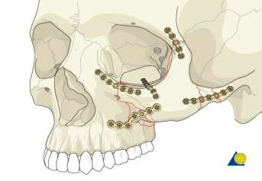
Four point fixation:
Unique from 3 point technique in that the surgeon visualizes the Zygomatic arch.
The order of placement of the plates will be dependant on the least damaged landmarks.
The zygomatic arch is an excellent reference to restore

Slide 52
Other approaches to zmc
Supraorbital eyebrow approach
Upper eye lid approach
Lower eye lid approaches- sub tarsal , subciliary, transconjunctival
Coronal approach

