Slide 1
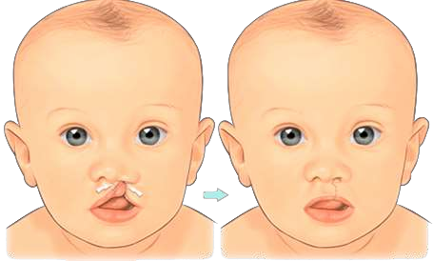
CLEFT LIP AND
PALATE

Slide 2

CONTENTS
Introduction
Incidence
Embryology
Aetiology
Classification
Diagnosis
Problems associated with clefts
Syndromes associated with clefts
Management of Cleft lip and palate
Timing of treatment sequence
Alveolar Bone grafting Prosthetic rehabilitation Recent advances
Conclusion
References
2

Slide 3

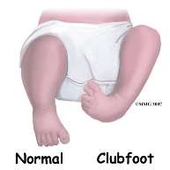
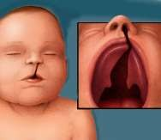
INTRODUCTION
Cleft lip and palate is the second most common congenital anamoly after clubfoot
Among the 15 types of orofacial clefting, cleft lip and palate is the most common one.
3

Slide 4
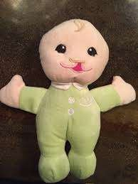
Hippocrates (400 BC) and Galen (150 AD) mention cleft lip,
Cleft palate – Fanco (1556)
4

Slide 5
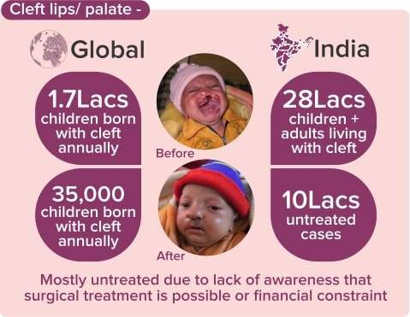
INCIDENCE

Slide 6


INCIDENCE
Worldwide one in 600 (1:600)
Birth prevalence of clefts between 27,000 and 33,000 clefts per year
A child is born with a cleft somewhere in the world every 2 minutes according to a WHO study published in 2001
6
Reddy S et al. Incidence of cleft Lip and palate in the state of Andhra Pradesh, South India. Indian J Plast Surg. 2010 Jul-Dec; 43(2): 184–189.

Slide 7
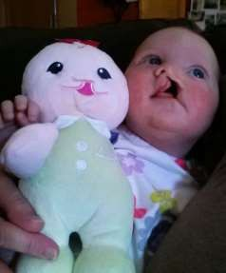
More common clefts are –
  Unilateral clefts
  Males female ratio is 2:1
  Left side common
  Males more affected by cleft lip and Females by cleft palate
78 affected infants are born every day, or 3 infants with clefts born
every hour
9
Reddy S et al. Incidence of cleft Lip and palate in the state of Andhra Pradesh, South India. Indian J Plast Surg. 2010 Jul-Dec; 43(2): 184–189.

Slide 8
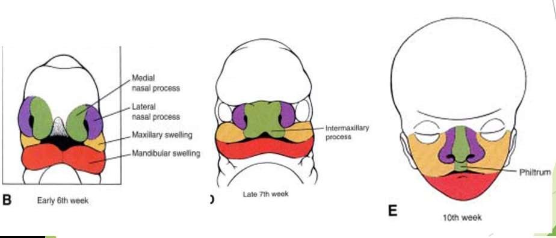
EMBRYOLOGY

Slide 9

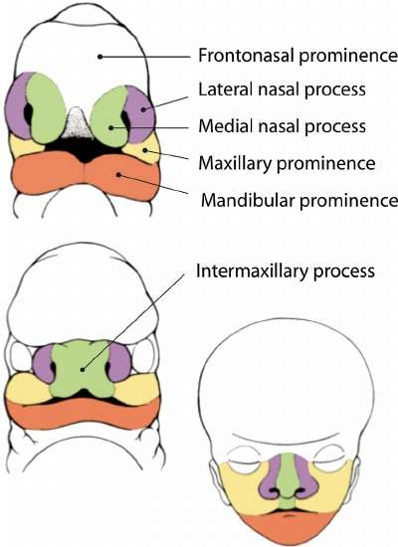
EMBRYOLOGY
Development of facial structures starts at the end of 4th week
5 facial prominences around stomatodeum
1. Unpaired frontonasal process
2. Paireed maxillary prominences
3. Paired mandibular prominences
4. Medial nasal process
5. Lateral nasal process
12
Thronton JB, Nimer S and Howrd P. The incidence, classification, etiology and embryology of oral clefts. Semin Orthod 1996;2:162-168

Slide 10
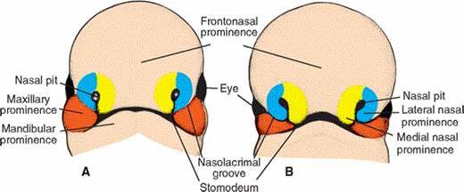
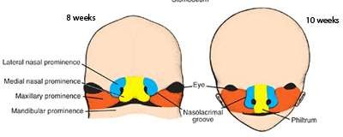
In following 2 weeks –
  The 2 medial nasal processes fuse in midline – upper lip
  Mandibular processes fuse in midline – lower lip
Thronton JB, Nimer S and Howrd P. The incidence, classification, etiology and embryology of oral clefts. Semin Orthod 1996;2:162-168

Slide 11
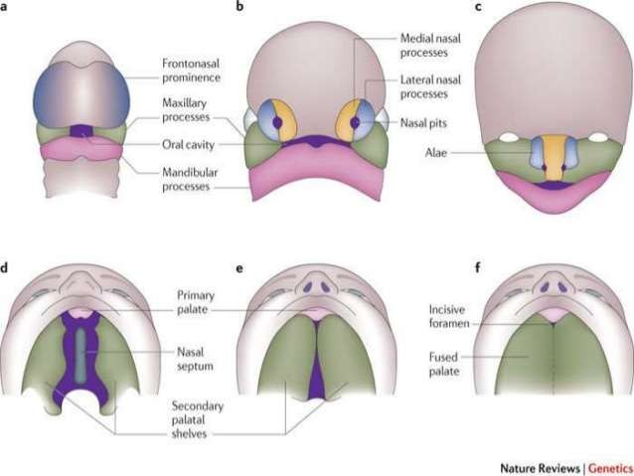
Primary palate – maxillary and medial nasal process merge
Thronton JB, Nimer S and Howrd P. The incidence, classification, etiology and embryology of oral clefts. Semin Orthod 1996;2:162-168

Slide 12
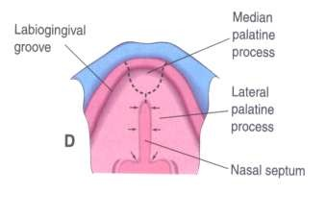
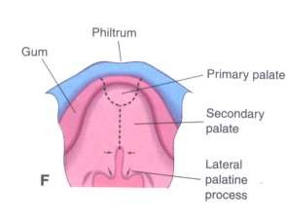
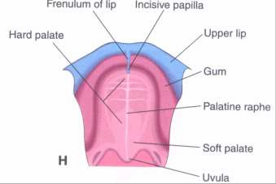
Secondary palate – formed from 2 outgrowths from maxillary prominences – palatine shelves
Fuse in midline at 7th week
Incisive foramen – midline landmark between primary and secondary palate
Thronton JB, Nimer S and Howrd P. The incidence, classification, etiology and embryology of oral clefts. Semin Orthod 1996;2:162-168

Slide 13

Formation of clefts
Failure of fusion of maxillary and medial nasal processes – anterior
to incisive foramen
Failure of fusion of palatine shelves – posterior to incisive foramen
Cleft lip – failure of proliferation of mesodermal cells in midline
Thronton JB, Nimer S and Howrd P. The incidence, classification, etiology and embryology of oral clefts. Semin Orthod 1996;2:162-168

Slide 14
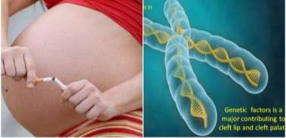
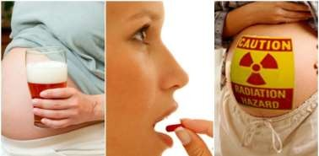
ETIOLOGY

Slide 15
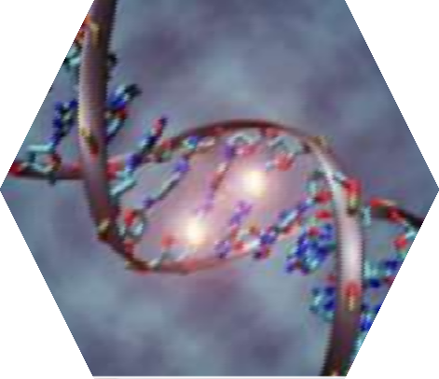

Genetic
AETIOLOGY
Environ mental
Multi factorial

Slide 16
1] Genetic
Genetic disorders are classified into
  Chromosomal
  Single gene
John B. Thornton, Sue Nim Paul S. Howard. The incidence, classification, etiology and embryology of oral clefts. Semin Orthod 1996;2:162-168

Slide 17
2] Multifactorial :
1) Chances increases if more than one family member if affected
2) More the severity, greater the chances of recurrence in sibling
3) Higher risk if affected individual is of less affected sex
4) Risk decreases in remotely related individuals
John B. Thornton, Sue Nim Paul S. Howard. The incidence, classification, etiology and embryology of oral clefts. Semin Orthod 1996;2:162-168

Slide 18
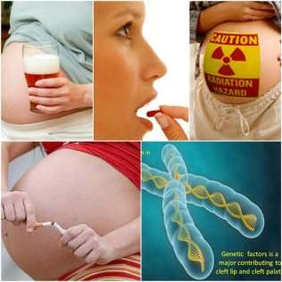
3] Environmental factors
Maternal smoking or tobacco exposure
Viral infections
Poor nutrition
Certain Medicinal drugs
Teratogens like:
  Rubella virus, Cortisone/ steroids, Mercaptopurine,
Methotrexate, Valium, Dilantin
28
Peter Mosby et al. Cleft Lip and Palate. Lancet 2009; 374: 1773–85

Slide 19
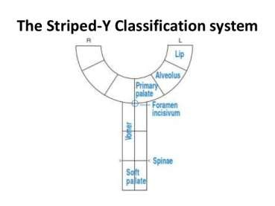
CLASSIFICATION

Slide 20

SYNDROMES
Around 400 syndromes
Chromosomal anomalies
  Trisomy 13 (Patau)
  Trisomy 18 (Edward)
  Trisomy 21 (Down’s)
  Velocardiofacial syndrome (22q11 deletion)
*Sommerland BC. Management of cleft lip and palate. Current Paediatrics 1994

Slide 21
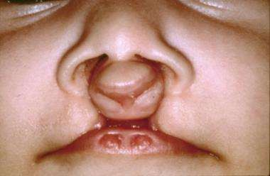
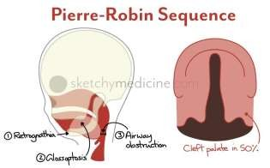
Inherited syndrome
  Sticklers (Autosomal dominant)
  Treacher Collins (AD)
  Van der Woude (AD)
Non-inherited syndrome
  Pierre Robin Syndrome – triad of cleft palate, glossoptosis, retrognathia
  Goldenhar syndrome
*Sommerland BC. Management of cleft lip and palate. Current Paediatrics 1994

Slide 22

CLASSIFICATION
Allori AC et al. Classification of Cleft Lip/Palate: Then and Now. Cleft Palate–Craniofacial Journal 2016;53(1)

Slide 23

Davis and Ritchie’s classification (1922)
Group I: Prealveolar process cleft (clefts affecting the lip)
Unilateral (right/left: complete/incomplete)
Bilateral (right: complete/incomplete; left: complete/incomplete)
Median (complete/incomplete)
Group II: Postalveolar process cleft (clefts affecting the palate)
Soft palate
Hard palate
Allori AC et al. Classification of Cleft Lip/Palate: Then and Now. Cleft Palate–Craniofacial Journal 2016;53(1)

Slide 24
Group III: Alveolar process cleft (any cleft involving the alveolar
process)
Unilateral (right/left: complete/incomplete)
Bilateral (right: complete/incomplete; left: complete/incomplete)
Median (complete/incomplete)
Allori AC et al. Classification of Cleft Lip/Palate: Then and Now. Cleft Palate–Craniofacial Journal 2016;53(1)

Slide 25





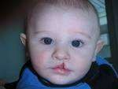
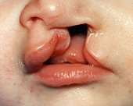

Victor Veau’s classification (1931)
A] Cleft lip
Class I : U/L notching of vermillion border, not extending into the lip. Class II : cleft extending into the lip, but not including the floor of the nose. Class III: extending into the floor of the nose.
Class IV: any b/l cleft of the lip, whether incomplete or complete.
Allori AC et al. Classification of Cleft Lip/Palate: Then and Now. Cleft Palate–Craniofacial Journal 2016;53(1)

Slide 26
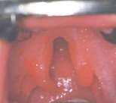



B] Cleft palate
Class I : soft palate
Class II : soft/hard palate extending no further than incisive foramen.
Class III: complete unilateral cleft, extending from uvula to incisive foramen, then deviating to one side
Class IV: two clefts extending forward from the incisive foramen into the alveolus.
Allori AC et al. Classification of Cleft Lip/Palate: Then and Now. Cleft Palate–Craniofacial Journal 2016;53(1)

Slide 27





Kernahan and Stark’s classification (1958)
Clefts of structures anterior to the incisive foramen
Clefts of structures posterior to the incisive foramen
Clefts affecting structures anterior and posterior to the incisive
foramen
Allori AC et al. Classification of Cleft Lip/Palate: Then and Now. Cleft Palate–Craniofacial Journal 2016;53(1)

Slide 28





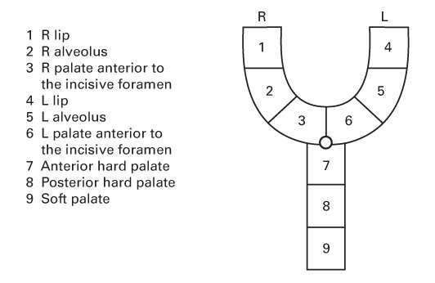
Kernahan and Stark’s stripped Y classification (1971)
Allori AC et al. Classification of Cleft Lip/Palate: Then and Now. Cleft Palate–Craniofacial Journal 2016;53(1)

Slide 29
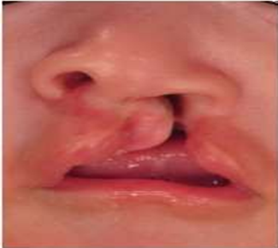
Unilateral cleft lip
Varying degrees of clefting
Orbicularis oris inserts at the columella medially and ala laterally on the cleft side
Columella is displaced to the normal side
Nasal tip is deflected towards
the non cleft side.
Nasal ala on the side of the cleft is displaced laterally, inferiorly, and posteriorly

Slide 30
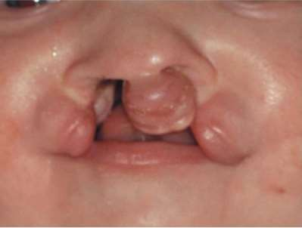
Bilateral cleft lip
Orbicularis oris attaches at the lateral cleft margins bilaterally at the nasal ala
Premaxilla protrusion
Symmetrical nasal deformities
Laterally displaced ala – widely flared
Extremely short columella

Slide 31
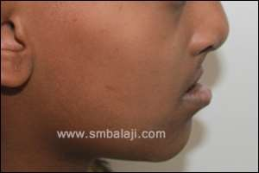
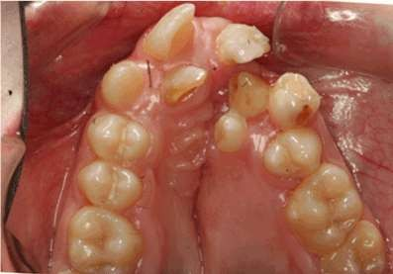
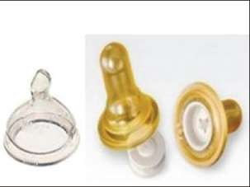
PROBLEMS ASSOCIATED
WITH CLEFT LIP & PALATE

Slide 32
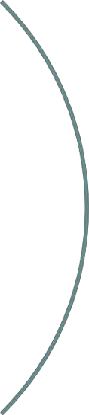














Dental
Skeletal
Nasal
Feeding
Ear problems Speech
Associated anomalies
*Jamal GA et al. Prevalence of Dental Anomalies in a Population of Cleft Lip and Palate Patients. Cleft Palate–Craniofacial Journal, 2010;47(4):413-20

Slide 33

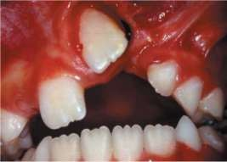
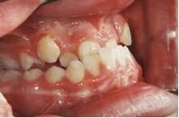
DENTAL
Tooth agenesis, hypodontia (most common)
Supernumerary teeth (2nd most common)
Enamel hypoplasia (CI)
Crossbites
Ectopic eruption, transposition
Taurodontism, dilacerations
*Jamal GA et al. Prevalence of Dental Anomalies in a Population of Cleft Lip and Palate Patients. Cleft Palate–Craniofacial Journal, 2010;47(4):413-20

Slide 34

SKELETAL
Maxillary deficiency
Mandibular prognathism
Class III malocclusion
Concave profile
57
*Ana Paula Ramos Bernardes da Silva, Beatriz Costa, Cleide Felício de Carvalho Carrara, Dental Anomalies of Number in The Permanent Dentition of Patients
With Bilateral Cleft Lip: Radiographic Study, The Cleft Palate-Craniofacial Journal. 2008;45(5):473-476.

Slide 35

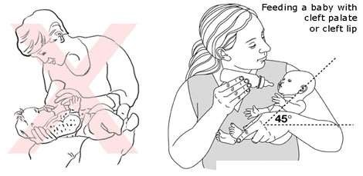
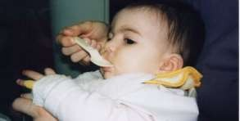
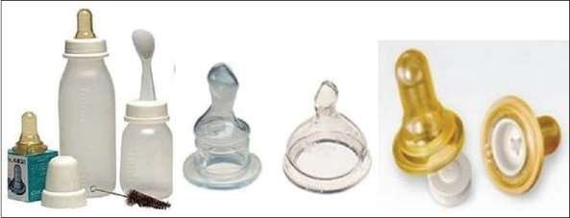
FEEDING PROBLEMS
Oronasal fistulas
Draining of oral fluids in nasal cavity and vice versa
Bottle, cup and spoon, tube feeding (Mead-Johnsons bottle, Pigeon nipple with one way valve, Haberman feeder)
Infant held at 30-45⁰ angle to aid swallowing
58

Slide 36
Ear infections and hearing loss
Babies with cleft palate are especially susceptible to middle ear infections. Ear infections are often due to a dysfunction of the tube that connects the middle ear and the throat.
Over time, repeated ear infections can damage hearing, but hearing loss may resolve with treatment.
It's important for children with cleft palate to be evaluated regularly by an audiologist.
Most children with clefts have tubes inserted in their ears to drain fluids and help prevent infections.

Slide 37
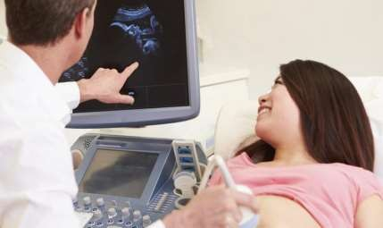
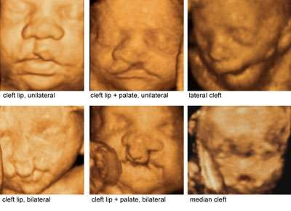
DIAGNOSIS

Slide 38

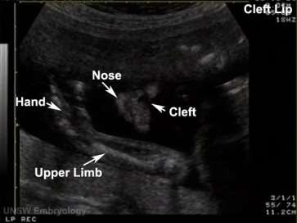
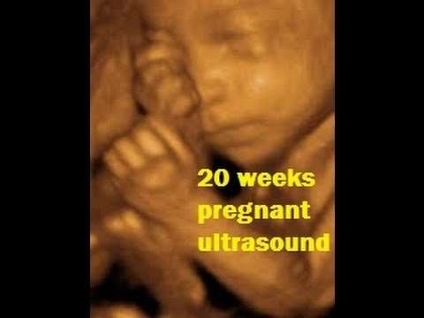
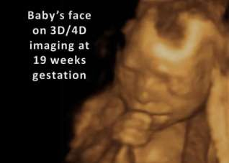
DIAGNOSIS
Prenatal ultrasound – 2D or 3D
Transabdominal US
Transvaginal USG
Graber Vanarsdall and Vig. Orthodontics: Current Principles and Techniques. Elsevier 2012

Slide 39
MANAGEMENT OF CLEFT LIP
& PALATE

Slide 40












MULTIDISCIPLINARY MANAGEMENT
Dentist
ENT/
audiologist
Surgeon
Speech
therapist
Nursing
CLEFT
TEAM
Paediatrician
Genecists
Psychologi st
Social worker
Ophthalmol ogist
64

Slide 41
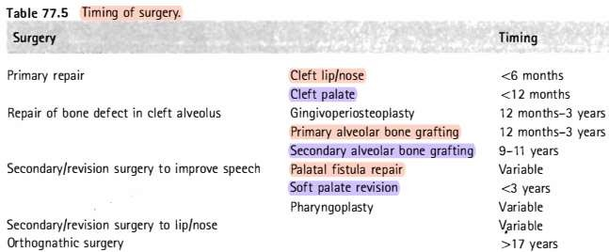

Slide 42
Cleft lip repair
Typically performed at 3 months of age
“Rule of Tens”
10 weeks old, 10 lbs, and hemoglobin of 10
Wide clefts or clefts with premaxilla protrusion that require lip adhesions will have definitive lip repair at 5-6 months of age

Slide 43
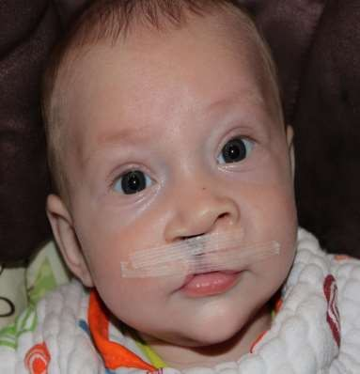
Pre surgical Orthopedics
Wide cleft lip or premaxilla protrusion
Advantageous to narrow the cleft and mold the
premaxilla before proceeding with
surgery
Taping
Effective in reducing the width of the cleft
it is placed with tension across the
cleft

Slide 44
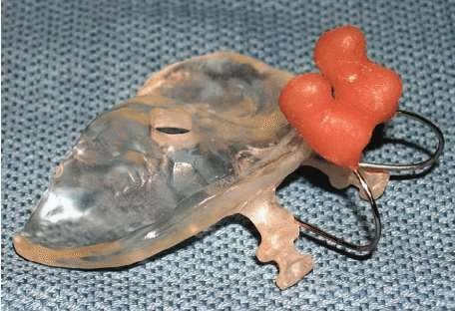
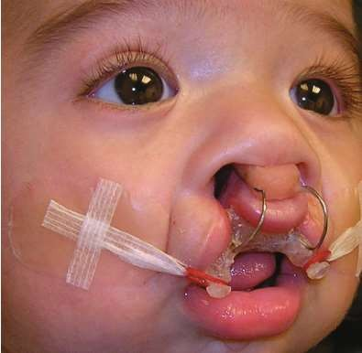
Pre surgical
Nasoalveolar molding devices
Custom made devices which utilize wiring and nasal stenting to mold the nasal cartilage, premaxilla, and alveolar ridge
Nasal stenting can be elongated and adjusted to lengthen the columella and mold the nasal cartilage

Slide 45
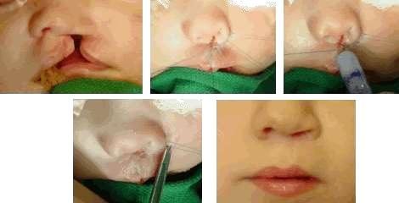
Pre surgical
Lip adhesion
Considered when adhesive tapes and moulds are ineffective
Surgically convert a complete cleft
to an incomplete cleft
Performed at 2-4 weeks with definitive repair at 5-6 months
Indications
Wide unilateral cleft where conventional repair might produce excessive tension

Slide 46
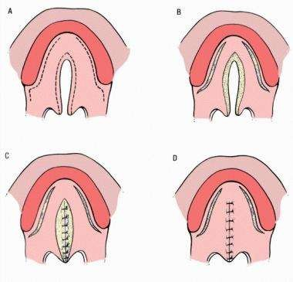
SURGERIES FOR CLEFT PALATE
Von Langenback
Bardach Two-flap Palatoplasty
Wardill Kilner’s push back (V-Y)
Furlow’s technique
103

Slide 47
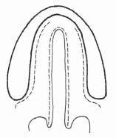
von Langenbeck technique
Bernard von Langenbeck (1861) described a method of palatoplasty using mucoperiosteal flaps for the repair of the hard palate region.
He maintained the anterior attachment of the mucoperiosteal flap to the alveolar margin to make it a bipedicle flap.
Originally only the cleft edges were incised, a lateral incision was made, the flap was elevated from the hard palate, the palatine musculature was divided and finally the sutures were applied.

Slide 48
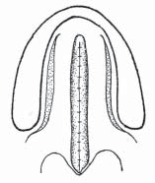
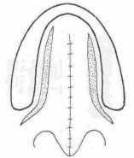
This technique is still used in isolated cleft palate repair.
Line diagram of von Langenbeck palatoplasty for an isolated complete cleft palate

Slide 49



Slide 50

Bardach Two-flap Palatoplasty
This is a modification of the von Langenbeck technique in which the incision is made along the cleft margin and the alveolar margin.
These are joined anteriorly to free the mucoperiosteal flaps.
These flaps are based on the greater palatine vessels.
The soft palate is repaired in a straight line.
The levator palati muscle dissection and reconstruction of the muscle sling is performed as in intravelar veloplasty.
This is a technique commonly followed presently.

Slide 51


Line diagram showing Bardach two-ß ap technique of palatoplasty in a bilateral cleft lip and palate

Slide 52



Veau-Wardill-Kilner Palatoplasty
Till a few years back this procedure was the commonest technique of palatoplasty.
In this technique V-Y procedure is performed so that the whole mucoperiosteal flap and the soft palate are retroposed and the palate is lengthened.
Line diagram showing the Veau-Wardill-Kilner technique of palate repair in a unilateral cleft lip and palate

Slide 53
Drawbacks
However, it leaves an extensive raw area anteriorly and laterally along the alveolar margin with exposed bare membranous bone.
The raw area heals with secondary intention. This causes shortening of the palate and results in velopharyngeal incompetence.
The raw area adjacent to the alveolar margin also results in alveolar arch deformity and dental malalignment.
Because of these drawbacks pushback and V-Y techniques have fallen into disrepute and now less and less centres practise this technique

Slide 54
Furlow Double Opposing Z-Plasty
Furlow adopted a double reverse Z-plasty for the oral and nasal surfaces of the soft palate.
The cleft margin forms the central limb.
The muscle is incorporated into the posteriorly based triangular flap on the left side for ease of dissection.
The hard palate region is closed by making an incision along the cleft margin, elevating the mucoperiosteum from the medial side and taking advantage of the high arch, the cleft is closed in two layers without making a lateral incision.
Furlow described the use of the lateral relaxing incision only when necessary.
On transposition of the triangles there is an effective lengthening of the soft palate, the suture line is horizontal and there is good overlap of the levator muscle.

Slide 55



Many surgeons claim to have better speech outcome with Furlow repair technique.
However, the studies have not proved this objectively.
The major objection to the technique is the non-anatomic placement of the muscle
Line diagram showing Furlow Z-plasty technique of palatoplasty in a unilateral cleft lip and palate patient

Slide 56
Other techniques
Two-stage palatal repair
• Hole in one repair
• Raw area free palatoplasty
• Alveolar extension palatoplasty (AEP)
• Primary pharyngeal flap
• Intravelar veloplasty
• Vomer flap
• Buccal myomucosal flap

Slide 57

Cleft lip repair
Milliard rotation-advancement technique
widely used
Advantages
Flexible
Minimal tissue discarded
Good nasal access
Minimized suture line

Slide 58
Disadvantages-
Requires experienced surgeon
Possible excessive tension
Excessive undermining required
Tendency towards small nostril

Slide 59


Millard rotation and advancement
Landmarks for millard procedure

Slide 60

Marking of Incisions (3+5+X=Rotation incision and 8+9= Advancement incision)

Slide 61

A-Rotation flap B- Advancment flap C-Columellar base soft tissue
D- Alar rim m- medial mucosal flap l- lateral mucosal flap

Slide 62


Millards rotation and advancement
Goals
Tensionless closure Reapproximation of orbicularis oris
Formation of Cupid’s bow Creation of a philtrum Repositioning of nasal ala
Complications - Hypertrophic scarring
Aggressive massage Nostril stenosis on cleft side

Slide 63

Modified delaire procedure
Avoids crossing aesthetically sensitive areas, such as the columella base and alar rim unlike Millards procedure
Incorporation of wavy lines and small triangular flaps above the vermillion allow some degree of lengthening
.
important contribution that the restoration of labiomaxillary muscle fnction makes towards

Slide 64
Bilateral cleft lip repair
Technically challenging
Goals
Symmetry
Orbicularis oris closure Proper philtral size and shape Tubercle formation
Positioning of alar cartilages to construct the nasal tipand columella

Slide 65

Bilateral cleft lip
more severe deformity than unilateral.
Signifcant degree of hypoplasia in the midline
prolabium
characteristic feature of complete bilateral clefs is the marked projection of the prolabium and
premaxilla,

Slide 66
Alveolar cleft repair
There are two main ways in which this can be achieved.
Secondary alveolar bone grafting
at age 9 to 11 years preceded by primary soft-tissue closure with a vomer flap at the time of primary lip repair, although the alveolar cleft may be left unrepaired at the time of primary surgery.
Primary gingivo-periosteoplasty (GPP) at either the time of palate closure or delayed until the age of three to five years.

Slide 67















BONE GRAFTING FOR ALVEOLAR CLEFT DEFECTS
BONE GRAFTING
Primary bone grafting
Secondary bone grafting
First 2 years of
life
Early – 2 to 5 years of life
Late – 11 to 14 years of life
67
*Waite P, Waite D. Bone Grafting for the Alveolar Cleft Defect. Semin Orthod 1996;2:192-196

Slide 68
OBJEVTIVES FOR SURGICAL GRAFTING:
Stabilization of segments
Improved oral hygiene
Nasal secretions prevented from draining into the mouth
Unites maxilla to better withstand occlusal forces
Bony base for teeth eruption
Improves nasal symmetry
Provide feeling of normalcy and improve social acceptance
68
*Waite P, Waite D. Bone Grafting for the Alveolar Cleft Defect. Semin Orthod 1996;2:192-196

Slide 69
SURGICAL MANAGEMNT OF ALVEOLAR CLEFT
Ideal timing:
  9 to 11 years of age
  Before canine eruption, canine root is 1/3rd formed (Bergland et al)
Best source of bone graft: (autologous cancellous bone)
  Anterior portion of iliac crest
  The rib, tibia
  The cranium
  The mandible
69
*Waite P, Waite D. Bone Grafting for the Alveolar Cleft Defect. Semin Orthod 1996;2:192-196

Slide 70

108

Slide 71



PROSTHETIC REHABILITATION FOR CLEFT PALATE PATIENTS
Ambrose Pare (1565) – prosthesis to obturate palate
Obturators using sponges, wax, and silver to more modern materials
Latham appliance (1980) – unilateral or bilateral clefts
123
*Gardener LK, Parr GR. Prosthetic Rehabilitation of the Cleft Palate Patient. Semin Orthod 1996;2:215-19

Slide 72


VELOPHARYNGEAL IMPAIRMENT
Velopharyngeal impairment – insufficient contact between the velum and the posterior and lateral pharyngeal walls
Velopharyngeal insufficiency – deficiency
Velopharyngeal incompetence – neuromuscular
125
*Dalston R. Velopharyngeal Impairment in the orthodontic patients. Semin Orthod 1996;2:220-7.

Slide 73


Treatment
Speech therapy
Non-surgical or speech aid prosthesis
Obturators
Transitional appliance in growing patients
3. Surgical
Palatoplasty, Sphincter pharyngeoplasty
126
*Gardener LK, Parr GR. Prosthetic Rehabilitation of the Cleft Palate Patient. Semin Orthod 1996;2:215-19

Slide 74

RECENT ADVANCES
Fetal surgery – done in intrauterine life (prior to 20 weeks)
Non-life threatening defects like cleft lip, cleft palate, Pierre Robin
syndrome, Treacher-Collins syndrome, craniofacial microsomia
Open fetal surgery
Feto-endoscopic approach
127
*Papadopulos NA. Foetal surgery and cleft lip and palate: current status and new perspectives. Br J Plast Surg. 2005 Jul;58(5):593-607

Slide 75


ADVANTAGES
Provide a scarless repair, “ripple effect” is eliminated
Correct the primary deformity,
Prevent secondary deformities, and
Give the parents a "normal“ - appearing child at birth
128
*Papadopulos NA. Foetal surgery and cleft lip and palate: current status and new perspectives. Br J Plast Surg. 2005 Jul;58(5):593-607

Slide 76











CONCLUSION
Oral clefts are the second most common congenital anamoly, having
multifactorial origin
A considerable knowledge about the etiology and embryology is required for proper diagnosis and treatment planning of such patients
Treatment begins soon after birth and continues till adulthood requiring a team approach.
76

Slide 77

REFERENCES
Reddy S et al. Incidence of cleft Lip and palate in the state of Andhra Pradesh, South India. Indian J Plast Surg. 2010 Jul-Dec; 43(2): 184–9.
Allori AC et al. Cleft lip and palate classification: Then and Now. Cleft Palate–Craniofacial Journal 2016;53(1)
Graber Vanarsdall and Vig. Orthodontics: Current Principles and Techniques. Elsevier 2012.
John B. Thornton, Sue Nim Paul S. Howard. The incidence, classification, etiology and embryology of oral clefts. Semin Orthod 1996;2:162-168
Inderbir Singh. Human embryology. Macmillan India. Seventh edition 2001.
Peter Mosby et al. Cleft Lip and Palate. Lancet 2009; 374: 1773–85
77

Slide 78
REFERENCES
1. Graber Vanarsdall and Vig. Orthodontics: Current Principles and Techniques. Elsevier 2012
2. Jamal GA et al. Prevalence of Dental Anomalies in a Population of Cleft Lip and Palate Patients. Cleft Palate–Craniofacial Journal, 2010;47(4):413-20
3. Ana Paula Ramos Bernardes da Silva, Beatriz Costa, Cleide Felício de Carvalho Carrara, Dental Anomalies of Number in The Permanent Dentition of Patients With Bilateral Cleft Lip: Radiographic Study, The Cleft Palate-Craniofacial Journal. 2008;45(5):473-476.
4. Sommerland BC. Management of cleft lip and palate. Current Paediatrics 1994
5. Berkowitz S. A Comparison of Treatment Results in Complete Bilateral Cleft Lip and Palate Using a Conservative Approach Versus Millard-Latham PSOT Procedure. Semin Orthod 1996;2:169-184
6. Peterson S. The Relationship Between Timing of Cleft Palate Surgery and Speech Outcome: What Have We Learned, and Where Do We Stand in the 1990s? Semin Orthod 1996;2:185-191
78

Slide 79
7. Samuel Berkowitz. Celft Lip and Palate. 2006. 2nd edition Page number 451-8.
8. Waite P, Waite D. Bone Grafting for the Alveolar Cleft Defect. Semin Orthod 1996;2:192-
196
9. Vlachos C. Orthodontic Treatment for the Cleft Palate Patient. Semin Orthod 1996;2:197- 204
10. Posnick J. Orthognathic Surgery for the Cleft Lip and Palate Patient. Semin Orthod 1996;2:205-14
11. Gardener LK, Parr GR. Prosthetic Rehabilitation of the Cleft Palate Patient. Semin Orthod 1996;2:215-19
12. Dalston R. Velopharyngeal Impairment in the orthodontic patients. Semin Orthod 1996;2:220-7.
13. Papadopulos NA. Foetal surgery and cleft lip and palate: current status and new
perspectives. Br J Plast Surg. 2005 Jul;58(5):593-607
14. Chang J. Fetal plastic surgery: a review and preview. © Chang www.thefetus.net/
79

Slide 80










THANK YOU
THANK YOU
80

