Slide 1

Odontogenic cysts

Slide 2
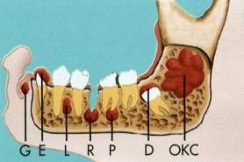
Contents
Definition
Introduction
Mechanism of cyst formation
Classification.
Description of cysts
Treatment aspects
References.
Conclusion.

Slide 3
Cyst
Definition:
A Cyst is a pathological cavity having fluid, semifluid or gaseous contents and which is not created by the accumulation of pus. Most cysts, but not all, are lined by epithelium. (KRAMER 1974).

Slide 4
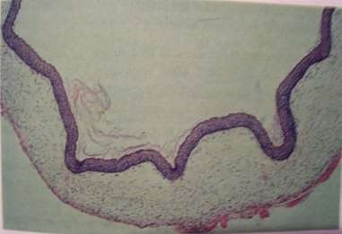
PARTS OF A CYST
Cyst has following parts:
WALL (made of connective tissue)
EPITHELIAL LINING
LUMEN OF CYST

Slide 5
CLASSIFICATION
Cysts of Jaws
Intraosseous cysts
Soft tissue cysts
Epithelial
Non Epithelial
Cysts of maxillary antrum
Odontogenic
Non Odontogenic
Developmental
Inflammatory

Slide 6
I. Cysts of the jaws
a) Odontogenic epithelium
1. Developmental
Gingival cyst of infants
Odontogenic keratocyst
Dentigerous cyst
Eruption cyst
Gingival cyst of adults
A. EPITHELIAL-LINED CYSTS
b) Non-odontogenic
2 Inflammatory origin
Radicular cyst, apical and lateral
Residual cyst
Paradental cyst and juvenile paradental cyst
Inflammatory collateral cyst
i. Midpalatal raphé cyst of infants
ii. Nasopalatine duct cyst
iii.
Nasolabial cyst
Developmental lateral periodontal cyst
Botryoid odontogenic cyst
Glandular odontogenic cyst
Calcifying odontogenic cyst

Slide 7
I. Cysts of the jaws
B. NON-EPITHELIAL-LINED CYSTS
Solitary bone cyst- Traumatic/heamorrahagic- Above IANC (cuspid & molar region- Empty cyst cavity
Aneurysmal bone cyst/heamorraghic osteomyelitis/atypical giant cell tumour-mandi. Post. region
Stafne’s bone cyst/static bone cyst-below IANC

Slide 8
II. Cysts associated with the maxillary antrum
Mucocele
Retention cyst
Pseudocyst
Postoperative maxillary cyst

Slide 9
Reduced enamel epithelium
Dentigerous cyst
Eruption cyst
From Rests of Malassez
Radicular cyst, apical and lateral
Residual cyst
From Dental lamina
Gingival cyst of infants
Odontogenic keratocyst
Glandular odontogenic cyst
Calcifying odontogenic cyst
Classification by tissue of origin

Slide 10
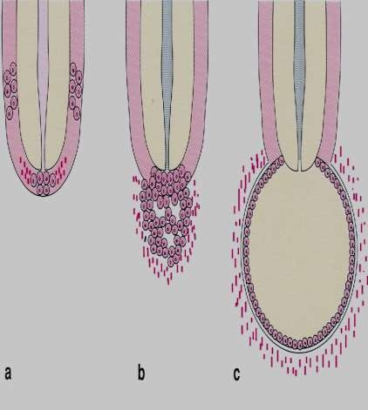
PATHOGENESIS
TWO STAGES
Cyst initiation
Cyst enlargement or expansion
Initiation
Formation
Enlargement

Slide 11
CYST INITIATION
Initiation results in the proliferation of the epithelial cells an formation of small cavity.
Cell Rests of Malassez :
Remanants of Hertwigs epithelial root sheath in the PDL after the root
formation is completed.
Reduced Enamel Epithelium :
Residual epithelial cells surrounds the crown of the tooth after enamel formation is complete.
Cell Rests of Serres (Dental Lamina) :
Islands of epithelial cells that originate from the oral epithelium and remain in the tissue after inducing tooth development.
d the

Slide 12
CYST ENLARGEMENT
THEORY
Harris (1974) Postulated the theories
Mural growth
  Peripheral cell division
  Accumulated contents
Hydrostatic
  Secretion
  Transuduation & exudation
  Dialysis

Slide 13

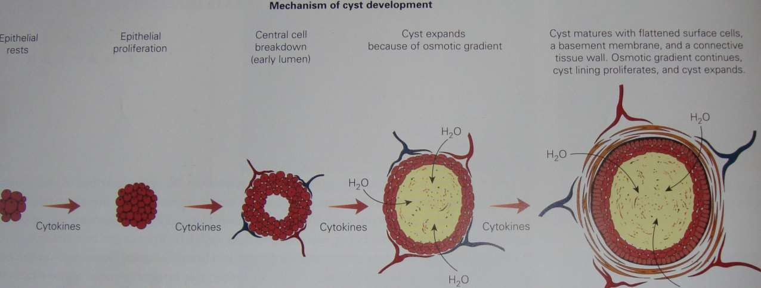

Slide 14
Mechanism regarding enlargement
Increase in the volume of its contents.
Increase in the surface area of the sac or epithelial proliferation.
Resorption of surrounding bones.

Slide 16

Frequency of Epithelial Cysts of Jaws
4.20%
SHEAR 2006
Radicular cyst
5.60%
Dentigerous cyst
8%
Odontogenic keratocyst
11.60%
52.30%
Residual cyst
Paradental cyst
18.10%
Unclassified odontogenic cysts
2/7/2017
odontogenic cysts/ Guru Karthik/ 104
21

Slide 17

Odontogenic keratocyst(okc)
or keratocystic odontogenic tumour(KCOT)

Slide 18
Term coined by philipsen in 1956 as OKC and in 2005 himself suggested the name KCOT.
The more focus odontogenic keratocyst (OKC) is due to
That OKC may grow to a large size before it manifests clinically unlike other jaw cysts,
OKC’s tendency to recur following surgical treatment.
Forssell estimated that the rate of growth of OKCS varied from 2- 14 mm a year, with a average of about 7mm and the rate was slow in patients over 50 years.

Slide 19








E t i o l o g y
In the past OKC - originate from the primordium of a tooth before mineralization.
Later on OKC thought to - Arise from
.
According to Stoelinga and Bronkhorst and Stoelinga and Peters OKCS may arise from proliferations of basal cells of oral mucosa.

Slide 20




Evidence of genetic factors in the etiology of sporadic keratocysts
There is a gp 38 altered gene expression in keratocysts
Increased expression of P53 protein in keratocysts noted.
Tumor suppressor genes are expressed more strongly in OKCS than in other cysts.
Several investigators suggest that odontogenic keratocysts be regarded as benign cystic neoplasms rather than cysts
Incidence- 7-11%
JOPM 2009( 38) 99-103

Slide 21
CLINICAL FEATURES
AGE :
occur over a wide age range and cases have been
recorded as early as the first decade and as late as the ninth.
In most series there has been a pronounced peak frequency in the second and third decades.
GENDER:
more frequently in males than in females (1.44:1).
2/7/2017
34

Slide 22
SITE :
The mandible is involved far more frequently than the maxilla 50% cases occur in angle region and extend to ascending ramus and forwards to b o d y of m a ndi b le.
According to woolger et al. After the age of 50yrs OKCs occur more common in maxilla.

Slide 23
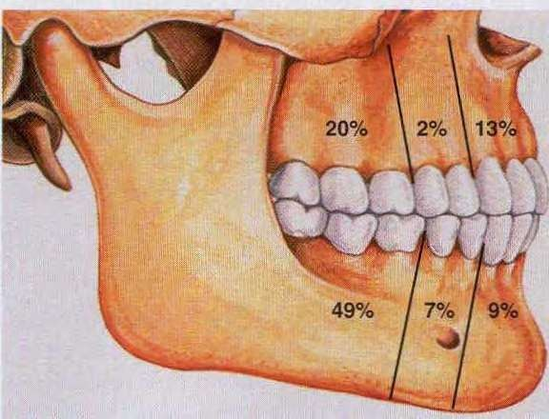
SITE DISTRIBUTION
Relative distribution of
odontogenic cysts/ Guru Karthik/ 104
odontogenic keratocysts in the jaws.
2/7/2017
35

Slide 24
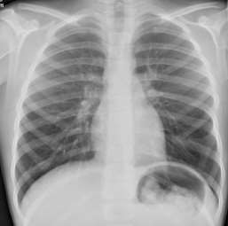
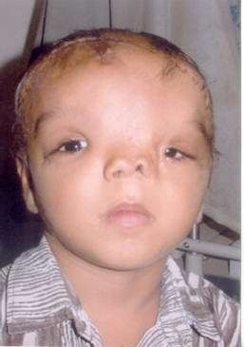
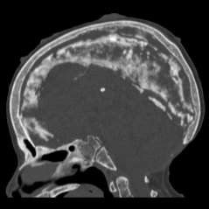
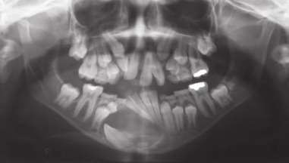
Variants of OKCs
1.Sporadic
2. Syndromic (With nevoid basal cell carcinoma)
Multiple OKC’s are seen in Gorlin’s syndrome or Gorlin-Goltz syndrome or naevoid basal cell carcinoma syndrome
Multiple nevoid basal cell epitheliomas
Odontogenic Keratocyst of the jaws
Bifid ribs– sixth rib
Plantar & palmar pits
Occular hypertelorism
Frontal bossing
Ectopic calcifications

Slide 25
Clinical Presentation
Patients with OKCs complain of pain, swelling or discharge.
Occasionally, they experience paresthesia of the lower lip or teeth.
Other cysts have been discovered fortuitously during dental examination when radiographs were taken.
OKC tends to extend in the medullary cavity and clinically observable expansion of the bone occurs late.
Enlarging cyst may lead to displacement of tooth.
FORSSELL IN 1980 SUGGESTED THAT MAXILLARY CYST USUALLY GETS INFECTED RATHER THAN MANDIBULAR CYST.

Slide 26
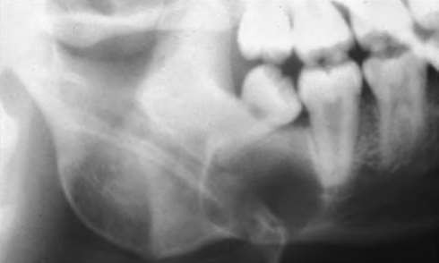
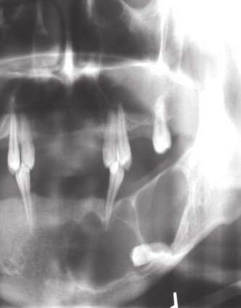
Radiographic appearance:
OKC demonstrate a well-defined radiolucent
area with smooth and often corticated margins.
Large lesions, particularly in the posterior body and ascending ramus of the mandible, may appear multilocular
An unerupted tooth is involved in the lesion in 25% to 40% of cases; in such instances, the radiographic features suggest the diagnosis of dentigerous cyst

Slide 27
“Main “ (1970 )has referred the variety of okc that embraces an adjacent unerupted tooth as envelopmental .
Those that formed in place of normal tooth series called as replacement variety
Those in the ascending ramus are away from the teeth as extraneous
Those adjacent to the roots of teeth as collateral

Slide 28
DIFFERENTIAL DIAGNOSIS
•
In case of unilocular radiolucencies – Dentigerous cyst,
Eruption cyst, COC, AOT, Unicystic ameloblastoma etc.
•
In case of multilocular radiolucencies – Conventional ameloblastoma, AOT, Central giant cell granuloma, Aneurysmal bone cyst etc.

Slide 29
Aspirational biospy
Dirty, creamy white viscoid suspension.
Para keratinized / ortho keratinized squamous epithelium.
Total protein less than 4 g /100ml. Mostly albumin

Slide 30
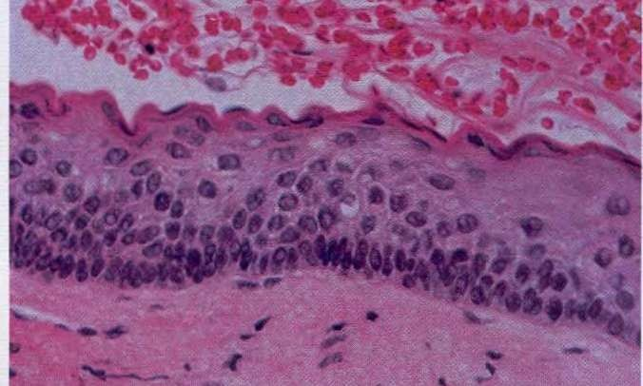
Histopathology
Epithelial lining is 6 to 8 cells thick, with a hyperchromatic and
palisaded basal cell layer. Note the corrugated parakeratotic surface
ORTHOKERATINISED OKC’s HAVE A SUBSTANTIALLY LOWER RECURRENCE RATE THAN THOSE THAT WERE PARAKERATINISED (WRIGHT,1981; SIAR AND NG, 1988; CROWLEY ET AL., 1992)
.

Slide 31

MANAGEMENT :
Treatments
are generally classified as
Conservative
Aggressive
Simple enucleation, with or without curettage
Marsupialization
Peripheral ostectomy .
Chemical Curettage with Carnoy’s solution .
Cryotherapy .
Electrocautery and
resection .
Walid Ahmed Abdullah Surgical treatment of keratocystic odontogenic tumour: A review article 2011

Slide 32
1.All unilocular cystic lesions (except in mandibular 3rd molar region
Enucleation
2.Unilocular lesion in 3rd molar region extending in to ascending ramus
Wide excision of overlying mucosa+ liquid nitrogen or carnoy’s solution
3. Multilocular or multilobular cyst (In maxilla & mandible)
Incisional biopsy
Cyst enucleation with excision of overlying mucosa+ carnoy’s solution for electrocoagulation
Stoelinga’s protocol of treatment

Slide 33
Carnoys solution
Carnoy's solution described by Voorsmit (1981)
It contains 60% ethanol, chloroform and glacial acetic acid in a 6:3:3:1 ratio with added ferric chloride.
This chemical composition provides a tissue-fixation property used in histology and a tissue cauterization property utilized in chemical curettage.

Slide 34
COMPLICATIONS IN OKC :
  Malignant transformation of cyst lining rare, but has reported.
  Recurrence – high rate of recurrence.
REASONS FOR RECURRENCE :
  Thin, fragile lining is very difficult to remove completely.
  New cysts develop from satellite cysts left behind.
  Some cysts may be left behind in cases of Gorlin – Goltz syndrome.
  New cysts can also develop from basal cells of overlying oral epithelium, especially in ramus – 3rd molar region.
been

Slide 35
Dentigerous cyst

Slide 36
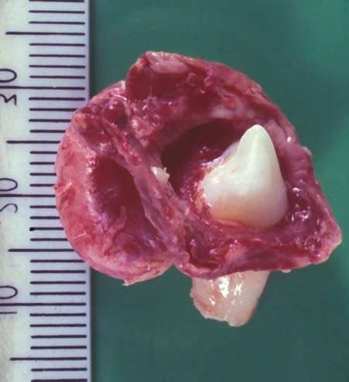
A dentigerous cyst (Follicular) is odontogenic cyst that surrounds the crown of an impacted tooth; caused by fluid accumulation between the reduced enamel epithelium and the enamel surface.
The dentigerous cyst is attached to the
tooth at the cementoenamel junction.
The pathogenesis of this cyst is uncertain, but apparently it develops by accumulation of fluid between the reduced enamel epithelium and the tooth crown.

Slide 37
Clinical Features:
AGE : 1st to 3rd decades. (Paget)
GENDER :
SITE :
More frequently in males than in females (3:2).
2/3rd of follicular cyst associated with unerupted mandibular teeth, primarily III molar.
Maxillary canine
Mandibular premolar
Maxillary 3rd Molar
Supernumerary tooth also can be involved

Slide 38
Clinical presentation:
Dentigerous cysts may grow to a large size before they are diagnosed. Most of them are discovered on radiographs when these are taken because a tooth has
Failed to erupt, or a tooth is missing, or
Because teeth are tilted or are otherwise out of alignment.
Most common form of presentation:
Slowly enlarging swelling.
They are seldom painful unless infected.
Seward (1964) has shown radiologically that lesions of 4–5cm in diameter may
develop in 3–4years.

Slide 39
Most of the dentigerous cysts are solitary. Bilateral and Multiple dentigerous cysts are associated with Maroteux-Lamy sundrome, Cleidocranial dysplasia.

Slide 40
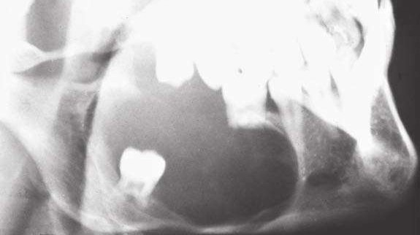
It often presents radiographically with root resorption .
Struther and Shear in 1976 suggested that the dentigerous cyst’s potential for root resorption may be derived from its origin from dental follicle and the ability of the latter to resorb the roots of the deciduous predecessors of the teeth, the crowns of which
they s^{2/}u^{7/}r²r⁰¹o⁷und
odontogenic cysts/ Guru Karthik/ 104 26

Slide 41

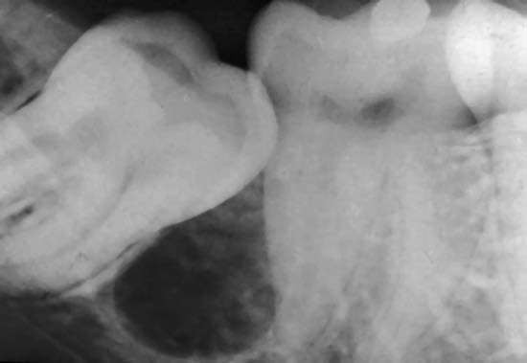
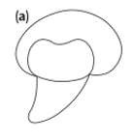
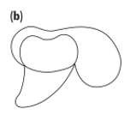
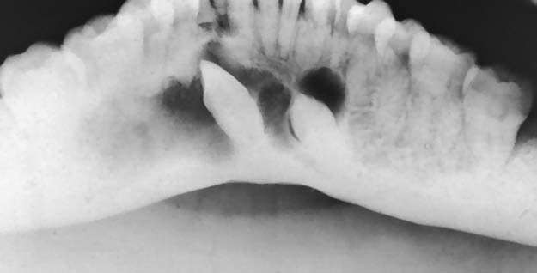
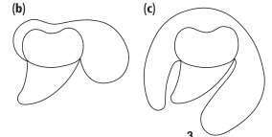
Central type
Lateral type
Radiograph showing both circumferent ial and peripheral type

Slide 42
Although it presents a unique feature, yet some lesions must be considered in its differential diagnosis :
DIFFERENTIAL DIAGNOSIS
Unicystic ameloblastoma
Adenomatoid odontogenic tumor.

Slide 43
COMPLICATIONS
Recurrence due to incomplete surgical removal.
Development of ameloblastoma either from lining epithelium or from odontogenic islands in the connective tissue wall.
Development of squamous cell carcinoma from same two sources.
Development of mucoepidermoid carcinoma from mucus
secreting cells in the lining.

Slide 44
Aspirational biopsy
Clear, pale straw colour fluid
Cholesterol crystals.
Total protein in excess 4 g / 100ml. Resembles serum

Slide 45
Marsupialization
Treatment

Slide 46
TREATMENT
Cysts of the jaws, may be treated by one of the following basic methods:
1. Enucleation
2. Marsupialization (decompression)
• Partsch I
• Partsch II (combined marsupialization and enucleation) bone grafting

Slide 47
Enucleation allows for the cystic cavity to be covered by a mucoperiosteal flap and the space fills with blood clot, which will eventually organize and form normal bone. Indications
• Treatment of odontogenic keratocysts
• Recurrence of cystic lesions of any cyst
1. Enucleation

Slide 48
Enucleation
Advantages :
pathologic examination of the entire cyst can be undertaken
the initial excisional biopsy (i.e., enucleation) has also appropriately treated the lesion.
The patient does not have to care for a marsupial cavity with constant
irrigations.
Disadvantages
Normal tissue may be jeopardized
Fracture of the jaw
Devitalization of associated teeth
Impacted teeth that the clinician may wish to save could be removed.

Slide 49
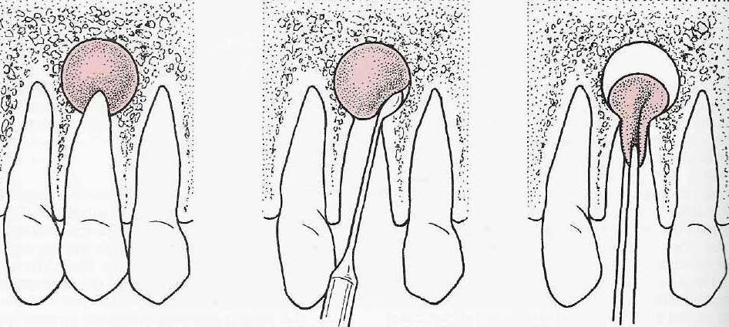
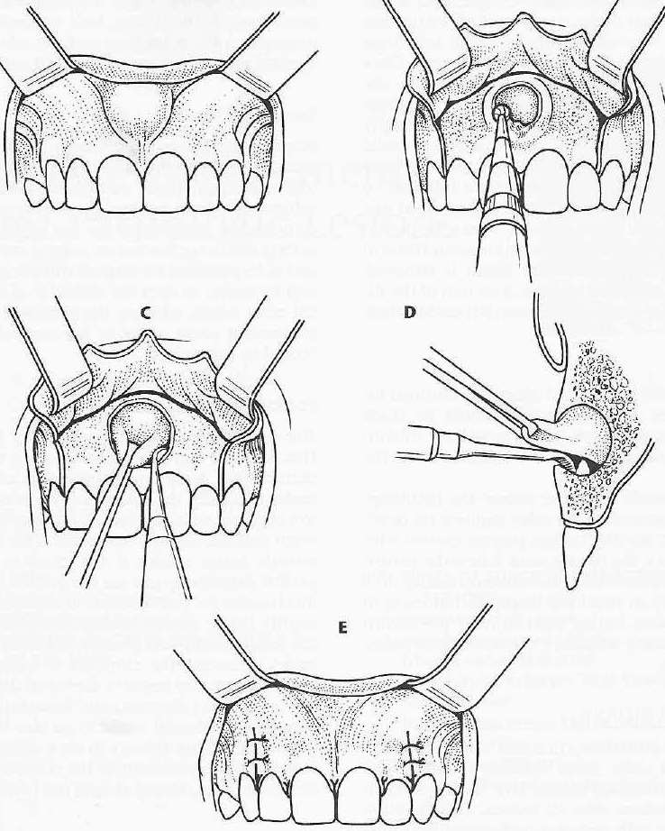
_{ENU}odo_{C}nto_{L}ge_{E}nic_{A}cy_{T}sts_{I}/_{O}Gur_{N}u Kar_{O}thik_{F}/ 10_{C}4 _{YST}
2/7/2017
94

Slide 50
1. Enucleation with Primary Closure
Approach- Intra/Extraoral
2. Enucleation and packing
This technique if advocated, when it is believed that due to a previous infection or in infected large cysts, a primary closure would be unsuccessful as it could lead to a breakdown of the wound; or where there is difficulty in approximating the wound edges
Different Techniques in Enucleation

Slide 51
3. Enucleation and primay closure with reconstruction/bone grafting
In large cystic lesions that have perforated and destroyed the cortical plates and inferior border of the mandible that is beyond salvage or is nonexistent.
It is advisable to reconstruct primarily with a stainless steel or titanium reconstructive plate.
Different Techniques in Enucleation

Slide 52
Marsupialization, (Partsch) or decompression, refers to creating a surgical window in the wall of the cyst, and evacuation of the cystic contents.
This process decreases intra-cystic pressure and promotes shrinkage of the cyst and bone fill.
The only portion that is removed is the piece removed to produce the window.
2. Marsupialization (Decompression)

Slide 53
Indications
Age: In a young child:
Proximity to vital structures.
Size of cyst In very large cysts
Vitality of teeth -When the apices of many adjacent erupted teeth, are involved within a large cyst, enucleation could prejudice the vitality of these teeth.

Slide 54
1. Anaesthesia- GA
2. Aspiration- Cystic Contents
3. Incisions- a circular, oval or elliptic
4. Removal of bone-
5. Removal of cystic lining specimen for histopathological examination
6. Irrigation of the cystic cavity
7. Suturing The remaining cystic lining is sutured with the edge of the oral mucosa by continuous sutures or interrupted sutures
8. Packing -The cavity is then packed with a half or one inch width ribbon gauze, which may be impregnated with an antibiotic ointment, White head’s varnish, tincture of benzoin or bismuth iodoform paraffin paste (BIPP
Procedure

Slide 55
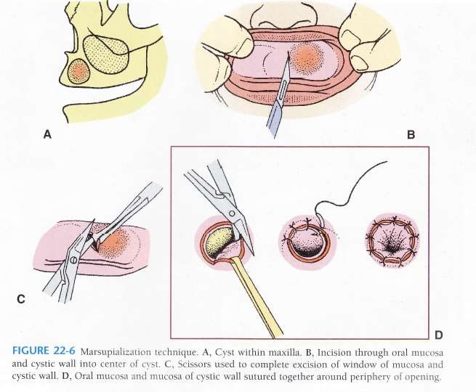

Slide 56
Waldron’s Method (1941) or Partsch II
This is a two-stage technique that combines the two standard procedures, in which, first marsupialization is performed and at a later stage, when the cavity becomes smaller, the procedure of enucleation is performed and the entire tissue is examined histopathologically.
Modifications of Marsupialization

Slide 57
Eruption cyst

Slide 58
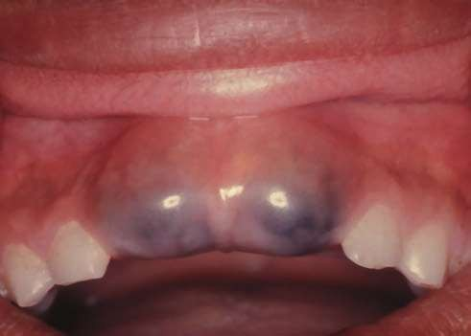
An eruption cyst is in essence a dentigerous cyst occurring in the soft tissues.
Whereas the dentigerous cyst develops around the crown of an unerupted tooth lying in the bone.
the eruption cyst occurs when a tooth is impeded in its eruption within the soft tissues overlying the bone.

Slide 59
Clinical features:
AGE :
found in children of different ages, and occasionally in adults if there is delayed
eruption
SITE : most commonly associated with the first permanent molars and the maxillary incisors
Deciduous and permanent teeth may be involved, most frequently anterior to the first permanent molar.
AGUILO ET AL. (1998) FOUND THAT THEIR MOST FREQUENT LOCATION WAS IN RELATION TO THE MAXILLARY PERMANENT DENTITION

Slide 60
Radiographic features:
The cyst may throw a soft-tissue shadow, but there is usually no bone involvement except that the dilated and open crypt may be seen on the radiograph.

Slide 61
Treatment :
Marsupilization.

Slide 62
GINGIVAL CYST OF ADULTS

Slide 63
pathogenesis
A number of suggestions have been made about the pathogenesis of the gingival cyst in adults.
It was originally proposed that they may arise from odontogenic epithelial cell rests; or by traumatic implantation of surface epithelium; or by cystic degeneration of deep projections of surface epithelium.

Slide 64
origin
Cystic transformation of dental lamina, traumatic implantation of surface epithelium.
Dome shaped soft, fluctuant swelling which is <1cm in diameter
Lesion is slow growing and painless
Adjacent teeth usually vital

Slide 65
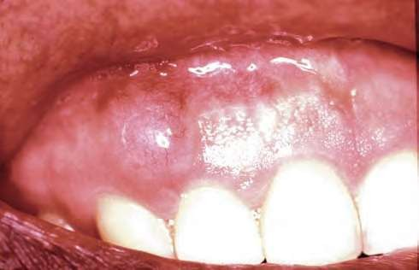
Clinical features
AGE :
5th – 6th decade of life
SITE :
mand. canine and Pre Molar
area; attached gingiva or I/D papilla
Signs and symptoms:
Slowly enlarging, well circumscribed painless swelling.
Invariably occurs on facial aspect
of free / attached gingiva.
Surface of lesion is smooth and of normal color.
Fluctuant lesion, adjacent teeth
Clinical photograph of a gingival cyst of an adult
2/7/2017
are vital
odontogenic cysts/ Guru Karthik/ 104
50

Slide 66
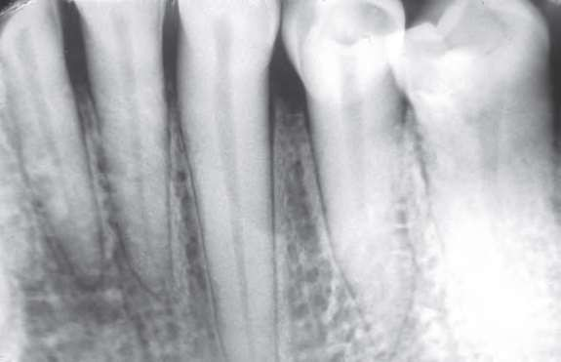
Radiological features
Radiograph of a gingival cyst in an adult. There is a faint radiographic shadow (marked with arrows) indicative of superficial bone erosion.
odontogenic cysts/ Guru Karthik/ 104
2/7/2017
51

Slide 67
LATERAL PERIODONTAL CYST

Slide 68
LATERAL PERIODONTAL CYST
Uncommon, but well recognized type of odontogenic cyst.
The designation ‘lateral periodontal cyst’ is confined to those cysts that occur in the lateral periodontal position and in which an inflammatory etiology and a diagnosis of collateral OKC have been excluded on clinical and histological grounds(Shear and Pindborg, 1975).

Slide 69
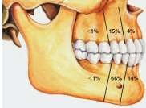
CLINICAL FEATURES
Age : 20 – 60 years, peak in 6th decade.
Sex : Male predilection.
Site : Lateral PDL regions of mandibular premolars, followed by anterior maxilla

Slide 70
Signs & symptoms
Usually asymptomatic as it occurs on the lateral aspect of root of tooth.
Occasionally pain and swelling may occur.
Associated teeth are vital, unless otherwise affected.
Cysts rarely < 1cm in size, except for BOTRYOID VARIETY which is larger and also a multilocular lesion.

Slide 71
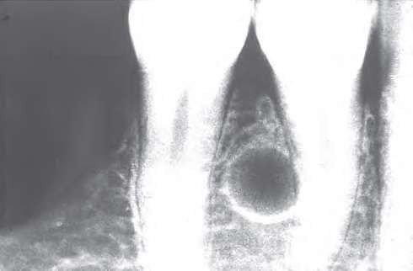
Radiological features
Round to ovoid ‘lucency with sclerotic margins.
Cyst can be present anywhere between cervical margin to root apex.
Radiographically, it can be confused with collateral OKC.
Radiograph of a lateral periodontal cyst lying between the mandibular premolar teeth. The margins are well corticated,
odontogeniicncdyisctsa/tGivueruoKfarstlhoikw/ 1e04nlargement.
2/7/2017
56

Slide 72
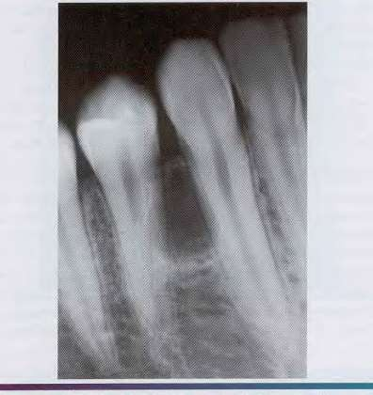
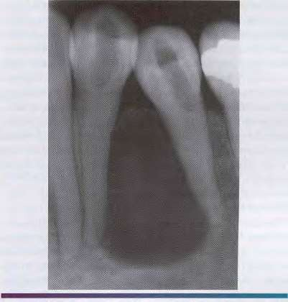
Radiological features
Lateral periodontal cyst. Radiolucent lesion
Lateral periodontal cyst. A larger lesion causing
2/7/2017
between the roots of a vital mandibular canine and
root divergence.
first premolar.
odontogenic cysts/ Guru Karthik/ 104
57

Slide 73
Botryoid odontogenic cyst

Slide 74
It clinically and radiographically resembles lateral periodontal cyst.
The distinguishing feature with lateral periodontal cyst being the multi cystic
variety

Slide 75
Clinical features:
Age: 5th – 7th decade.
Sex: no sex predilection.
Site of occurrence : mandible. Presentation:
Swelling.
Paresthesia.
Pain.
Discharge.

Slide 76
Radiographic appearance:
1. Multilocular radiolucencies ranging from 0.4-4.5cms.
Treatment:
1. Careful surgical excision has to be done as its tendency to recur in highest
number of cases.

Slide 77
Glandular odontogenic cyst

Slide 78
It was first documented as sailo-odontogenic cyst by Padayache and Van Wyk in 1984.
Gardner called it as glandular odontogenic cyst(GOC) in the year 1988.
The cyst resembles both Botryoid Odontogenic Cyst and Mucoepidermoid Carcinoma.
It is of typical multilocular intrabony variety.

Slide 79
Clinical features:
Age : 31- 81 yrs.
Sex: Male: Female ratio is 2:1
Site of occurrence: mandible > maxilla
Clinically presents with painless swelling.

Slide 80
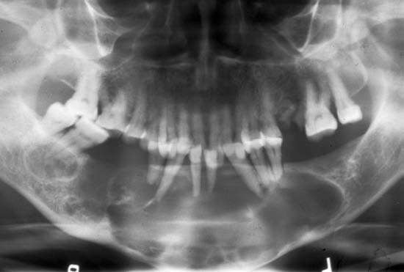
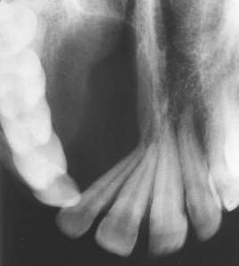
Radiographic appearance:
Tooth displacement
Root resorption

Slide 81
Treatment:
For small unilocular lesion- enucleation
For large unilocular/ multilocular lesions – enucleation with curettage or
enucleation with peripheral ostectomy to be performed.
Inadequate removal has highest recurrence rate with chances of turning into mucoepidermoid carcinoma.

Slide 82
CALCIFYING ODONTOGENIC CYST

Slide 83
CALCIFYING ODONTOGENIC CYST
Also called as Odontogenic ghost cell cyst or Gorlin cyst.
It Has many features of odontogenic tumor, therefore In the latest WHO publication on odontogenic tumours (Prætorius and Ledesma-Montes, 2005) it was classified as a benign odontogenic tumour and was renamed calcifying cystic odontogenic tumour (CCOT).

Slide 84
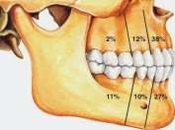
Clinical FeAtures
Age : Wide range, peak in 2nd decade.
Sex : Equal.
Site : Anterior segment of both jaws

Slide 85
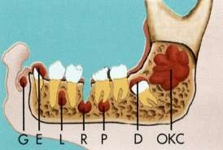
pathogenesis
COC is a unicystic process and develops from the reduced dental epithelium or remnants of dental lamina.
The cyst lining has the potential to induce formation of dentinoid or even odontoma in adjacent CT wall.

Slide 86
classification of the odontogenic ghost cell lesions
Group 1 : ‘Simple’ cysts Calcifying odontogenic cyst (COC)
Group 2 : Cysts associated with odontogenic hamartomas or benign neoplasms: calcifying cystic odontogenic tumours (CCOT).
Group 3 : Solid benign odontogenic neoplasms with similar cell morphology to that in the COC, and with dentinoid Formation
Group 4 : Malignant odontogenic neoplasms with features similar to those of the dentinogenic ghost cell tumour Ghost cell odontogenic carcinoma

Slide 87
Signs & symptoms
Swelling is the commonest complaint, seldom associated with pain.
Intraosseous lesions can cause hard bony expansion and resulting facial asymmetry.
Displacement of teeth can also occur.

Slide 88
Cysts of inflammatory origin

Slide 89
Periapical cyst/ Radicular cyst

Slide 90
RADICULAR CYST
Also called APICAL PERIODONTAL CYST
Radicular cysts are the most common inflammatory cysts and arise from the epithelial residues in the periodontal ligament as a result of periapical periodontitis following death and necrosis of the pulp.
Quite often a radicular cyst remains behind in the jaws after removal of the offending tooth and this is referred to as a residual cyst.

Slide 91
PATHOGENESIS
1. PHASE OF INITIATION:
Accepted generally that rests of Malassez included within a developing periapical granuloma proliferates to form the lining of radicular cyst
Products from non vital pulp can be responsible which simultaneously evokes an inflammatory response in CT.
Immune factors also held responsible as plenty of plasma cells are
seen in a periapical granuloma.

Slide 92
PATHOGENESIS
2. PHASE OF CYST FORMATION:
Can occur in two possible ways.
One theory states that epithelium proliferates and covers the bare connective tissue surface of the abscess cavity.
Another theory – cyst cavity forms within proliferating epithelium as the cells in center move away from their nutrient source.

Slide 93
PATHOGENESIS
3. PHASE OF ENLARGEMENT:
Enlargement occurs by collection of fluid within the lumen of the cyst.
Osmosis plays an important role here as the cyst wall appears to have the properties of a semi permeable membrane.

Slide 94
CLINICAL FEATURES
Age :
peak in 3rd, 4th and 5th decades.
Sex :
Slightly more in males.
Site :
Maxillary anterior region.
Frequency: Commonest cystic lesion of jaws.

Slide 95
Signs & symptoms
Primarily symptom less.
Discovered accidentally during routine dental X ray exam.
Slowly enlarging hard bony swelling initially. Later, if cysts breaks through cortical plates, lesion becomes fluctuant.
Diagnostic criteria – associated teeth are non vital
Rare in deciduous teeth.

Slide 96
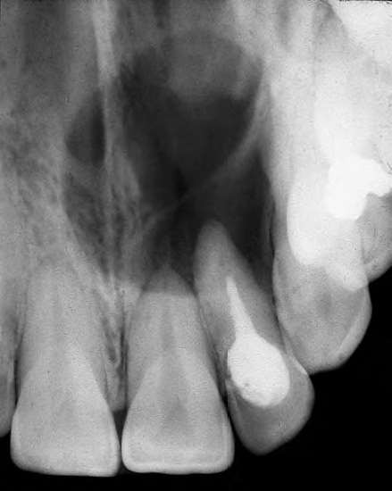
RADIOLOGICAL FEATURES
Classically presents as round / ovoid lucency with sclerotic borders and associated with pulpally affected tooth / teeth.
If infection supervenes, the margins become indistinct, making it impossible to distinguish it from a peripaical granuloma.
Radiograph of a radicular cyst. The lesion is a well defined radiolucency associated with the apex of a non-
odontogenic cysts/ Guru Karthik/ 104
2/7/2017
vital root filled tooth.
81

Slide 97
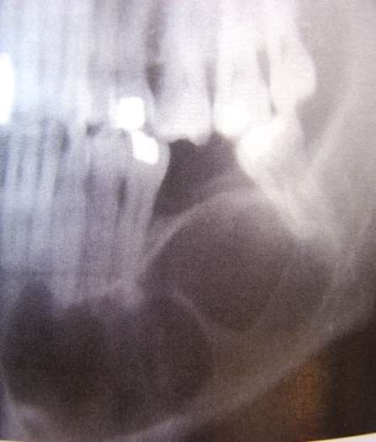
Residual cysts
The histopathological features residual cyst are similar to those described above for conventional radicular cysts. However, because the cause of the cyst has been removed, residual cysts may progressively become less inflamed so that eventually the cyst wall is composed of uninflamed
of the
The epithelial lining may be thin and regular and indistinguishable from a developmental cyst such as a dentigerous cyst or lateral periodontal cyst. collagenous fibrous tissue.
Radiographic appearance of a large residual cyst left behind after extraction of 1st mandibular molar.

Slide 98
Aspirational biopsy
Clear, pale yellow straw colour fluid.
Cholesterol crystals.
Total protein 5 — 11g / 100ml

Slide 99
DIFFERENTIAL DIAGNOSIS:
Following lesions must be distinguished from other peria radiolucencies–
▪
Periapical granuloma
Peripaical cemento – osseous dysplasia (early lesions)
pical

Slide 100
Paradental Cysts

Slide 101
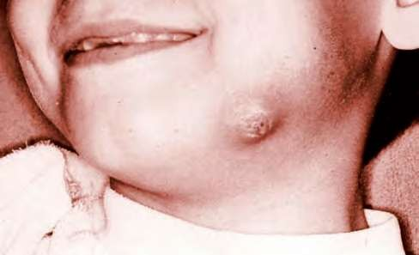
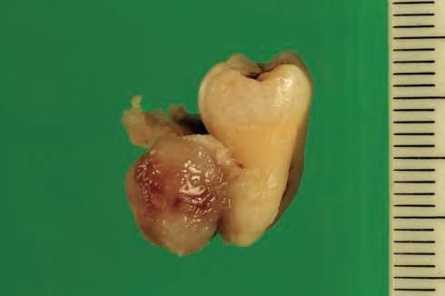
Paradental Cysts
A cyst of inflammatory origin- occurring on lateral aspect of root of partially erupted mandibular 3rd molar with an associated history of pericoronitis
Age : 20-40 years
Tooth is vital
Facial swelling
Facial sinus in some cases
2/7/2017
odontogenic cysts/ Guru Karthik/ 104
86

Slide 102
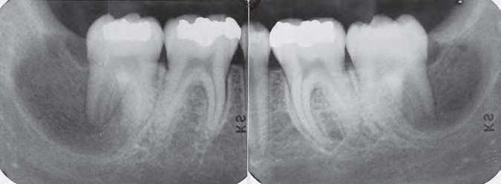
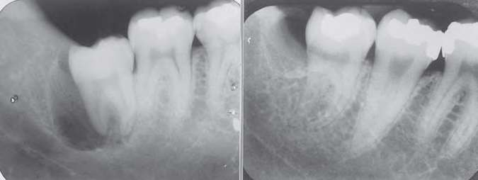
Radiographic features
Affected tooth is tilted Well demarcated RadioLucency Distal to partially erupted tooth
Lamina Dura is intact
New bone may be laid down
(a,b) Two cases of bilateral paradental cysts associated with erupting mandibular third molar teeth. The cysts are distal and buccal to the involved teeth. Note that the periodontal ligament space is not widened and that the distal part of the cyst is separate from the distinct distal
odontofgoellnicicuclyasrtss/pGaucreu. Karthik/ 104
2/7/2017
87

Slide 103
Treatment

Slide 104

106

