Slide 1
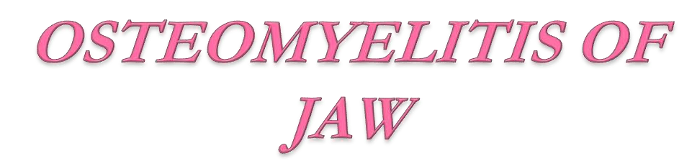
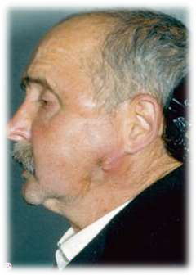
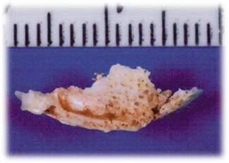
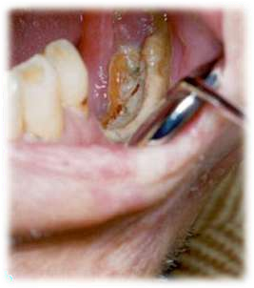

Slide 2
OSTEOMYELITIS
WHAT’S IN THE NAME?
The word “osteomyelitis” originates from the ancient Greek words osteon (bone) and muelinos (marrow)
and literally means infection of medullary portion of the bone.
WHAT IS IT?
It is an acute & chronic inflammatory process in the medullary spaces or cortical surfaces of bone that extends away from the initial site of involvement.

Slide 3
FACTORS PREDISPOSING TO OSTEOMYELITIS
(Conditions that
Altered host defense)
(Conditions decreased vascularity of bone)
Trauma.
Radiation injury.
Paget’s disease.
Osteoporosis.
Bone malignancy
Immune deficiency states.
Immunosuppression Diabetes mellitus.
Malnutrition. Extremes of age.

Slide 4
Etiology
Odontogenic Infections
Trauma
Infections of orofacial regions
Gingival ulcerations,
furuncles,
Lacerations
Peritonsillar abscess

Slide 5
PATHOGENESIS OF OSTEOMYELITIS
Trauma to Bone
Acute Inflammation
(Infiltration of WBCs)
Proteolytic enzyme
Tissue necrosis
Intramedullary pus formation
Haversion & Nutrient canal
Further Ischaemia
Periosteum involve
SEQUESTRUM

Slide 6
Microbiology
Streptococci-Most common Organism
Other-
Anaerobes like
Fusobacterium, Bacteroides
Klebsiella, Pseudomonas and Proteus, Actinomycoses

Slide 7
Classification
Based on Clinical Course
Acute
4Weeks
2. Chronic

Slide 8
Based on Suppuration
Suppurative Non suppurative
Acute Suppurative Chronic Sclerosing OML
Chronic Suppurative a) Focal
Infantile Osteomyelitis b) Diffuse
Garres Sclerosing OML
Actinomycotic OML
Radiation OML

Slide 9
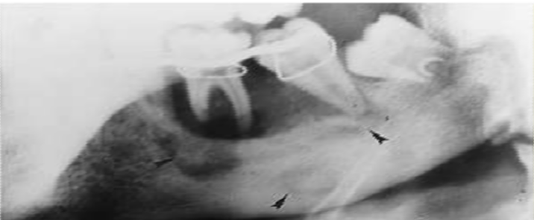
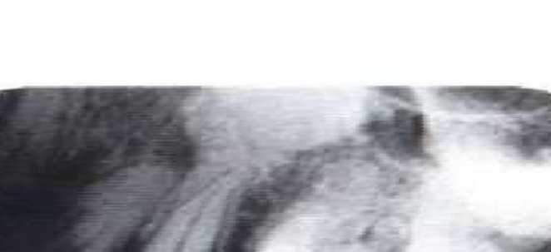
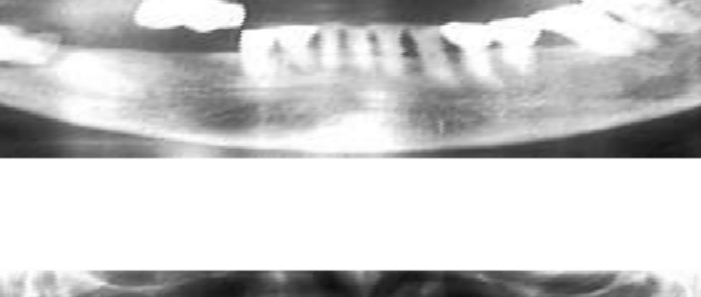
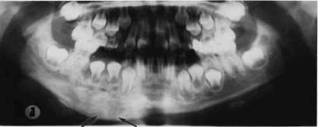
TYPES OF OSTEOMYELITIS
SUPPURATIVE OSTEOMYELITIS
FOCAL SCLEROSING OSTEOMYELITIS
DIFFUSE SCLEROSING OSTEOMYELITIS
PROLIFERATIVE PERIOSTITIS

Slide 10
SUPPURATIVE OSTEOMYELITIS
ONSET OF DISEASE
4 WEEKS
Acute suppurative
osteomyelitis
Chronic suppurative osteomyelitis
t
Onset of disease
Deep bacterial invasion into medullary & cortical bone

Slide 11
ACUTE SUPPURATIVE OSTEOMYELITIS
Appearance of typical odontogenic infection
Microbiology-
polymicrobial in nature.
most common- staph. aureus;
Other- Strept. pyogenes. Vincent’s spirochaetes ,E. coli.

Slide 12
Etiology
Odontogenic Infections-Most common
Trauma-Compound Fractures
Infections of orofacial regions
Gingival ulcerations,
furuncles,
Lacerations
Peritonsillar abscess

Slide 13
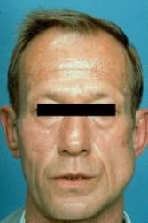
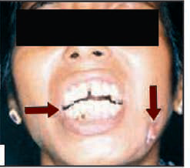
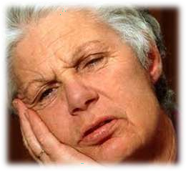
Clinical features
Most common- Adults
Site-Mandible (alveolar process, angle of mandible, post. Part of ramus, coronoid
EARLY :
  Generalised constitutional symptoms.
  Deep seated boring,
  continuous intense pain Facial cellulitis, or indurated Trismus
  swelling of moderate size
  Anaesthesia or parasthesia of affected area
  Laboratory Studies: Show mild leucocytosis (PMNL) and albuminuria.

Slide 14
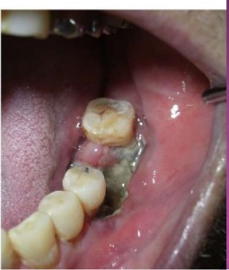
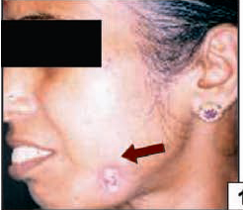
LATE :
Generalised constitutional symptoms and deep seated pain
2. Teeth in involved area begin to loosen and become sensitive to percussion.
3. Purulent discharge through sinuses: a. Intraorally b.Extra-orally
through cutaneous fistulae.
4. Foetid odour is often present.
5. Trismus may be present.
6. Regional lymphadenopathy is usually pese
Lab- Moderate Leucocytosis, anaemia, Elevated ESR

Slide 15
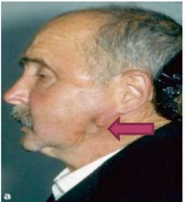
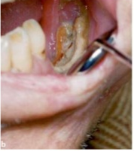
CHRONIC OSTEOMYELITIS
It is resulted from organisms which are less virulent or occur secondary after acute OML
CLINICAL FEATURES
1. Pain-minimal,
(2) Non healing bony and overlying soft tissue wounds
(3) Intraoral or extraoral draining fistulae,
(4) Thickened or “wooden” character of bone,
(5) Enlargement of mandible, because of deposition of
subperiosteal new bone.
(6) Pathological fractures may occur,
(7) Sterile abscess

Slide 16
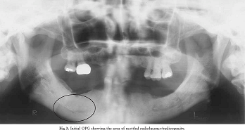
Radiographic features
Radiographic changes occur only 3 weeks after initiation of OML process.
In early stage, there is widening of marrow spaces,
and enlargement of Volkmann’s canals, which imparts a “mottled appearance”.

Slide 17
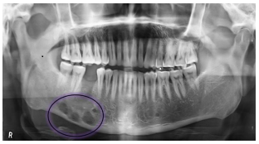
Established Cases- Irregular radioluscency (Moth Eaten appearance
Moth eaten appearance

Slide 18
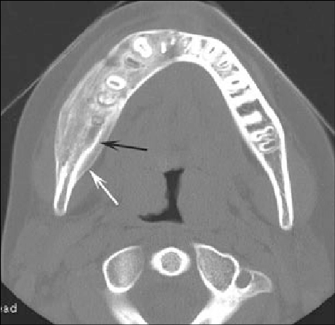
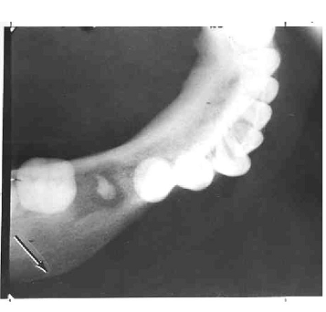
In later stages-Subperiosteal new bone, the involucrum seen as onion skin appearance

Slide 19
Management
Conservative management:
Complete bed rest.
2. Rehydration:
3. Analgesics
4. IV antimicrobial agents: Penicillin-1st
2nd- clindamycin
3rd- Cephazolin, cephalexin
4th - Erythromycin

Slide 20
B. Surgical management:
Incision and drainage:
Extraction of loose or offending teeth:
Debridement:
Followed by I/D, through debridement of affected area should be carried out.
The area may be irrigated with hydrogen peroxide and saline.
Any foreign body, necrotic tissue or small sequestrum should be removed

Slide 21
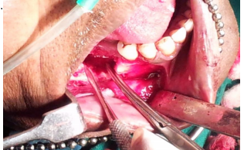
4. Decortication:
Removal of chronically infected lateral and inferior cortical plates of bone 1-2 cms beyond the area of involvement.
,

Slide 22
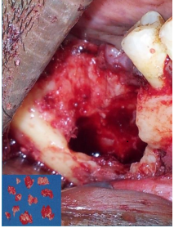
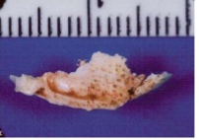
5. Sequestrectomy:
An integral part of definitive therapy. It helps in establishment of local microvascular proliferation.
It should be undertaken through an intra-oral incision; or extraoral (submandibular) approach

Slide 23
6. Saucerization:
Excision of margins of necrotic bone overlying a focus of osteomyelitis. It is useful in chronic form.
7. Trephination: or fenestration
is the creation of bony holes or windows in the overlying cortical bone adjacent to the infectious process for tissue ammoniation and decompression of the medullary compartment.

Slide 24
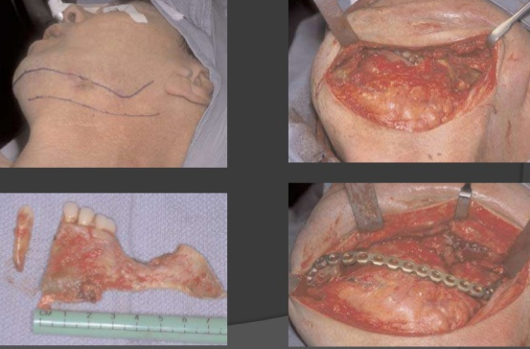
Resection:
When extensive portion of the bone is involved in the disease process, then resection of the jaw bone is advocated. Following resection, reconstruction is advocated

