Slide 1
The X-Ray Machine

Slide 2
X-Ray machine
It consists of x ray tube and its power supply
X ray tube is positioned within the tube head, along with some components of power supply
Tube head is supported by an arm that is usually mounted on a wall
A control panel allows the operator to adjust the time of exposure

Slide 3
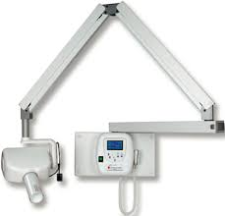

Slide 4
X-ray tube
X ray tube is composed of a cathode and anode
Cathode serves as the source of electrons that flow to the anode
When electrons from cathode strike target in anode, they produce x rays
Power supply: 1. to heat the filament to generate electrons
2. Establish a high voltage potential b/w anode and cathode to accelerate the electrons
Cathode and anode lie in an evacuated glass envelope or tube

Slide 5
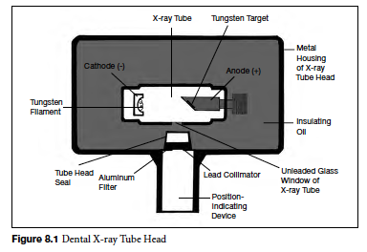

Slide 6
Cathode
It consists of a filament and a focusing cup
Filament is the source of electrons within the tube
It is a coil of tungsten wire about 2 mm in diameter and 1cm or less in length
It is mounted on two stiff wires that support it and carry the electric current
These 2 mounting wires lead through the glass envelope and connect to both the high and low voltage electrical sources

Slide 7
Filament is heated to incandescence by the flow of current from the high voltage source and emits electrons at a rate proportional to temperature of filament
Filament lies in a focusing cup, a negatively charged concave reflector made of molybdenum
Focusing cup electrostatically focuses the electrons emitted by filament into a narrow beam directed at a small rectangular area on anode called focal spot

Slide 8
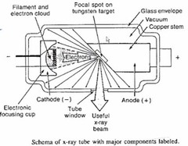
The x ray tube is evacuated to prevent collision of moving electrons with gas molecules, which significantly reduces their speed
This also prevents oxidation and burn out of the filament

Slide 9
Anode
It consists of a tungsten target embedded in a copper stem
Purpose of target is to convert kinetic energy of electrons generated from the filament into x ray photons
Target is made up of tungsten, which has ideal characteristics:
High atomic no, 74, more efficient in producing x rays
High melting point
High thermal conductivity
Low vapor pressure, at high temperatures helps maintain vacuum in the tube at high operating temperatures

Slide 10
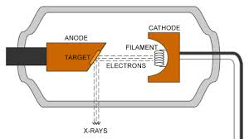
Tungsten target is typically embedded in a large block of copper to dissipiate heat and thus prevents target melting
Insulating oil b/w the glass envelope and the housing of the tube head carries heat away from the copper stem

Slide 11
Focal spot
It is the area on the target to which the focusing cup directs the electrons from the filament
To take advantage of a small focal spot while distributing the electrons over a larger area of target, target is placed at an angle to the electron beam
Projection of the focal spot perpendicular to the electron beam, effective focal spot is smaller than actual size of focal spot
Target is inclined at 20 degrees to CR of x ray beam, which causes EFS 1x1, whereas actual spot is 1x3mm

Slide 12
The effect is a small apparent source of x rays and an increase in image sharpness with a larger actual FS for heat dissipation
Rotating anode: target s in the form of a beveled disk that rotates when tube is in operation
The electrons strike successive areas of the target, widening the FS by an amount corresponding to the circumference of the beveled disk and distributing the heat over this expanded area

Slide 13
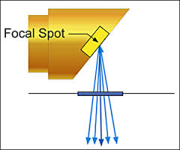
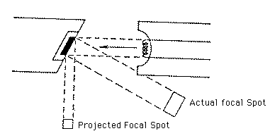

Slide 14
Power supply
Primary function:
Provide a low voltage current to heat the x ray tube filament by use of a step down transformer
Generate a high potential difference between anode and cathode by use of a high voltage transformer
The transformers and x ray tube lie within an electrically grounded metal housing called the head of the x ray machine
An electrical insulating material, usually oil, surrounds the transformers

Slide 15
Tube current
Filament step down transformer reduces the voltage of the incoming alternating current to about 10 volts
Its operation is regulated by filament current control, mA switch
mA switch adjusts the resistance and thus the current flow through the low voltage circuit, including the filament
This in turn regulates the temperature of the filament and thus the number of electrons emitted
It is the flow of electrons through the tube i.e., from the filament to the anode and then back to the filament through the wiring of power supply

Slide 16
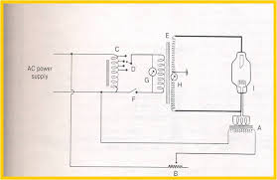

Slide 17
TUBE VOLTAGE
A high voltage is required b/w anode and cathode to generate x rays
An autotransformer converts the primary voltage from the input source into the secondary voltage
secondary voltage is regulated by kVp selector dial
kVp dial selects a voltage from different levels on autotransformer and applies it across the primary winding of the high voltage transformer
It controls the voltage b/w anode and cathode of x ray tube

Slide 18
The high voltage transformer provides the high voltage required by the x ray tube to accelerate the electrons from the cathode to the anode and generate x rays
It accomplishes this by boosting the peak voltage of the incoming line current to as high as 60 to 100 kv, thus boosting the peak energy of electrons passing through the tube to as high as 60 to 100 keV
kVp selector dial setting thus determines the peak kV across the tube

Slide 19
Coz the line current is AC, polarity of x tube alternates at the same frequency
When polarity of voltage applied across tube causes the target anode to be positive and filament negative, electrons around filament accelerate toward the positive target and current flows through the tube
The line voltage is variable, voltage potential b/w anode and cathode varies
As tube voltage is increased, speed of electrons increases
X rays are produced with greatest efficiency, when voltage applied is high
The intensity of x ray pulses tends to be sharply peaked at centre of each cycle

Slide 20
During the following half of cycle, polarity of AC reverses and filament becomes positive and target negative and electrons stay in vicinity of filament and do not flow across the gap – inverse voltage or reverse bias
When an x ray tube is powered with 60-cycle AC, 60 pulses of x rays are generated each second, each with a duration of 1/120 second
This AC cycle limits x ray production to half of AC cycle and is called self rectified or half wave rectified

Slide 21
Timer
A timer is built into high voltage circuit to control the duration of x ray exposure
It controls the length of time that high voltage is applied to tube and therefore the time during which current flows and x rays are produced
Filament must be brought to operating temperature to ensure an adequate rate of electron emission
Filament cannot be subjected to continuous heating coz of long period heating may shorten its life
The timing circuit first sends a current through the filament for about half a second to bring to proper operating temperature
After the filament is heated, timer then applies power to high voltage circuit

Slide 22
Tube rating and duty cycle
Tube rating specifications describes the maximal exposure time the tube can be energized without risk of damage to target from overheating
These are described in graph form the maximal safe intervals (seconds) that the tube can be used for a range of voltages and filament current values
Duty cycle relates to the frequency with which successive exposures can be made
The heat build up at the anode is measured in heat units defined by kVpxmAx seconds

