Slide 1
Intra Oral Radiographic Examinations

Slide 2
3 categories
Periapical projections
Bitewing projections
Occlusal projections

Slide 3
Criteria of quality
r/g should record the complete areas of interest on the image
r/g should have the least possible amount of distortion
r/g should have optimal density and contrast to facilitate interpretation

Slide 4
Periapical radiography
Projection techniques are:
Paralleling technique
Bisecting angle

Slide 5
General steps for making an exposure
Greet and seat the patient
Adjust the x ray unit setting
Position the tube head
Wash hands thoroughly
Examine the oral cavity
Position the film
Position the x ray tube
Make the exposure

Slide 6
Paralleling technique
Syn: right angle or long cone technique
X ray film is supported parallel to the long axis of teeth
Central ray of x ray beam is directed at right angles to the teeth and film
This orientation minimizes geometric orientation
Use of long source to object distance reduces the apparent size of focal spot

Slide 7
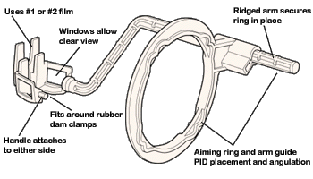
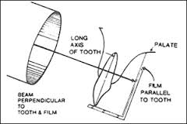
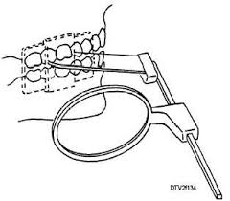
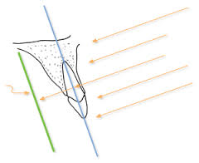

Slide 8
Film holding instruments
To position the film parallel to teeth and project periapical areas onto film, position the film away from the teeth and toward the centre of the mouth
Commercial instruments: precision instrument
XCP instrument with rectangular aiming device

Slide 9
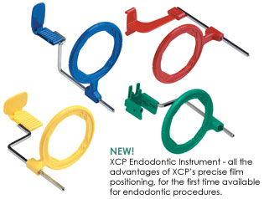
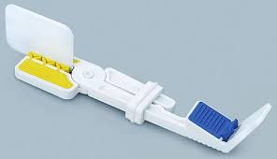

Slide 10
Angulation of tube head
Adjust vertical and horizontal planes so that central ray is oriented perpendicular to long axis of teeth and film
Vertical angulation: positive or negative degrees
Horizontal angulation: influences degree of overlapping of crowns at interproximal spaces
Central ray is directed through the contacts in the region being examined

Slide 11
Point of entry – maxillary teeth
Central incisor - Direct the central ray high on lip, in midline, just below septum of nostril
Lateral incisor – orient the central ray to enter high on the lip about 1cm from the midline
Canine – through canine eminence. POI is at the intersection of distal and inferior borders of ala of nose
Premolar – CR passes through the centre of the 2nd premolar root. Point is usually below pupil of eye

Slide 12
Molar – CR should be on the cheek below the outer canthus of eye and zygoma at the position of maxillary 2nd molar
3rd molar – CR enters the maxillary 3rd molar region just below the middle of the zygomatic arch, distal to the lateral canthus of the eye

Slide 13
Point of entry – mandibular teeth
Centrolateral projection – CR enters below the lower lip and about 1 cm lateral to midline
Canine – POI is nearly perpendicular to ala of nose, over the position of canine and about 3cm above inferior border of mandible
Premolar – CR is below pupil of eye and about 3cm above inferior border of mandible
Molar – below the outer canthus of eye about 3cm above inferior border of mandible
3rd molar – orient the POI about 3cm above the antegonial notch on the inferior border of mandible, in line with anterior border of ramus

Slide 14
Bisecting angle technique
Cieszynski’s rule of isometry: 2 triangles are equal when they share one complete side and have 2 equal angles
Position the film as close as possible to the lingual surface of teeth, resting in palate or FOM.
The plane of film and long axis of teeth form an angle with its apex at the point where the film is in contact with the teeth
Construct an imaginary line that bisects this angle and direct the central ray of the beam at right angles to this bisector

Slide 15
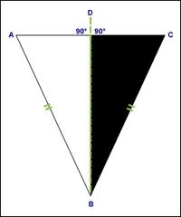
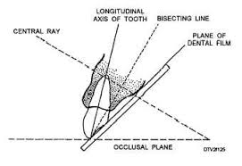
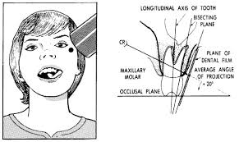
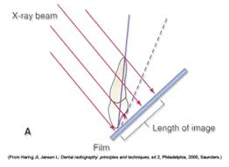

Slide 16
This forms 2 triangles with 2 equal angles and a common side
Images cast on film are of same length as the projected object
Film holding instrument: Snap-A-Ray or bisecting angle instrument
Both provide external device for localizing the x ray beam

Slide 17
Position of patient
For maxillary arch, patients head should be positioned upright with saggital plane vertical and occlusal plane horizontal
For lower arch, head is tilted back slightly to compensate for the changed occlusal plane when the mouth is opened

Slide 18
Angulation guidelines
Projection | Maxilla | Mandible
Incisors | +40 | -15
Canines | +45 | -20
Premolars | +30 | -10
Molars | +20 | -5

Slide 19
Bitewing examinations
Syn: interproximal view
Includes crowns of maxillary and mandibular teeth and alveolar crest on the film
To detect interproximal caries in early stages
To detect secondary caries below restorations
To evaluate periodontal condition
Effective to detect calculus deposits in interproximal areas

Slide 20
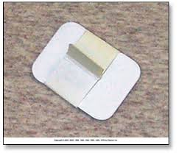
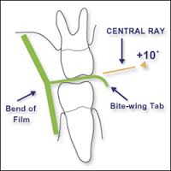
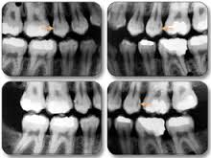

Slide 21
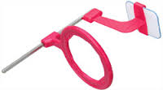
Film holding instruments
XCP bitewing instrument
Film fitted with a tab or loop
The beam is angulated +7 to +10 degrees vertically to preclude overlap of the cusps onto the occlusal surface

Slide 22
Occlusal radiograph
Displays a relatively large segment of a dental arch
Includes the palate or FOM and a reasonable extent of contiguous lateral structures
Indications: restricted mouth opening
To locate roots and supernumerary, unerupted and impacted teeth
To locate foreign bodies in jaws and salivary gland stones
To evaluate the integrity of maxillary sinus
Location, nature, extent and displacement of fractures of maxilla and mandible
To know the medial and lateral extent of disease

Slide 23
Occlusal radiograph
The film is inserted between the occlusal surfaces of the teeth
Tube side of the film is positioned toward the jaw to be examined and x ray beam is directed through the jaw to the film

Slide 24
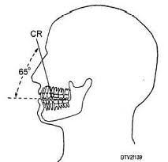
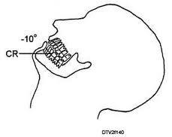
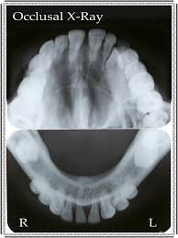

Slide 25
Anterior maxillary occlusal projection
Image field: the anterior maxilla and its dentition and anterior floor of nasal fossa and teeth from canine to canine
CR: through the tip of nose towards the middle of the film with approx 45 degree vertical angle
POI: tip of the nose

Slide 26
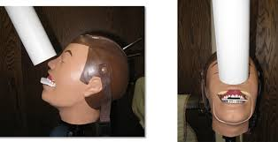
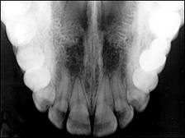

Slide 27
Cross-sectional maxillary occlusal projection
Image field: this view shows the palate, zy processes of maxilla, anteroinferior aspects of each antrum, nasolacrimal canals, teeth from 2nd molar to 2nd molar and nasal septum
CR: at a vertical angle of 65 degree to the bridge of the nose just below the nasion, toward the middle of the film
POI: bridge of the nose

Slide 28
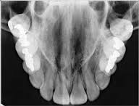

Slide 29
Lateral maxillary occlusal projection
Image field: shows a quadrant of alveolar ridge of maxilla, inferolateral aspect of antrum, tuberosity, teeth from lateral incisor to contralateral 3rd molar. Zy process of maxilla superimposes over molar roots
CR: vertical angle of 60 degree, to a point 2cm below the lateral canthus of the eye, directed toward centre of film
POI: CR enters at a point approx 2 cm below the lateral canthus of the eye

Slide 30
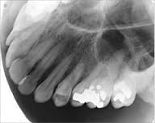

Slide 31
Anterior mandibular occlusal projection
Image field: view includes anterior portion of mandible, teeth from canine to canine
CR: orient CR with -10 degrees angulation through the point of the chin toward the middle of the film, this gives -55 degree to film plane
POI: is in the midline and through the tip of the chin

Slide 32
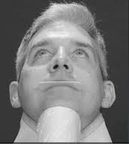
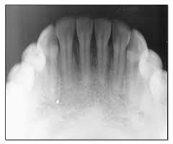

Slide 33
Cross-sectional mandibular occlusal projection
Image field: includes the soft tissues of the FOM, lingual and buccal plates, teeth from 2nd molar to 2nd molar
CR: at the midline, through the floor of mouth approx 3 cm below the chin, at right angles to centre of film
POI: is in the midline through the FOM approc 3 cm below the chin

Slide 34
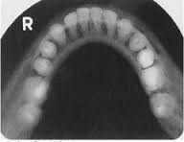

Slide 35
Lateral mandibular occlusal projection
Image field: it covers the soft tissues of half of the mouth, both the cortical plates of half of mandible, teeth from lateral incisor to contralateral 3rd molar
CR: direct CR perpendicular to centre of film through a point beneath the chin, approx 3 cm posterior to the point of chin and 3 cm lateral to the midline
POI: is beneath the chin, approx 3 cm posterior to the chin and approx 3 cm lateral to the midline

Slide 36
