Slide 1
Normal radiographic anatomy

Slide 2
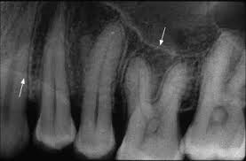

Slide 3
Lamina dura
Tooth sockets are bounded by a thin r’opaque layer of dense bone
This layer is continuous with the shadow of cortical bone at the alveolar crest
It is only slightly thicker and no more highly mineralized than the trabeculae of cancellous bone in the area
r/g appearance is due to the fact that x ray beam passes tangentially through many times the thickness of thin bony wall, which results in observed attenuation

Slide 4
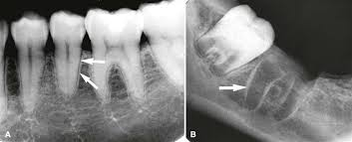
Thickness and density of lamina dura vary with the amount of occlusal stress on the tooth
It is more wider and more dense around the roots of teeth in heavy occlusion and thinner and less dense when subjected to no occlusal function

Slide 5
Alveolar crest
Gingival margin of alveolar process that extends b/w the teethis apparent as a r’opaque line, the alveolar crest
Level of the crest is normal when it is not more than 1.5mm from CEJ of adjacent teeth
In anterior region, crest is reduced to only a point of bone b/w close set incisors
Posteriorly, it is flat, aligned parallel with and slightly below a line connecting CEJ of adjacent teeth
Crest of bone is continuous with lamina dura and forms a sharp angle with it
Rounding of these sharp junctions is indicative of periodontal disease

Slide 6
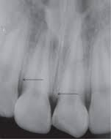
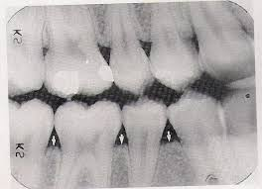

Slide 7
Periodontal ligament space
It appears as a radiolucent space b/w the tooth root and lamina dura
This begins at alveoalr crest, extends around the portions of tooth roots within the alveolus and returns to the alveolar crest on opposite side of tooth
It is thinner in middle of the root and slightly wider near alveolar crest and root apex

Slide 8
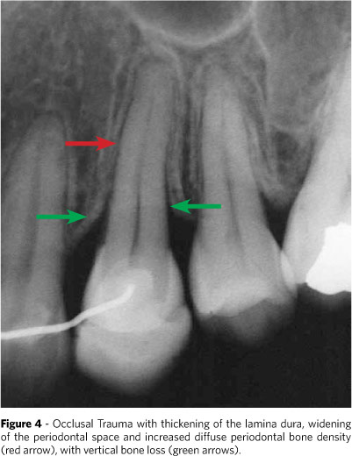

Slide 9
Cancellous bone
Lies b/w cortical plates in both jaws
It is composed of thin r’opaque plates and rods surrounding many small r’lucent pockets of marrow
Trabeculae in anterior maxilla are thin and numerous forming a fine, granular, dense pattern and marrow spaces are small and relatively numerous
In posterior maxilla, similar to anterior maxilla, but marrow spaces are slightly larger
In anterior mandible, trabeculae are somewhat thicker than in maxilla, resulting in a coarser pattern with trabecular plates oriented more horizontally

Slide 10
Trabecular plates are also fewer than in the maxilla and marrow spaces are larger
In posterior mandible, periradicular trabeculae and marrow spaces are comparable to anterior mandible but are somewhat larger
Trabeculae plates are oriented more horizontally here
Below the apices of mandibular molars the no of trabeculae dwindles still more

Slide 11
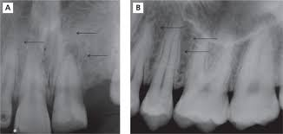
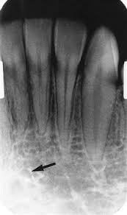
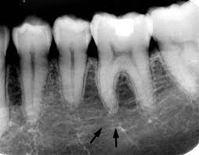

Slide 12
Maxilla
Intermaxillary suture
Anterior nasal spine
Nasal fossa
Incisive foramen
Superior formina of nasoplaltine canal
Lateral fossa
Nose
Nasolacrimal canal
Maxillary sinus
Zygomatic process and zygomatic bone
Nasolabial fold
Pterygoid plates

Slide 13
Intermaxillary suture
Also called median suture
Appears as a thin r’lucent line in the midline b/w 2 portions of the premaxilla
It extends from the alveolar crest b/w central incisors superiorly through the anterior nasal spine and continues posteriorly b/w maxillary palatine processes to the posterior aspect of hard palate
This narrow r’lucent suture terminates at the alveoalr crest in a small rounded or V shaped enlargement
This is bordered by radiopaque borders of thin cortical bone on each side of maxilla
This r’lucent region is usually of uniform width

Slide 14
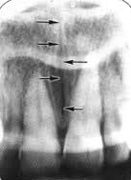

Slide 15
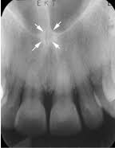
Anterior nasal spine
Located in the midline, it lies some 1.5 to 2 cm above the alveolar crest, usually at or just below the junction of inferior end of nasal septum and the inferior outline of nasal fossa
It is r’opaque and is usually V shaped

Slide 16
Nasal fossa
Inferior border of fossa appears as a r’opaque line extending bilaterally away from the base of ANS
Above this line is a r’lucent space of inferior portion of fossa
Nasal cavity contains the hazy shadows of inferior conchae extending from right and left lateral walls for varying distances toward the septumthese conchae fill varying amounts of lateral portions of fossa

Slide 17
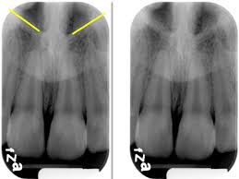

Slide 18
Incisive foramen
Syn: nasopalatine or anterior palatine foramen
Is the oral terminus of nasopalatine canal
It transmits the nasopalatine vessels and nerves
it is usually projected b/w the roots and in the region of middle and apical thirds of central incisors
It may appear smoothly symmetric, with numerous forms or very irregular with a well demarcated or ill defined border
It is site for cyst formation
Presence of cyst is presumed if the width of foramen exceeds 1cm
Lateral walls of nasopalatine canal appears as a pair of r’opaque lines running vertically from superior formina of canal to incisive foramen

Slide 19
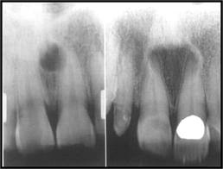

Slide 20
Superior formina of the nasopalatine canal
Originates at 2 formina in the floor of nasal cavity
Openings are on each side of nasal septum, close to anteroinferior border of nasal cavity, and each branch passes downward somewhat anteriorly and medially to unite with the canal from the other side in a common opening, incisive foramen
Is seen when exaggerated vertical angle is used
Appear as 2 r’lucent areas above the apices of central incisors in the floor of nasal cavity near its anterior border and on both sides of septum
Are usually round or oval

Slide 21
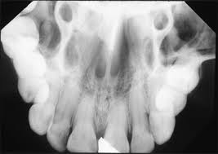
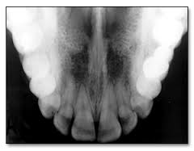

Slide 22
Lateral fossa
Syn: incisive fossa
Is a gentle depression in maxilla near the apex of lateral incisor
Appears as diffusely radiolucent

Slide 23
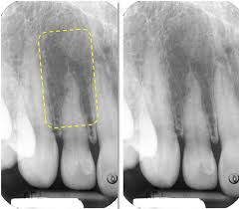

Slide 24
Nose
Soft tissue of the tip of the nose is frequently seen in projections of central and lateral incisors, superimposed over roots of these teeth
Appears as a uniform, slightly opaque appearance with a sharp border

Slide 25
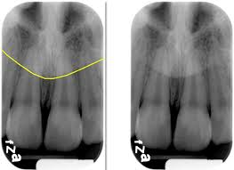

Slide 26
Nasolacrimal canal
Nasal and maxillary bones form the nasolacrimal canal
It runs from the medial aspect of the anteroinferior border of the orbit inferiorly, to drain under inferior conchae into the nasal cavity
Ocasionally can be visualised above the apex of canine, splly when steep angle is used in IOPA

Slide 27
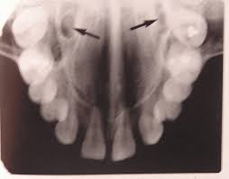

Slide 28
Maxillary sinus
Is an air containing cavity lined with mucous membrane
Borders of sinus appears as a thin, delicate, tenous r’opaque line
Extend from distal aspect of canine to posterior wall of maxilla above the tuberosity
Anteriorly, each sinus is restricted by canine fossa and is usually seen to sweep superiorly, crossing the level of floor of nasal cavity in premolar or canine region
In IOPA of canine, floor of sinus and nasal cavity are often superimposed and may be seen crossing one another, forming an inverted Y in the area

Slide 29
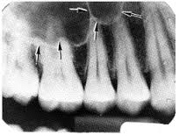

Slide 30
Degree of extension of sinus into alveolar process is extremely variable
In some, floor of sinus will be well above apices of posterior teeth, in others it may extend well beyond the apices toward the alveolar ridge
In edentulousness, sinus may expand further into alveolar bone, occasionally extending to alveolar ridge
Root apices may project anatomically into floor of sinus, causing small elevations or prominences
Thin layer of bone covering the root is seen as a fusion of lamina dura and floor of sinus

Slide 31
R’opaque lines traverse the image of sinus and represents folds of cortical bone projecting a few mm away from floor and wall of antrum
They are usually oriented vertically
Floor of sinus occasionally shows r’opaque projections, which are nodules of bone, and show trabeculation

Slide 32
Zygomatic process and zygomatic bone
Zy process of maxilla is an extension of lateral maxillary surface that arises in the region of apices of 1st and 2nd molars and serves as articulation for zy bone
Process appears as U shaped r’opaque line with its open end directed superiorly
Identified as a uniform gray or white r;opacity over the apices of molars

Slide 33
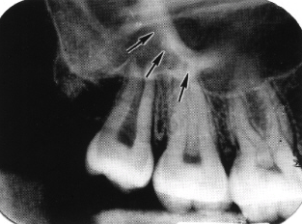
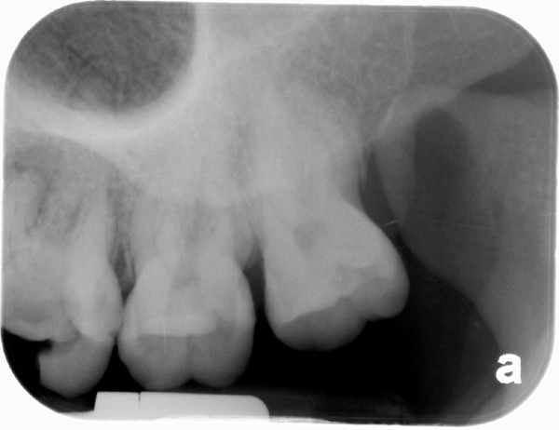

Slide 34
Nasolabial fold
An oblique line demarcating a region that appears to be covered by a veil of slight r’opacity frequently traverses IOPA of premolar region
Line of contrast is sharp, and area of increased r’opacity is posterior to the line
Opaque veil is a thick cheek tissue superimposed on teeth and alveolar process

Slide 35
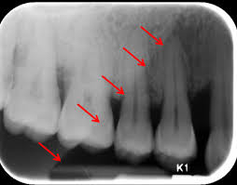

Slide 36
Pterygoid plates
Medial and lateral pterygoid plates lie immediately posterior to tuberosity of maxilla
Image is extremely variable
They always cast a single r’opaque homogenousshadow without any evidence of trabeculation
Extending inferiorly from medial pterygoid plate may be seen the hamular process, which on close inspection can show trabeculation

Slide 37
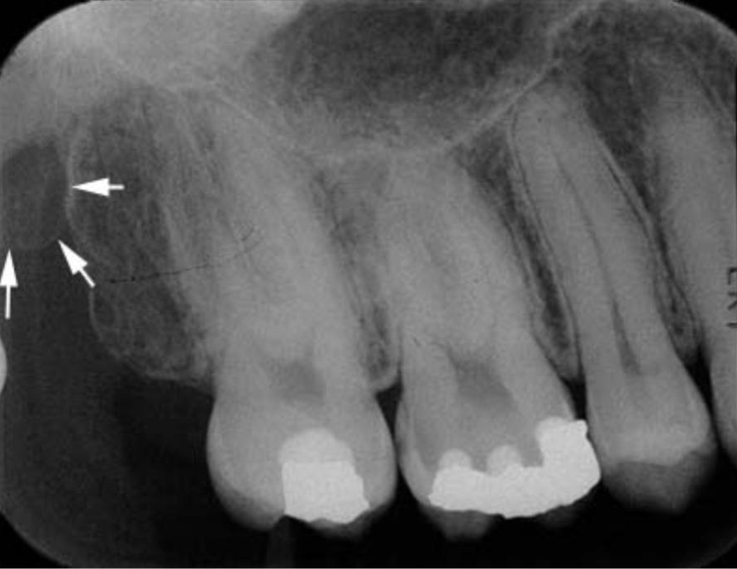

Slide 38
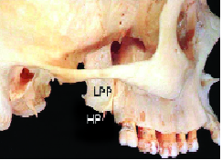
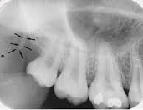

Slide 39
Mandible
Symphysis
Genial tubercles
Mental ridge
Mental fossa
Mental foramen
Mandibular canal
Nutrient canals
Mylohyoid ridge
Submandibular gland fossa
External oblique ridge
Inferior border of the mandible
Coronoid process

Slide 40
Symphysis
In infants demonstrate a r’lucent line through the midline of jaw b/w images of forming deciduous central incisors
This suture usually fuses by end of 1st year of life
If this r’lucency is found in adults, it represents cleft or fracture

Slide 41
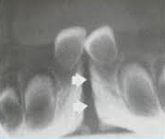

Slide 42
Genial tubercles
Syn: mental spine
Are located on the lingual surface of mandible slightly above the inferior border and in the midline
They are bony protuberances, more or less spine shaped
Are seen on occlusal projections as one or more small projections
On IOPA, appear as 3-4mm r’opaque mass in midline below incisor roots

Slide 43
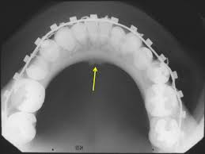

Slide 44
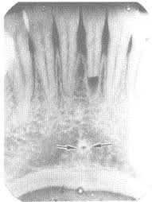
Lingual foramen
It contains the termination of incisive branch of mandibular canal
Is seen as a r’lucent dot surrounded by its cortical wall

Slide 45
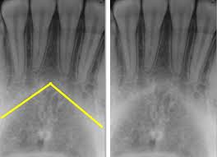
Mental ridge
On IOPA, is seen as 2 r’opaque lines sweeping bilaterally forward and upward toward the midline
Are of variable width and density and seen extending from low in premolar region to each side up to midline

Slide 46
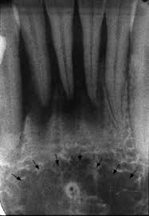
Mental fossa
Is a depression on labial aspect of mandible extending laterally from midline and above the mental ridge

Slide 47
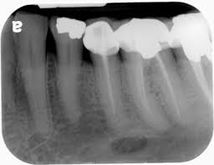
Mental foramen
Is usually the anterior limit of inferior dental canal
It appears as oblong, round, slitlike or very irregular and partially or completely corticated
Is located about halfway b/w lower border of mandible and crest of alveolar process in region of 2nd premolar

Slide 48
Mandibular canal
Image is that of a dark linear shadow with thin r’opaque superior and inferior borders casst by the lamella of bone that bounds the canal
Relationship of mandibular canal to the roots of lower teeth may vary – close contact with all molars to one in which there is no intimate contact with posteriors

Slide 49
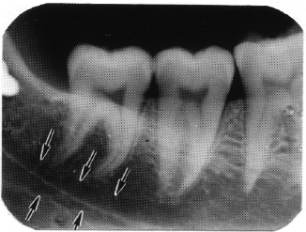

Slide 50
Nutrient canals
Carry neurovascular bundle and appear as r’lucent lines of fairly uniform width
Seen on mandibular periapical r/g running vertically from inferior dental canal directly to the apex of a tooth or into the interdental space b/w mandibular incisors
More frequent in blacks, males, older persons and individuals with high blood pressure or advanced periodontal disease

Slide 51
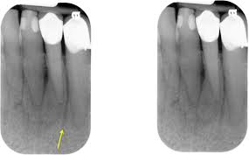

Slide 52
Mylohyoid ridge
Is a slightly irregular crest of bone on lingual surface of mandibular body
Extending from the area of 3rd molars to the lower border of the mandible in the region of the chin, it serves as an attachment for mylohyoid mm
r/g it runs diagonally downward and forward from the area of 3rd molars to the premolar region, at approx the level of apices of posteriors
As the ridge becomes less defined, its anterior and posterior limits blend gradually with the surrounding bone

Slide 53
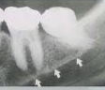
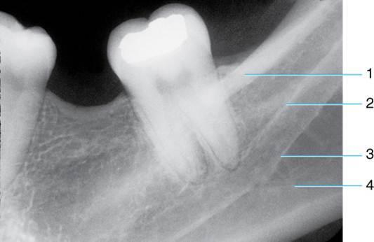

Slide 54
Submandibular gland fossa
On lingual surface of mandibular body, immediately below the mylohyoid ridge in the molar area, there is frequently a depression in bone
This cavity accomodates submandibular gland and appears as a r’lucent area with sparse trabeculae
Superior border is limited by mylohyoid ridge and inferiorly by the lower border of the mandible

Slide 55
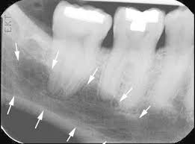

Slide 56
External oblique ridge
It is a continuation of anterior border of mandibular ramus
It follows an anteroinferior course lateral to the alveolar process, being relatively prominent in its upper part and jutting considerably on outer surface of mandible in the region of third molar
This bony elevation gradually flattens, and usually disappears, at about where the alveolar process and mandible join below the first molar
It appears as a r’opaque line of varying width, density and length, blending at its anterior end with the shadow of alveolar bone

Slide 57
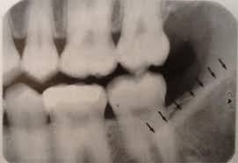

Slide 58
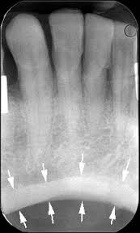
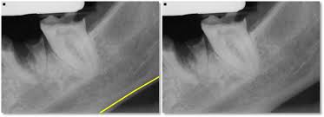
Inferior border of the mandible
Appears as a characteristically dense, broad r’opaque band of bone

Slide 59
Coronoid process
Is frequently apparent on IOPA of maxillary molar region as a triangular r’opacity, with its apex directed superiorly and somewhat anteriorly, superimposed on the region of 3rd molar
Shadow is homogenous, although internal trabeculation can be seen
Its appearance is due to the fact that mandible moves downward and forward when the mouth is open

Slide 60
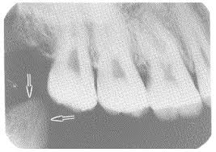

Slide 61
Restorative materials
They vary in their r/g appearance depending primarily on thickness, density and atomic no
Silver amalgam is completely r’opaque
Gold is equally r’opaque to x rays
Stainless steel pins appear r’opaque
Ca hydroxide base is r’lucent but may appear r’opaque due to fillers
Gutta percha and silver points are r’opaque
R’lucent appearance is by silicates, composite, porcelain
Composites may also be r’opaque

Slide 62
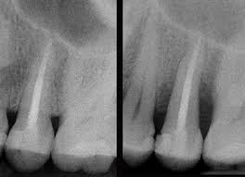
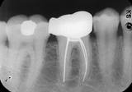
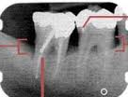
Silver points
Gutta percha
Steel pins

Slide 63
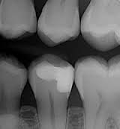
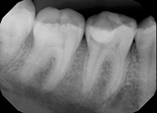
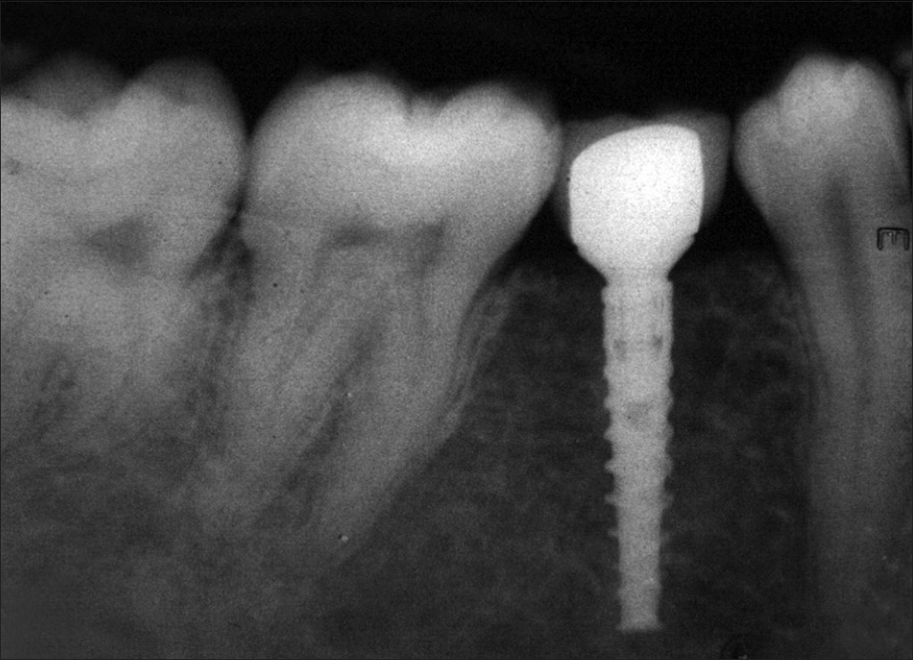
Calcium hydroxide
Composite
Porcelain

