Slide 1
Extraoral radiographic examinations

Slide 2
Different radiographs
Lateral cephalometric projection
Submentovertex projection
Waters projection
Posteroanterior cephalometric projection
Reverse-Towne projection (open-mouth)
Mandibular oblique lateral projection
Mandibular body
Mandibular ramus

Slide 3
Lateral cephalometric projection
Syn: Lateral skull projection
Image receptor is positioned parallel to pts midsaggital plane
Site of interest is towards image receptor to lessen distortion
Wedge filter at the tube head is positioned over the anterior aspect of the beam to absorb some of radiation allow visualization of soft tissues of the face

Slide 4
Position of central x ray beam: perpendicular to midsaggital plane of pt and plane of image receptor and is centered over EAM
Resultant image: exact superimposition is impossible coz structures on side near to image receptor are magnified less than on other side
Structures close to midsaggital plane should be nearly superimposed eg. Clinoid process

Slide 5
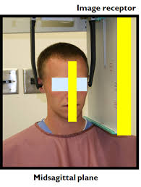
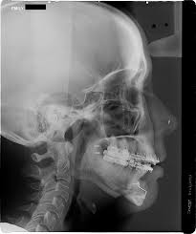

Slide 6
Submentovertex (base) projection
Image receptor and pt placement: receptor is positioned parallel to pts transverse plane and perpendicular to mid saggital and coronal planes
Pts neck is extended as far backwards as possible, with canthomeatal line forming a 10 degree angle with receptor
CR beam: is perpendicular to receptor, directed from below the mandible towards the vertex of skull and centered about 2cm anterior to a line connecting the rt and lt condyles

Slide 7
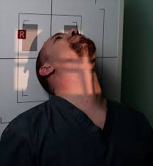
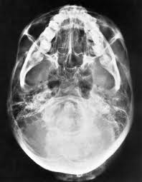

Slide 8
Resultant image: midsaggital plane should divide the skull image into two symmetric halves
Buccal and lingual cortical plates of mandible should be projected as uniform opaque lines
An underexposed view is reqiuired for the evaluation of zy arches as they will be overexposed or “burned out” on r/gs obtained with normal exposure factors

Slide 9
Waters projection
Image receptor and pt placement: receptor is placed in front of the pt and perpendicular to midsaggital plane
The pts head is tilted upwards so that the canthomeatal line forms a 37 degree angle with receptor
If pts mouth is open, sphenoid sinus will be seen superimposed over palate
CR: beam is perpendicular to receptor and centered in area of maxillary sinus

Slide 10
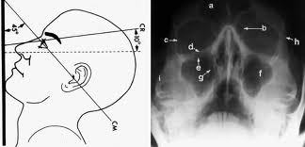

Slide 11
Resultant image: midsagittal plane should divide the skull image into 2 symmetric halves
The petrous ridge of the temporal bone should be projected below the floor of maxillary sinus

Slide 12
Posteroanterior cephalometric projection
Image receptor and pt placement: receptor is place in front of the pt, perpendicular to the midsagittal plane and parallel to coronal plane
Pt is placed so that canthomeatal line forms a 10 degree angle with the horizontal plane and Frankfurt plane is perpendicular to receptor
In PA skull projection, canthomeatal line is perpendicular to image receptor
CR: beam is perpendicular to receptor, directed from the posterior to the anterior, parallel to pts midsagittal plane and is centered at the level of bridge of nose

Slide 13
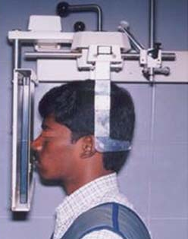
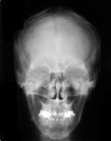

Slide 14
Resultant image: midsagittal plane should divide the skull image in two symmetric halves
Superior border of petrous ridge should lie in the lower third of orbit

Slide 15
Reverse-Towne projection
Image receptor and pt placement: receptor is placed in front of pt, perpendicular to midsagittal and parallel to coronal plane
Pts head is tilted downwards so that the canthomeatal line forms a 25 to 30 degree angle with image receptor
To improve visualisation of condyles, pts mouth is opened so that the condylar heads are located inferior to articular eminence
CR: is perpendicular to image receptor and parallel to pts midsagittal plane and is centered at the level of condyles

Slide 16
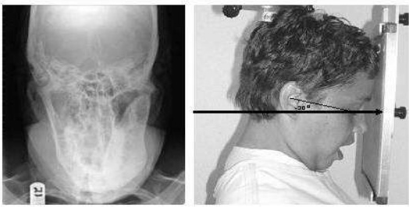

Slide 17
Resultant image: midsagittal plane should divide the skull image into 2 symmetric halves
Petrous ridge of temporal bone should be superimposed at the inferior part of occipital bone, and the condylar heads should be projected inferior to articular eminence

Slide 18
Mandibular oblique lateral projection
Mandibular body projection
Mandibular ramus projection

Slide 19
Mandibular body projection
Image receptor and pt placement: receptor is placed against pts cheek on side of interest and centered in molar- premolar area
Lower border of cassette is parallel and atleast 2cm below the inferior border of the mandible
The head is tilted towards the side being examined and mandible is protruded
CR: is directed towards the molar-premolar region from a point 2cm below the angle of opposite of mandible

Slide 20
Resultant image: a clear image of teeth, alveolar ridge and body of mandible should be obtained

Slide 21
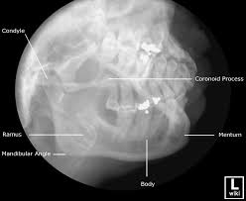

Slide 22
Mandibular ramus projection
Image receptor and pt placement: receptor is placed over the ramus and far enough posteriorly to include the condyle
Lower border of cassatte is parallel and atleast 2cm below the inferior border of mandible
Head is tilted towards the side being examined such that the condyle of area of interest and the contralateral angle of mandible form a horizontal line
The mandible is protruded

Slide 23
CR: beam is directed toward the centre of imaged ramus, from 2 cm below the inferior border of opposite side of mandible at the area of 1st molar
Resultant image: a clear image of 3rd molar-retromolar area, angle of mandible, ramus and condyle head should be obtained

Slide 24
