Slide 1
Principles of Radiographic Interpretation

Slide 2
Introduction
Acquiring appropriate diagnostic images
Quality of the diagnostic image
Number and type of available images
Viewing conditions

Slide 3
Viewing conditions
Ambient light in the viewing room should be reduced
Intraoral radiographs should be mounted in a film holder
Light from the viewbox should be of equal intensity across the viewing surface
The size of the viewbox should accommodate the size of the film
An intense light source is essential for evaluating dark regions of the film
A magnifying glasss allows detailed examination of small regions of the film

Slide 4
Image analysis
Systematic radiographic examination
Intraoral images
Extraoral radiography

Slide 5
Analysis of intraosseous images
Aunt minnie
Step – by – step analysis

Slide 6
Step – by – step analysis
Step 1: localize the abnormality
Step 2: assess the periphery and shape
Step 3: analyze the internal structure
Step 4: analyze the effects of the lesion on surrounding structures
Step 5: formulate a radiographic interpretation

Slide 7
Step 1
Localized or generalized:
Anatomic location / generalized
Localized: uni/bilateral
Gen conditions: metabolic or endocrine
Position in the jaws:
If epicentre is coronal to a tooth: lesion is composed of odontogenic ept
If above IANC, od tissue origin
If below IANC, unlikely od in origin
If in IANC, neural or vascular in origin
Condylar region: cartiliginous or osteochondroma
Max antrum, lesion from alveolar process of maxilla

Slide 8
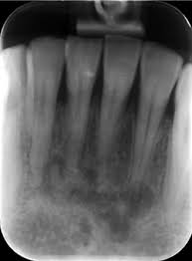
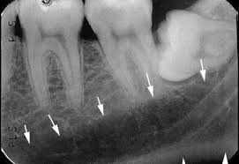
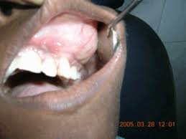
localized
Cgcg
bilateral

Slide 9
Single or multifocal: multifocal lesions could be:
Periapical cemental dysplasia
Odontogeic keratocysts
Metasstatic lesions
Multiple myeloma
Leukemic infilterates
Size: dentigerous cyst / hyperplastic follicle

Slide 10
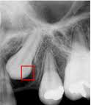
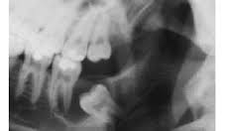
Follicle
Follicular cyst

Slide 11
Step 2: Assess the periphery & shape
Well defined borders:
Punched out border, has a sharp border with no bone reaction
Corticated margin, is a thin, fairly uniform r’opaque line of reactive bone at periphery of lesion
Sclerotic margin, wide, r’opaque border of reactive bone that is usually not uniform in width
A r’opaque lesion may have a soft tissue capsule, indicated by presence of r’lucent line at periphery

Slide 12
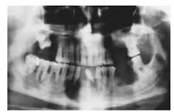
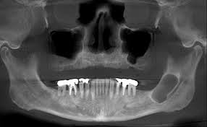
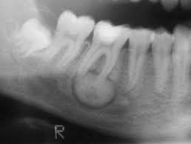
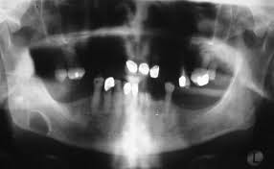
Punched out border
Corticated border
Sclerotic border

Slide 13
Ill defined borders: coz of the gradual transition b/e normal appearing bone and abnormal appearing trabeculae of lesion
Invasive border: an area of r’lucency representing bone destruction can be seen behind the margin
Blending border: enlarging r’lucency at the expense of bone trabeculae
Permeative border: lesion grows around existing trabeculae producing r’lucent, fingerlike or bay like extensions at periphery

Slide 14
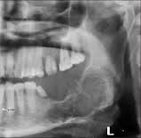
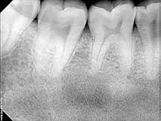
Ill defined border
Blending border

Slide 15
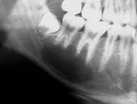
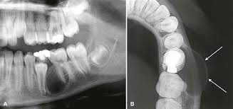
Shape
Circular or fluid filled shape, is like an inflated balloon
Scalloped shape, a series of contagious arcs or semicircles
Scalloped periphery is referred to as multilocular
Scalloped
Hydraulic

Slide 16
Step 3: Analyze the internal structure
3 basic categories:
Radiolucent
Totally radiopaque
Mixed density
R’lucent to r’opaque materials:
Air, fat and gas
Fluid
Soft tissue
Bone marrow
Trabecular bone
Cortical bone and dentine
Enamel
Metal

Slide 17
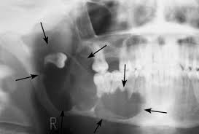
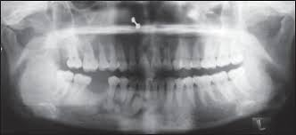
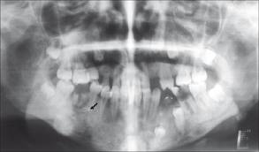
Radiolucent
Mixed
Radiopaque

Slide 18
Abnormal bone: fibrous dysplasia
Septa: OKC
Dystrophic calcification
Cementum
Tooth structure

Slide 19
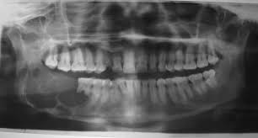
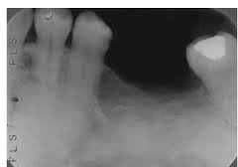
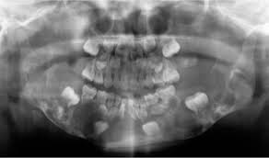
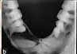
Abnormal bone
Septa
Dystrophic calcification
Cementum
Tooth like structure

Slide 20
Step 4: Analyze the effects of lesion on surrounding structures
Teeth, lamina dura and PDL space:
Lesion with epicentre above the tooth crown, displaces the tooth apically
Lesions such as cherubism push teeth in anterior direction
Widening of PDL space, orthodontic treatment, malignant lesions
Resorption of teeth: chronic inflammation and benign processes

Slide 21
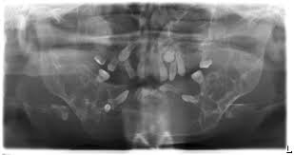
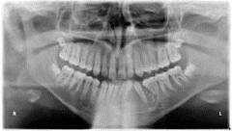
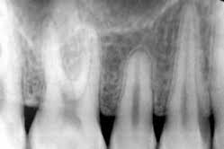
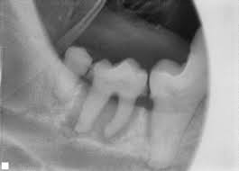
Displacement of teeth
Cherubism
PDL space widening
Resorption of teeth

Slide 22
Surrounding bone density and trabecular pattern:
Presence of reactive bone at periphery of lesion, corticated or sclerotic signifies slow, benign growth
IAN canal and mental foramen:
Superior displacement of canal – fibrous dysplasia
Widening of canal – vascular or neural benign lesion
Irregular widening with cortical destrucion – malignant process

Slide 23
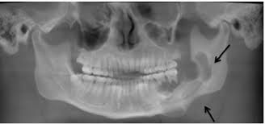
Lesion in Mandibular canal

Slide 24
Outer cortical bone and periosteal reactions:
A slow growing lesion may allow time for outer periosteum to stimulate new bone
A rapidly growing lesion outstrips the ability of periosteum to respond and cortical plate may be missing
Exudate from an inflammatory lesion can lift the periosteum off the surface of cortical bone and stimulate the periosteum to lay down new bone – onion skin type

Slide 25
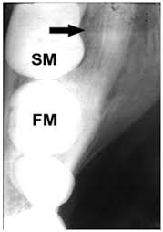
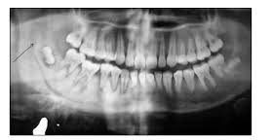
Osteosarcoma
Reactive bone

Slide 26
Step 5: Formulate a r/g interpretation
Decision 1: normal vs abnormal
Decision 2: developmental vs acquired
Decision 3: classification
Cysts
Benign/malignant tumors
Inflammatory lesions
Bone dysplasias
Vascular abnormalities
Metabolic diseases
Fractures
Decision 4: ways to proceed

