Slide 1
Dental caries

Slide 2
Introduction
The demineralized tooth surface is called carious lesion
Initial carious lesion is a subsurface loss of mineral in the outer tooth surface
It appears clinically as chalky white or opaque or dark, brownish spot
Demineralization may extend well into dentin before a breakdown of the outer surface occurs, resulting in clinically visible cavity

Slide 3
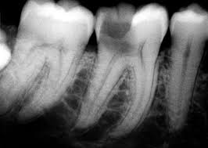
Use of intraoral radiographs
Lesion is seen as r’lucent zone as it does not absorb as many x ray photons as the unaffected portion
A second radiograph at a later time reveals whether the lesion is active or arrested

Slide 4
Radiographic examination to detect caries
bitewing projection is the most useful to detect caries
Use of film holder with a beam aiming device reduces the no of overlaps and improves image quality
IOPA are useful primarily for detecting changes in periapical bone
Paralleling technique, to detect caries in anterior and posterior teeth, splly in heavily restored teeth
r/g used to detect carious lesions should be mounted in frames with dark borders and interpreted using a magnifying glass

Slide 5
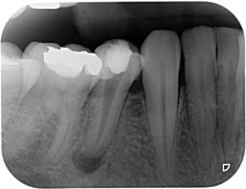
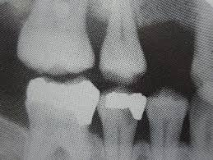
Periapical lesion
Secondary caries

Slide 6
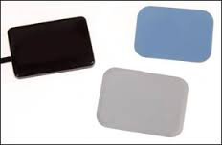
Digital image receptors for a bitewing examination
2 different method available:
CCD and CMOS Technology
Here a cord connects the receptor to computer and storage phosphors that use a film like plate that is processed after exposure
Surface area of sensor is smaller than size 2 film, resulting in display of an average of 3 fewer interproximal tooth surfaces
Stiffness and increased thickness of sensors may result in projection errors

Slide 7
r/g detection of lesions
Proximal surfaces: shape of early r’lucent lesion in enamel is classically a triangle with its broad base at tooth surface, spreading along enamel rods
Other appearances, notch, dot, band, or a thin line
When demineralizing front reaches DEJ, it spreads along the junction, frequently forming the base of a second triangle with apex directed towards the pulp chamber
This triangle has a wider base than in the enamel and progresses towards the pulp along the direction of dentinal tubules

Slide 8
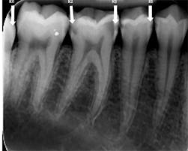

Slide 9
lesion is found in an area b/w the contact point and free gingival margin
Approx half of lesions that are just into dentin have surface cavitation
The deeper the lesion has penetrated into dentin, the more likely it is cavitated
Temporarily separating proximal surfaces with ortho elastics or springs may allow direct inspection for cavitation

Slide 10
Occlusal surfaces
Demineralization process starts in pits and fissures and spreads along the enamel rods and if undisturbed penetrates DEJ and is seen as a thin r’lucent line b/w enamel and dentin
Occlusal lesions commonly start in the sides of the fissure wall rather than at the base and then tend to penetrate nearly perpendicularly toward DEJ
Early lesions appear chalky white, yellow, brown or black discolorations
As lesion extends into dentin, margin b/w carious and noncarious dentin is diffuse and may obscure the fine r’lucent line at DEJ

Slide 11
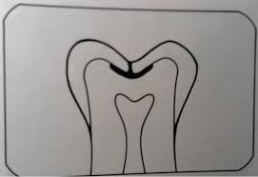

Slide 12
Classic r/g appearance of occlusal caries extending into dentin is a broad based, r’lucent zone, often beneath a fissure, with little or no apparent changes in enamel
A pitfall in interpretation of dentinal occlusal caries is superimposition of the image of buccal pit, with or without a carious lesion, which may simulate an occlusal lesion
Occlusal caries spreads through the dentin, it undermines the enamel and eventually masticatory forces causes cavitation

Slide 13
Mach band
When there is a sharply defined density difference, such as in enamel and dentin, there appear to be a more r’lucent region immediately adjacent to the enamel.
This is an optical illusion referred to as mach band

Slide 14
Buccal and lingual caries
Often occur in enamel pits and fissures of teeth
When small, these lesions are usually round, as they enlarge, they become elliptic or semilunar
They demonstrate sharp, well defined borders
Clinicaian should look out for a uniform noncarious region of enamel surrounding the apparent r’lucency
This well defined circular area represents parallel noncarious enamel rods surrounding the buccal or palatal lesion

Slide 15
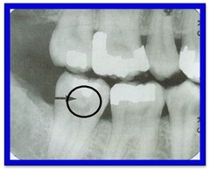

Slide 16
Root surfaces
Root surface lesions involve both cementum and dentin and are associated with gingival recession
The exposed cementum is relatively soft and usually only 20-50 microns near CEJ, and rapidly degrades by atttrition, abrasion and erosion
True caries shows the absence of an image of the root edge and by the appearance of a diffuse rounded inner border where the tooth substance has been lost

Slide 17
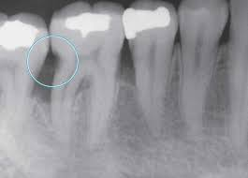

Slide 18
Caries associated with dental restorations
Carious lesion developing at the margin of an existing restoration may be termed recurrent caries
Causes: faulty shaping or inadequate extension of restoration, leading to plaque accumulation
Clinical examination is needed coz restoration may obscure caries on r/g
Recurrent caries at mesiogingival or distogingival margins are seen r/g
Ca hydroxide liners without barium, lead or zinc, composite, plastic or silicate restorations simulate caries

Slide 20
Radiation caries
Radiation therapy pts suffer a loss of salivary gland function, leading to xerostomia
This causes rampant destruction of teeth
The caries start at cervical region and may aggressively encircle the tooth, causing entire tooth loss, with only root fragments remaining
r/gically appear as R’lucent shadows appearing at the necks of teeth
Use of topical fluorides and good oral hygiene is recommended

Slide 21
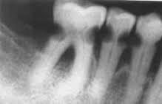

Slide 22
Alternative diagnostic tools
Light fluorescence (QLF) – to quantify mineral loss on smooth surfaces
“Diagnodent” laser-light – for occlusal caries
Fibre-optic transillumination – splly for proximal surfaces
Electrical conductance measurements - for occlusal caries
Ultrasound

