Slide 1
Cysts of the jaws

Slide 2
Definition
A cyst is a pathologic cavity filled with fluid, lined by epithelium and surrrounded by a definite CT wall
Cystic fluid either is secreted by the cells lining the cavity or derives from the surrounding tissue fluid

Slide 3
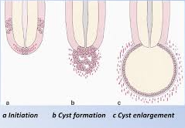

Slide 4
Radiographic features
Location: centrally within maxilla and mandible and rare in coronoid and condylar process
Found in tooth bearing region
In mandible, originate above IAC
Periphery: well defined and corticated
In secondary infection or chronic state, changes to thicker, more sclerotic boundary
Shape: round or oval, some have a scalloped boundary

Slide 5
Internal structure: totally r’lucent
Long standing cases may have dystrophic ossification
Some may have septa
Effects on surrounding structures: cysts grow slowly sometimes causing displacement and resorption of teeth
Area of tooth resorption often has a sharp, curved shape
Cysts can expand mandible, usually in smooth, curved manner
May displace IANC in inferior direction or invaginate maxillary antrum, maintaining a thin layer of bone

Slide 6
Odontogenic cysts
Radicular cyst
Residual cyst
Dentigerous cyst
Buccal bifurcation cyst
Odontogenic keratocyst
Basal cell nevus syndrome
Lateral periodontal cyst
Calcifying odontogenic cyst

Slide 7
Nonodontogenic cyst
Nasopalatine duct cyst
Nasolabial cyst
Dermoid cyst
Cyst like lesions:
Simple bone cyst

Slide 8
Radicular cyst
Syn: periapical cyst, apical periodontal cyst, dental cyst
3rd to 6th decade and slight male predominance
Results when rests of ept cells (Malassez) in the periodontal ligament are stimulated to proliferate and undergo cystic degeneration by inflammatory products from a nonvital tooth
C/F: are most common type of cyst in jaws
Arise from nonvital tooth asymptomatic unless secondary infection occurs
Swelling may feel bony hard if cortex is intact, crepitation as bone thins and rubbery and fluctant if cortex is lost

Slide 9
Radiographic features
Epicentre: apex of a nonvital tooth
Occasionally occurs on mesial or distal surface of root, at opening of accesory canal or infrequently in a deep periodontal pocket
60% are found in maxilla, splly around incisors and canines
Periphery and shape: well defined corticated border
If infection occurs, cortex is lost
Outline is curved or circular

Slide 10
Internal structure: radiolucent
Occasionally dystrophic calcification may develop In long standing cases, and appear as sparsely distributed, small particulate r’opacities
Effects on surrounding structures: displacement and resorption of roots of adjacent teeth may occur
Resorption pattern may have a curved pattern
cyst may invaginate the antrum with evidence of a corticated boundary b/w contents of cyst and internal structure of antrum
Outer paltes of maxilla and mandible may expand in a curved or circular shape
IANC may dispalce in inferior direction

Slide 11
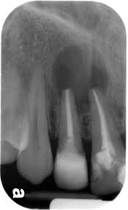
Management
Extraction, endo hterapy and apical surgery
Larger cyst: surgical removal or marsupialization

Slide 12
Residual cyst
Is a cyst that remains after incomplete removal of the original cyst
C/F: asymptomatic cyst there may be some expansion of the jaw or pain in case of secondary infection
r/g: occur in both jaws, more often seen in mandible
Epicentre: periapical in location
Periphery and shape: has a cortical margin unless it becomes secondary infected
Shape is circular and oval

Slide 13
Internal structure: is radiolucent.
Dystrophic calcifications may be seen in long standing cases
Effects on surrounding structures: tooth dispalcement or resorption
Outer cortical paltes of jaws may expand
Cyst may invaginate the antrum or depress IANC
Management: surgical removal or marsupialization

Slide 14
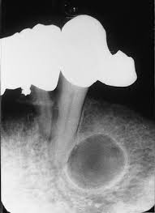

Slide 15
Dentigerous cyst
Syn: follicular cyst
A dentigerous cyst is a cyst that forms around the crown of an unerupted tooth
It begins when fluid accumulates in layers of REE or b/w epithelium and crown of unerupted tooth
Eruption cyst is soft tissue counterpart of dentigerous cyst
C/F: are second most common type of cysts in jaws
Develop around crown of unerupted or supernumerary tooth

Slide 16
Clinical examination reveals a missing tooth and possibly hard swelling, occasionally resulting in facial asymmetry
Pt typically has no pain or discomfort
R/G: Epicenter: just above the crown of involved tooth
Cyst attaches at CEJ
Some cysts are eccentric, developing from lateral aspect of follicle
Periphery and shape: well defined cortex with a curved or circular outline
If infection is present, cortex may be missing

Slide 17
Internal structure: completely r’lucent
Effects on surrouding structures: propensity to displace and resorb adjacent teeth
It displaces associated tooth in an apical direction
It may displace IANC in an inferior direction
Expands the outer cortical boundary
Floor of antrum may be dispalced as cyst invaginates antrum
Management: surgical removal with tooth, large cyst with marsupialization

Slide 18
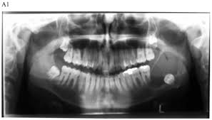

Slide 19
Buccal bifurcation cyst
Syn: mandibular Infected buccal cyst, paradental cyst, inflammatory collateral dental cyst
Source: epithelial cell rests in the periodontal membrane of the buccal bifurcation of mandibular molars
C/F: common sign is the lack of or a delay in eruption of a mandibular first or second molar
Molar may be missing or lingual cusp tips may be abnormally protruding through the mucosa, higher than position of buccal cusps

Slide 20
1st molar is involved more frequently than 2nd molar
Teeth are always vital
Hard swelling may be present buccal to involved molar
Pt experiences pain if secondary infection is present
Occurs within first 2 decades
R/G: mandibular 1st molar is most common location
Followed by 2nd molar
It is occasionally bilateral
Always located in buccal bifurcation of affected molar

Slide 21
Periphery and shape: lesion may be very subtle r’lucent region superimposed over the image of roots of molar
Lesion is circular in shape and well defined cortical border
Internal structure: is r’lucent
Effects on surrounding structures: molar is tipped and so the root tips are pushed into lingual cortical plate of mandible
Larger cyst may displace and resorb adjacent teeth and cause expansion

Slide 22
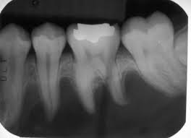
If cyst is secondarily infected, periosteal new bone formation is seen on buccal cortex adjacent to involved tooth
Management: conservative curettage
No recurrence

Slide 23
Odontogenic keratocyst
Syn: primordial cyst
Is a noninflammatory odontogenic cyst that arises from dental lamina
C/F: wide age range
Mostly during 2nd and 3rd decades
Slight male predominance
Cyst sometimes form around an unerupted tooth
Asymptomatic, mild swelling may occur
Pain may occur with secondary infection

Slide 24
r/g: location is posterior body of mandible and ramus
Epicenter is above IANC
Periphery and shape: cortical border, cyst may have a smooth round or oval shape or may have a scalloped border
Internal structure: r’lucent
In some cases, curved internal seepta may be present
Effects on surrounding structures: has the propensity to grow along the internal aspects of the jaws, causing minimal expansion

Slide 25
OKC’s may displace and resorb teeth
IANC may be displaced inferiorly
In maxilla, it may invaginate and occupy the entire maxillary sinus
Management: resection, curettage or marsupialization

Slide 26
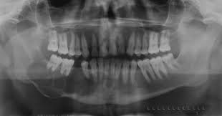

Slide 27
Basal cell nevus syndrome
Syn: nevoid basal cell carcinoma syndrome or Gorlin-Goltz syndrome
It comprises a number of abnormalities such as multiple nevoid basal cell carcinomas of skin, skeletal abnormalities, CNS abnormalities, eye abnormalities and multiple OKC’s
C/F: starts to appear early in life usually after 5 yrs of age and before 30 yrs
Lesion occur as multiple OKC’s of jaws

Slide 28
Skin lesions are small, flattened, flesh-colored or brown papules that occur anywhere on body and are especially prominent on face, neck and trunk
Skeletal abnormalities are bifid rib, and other coastal abnormalities such as agenesis, deformity and synostosis of ribs, kyphoscoliosis, vertebral fusion, polydactyly, shortening of metacarpals, temporal and temporoparietal bossing, minor hypertelorism and mild prognatism
Calcification of the falx cerebri and other parts of dura occur early in life

Slide 29
Radiographic features
Location: multiple OKC’s may develop bilaterally and can vary in size from 1mm to several cms in diameter
Radiopaque line of calcified falx cerebri may be prominent on PA skull projection
Occasionally this calcification may occur laminated
Management: treated more aggressively

Slide 30
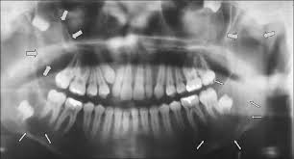

Slide 31
Lateral periodontal cyst
Are thought to arise from epithelial rests in periodontium lateral to tooth root
C/F: lesions are usually asymptomatic and less than 1cm in diameter
No sexual predilection
2nd to 9th decade, mean age is 50 yrs
R/G: occur mostly in the region of lateral incisor to 2nd premolar in mandible
Occasionally appear in maxilla, b/w lateral incisor and cuspid

Slide 32
Periphery and shape: well defined r’lucecy with a prominent cortical boundary and a round or oval shape
Rare large lesions have a more irregular shape
Internal structure: radiolucent
Botryoid variety have a multilocular appearance
Effects on surrounding structures: small cysts may efface lamina dura of addjacent root
Large cysts can displace adjacent teeth and cause expansion
Management: excisional biopsy or simple enucleation

Slide 33
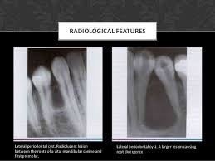

Slide 34
Calcifying odontogenic cyst
Syn: calcifying epithelial odontogenic cyst or Gorlin cyst
Are uncommon, slow growing benign lesions
C/F: wide age range that peaks at 10-19 yrs of age, mean age of 36 yrs
2nd incidence peak in 7th decade
Lesion appears as a slow growing, painless swelling of jaw
Occasionally pt c/o pain

Slide 35
In some cases, expanding laesion may destroy cortical plate and cystic mass may become palpable as it extends into soft tissue
Pt may report a discharge from advanced lesions
Aspiration yeilds a viscous, granular, yellow fluid
R/G: equally distributed in both jaws
Most occur anterior to 1st molar, splly associated with cuspids and incisors

Slide 36
Periphery and shape: well defined and corticated with a curved, cyst like shape to illdefined and irregular
Internal structure: completely r’lucent
It may show evidence of small foci of calcified material that appear as white flecks or small smooth pebbles or even larger, solid, amorphous massses
Rarely lesion appear multilocular
Effects on surrounding structures: cyst is associated with a tooth and impedes its eruption

Slide 37
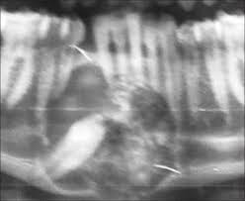

Slide 38
Displacement of teeth and resorption of roots may occur
Perforation of cortical plate may be seen with enlarging lesions
Management: enucleation and curettage

Slide 39
Non odontogenic cysts

Slide 40
Nasopalatine duct cyst
Syn: nasoplatine canal cyst, incisive canal cyst, nasoplatine cyst, medial palatine cyst, median anterior maxillary cyst
C/F: 4th through 6th decades
M:F::3:1
Asymptomatic or cause minor symptoms
Frequent complaint is a small well defined swelling just posterior to palatine papilla
Swelling is usually fluctuant and blue if cyst is near the surface

Slide 41
Deeper lesions have normal appearing mucosa
If cyst expands, it may penetrate labial plate and produce a swelling below maxillary labial frenum
Lesion also may bulge into nasal cavity and distort nasal septum
Pressure from cyst on adjacent nerves may cause a burning sensation or numbness over palatal mucosa
In some cases, cystic fluid may drain into oral cavity through a sinus tract or a remnant of nasopalatine duct
Pt usually detects fluid and reports a salty taste

Slide 42
Radiographic features
Location: nasopalatine canal or foramen
If it extends posteriorly to involve hard palate, It is referred to as median palatal cyst
If it extends anteriorly b/w central incisors, destroying or expanding labial plate of bone and causing the teeth to deverge, it is median anterior maxillary cyst
Periphery and shape: well defined and corticated and is circular or oval
Shadow of nasal spine is superimposed on cyst, giving it a heart shape

Slide 43
Internal structure: totally r’lucent
Rarrely, they amy have dystrophic calcifications, appearing as ill defined, amorphous, scattered r’opacities
Effects on surrounding structures: cyst causes the roots of central incisors to diverge
Occasionally root resorption occurs

Slide 44
Cyst may expand the labial and palatal cortex
Floor of nasal fossa may be displaced in a superior direction
Management: enucleation

Slide 45
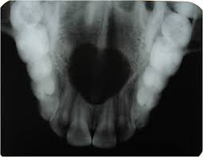

Slide 46
Nasolabial cyst
Syn: nasoalveolar cyst
Arise from epithelial rests in fusion lines of globular, lateral nasal and maxillary processes
C/F: small lesion produce a very subtle, unilateral swelling of nasolabial fold and may elicit pain or discomfort
If large, it may bulge into floor of nasal cavity, causing some obstruction, flaring of the alae,distortion of nostrils and fullness of upper lip
If infected, may drain into nasal cavity
Usually unilateral but bilateral lesions have occured

Slide 47
Mean age is 44 yrs
75% of lesions occur in females
R/G: are primarily soft tissue lesions located adjacent to alveolar process above apices of incisors
Periphery and shape: thin axial CT images using soft tissue algorithm with contrast reveal a circular or oval lesion with a slight soft tissue enhancement of periphery

Slide 48
Internal structure: homogenous and relatively r’lucent compared with surrounding soft tissues
Effects on surrounding structures: occasionally causes erosion of underlying bone, producing an increased r’lucency of alveolar process beneath the cyst and apical to incisors
The usual outline of inferior border of nasal fossa may become distorted, resulting in a posterior bowing of this margin
Management: excised through intraoral approach

Slide 49
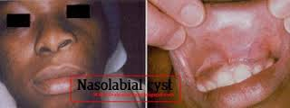

Slide 50
Dermoid cyst
Are a cystic form of a teratoma thought to be derived from trapped embroynic cells that are totipotential
C/F: may develop in the soft tissues at any time from birth
Become apparent from 12 to 25 yrs of age
Equally distributed b/w both sexes
Swelling, which is slow and painless, can grow to several cms in diameter
If located in tongue or neck, may interfere with breathing, speaking and eating
Depending on the depth, it may deform the submental area

Slide 51
On palpation, these cysts may be fluctuant or doughy
These cysts are usually in the midline
R/G: 10% or fewer arise in head and neck
1-2% in oral cavity
25% in FOM and tongue
They may be midline or lateral in location
Periphery and shape: well defined by more r’opaque soft tissue of this cyst compared with surrounding soft tissue

Slide 52
Internal structure: in oral cavity, r’lucent
CT sdcan of the area, soft tissue multilocaular appearance
If teeth or bone form in cyst, r’opaque with characteristics shape and densities
Management: surgical removal

Slide 53
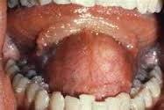

Slide 54
Simple bone cyst
Syn: traumatic bone cyst, hemorrhagic bone cyst, extravasation cyst, progressive bone cavity, solitary bone cyst, unicameral bone cyst
Male predominance of 2:1
It is a cavity within bone lined with CT
It may be empty or may contain fluid
C/F: are very common lesions
Most occur in first 2 decades, mean age is 17 yrs
Asymptomatic but ocasionally pain or tenderness may be present

Slide 55
Expansion of of mandible or tooth movement is possible but unusual
Teeth in the region are vital
Aspiration shows a straw colored or serosanguineous fluid
R/G: occur in mandible, rarely develop in maxilla
Seen most often in ramus and posterior mandible in older pts
SBC’s also frequently occur with cemento-osseous and fibrous dysplasia

Slide 56
Periphery and shape: well defined, delicate cortex to an ill defined border that blends into surrounding bone
Border is usually well defined in alveolar process around the teeth than in the inferior aspect of body of mandible
Shape most often is smooth and curved with an oval or scalloped border
Lesion often scallops b/w roots of teeth

Slide 57
Internal structure: totally r’lucent, but occasionally appear multilocular (no septa present)
This appearance is the result of pronounced scalloping of endosteal surface of either buccal or lingual plates
Ridges of the bone produced by the scalloping give the appearance of septa on lateral view of mandible

Slide 58
Effects on surrounding structures: rarely cause tooth displacement or resorption
Lesion involves the bone around roots of teeth but leaves lamina dura intact or only partially disrupted
Management: conservative opening into lesion and careful curettage of lining
This initiates bleeding and subsequent healing

Slide 59
