Slide 1
Production of x rays
Bremsstrahlung radiation
Characteristic radiation

Slide 2
Bremsstrahlung radiation
These interactions are the primary source of x ray photons from x ray tube
They are produced by sudden stopping or slowing of high speed electrons at target
When electrons from filament strike target, x ray photons are created if electrons hit a target nucleus directly or if their path takes them close to a nucleus
If electron directly hits nucleus, all its kinetic energy is tranformed into single x ray photon
Energy of resultant photon is equal to energy of kV applied across x ray tube at that instant of its passage

Slide 3
Most electrons have near or wide misses with atomic nuclei
Here –vely charged high speed electron is attracted toward +vely charged nuclei and losses some of its velocity
This deceleration causes electron to lose some kinetic energy, which is given off in the form of many new photons
The closer the high speed electron approaches the nuclei, greater is the electrostatic attraction on electron, the braking effect, and the energy of the resulting bremsstrahlung photons

Slide 4
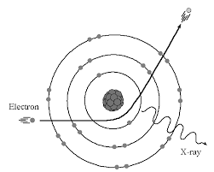
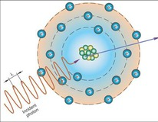

Slide 5
These interactions generate x ray photons with a continuous spectrum of energy: reasons being:
Continuously varying voltage difference b/w target and filament, characteristics of half wave recitification, causes the electron striking the target to have varying levels of KE
The bombarding electrons pass at varying distances around tungsten nuclei and are thus deflected to varying extents. As a result, they give up varying amounts of energy in the form of radiation
Most electrons participate in this interactions. Consequently, electron carries differing amounts of energy at the time of each interaction with tungsten nucleus results in generation of x ray photons

Slide 6
Characteristic radiation
It occurs when an electron from filament displaces an electron from a shell of tungsten target atom, thereby ionising the atom
Higher energy electron in an outer shell of tungsten atom is quickly attracted to the void in deficient inner shell
When outer shell electron replaces displaced electron, a photon is emmitted with an energy equivalent to the difference in the two orbital binding energies

Slide 7
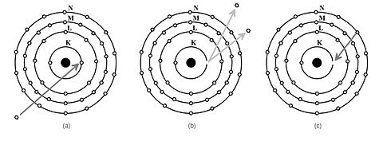

Slide 8
Characteristic radiation from K shell occurs only above 70 kVp with a tungsten target and occurs as discrete increments compared to Bremsstrahlung radiation
Energies of characteristic photons are a function of the energy levels of various electron orbital levels and hence are characteristic of target atoms
Characteristic radiation is only a minor source of radiation from an x ray tube

Slide 9
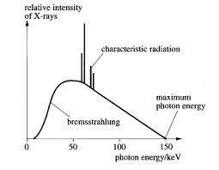

Slide 10
Factors controlling the X ray beam
Exposure time: when exposure time is doubled, no of photons generated at all energies in x ray emmission spectrum is doubled
Changing the time controls the quantity of the exposure, the no of photons generated

Slide 11
Tube current
As mA setting is increased, more power is applied to filament, which heats up and releases more electrons that collide with the target to produce radiation
Quantity of radiation produced by x ray tube is directly proportional to tube current and the time the tube is operated
It is expressed as product of time and tube current
Quantity of radiation remains constant regardless of variations in mA and time as long as their product remains constant

Slide 12
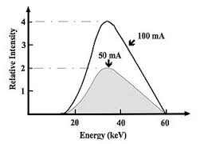

Slide 13
Tube voltage
Increasing the kVp increases the potential difference b/w cathode and anode, thus increasing the energy of each electron when it strikes the target
This results in increased efficiency of conversion of electron energy into x ray photons and thus an increase in:
The no of photons generated
Their mean energy
Their maximal energy

Slide 14
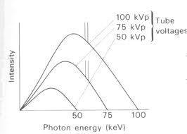

Slide 15
Half – value layer
It’s a useful way to characterize the penetrating quality of an x ray beam
It is the thickness of an absorber, such as aluminium, required to reduce by one half the no of x ray photons passing through it
As the average energy of an x ray beam increases, so does its HVL

Slide 16
Filtration
The x ray photons carry different energies and photons with sufficient energy can penetrate through atomic structures and reach image receptor
Low energy photons contribute to pt exposure and thus should be removed
This is accomplished by placing an aluminium filter in the path of beam
Al preferentially removes many low energy photons with less effect on high energy photons that are able to penetrate the film

Slide 17
Amount of filteration required for particular x ray machine, kVp and inherent filteration of tube and its housing must be considered
Inherent filteration consists of materials that x ray photons encounter as they travel from focal spot on target to form a usable beam outside tube enclosure
These include, glass wall of x ray tube, insulating oil, and barrier that prevents oil from escaping through the x ray port
Inherent filteration ranges from 0.5 to 2mm of aluminium

Slide 18
Total filteration is sum of inherent filteration plus any added external filteration
External filteration supplied in the form of aluminium disks placed over the port in the head of x ray machine
Governmental regulations require total filteration to equivalent of 1.5mm aluminium to 70 kVp and 2.5 mm for all higher voltages

Slide 19
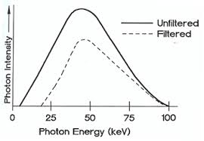

Slide 20
Collimation
A collimator is a metallic barrier with an aperature in the middle used to reduce the sixe of x ray beam and therefore volume of irradiated tissue within the pt
Round and rectanglar are frequently used
Dental x ray beams are usually collimated to a circle 23/4 inches/7cm in diameter
Round collimator is a thick plate of r’opaque material, usually lead with a circular opening centered over the port in x ray tube head through which x ray beam emerges

Slide 21
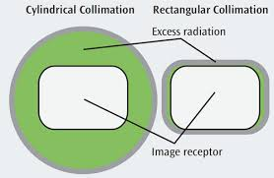
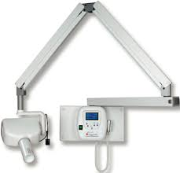


Slide 22
Rectangular collimators further limit the size of the beam to just larger than the x ray film
Use of collimation also improves image quality
Tissues in the path absorbs about 90% of photons and 10% of photons pass through the pt and reach the films
Many absorbed photons generate scattered radiation within the exposed tissues by comptom scattering
These scattered photons travel in all directions and some reach the film and degrade image quality
Collimating the beam to reduce exposure area and thus no of scattered photons reaching the film can minimize the detrimental effect of scattered radiation on images

Slide 23
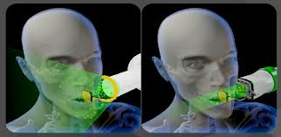

Slide 24
Inverse square law
Intensity of an x ray beam at a given point depends on the distance of the measuring device from focal spot
For given beam, intensity is directly proportional to square of the distance from the source
Reason for this decrease in intensity is that the x ray beam spreads out as it moves from the source
Relationship: I1/I2 = (D2)/(D1)

Slide 25
Interactions of x rays with matter
intensity of an x ray beam is reduced by interaction with the matter it encounters
Attenuation results from interactions of individual photons in the beam with atoms In the absorber
X ray photons are either absorbed or scattered out of the beam

Slide 26
Coherent scattering
Syn: classical, elastic or Thompson scattering
It occurs when a low energy incident photon passes near an outer electron of an atom
Incident photon interacts with the electron by causing it to become momentarily excited at the same frequency as the incoming photon
Incident photon ceases to exist
Excited electron then returns to ground state and generates another x ray photon with the same frequency and energy as in the incident beam

Slide 27
The secondary photon is emitted at an angle to the path of the incident photon
This interaction accounts for 8% of total no of interactions per exposure
It contributes very little to film fog coz the total quantity of scattered photons is small and its energy level is too low for it to reach the film

Slide 28
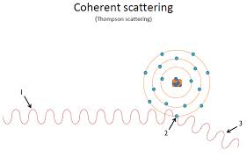

Slide 29
Photoelectric absorption
This occurs when an incident photon collides with a bound electron in an atom of the absorbing medium
At this point, incident photon ceases to exist
Electron is ejected from its shell and becomes a recoil electron/photoelectron
Kinetic energy imparted to recoil electron is equal to the energy of incident photon minus that used to overcome the binding energy of the electron
Absorbing atom is now ionised coz it has lost an electron

Slide 30
This electron deficiency is instantly filled with a release of characteristic radiation
Recoil electrons ejected travel only short distances in the absorber before they give up their energy through secondary ionisations
Most interactions occur in K shell coz the density of electron cloud is greater in this region and higher probability of interaction exists
About 30% of interactions are by photoelectric process

Slide 31
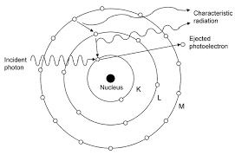

Slide 32
Compton scattering
It occurs when a photon interacts with an outer orbital electron
Incident photon collides with an outer electron, which receives kinetic energy and recoils from the point of impact
The path of the incident photon is deflected by its interaction and is scattered from the site of the collision
Energy of the scattered photon equals the energy of the incident photon minus the sum of kinetic energy gained by recoil electron and its binding energy

Slide 33
This results in the loss of an electron and ionisation of the absorbing atom
Scattered photons continue on their new paths, causing further ionizations
Recoil electrons also give up their energy by ionizing other atoms
About 62% of photons are absorbed by this process
Scattered photons travel in all directions
Higher the energy of incident photon, greater the probability that the angle of scatter of secondary photon will be small and its direction forward

Slide 34
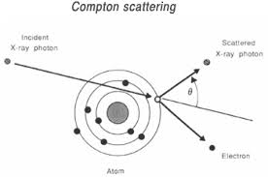

Slide 35
30% of scattered photons formed during exposure will exit through pts head
It is disadvantageous coz it causes film darkening

