Slide 1
Salivary gland diseases

Slide 2
Developmental abnormalities
Inflammatory and reactive lesions
Viral diseases
Systemic conditions with salivary gland involvement
Medication induced salivary dysfunction
Immune conditions
Granulomatous conditions
Sialorrhea
Salivary gland tumors
Evaluation of dry mouth
Treatment of xerostomia

Slide 3
Developmental abnormalities
Absence of glands is rare and occurs in association with other developmental defects, splly malformations of 1st brachial arch
Aplasia – xerostomia and dental caries
Enamel hypoplasia, congenital absence of teeth and extensive occlusal wear are other symptoms
Parotid agensis is reported with several congenital conditions, including hemifacial microstomia, mandibulofacial dysostosis, cleft palate, lacrimoauriculodentodigital syndrome, treacher collins syndrome and anopthalmia
Hypoplasia of parotid gland is associated with Melkersson-Rosenthal syndrome

Slide 4
Aberrant salivary glands are salivary tissues that develop at unusual anatomic sites
Locations for aberrant glands are middle ear cleft, EAC, neck, posterior mandible, anterior mandible, pituitary and cerebellopontine angle
Stafne’s cyst: located b/w angle and first molar below the level of inferior alveolar nerve
Gland is usually asymptomatic and appears as a round radiolucency
Less commonly anterior lingual submandibular salivary glands have been reported
Aberrant glands: anterior mandible, appearing as r’lucency at tooth apex, extraction sites, b/w roots

Slide 5
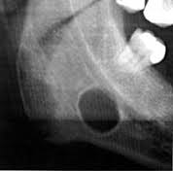

Slide 6
Accessory salivary ducts
Are common
Do not require treatment
Frequent location was superior and anterior to normal location of Stenson’s duct

Slide 7
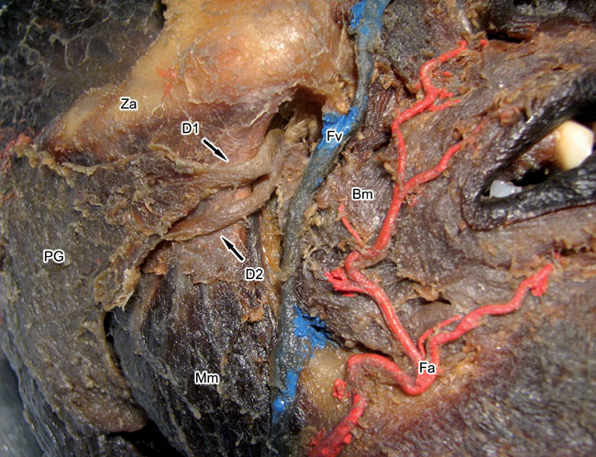

Slide 8
Diverticuli
It is a pouch or sac protruding from the wall of a duct
It leads to pooling of saliva and recurrent sialadenitis
Diagnosis: sialography
Pts are encouraged to regularly milk the involved gland and promote salivary flow through the duct

Slide 9
Darier’s disease
Sialography revealed duct dilatation, with periodic stricture affecting the main ducts
Symptoms of occasional obstructive sialadenitis are reported

Slide 10
Sialolithiasis
Are calcified that form within the secretory system of major salivary glands
Factors are inflammation, irregularities in duct system, local irritants and anticholinergic medications may cause pooling of saliva within duct
A nidus of salivary organic material becomes calcified and gradually forms a sialolith
Submandibular gland is most common site of involvement with 80-90% liths occuring

Slide 11
Common in submandibular gland coz:
Torturous corse of Whartons duct
Higher calcium and phosphate levels
Dependent position of submandibular glands
Gout can cause calculi composed of uric acid

Slide 12
Clinical presentation
h/o acute, painful and intermittent swelling of affected major gland
Degree of symptoms depends on extent of obstruction and presence of secondary infection
Eating will initiate swelling
Stone totally or partially blocks the flow of saliva, causing saliva pooling within ducts and gland body
Since glands are encapsulated, there is little space for expansion and enlargement causes pain

Slide 13
Involved gland is usually enlarged and tender
Stasis of saliva may lead to infection, fibrosis and gland atrophy
Fistulae, a sinus tract or ulceration may occur over stone in chronic cases
Soft tissue examination surrounding duct may show a severe inflammatory reaction
Palpation may confirm the presence of a stone
Bacterial infections may or may not be superimposed and are more common with chronic obstructions
Other complications: acute sialadenitis, ductal stricture and ductal dilatation

Slide 14
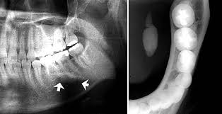
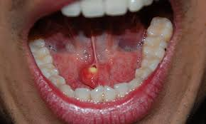

Slide 15
r/g examination is needed coz bimanual palpation may not be accessible
Poorly calcified liths may not be visible r/g
Occlusal view is recommended for submandibular glands
parotid gland r/g: AP view with puffed cheek
Occlusal film adjacent to duct
CT has 10 times the sensitivity of plain film r/g for liths

Slide 16
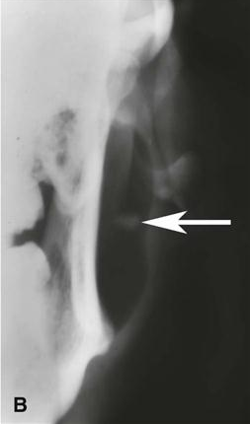
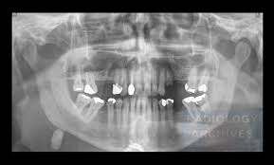

Slide 17
Calcified phleboliths are stones that lie within a blood vessel
Easily mistaken for sialoliths
These occur outside the ductal structure
Diagnosis: sialography

Slide 18
Treatment
Acute phase: supportive
Standard care includes, analgesics, hydration, antibiotics and antipyretics
In pronounced exacerbations, surgical intervention
Liths at or near orifice: removed transorally by milking the gland
Deeper stones require surgery
Intraglandular stone: removal of the gland
Lithotripsy: noninvasive treatment
Ultrasonography and extracorporeal lithotripsy to fragment the stone

Slide 19
Mucoceles
Is a clinical term that describes swelling caused by accumulation of saliva at site of traumatized or obstructed minor salivary gland duct
Classified as extravasation and retention types
A large form of mucocele located in floor of mouth is known as ranula

Slide 20
Mucocele
Extravasation mucocele: results from trauma to minor glands. Laceration leads to pooling of saliva in adjacent submucosal tissue and consequent swelling
Retention mucocele: due to obstruction of minor salivary gland duct by calculus or due to contraction of scar tissue around injured minor salivary gland duct
Blockage causes accumulation of saliva and dilation of duct
Eventually, an aneurysm like lesion forms, which can be lined by ept of dilated duct

Slide 21
Clinical presentation
Extravasation type most frequently occur on lower lip, other regions being buccal mucosa, tongue, FOM,retromolar region
Retention cyst: palate or FOM
h/o trauma followed by development of lesion
Present as discrete painless smooth surfaced swellings ranging from few mm to cm
Superficial lesions always have a bluish hue
Lesions size vary over time
Pts frequently traumatize superficial one, allowing to drain and deflate
In these circumstances, they recur

Slide 22
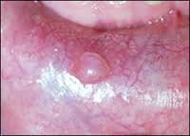
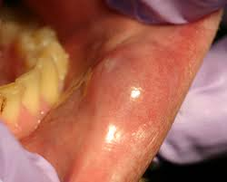

Slide 23
Treatment
Surgical excision
Removal of associated salivary glands is essential to prevent recurrence
Surgical removal may traumatize adjacent glands
Intralesional injections of corticosteroids have been successfully used

Slide 24
Ranula
Is a large mucocele located on the FOM
May be extravasation or retention type
Are most commonly associated with sublingual salivary gland duct
Etiology: trauma
Obstructed salivary gland or ductal aneurysm

Slide 25
Clinical presentation
Presents as painless, slow growing, soft and movable mass located in the FOM
Lesion forms on one side of lingual frenum
If lesion extends deep into soft tissue, it can cross the midline
Superficial ranulas can have a blue hue
Deep seated one have normal appearing mucosa
Large lesion cause deviation of tongue
Deep lesion that herniates through the mylohyoid muscle and extends along the facial planes is referred to as plunging ranula and may become large, extending into the neck

Slide 26
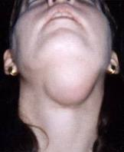
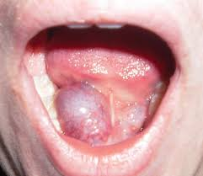

Slide 27
Treatment
Treated surgically
Marsupialization unroofs the lesion, for smaller lesions
Recurrent cases, excision of lesion and gland is recommended
Intralesional injections of corticosteroids have been successfully used in treatment

Slide 28
Inflammatory and reactive lesions

Slide 29
Necrotizing sialometaplasia
Is a benign self-limiting reactive inflammatory disorder of salivary tissue
this lesion mimics a malignancy
Initiated by a local ischemic event
C/f: has a rapid onset
Occur predominantly on palate
Lesions initially start as a tender erythematous nodule
Once mucosa breaks down, a deep ulceration with yellowish base fprms
Even though lesions can be large and deep, pts experience moderate degree of pain

Slide 30
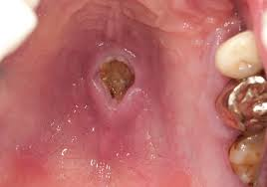

Slide 31
Lesions often occur shortly after oral surgical procedures, restorative dentistry or administration of LA
Lesions may also develop weeks after a dental procedure or trauma
Treatment: self limiting, lasts approx 6 weeks and heals by secondary intention
No specific treatment required
Debridement and saline rinses may help healing

Slide 32
Radiation induced pathology
Effects of external beam radiation: is standard treatment for head and neck tumors
Doses more than or equal to 50 Gy will result in permanent salivary gland damage and symptoms of oral dryness
C/p: r’therapy is usually delivered in fractionated doses 5 days per week for 6 to 8 weeks
Acute effects on salivary function can be recognized within a week of beginning treatment at doses of approx 2 Gy daily and pts will often have c/o oral dryness by end of 2nd week

Slide 33
Mucositis is a very common consequence of treatment and can be severe to alter radiation therapy
If permanent salivary dysfunction develops, pts are at risk of full range of associated oral complications
Typically, at doses more than or equal to 50 Gy, dysfunction is severe and permanent
Difficulty in speaking, dysphagia and increased caries are common complaints
Saliva is minimal and is thick and ropy

Slide 34
Radiation caries: rapidly advancing caries and characteristically occur at incisal or cervical aspect of teeth and wrap around the teeth in an apple core fashion
Other complications: candidiasis
Sialadenitis
Osteonecrosis

Slide 35
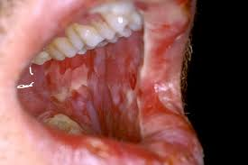
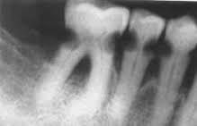
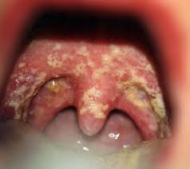
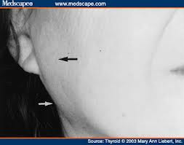
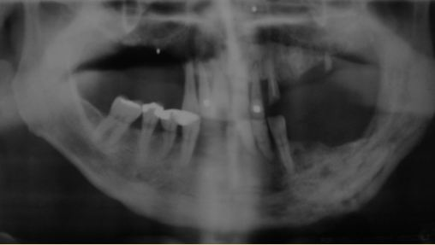

Slide 36
Treatment
Amifostine, a radioprotective agent
Is useful for the preservation of salivary function and for reduction of dry mouth in pts undergoing r’therapy
Proposed mech involves scavening of free oxygen radicals

Slide 37
Amifostine is dephosphorylated in the circulation by alkaline phosphatase to a pharmacologically active free thiol metabolite
Thiol metabolite scavenges free oxygen species generated by radiation
Normal tissue is more vascular than tumor and has higher capillary levels of alkaline phosphatase
So, the concentration of active thiol metabolite is higher in normal tissue and thus will protect the normal tissue but not cancer
Is administered iv 15 to 30 mts prior to each fractionated radiation treatment

Slide 38
Side effects are hypotension, hypocalcemia, nausea and vomitting
candidiasis: antifungal agents free of sugar
Vaginal clotrimazole troches and dissolved nystatin pwdr
Caries: daily prescription – strenght topical fluoride is recommended

Slide 39
Effects of internal radiation therapy
Disseminated thyroid cancer is treated by removal of thyroid gland
To insure all thyroid tissue is removed or destroyed, pts are given radioactive iodine (131I) after surgery
R’active iodine is taken up not only by thyroid tissue but also by oncocytes in salivary gland tissue
R’active iodine can cause permanent salivary gland damage and fibrosis resulting in salivary gland hypofunction

Slide 40
Clinical presentation
Pts with DTC treated with radioactive iodine may experience xerostomia and decreased salivary gland function
Treatment: following administration of r’active iodine, pts should suck o lemon drops or chew gum to stimulate salivary flow
This will aid in clearing radioactive iodine from salivary glands and potentially decrease gland damage

Slide 41
Allergic sialadenitis
Enlargement of salivary glands is associated with exposure to various pharmaceutical agents and allergens
Characterisitic feature of allergic reaction is acute salivary gland enlargement and itching over gland
Following compounds show gland enlargement:
Phenobarbital, phenothiazine, ethambutol, sulfisoxazole, iodine compounds, isoproterenol and heavy metals
Allergic sialadenitis is self limiting: avoid allergen, hydration and monitor for secondary infection

Slide 42
Viral diseases : mumps
Syn: epidemic parotitis
Is caused by a RNA paramyxovirus
Transmitted by direct contact with salivary droplets
C/p: occurs in children b/w ages of 4 and 6 yrs
Incubation period is 2 to 3 weeks
Followed by salivary gland inflammation and enlargement, preauricular pain, fever, malaise, headache and myalgia
Majority involve parotid glands
Skin over gland is oedematous

Slide 43
Salivary gland enlargement is sudden and painful to palapation
Ducts are inflammed but without purulent discharge
If partial duct obstruction occurs, pt may experience pain when eating
One gland can become symptomatic 24 to 48 hrs before another gland does so
Swelling is usually bilateral and lasts approx 7 days

Slide 44
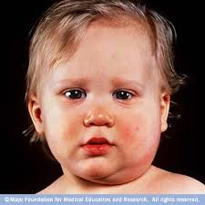

Slide 45
Lab: demo of antibodies to mumps S and V antigens and to hemagglutination antigen
Serum amylase levels may be elevated
Complications: mild meningitis and encephalitis
Deafness, myocarditis, thyroiditis, pancreatitis and oophoritis occur less frequently
Males may experience epididymitis and orchitis, resulting in testicular atrophy and infertility, if occur in adolesence
Treatment: symptomatic

Slide 46
Cytomegalovirus infection
Is a beta herpes virus infecting only humans
May remain latent after initial exposure and infection
c/p: occur In young adult population and presents as an acute febrile illness that causes salivary gland enlargement
Transplacental transmission can cause prematurity, low birth weight and congenital malformations
Infected newborns and young children suffer from hepatitis, myocarditis, hematologic abnormalities, pneumonitis and nervous system damage
Infection is fatal

Slide 47
Those children who survive frequently experience permanent nerve damage resulting in mental retardation and seizure disorders
In adults, could be due to reactivation of virus in immunocompromised pts or pts with hematologic abnormalities or HIV infection
Advent of highly active antiretroviral therapy for treating HIV infection has resulted in a decline of CMV end organ damage

Slide 48
CMV infected tissue contains large atypical cells with inclusion bodies
These cells can be 2 times the normal size and have eccentrically places nuclei, resulting in “owl-like” appearance
Lab: culture, antigen detection, CMV DNA detection
Diagnosis of primary infection: combination of IgM anti CMV antibody seropostivity, Ig G seroconversions, and viral culture

Slide 49
Treatment
Immunocompetent pts are treated symptomatically
Immunocompromised pts require aggressive management
Iv gancyclovir, foscarnet or cidofovir

Slide 50
HIV infection
Neoplastic and non neoplastic salivary gland enlargement occur with increased frequency in HIV infected pts
HIV-salivary gland disease describes xerostomia and benign salivary gland enlargement
HIV-SGD is associated with a cluster designation 8 cell lymphocytosis of salivary glands and with diffuse infilterative lymphocytosis sysdrome (DILS)

Slide 51
C/p: most notable symptom is salivary gland swelling, may or may not be accompanied by xerostomia
HIV-SGD frequently resembles Sjogren’s syndrome
multiple cystic masses are characteristic of HIV associated benign lymphoepihelial hypertrophy
These pts also frequently experience medication induced xerostomia
Treatment: symptomatic
Xerostomia may be relieved by sipping water, saliva substitute, chewing sugar free gum,suckng sugar free candy

Slide 52
Topical fluoride for caries
parotid enlargement is esthetic concern and surgery has been performed
Aspiration of cysts and tetracycline sclerosis – inj of tetracycline solution into cystic areas will sometimes induce an inflammatory reaction and eventual sclerosis

Slide 53
Hepatitis C virus infection
C/p: extrahepatic manifestations include salivary gland enlargement
Pt may report xerostomia along with chronic major salivary gland enlargement
Diagnosis: detection of anti-HCV antibodies and HCV DNA
Treatment: symptomatically

Slide 54
Bacterial sialadenitis
Syn: surgical parotitis
Bacterial infections of salivary glands are most commonly seen in pts with reduced salivary gland function
Postsurgery pts often experienced gland enlargement from ascending bacterial infections due to decreased salivary flow during anesthesia, often as a result of administered anticholinergic drugs and relative dehydration due to restricted fluids

Slide 55
Reduction of salivary flow results in diminished mechanical flushing, allowing bacteria to colonize the oral cavity and then to invade the salivary duct and cause acute bacterial infection
Geriatric population is most susceptible due to frrequent combination of medication induced xerostomia and poor oral hygiene
Submandibular gland is least susceptible coz of presence of mucin having potent antibacterial activity

Slide 56
Clinical presentation
Usually present with a sudden onset of uni/bilateral swelling of gland
Involved gland is painful, indurated and tender to palpation
Overlying skin may be erythematous
Purulent discharge may be expressed from duct orifice
US or CT is recommended for visualizing possible cystic areas

Slide 57
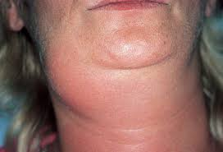
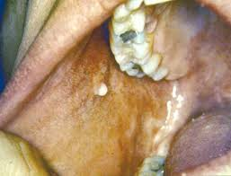

Slide 58
Treatment
If purulent discharge is present, empiric iv pencillinase-resistant antistaphylococcal antibiotic is used
Instruct pt to milk the gland several times throughout the day
Increased hydration and improved oral hygiene are required
Significant improvement is noted in 24 to 48 hrs
If not, I and D should be considered

Slide 59
Systemic conditions with salivary gland involvement
Diabetes: pts with uncontrolled diabetes often have dry mouth, which is due to polyuria and poor hydration
Poor glycemic control directly effects salivary gland metabolism
Autonomic nervous system dysfunction may also play a role

Slide 60
Anorexia nervosa
Salivary gland enlargement and dysfunction can occur in pts with anorexia nervosa and bulimia
Enlargement appears to be related to nutritional deficiencies and to habit of induced vomitting
Enlargement resolves when pts return to normal weight and discontinue unhealthy eating habits
Hypertrophy may persist and be a esthetic concern
Total and salivary specific amylase levels are increased with bulimia
Salivary amylase tends to increase with frequency of binge eating

Slide 61


Slide 62
Chronic alcoholism
It is associated with salivary gland dysfunction and bilateral salivary gland enlargement
Decreased salivary flow is due to dehydration and poor nutrition
Enlarged gland show fatty tissue changes on histologic examination

Slide 63
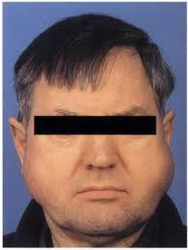

Slide 64
Medication induced salivary dysfunction
Drugs include:
Anticholinergics
Antidepressants
Antihypertensives
Antihistaminics
Medication induced hypofuntion affects unstimulated output
When causative drug is withdrawn, function often returns to normal

Slide 65
Immune conditions
Benign lymphoepithelial lesion (Mikulicz’s disease)
Sjogren’s syndrome

Slide 66
Benign lymphoepithelial lesion (Mikulicz’s disease)
Etiology : unknown
Autoimmune, viral or genetic are trigger factors
Mid aged women
Pts present with uni/bilateral salivary gland swelling due to benign lymphoid infilteration
Reduced salivary flow makes pts susceptible to gland infections
Diagnosis: salivary gland biopsy
Absence of abnormalities in peripheral blood counts
Autoimmune serologies

Slide 67
D/D and treatment
D/D: sjogrens syndrome
Lymphoma, sarcoidosis
diseases associated with salivary gland enlargement
Treatment: palliative

Slide 68
Sjogren’s syndrome
Is a chronic autoimmune disease characterized by symptoms of oral and ocular dryness and lymphocytic infilteration and destruction of exocrine glands other exocrine tissues, thyroid, lungs and kidney may also be involved
Ss pts frequently experience arthralgias, myalgias, peripheral neuropathies and rashes
Autoimmune associated anemia, hypergammaglobulinemia and other serologic abnormalities are found In this pt

Slide 69
SS primarily affects postmenopausal women
F:M::9:1
Primary SS: is a systemic disorder that includes both salivary and lacrimal gland dysfunctions without another autoimmune condition
In secondary SS, another CT disease is also present

Slide 70
Clinical presentation
Pts with SS experience full spectrum of oral complications due to decreased salivary function
Almost all pts experience dry mouth and need to sip liquids throughout the day
Oral dryness causes difficulty in chewing, swallowing and speaking
Cracked lips and angular chelitis
Mucosa is pale and dry
Minimal saliva pooling is noted
Saliva tends to be ropy and thick

Slide 71
Mucocutaneous candidiasis are common
Decreased salivary flow results in increased caries and erosion of enamel structure
Salivary gland enlargement and also susceptible to gland infections and/or gland obstructions that present as acute exacerbations of chronically enlarged glands

Slide 72
Diagnosis
objective measurement of decreased salivary gland and lacrimal gland functions
Positive autoimmune serologies
minor salivary gland biopsy
Presence of autoantibodies gainst extractble nuclear antigens SS-A/RO or SS-BLa
Lacrimal dysfunction

Slide 73
MRI or CT can be helpful in the assessment of gland enlargement and potential lymphoadenopathies
Tc-99m radionuclide studies to determine salivary gland function
Sialography:

Slide 74
Treatment
Treatment for SS is limited
Primarily symptomatic
Artifical saliva, oral rinses and gels and water sipping
Pts with remaining salivary function can also stimulate salivary flow by chewing sugar free gum or sucking sugar free candies
Cholinergic drugs that stimulate salivary flow are pilocarpine and cevimeline

Slide 75
Granulomatous conditions
Tuberculosis: is a chronic bacterial infection that leads to the formation of granulomas in infected tissues
Salivary gland may also be involved
Pts may experience xerostomia and /or gland swelling, with granuloma or cyst formation within glands

Slide 76
Sarcoidosis
Is a chronic condition in which Tlymphocytes, mononuclear phagocytes and granulomas cause destruction of involved tissue
3rd or 4th decade
Women are affected more than men
Heerfordt’s syndrome: uveoparotid fever: is a form of sarcoid that can occur in presence or absence of systemic sarcoidosis
Syndrome is defined by a triad of inflammation of uveal tract of eye, parotid swelling and facial palsy

Slide 77
Pts present with bilateral, painless and firm salivary gland enlargement
Decreased salivary gland function is usually noted
Lab: serum calcium, autoimmune serologies and angiotensin I-converting enzyme concentration
Treatment: palliative, corticosteroids may be given, immunomodulators or immunosuppressive drugs are used if failed t respond to corticosteroids

Slide 78
Treatment of xerostomia
Preventive therapy
Symptomatic treatment
Local or salivary stimulation
Systemic salivary stimulation

Slide 79
Preventive therapy
Topical fluorides – controlcaries
Meticulous oral hygiene
Remineralizing solutions
Erythematous candidiasis – antifungal therapy

Slide 80
Symptomatic treatment
Sipping water – moistens oral cavity, hydrate mucosa and clear debris from mouth
Use of water with meals makes formation of bolus easier and swallowing easier, improves taste perception
Use of room humidifiers at night lessens discomfort
Oral rinses and gels without alcohol, sugar or strong flavorings are recommended, coz they irritate sensitive dry mucosa
Moisturising creams
Use of proucts containing aloe vera or vit E should be encouraged

Slide 81
Salivary stimulation
Local or topical stimulation: chewing mints or gums
Electrical stimulation for salivary hypofunction pts
Device delivers a very-low voltage electrical charge to tongue and palate

Slide 82
Systemic stimulation: systemic secretogogues for salivary stimulation
Bromhexine: is mucolytic agent. May stmulate lacrimal function in pts with SS
Anetholetrithione: is a mucolytic agent
It may upregulate muscarinic receptors
It is ineffective in pts with marked hypofunction
Pilocarpine HCL: dryness foll r’therapy and SS pts
Is a parasympathomimetic drug, functioning as a muscarinic cholinergic agonist

Slide 83
Pilocarpine increases salivary output, stimulating any gland function
Side effects of pilocarpine: sweating, hot flashes, urinary frequency, diarrhea and blurred vision
After administration of pilocarpine, salivary output increases fairly rapidly, reaches maximum in 1 hr
5 and 7.5 mg , given 3-4 times /day
Duration of action is 2-3 hrs
Is contraindicated in pts with pulmonary disease, asthma, CV disease, glaucoma or urethral reflux

Slide 84
Cevimeline HCl: is parasympathomimetic agonist
It specifically targets muscarinic receptors of salivary and lacrimal glands

Slide 85
Sialorrhea
Refers to excess saliva production
Cerebral vascular accident
Various neuromuscular disorders, parkinsons disease
Neurologic deficit pts experience drooling due to inability to swallow effectively
Temporary reduction in salivary flow is seen after inj of botulinium toxin into gland of pts with neurologic disease

Slide 86
Salivary gland tumors
Majority of tumors about 805 arise in parotid glands
Submandibular gland accounts for 10-15%
Remaining tumor develop in sublingual and minor salivary gland

Slide 87
Benign tumors – pleomorphic adenoma
Is most common tumor
It accounts for about 60% of all salivary gland tumors
It is often called as mixed tumor as it contains ept and mesenchymal component
Occur at any age
Peak incidence in 4th to 6th decades
Female predilection
c/p: appear as painless, firm and mobile masses that rarely ulcerate overlying skin or mucosa
In parotid, they occur in posterior inferior aspect of superficial lobe

Slide 88
Appears as well defined palpable masses in submandibular gland
Intraorally, occurs on palate then upper lip and buccal mucosa
In parotid, they measure several cms and can reach large size if untreated
Tumors exhibit a lobulated appearance
Treatment: surgical excision with adequate margins in parotid
Insubmandibular, removal of entire gland

Slide 89
Monomorphic adenoma
Is a tumor that is composed of one cell type
Management: same as pleomorphic adenoma

Slide 90
Papillary cystadenoma lymphomatosum
Syn: warthins tumor
Second most common benign tumor of parotid
Location : inferior pole of parotid, posterior to angle of mandible
Male predilection
5th to 8th decades
Occur bilaterally in 6 to 12% cases
C/p: well defined slow growing mass in tail of parotid
Usually painless unless it is superinfected
Coz it contains oncocytes, it will take up Tc in Tc-99m nuclear imaging
Treatment excision with wide margins

Slide 91
Oncocytoma
Less common benign tumor that make up 1% of salivary gland neoplasms
Occurs exclusively in parotid
Equal distribution in men and female
6th decade
C/p: are solid round tumorslocation: superficial lobe, extremely rare intraorally
Occurs bilaterally
Treatment: superficial parotidectomy

Slide 92
Basal cell adenomas
Are slow growing and painless masses and account for app 1-2% of salivary gland adenomas
Male predilection, 5:1
Majority occur in parotid
In minor salivary gland, upper lip is most common site
Treatment: conservative surgical excision

Slide 93
Canalicular adenoma
In pts older than 50 yrs of age
Most women
Most cases occur on upper lip
Lesions are slow growing, movable and asymptomatic
Surgical excision with normal tissue as margin

Slide 94
Myoepithelioma
Most occur in parotid gland
Palate being most common site
No gender predilection
Av age – 53 yrs
Presents as well circumscribed asymptomatic, slow growing mass
Treatment: standard surgical excision with a margin of normal tissue

Slide 95
Sebaceous adenoma
Are rare
Derived from sebaceous glands lcated within salivary gland tissue
Occurs mostly in parotid
Treatment: removal of involved gland
Intraoral lesions are surgically removed with normal tissue border

Slide 96
Ductal papilloma
Arise from excretory ducts, predominantly from minor salivary glands
3 forms are:
Simple ductal papilloma
Inverted ductal papilloma
Sialadenoma papilliferum

Slide 97
Simple ductal papilloma
Presents as an exophytic lesion with a pedunculated base
Lesion often has a reddish color
Local surgical excision is recommended

Slide 98
Inverted ductal papilloma
Occurs in the minor salivary glands
Appears as a submucosal nodule similar to a fibroma or lipoma
Treated by surgical excision

Slide 99
Sialadenoma papilliferum
Male predilection
occur b/w 5th and 8th decade of life
Occurs primarily on palate and buccal mucosa
Presents as a painless exophytic mass
Local surgical excision is recommended treatment

Slide 100
Malignant tumors – mucoepidermoid carcinoma
Is most common malignant tumor of parotid
2nd most common malignant tumor of submandibular gland
Intraorally, palate is favored site
Men = female
3rd to 5th decade
This tumor is classified as high grade or low grade, depending on ratio of epidermal cells to mucus cells
Low grade has higher ratio and is less aggressive
High grade has poor prognosis

Slide 101
Clinical presentation
Low grade tumors undergo a long period of painless enlargement
High grade represents rapid growth and higher likelihood for metastasis
Pain and ulceration of overlying tissue are occasionally associated
If facial nerve is involved, pt exhibit a facial palsy
Treatment: low grade: superficial parotidectomy
High grade: total parotidectomy

Slide 102
Adenoid cystic carcinoma
Make up about 6% of all salivary gland tumors
Most common tumor of submandibular and minor salivary gland
Men = female
5th decade of life
C/P: usually presents as a firm uniloculaar mass in gland
Occasionally, this tumor is painful and parotid tumors may cause facial nerve paralysis
This tumor has a propensity for perineural invasion

Slide 103
r/g: tumor reveals extension into adjacent bone
Treatment: coz it spreads along nerve sheath, radical surgical excision is recommended

Slide 104
Acinic cell carcinoma
Represents about 1% of all salivary gland tumors
90-95% of these tumors occur in parotid
Higher frequency in females
5th decade of life
Slow growing masses, pain is associated with the lesion
Location : superior and inferior pole of parotid
Treatment: superficial parotidectomy
Removal of gland if submandibular gland is involved

Slide 105
Carcinoma ex pleomorphic adenoma
Is a malignant tumor that arises within a pre existing pleomorphic adenoma
This tumor represents 2-5% of salivary gland tumors
C/P: these tumors are slow growing and increases in sixe and become clinically evident
Occurs more often in pleomorphic adenoma that is left untreated for long periods
Treatment: has aggressive course and has poor prognosis
Local and distant metastases are common
Surgical removal with postoperative radiation therapy

Slide 106
Adenocarcinoma
Tumors arising from salivary duct ept

Slide 107
Lymphoma
Primary lymphoma of salivary glands arise from lymph tissues within the glands
Non Hodgkins and Hodgkins lymphoma are major forms
Parotid is most commonly involved followed by submandibular gland
Appears as apainless gland enlargement or adenopathy
Treatment: superficial parotidectomy, radiation therapy, chemotherapy or combination

Slide 108
Sialocele
Occurs whn an edge of parotid gland capsule is cut and gland continues to leak fluid, leading to a palpable collection

Slide 109
Frey’s syndrome
Is a relative complication of parotidectomy
Presents as a gustatory sweating
When regenerating postganglionic secretory parasympathetic fibres from parotid become mixed with post ganglionic sympathetic fibers to sweat glands, a condition in which a pt will flush or sweat with salivary stimulation results
Diagnosis: Minor’s starch-iodine test is used to demonstrate area of gustatory sweating

Slide 110
Iodine is applied to pts face and is allowed to dry
Starch is then lightly applied to regions of interest
After a sialogogue is administered
Pt will begin to sweat in areas of involvement
Wetting the starch and iodine, sweat will turn the involved areas black and aids in delineating distribution of affected area
treatment: topical application of antiperspirants or anticholinergics
Botulinum toxin injections are used to treat Frey’s syndrome

Slide 111
Salivary gland imaging
Plain-film radiography: panoramic or lateral oblique and AP projections are used to visualize parotid glands
Panoramic views: overlap anatomic structures tha tmasks salivary stone
Occlusal film is placed intraorally adjacent to parotid duct to visualize a stone close to gland orifice
Submandibular gland can be visualized by panoramic, occlusal or lateral oblique views

Slide 112
Sialography
It is the radiographic visualization of the salivary gland following retrograde instillation of soluble contrast material into the ducts
Mentioned by Carpy in 1902
It is recommended for evaluation intrinsic and acquired abnormalities of ductal system coz it provides the clearest visualization of branching ducts and acinar endpieces

Slide 113
Contraindications
Active infection – sialography may further irritate and potentially rupture the already inflamed gland
Injection of contrast media might force bacteria throughout the ductal structure and worsen the infection
Allergy to contrast media - iodine in contrast agent may induce an allergic reaction and also can interfere with thyroid function tests and with the thyroid cancer evaluation

Slide 114
Sialography can be performed on both parotid and submandibular glands
Initial plain film radiography is recommended for
visualizing r’opaque stones
potential bony destruction from malignant lesions
To provide a background for interpreting a sialogram
Contrast media containing iodine is contraindicated in pts with iodine sensitivity

Slide 115
Oil based contrast media is not diluted in saliva or absorbed across the mucosa, which allows for maximum opacification of ductal and acinar structures
Water based dyes are soluble in saliva and can diffuse into glandular tissue, which can result in decreased r’graphic density and poor visualization of peripheral ducts
Higher viscosity water soluble contrasst agents allow better visualization of ductal structures are recommended

Slide 116
Routine r’graphy includes panoramic, lateral oblique, AP and puffed cheek AP views
Normal ductal architecture has a leaf less pattern
Ductal stricture, obstruction, dilatation, ductal ruptures and stones are visualized by sialography
To delineate ductal anatomy
To identify and localize sialoliths
In presurgical planning prior to removal of salivary masses

Slide 117
Following the procedure, pt should be encouraged to massage the gland and/or to suck on lemon drops to promote the flow of saliva and contrast material out of the gland
Post surgery radiography is done approx 1 hour later
Follow up visits be scheduled until the contrast material empties or is fully resorbed
Incomplete clearin can be due to obstruction of salivary outflow, extraductal or extravasated contrast, collection of contrast material in abscess cavities or impaired secretory function

Slide 118
Ultrasonography
Due to their superficial locations, parotid and submandibular glands are easily visualized
It is best at differentiating intra and extra glandular masses as well as b/w cystic and solid lesions
Solid benign lesions present as well circumscribed hypoechoic intraglandular masses
Can also demonstrate presence of an abscess in an acutely inflamed gland, as well as presence of sialolith, appears as echogenic densities that exhibit acoustic shadow
It is noninvasive and cost effective

Slide 119
Radionuclide salivary imaging
Scintigraphy with technetium 99m is dynamic and minimal invasive test to assess salivary gland function and to determine abnormalities in gland uptake and excretion
Tc is a pure gamma ray emitting radionuclide that is taken up by the salivary glands foll iv inj
Transported through the glands and then secreted in the oral cavity
Uptake and secretion phases can be recognized on scans
Uptake of Tc by salivary gland indicates that functional epithelial tissue is present

Slide 120
This scan can be used as a measure of secretory function as it has been shown to correlate well with salivary output
Tc 99m is capable of substituting for Cl¯ in the Na†K† /2Cl¯ salivary transport pump and serves as a measurement of fluid movement in salivary acinar glands
Duct cells can also accumulate Tc99m

Slide 121
Indications
When sialography is contraindicated or cannot be performed
When major duct cannot be cannulated successfully
To aid in the diagnosis of ductal obstruction, sialolithiasis, gland aplasia, bells palsy and Sjogrens syndrome

Slide 122
Imaging is performed following the injection of 10 to 20 mCi of Tc 99m pertechnetate
Uptake, concentration and excretion of Tc by major salivary glands and other organs is imaged with a gamma detector that records both the no and location of gamma particles released in a given field during a period of time
This information can be stored in a computer for later analysis or recorded directly on film from gamma detector, to give static images

Slide 123
Functional assessments can be done by
Visual interpretation
Time-activity curve analysis
Numeric indices

Slide 124
Salivary gland function can be obtained by time-activity curve
time-activity curve has 3 phases: flow, concentration and wash out
Flow phase is about 15 to 20 seconds in duration
Concentration phase represents accumulation in gland through active transport
This phase starts in 1 mt and increases over next 10 mts
With normal function, tracer activity should be apparent in oral cavity without stimulation after 10-15 mts
Approx 15 mts after administration, tracer begins to increase in oral cavity and decrease in salivary glands

Slide 125
A normal image should demonstrate uptake of Tc 99m by parotid and submandibular glands, and the uptake should be symmetrical
Last phase is excretory or wash out phase.
Here, pt is given lemon drops or citric acid is applied to tongue to stimulate secretion
Normal clearing should be prompt, uniform and symmetrical
Activity remaining in the glands after stimulation is suggestive of obstruction, certain tumors and inflammation

Slide 126
Warthins tumor and oncocytoma, which arise from ductal tissue are capable of concentrating the tracer
They appear as areas of increased activity on static images
In washout phase, normal tissue activity decreases with stimulation but activity is retained in these tumors
Other salivary tumors may appear as areas of decreased activity on scintiscans

Slide 127
CT and MRI
Are useful for evaluating salivary gland pathology and the proximity of salivary lesions to facial nerve
Retromandibular vein, carotid artery and deep lymph nodes also can be noted on CT
Osseous erosions and sclerosis are better visualised by CT
Calcified structures are better visualised by CT
Abscess have a characteristic hypervascular wall that is evident with CT imaging
provides definition of cystic walls and helps distinguish fluid filled masses

Slide 128
Disadvantages of CT
Radiation exposure
Administration of iv iodine containing contrast media for enhancement
Potential scatter from dental restorations

Slide 129
For preoperative evaluation of salivary gland tumors coz of its excellent ability to differentiate soft tissues and its ability to provide multiplanar imaging
Provides imaging for evaluating salivary gland pathology, adjacent structures and proximity to facial nerve
In T1 weighted images – normal parotid has greater intensity than muscle and lower intensity than fat or subcutaneous tissue
In T2 weighted images – parotid has a greater intensity than adjacent muscle and lower intensity than fat

Slide 130
Advantages
Pts are not exposed to radiation
No iv contrast media is required routinely
Minimal artifact from dental restorations
Contraindications:
Pts with pacemakers or metallic implants
Pts having difficulty to maintain a still position
Pts with claustrophobia may have difficulty tolerating the procedure, resulting in poor image quality

Slide 131
Salivary gland biopsy
In Sjogrens syndrome, labial minor salivary gland biopsy
Major gland biopsy: requires an extraoral approach

Slide 132
Serologic evaluation
Nonspecific markers of autoimmunity:
Antinuclear antibodies, rheumatoid factors, elevated immunoglobulins (particularly IgG) ESR
Antibodies directed against more specific extractable nuclear antigens SS-A/Ro or SS-B/La
Serum amylase – increased in slaivary gland inflammation

Slide 133
Fine needle aspiration biopsy
Is simple and effective technique that aids in diagnosis of solid lesions
A syringe is used to aspirate cells from lesions for cytologic examination

Slide 134
Clinical examination
Obvious signs of mucosal dryness
Lips are often cracked, peeling and atrophic
Buccal mucosa may be pale and corrugated in appearance
Tongue may be smooth and reddened, with loss of papillation
Pts may c/o that their lip stick to their teeth and oral mucosa may adhere to dry enamel
There is a marked increase in erosion and caries, particularly decay on rrot surfaces and even cusp tip involvement
erytematous candidiasis is most common

Slide 135
Lip stick sign: presence of lip stick or shed ept cells on labial surfaces of anterior maxillary teeth
Tongue blade sign: examiner can hold a tongue blade against the buccal mucosa. In dry mouth, the tissue will adhere to blade as it is lifted away
Saliva examination: saliva should be clear, watery and copious
Viscous and scant saliva suggest chronically reduced function
Cloudy exudate: bacterial infection

Slide 136
Saliva collection
Draining
Spitting
Suction
Absorbent (swab) methods

Slide 137
Draining method is passive and requires the pt to allow saliva to flow from mouth into a preweighed test tube or graduated cylinder for a timed period
Spiiting: pt allows saliva to accumulate in mouth and then expectorates into a preweighed grduated cylinder, usually every 60 seconds for 2 to 5 mts
Suction: uses an aspirator or saliva ejector to draw saliva from mouth into a test tube for a defined period of time

Slide 138
Absorbent: uses a preweighed gauze sponge that is placed in the pts mouth for a set amount of time
After collection, the sponge is weighed again, and the volume of saliva is determined gravimetrically
unstimulated whole saliva flow rates of <0.1mL/min and stimulated whole saliva of <1.0mL/min are considered abnormally low

Slide 139
Parotid gland saliva
Collection is by using Carlson-Crittenden collectors
They are placed over Stenson duct orifices and are held in place with gentle suction
Saliva from submandibular and sublingual gland is collected with an aspirating device or an alginate-held collector called a segregator

