Slide 1
Salivary gland radiology
Presented by, Dr. Priyanka L

Slide 2
Applied diagnostic imaging
To differentiate inflammatory from neoplastic disease
Diffuse from focal suppurative disease
Identify and localize sialoliths
Demonstrate ductal morphology
Anatomic location of tumor
Differentiate benign from malignant disease
Demonstrate relationship b/w mass and adjacent anatomic structures
Aid in the selection of biopsy sites

Slide 3
Plain film radiography
PA skull r/g may demonstrate bone lesions
PA r/g with puffed cheek to demo parotid stones
Not well calcified stones are r’lucent and not visible on r/g

Slide 4
Intraoral r/g
Sialoliths in anterior 2/3rd of submandibular duct are imaged with a cross sectional mandibular occlusal projection
Posterior part of the duct is demo with posterior oblique view
posterior oblique view, here head of pt is tilted back and maximally inclined toward the unaffected side
CR is directed parallel with mandible in area of submandibular fossa and into the posterior part of the FOM
Liths in anterior part of stensons duct is imaged with intraoral r/g

Slide 5
Extraoral r/g
OPG demo stones in posterior duct or demo intraglandular liths in submandibular gland
Parotid liths is superimposed over ramus and body in lateral r/g
Liths in submandibular gland, lateral projection is modified by opening the mouth, extending the chin, and depressing the tongue with index finger
Sialoliths in distal portion of parotid duct – PA with puffed cheek

Slide 6
Conventional sialography
Is a r/g technique wherein a r’opaque contrast agent is infused into the ductal system of salivary gland before imaging with plain films
It is the most detailed way to image the ductal system
Survey or scout film is usually made before the infusion of contrast solution into ductal system
A lacrimal or periodontal probe is used to dilate the sphincter at ductal orifice before the passage of cannula connected by extension tubing to a syringe containing contrast agent

Slide 7
Lipid soluble and non lipid soluble contrast solution is then slowly infused until the pt feels discomfort
Filling phase is monitored by fluoroscopy or with static films
Intent is to opacify the ductal system all the way to acini
Image of ductal system appears ‘’tree limbs’
Image of acinar filling appears as tree comes to bloom
Gland is allowed to empty for 5 mts without stimulation
If postevacuation images shows contrast agent, a sialogogue such as lemon juice or 2% citric acid may be admininstered to augment evacuation by stimulating secretion

Slide 8
Non-lipid soluble contrast agents are preferred
For evaluation of chr inflammatory diseases and ductal pathoses
Contraindications include: acute infection
Known sensitivity to to iodine containing compounds
Immediately anticipated thyroid function tests

Slide 9
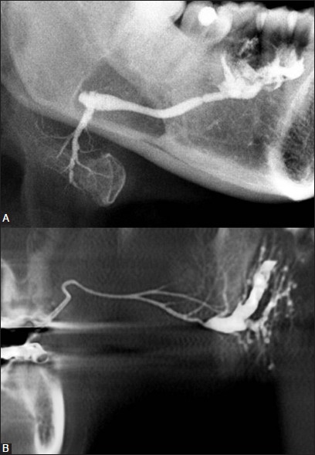
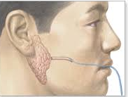
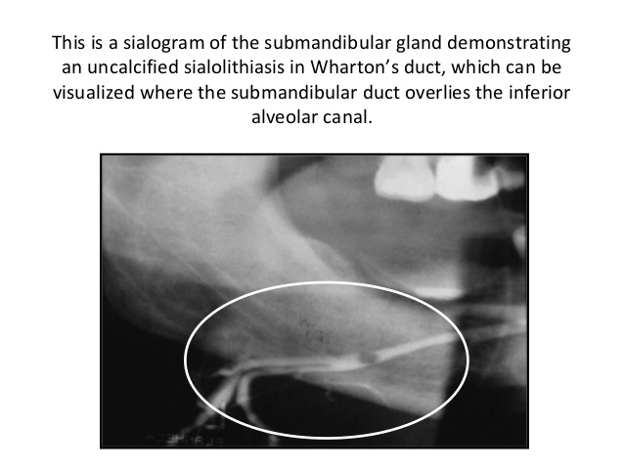

Slide 10
Computed tomography
Is useful In evaluating structures in and adjacent to salivary glands
It displays both hard and soft tissues as well as minute differences in soft tissue densities
Axial and coronal images are typically acquired
Glandular tissues are usually easily discernible from surrounding muscle and fat
Parotid glands are more r’opaque than surrounding fat but less opaque than adjacent muscles

Slide 11
Submandibular and sublingual glands are similar in density to adjacent muscles, they are identified on basis on shape and locality
CT is useful in assessing acute inflammatory processes and abscesses, as well as cysts, mucoceles and neoplasia
Calcifications, such as sialoliths are also well depicted with CT

Slide 12
Magnetic resonance imaging
Typically provides better images of soft tissue structures than does Ct
It also results in few problems with streak artifacts from metallic dental restorative materials
Noncontrast T1 and T2 weighted sequences are obtained followed by T1 weighted postcontrast, fat suppressed images
MRI demo as well as or better than CT the margins of salivary gland massses, internal structures and regional extension of lesions into adjacent tissues or spaces
It also discloses major vessels, appears as areas of no tissue signal without the use of contrast media
Use of iv contrast is helpful in distinguishing b/w cystic and solid masses in evaluation of perineural spread of malignant tumors

Slide 13
Scintigraphy
Provides a functional study of salivary glands, taking advantage of selective concentration of specific radio pharmaceuticals in glands
99m Tc-pertechnetate is injected iv, it is concentrated in and excreted by glandular structures, including the salivary, mammary and thyroid glands
Radionuclide appears in ducts of salivary glands within minutes and reaches maximal concentration within 30 to 45 mts
A sialogogue is then administered to evacuate secretory capacity
All major glands cane studied at once b

Slide 14
High diagnostic sensitivity
Lacks specificity and little morphology
Pathosis can be demo by an increased, decreased or absent radionuclide uptake
Lesions that concentrate r’nuclide are Warthin tumor and oncocytoma

Slide 15
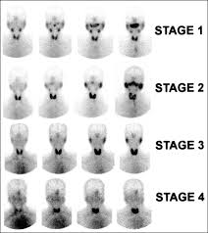

Slide 16
Ultrasonography
US has the advantages of being relatively inexpensive, widely available, painless, easy to perform and noninvasive
Primary application is in differentiation of solid masses from cystic masses
Useful in detecting liths and diagnosing advanced autoimmune lesions

Slide 17
Image interpretation of salivary disorders

Slide 18
Obstructive and inflammatory disorders
Sialolithiasis
Bacterial sialadenitis
Sialodochitis
Autoimmune sialadenitis

Slide 19
Sialolithiasis
Syn: calculus and salivary stone
Liths may appear r’opaque or r’lucent
They vary in shape from long cigar shapes to round and oval
Homogenous, r’opaque internal structure
Contrast agent flows around lith, filling the duct proximal to obstruction
Ductal system is frequently dilated proximal to obstruction
Contrast agent that flows around lith is more r’opaque and may obscure small liths
R’lucent liths appear as ductal filling defects

Slide 20
US is reliable in demonstrating liths
More than 90% of liths larger than 2mm appear as echo-dense spots with characteristic acoustic shadow
Phleboliths – radiolucent center
Calcified lymph nodes appear cauliflower shaped

Slide 22
Bacterial sialadenitis
Is contraindicated in acute infections coz of disrupted ductal ept where extravasation of contrast agent may occur and have foreign body reaction and severe pain
Ept flattening may lead to midly terminated terminal ducts and sac like acini
Sac like acinar areas are referred to as sialectasia
An even distribution throughout the gland is seen in recurrent parotitis and AI disordersabscess cavities appear on CT as walled off areas of lower attenuation within an enlarged gland

Slide 23
US may distinguish b/w diffuse inflammation (echo free, light image) and suppuration (less echo-free, darker image)
Us may detect liths more than 2mm in diameter
US is the study of choice for recurrent parotitis, splly in children
Contrast enhanced CT may demo glandular enlargement
MRI is appropriate tech in which sialography is contraindicated or technically not possible
On MRI, inflammed glands are usually enlarged and demo low tissue signal of T1 weighted and high On T2 than surrounding muscle

Slide 24
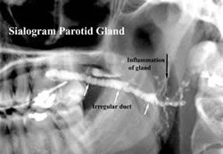

Slide 25
Sialodochitis
Syn: ductal sialadenitis
It is inflammation of the ductal system of salivary glands
It is seen in submandibular and parotid glands
It is seen as dialtation of ductal system on sialography
If interstitial fibrosis develops, it appears as sausage string of main duct and its major branches produced by alternate strictures and dilations

Slide 26
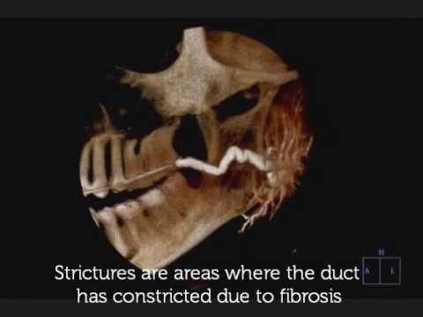

Slide 27
Autoimmune sialadenitis
Sialography is helpful in diagnosis and staging of AI disorders
Early stages – initiation of punctate, less than 1mm and globular, 1-2mm spherical collections of contrast agent evenly distributed throughout the glands
These collections are called as sialectases
At this stage, main duct appear to be normal but intraglandulr ducts may be narrowed or not even evident

Slide 28
Sialectasia typically remains after the administration of a sialogogue which indicates that contrast agent is pooled extraductally
As disease progresses, collections of contrast agent increase in size, greater than 2mm in diameter and irregular in shape
These pools of contrast agent are called cavitary sialectases
These larger sialectases are fewer in no and less uniformly distributed throughout the glands

Slide 29
Progressive larger cavities of contrast agent and dilation of main ductal system may also be present
At endpoint, complete destruction of gland occurs
Cavitation and glandular fibrosis are result of recurrent inflammation

Slide 30
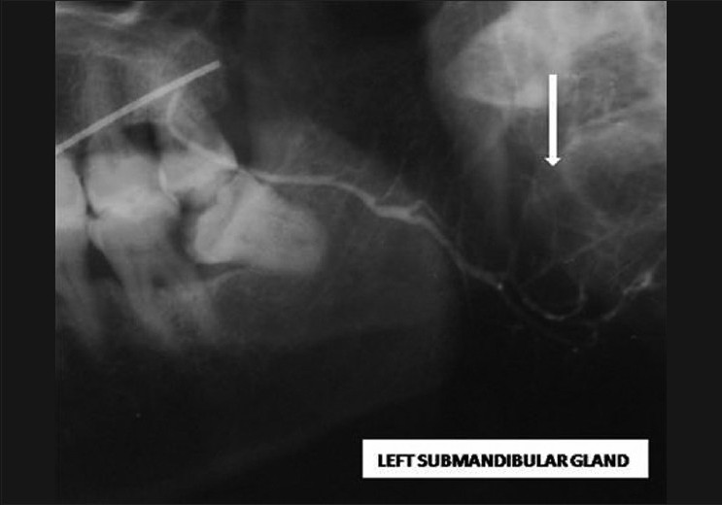
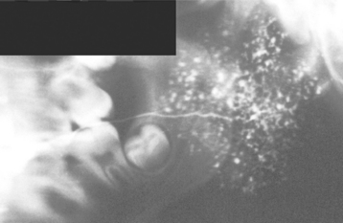
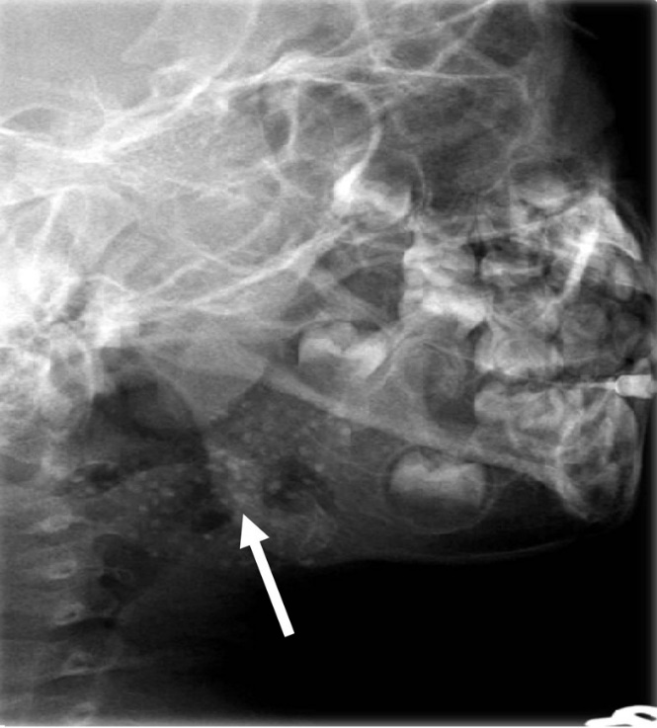

Slide 31
Noninflammatory disorders
Sialadenosis
Cystic lesions
Benign tumors

Slide 32
Sialadenosis
Syn: sialosis
It is a nonneoplastic, noninflammatory enlargement of primarily parotid glands
Usually related to metabolic and secretory disorders of parenchyma associated with diseasesd of nearly all endocrine glands
Protein deficiencies, malnutrition in alcoholics, vitamin deficiencies and neurologic disorders
c/f: affected glands are typically enlarged

Slide 33
Radiographic features
Sialography may demo enlargement of the affected glands or a normal appearance
In enlarged glands, ducts will be splayed

Slide 34
Cystic lesions
Cysts are rare
Occur unilalerally
May be congenital (branchial), lymphepithelial, dermoid or acquired
Cystic lesions may be intraglandular or extraglandular
Benign lymphoept cysts are sequalae of cystic degeneration of salivary inclusions within lymph nodes
Multiple parotid cysts associated with HIV are reported

Slide 35
Radiographic features
On sialography, cystic masses are indirectly visualized by displacement of the ducts arching around them
Cystic lesions aooear as well circumscribed, nonenhancing (with contrast), low density areas on CT
Appear as well circumscribed, high signal areas on T2 MRI
US, cysts are sharply marginated and echo-free (as dark area)

Slide 36
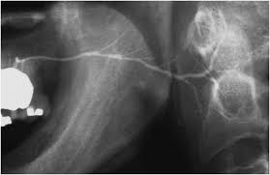

Slide 37
Benign tumors
Typically have well defined margins and are most apparent on CT and MRI
Coz of higher density of submandibular gland, which can equal that of neoplasm and obscure the tumor
Iv contrast enhancement is required during CT examination
This causes the tumor to appear more r’opaque coz the vascularity of tumor is greater than adjacent salivary gland tissue

Slide 38
US benign masses are typically sharply defined, less echogenic than parenchyma, and of essentially homogenous echo strength and density
Benign tumors appear as low intensity (dark) or high intensity (light) signals on MRI
Relative intensity of signal may indicate presence of lipid, vascular or fibrous tissues
Space occupying lesions – ducts are compressed or smoothly displaced around the lesion (ball in hand appearance)

Slide 39
Benign mixed tumor
Syn: pleomorphic adenoma
CT – sharply circumscribed, infrequently lobulated and essentially round homogenous lesion with higher density than adjacent gland
Calcifications within tumor are well depicted on CT
Various tissue signals on MRI:
Relatively low / dark in T1 weighted images
Intermediate on proton density weighted images
Homogenous high density / bright on T2 weighted images

Slide 40
Foci of low signal intensity / dark areas usually represent areas of fibrosis or dystrophic calcifications
If a calcification is present (signal void), diagnosis favors a benign mixed tumor
Tumor appears cold spot on scintigraphy
Solid tumors larger than 5mm are usually well visualized

Slide 41
Warthin tumor
Syn: papillary cystadenoma lymphomatosums
CT and MRI are preferred techniques
CT – this may be either a soft tissue or cystic density
MRI – it is heterogenous and demo hemorrhagic foci
Intensely hot on scintigraphy scans
US – appears as a solid mass, hypoechoic unless it appears to be cystic in nature

Slide 42
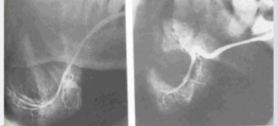

Slide 43
Hemangioma
Syn: vascular nevus
Is a benign neoplasm of proliferating endothelial cells (congenital hemangioma) and vascular malformations, including lesions resulting from abnormal vessel morpogenesis
c/f: frequently occuring nonepithelial salivary neoplasm
Most common tumor during infancy and childhood
Av age opf diagnosis is 10 yrs
Are frequently unilateral and asymptomatic
2:1:: female to male ratio

Slide 44
Radiographic features
Phleboliths are common in this tumor
Appears as calculi with a r’lucent centre and best identified on plain films and CT
Displaced ducts curving about the mass may also be apparent on sialography
CT presentation of hemangioma is a soft tissue mass that is well distinguished from surrounding tissue, splly when IV contrast is used
MRI – similar signal of tumor and adjacent muscle on T1 weighted images and a very high signal on T2

Slide 45
US usually demonstrated well defined margins in hemangioma, illdefined margins may also be noted
Strongly hypoechoic hemangiomas may have a complex appearance
Coz of multiple interferences in lesion
Phleboliths appear as multiple hyperechoic areas within the body of the gland itself

Slide 46
Malignant tumors
Is variable and is related to grade, aggressiveness, location and type of tumor
Illdefined margins, invasion of adjacent soft tissues and destruction of adjacent osseous structures are typical indicators of malignancy

Slide 47
Mucoepidermoid carcinoma
Low grade tumors are typically not apparent on plain film r/g unless destructive changes to adjacent osseous structures have occurred
Low grade tumors present as lobulated or irregularly shaped circumscribed appearance on CT or MRI
Cystic areas may present and rarely calcifications may be seen
High grade carcinomas relies on irregular margins and ill defined form when the mass is examined with CT or MRI

Slide 48
CT with contrast -- sharply defined homogenous mass that is considerably more opaque than on CT without contrast
CT is reliable tech for detection of bony invasion
Low signal intensity on T1 and T2 weighted MRI
T1 weighted images have low intensity / are darker than surrounding structures and are relatively homogenous
T2 weighted images are more heterogenous and intensed / brighter than T1 and are just darker than surrounding structures

Slide 49
Malignant mixed tumor
Is same as high grade mucoepidermoid carcinoma
MRI is usually more superior to CT for tumor definition

Slide 50
Other malignant and metastatic tumors
Presentation is nonspecific and similar to that of high grade mucoepidermoid carcinoma
US may demonstrate echo-free cystic areass in adenoid cystic carcinomas

