Slide 1
Pigmented lesions of the oral mucosa

Slide 2
Brown melanotic lesions
Ephelis and oral melanotic macule
Nevocellular nevus and blue nevus
Malignant melanoma
Drur-induced melanosis
Physiologic pigmentation
Café au lait pigmentation
Smokers melanosis
Pigmented lichen planus
Endocrinopathic pigmentation
HIV oral melanosis
Peutz Jeghers syndrome

Slide 3
Focal melanocytic pigmentation

Slide 4
Freckle/Ephelis
Cutaneous freckle or ephelis represents an increase in melanin pigment synthesis
On skin, this can be attritubed to actinic exposure
Lesion is macular, asymptomatic small 1-3mm well circumscribed tan or brown colored
Lower lip is the favored site ephelis are more abundant in no and darker during childhood and adolesence
Freckles are darker during prolonged sun exposure and less intense in winter

Slide 5
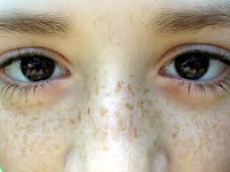
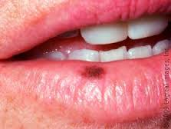

Slide 6
Oral/labial melanotic macule
It is a unique, benign, pigmented lesion
Are most common oral lesions
Trauma is postulated to play a role
Frequently in females, usually lower lip and gingiva
Small, less than a cm, well circumscired, oval or irregular in outline and uniformly pigmented
d/d: malignant melanoma, amalgam tattoo, focal ecchymosis

Slide 7
Oral melanoacanthoma
Is usual, benign, melanocytic lesion
Most pts report a rapid onset
Acute trauma or chr irritation preceds the lesion
Presents as a rapidly enlarging, ill defined, darkly pigmented macular or plaque like lesion
Any age, 3/4th decade
Asymptomatic, any mucosal surface may be involved
Buccal mucosa is most common
Small and localized to large diffuse areas
Borders are irregular and pigmentation may not be uniform

Slide 8
Melanocytic nevus
Are a common occurance
Lesions are usually asymptomatic and present as small, less than a cm, solitary, brown or blue, well circumscirbed nodule or macule
Once lesion reaches definite size, growth tends to cease and remain static indefinitely
Develop at any age, most at age of 30
Hard palate is common site, followed by buccal and labial mucosae and gingiva

Slide 9
Nevi are due to benign proliferations of melanocytes
In evolutionary stages, nevus cells maintain their localization to basal layer, residing at junction of ept and basement membrane and underlying ct
These junctional nevi are usually small, les than 5mm, macular or nonpalpable and tan to brown
Over time, clustered melanocytes proliferate down into ct, as nests and some are at mucosal-submucosal jn – compound nevi and are dome shaped
As lesion matures, nevus cells completely lose association with ept layer and get confined to submucosal tissue – intramucosal nevus

Slide 10
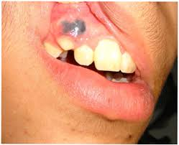
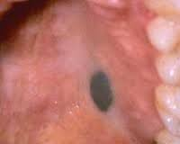

Slide 11
Blue nevi - melanocytes may reside deep in ct and overlying blood vessels often dampen the brown coloration of melanin, yeilding a blue tint
It behaves aggressively
Greater rate of recurrence
Diagnosis – biopsy
Treatment - conservative surgical excision

Slide 12
Malignant melanoma
Is least common and most deadly
Etiology: multiple episodes of acute sun exposure at a younger age
Immunosuppression
Presence of multile cutaneous nevi
Family h/o melanoma
Male predilection
May develop de novo or less commonly from existing melanocytic nevus
ABCDE criteria: asymmetry, irregular borders, color variation, diameter more than 6mm, evolution of surface elevation

Slide 13
Malignant melanoma
On face, malar region is a common site
Facial cutaneous melanomas may appear macular or nodular and color varies from brown to black to blue with zones of depigmentation
They show jagged irregular margins
Lentigo maligna melanoma or Hutchinson’s freckle are facial skin lesions that exhibit atypical melanocytic hyperplasia or melanoma in situ
Tumor cells spread laterally – radial growth phase
Tumor cells that spread vertically – vertical growth phase

Slide 14
4 main clinicopathologic subtypes
Superficial spreeading melanoma
Lentigo maligna melanoma
Acral lentiginous melanoma
Nodular melanoma
In first 3 types, initial growth is characterised by radial extension of tumor cells

Slide 15
Melanoma occur o anterior labial gingiva and anterior aspect of hard palate
In early stages, they are macular brown and black plaques with irregular outline
They may be focal and diffuse and mosaic
Eventually they become more diffuse, nodular and tumefactive with foci of hypo and hyperpigmentation
Radial growth pattern melanoma are macular
Vertical growth phase melanoma show tumefactions
Treatment: excision with wide margins

Slide 16
Microscopic findings
Breslow tumor thickness
Clark’s level of invasion ( tumor involvement in the dermis)
Surface ulceration
Vascular or lymphatic invasion
Neurotropism
Mitotic index
Absence of tumor infiltrating lymphocytes
Additionally, tumor site, above 60 yrs age, male pts, regional or distant metastasis, are indicative of poor prognosis

Slide 17
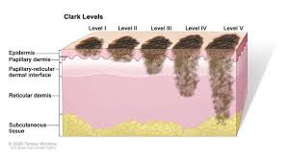
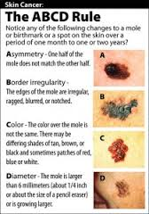

Slide 18
Oral melanoma
May devlop at any age
Most present over the age of 50
Any mucosal site may be involved, palate being the most common
Maxillary gingiva is second most common
Presents as macular, plaque-like or mass forming, well circumscribed or irregualr and exhibit focal or diffuse areas of brown, blue or black pigmentation
1/3rd cases show amelanosis
Other features: ulceration, pain, tooth mobility or spontaneous exfoliation, root resorption, bone loss, paresthesia/anesthesia

Slide 19
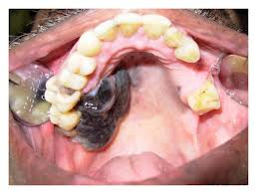
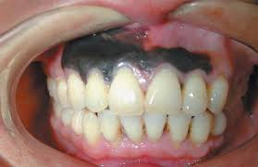
d/d: melanocytic nevus, oral melanotic macule, amalgam tattoo, vascular lesions, soft tissue neoplasms
Very poor prognosis

Slide 20
Multifocal/diffuse pigmentation

Slide 21
Physiologic pigmentation
Black people and asians show diffuse melanosis of facial gingiva
Lingual gingiva and tongue may exhibit multiple, diffuse and reticulated brown macules
d/d: idiopathic, drug induced, soking induced melanosis, associated with endocrinopathy or other systemic disease
Treatment: gingivectomy and laser therapy

Slide 22
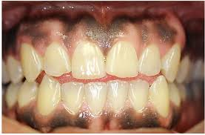

Slide 23
Drug induced melanosis
A variety of drugs can induce oral pigmentation
They are large yet localized to hard palate or can be multifocal
Lesions are falt and no evidence of nodularity or swelling
Quinolone, hydroxyquinolone and amodiaquine antimalarials, cyclophosphamide, busulfan, phenothiazines
Minocycline used for treatment of acne
Oral contraceptives and pregnancy are occasionally associated with hyperpigmentation of facial skin, particularly periorbital and perioral regions – melasma or chloasma

Slide 24
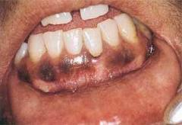
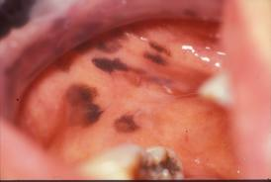
Discoloration tends to fade within a few months after the drug is discontinued
Pigmentation associated with hormone therapy may tend to persist for longer periods

Slide 25
Smokers melanosis
diffuse melanosis of anterior facial maxillary and mandibular gingivae, buccal mucosa, lateral tongue, palate and FOM
Melanin synthesis is stimulated by smoke products
Pigmented areas are brown, flat and irregular or geographic or map like
Alcohol is associated with oral pigmentation
Posterior regions of the mouth, including soft palate is frequently pigmented
Diffuse or patchy melanosis is associated with OSMF

Slide 26
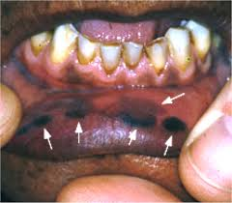

Slide 27
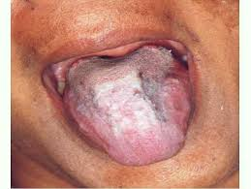
Postinflammatory hyperpigmntation
Present as focal or diffuse pigmentation of area subject to previous injury or inflammation
Acne prone face is relatively common site
Upon resolution of Lichenoid lesion, pigmentation may or may not disappear
Oral pigmentation is described in pts with LP

Slide 28
Melasma
Oral contraceptives and pregnancy are occasionally associated with hyperpigmentation of facial skin, particularly periorbital and perioral regions – melasma or chloasma
Is relatively common, acquired symmetric melanosis occuring on sun exposed areas of skin
Forehead, cheeks, upper lips and chin are commonly affected
Female predilection
Most cases progesterone and estrogen combination induces pigmentation

Slide 29
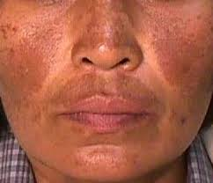
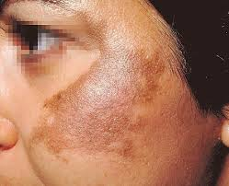

Slide 30
Melanosis associated with systemic or gentic disease

Slide 31
Hypoadrenocorticism
Syn: adrenal insufficiency, addison’s disease
Life threatening disease
Etiology: autoimmune disease, infectious agents, neoplasia, trauma, certain medications, iatrogenic
Leads to adrenal destruction or an impairment of endogenous steroid production causing decrease in corticosteroid level

Slide 32
As steroid level decrease, there is a compensatory activation of ACTH secretion from anterior pituitary gland
ACTH then acts on adrenal cortex to stimulate steroid production and ACTH secretion stops
If low steroid level persists, there is loss of feed back inhibition resulting in persistent secretion of ACTH into the serum
Concurrently α MSH also increase in serum

Slide 33
Clinical features
Weakness, poorly controlled fatigue and depression
first sign of disease may be mucoctaneous hyperpigmentation
Gen bronzing of the skin and diffuse but patchy melanosis of oral mucosa are hall marks
Diffuse hyperpigmentation is more commonly associated with chronic rather than acute onset
d/d: physiologic, drug induced
Lab: elevation of serum cortisol and electrolyte levels.
Hyponatremia and hyperkalemia
Treatment: exogenous steroid replacement therapy

Slide 34
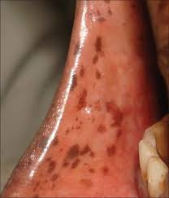

Slide 35
Cushing’s syndrome/ cushing’s disease
Develops as a consequence of prolonged exposure to relatively high concentrations of endogenous or exogenous corticosteroids
Etiology: iatrogenic, associated with poorly controlled or unmonitored use of topical or systemic steroids, activating pituitary tumor (Cushing’s disease), primary, activating adrenal pathology (hypoadrenocorticism), ectopic secretion of corticosteroids, ACTH, CRH

Slide 36
Clinical features
More prevalent in female pts
Weight gain and characteristic moon facies
Diffuse mucocutaneous pigmentation splly In pts with increased ACTH secretion
Diagnosis: serum steroid and ACTH determinations
Treatment: surgical, radiation or medicinal therapy

Slide 37
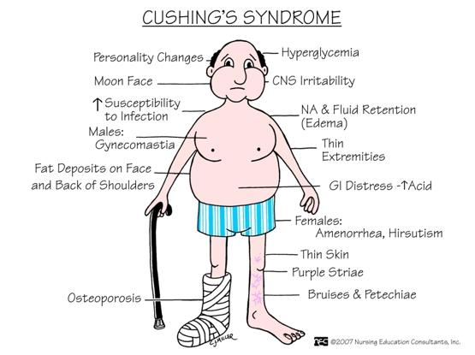

Slide 38
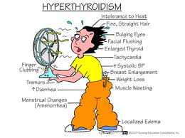
Hyperthyroidism
Melanosis is a common consequence
Pigmentation tends to resolve foll treatment of thyroid abnormality

Slide 39
Primary biliary cirrhosis
Diffuse mucocutaneous hyperpigmentation may be the earliest manifestation
In middle aged women
It is due to damage to small intrahepatic bile ducts
Jaundice is usually an end stage complication
It is caused by excessive levels of serm bilirubin causing yellow discolaration of skin, eyes and mm
d/d: carotenemia and lycopenemia

Slide 40
Vitamin B12 / cobalamin deficiency
May be associated with a variety of systemic manifestations, megaloblastic anemia, various neurologic signs and symptoms and various cutaneous and oral manifestation
Gen burning sensation and erythema and atrophy of mucosal tissue
Diffuse mucocutaneous hyperpigmentation is rare
Pigmentation resolves following restoration of vit B12 levels

Slide 41
Peutz-Jeghers syndrome
Is an autosomal dominant disease
Intestinal polyposis, cancer susceptibility and multiple, small, pigmented macules of lips, perioral skin, hands and feet
Macules resemble ephelis, less than 0.5 cm in diameter
These may appear on anterior tongue and buccal and labial mucosae
Lip and perioral region involvement is pathognomonic

Slide 42
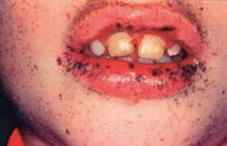

Slide 43
Café-au-lait pigmentation
Presents as tan or brown colord, irregularly shaped macules of variable size
In neurofibromatosis, nodular and diffuse pendulous neurofibromas occur on skin and rarely in oral cavity, Crowe’s sign ( axillary or inguinal freckling), Lisch nodules (pigmented lesions of the iris)
Pigmentation varies from small ephelis like macule to broad diffuse lesions, borders are typically smooth
It represents basilar melanosis without melanocytic proliferation

Slide 44
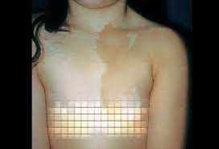
McCune –Albright syndrome: polyostotic FD, various endocrinopathies, soft tissue myxomas
Pigmentation appears distinct and borders are ill defined

Slide 45
Noonan’s syndrome: mucocutaneous macules and multiple melanocytic nevi
LEOPARD syndrome: multiple lentigines, electrocardiographic conduction abnormalities, ocular hypertelorism, pulmonary stenosis, abnormal gentilia, growth retardation and sensineural deafness
Associated with numerous, small, freckle like macules involving facial skin

Slide 46
HIV/AIDS associated melanosis
Pigmentation is related to various medication, antifungal and antiretroviral drugs or as a result of adrenocortical destructipon by virulent infectious organisms
Presents with a h/o progressive hyperpigmentation of skin, nails and mm
Buccal mucosa is frequently associated but gingiva, palate and tongue

Slide 47
Blue/purple vascular lesions
Hemangioma
Varix
Angiosarcoma
Kaposi’s sarcoma
Hereditary hemorrhagic telangiectasia

Slide 48
Endogenous pigmentation:
Hemoglobin: imparts red or blue color and represents lesions associated with vascular lesions
Hemosiderin: appears brown and is due to extravasation of of blood
Hemochromatosis: gen hemosiderin tissue deposition, occurs as a result of pathologic states
Exogenous pigmentation: pigments are traumaticaly deposited in submucosa and are ppt’ed in areas of chr inflammation

Slide 49
Hemangioma
Vascular lesions presenting as proliferations of vascular channels are tumor like hamartomas when they arise in childhood
In adults, benign vascular proliferations are called varicosities
Hemangiomas of childhood are found on skin, in scalp and within ct of mm
Color: depends on depth in submucosa, reddish blue when close to overlying ept, deep blue , if deep in ct
Intramuscular variety may not show any surface discoloration
Shape: most are raised and nodular, some are flat, macular and diffuse, splly on facial skin

Slide 50
Port wine stain on face can continue in macular fashion/ be tumefactive when involves oral mucosa
Tongue: they are multinodular and bluish red
Multinodularity is racemose and diffuse
Tongue angiomas extend deeply b/w intrinsic muscles of tongue
Lip angiomas: lesions are usually localised, blue and raised
Concurrent h/o seizures if present – encephalotrigeminal angiomatosis / Sturge-Weber syndrome
Skull r/g reveals vessel wall calcifications giving a bilamellar r’opaque tracks – tram line calcifications

Slide 51
Hemodynamics
It is perturbed in angiomas, stasis with thrombosis is frequently encountered
Patent vaascular lesions will blanch under pressure
If intraluminal clots form, they become palpable and lesion usually don’t blanch
Thrombi in angiomaas may eventually clacify and feel hard on plapation and may be seen r/g’y

Slide 52
Microscopically
A hemangioma may comprise numerous large dilated vascular channels lined by endothelial cells without a muscular coat – cavernous hemangioma
Cellular or capillary hemangioma show significant endothelial proliferation and vascular channels are very small
Treatment: many involute spontaneously during teenage period
Conventional surgery, laser surgery or cryosurgery
Larger lesions extending into muscles can be treated by sclerosing agents such as 1% sodium tetradecyl sulphate by intralesional injections
Cutaneous port wine stains treated by: subcutaneous tattoing or argon laser

Slide 53
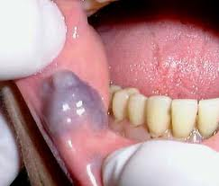

Slide 54
Varix
Pathologic dilatations of veins or venules are varices or varicosities
Site: ventral tongue
They become progressively prominent with age
They appear as tortous serpentine, blue, red and purple elevations that course over the ventrolateral surface of the tongue with extension anteriorly
They represent a degenerative change in the adventitia of venous wall
They are painless and not subject to rupture and hemorrhage

Slide 55
A focal dilatation of a vein or group of venules is known as varix
Occur in elderly and are located on lower lip
Appear as focal raised pigmentation
They may be red, blue or purple and surface is lobulated or nodular
Some can be blanched others show thrombi
Treatment: electrosurgery and cryosurgery
Intralesional 1% sodium tetradecyl sulphate inj is effective

Slide 56
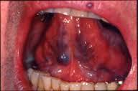

Slide 57
Angiosarcoma
Oral cavity is an extremely rare site
Appears as red, blue or purple
They are rapidly proliferative and therefore present as nodular tumors
Can arise from blood or lymph vessel endothelial cells or from pericytic cells of vasculature
Poor prognosis
Treatment: radical excision

Slide 58
Kaposi’s sarcoma
Oral tumors are red, blue and purple
Posterior Hard palate is the favored site
They begin as flat red macules of variable size and irregular configuration
They appear as focal lesion with numerous isolated ans coalescing plaques
Eventually these lesions increase in size to become nodular growths and involve entire palate, protruding below the plane of occlusion
Facial gingiva is second most favored site

Slide 59
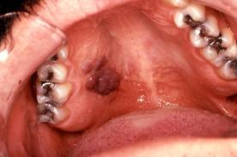

Slide 60
Treatment
Macular stae lesions are painless and no treatment is required
Larger lesions: electrocautery is recommended
Intralesional injection of 1% sodium tetradecyl sulphate will result in necrosis of tumefactions
Intralesional 1% vinblastine sulphate is also beneficial, multiple biweekly injections

Slide 61
Hereditary hemorrhagic telangiectasia
Characterized by multiple, round or oval purple papules measuring less than 0.5 cm In diameter is a genetically transmitted disease
Lesion represents multiple microaneurysms, owing to a weakening defect in adventitial coat of venules
There may be 100 such purple papules on vermillion and mucosal surfaces of lips and tongue and buccal mucosa
Facial skin and neck are also involved
Nasal mucosa also may reveal such lesions and a past h/o epistaxis may be seen
No treatment, for cosmetic reasons, electrocautery can be done

Slide 62
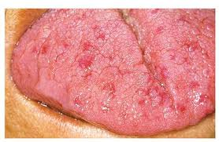
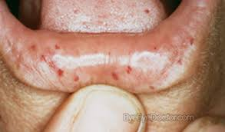

Slide 63
Ecchymosis
Traumatic ecchymosis is common on lips and face
Immediately following trauma, erythrocytes extravasate into submucosa and appear as bright red macule or as swelling if hematoma forms
Lesion will assume a brown color after hb is degraded to hemosiderin
Lab: BT, PT,PTT, INR

Slide 64
Purpura/petechiae
Capillary hemorrhages will appear red initially
Petechiae are pin point or slightly larger
Purpura are multiple, small 2-4mm collections of extravasated blood
Etiology: trauma, viral or systemic disease
If traumatic, remove the causative factor and in 2 weeks lesions will resolve

Slide 65
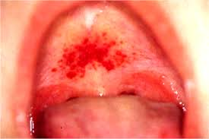
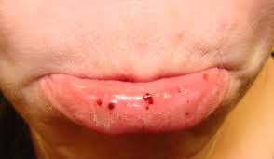

Slide 66
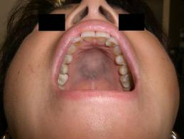
Hemochromatosis
Is a chronic, progressive disease that is characterized by excessive iron deposition in liver and other organs and tissues
oral pigmentation is often diffuse and brown to gray in appearance
Palate and gingiva are most commonly affected

Slide 67
Exogenous pigmentation

Slide 68
Amalgam tattoo
Syn: argyrosis
Single most common source of solitary or focal pigmentation in oral mucosa
Iatrogenic in origin
Lesions are typically small, symptomatic, macular and bluish gray or even black
Gingiva, alveolar mucosa, buccal mucosa and FOM represent the most common sites
Lesions are often found in the vicinity of the teeth with large restorations
They often show a fine brown granular stippling of reticulum fibers, with particular affinity for vessel walls and nerve fibers

Slide 69
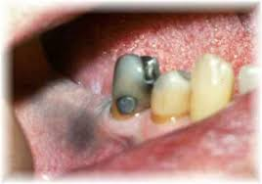

Slide 70
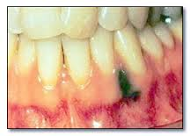
Graphite tattoo
Are an unusual source of focal exogenous pigmentation
Commonly seen on palate
Appear as solitary gray or black macule

Slide 71
Ornamental tattoo
Mucosal tattoos in the form of lettering or intricate artwork
Amateur tattoo inks consists of simple carbon particles from a variety of sources, including burnt wood, plastic or paper and from variety of inks such as india ink, pen ink and plant derived matter
Brushing the teeth and gums with root of euclea natalensis in belief of promoting oral health and mouth changes to orange color, coloration is transient and reversible

Slide 72
Medicinal metal induced pigmentation
Gold and colloidal silver have been associated with diffuse cutaneous pigmentation
Silver may cause a gen blue gray discoloration (argyria)
Gold induced pigment may appear blue gray or purple – chrysiasis
Zinc and medicinal silver associated pigment is gray-black in appearance
Both appear as brown or black particulate matter dispersed throughout the submucosa
Gen black discoloration of tongue is attributed to chewing of bismuth subsalicylate tablets, commonly used antacid, actual pigment that is bismuth sulphide gets ppted

Slide 73
Heavy metal pigmentation
Diffuse oral pigmentation may be associated with ingestion of heavy metals
Lead, Hg, Bi, and arsenic have been deposited in oral tissue if ingested over an extended period of time
These metal salts tend to extravasate from vessels in areas of chronic inflammation
This is found along the free gingival margin, where it outlines the gingival cuff
This line has a gray or black appearance
Additional symptoms: behavioral changes, neurologic disorders, intestinal pain and sialorrhea

Slide 74
Drug induced pigmentation
Minocycline, for treatment of acne, causes pigmentsation of develping teeth
O chronic use, minocycline metabolites get incorporated into normal bone
Bone may appear green, blue or even black
Causes pigmentation of skin and nails
Pigmentation may appear patchy and diffuse

Slide 75
Depigmentation
Vitiligo: is a relatively common , acquired autoimmune disease that is associated with hypomelanosis
Etiology: multifactorial, genetic and environmental
Presents from focal areas to entire segment on one side of body
Vitiligo universalis: skin and hair of body may lose pigmentation
Presents as well circumscribed, round, oval or elongated, pale or white colored macules that may coalesce into larger areas of diffuse depigmentation
Before 3rd decade of life
Rarely seen intraorally, hypomelanosis of inner and outer surface of lips and perioral skin may be seen

Slide 76
Treatment
Topical corticosteroids
Systemic photochemotherapies
Autologous epthelial grafts

