Slide 1
Paranasal sinuses

Slide 2
Introduction
These are air filled cavities of craniofacial complexes
Comprises of frontal, maxillary, and sphenoid sinuses and ethmoid air cells
Functions of sinuses: air conditioning, air reserboir, ventilation, aids in olfaction,reduces weight of cranium, adds resonance to voice, protection, insulation of cerebrum and orbits, participation in the formation of cranium

Slide 3
Diseases associated with the PNS
Intrinsic diseases and those that originate outside the sinus
Clinical features: feeling of pressure, altered voice characeristics, pain on movement of head, percussion sensitivity of teeth or cheek region, regional paresthesia or anesthesia, and swelling of facial structures adjacent to maxilla

Slide 4
Applied diagnostic imaging
IOPA: limited view of floor of max sinus
Maxillary lateral occlusal projection
OPG, depicts both max sinus
Waters view, lateral submentovertex view, and Caldwell skull views
Waters view: visualize max sinus
SMV: Lateral and posterior borders of max sinus and ethmoid air cells
Cald well view, frontal and ethmoid air cells
Lateral skull view, all 4 sinuses can be viewed

Slide 5
CT and MRI: delineate extent of disease
Coronal CT gives super visualization of ostiomeatal cx and nasal cavities
MRI: superior visualization of soft tissues and for differentiation of retained fluid secretions from soft tissue masses in sinuses

Slide 6
Intrinsic diseases of PNS
Inflammatory disease: mucositis
Sinusitis
Empyema
Retention pseudocysts
Polyps
Mucocele
Neoplasms

Slide 7
Extrinsic diseases
Inflammatory diseases: periostitis
Benign odontogenic cysts and tumors
Fibrous dysplasia
Traumatic injuries to PNS

Slide 8
Intrinsic diseases of the PNS

Slide 9
MUCOSITIS
Syn: thickened mm
Mucosal lining of PNS is composed of respiratory ept and is normally about 1mm thick
Etiology: infection or allergy
Thickness of ept increases to 10-15 times
Clinical features: vary considerable in short period
r/g features: as a noncorticated band, more r’opaque than air filled sinus, paralleling the bony wall of the sinus

Slide 10
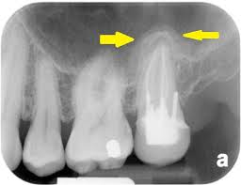

Slide 11
Sinusitis
Condition involving gen inflammation of PNS mucosa
Etiology: allergy, bacterial or viral
Sinusitis may cause blockage of drainage from ostimeatal complex
Inflammatory changes may lead to ciliary dysfunction and retention of sinus secretions
Acute sinusitis: present for less than 2 weeks
Subacute sinusitis: from 2 weeks to 3 months
Chronic sinusitis: present for more than 3 months
Pansinusitis: sinusitis affecting all the PNS

Slide 12
Clinical features
Acute condition is often a complication of common cold and is accompanied by clear nasal discharge or pharyngeal drainage
After few days, stuffiness and nasal discharge increase, pt c/o pain and tenderness to pressure or swelling over involved sinus
Pain may also be referred to premolar and molar tooth on affected side and may be POP +
Bacterial sinusitis: green or greenish yellow nasal discharge may be appreciated
Fever, chills, malaise and an elevated leukocyte count

Slide 13
Chronic sinusitis
Is a sequela of acute infection that fails to recove by 3 months
No external signs appear
Acute exacerbations, pain and discomfort
Chr sinusitis is associated with anatomic derangements that inhibit the outflow of mucus, including DNS, presence of concha bullosa
Chr sinusitis is also associated with allergic rhinitis, asthama, cystic fibrosis and dental infections

Slide 14
Radiographic features
Thickening of sinus mucosa and accumulation of secretions reduce the air content of sinus and cause it to become more radiopaque
Waters or CT may show presence of thickened mucosal tissue causing blockage of ostium
The image of thickened sinus mucosa on r/g may be uniform or polypoid
In allergy, it tends to be more lobulated
In infection, mucosal outline tends to be smoother, with contour following sinus wall

Slide 15
An air-fluid level resulting from accumulation of secretions may also be present
R’opacities of transudate, exudate, blood and altered mucosa are typically same
Fluid appears r’opaque and occupies inferior aspect of sinus
Border is straight and horizontal with a meniscus
Take a second r/g by tilting pts head
CR must be horizontal at the level of air fluid interface to demonstrate it

Slide 16
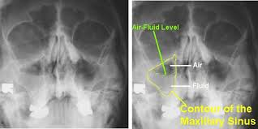

Slide 17
Chr sinusitis may result in persistent r’opacification of sinus with sclerosis and /or thickening of sinus wall
Resorption of bony border is unusual
On resolution: a small clear area appears in the interior of sinus
Thickened mm gradually shrinks and begins to follow the outline of bony wall
In chronic cases, inflammation may stimulate the sinus periosteum to produce bone, resulting in thick sclerotic borders of maxillary antrum

Slide 18
Management
Goals are to control infection, promote drainage and releive pain
Acute: decongestants and antibiotics in bacterial infection
Chronic: is due to obstruction and goal is ventilation and drainage
Endoscopic surgery to enlarge obstructed ostia or by establishing an alternate path of drainage

Slide 19
Empyema
Is a cavity filled with pus
May result as a possible sequela of sinus ostium blocked by a thickened, inflammed mm or some other pathologic process, splly in max sinus
Is a variant of mucocele or pyocele

Slide 20
Retention pseudocysts
Syn: antral pseudocyst, benign mucous cyst, mucous retention cyst, mesothelial cyst, pseudocyst, interstitial cyst, lymphangiectatic cyst, false cyst, retention cyst of max sinus, benign cyst of antrum, benign mucosal cyst of sinus, serous non secretory retention pseudocyst and mucosal antral cyst
Etiology: blockage of the secretory ducts of seromucous glands in sinus mucosa may result in submucosal accumulation of secretions, leading to swelling of tissue
Serous nonsecretory retention cyst arises as a result of cystic degeneration with an inflammed, thickened sinus lining

Slide 21
Clinical features
Occur more often in november and april due to change in climate or a heating or air conditioning in buildings
More common in males
c/f: rarely causes any signs and symptoms
Incidental finding on radiograph
When pseudocysts completely fill In the max sinus, it may extrude out through ostium and cause nasal obstruction and post nasal discharge

Slide 22
Radiographic features
Partial images be may seen on IOPA
Periphery and shape: noncorticated, smooth, dome shaped r’opaque masses
Base of lesion may be narrow or more commonly broad
Internal structure: homogenous and more r’opaque than surrounding air in sinus
R’opacity is due to accumulation of fluid
Effects on surrounding structures: no effects seen

Slide 23
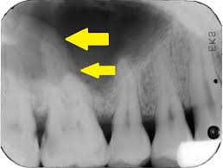

Slide 24
D/d: odontogenic cysts
Antral polyps
Rounded neoplastic mass
Treatment: usually require no treatment
Resolve spontaneously without any residual effect on antral mucosa

Slide 25
Polyps
Thickened mm of a chronically inflammed sinus frequently forms into irregular folds called polyps
May develop in an isolated area or throughout sinus mucosa
C/f: may cause displacement or destruction of bone
In ethmoid air cells, may cause destruction of medial wall of orbit and unilateral proptosis may develop

Slide 26
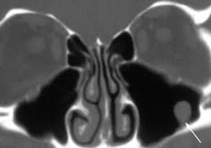
r/g features
r/g image of bone displacement or destruction associated with polyps may mimic a benign or malignant process

Slide 27
Antroliths
Occur within the maxilary sinuses and are the result of deposition of mineral salts such as calcium phosphate, calcium carbonate and magnesium around a nidus, which may be introduced in the sinus or could be intrinsic (masses of stagnant mucous in sites of previous inflammation)
c/f: smaller liths are asymptomatic
If continue to grow, pt may have associated sinusitis, blood stained nasal discharge, nasal obstruction or facial pain

Slide 28
Radiographic features
Position: above floor of max antrum in periapical, occlusal or panoramic r/g
Periphery or shape: well defined and may have a smooth or irregular shape
Internal structure: perceptible r’opacity to extremely r’opaque
Internal density may be homogenous or heterogenous or altering layers in the form of laminations

Slide 29
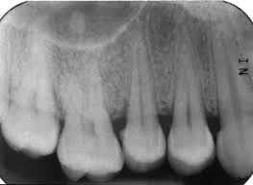

Slide 30
d/d and treament
d/d: root fragments
Rhinoliths
Management: remove symptomatic liths

Slide 31
Mucocele
Syn: pyocele and mucopyocele
Is an expanding, destructive lesion that results from a blocked sinus ostium
Blockage may result from intranasal or intraantral inflammation, polyp or neoplasm
Entire sinus becomes pathologic cavity or cyst like lesion
As mucus is accumulated and sinus cavity has filled, intraantral pressure results in thinning, displacement and rarely destruction of sinus walls
If mucocele becomes infected, it is called pyocele or mucopyocele

Slide 32
Clinical features
Mucocele in max sinus may exert pressure on superior alveolar nerves and thus cause radiating pain
Pt 1st c/o sensation of fullness in cheek and area may swell
Swelling 1st become apparent over anteroinferior aspect of antrum, area where wall is thin or destroyed
If lesion expands inferiorly, it may cause loosening of posterior teeth in the area
If medial wall is expanded, lateral wall of nasal cavity will deform and nasal airway may be obstructed
Expansion into orbit, causes diplopia or proptosis

Slide 33
Radiographic features
Location: 90% occur in ethmoidal and frontal sinuses and rare in sphenoid and maxillary sinuses
Periphery and shape: normal shape of sinus is changed into a more circular shape as mucocele enlarges
Internal structure: uniformly radiopaque
Effects on surrounding structures: septa and bony walls may be thinned or destroyed
Teeth will be displaced or roots resorbed
Scalloped border of frontal sinus may be smoothed out and intersinus septum may be displaced
Supramedial border of orbit is displaced or destroyed
In ethmoid sinus, it may displacet the contents of orbit
In sphenoid sinus, expansion may occur in superior direction, suggesting a pituitary neoplasm

Slide 34
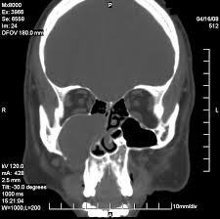
Management: surgical using Caldwell –Luc operation to allow excision of lesion
Prognosis is excellent

Slide 35
Neoplasms
Benign neoplasms:
Epithelial papilloma
Osteoma
Malignant neoplasms:
Squamous cell carcinoma
Pseudotumor

Slide 36
Epithelial papilloma
Is a rare neoplasm of respiratory epithelium that occurs In the nasal cavity and paranasal sinuses
It occurs predominantly in men
c/f: unilateral nasal obstruction
Nasal discharge
Pain and epistaxis
Pt may have c/o recurring sinusitis for yrs and a subsequent nasal obstruction on same side as sinusitis

Slide 37
Radiographic features
Location: is usually in the ethmoidal or maxillary sinus
It may also appear as an isolated polyp in nose or sinus
Internal structure: appears as a homogenous radiopaque mass of soft tissue density
Effects on surrounding structures: if bone destruction is apparent, it is the result of pressure erosion

Slide 38
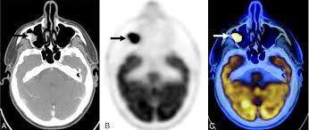

Slide 39
Osteoma
Are almost twice as common in males
Common in 2nd, 3rd and 4th decades
Most are slow growing and asymptomatic
When symptoms occur, they are the result of obstruction of sinus ostium or infundibulum or are secondary to erosion or deformity, orbital or intracranial extension
Those growing in the max sinus may extend into the nose and cause nasal obstruction or a swelling of the side of the nose
They may expand the sinus and produce the swelling of cheek or hard palate
Cases extending to orbit, proptosis may result

Slide 40
Radiographic features
Location: occasionally develop in max sinus
More often occur in frontal and ethmoid sinus
Periphery and shape: it is usually lobulated or rounded and has a sharply defined margin
Internal structure: is homogenous and extremely radiopaque
Differential diagnosis: antrolith, mycolith, teeth or odontogenic neoplasms

Slide 41
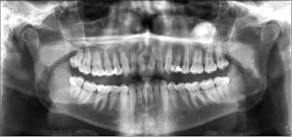

Slide 42
Malignant neoplasms of PNS
Are rare
Accounts for less than 1% of all malignancies of body

Slide 43
Squamous cell carcinoma
Originates from metaplastic ept of sinus mucosal lining
c/f: facial pain or swelling
Nasal obstruction
Lesion In the oral cavity
Mean age: 60 yrs
Males: females: :2:1
Lymph nodes are involved in about 10% cases
Medial wall is 1st to become eroded causing nasal obstruction, discharge, bleeding and pain
FOS, dental signs i.e., expansion of alveolar process, unexplained pain and numbness of the teeth, loose teeth and swelling of the palate or alveolar ridge and ill fitting dentures

Slide 44
May erode the floor and penetrate oral cavity
Lateral wall involvement: fscial and vestibular swelling becomes apparent
Pt may c/o pain and hyperesthesia of posterior teeth
Sinus roof: diplopia, proptosis, pain and hyperesthesia or anesthesia and pain over the cheek and upper teeth
Posterior wall: invasion of the muscles of mastication causing painful trismus, obstruction of eustachian tube causing stuffy ear and referred pain and hyperesthesia over the distribution of 2nd and 3rd divisions of 5th nerve

Slide 45
Radiographic features
Location: most occur in max sinuses, even frontal and sphenoid sinus involvement is common
Internal structure: soft tissue radiopaque appearance
Effects on surrounding structures: as it enlarges, it may destroy sinus walls and cause irregular r’lucent areas in surrounding bone
Bone destruction around teeth or irregular widening of PDL space
Frequently medial wall is thinned or destroyed
It may extend into nasal cavity

Slide 46
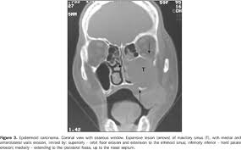

Slide 47
Additional imaging
On CT, characteristic sign is invasion into soft tissue facial planes beyond the sinus walls
CT is useful in revealing the extent of PNS neoplasms, splly when extension into orbit, infratemporal fossa or cranial cavity has occurred
MRI reveals extent of soft tissue penetration into adjacent structures
It differentiates mucus accumulatio fron soft tissue mass of the neoplasm

Slide 48
Differential diagnosis
Sinusitis
Large retention pseudocyst
Od cysts
Treatment: surgery and radiation therapy

Slide 49
Pseudotumor
Syn: invasive fungal sinusitis
Inflammatory pseudotumor
Fibroinflammatory pseudotumor
Plasma cell granuloma
Sinonasal fungal disease
Mucormycosis
Aspergillosis
Zygomycosis of PNS
Rhizopus sinusitis

Slide 50
Pseudotumor
It is a descriptive name for a group of apparently related diseases of fungal origin that occurs in PNS and other parts of head and neck
C/f: occurs after a series of recurrent infections
Recurring pain, and a mass simulating a neoplasm
Mass may cause erosion of walls of involved sinus and proptosis if eye is involved
Altered nerve function due to involvement of nerve or occlusion of blood vessels by mass

Slide 51
Radiographic features
Mass simulating neoplasms that cause erosion of bony walls of involved sinuses
D/D: benign and maliganant neoplasms
Treatment: debridement of sinuses
Administration of antifungal medications
Caldwell-Luc surgical approach and therapy

Slide 52
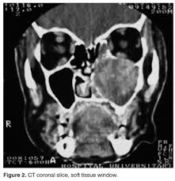

Slide 53
Extrinsic diseases involving the PNS

Slide 54
Periostitis
Dental inflammatory lesions may cause a localized mucositis in adjacent floor of antrum
It is due to diffusion of inflammatory exudate beyond the cortical floor of antrum and into the periosteum and mucosal lining of sinus
These products can strip and elevate the periosteal lining of cortical bone of floor
Stimulates the periosteum to produce a thin elevated layer of new bone adjacent to root apex of involved tooth

Slide 55
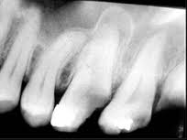
Radiographic features
This new bone may take the form of one thin r’opaque line or very thick or rarely laminated
This is centered directly above inflammatory lesion

Slide 56
Odontogenic cysts
Common extrinsic lesions that encroach on max sinuses
Cysts encroach on sinus space displacing sinus borders
Radicular cyst, dentigerous cyst and OKC originate outside sinus and encroach on sinus
Cyst cortex and sinus walls may be indistinguishable, result is a r’opaque line b/w cyst and air space of sinus

Slide 57
Radiographic features
Periphery and shape: invaginating cyst has a curved or oval shape defined by a corticated border
Internal structure: homogenous and radiopaque relative to sinus cavity
Effects on surrounding structures: may displace the floor of antrum
When most of sinus has been occupied by cyst, residual sinus space may appear as a thin saddle over the cyst

Slide 58
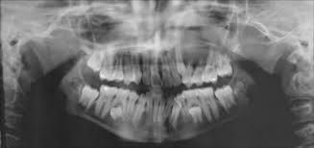
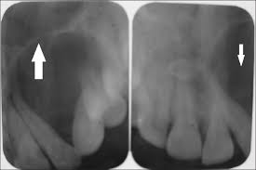

Slide 59
Odontogenic tumors
Cause facial deformity
Nasal obstruction
Displacement or loosening of teeth
Aggressive growth pattern such as ameloblastoma may directly invade into adjacent structures including skull base and compromise pts
R/g: periphery and shape: curved, oval or multilocular shape that may be defined by a thin, cortical border
Internal structure: coarse or fine septae or regions of dystrophic calcification

Slide 60
Effects on surrounding structures: tumor may displace the floor of sinus and cause thinning of peripheral cortex
Bony walls of sinus may be thinned or eroded
Adjacent structures may be displaced
A tooth or part of tooth may be embedded in the neoplasm
Thin Saddle over the tumor may appear on r/g when tumor occupies the entire sinus

Slide 61
Fibrous dysplasia
Craniofacial FD causes dispalcement of sinus borders and results in smaller sinus on affected side
Facial symmetry
Nasal obstruction
Proptosis
Pituitary gland compression
Impingement on cranial nerves
Sinus obliteration: results when expanding lesion of dystrophic bone encroaches on it
Lesion may displace tooth roots and cause teeth to seprate or migrate

Slide 62
Radiographic features
Location: posterior maxilla is the most common location
Periphery: blending borders seen
External cortex of bone is maintained intact although it may be displaced
Internal structure: antrum may be partially or totally replaced by increased r’opacity of this lesion
R’opaque areas have ground glass appearance on extra oral r/g
Orange peel appearance on IOPA views

Slide 63
Effects on surrounding structures: may replace most of sinus by encroaching on and displacing the antral walls, elevating the orbital floor or obstructing the nasal fossa

Slide 64
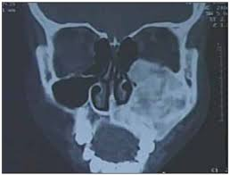

Slide 65
Traumatic injuries to the PNS
Tooth roots may be fractured as a result of various forms of trauma
Fractured roots may be forced into sinus during extraction or subsequent attempts to retrieve them
C/f: asking the pt to hold his or her nose while attempting to breathe out through it will cause bubbles to appear within the blood contained within fresh extraction socket
If root is since many days, pt may present with sinusitis

Slide 66
Radiographic features
Location: premolar or molar roots are close to sinus
Located near floor of antrum
Sometimes may be submucosal, b/w osseous wall and periosteum of sinus
Periphery and shape: no immediate evidence present
Internal structure: r’opaque mass
Effects on surrounding structures: sinusitis may result
Management: remove root tip via ostium or by Caldwell –Luc surgery

Slide 67
