Slide 1
DIAGNOSTIC IMAGING OF TEMPOROMANDIBULAR JOINT

Slide 2
Clinical features
Pain in the TMJ or ear or both
Headache
Muscle tenderness
joint stiffness
Clicking and other joint noises
Reduced range of motion
Locking and subluxation

Slide 3
Anatomy of interarticular disk
It is composed of fibrous connective tissue and is located b/w condylar head and mandibular fossa
Disk divides joint cavity into 2 compartments called inferior and superior joint spaces, which are located below and above the disk
Disk has a biconcave shape with a thick anterior band, thicker posterior band and a thin middle part
It is also thicker medially than laterally
Medial and lateral margins of disk blend with the capsule
Thin central portion normally serves as an articulating cushion b/w condyle and articular eminence

Slide 4
Anterior band is thought to be attached to the superior head of lat pterygoid muscle and posterior band attaches to posterior retrodiskal tissues
Junction b/w posterior band and posterior attachment usually lies within 10 degrees of vertical above condylar head
Disk and posterior attachment are called soft tissue component of TMJ

Slide 5
During mandibular opening, condyle translates downward and forward, disk also moves forward and rotates so that its thin central portion remains b/w articulating convexities of condylar head and art eminence
Laterally and medially, disk attaches to condylar poles, helping to ensure passive movement of disk with condyle so that condyle and disk translate froward to the summit of art eminence
As mandible opens, condyle also rotates against the lower surface of disk in inferior joint space
On closing, reverse occurs with disk moving back with condyle into fossa

Slide 6
Posterior attachment
Syn: retrodiskal tissues
It consists of bilaminar zone of vascularised and innervated loose fibroelastic tissue
Superior lamina, rich in elastin, inserts into posterior wall of fossa
Superior lamina stretches and allows the disk to move forward with condylar translation
Inferior lamina attaches to posterior surface of condyle
As condyle moves forward, tissues of posterior attachment expands, primarily as a result of venous distension, as the disk moves forward, tension is produced in the posterior attachment
This tension is responsible for smooth recoil of disk posteriorly as mandible closes

Slide 7
TMJ bony relationships
Radiographic joint space is used to describe the radiolucent area b/w condyle and temporal component
Left and right condylar positions within the fossa can be determined and compared by the dimensions of the r/g joint spcae
Condyle is positioned concentrically when anterior and posterior joint space are uniform in width
In retruded position, posterior joint space width is less than the anterior
In protrusion, posterior joint space is wider than anterior joint space

Slide 8
Condylar movement
Opening: Downward and forward translation of condyle occurs, whereby te superior surface of disk slides against the articular eminence
Same time, a hinge type, rotatory movement occurs with superior surface of condyle against the inferior surface of disk
At maximal opening, condyle moves down and forward to the summit of art eminence or slightly anterior to it
Condyle typically is found within a range of 2 to 5mm posterior and 5 to 8mm anterior to the crest of eminence
Hypermobility of the joint if condyle translates more than 5mm anterior to eminence

Slide 9
Diagnostic imaging of the TMJ
Depends on:
Imaging of hard or soft tissues
Amount of diagnostic information available from particular imaging
Cost of examination
Radiation dose

Slide 10
Hard tissue imaging
Panoramic projection
Transcranial projection
Transpharyngeal projection
Transorbital projection
Submentovertex projection
Conventional tomography
Computed tomography

Slide 11
Panoramic projection
Provides an overall view of teeth and jaws
As a screening projection to odontogenic diseases and to disorders that may be source of TMJ symptoms
Gross changes such such as asymmetries, extensive erosions, large osteophytes or fractures can be identified

Slide 12
Transcranial projection
It provides a saggital view of lateral aspects of condyle and temporal component
Pt is positioned in a cephalostat and x ray beam is directed downward from the opposite side, through the cranium and above the petrous ridge of temporal bone, at a 25 degree angle centered through the joint and 20 degree anterior angle may be used
Film cassatte is placed on side of concern
It includes in closed and maximal open positions

Slide 13
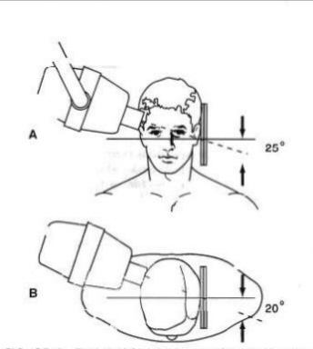

Slide 14
Coz of positive beam angulation, central and medial aspects of joint are projected inferiorly and only lateral joint contours are visible in this projection
Ipsilateral petrous ridge is often supermposed over condylar neck and so condylar head, temporal component and joint space is distorted. So horizontal beam angle be individualized to each pt
Indications: gross osseous changes on lateral aspect of joint, displaced condylar fractures, and range of motion

Slide 15
Transpharyngeal projection (Pharma)
Provides a saggital view of medial pole of condyle
Beam is directed superiorly at -5 degrees through the sigmoid notch of opposite side and 7 to 8 degrees from anterior
Film cassatte is palced on side being imaged
Pt opens the mouth maximally to avoid superimposition of condyle on temporal component
Coz of negative angulation, this view depicts medial aspect of condyle
Indications: for visualizing erosive changes of condyle rather than subtle changes

Slide 16
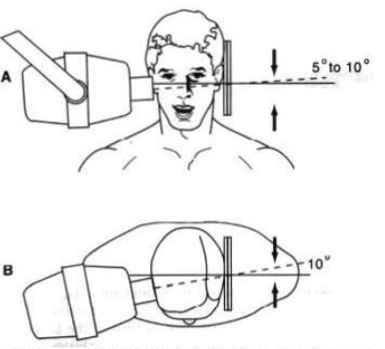

Slide 17
Transorbital projection
Provides anterior view of the TMJ
Pts head is tilted downward 10 degrees so that the canthomeatal line is horizontal
Beam is directed from the front of pt through the ipsilateral orbit and TMJ of interest
Cassatte is placed behind the pts head, perpendicular to beam
Pt opens mouth maximally or protrudes mandible. Thereby placing condyle at summit of eminence

Slide 18
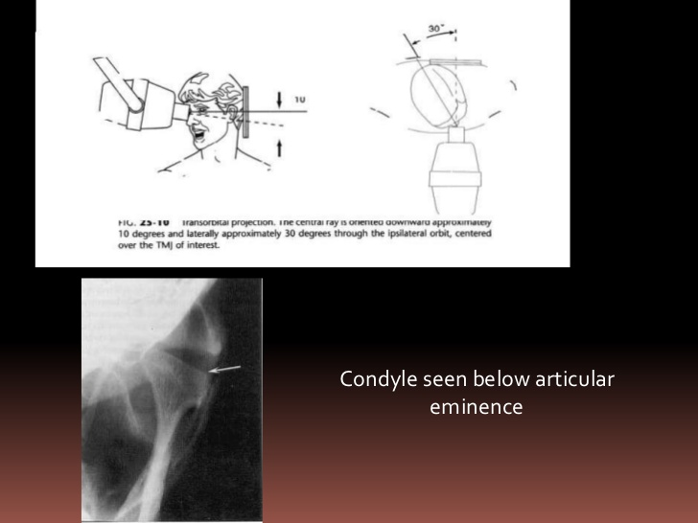

Slide 19
Entire mediolateral dimension of eminence, condylar head and neck is visible
Indications: condylar neck fractures, in gross degenerative changes or other anomalies to look for gross changes in morphology of convex surface of condylar head
This projection is limited by the ability of condyle to move to the summit of art eminence

Slide 20
Reverse open Towne’s projection
Is used to image condylar neck fractures, particularly if medial displacement has occurred
Here the condylar head and neck are visualized in the frontal plane

Slide 21
Submentovertex (Basal) projection
Provides a view of skull base and condyles superimposed on condylar necks and mandibular rami
It is used to determine the angulations of long axis of condylar head for corrected tomography
Useful to evaluate facial asymmetries, condylar dispalcement or rotation of mandible in horizontal plane associated with trauma or orthognathic surgery

Slide 22
Conventional tomography
Technique that produces multiple thin image slices, permitting visualization of an anatomic structure essentially free of superimpositions of overlapping structures
Coz it provides multiple image slices at right angles through the joint, it is superior to transcranial view
It Is exposed in sagittal plane with several image slices in closed postion and usually one image in maximal open position

Slide 23
In corrected sagittal tomography, condylar long axis with respect to midsagittal plane is determined using an SMV
Pts head is then rotated to this angle, permitting alignment of image slices perpendicular to condylar long axis
This minimizes geometric distortion of joint and allows accurate assessment of condylar position
Coronal (frontal) tomographs, pt is in maximal open or protruded position and useful when morphologic abnormalities or erosive changes of condylar head is suspected

Slide 24
Computed tomography
Indicated when information about 3 D shape and internal structure of osseous components of joint or if information regarding the surrounding soft tissues is required
Image slices are made in both axial and coronal planes
Reformat images are produced in sagittal planes and 3D
Indications: to assess osseous deformities of jaws or surrounding structures

Slide 25
Indications
Presence and extent of ankylosis and neoplasms
Extent of bone involvement in some arthritis
Imaging complex fractures
Evaluating complications from use of polytetrafluoroethylene or silicon sheet implants such as erosions into middle cranial fossa and heterotopic bone growth

Slide 26
Soft tissue imaging
Arthrography
Magnetic resonance imaging

Slide 27
Arthrography
Is a technique in which an indirect image of disk is obtained by injecting a r’opaque contrast agent into one or both joint spaces under fluoroscopic guidance
Perforation is detected by flow of contrast agent into superior joint space from lower space
Adhesions ared etected by the manner in which contrast agent fills the joint space
After both spaces are filled, disk function is studied using fluoroscopy during opening and closing movements

Slide 28
Is indicated when information about disk position, function, morphology and integrity of diskal attachments is required for treatment
Drawbacks: invasive nature and postoperative discomfort

Slide 29
Magnetic resonance imaging
MRI uses a magnetic field and radiofrequency pulses rather than ionizing radiation to produce multiple digital image slices
it allows construction of images in sagittal and coronal planes without repositioning the pt
Images are acquired in open and closed mandibular positions using surface coils to improve image resolution
Examination usually are performed using T1 weighted, proton weighted or T2 weighted pulse sequences

Slide 30
T1 weighted or proton weighted images best demonstrate osseous and diskal tissues
T2 weighted demonstrate inflammation and joint effusion
medial disk displacements are best detected using MRI
Contraindications: pregnancy
Pts with pacemakers
Intracranial vascular clips or metal particles in vital structures

Slide 31
Radiographic abnormalities of the TMJ

Slide 32
Developmental abnormalities
Condylar hyperplasia
Condylar hypoplasia
Juvenile arthrosis
Coronoid hyperplasia
Bifid condyle

Slide 33
Condylar hyperplasia
Is a developmental abnormality that results in enlargement and occasionally deformity of condylar head
This has secondary effect on mandibular fossa as it remodels to accommodate the abnormal condyle
Etiology may be overactive cartilage or persistent cartilaginous rests, increasing the thickness of entire cartilaginous and precartiliginous layers
Condition is unilateral and may be accompanied by varying degrees of hyperplasia of ipsilateral mandible

Slide 34
Clinical features
Is more common in males
Before age of 20 yrs
Self limiting condition and tends to arrest with termination of skeletal growth
May progress slowly or rapidly
Mandibular asymmetry that varies in severity, depending on degree of condylar enlargement
Chin may be deviated to unaffected side or may remian unchanged
Increase in vertical dimension of ramus, mandibular body or alveolar process of affected side
Posterior open bite on affected side, limited/ deviated opening

Slide 35
Radiographic features
Condyle may appear relatively normal but enlarged or altered in shape
May be more r’opaque coz of additional bone present
It is seen as elongation of condylar head and neck with a compensating forward bend, forming an inverted L
Condylar neck may be elongated and thickened and may bend laterally
Cortical thickness and trabecular pattern of enlarged condyle are normal
Glenoid fossa may be enlarged at the expense of posterior slope of eminence

Slide 36
Ramus and mandibular body on affected side also may be enlarged, resulting in a characteristic depression of inferior border at midline
Affected ramus may have increased vertical depth amd may be thicker in AP dimension

Slide 37
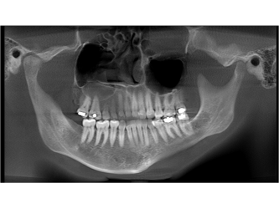

Slide 38
Treatment
Orthodontics and orthognathic surgery after condylar growth is complete

Slide 39
Condylar hypoplasia
Is a failure of the condyle to attain normal size coz of congenital and developmental abnormalities or acquired diseases that affect condylar growth
Condyle is small but with normal morphology
Early injury or injury to art cartilage by birth trauma or intraarticular inflammatory lesions

Slide 40
Clinical features
Often is associated with underdeveloped ramus and mandibular body
Congenital abnormalities may be uni/bilateral and are manifested as a gen condition
Also may be associated with congenital defects of ear and zygomatic arch
Pts have mandibular asymmetry and may have symptoms of TMJ dysfunction
Chin is deviated to affected side
Mandible deviates to affected side during opening

Slide 41
Radiographic features
Condyle is normal in shape and structure but diminished in size
Mandibular fossa is proportionally small
Condylar neck and coronoid process usually are very slender and in some cases are shortened or elongated
Posterior border of ramus and condylar neck may have a dorsal inclination
Ramus and mandibular body on affected side may also be small, resulting in mandibular asymmetry and occasional dental crowding
Antegonial notch is deepened

Slide 42
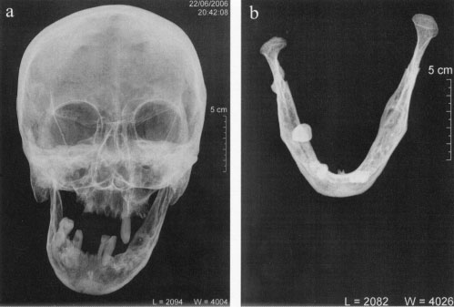

Slide 43
Juvenile arthrosis
Syn: Boering’s arthrosis
Arthrosis deformans juvenilis
Manifests as hypoplasia and characteristic morphologic abnormalities
Affected condyle was normal at one time and became abnormal during growth
May be uni/bilateral

Slide 44
Clinical features
Affects children and adolescents during period of mandibular growth
It is more common in females
Pt may have mandibular mandibular asymmetry, signs and symptoms of TMJ dysfunction or both

Slide 45
Radiographic features
Condylar head develops a characteristic toadstool appearance, with marked flattening and apparent elongation of the articulating condylar surface and dorsal inclination of condyle and neck
Condylar neck is shortened or even absent in some cases
Articulating surface of temporal component often is flattened
Progressive shortening of ramus occurs on affected side, and antegonial notch may be deepened, indicating mandibular hypoplasia
In longstanding cases, superimposed degenerative changes may be present

Slide 46
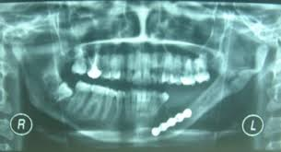

Slide 47
Treatment
Orthognathic surgery and orthodontic therapy may be required to correct mandibular asymmetry

Slide 48
Coronoid hyperplasia
May be acqiured or developmental, resulting in elongation of coronoid process
In developmental variant, it is usually bilatral
Acquired types may be unilateral or bilateral and are usually are a response to restricted condylar movement caused by abnormalities such as ankylosis

Slide 49
Clinical features
Bilateral developmental coronoid hyperplasia is more common in males
Often commences at the onset of puberty
Pt c/o progressive inability to open the mouth and may have an apparent closed lock
Condition is painless

Slide 50
Radiographic features
Coronoid processes are elongated and the tips extend atleast 1cm above the inferior rim of zy arch
This results in impingement on medial surface of zy arch during opening, restricting condylar translation
Coronoid processes may have a large but normal shape or may curve anteriorly and may appear very r’opaque
Posterior surface of zy process of maxilla may be remodelled to accommodate enlarged coronoid process

Slide 51
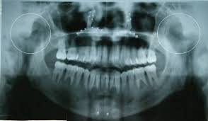

Slide 52
Treatment
Osteotomy or surgical removal of coronoid process and postoperative physiotherapy

Slide 53
Bifid condyle
Condyle develops a vertical depression, notch, or deep cleft in the centre of condylar head
Could be uni/bilateral
It results from obstructed blood supply or other embryopathy

Slide 54
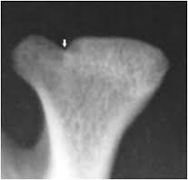
Clinical features
An incidental finding
Some pts c/o TM dysfunction, including joint noises and pain

Slide 55
Radiographic features
A depression or notch is present on superior condylar surface, giving AP silhoutte a heart shape
In more severe cases, a duplicate condylar head is seen
Mandibular fossa may remodel to accommodate altered condylar morphology
Treatment: not indicated until pain or functional impa

Slide 56
Soft tissue abnormalities
Internal derangements: is an abnormality in position and sometimes morphology of disk that interferes with normal function
Etiology: parafunction, jaw injuries, whiplash injury, forced mouth opening
Disk may resume a normal position wrt condyle – reduction
If disk remains displaced throughout the mand movement – non reduction
A chronically displaced disk may become deformed losing its shape and become thick and fibrotic

Slide 57
Clinical features
It’s a normal variant
Symptomatic pts may have a decreased range of motion
Internal derangements may be uni/bilateral
Unilateral cases manifests as deviation to affected side
Joint noises are common and manifsts as click as the joint reduces to normal position during opening and occasionally as a softer click as disk becomes displaced again during mand closing
Pain in preauricular region or headaches
Episodes of closed or opening locking of joint

Slide 58
DISK DISPLACEMENT
anterior disk displacement is most common
When mandible is in maximum intercuspation, partial or full ant disk dispalcement is indicated by anterior location of posterior band of disk, which is directly superior to the condylar head
Normal articulating surface (thin zone) is somewhat anteriorly positioned and as a result the osseous structures of the joint articulate with the posterior band of disk or retro diskal tissues

Slide 59
DISK PERFORATION AND DEFORMITIES
Arthrography can reveal tear in the joint capsule or disk perforation by demonstrating flow of contrast agent from inferior to suprior joint space during injection phase.
Fibrous adhesions and effusion: adhesions are masses of fibrous tissue or scar tissue that form in joint space.
adhesions show resistance to injection of contrast agent
MRI can detect accumulation of fluid in joimnt spaces, and appears as high signal in T2 weighted images

Slide 60
REMODELING AND ARTHRITIC CONDITIONS
Remodeling: is an adaptive response of cartilage and osseous tissue to forces applied to the joint that may be excessive, resulting in alteration of shape of condyle and art eminence.
This adaptive response may result in flatenning of curved joint surfaces, which effectively distributes forces over a greater surface area
No destruction or degeneration of articular soft tissue occurs
TMJ remodelling occurs throughout life and is considered abnormal if accompanied by signs and symptoms of pain and dysfuction

Slide 61
Clinical features
May be asymptomatic or have signs and symptoms of TMJ dysfunction.
r/g: features include flattening, cortical thickening of articulating surfaces,and subchondral sclerosis,
Could involve condyle, temporal component or both.
First occur on anterosuperior surface of condyle and posterior slope of art eminence,
Lateral aspect of joint is involves in early stages

Slide 62
d/d: degenerative joint disease
Treatment: directed to relieve stress
Splint therapy

Slide 63
DEGENERATIVE JOINT DISEASE
Syn: osteoarthritis
c/f: noninflammatory disorder of joints characterised by joint deterioration and proliferation
joint deterioration - characterised by loss of articular cartilage and bone erosion
Proliferative-newbone formation at art surface&subchondral region
c/f: can occur at any age
Female predominance
Pts may c/o TMJ dysfunction
Pain on palpation and movement
Joint noises, limited range of motion
Muscle spasm

Slide 64
Onset may be sudden or gradual and symptoms may disappear spontaneously only to return in recurring cycles.
r/g: in maximum intercuspation, joint space may be narrow or absent and together with disk perforation, bone to bone contact of joint components results.
Remodeling signs, flatenning and subchondral sclerosis may be evident.
R’lucent areas with irregular margins surrounded by varying area of increaed density are visible deep to the art surfaces – Ely cysts (areas of degeneration that contain fibrous tissue, granulation tissue and osteoid)

Slide 65
Later, bony proliferation occurs at periphery of art surface, new bone is called osteophyte on anterosuperior surface of condyle and lateral aspect of temporal component or both.
Osteophytes may break off and lie free within the joint space – joint mice.
Severe cases – fossa appears grossly enlarged coz of erosion

Slide 66
Treatment
Relieve joint stress, splint therapy
Antiinflammatory drugs
Physiotherapy

Slide 67
Rheumatoid arthritis
Manifests mainly as synovial membrane inflammation in several joints
r/g features are result of villous synovitis, which leads to formation of synovial granulomatous tissue/pannus that grows into fibrocartilage and bone, releasing enzymes that destroy articular surfaces and underlying bone

Slide 68
Clinical features
Is common in females
Pt c/o swelling, pain, tenderness, stiffness on opening, limited range of motion and creptius
Cin appears receded
Anterior open bite coz of bilateral destruction and anterosuperior positioning of condyles
Involvement is bilateral and symmetric

Slide 69
Radiographic features
Initial changes may be gen osteopenia Of condyle and temporal component
Pannus may destroy the disk, resulting in diminished width of joint space
Bone erosions by pannus most often involve the articular eminence and the anterior aspect of condylar head, which permits anterosuperior positioning of condyle when the teeth are in maximal intercuspation and results in anterior open bite

Slide 70
Erosion of anterior and posterior condylar surfaces at the attachment of synovial lining may result in sharpened pencil appearance of condyle
Erosive changes may be so severe that the entire condylar head is destroyed, with only the neck remaining as the articulating surface
Joint destruction eventually leads to secondary DJD
Subchondral sclerosis and flattening of articulating surfaces may occur, as well as subchondral cyst and osteophyte formation

Slide 71
Fibrous ankylosis or rarely bony ankylosis may occur
Reduced mobility is related to duration and severity of disease
Treatment: analgesics, NSAIDS
Preservation of muscle and joint function, physiotherapy
Joint replacement surgery may be required in severe joint destruction

Slide 72
Juvenile chronic arthritis
Syn: juvenile rheumatoid arthritis/ Stills disease
Is a chronic inflammatory disease that appears before the age of 16 yrs
Characterized by chronic, intermittent synovial inflammation that results in synovial hypertrophy, joint effusion and swollen, painful joints
As disease progresses, cartilage and bone are destroyed
TMJ involvement may be uni/bilateral

Slide 73
Clinical features
Pt usually has pain and tenderness in affected joint
Unilateral onset is common but contralateral involvement occurs as disease progresses
Severe involvement results in inhibition of mandibular growth
Affected pts have micrognathia and posteroinferior chin rotation, resulting in bird face and also anterior open bite
If unilateral involvement is very severe, then pt may have mandibular asymmetry with chin deviated to affected side

Slide 74
Radiographic features
Osteopenia of affected TMJ components
Erosions may extend to mandibular fossa, and the articular eminence may be destroyed
III’y erosion of anterior or superior aspect of condyle may occur and pencil shaped condyle may remain
Coz the inflammation is intermittent, during quiescent period, the cortex of joint surfaces may reappear, and surfaces appear flattened
As a result of bone destruction, condylar head is positioned anterosuperiorly in fossa
Hypmobility at maximal opening is common
Secondary degenrative changes manifest as sclerosis and osteophyte formation may be superimposed on rheumatoid changes

Slide 75
Ankylosis may occur
Manifestations of inhibited mandibular growth occur such as deepening of antegonial notch, diminished ht of ramus and dorsal bending of ramus and condylar neck

Slide 76
Psoriatic arthritis and Ankylosing Spondylitis
Are seronegative, systemic arthritis that may affect TMJ
Psoriatic arthritis occurs in pts suffering from psoriasis
Ankylosing Spondylitis occurs predominantly in men, progressing to spinal fusion
TMJ changes are indistinguishable from RA

Slide 77
SEPTIC ARTHRITIS
Is infection and inflammation of joint that can result in joint destruction
May be caused by direct spread of organisms from an adjacent cellulitis or from parotid, otic or mastoid infections
May also occur by direct extensions of osteomyelitis of mandibular body and ramus or spread from middle ear infection, although hematogenous spread from distant nidus is reported

Slide 78
Clinical features
Any age
No gender predilection
Usually occurs unilaterally
Pt may have redness and swelling over joint, trismus, severe pain on opening, inability to occlude teeth
Large, tender cervical lymph nodes, fever and malaise
Mandible may be deviated to unaffected side as a result of joint effusion

Slide 79
Radiographic features
Space b/w condyle and roof of mandibular fossa may be widened coz of inflammatory exudate in joint spaces
Osteopenic changes of joint components and mandibular ramus may be evident
More obvious bony changes are seen approx 7 to 10 days after the onset of clinical symptoms
As a result of osteolytic effects of inflammation, the condylar articular cortex may become slightly r’lucent and discontinuity or subtle irregularity of anterior cortical surface may be seen
As disease progresses, condylar and articular eminence, including disk may be destroyed

Slide 80
Osseous ankylosis may occur after infection subsides
If infection occurs during active mandibular growth, inhibited mandibular growth occurs
Treatment: antimicrobial therapy
Drainage of effusion and joint rest
Physiotherapy to reestablish joint mobility

Slide 81
Articular loose bodies

Slide 82
Synovial chondromatosis
Characterized by metaplastic formation of multiple cartilaginous and osteocartiligainous nodules within CT of synovial membrane of joints
Some of these nodules may detach and form loose bodies in joint space, where they persist and may increase in size , being nourished by synovial fluid
When these cartiliginous nodules ossify, term syn osteochondromatosis may be used

Slide 83
Clinical features
Pts may be asymptomatic or may c/o preauricular swelling, pain and decreased range of motion
Some pts have crepitus or joint noises
Condition occurs unilaterally

Slide 84
Radiographic features
Osseous components may appear normal or may exhibit osseous changes
Joint space may be widened and several r’opaque loose bodies may be seen surrounding the condylar head
Treatment: removal of loose bodies and resection of abnormal synovial tissue in the joint

Slide 85
Chondrocalcinosis
Characterized by acute or chronic synovitis and ppt of calcium pyrophosphate dihydrate crystals in joint space
Clinical features: TMJ involvement is uncommon
Condition occurs unilaterally and is common in males
Pt may be asymptomatic or may c/o pain and joint swelling

Slide 86
Radiographic features
R’opacities in joint spaces are finer and have a more even distribution
Bone erosion as well as severe increase in condylar bone density seen
Erosion of glenoid fossa may be present
Treatment: surgical removal of crystalline deposits
Steroids, aspirin and NSAIDS may provide relief

Slide 87
Trauma
EFFUSION: is an influx of fluid into joint, usually as a result of trauma or inflammation
C/F: pt may have swelling over affected joint, pain in TMJ, preauricular region or ear and limited range of motion
Pts may also c/o sensation of fluid in ear, tinnitus and hearing difficulties as well as difficulty occluding the posterior teeth
Radiographic features: Joint space is widened
T2 weighted signal shows brighter signal indicating fluid adjacent to disk or posterior to condyle
Treatment: antiinflammatory drugs, occasionally surgical drainage

Slide 88
Dislocation
Is abnormal positioning of condyle out of fossa but within the joint capsule
Usually occurs bilaterally and most common;ly in an anterior direction
Dislocation maybe caused by failure of muscular cordination, subluxation or external trauma and may be associated with a condylar fracture
c/f: pts are unable to close mandible to maximal intercuspation
Pain and muscle spasm often are present

Slide 89
Radiographic features
In bilateral cases, both condyles are located anterior and superior to the summits of articular eminence
Treatment: manual manipulation of mandible to reduce dislocation

Slide 90
Fracture
Usually occur at condylar neck and often are accompanied by dislocation of the condylar head
May be divided into fractures involving condylar head and those involving condylar neck
C/f: unilateral fractures may be acompanied by parasymphyseal fracture or mandibular body fracture on contralateral side
Pt may have swelling over TMJ, pain, limited range of motion and anterior open bite

Slide 91
Radiographic features
Recent condylar neck fractures show r’lucent line limited to the outline of neck
Narrow r’lucent line is bony fragments are still aligned or wider line if displacement or dislocation has occurred
If bony fragments overlap, an area of apparent r’opacity is seen
Outer cortical boundary may have an irregular outline or a step defect
Condyle remodels to a form that is essentially normal, in other cases condyle and mandibular fossa become flattened, with loss of vertical ht on affected side

Slide 92
Condyle eventually may show degenerative changes, including flatening, erosion and osteophytes and ankylosis
Changes are more severe if condyle is displaced

Slide 93
Trauma to the developing condyle
If condylar fracture occurs during the period of mandibular growth, growth may be inhibited coz of damage to condylar growth centre
Subsequent hypoplasia is related to stage of mandibular development at the time of injury and its severity
Injury may result in haemorrhage or effusion into joint spaces that eventually may form bone during healing process, which inturn may result in severe hypoplasia and limited joint function

Slide 94
Neonatal fractures
Use of forceps during delivery of neonates may result in fracture and displacement of rudimentary condyle, which later manifests as severe mandibular hypoplasia and lack of development of glenoid fossa and art eminence
R/g: appear as partly opened pair of scissors
Treatment: fracture is not treated, but mandibular asymmetry may be corrected with combination of orthodontics and orthognathic surgery

Slide 95
Ankylosis
A condition in which condylar movement is limited by a mechanical problem in joint or by a mechanical cause not related to joint components
True ankylosis may be bony or fibrous
In bony ankylosis, the condyle or ramus is attached to the temporal bone by an osseous bridge
In fibrous ankylosis, a fibrous union of joint components occurs
False ankylosis may result from conditions that inhibit condylar movement such as muscle spasm, myositis ossificans or coronoid process hyperplasia

Slide 96
Clinical features
Unilateral cases are caused by mandibular trauma or infection
Causes: Rheumatoid arthritis, bilateral fractures, secondary to birth injury
Pts have a h/o progressively restricted jaw opening, or they may have a long-standing h/o limited opening
Restricted mouth opening

Slide 97
Radiographic features
Fibrous ankylosis: articulating surfaces are usually irregular coz of erosions
Joint space is usually very narrow and the 2 irregular surfaces may appear to fit one another like a jigsaw puzzle
Little or no condylar movement is seen
Bony ankylosis: joint space may be partly or completely obliterated by osseous bridge, which varies from a slender segment to large bone mass
This extensive new bone may fuse the condyle to the cranial base

Slide 98
Other morphologic changes: compensatory progressive elongation of coronoid processes, deepening of antegonial notch in mand ramus on affected side as a result of muscle function during attempted mandibular opening
If ankylosis occurs before mand growth is complete, growth of the affected side of mandible is inhibited
Treatment: joint mobility is improved by surgical removal of osseous bridge or creation of a pseudoarthrosis

Slide 99
Benign Tumors
Osteomas, osteochondroma, Langerhans histiocytosis and osteoblastomas
C/F: grow slowly and may attain considerable size
Pts may c/o Tmj swelling, with pain and decreased range of motion
Clinical examination may reveal facial asymmetry, malocclusion and deviation of the mandible to unaffected side
Tumors of coronoid process are painless, but pts may c/o progressive limitation of motion

Slide 100
Radiographic features
Condylar tumors cause condylar enlargement that is often irregular in outline
Trabecular pattern may be altered, resulting in regions of destruction seen as r’lucencies or new abnormal bone formation, which may increase the r’opacity of condyle with abnormal trabeculae
Osteoma or osteochodroma appears as an abnormal, pedunculated mass attached to condyle

Slide 101
Tumors of coronoid process may affect TMJ function
Most common tumor is osteochondroma and it may interfere with joint function and eroder adjacent osseous structures
Treatment: surgical excision of tumor and occasionally excision of condylar head or coronoid process

Slide 102
Malignant tumors
May be primary or more commonmly metastatic
Chondrosarcoma, osteogenic sarcoma, synovial sarcoma and fibrosarcoma of joint capsule
Extrinsic tumors may represent direct extension of adjacent salivary gland malignancies, rhabdomyosarcoma or other regional carcinomas
C/F: asymptomatic or pts may have symptoms of TMJ dysfunction such as pain, limited mandibular opening, mandibular deviation and swelling

Slide 103
Radiographic features
Appear as a variable degree of bone destruction with ill-defined, irregular margins.
Most lack tumor bone formation with the exception of osteogenic sarcoma
Chondrosarcoma may appear as an indistinct, essentially r’lucent destructive lesion of condyle with surrounding discrete soft tissue calcifications that may simulate the appearance of loose bodies
In metastatic tumors, nonspecific condylar destruction is seen

Slide 104
Treatment: primary malignant tumors: wide surgical removal of the tumor
Metastatic tumors: radiotherapy and chemotherapy

