Slide 1
Diseases of tongue

Slide 2
Macroglossia
Congenital causes:
Vascular malformations
Hemihyperplasia
Cretinism
Beckwith-Wiedemann syndrome
Down syndrome
Mucopolysaccharides
Neurofibromatosis
Multiple endocrine neoplasia type 2B

Slide 3
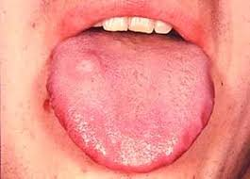
Acquired:
Edentulous pts
amyloidosis
Myxedema
Acromegaly
Angioedema
Carcinoma and other tumors

Slide 4
Most common in children
Ranges from mild to severe
Manifestations: noisy breathing, drooling, and difficulty in eating
Tongue enlargement can result in lisping speech
Pressure of tongue against mandible can result in crenated lateral border of tongue, open bite and mandibular prognatism
Multinodular appearance – amyloidosis, neurofibromatosis, MEN

Slide 5
Lymphangioma – tongue appears pebbly and shows multiple vesicle like blebs
Down syndrome – papillary, fissured surface
Hemifacial hyperplasia – unilateral enlargement
Edentulous – tongue appears elevated and tends to spread out laterally

Slide 6
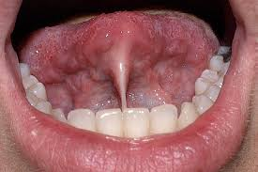
Ankyloglossia
Is a developmental anamoly of the tongue characterized by short, thick lingual frenum resulting in limitation of tongue movement
Complete ankyloglossia – tongue is actually fused to the floor of the mouth
Results in speech defects

Slide 7
Lingual thyroid
During the 3rd to 4th week of fetal life, the thyroid gland begins as an epithelial proliferation in the floor of the pharyngeal gut
By 7th embryonic week, this thyroid bud normally descends into the neck to its final resting position anterior to trachea and larynx
The site where this descending bud invaginates later becomes the foramen caecum
If the primitive gland does not descend normally, ectopic thyroid tissue may be found b/w foramen caecum and epiglottis

Slide 8
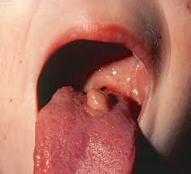
Frequent in females
Small, asymptomatic nodular lesions to large masses to block airway
Clinical symptoms: dysphagia, dysphonia and dyspnea

Slide 9
Fissured tongue
Syn: Scrotal tongue
Relatively common
Numerous grooves and fissures are present on dorsal surface ranging from 2 -6 mm in depth
Fissures cover the entire dorsal surface and divide the tongue papilla into multiple several islands
Condition is asymptomatic
Some patients may complain of mild burning or soreness

Slide 10
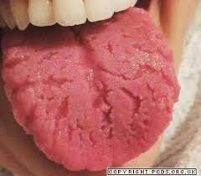

Slide 11
Hairy tongue
Is characterized by marked accumulation of keratin on the filiform papillae of the dorsal surface, resulting in hair like appearance
It represents decrease in keratin production or decrease in normal keratin desquamation
Antibiotic therapy
Poor oral hygiene
General debilation
Radiation therapy
Use of oxidising mouthwashes or antacids
Overgrowth of fungal or bacterial organisms

Slide 12
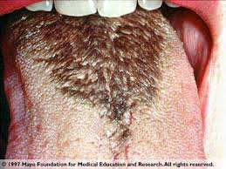

Slide 13
Most commonly affects the midline just anterior to circumvallate papillae, sparing the lateral and anterior borders
Elongated papillae are brown, yellow or black as a result of growth of pigment producing bacteria or stains
The dorsum may sometimes appear as thick, matted appearance
Pts are asymptomatic
Occasionaly pts c/o gagging sensation or bad taste

Slide 14
Varicosities/ Varices
Are abnormally dialated and tortuous veins
Age is a predominant factor
Loss of CT tone supporting the vessels
Presents as multiple bluish-purle, elevated or papular blebs on the lesions and are asymptomatic
Varices: esplly on lips and buccal mucosa
Thrombosed varix presents as a firm, nontender, bluish-purple nodule

Slide 15
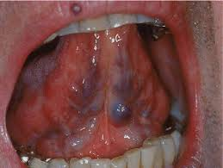

Slide 16
Median rhomboid glossitis
Was thought to be a developmental defect, resulting from failure of embryologic tuberculum impar to be covered by lateral processes of tongue
Appears as a well demarcated erytematous zone affecting the midline and is often asymptomatic
The erythema is due to loss of filiform papillae

Slide 17
