Slide 1
X-Ray film, Intensifying screens and Grids

Slide 2
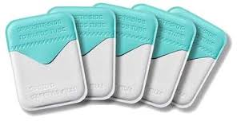
X ray film
It has 2 principal components:
Emulsion and Base
Emulsion is sensitive to x rays and visible light, records the r/g image
Base is a plastic supporting material onto which emulsion is coated

Slide 3
Emulsion
2 principal components are silver halide grains, which are sensitive to x radiation and visible light
Vehicle matrix in which crystals are suspended
Silver halide grains are composed primarily of silver bromide crystals
Iodide is added to ultra speed film coz of its larger diameter disrupts the regularity of silver bromide crystal structure, and increasing sensitivity to x radiation

Slide 4
Photosensitivity of silver halide crystals also depends on the presence of trace amounts of sulphur containing compound
In addition, trace amounts of gold are sometimes added to silver halide crystals to improve their sensitivity
Silver halide grains in Insight film are flat, tabular crystals with a mean diameter of about 1.8µm
Ultraspeed film is composed of globular shaped crystals about 1µm in diameter
Tabular grains of insight film are oriented parallel with film surface to offer a large cross sectional area to x ray beam
As a result, insight film requires only about half the exposure of ultraspeed film

Slide 5
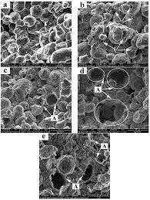
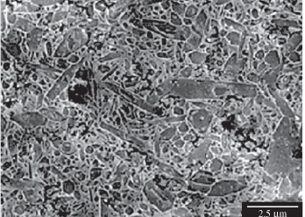

Slide 6
Silver halide grains are suspended in a supporting vehicle that is applied to both sides of supporting base
Vehicle composed of gelatinous and nongelatinous materials, keeps silver halide grains evenly dispersed
A thin layer of adhesive material is added to base to ensure good adhesion of emulsion to film base
During processing, vehicle absorbs processing solutions, allowing chemicals to reach and react with silver halide grains
An additional layer of vehicle is added to film emulsion as an over coat
This helps protect film from damage by scratching, contamination or pressure from rollers

Slide 7
Film emulsions are sensitive to both x ray photons and visible light
Film intended to be exposed by x rays is called direct exposure film
Screen film , which is sensitive to visible light, is used with intensifying screens that emit visible light

Slide 8
Base
It supports the emulsion
It must the proper deree of flexibility to allow easy handling of the film
It is 0.18mm thick and is made of polyester polyethylene terephthalate
It is uniformly translucent and casts no pattern on resultant r/g
Base with slight blue tint improve viewing of diagnostic detail
Base must also withstand exposure to processing solutions without becoming distorted

Slide 9
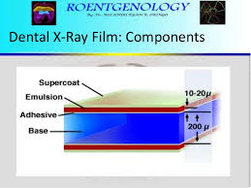

Slide 10
Intraoral x ray film
Film is a double emulsion film, that is coated on both sides of base with emulsion
With double layer of emulsion, less radiation can be used to produce an image
One corner of each film has a small, raised dot that is used for orientation
Film packets contain either one /two sheets of film
Second film serves as a duplicate record
Film is encased with a black wrapper and then in an outer white paper or plastic wrapping

Slide 11
B/w the wrappers in packet is a thin lead foil backing with an embossed pattern
Foil is behind the film, away from tube
It serves: sheilds film from backscatter radiation
It also reduces pt exposure by absorbing some residual x ray beam

Slide 12
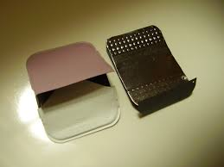
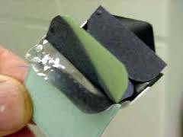
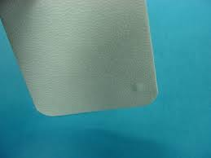
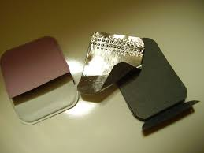

Slide 13
Periapical view
Are used to record the crowns, roots and surrounding bone
3 sizes available:
0 for small children, 22x35mm
1, relatively narrow to view anterior teeth, 24x40mm
2, standard film used for adults, 31x41mm

Slide 14
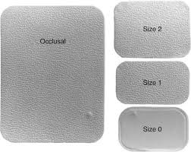

Slide 15
Bitewing view
Are used to record the coronal portions of maxillary and mandibular teeth in one image
Useful for detecting interproximal caries
Evaluate height of alveolar bone
Films often have a paper tab projecting to support the film

Slide 16
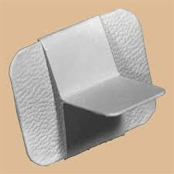
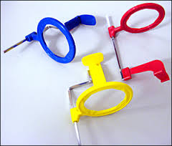

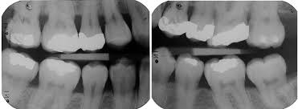

Slide 17
Occlusal film
It is more than 3 times larger than size 2 film, 57x76mm
Used to show larger areas of maxilla and mandible
they obtain right angle views to usual periapical film
Pt bite lightly onto film to support it b/w occlusal surfaces of teeth

Slide 18
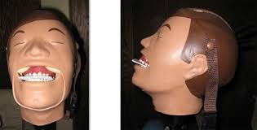
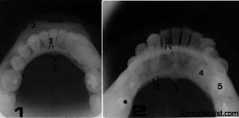

Slide 19
Screen film
It is used with intensifying screens to reduce pt exposure
It is designed to be sensitive to visible light coz it is placed b/w two intensifying screens when an exposure is made
Screens absorb x rays and emit visible light, which exposes the screen film
Silver halide crystals are inherently sensitive to UV and blue light and thus are sensitive to screens that emit UV and blue light
When film is used with screens that emit green light, silver halide crystals are coated with sensitizing dyes to increase absorption

Slide 20
Intensifying screens
Phosphors are been incorporated into intensifying screens for use with screen film
these phosphors fluoresce when exposed to x ray beam
Sum of the effects of x rays and visible light emitted by the screen phosphors exposes the film in an intensifying cassette

Slide 21
Function: presence of intensifying screens created an image receptor system that is 10-60 times more sensitive to x rays than film alone
Use of intensifying screens means a substantial reduction in the dose of x radiation to which pt is exposed
Resolving power of screens is related to their speed:
Slower the speed of film, greater is the resolving power

Slide 22
Composition
Base supporting material
A phosphor layer
Protective polymeric coat
Intensifying screens are used in pairs, one on each side of the film and are positioned inside a cassette
Purpose of cassette is to hold each intensifying screen in contact with x ray film to maximize the sharpness of image
Most cassetes are rigid, but may be flexible

Slide 23
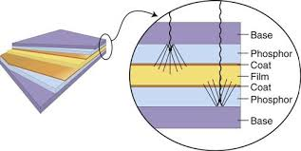
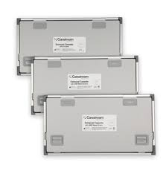
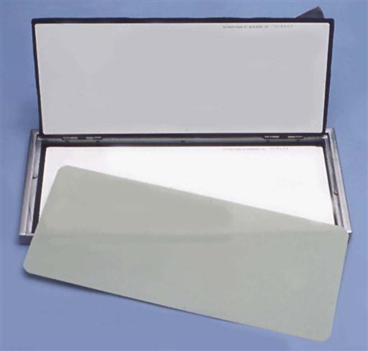

Slide 24
Base
Base material is some form of polyester plastic about 0.25mm thick
It provides mechanical support for other layers
In some, intensifying screens base are also reflective and it reflects light emitted from phosphor layer back toward the x ray film
Some unsharpness results coz of the divergence of light rays reflected back to the film
Some fine detail intensifying screens omit this reflecting layer to improve image sharpness
In some, base is not reflective and a seprate coating of titanium di oxide is applied to base material to serve as a reflecting layer

Slide 25
Phosphor layer
It is composed of phosphorescent crystals suspended in a polymeric binder
When crystals absorbs x ray photons, they fluoresce
Phosphor crystals often contain rare earth elements, commonly lanthanum and gadolinium
Their fluoresence can be increased by the addition of small amounts of elements such as thulium, niobium, or terbium
A pair of rare earth intensifying screens absorbs about 60% of photons that reach the cassete after passing through a pt

Slide 26
These phosphors are about 18% efficient in converting x ray energy to visible light
Rare earth screens convert each absorbed x ray photon in to about 4000 lower energy, visible light photons
These visible photons then expose the film

Slide 27
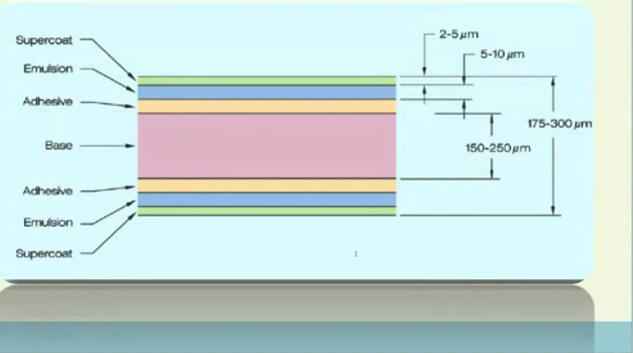

Slide 28
Speed and resolution of screen depends on
Phosphor type and phosphor conversion efficiency
Thickness of phosphor layer and coating weight
Presence of reflective layer
Presence of light absorbing dye in phosphor binder or protective coating
Phosphor grain size

Slide 29
Fast screens have large phosphor crystals and efficiently convert x ray photons to visible light but produces images with lower resolution
As size of crystals or thickness of screen decreases, speed of screen also declines but sharpness increases
Fast screens also have thicker phosphor layer and a reflective layer, these also decrease sharpness

Slide 30
Protective coat
A protective polymer coat, upto 15µm thick is placed over phosphor layer to protect the phosphor and provide a surface that can be cleaned
Intensifying screen should be kept clean because any debris, spots or scratches may cause light spots on the resultant radiograph

Slide 31
Image characteristics

