Slide 1
Image characteristics and grids

Slide 2
Image characteristics
Radiographic density
Radiographic contrast
Radiographic speed
Film latitude
Radiographic noise
Radiographic blurring

Slide 3
Radiographic Density
The overall degree of darkening of an exposed film is r/g density
It can be measured as the optical density of an area of an x ray film,
      Optical density = Log10 I0/I1
      I0 is the intensity of incident light
      I1 is intensity of light transmitted through the film
      Measurement of film density also is a measure of opacity of the film

Slide 4
Characteristic curve
A plot of the relationship b/w film optical density of film and the log of the corresponding exposure
As exposure of film increases, optical density also increases
A film is of diagnostic value, when structures of interest are imaged on relatively straight portion of graph, b/w 0.6 and 3 optical density values

Slide 5
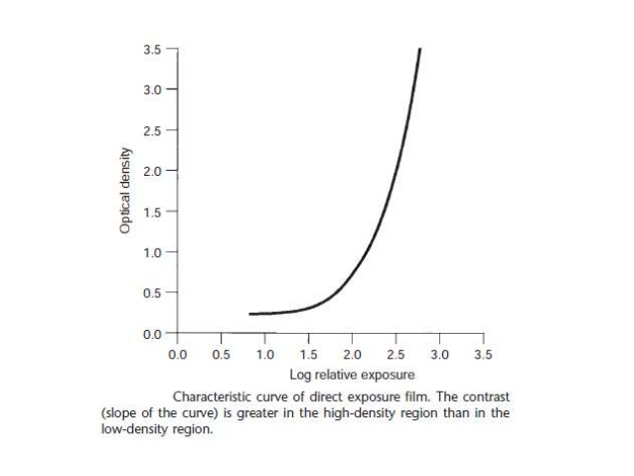

Slide 6
Base plus fog
An unexposed film when processed, shows some density
This is caused by the inherent density of the base and added tint and the development of unexposed silver halide crystals
This minimal density is called gross fog
The optimal density of gross fog typically is 0.2 to 0.3
r/d density is influenced by exposure and thickness and density of subject

Slide 7
Exposure
Overall film density depends on no of photons absorbed by film emulsion
Increase in mA, kVp, or exposure time increases the no of photons reaching the fil and thus increases the density of r/g
Reducing the distance b/w focal spot and film also increases film density

Slide 8
Subject thickness
The thicker the subject, the more the beam is attenuated and the lighter the r/g
If exposure factors intended for adults are used for children or edentulous pt, the r/g will appear dark, coz of smaller amount of absorbing tissue in the path

Slide 9
Subject density
The greater the density of a structure within the subject, the greater the attenuation of the x ray beam directed through that subject or area
The relative densities, in decreasing order
Enamel
Dentin
Cementum
Bone
Muscle
Fat
air

Slide 10
Metallic objects are far denser and hence better absorbers
Coz the x ray beam attenuates differently, the resulting r/g has light and dark areas
Dense objects cause image to be light and are said to be radiopaque
Objects with low density are weak absorbers and allow most photons to pass through and cast dark areas on film, called radiolucency

Slide 11
Radiographic contrast
Describes the range od densities on a radiograph
It is defined as difference in densities b/w light and dark regions on a r/g
Thus an image which shows both light and dark areas has high contrast / short gray scale of contrast
A r/g composed only of light gray and dark gray zones has low contrast / long gray scale of contrast
r/g contrast is the result of subject contrast, film contrast and scattered radiation

Slide 12
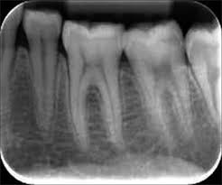
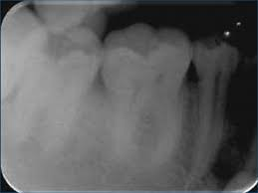

Slide 13
Subject contrast
It is the range of characteristics of the subject that influences r/g contrast
It is influened largely by subjects thickness, density and atomic no
The subject contrast of a pts head and neck exposed in a lat ceph view is high
The dense regions of bone and teeth absorb most of the radiation, whereas less dense soft tissue facial profile transmits most of the radiation

Slide 14
Subject contrast also is influenced by beam energy and intensity
As the kVp of x ray beam increases, the subject contrast decreases
Subtle changes in mA may also slightly change subject contrast by changing the location of the r/g’ed structures on the characteristic curve

Slide 15
Film contrast
Describes the capacity of r/g films to display differences in subject contrast
A high contrast film reveals areas of small difference in subject contrast more clearly
It is measured by the average slope of useful portion on curve
The greater the slope of curve in this region, the greater the film contrast
When the slope of curve in the useful range is greater than 1, the film exaggerates film contrast

Slide 16
Films used with intensifying screens show a slope in the range of 2 to 3
Properly exposed films have more contrast than do underexposed films
Film contrast is maximised by optimal film processing conditions
Incomplete or excessive development diminishes contrast
Improper handling of film, such as storage at too high temperature, exposure to excessively bright safe lights or light leaks in dark room degrades contrast

Slide 17
Scattered radiation
Scattered radiations results from photons that have interacted with the subject by comptom or coherent interactions
These interactions cause the emission of photons that travel in directions other than that of primary beam, consequently causing fogging and loss of contrast

Slide 18
Best means of reducing scattered radiation:
Use a relatively low kVp
Collimate the beam to the size of film to prevent scatter from an area outside the region of image
Use of grids in extra oral radiography

Slide 19
Radiographic speed
Refers to the amount of radiation required to produce an image of standard density
It is frequently expressed as the reciprocal of exposure required to produce an optical density of 1 above gross fog
a fast film requires a relatively low exposure to produce a density of 1
Slow film requires a long exposure
Film speed is controlled by size of silver halide grains and their silver content

Slide 20
F speed film is faster than D speed film because tabular crystal grains are used in emulsion of F speed film
Film speed can be increased slightly by processing the film at a higher temperature, but is achieved at the expense of fog and graininess
Processing in depleted solutions can reduce speed
Always preferrable to use fresh processing solutions and follow recommended processing time and temperature

Slide 21
Film latitude
Is a measure of the range of exposures that can be recorded as distinguisable densities on a film
A film with characteristic curve that has a long straight line portion and a shallow slope has a wide latitude
Films with wide latitude have lower contrast
Wide latitude films are useful when both osseous structures and soft tissue must be recorded

Slide 22
Radiographic noise
Is the appearance of uneven density of a uniformly exposed r/g film
It is seen on a small area of film as localized variations in density
Primary causes are:
Radiographic mottle
Radiographic artifact

Slide 23
Radiographaic mottle: is uneven density resulting from physical structure of film or intensifying screens
Radiographic artifacts: are defects caused by errors in film handling, such as fingerprints or bends in the film, or errors in film processing such as splashing developer or fixer on a film or marks or scratches from rough handling

Slide 24
Mottle may be seen as film graininess, which is caused by visibility of silver grains in the film emulsion, specially when magnification is used
It is evident when high temperature processing is used
It is also evident when film is used with fast screens

Slide 25
Two important causes of the phenomenon are:
Quantum mottle: caused by fluctuation in the number of photons per unit of the beam cross sectional area absorbed by the intensifying screen
It is most evident when fast film screen combination is used coz here the relative non uniformity of beam is highest
Screen structure mottle: is graniness caused by screen phosphors.
It is evident when fast screens with large crystals are used

Slide 26
Radiographic blurring
Sharpness: is the ability of the radiograph to define an edge precisely
Resolution: or resolving power is ability of the radiograph to record separate structures that are close together

Slide 27
It is measured by radiographing an object made up of a series of thin lead strips with alternating radiolucent spaces of the same thickness
Groups of lines and spaces are arranged in order of increasing numbers per mm
Resolving power is measured as the highest no of line pairs per mm that can be distinguished on r/g with low power magnification
Panoramic view can distinguish 5 line pairs/mm
IOPA can delineate 20 line pairs/mm

Slide 28
Radiographic blurring
It is caused by
Image receptor blurring (film and screen)
Motion blurring
Geometric blurring

Slide 29
Image receptor blurring
Size and number of silver grains in emulsion determines sharpness
Finer the grain, finer the sharpness
Slow speed film have fine grains and faster films have larger grains
In intensifying screens, visible light and UV light emitted by screen spread out beyond the point of origin and expose a film area larger than the phosphor crystal
Spreading light causes a blurring of fine detail on r/g

Slide 30
screens with larger crystals are relatively fast and gives diminished sharpness
Fast screens have relatively thick phosphor layer, which contributes to dispersion of light and diminished sharpness
Diffusion of light from a screen can be minimized and image sharpness maximized by ensuring close contact b/w screen and film

Slide 31
Parallax
Presence of image on both side of a double emulsion film causes loss of image sharpness
It results from apparent change in position or size of a subject when viewed from different perspective
In intraoral images, it is most apparent on wet films, here the emulsion is swollen with water and loss of sharpness by parallax is seen
In screens, light from one screen may cross the film base and reach the emulsion on other side, this is solved by incorporating dyes into the base that absorb the light emitted by the screens

Slide 32
Motion blurring
Movement of the film, subject or x ray source causes loss sharpness
Movement of x ray source enlarges the focal spot and diminishes sharpness
Pt movement can be minimized by stabilizng the pts head with headrest during exposure
Use of higher mA and kVp and correspondingly shorter exposure times resolve this problem

Slide 33
Geometric blurring
Larger the focal spot, greater the loss of image sharpness
Image shapness is improved by increasing the distance b/w the focal spot and object and reducing the distance b/w object and image receptor

Slide 34
Grids
The function of the grid is to reduce the amount of scattered radiation exiting a subject that reaches a film
It is placed b/w subject and the film, preferentially removes the scattered radiation and spares primary photons
This reduces nonimaging exposure and increases subject contrast

Slide 35
Composition
A grid is composed of alternating strips of radiopaque material and strips of radiolucent material
When scattered photons generated in subject are scattered toward film, they are usually absorbed by radiopaque material in the grid
This is because the direction of scattered photons deviates from that of primary beam and can not pass through parallel plates of grid

Slide 36
Focussed grids are used most often
In this, r’opaque strips are all directed toward a common point, focal spot of x ray tube
Coz the strips are angled toward the focal spot, their direction coincides with the paths of divering photons in the primary beam
Lead strips absorb the scattered photons as their paths diverge from those of the primary photons

Slide 37
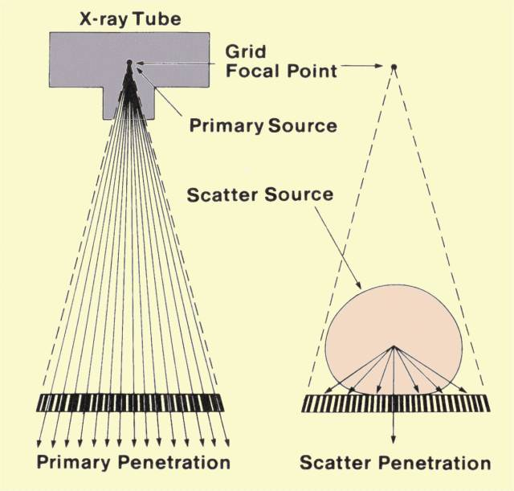

Slide 38
Grids are manufactured with varying numbers of line pairs of absorbers and r’lucent spaces per inch
Grids with 80 or more line pairs / inch do not show objectionable grid lines on the image
Grid ratio: ratio of grid thickness to the width of radiolucent spacer
The higher the grid ratio, the more effectively the scattered radiation is removed
Grids with a ratio 8 or 10 are preferred

Slide 39
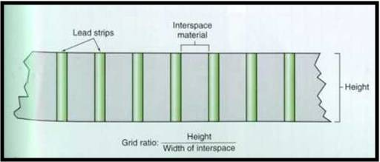

Slide 40
Image of radiolucent grid lines on the film can be deleted by moving the grid perpendicular to the direction of grid lines during exposure
This causes blurring out of r’lucent lines and allows a more uniform exposure
The apparatus or moving a grid is called Bucky
To compensate for absorbing materials, exposure required is approximately double that when a grid is not used

