Slide 1
Processing X ray Film

Slide 2
Formation of the latent image
Film emulsion consists of photosensitive crystals containing primarily Ag bromide suspended in a vehicle and layered on a plastic base
Some crystals also contain small amounts of Ag iodide
These Ag halide crystals also contain a few free ag ions b/w lattice atoms

Slide 3
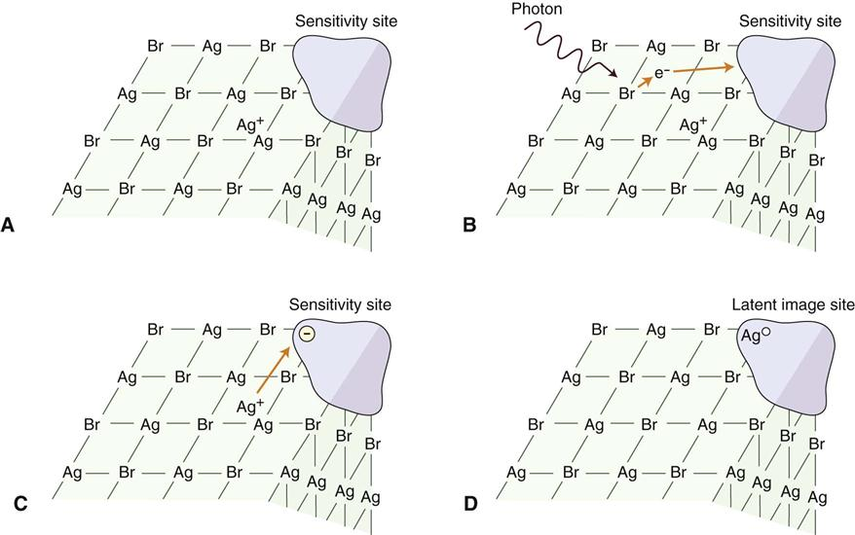

Slide 4
The crystals are chemically sensitized by addition of trace amounts of sulfur compounds, which bind to the surface of crystals
Sulfur compounds play a crucial role in image formation
Sulfur compounds create sensitivity sites, these are sensitive to radiation
Each crystal has many sensitvity site, which begins the process of image formation by trapping electrons

Slide 5
When the film is irradiated, it chemically changes the Ag halide crystal in film
After irradiation, the sensitivity sites starts trapping electrons for image formation
X ray photons interact primarily with the bromide ions by compton and photoelectric interactions
These interactions results in the removal of an electron from bromide ions
By loss of an electron, bromide ion is converted into neutral bromine atom

Slide 6
The free electrons move through the crystal until they reach a sensitivity site, where they become trapped and impart a negative charge to the site
This negatively charged site then attracts positively charged free interstitial silver ions
When silver ions reaches the sensitivity site, it is reduced and forms a neutral atom of metallic silver
The sites containing neutral silver atoms are called latent image sites

Slide 7
Film processing converts the latent image into one that can be visualized
The neutral silver atoms at each latent image site renders the crystals sensitive to development and image formation
The larger the aggregrate of neutral silver atoms, the more sensitive the crystal is to the effects of developer
Most latent image sites that are capable of being developed have atleast 4 or 5 Ag atoms
Developer converts Ag bromide atoms with neutral Ag atoms deposited at the latent image sites into black, solid silver metallic grains
Fixer removes unexposed, undeveloped silver bromide crystals leaving the film clear in unexposed areas

Slide 8
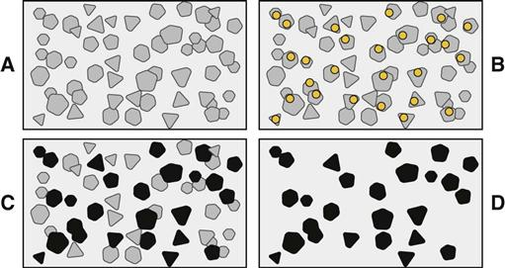

Slide 9
Processing solutions
Film processing involves following procedures:
Immerse exposed film in developer
Rinse film in water bath
Immerse film in fixer
Wash film in water bath
Dry film and mount for viewing

Slide 10
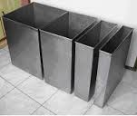
Processing tanks

Slide 11
Developing solution
Developer reduces all silver ions in the exposed crystals of Ag halide to metallic silver grains
To produce diagnostic image, this process must be restricted to crystals containing latent image sites
Silver atoms acts as a bridge by which reducing agents reach silver ions in the crystal and convert them to solid grains of metallic silver
Variations in density is due to different ratios of exposed and unexposed crystals

Slide 12
The developer initially has no visible effect
After this initial phase, density increases ver rapidly at first and then more slowly
Eventually, all exposed crystals are reduced to black metallic silver and then starts reducing even unexposed crystals
Development of unexposed crystals results in chemical fog on film
A properly exposed film doesn’t get overdeveloped even if it remains in contact for long time

Slide 13
Developer solution contains 4 components, all dissolved in water:
Developer
Activator
Preservative
Restrainer

Slide 14
Developer
Two developing agents are used, a pyrazolidone type compound, usually phenidone and hdroquinone
Phenidone serves as first electron donor that converts silver ion to metallic silver
This electron transfer generates the oxidised form of phenidone
Hydroquinone provides electron to reduce the oxidised phenidone to original state so that it continues to reduce Ag halide grains

Slide 15
Activator
Developers are active only at alkaline pH, usually around 10
Alkali compounds, sodium or potassium hydroxide are added
Buffers, sodium bicarbonate are used to maintain this condition
Activators also cause gelatin to swell so that developing agents can diffuse more rapidly into the emusion and reach the suspended silver bromide crystals

Slide 16
Preservative
Antioxidant or preservative, sodium sulfite protects the developers from oxidation b atmospheric oxygen and thus extends their useful life
It also combines with the brown oxidized developer to produce a colourless soluble compound
If not removed, oxidation products interfere with the developing reaction and stain the film

Slide 17
Restrainer
Potassium bromide and benzotriazole are added to restrain development of unexposed silver halide crystals
They depress reduction of both exposed and unexposed crystals, they are much effective in depressing the reduction of unexposed crystals
The restrainer acts as antifog agents and increases contrast

Slide 18
Developer replenisher
Phenidone and hydroquinone are consumed and bromide ions and other bproducts are released into solution
Developer also becomes inactive b exposure to oxgen
The developer should be replenished with fresh solution every morning to prolong the life of seasoned developer
The recommended amount is 8 ounces per gallon of developing solution

Slide 19
Rinsing
After development, the film emulsion swells and becomes saturated with developer
At this point, films are rinsed in water for 30 seconds with continuous, gentle agitation before placing in fixer
Rinsing dilutes the developer, slowing the development process
It also removes alkali activator, preventing neutralization of acid fixer

Slide 20
Fixing solution
Primary function is to dissolve and remove the undevloped silver halide crystals from the emulsion
It also helps harden and shrink film emulsion
Fixer should also be replenished daily at the rate of 8 ounces per gallon

Slide 21
Components of fixer
Clearing agent
Acidifier
Preservative
Hardener

Slide 22
Clearing agent
An aqueous solution of ammonium thiosulphate dissolves the silver halide grains
It forms stable, water soluble complexes with silver ions, which then diffuse from the emulsion
Excessive fixation results in gradual loss of film density coz the grains of silver slowly dissolve in the acetic acid of the fixing solution

Slide 23
Acidifier
Fixing solution contains an acetic acid buffer system to keep pH constant (4 to 4.5)
Acidic pH is required to promote good diffusion of thiosulfate into the emulsion and silver thiosulfate complexes out of the emulsion
The solution also inactivates any carry over developing agents in the film emulsion, blocking continued developed of any unexposed crystals while the film is in the fixing tank

Slide 24
Preservative
Ammonium sulfite, prevents oxidation of thiosulfate clearing agent, which is unstable in the acid environment of the fixing solution
It also binds with any colored oxidised developer carried over into the fixing solution and effectively removes it from the solution, which prevents oxidised developer from staining the film

Slide 25
Hardener
Aluminium sulfate, Al complexes with gelatin during fixing and prevents damage to the gelatin during handling
The hardeners also reduce swelling of the emulsion during final wash, this lessens mechanical damage to emulsion and limits water absorption, shortening drying time

Slide 26
Washing
After fixing, processed film is washed in sufficient flow of water for an adequate time to ensure removal of all thiosulfate ions and Ag thiosulfate complexes
Any silver compound or thiosulfate remains coz of improper washing discolors and causes stains
This discoloration results from the thiosulfate reacting with silver to form brown silver sulfide, which can obscure diagnostic information

Slide 27
Darkroom equipment
Darkroom should be atleast 4x5 feet (1.2x1.5m)
Lightproof: stray light will cause film fogging and loss of contrast
A light-tight door or doorless maze is used
Room should be well ventilated
Comfortable room temperature helps maintain optimal conditions for developing, fixing and washing solutions
If supplies are to stored, ventilation is doubly important coz temperature of 90 F or higher can cause a gen fil fog on film

Slide 28
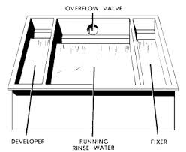

Slide 29
Safe lighting
Processing room should have both white illumination and safe lighting
Safelighting is a low intensity illumination of relatively long wavelength that does not rapidly affect open film
Safelight should have a 15 watt bulb and should be mounted atleast 4 feet above the surface where films are handled
A red GBX-2 filter is recommended as a safelight
Film handling under safelight should be limited to about 5 minutes

Slide 30
Manual processing tanks
All offices should have tank processing as a backup for automatic processing
Tank must have hot and cold running water
Master tank about 20x25 cm (8x10inches) that serves as a water jacket for two removable inserts that fit inside
The insert tanks usually hold 3.8L of developer or fixer and are placed within the outer, larger master tank
The outer tank holds the running water for maintaining the temperature of developer and fixer in insert tanks and for washing films

Slide 31
Developer is placed on left side and fixer on right side of master tank
All tanks are made of stainless steel
Master tank should have a cover to reduce oxidation of processing solutions, protecting the developing film from from accidental exposure to light and minimize evaporation of processing solutions

Slide 33
Thermometer
Temperature of all processing solution and washing solutions should be closely controlled
A thermometer should be left in water circulating through the master tank to monitor temperature

Slide 34
Timer
Films must be exposed to processing chemicals for specific intervals
An interval timer is indispensible for controlling development and fixation times

Slide 35
Drying racks
2/3 drying racks can be mounted on a convenient wall for film hangers
Drip trays are placed underneath the racks to catch water that may run off the wet films
An electric fan, to circulate air and speed the drying of films
Cabinet dryers, circulate warm air around film and accelerate drying
Excessive heat be avoided coz it may damage the emulsion
If dryers are installed in darkroom, they should be ventilated outside room to preclude humidity and heat, which are detrimental to any unexposed film stored in room

Slide 36
Manual processing procedures
Replenish solutions: developer and fixer need to be replenished. Add 8 ounces / gallon to maintain proper strength of solution. Check the solution levels to ensure the developer and fixer cover the films on the top clips of hangers
Stir solution: to mix the chemicals and equalise the temperature throughout the tanks. Use a separate paddle for each solution
Mount film on hangers: use only safelight in darkroom. Hold the films at edges. Clip the film to hanger. Label racks with pts name and exposure date

Slide 37
Set timer: check the temperature of the developer and set the interval timer to the time indicated by the manufacturer
Any alteration in temperature or time results in diminished contrast
Processing too long or at temperatures higher than recommended results in film fog, diminishing contrast
Temperature | Development time
68 F | 5 mts
70 F | 4 & 1/2 mts
72 F | 4 mts
76 F | 3 mts
80 F | 2 & ½ mts

Slide 38
Develop: start timer and immerse in developer. Agitate the hanger for 5 seconds to sweep air bubbles. Leave film in solution for predetermined time . When removing the film, drain the excess developer into wash bath
Rinse: now remove film from developer and place in running water bath for 30 seconds. Agitate films continuously to remove excess developer and slowing development and minimising contamination of fixer

Slide 39
Fix: place hanger and film in fixer solution for 2-4 mts and agitate for 5 of every 30 seconds, eliminating air bubbles and bringing fresh fixer solution in contact with the emulsion
Wash and dry: place hanger in running water for atleast 10 mts to remove residual processing solution. Then remove surface moisture by gently shaking excess water from the films and hanger. Dry the films in circulating, moderately warm air.

Slide 40
Rapid processing chemicals
These solutions typically develop films in 15 seconds and fix them in 15 seconds at room temperature
Contains same formulation of processing solutions but often contain higher concentration of hydroquinone
They also more have alkaline pH which causes the emulsion to swell more
These are advantageous in endodontics or emergency cases
Reduced contrast
After viewing, film is placed in fixer for 4 mts and washed for 10 mts to improve contrast and to keep stable in storage

Slide 41
Changing solutions
All processing solutions deteriorate as a result of continued use and exposure to air
Although regular replinshment prolongs their useful life, the build up of reaction products eventually causes these solutions to cease functioning properly
Exhausation of developer results from oxidation of developing agents, depletion of hydroquinone and buildup of bromide
Use of exhausated developer results in films that show reduced density and contrast

Slide 42
When fixer becomes exhausted, silver thiosulfate complexes form and halide ions build up
The increased concentration of silver thiosulfate complexes form and halide ions build up
The increased concentration of silver thiosulfate complexes slows the rate of diffusion of these complexes from emulsion.
halide ions slows the rate of clearing of unexposed silver halide crystals
These changes result in films with incomplete clearing that turn brown with age

Slide 43
Automatic film processing
Requires 4 to 6 mts to develop, fix, wash and dry a film.
Many processors have day light loading compartment in which operator can unwrap films and feed in machine without working in darkroom
Density and contrast of film tend to be consistent
Coz of higher temperature used for developer and artifacts caused by rollers, quality of processed films is not as high as those developed manually
More grain is evident in processed film
Equipment is expensive and needs frequent cleaning

Slide 44
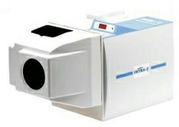
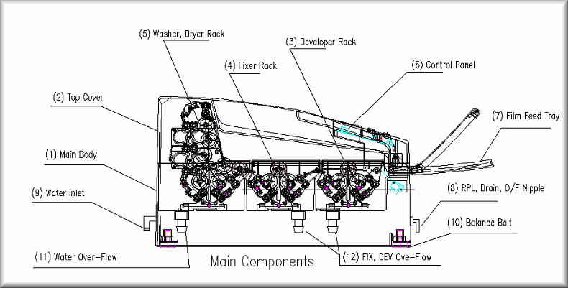

Slide 45
Mechanism of automatic film processing
This consists of a transport mechanism that picks up unwrapped film and passes it through developing, fixing, washing and drying sections
The transport system most often used is a series of rollers driven by a constant-speed motor that operates through gears, belts or chains
Rollers often consist of independent assemblies of multiple rollers in a rack, with one rack for each step in operation
These assemblies are designed and positioned so that the film crosses over from one roller to the next, the operator may remove them individually for soaking, cleaning and repairing

Slide 46
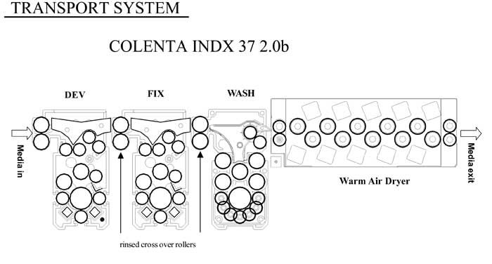

Slide 47
Function of rollers
Primary function of rollers is to move the film through the developing solutions
Motion of rollers helps keep the solutions agitated, which contributes to uniformity of processing
The rollers press on film emulsion, forcing some solution out of the emulsion
The top rollers at he cross over point b/w developer and fixer tanks remove developing solution, minimising carry over of developer into fixer
Fixer has an additional hardener that helps the emulsion withstand the rigors of the transport system

Slide 48
Management of radiographic wastes
Primary concern is dissolver silver in used fixer
Another material of concern is lead foil
Siver may be recovered by use of either metallic replacement or methods
metallic replaelectroplating cements uses cartridges through which waste s
Solutions are poured
In this process, iron goes into solution and silver precipitates as sludge
In electroplating method, waste solutions come into contact with 2 electrodes through which a current passes
Cathode captures silver
Scrap silver and lead can be sold to silver refiners and buyers

Slide 49
Mounting radiographs
Mounts are made of plastic or cardboard and may have a clear plastic window that covers and protects the film
Operator can arrange several films in a mount in the proper anatomic relationship
Opaque mounts are best

Slide 50
Duplicating radiographs
The film to be duplicated is placed against the emulsion side of the duplicating film, and the two films are held in position by a glass-topped cassette or photographic printing plate
The films are exposed to light, which passes through the clear areas of the original r/g and exposes the duplicating film
The duplicating film is then processed
films result in less resolution and more contrast
Light source used is UV light

