Slide 1
Analytical Study Design

Slide 2
Second major type of epidemiological study designs
Occupies an intermediate position in the ‘Hierarchy of Evidence’
Experimental
Studies
Analytical Studies
Descriptive Studies

Slide 3
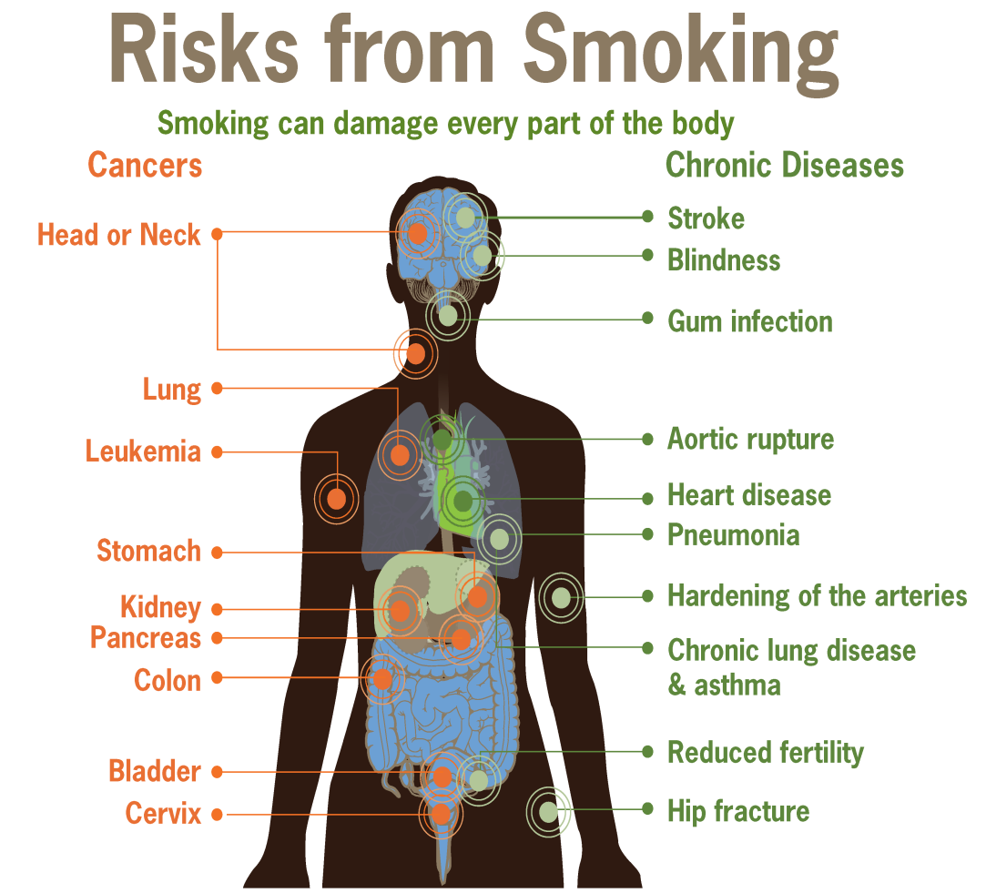

Association between a suspected factor(exposure) and specific outcome studied.
To test the hypothesis

Slide 4
Retrospective Study
Individual with particular disease
Individual without particular disease
Cases
Factors Present
or absent
Controls
Prospective Study
Individual exposed to particular factors
Individual unexposed to particular factors
Presence or absence of particular disease
time

Slide 5
Case control study
Often called as, “Retrospective Study”
First approach to test the casual hypothesis.
Has three distinct features
  Exposure and outcome have occurred before study
  Study proceeds backward from effect to cause
  It uses control or comparison groups to support or refute an inference.

Slide 6
Framework of the case control study
Suspected or risk factors | Cases (Disease present) | Control (Disease absent)
Present | a | b
Absent | c | d

Slide 7
Steps in case control study
Selection of cases and controls
Matching
Measurement of exposure
Analysis of data

Slide 8
Selection of Cases
There are two specification
  Diagnostic criteria
  Eligibility criteria
Sources of Cases
  Hospitals
  General population

Slide 9
Selection of Controls
Must be as similar to the cases as possible
Sources of controls
  Hospital controls
  Relatives
  Neighborhood controls
  General population

Slide 10
Case control study
Cases
Mothers who delivered babies with developmental disorder
Controls
Mothers who developed normal babies
“Thalimide trgedy” was exposed by case control study

Slide 11

How many cases? controls?
If adequate cases are available, Cases : Controls ratio is 1 : 1
If adequate cases are not available, Cases : Controls may be a maximum of 1 : 4 ratio

Slide 12

Case control studies
Matching –
  Controls may differ from the cases in a number of factors such s age, sex, occupation, social status etc
  crucial for controlling confounding

Slide 13
Case control study
CASES
Mother’s age
Mother’s nutrition
Other confounders
CONTROLS
Mother’s age
Mother’s nutrition
Other confounders

Slide 14
When I do, I learn….! Let us start Learning
‘thalidomide Tragedy’ was exposed by case control study
CASES: Mothers who delivered babies with developmental disorders (n=100)
Mothers who had thalidomide
(n=70)
Mothers who did not have thalidomide
(n=30)
CONTROLS: Mothers who delivered normal babies (n=100)
Mothers who had thalidomide
(n=30)
Mothers who did not have thalidomide
(n=70)

Slide 15
Result
Exposure to Thalidomide | Cases | Controls
Yes | 70(a) | 30(b)
No | 30(c) | 70(d)
Exposure rate among cases = a/a+c = 70/70+30 = 70%
Exposure rate among controls = b/b+d = 30/30+70 = 30%
70% vs 30%

Slide 16
Estimation of risk
Estimation of disease risk with exposure.
Relative Risk = ___________________
= {a/(a+b)} / {c/(c+d)}
= 2.33
Incidence among exposed
Incidence among non exposed

Slide 17
Result
Association between risk factor and outcome
Odds ratio (cross product ration) = ad/bc = 70x70/30x30 = 5.4
Interpretation
Mother who had thalidomide during pregnancy are 5.4 times at higher risk of delivering babies with developmental defects than the mothers who have not taken thalidomide during pregnancy.

Slide 18
Advantages
Relatively easy to carry out
Rapid and inexpensive
Require comparatively few subjects
Suitable to investigate rare diseases
No risk to subject
Allows the study of several different etiological factors
Risk factors can be identified
No attrition problems
Minimal ethical problems

Slide 19
Disadvantage
Problems of bias relies on memory and past records
Selection of an appropriate control group may be difficult.
We can not measure the incidence and only relative risk can be estimated
Not suited to evaluation of therapy or prophylaxis of disease
Another major concern is representativeness of cases and controls

Slide 20
Case control study – A recap
Group of interest
(ex cancer patients)
Compare histories
Draw Conclusion
Comparison group
Ex non patients

Slide 21
NEXT CLASS

Slide 22
Cohort study
Salient features:
Cohort is defined as a group of people who share a common characteristic or experience with in a defined time period
Cause to effect
Begins by assembling a ‘cohort’ who are followed up over a period of time – possible to find the incidence rate.
Association between an exposure (measured at the start of the study) and an outcome is studied.
Regarded as the ‘Gold Standard’ design to study association.

Slide 23
Indication for cohort study
  When there is good association between exposure and disease.
  When exposure is rare, but incidence of disease high among exposed ex: exposure to x ray
  Attrition of study population is minimized.
  Ample funds are available.

Slide 24
Design and study of cohort study
Define Population
Prospective 2015
Retrospective 2005
Exposed
Nonexposed
2025
Follow up
2015
Diseased
(a)
Nondiseased
(c)
Diseased
(b)
Nondiseased
(d)
2005
2015
2025

Slide 25
Framework of Cohort study
The data collection in cohort study is represented in a 2 x 2 contingency table.
Exposure | Outcome (disease)
 | Present | Absent
Yes | a | b
No | C | d

Slide 26
Following considerations should be taken into mind while assembling cohorts
Cohorts must be free from the disease under the study
Both the group should be equally susceptible to the disease under study
Both the groups should be comparable in respect of all the possible variables, which may influence the frequency of the disease
The diagnostic and eligibility criteria must be defined beforehand

Slide 27
Elements of cohort study:
1.) Selection of study subjects
2.) Obtaining data on exposure
3.) Selection of comparison
4.) Follow up
5.) Analysis

Slide 28
1.)Selection of study subjects
Cohorts can be selected from
  General population
  Special groups
    Select groups (eg. Doctors, lawyers, teachers, etc.)
    Exposure groups

Slide 29
2.) Obtaining data on exposure
Information can be obtained from
  Cohorts
  Review of records
  Medical examination or special tests
  Environmental surveys
Information about exposure should facilitate classification of cohort members
  According to whether or not they were exposed
  According to the degree of exposure.

Slide 30
3.) Selection of comparison groups:
Internal comparison
External comparison
Comparison with general population rates.
4.) Follow up
At the start of the study out come should be determined (morbidity, mortality) to asses this
Periodic medical examination
Reviewing physician and hospital records
Routine surveillance of death records
Mailed questionnaire, telephone calls etc.

Slide 31
Cohort study
The data collection in cohort study is represented in a 2 x 2 contingency table.
Exposure | Outcome (disease)
 | Present | Absent
Yes | a | b
No | C | d

Slide 32
Cohort study
Incidence rate among exposed group = a/a+b
Incidence rate among non-exposed group = c/c+d
a/a+b Vs c/c+d
Incidence rate among the exposed and non-exposed groups are compared; if the difference is found to be statistically significant, association said to exist.

Slide 33
Cohort study
Relative risk/risk ratio (RR):
Incidence among exposed
Incidence among nonexposed
RR = 1 : No Risk
RR > 1 : Harmful Effect
RR < 1 : Protective Effect

Slide 34
Cohort study
Attributable risk/Risk difference:
Incidence among exposed – Incidence among non-exposed
Incidence among exposed
It expressed in percentage
It is the extend to which the disease under study can be attributed to the exposure

Slide 35
Cannabis is a commonly abused substance worldwide. The association between cannabis use and periodontal disease was studied in a cohort study. The data given below
Exposure | Outcome (disease)
 | Present | Absent
Yes | 90(a) | 10(b)
No | 40(c) | 160(d)

Slide 36
Result
Incidence among exposed: a/a+b = 90/90+10 = 0.9
Incidence among nonexposed: c/c+d = 40/40+160 = 0.2
Relative risk = incidence among exposed = 0.9 = 4.5
incidence among non exposed 0.2
Subjects who use cannabis are 4.5 times at higher risk for periodontal disease than those who do not use cannabis

Slide 37
Results
Attributable risk calculation:
Incidence among exposed – Incidence among non-exposed
Incidence among exposed
= 0.9 – 0.2/0.9
= 0.7/0.9
= 77.78%
About 78% of periodontal disease in the study population can be attributed to cannabis usage.

Slide 38
Recap
Group of Interest
e.g. smokers
Follow
Over time
Compare outcomes
Comparison Group
e.g. non-smokers
Follow
Over time

Slide 39
Remember
No one design is better than the others.
Choose the appropriate study design that would answer the research question in proper manner.
Feasibility, availability of resources and ethical considerations have influence on choosing a study design.

Slide 40
Advantages
Incidence can be calculated
Several possible outcomes relate to exposure can be studied
Provide a direct estimation of relative risk
Dose response ratio can be calculated

Slide 41
Disadvantages
Involve a large no. of people, which is unsuitable for investing rare diseases
Attrition
Expensive
Administrative problems may occur
Changes may occur in diagnostic criteria's or standard method which can not be introduced later
Ethical problems can be faced.

Slide 42
Thank you

