Slide 1
BACTERIAL INFECTION OF ORAL CAVITY

Slide 2
LEARNING OBJECTIVES
At the end of the lecture student should be able to describe the
etiology, clinical features, histopathological features of Scarlet fever
etiology, clinical features, histopathological features of Noma
etiology, clinical features, histopathological features of Pyogenic granuloma

Slide 3
Scarlet fever
Occurs predominantly in children during winter months.
Caused by β-hemolytic streptococci.
Clinical features
Incubation period 3-5 days
Sever pharyngitis, tonsillitis, headache, fever, chills, vomiting
Enlargement of cervical lymphnodes.

Slide 4
Clinical features
2nd or 3rd day –characteristic, diffuse bright red scarlet skin rash.
Rash prominent in skin folds, & produced due to toxic injury to the vascular endothelium producing dilation of blood vessels & hyperemia.

Slide 5
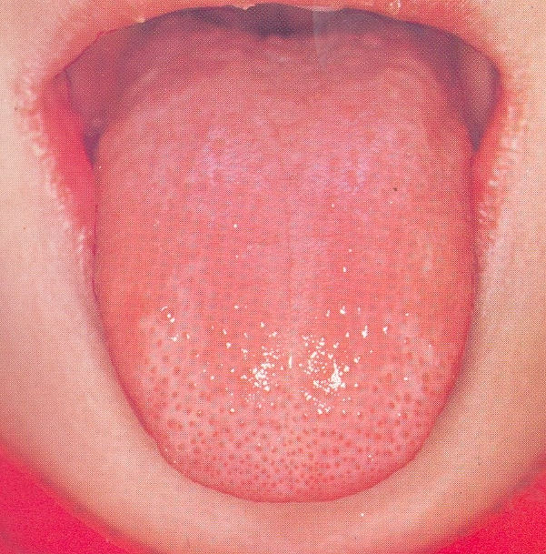
Oral manifestations-
Palatal mucosa congested, throat fiery red
Strawberry tongue
Raspberry tongue

Slide 6
Complications-
Peritonsillar abscess, rhinits, sinusitis, otitis media,mastoiditis, pneumonia, rheumatic fever

Slide 7
NOMA ( cancrum oris)
Rapidly spreading gangrene of oral and facial tissues that usually occurs in debilitated or nutritionally deficient patients.
Clinical features-
Begins as small ulcer of gingival mucosa which rapidly spreads to involve the surrounding tissues of jaws,lips and cheeks by gangrenous necrosis.

Slide 8
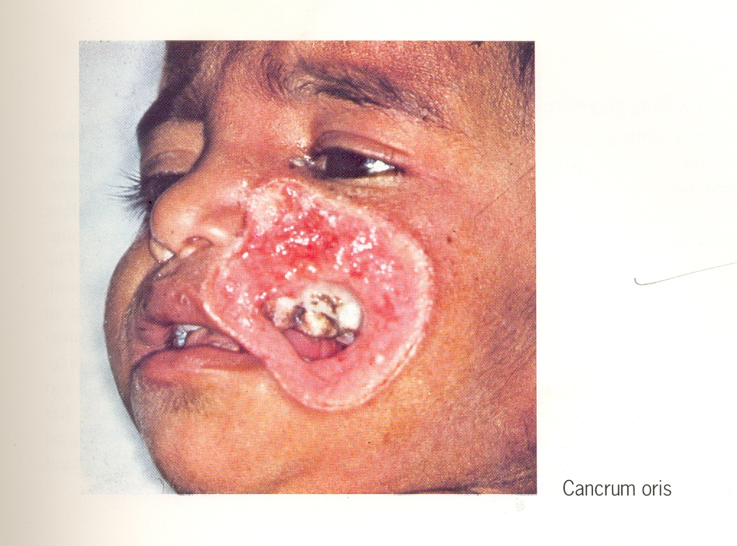

Slide 9
Initial site is usually one of stagnation around a fixed bridge or crown.
Overlying skin becomes inflamed, edematous and necrotic
A line of demarcation develops between healthy and dead tissue and large masses of tissue slough out leaving jaw exposed.
Occasionally tongue may be involved.

Slide 10
Pyogenic granuloma
Clinical features-
Frequently found on gingiva, lips, tongue , buccal mucosa and other areas.
Elevated, pedunculated, or sessile mass with smooth, lobulated or warty surface.
surface is commonly ulcerated, showing tendency for hemorrhage.
Deep red or reddish purple depending on the Vascularity
Soft in consistency.

Slide 11
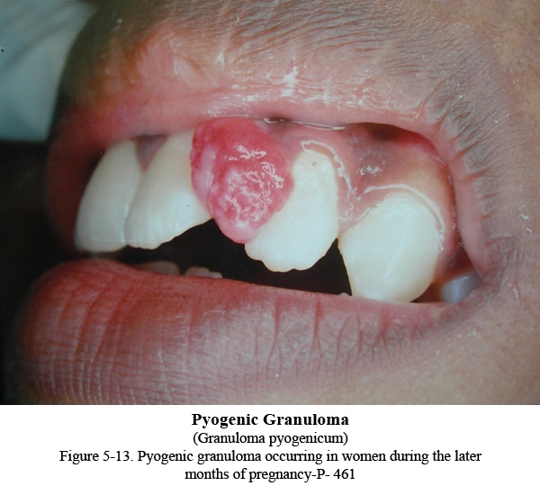

Slide 12
Histopathologic features-
Overlying epithelium thin and atrophic, may be hyperplastic
Large number of endothelium lined spaces, proliferation of fibroblasts and budding endothelial cells.
Moderate inflammatory cell infilterate

Slide 13
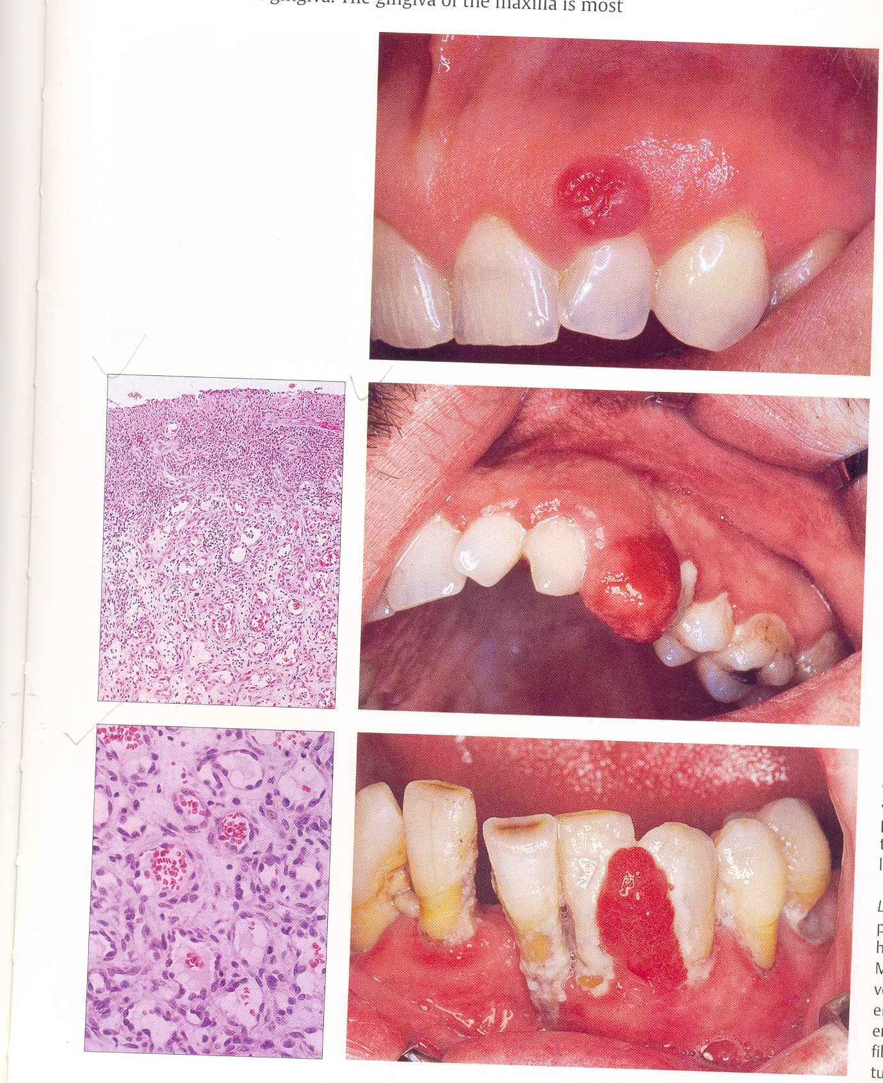
proliferation of inflammatory cells
Large number of
endothelium lined spaces,
Proliferation of fibroblasts

Slide 14
SUMMARY
etiology, clinical features, histopathological features of scarlet fever
etiology, clinical features, histopathological features of Noma
etiology, clinical features, histopathological features of Pyogenic granuloma

Slide 15
BIBLIOGRAPHY
Text Book of Microbiology Ananthanarayan R 7th Edition
Text book of oral pathology Shafer's, 5 & 6th edition
Color Atlas of Oral Diseases Cawson, R. 2nd edition
Oral and Maxillofacial Pathology Neville, Brad W. 2nd
Lucas’s Pathology Of Tumor’s of the Oral Tissues
Cawson, R. A., Bennie, W. H 5th edition

Slide 16
THANK YOU

