Slide 1
BIOSTATISTICS

Slide 2
Definition:
“It is the method of collection, organizing analyzing, tabulating & interpretation of data related to living organisms & human being”.
John Graunt – Father of health statistics

Slide 3
Bio-statistics
(Grant John)
Application of statistics to health problems.
Different names in different fields:
  Health statistics – public/ community health.
  Medical statistics – medicine.
  Vital statistics – demography.
  Dental statistics – dentistry.

Slide 4
General application of bio-statistics:
To define what is normal or healthy in a population. Ex:-pulse rate/ min.
To find:-
Statistical difference between means of two variables. Ex: mean plaque scores for two groups.
Co-relation between two variables.
Ex; - sugar & Dental caries, Fluoride Conc. & Fluorosis.
usefulness of sera & vaccines in the field. % of deaths among vaccinated compared to % of deaths among unvaccinated.
To test the efficacy of different tooth pastes.
Ex: Colgate, close up.

Slide 5
Uses of statistics in dental science:
To assess the state of oral health in the community and to determine the availability and utilization of dental care facilities.
To indicate the basic factors underlying the state of oral health by diagnosing the community and solutions to such problems.
To determine success or failure of specific oral health care programs or to evaluate the programme action.
To promote health legislation and in creating administrative standards for oral health

Slide 6
Collection of Data
Data: A collective recording of observations either numerical or other-wise
two broad categories:
Data
Qualitative data
Eg: sex, malocclusions
Quantitative data
Eg :arch length, width
Discrete:
fixed values
Continuous:
value in range
Notes:
Qualitative data: when the data is collected on the basis of attributes (characteristics)
Quantitative: when the data is collected through measurement

Slide 7
Sources of data
Sources of data
primary
Direct personal
interview
Oral health
examination
Questionnaire
method
Secondary
Surveys
Experiments
Records
in OPD

Slide 8
PRESENTATION OF DATA
objective of classification of data :
make the data simple,
concise, meaningful,
interesting and
helpful in further analysis.
two main methods of presenting data:
Tabulation and
Diagrams
Notes:
Data collected and compiled from experimental work, surveys, registers or records are raw data. These are unsorted and are not much helpful for understanding the underlying trends or its meaning, so these are to be sorted & classified in to characteristic groups or classes like, according to age, sex, social class, number of DMFT, etc.

Slide 9
TABULATION
classified on the following bases:
Geographical. i.e , area-wise, e.g. cities, districts etc.
Chronological i,e, on the basis of time.
Qualitative i.e according to some attribute.
Quantitative i,e in terms of magnitude.
The two elements of classification are
The variable and
The frequency.

Slide 10
Variable: a name denoting a condition , occurrence or effect that can assume different values
Divided: subgroups ,classes.
have lowest and highest values
Class interval : difference between the upper and lower limit of a class
Eg: in the class 5 -14,
5 - lower limit and 14 - upper limit.
class interval = 14 - 5 =9.
Frequency: is the number of units belonging to each group of the variable.
Frequency distribution table: way of presenting data in the tables

Slide 11
Types of Table
Master Table
Simple Table
Frequency Table

Slide 12
Master Table
Sr. no. | Age | sex | education | d | m | f | dmf
01
02
03

Slide 13
Simple Table
Region | Tobacco use
Maharashtra | 77%
Gujrat | 65%
Andra | 79%
UP | 84%

Slide 14
Frequency distribution table
Title of the table – named at the bottom
The no of class intervals - between 5 and 20. no rigidity about it.
The class intervals - at equal width.
Clearly defined class limits – to avoid ambiguity.
For e.g., 0-4, 5-9, 10-14. Etc.
Clearly defined row and column with the headings
Units of measurement should be specified.
If the data is not original, the source of the data should be mentioned at the bottom of the table.
Age group(yr) | frequency
11-20 | 44
21-30 | 43
31-40 | 39
41-50 | 35
Notes:
following basic rules are to be followed:

Slide 15
Diagrams:
Extremely useful
attractive to the eyes,
gives a bird's eye view of the entire data,
have a lasting impression
facilitate comparison of data relating to different time periods and regions.

Slide 16
TYPES OF DIAGRAMS:
Bar Diagram : qualitative data.
Multiple Bar: qualitative data
Proportional Bar Diagram: qualitative data.
Pie Diagram: qualitative data
Component Bar Diagram: qualitative data
Line diagram: qualitative data
Frequency Polygon: qualitative data
Cartograms or Spot Map: geographical distribution of frequencies
Histogram: quantitative data of continuous type.

Slide 17
Basic rules :
self explanatory
simple and consistent with the data.
values of the variables - on horizontal or X-axis and the frequency - vertical line or Y-axis.
No too many lines on the graph, should not look clumsy.
The scale of presentation – right hand top corner of the graph.

Slide 18
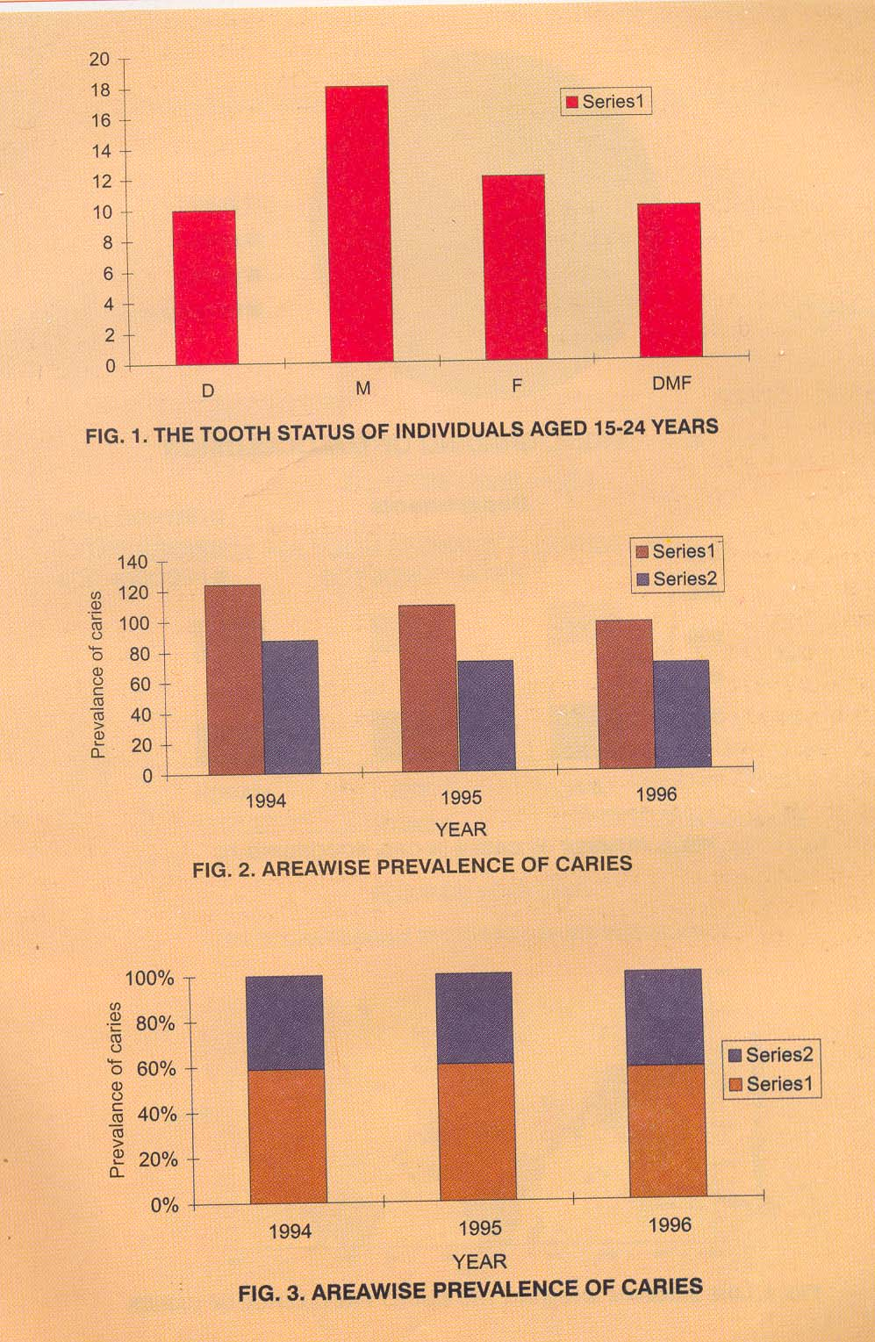
Bar Diagram
represent qualitative data.
only one variable.
width of the bar remains the same
the length varies according to the frequency in each category.
bars : vertical or horizontal.
Limitation :
represent only one classification
cannot be used for comparison

Slide 19
Multiple Bar:
compare qualitative data with respect to a single variable.
Eg: sex ­wise or with respect to time or region.
each category of the variable have a set of bars of the same width corresponding to the different sections without any gap in between the width and the length corresponds to the frequency.

Slide 20
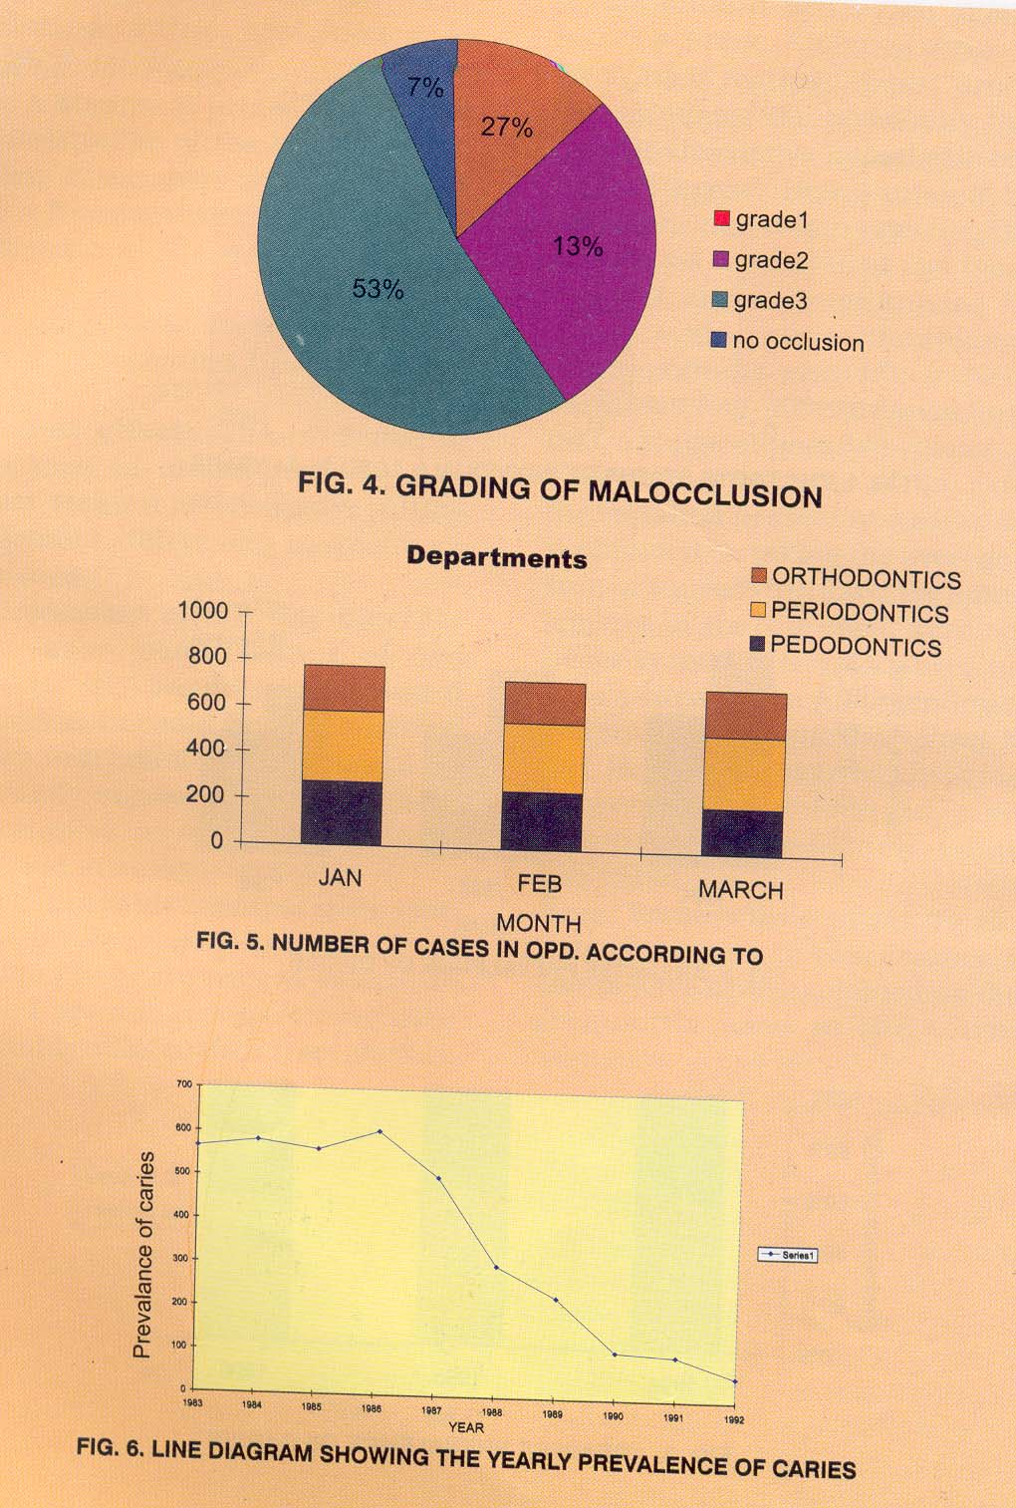
Proportional/Component Bar Diagram:
represent qualitative data.
both, the number of cases in major groups as well as the subgroups simultaneously
cases of the major group drawn
each rectangle is divided according to no in the subgroups.

Slide 21
PIE DIAGRAM
The frequency of the group is shown in a circle.
Degree of angle denotes the frequency.
Instead of comparing the length of bar , the areas of segments are compared.

Slide 22
Line diagram:
useful to study changes of values in the variable over time
simplest type
X-axis, - hours, days, weeks, months or years
Y-axis- value of any quantity pertaining to X-axis,

Slide 23
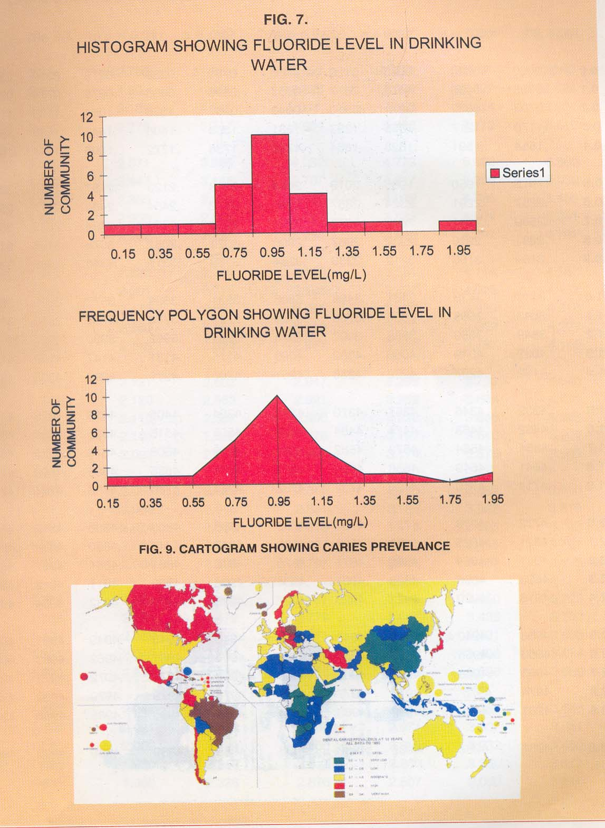
Histogram
quantitative data of continuous type.
bar diagram without gap between the bars.
represents a frequency distribution.
X-axis: the size of an observation is marked. Starting from 0 the limit of each class interval is marked, the width corresponding to the width of the class interval in the frequency distribution.
Y-axis :the frequencies are marked.

Slide 24
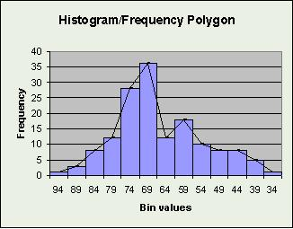
Frequency Polygon
frequency distribution of quantitative data
compare two or more frequency distributions.
a point is marked over the mid-point of the class interval, corresponding to the frequency.
points are connected by straight lines.
The first point and last point are joined to the midpoint of previous and next class respectively.
To compare two or more frequency distributions, lines of different types are drawn on the same graph.

Slide 25
Cartograms or Spot Map
show geographical distribution of frequencies of a characteristic.

Slide 26
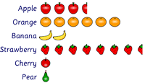
PICTOGRAM
The pictures representing the value of items are called pictograms.
It is most useful way of representing data to those people who cannot understand.

Slide 27
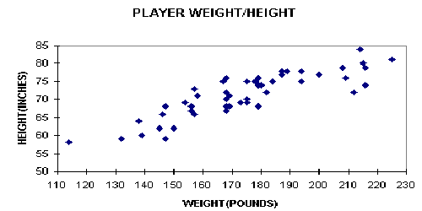
Scatter Diagram shows the relationship b/w two variables

Slide 28
Common Statistical Terms
Constant
  Quantities that do not vary e.g. in biostatistics, mean, standard deviation are considered constant for a population
Variable
  Characteristics which takes different values for different person, place or thing such as height, weight, blood pressure
Population
  Population includes all persons, events and objects under study. it may be finite or infinite.

Slide 29
Common Statistical Terms
Sample
  Defined as a part of a population generally selected so as to be representative of the population whose variables are under study
Parameter
  It is a constant that describes a population e.g. in a college of 200 students there are 40% girls i.e. 80 girls. This describes the population, hence it is a parameter.

Slide 30
Common Statistical Terms
Attribute
  A characteristic based on which the population can be described into categories or class e.g. gender, caste, religion.

Slide 31
Measures of central tendency:
Central Value around which the other values are distributed
Objective:
to condense the entire mass of data
to facilitate comparison
Types:
Arithmetic mean- mathematical estimate.
Median - positional estimate.
Mode- based on frequency.
Notes:
For overall comparison of the distributions, the entire mass of data may be summarized using a single value. This single estimate of a series of data that summarizes the data is known as the parameter and one such parameter is the measure of central tendency

Slide 32
Properties of central tendency:
Should be easy to understand and compute.
should be based on each and every item in the series.
should not be affected by extreme observations (either too small or too large values).
should be capable of further statistical computations.
It should have sampling stability. i..e, if different samples of same size, say 10 are picked up from the same population and the measure of central tendency is calculated, they should not differ from each other markedly.

Slide 33
Arithmetic Mean:
simplest measure of central tendency.
Ungrouped data:
Mean = Sum of all the observations of the data
Number of observations in the data
X = Σ Xi
n
Σ : sigma, means the sum of.
Xi : is the value of each observation in the data,
n: is the number of observations in the data.

Slide 34
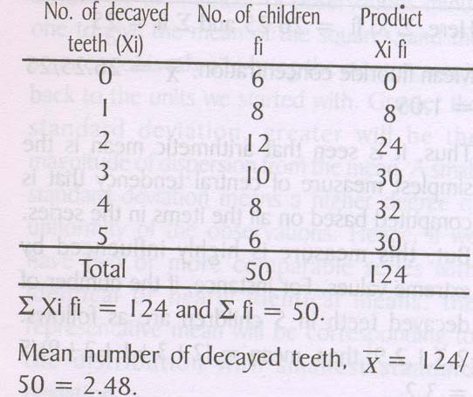
Grouped data with range for class interval:
frequencies in a class interval are equally distributed on either side of the mid point of the class interval.
The formula :
X = Σ X_{i}f_{i}
Σ f_{i}
Where,
X_{i} : midpoint of the class interval, mean
f_{i} : corresponding frequency

Slide 35
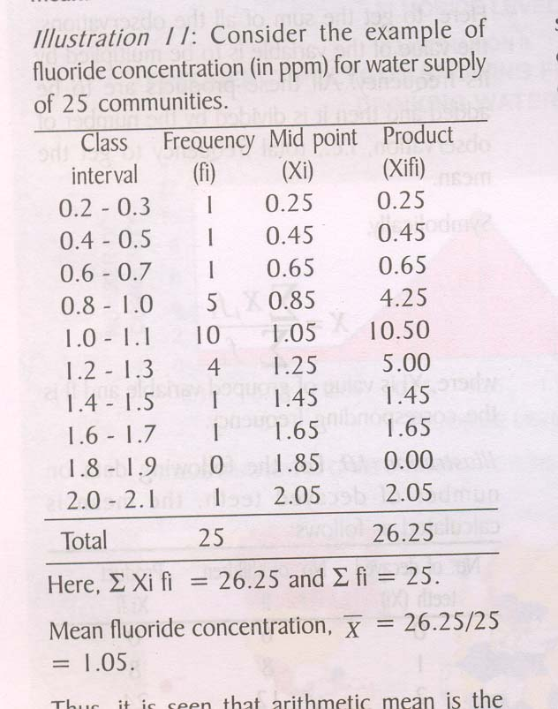
Grouped data with single value for class interval:
Symbolically,
X = Σ X_{i}f_{i}
Σ fi
Where,
X_{i} : is grouped variable ,
f_{i}: corresponding frequency
Notes:
When the numbers of observations are many, the above method will be tedious and hence frequency distribution tables are formed and the mean is calculated from the table.
In a frequency distribution the class interval may be a single value of the variable or a group of values of the variable. The calculation of the mean for the two methods of grouping is given below:

Slide 36
Median
– is the middle value, which divides the observed values into two equal parts, when the values are arranged in ascending or descending order

Slide 37
Median
In an ordered array, the median is the “middle” number
  If n or N is odd, the median is the middle number
  If n or N is even, the median is the average of the two middle numbers
0 1 2 3 4 5 6 7 8 9 10
0 1 2 3 4 5 6 7 8 9 10 12 14
Median = 5
Median = 5

Slide 38
Mode
– is the value of the variable which occurs most frequently
  Mode = (3median – 2mean)

Slide 39
Mode
Value that occurs most often
Not affected by extreme values
Used for either numerical or categorical data
There may be no mode
There may be several modes
0 1 2 3 4 5 6 7 8 9 10 11 12 13 14
0 1 2 3 4 5 6
No Mode
Mode = 9

Slide 40

.
mean

Slide 41
median

Slide 42
mode

Slide 43
Measures of Variation
Variation
Range
Standard Deviation
Variance

Slide 44

The Range
Measure of variation
Difference between the largest and the smallest observations:
Ignores the way in which data are distributed
Range = 12 - 7 = 5
Range = 12 - 7 = 5
7 8 9 10 11 12
7 8 9 10 11 12

Slide 45
Standard Deviation
The Standard Deviation is a measure of how spread out numbers are.
Its symbol is σ (the greek letter sigma)
The formula is easy: it is the square root of the Variance.
"What is the Variance?"

Slide 46
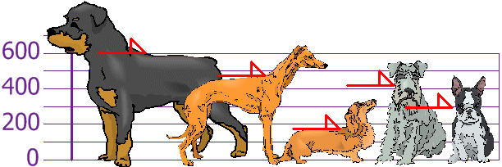
Variance
how far a set of (random) numbers are spread out from their mean
You and your friends have just measured the heights of your dogs (in millimeters):
The heights (at the shoulders) are: 600mm, 470mm, 170mm, 430mm and 300mm.

Slide 47
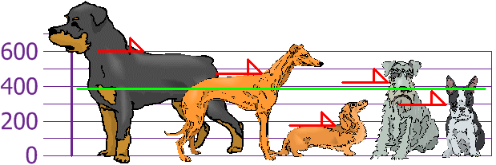
so the mean (average) height is 394 mm. Let's plot this on the chart:

Slide 48
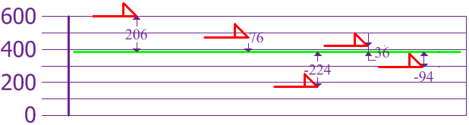

Slide 49
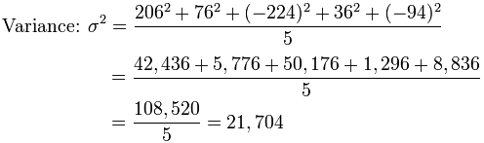
To calculate the Variance, take each difference, square it, and then average the result:

Slide 50
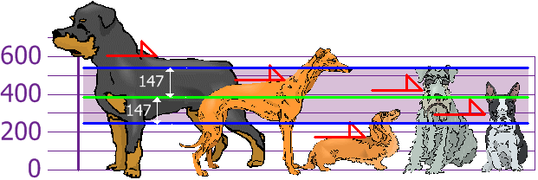
And the Standard Deviation is just the square root of Variance, so:
And the good thing about the Standard Deviation is that it is useful. Now we can show which heights are within one Standard Deviation (147mm) of the Mean:
Standard Deviation
σ | = √21,704
 | = 147.32...
 | = 147 (to the nearest mm)

Slide 51
Mean Deviation= ∑|(x-x)|/N = 30/8 =3.75
x | |(x-x)|
3 | 6
6 | 3
6 | 3
7 | 2
8 | 1
11 | 2
15 | 6
16 | 7
Mean= 9 | ∑|(x-x)| = 30

Slide 52
Standard deviation
(Root Mean Square deviation)
For small samples
For large samples

Slide 53
For frequency distribution
For small samples
For large samples

Slide 54
Uses of SD
  Summarizes the deviations of a large distribution from mean in one figure used as unit of freedom
  Indicates whether the variation from the mean is by chance or real
  Helps finding standard error- which determines whether the difference b/w means of two samples is by chance or real
  Helps finding the suitable size of the sample for valid conclusions

Slide 55
Coefficient of variation
is a measure used to measure relative variability
I.e,
For ex
CV of adult: (10/160)x100 = 6.25%
CV of children: (5/60)x100 = 8.33%
Thus we found that height in children shows the greater variation than adults
Persons | Mean ht | SD
Adults | 160 cm | 10cm
Children | 60cm | 5cm

Slide 56
Standard error
Standard deviation of mean values
Used to compare means with one another

Slide 57
Normal distribution
On preparing frequency distribution with small class intervals of the data collected, we can observe
  Some observations are above the mean & others
  are below the mean
  2. If arranged in order, maximum number of frequencies
  are seen in the middle around the mean & fewer at the
  extremes decreasing smoothly
  3. Normally half the observations lie above & half below
  the mean & all are symmetrically distributed on each
  side of mean
A distribution of this nature or shape is
called Normal or Gaussian distribution

Slide 58
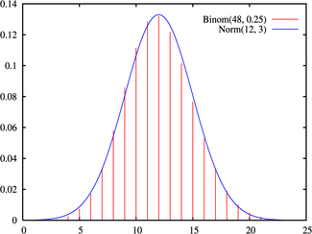
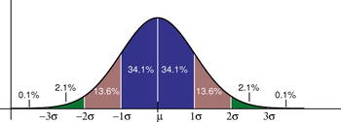
Normal distribution
Normal/ Gaussian curve
Mean ± 1 SD -- 68.3%
Mean ± 2 SD -- 95.4%
Mean ± 1 SD -- 99.7%

Slide 59
Characteristics of normal curve
  Bell shaped
  Symmetrical
  Mean, Mode & Median – coincide
  Has two inflections – the central part is convex, while at the point of inflection the curve changes from convexity to concavity

Slide 60
Arithmetically

Slide 61
Normal curve and distribution
68.26%
95.46%
99.72%

Slide 62
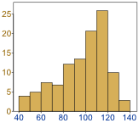
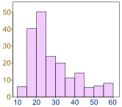
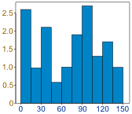
Normal Distribution
Data can be "distributed" (spread out) in different ways.
It can be spread out
more on the left
Or more on the right
Or it can be all jumbled up

Slide 63
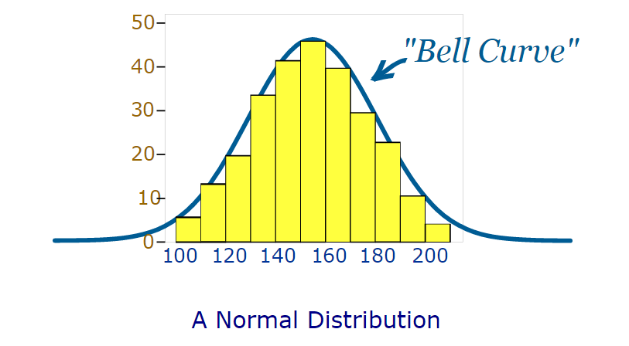
But there are many cases where the data tends to be around a central value with no bias left or right, and it gets close to a "Normal Distribution" like this

Slide 64
Hypothesis testing
Hypothesis
  is an assumption about the status of a phenomenon or is a statement about the parameters or form of population
Null hypothesis or hypothesis of no difference –
  States no difference between statistic of a sample & parameter
  of population or b/w statistics of two samples
  This nullifies the claim that the experiment result is different
  from or better than the one observed already
  Denoted by

Slide 65
Alternate hypothesis –
  Any hypothesis alternate to null hypothesis, which is to be tested
  Denoted by
Note : the alternate hypothesis is accepted when
null hypothesis is rejected

Slide 66
PROBABILITY
Probability is possibility of occurrence of any event or a permutation/combination of events.
Eg: Probability of drawing an ace from a pack of 52 cards is 4 out of 52. This is because there are 4 aces in a pack of 52 cards.

Slide 67
In biostatistics, we are interested in “Probability (P) of the observed difference in two samples due to chance (i.e. due to sampling variation)”. Here the probability scale has a range of 0 to 1.
By P=0, we mean that there is absolutely no chance that the observed difference could be due to sampling variation.
By P=1, we mean that we are absolutely certain that the observed difference in two samples is due to sampling variaton.

Slide 68

What does Not Significant really mean?
An impossible event has probability 0
An event which must occur has
probability 1
  P < 0.001 very highly significant (less than one in a thousand chance of being wrong)
  P < 0.01 Highly significant
  P < 0.05 Significant
  P > 0.05 Not significant
Measure on a scale
0
0.25
0.5
0.75
1
Event
Impossible
Event
Unlikely
happen
Event
= like
happen
Event
certain

Slide 69
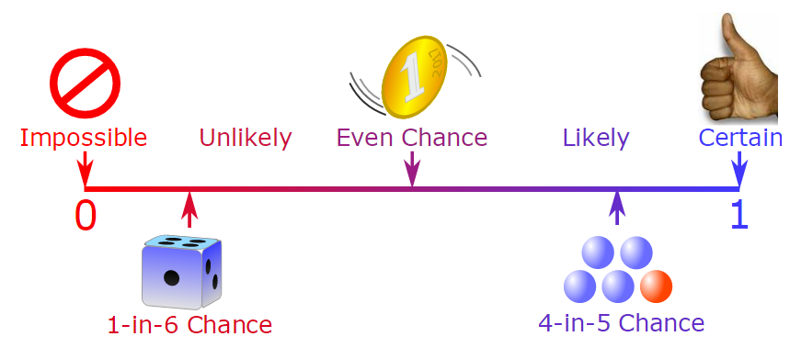

Slide 70
Sampling Distribution
Zone of
Rejection H₀
Zone of
Rejection H₀
1/2
α
1/2
Zone of
Acceptance H₀
α
Confidence interval
Confidence limits – 95%

Slide 71

Tests of Significance
Whenever 2 sets of observation have been compared, it becomes essential to find whether the diff observation b/w the 2 groups is bcos of sampling variation/ any other factor
Method – Tests of Significance

Slide 72
Tests of significance
To test whether the variation observed is of significance, the various tests of significance are done. The test of significance can be broadly classified as
Parameteric tests
Non parametric tests

Slide 73
Parameteric tests
Parametric tests are those tests in which certain assumptions are made about the population
  Population from which sample is drawn has normal distribution
  The variances of sample do not differ significantly
  The observations found are truly numerical thus arithmetic procedure such as addition, division and multiplication can be used

Slide 74
Parameteric tests
Since these test make assumptions about the population parameters hence they are called parametric tests .
These are usually used to test the difference
They are:
  t test( paired or unpaired)
  z test
  Test of significance between two means
  F test

Slide 75
Non parametric tests
In many biological investigation the research worker may not know the nature of distribution or other required values of the population.
Also some biological measurements may not be true numerical values hence arithmetic procedures are not possible in such cases.

Slide 76
Non parametric tests
In such cases distribution free or non parametric tests are used in which no assumption are made about the population parameters e.g.
  Mann Whitney test
  Phi coefficient test
  Fischer’s Exact test
  Sign Test
  Freidmans Test

Slide 77
Tests of significance for large samples

Slide 78
Test of significance for large samples
These tests are used for sample size greater than 30
The test used is Z test
Z is standard normal derivate and has been discussed under normal distribution
Z = observation – mean
SD

Slide 79
Test of significance for small samples

Slide 80
Test of significance for small samples
In case of samples less than 30
It was given by WS Gossett whose pen name was student

Slide 81
There are two types of student t Test
Unpaired t test
Paired t test

Slide 82
Unpaired t test
Applied to unpaired data of observation made on individuals of 2 separate groups to find the significance of difference between 2 means
Sample size is less than 30

Slide 83
Paired t test
It is applied to paired data of observation from one sample only .
Used in sample less than 30
The individual gives a pair of observation i.e. observation before and after taking a drug
The steps involved are

Slide 84
ANOVA

Slide 85
ANOVA
Analysis of variance
Investigations may not always be confined to comparison of 2 samples only
e.g. we might like to compare the difference in vertical dimension obtained using 3 or more methods like phonetics, swallowing, Niswonger’s method
In such cases where more than 2 samples are used ANOVA can be used

Slide 86
ANOVA
Also when measurements are influenced by several factors playing there role e.g. factors affecting retention of a denture, ANOVA can be used.
ANOVA helps to decide which factors are more important
Requirements
  Data for each group are assumed to be independent and normally distributed
  Sampling should be at random

Slide 87
ANOVA
One way ANOVA
  Where only one factor will effect the result between the groups
Two way ANOVA
  Where we have 2 factors that affect the result or outcome
Multi way ANOVA
  Three or more factors affect the result or outcomes between groups

Slide 88
Chi square test

Slide 89
Chi square test
Chi square is denoted by X²
It was developed by Karl Pearson

Slide 90
Chi square test
The most important application of chi square test in medical statistics are
  Test of proportion
  Test of association
  Test of goodness of fit

Slide 91
Chi square test
Test of proportion
  Used as an alternate test to find the significance of difference in 2 or more than 2 proportions
Test of association
  To measure the probability of association between 2 discreet attributes e.g smoking and cancer
Test of goodness of fit
  Tests whether the observed values of a character differ from the expected value by chance or due to play of some external factor

Slide 92
Chi square test
X² = Σ ( O – E ) ²
E
X² denotes Chi square
O = Observed Value
E = Expected Value

Slide 93
Chi square test
Steps in Chi Square Test
State the null hypothesis
Determine the Chi square value
Find the degree of freedom
Refer the Chi square table to find the probability value corresponding to the degree of freedom

Slide 94
Chi square test
Let us consider the following example
We are making a field trial of 2 vaccines
The results of field trial are
Vaccine | Attacked | Not Attacked | Total | Attack Rate
A | 22 | 68 | 90 | 24.4%
B | 14 | 72 | 86 | 16.2%
Total | 36 | 140 | 176

Slide 95
Chi square test
Vaccine B seems to be superior to Vaccine A
We perform Chi Square test to verify if the vaccine B is superior to vaccine A or is it merely due to chance
State the null hypothesis
It states that the vaccines have equal efficacy

Slide 96
Chi square test
Determining the Chi Square Value
Find total attack and non attack rates
Total Attack rate = 36/176 = 0.204
Total Non Attack Rate = 140/175 = 0.795
Vaccine | Attacked | Not Attacked | Total | Attack Rate
A | 22 | 68 | 90 | 24.4%
B | 14 | 72 | 86 | 16.2%
Total | 36 | 140 | 176

Slide 97
Chi square test
Vaccine | Attacked | Not Attacked
A (n=90) | O = 22 E = 0.204 X 90 =18.36 O - E = + 3.64 | O = 68 E = 0.795 X 90 = 71.55 O - E = - 3.55
B (n=86) | O = 14 E = 0.204 X 86 = 17.54 O - E = -3.54 | O = 72 E = 0.795 X 86 = 68.37 O - E = + 3.63

Slide 98
Chi square test
X² = Σ ( O – E ) ²
E
= 1.79

Slide 99
Chi square test
Find the Degree of Freedom = (c-1) (r-1)
c = number of Columns
r = number of Rows
d.f. = (2-1)(2-1) = 1

Slide 100
Chi square test
Find the p value
On referring to Chi square table with one degree of freedom the p value was more than 0.05.
Hence the difference is not statistically significant and the null hypothesis of no difference between vaccines is accepted.

