Slide 1

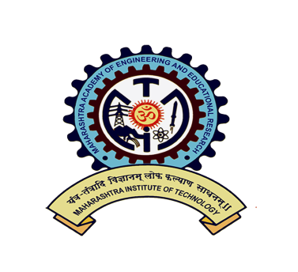


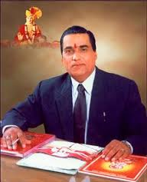

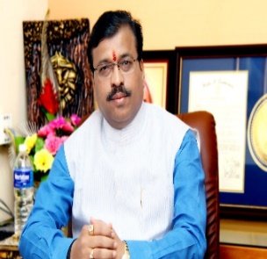

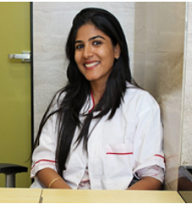
MAEER’s PUNE
MAHARASHTRA INSTITUTE OF DENTAL SCIENCES AND RESEARCH
(Dental College & Hospital)
Vishwanathpuram, Ambajogai Road, Latur.
ORGANISES CDE PROGRAMME ON
“Creating New smiles everyday: Prosthetically Driven Implantology”
Prof. (Dr.) Vishwanath D Karad
Executive President and
Managing Trustee,
MAEER’S MIT Group of institution.
MLC.Shri. Ramesh (Appa) Karad
Executive Director
MIT Campus
Latur.
Shri. Rahul Karad
Managing trustee & Executive Director
MAEER and executive president , MIT world campus.
Dr. Shri. Hanumant Karad
Executive Director,
MIT Campus,
Latur.
Guest speaker
Dr. Radhika chedda
Mds (prosthodontists)
ORGANISED BY
Dr.Aanad Ambekar
Principal
MIDSR Dental College, Latur
Dr. suresh kangane
Vice Principal
MIDSR Dental College, Latur
Dr. Ajit Jankar
HOD
MIDSR Dental College, Latur
DEPARTMENT OF PROSTHODONTICS AND CROWN & BRIGDE

