Slide 1
CONTENTS
Functions of cementum
Acellular Cementum (G.S.-10x)
Cellular Cementum (G.S.-10x)
Sharpey’s fibres (G.S.-10x)

Slide 2
Functions of cementum
Anchorage
Apical cementogenesis to maintain occlusal functional relationship thereby compensating for attrition of enamel tips & edges

Slide 3
Provides fiber reattachment & relocation due to mesial & occlusal shifting of teeth by deposition of new layer of cementum.
Maintenance of width of PDL

Slide 4
Other functions include assisting in
Repairing roots (horizontal fractures)
Walling-in filled canals
Sealing of necrotic pulps by occluding the apical foramen
Protecting underlying dentin
Modifying the affect of bone resorption
Effecting bone formation

Slide 5
Acellular Cementum (G.S.-10x)

Slide 6
Cellular Cementum (G.S.-10x)

Slide 7
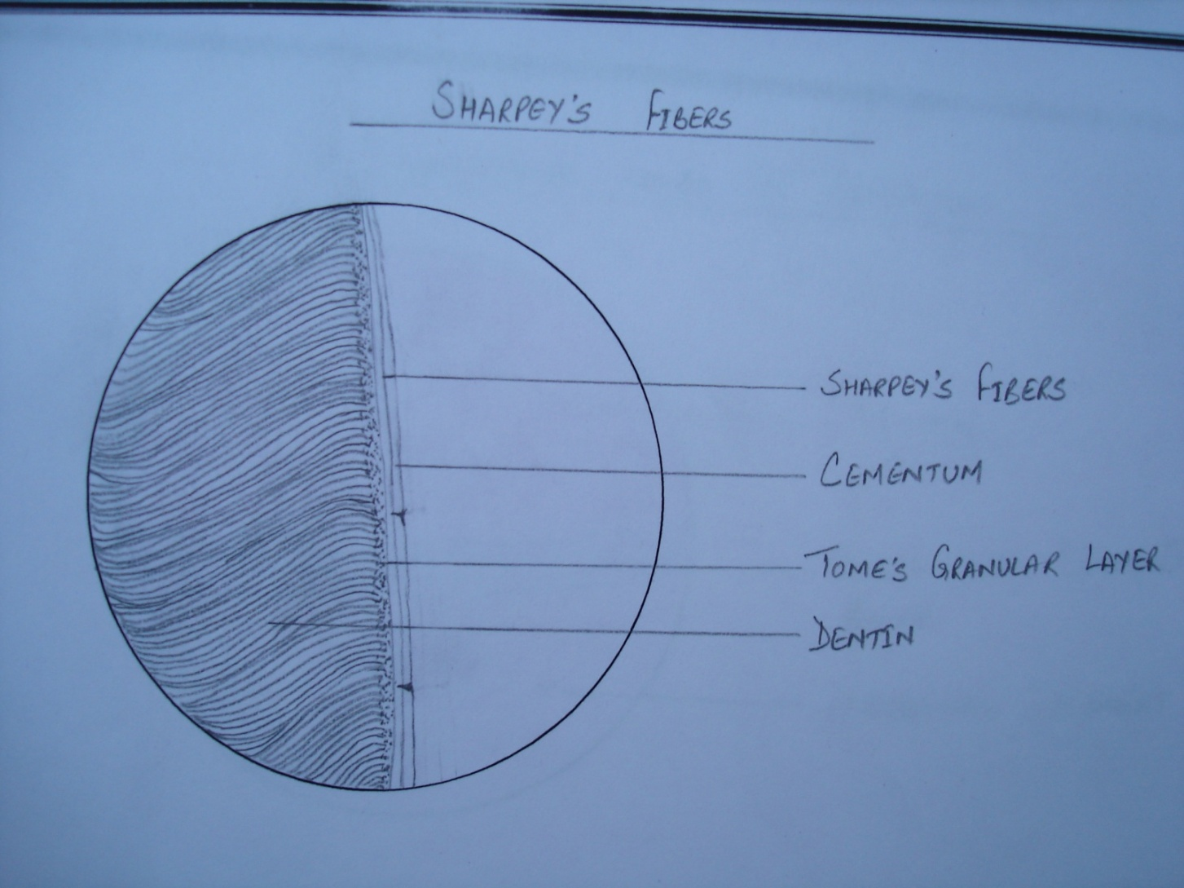
Sharpey’s fibres (G.S.-10x)

Slide 8
Incremental lines of Salter (G.S.-10x)

Slide 9
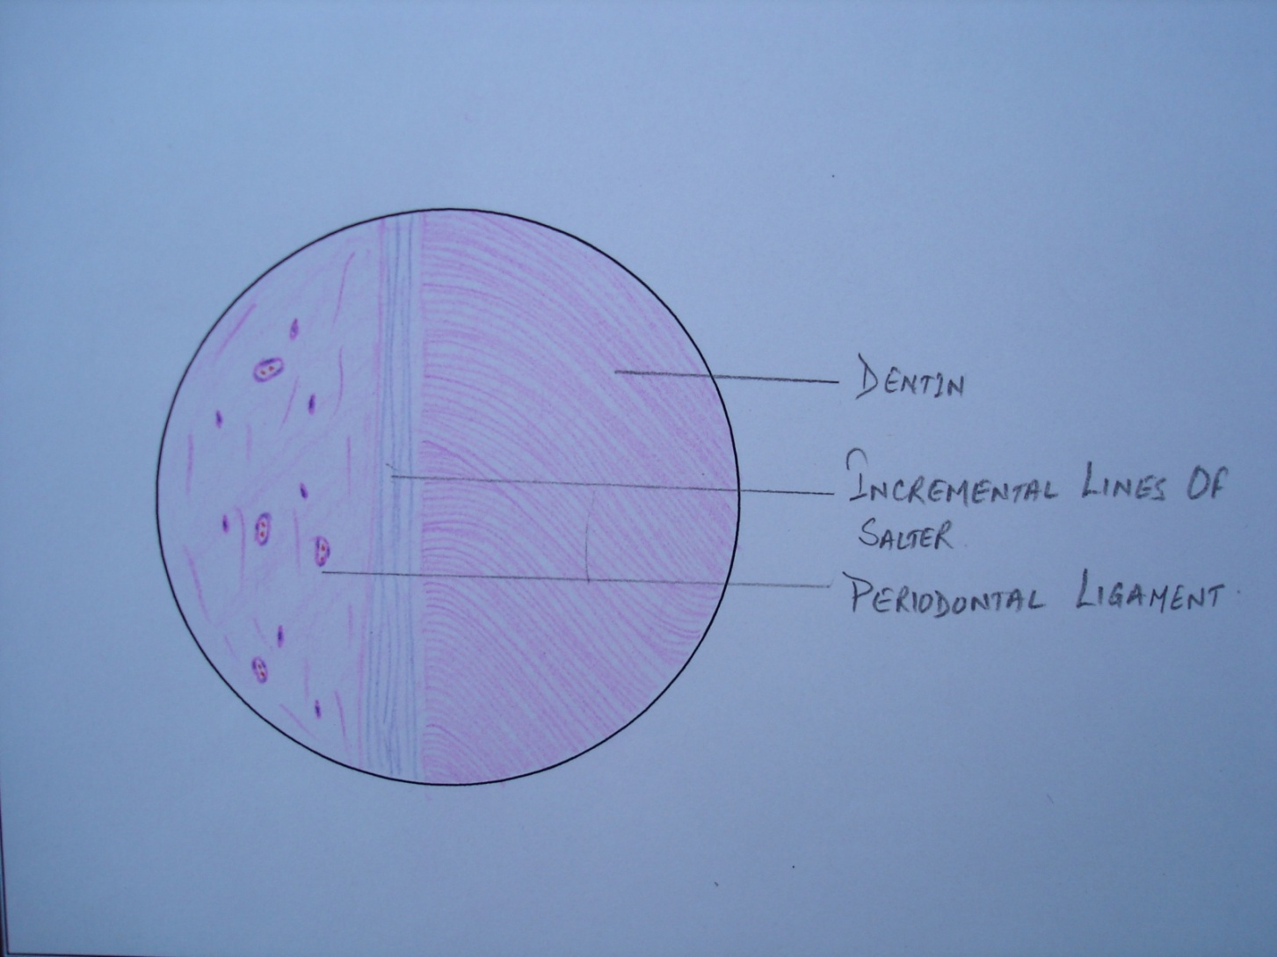
Incremental lines of Salter (D.S) (H&E-10x)

Slide 10
Cementoenamel Junction (G.S.-10x)
Overlap-60%

Slide 11
Cementoenamel Junction (G.S.-10x)
Edge to edge-30%

Slide 12
Cementoenamel Junction (G.S.-10x)
Gap-10%

Slide 13
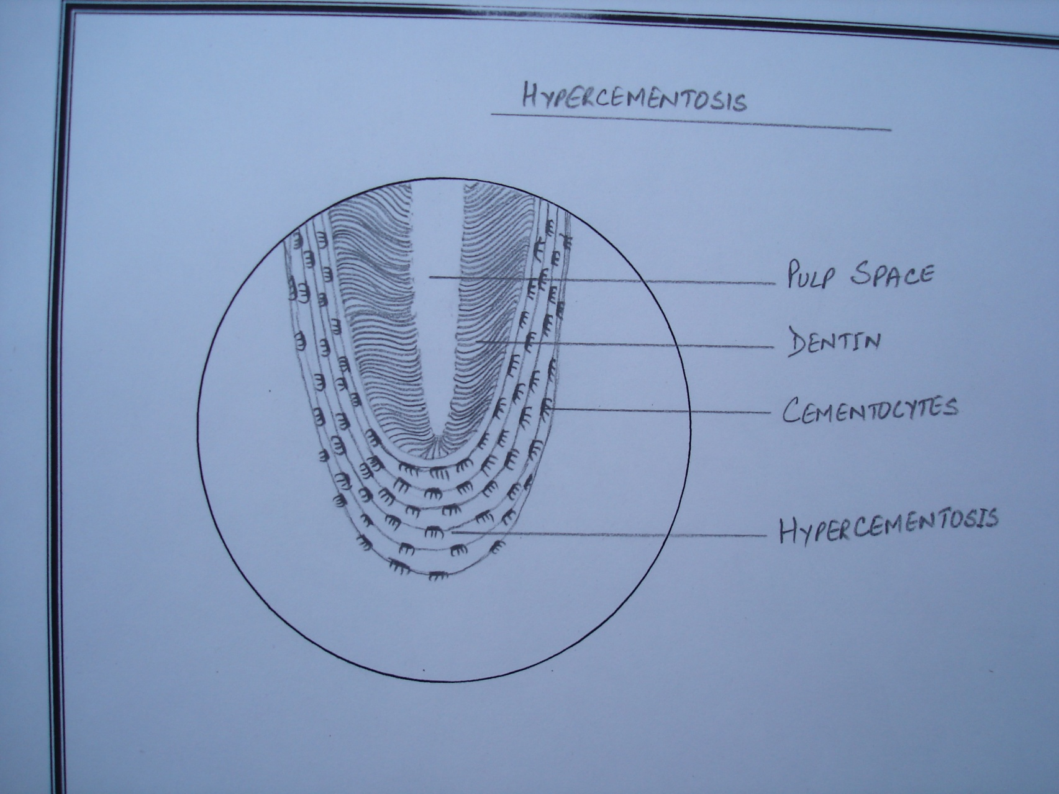
Hypercementosis (G.S.-10x)

