Slide 1
DEVELOPMENTAL DISTURBANCES
Department of oral pathology and microbiology

Slide 2
CONTENTS
DEVELOPMENTAL DISTURBANCES IN TOOTH STRUCTURE
Enamel Hypoplasia
Amelogenesis imperfecta
Dentinogenesis imperfecta
Dentin Dysplasia
Regional Odontodysplasia

Slide 3
DEVELOPMENTAL DISTURBANCES IN TOOTH STRUCTURE
DEVELOPMENTAL ENAMEL HYPOPLASIA
Caused by environmental factors.
Either primary or permanent dentition is involved.
Both enamel and dentin are affected.
Causes
Nutritional deficiencies
Exanthematous diseases
Congenital syphilis
Hypocalcemia
Birth injury, prematurity, Rh incompatibility
Local infection/trauma
Ingestion of chemicals
Idiopathic

Slide 4
Types
Mild-few small grooves, pits or fissures in enamel surface.
Moderate-rows of deep pits arranged horizontally across the tooth.
Severe-considerable portion of enamel may be lost.
Clinical Features
Due to nutritional deficiency-
Mainly deficiency of vitamin A, C and D during tooth formation, usually pitting type of hypoplasia is seen.
Involve those teeth that form within the 1st year after birth.

Slide 5
Due to exanthematous fevers
Measles, chickenpox, scarlet fever are the common causes. Ameloblasts being one of the most sensitive group of cells in terms of metabolic function are easily affected by any systemic diseases.
Due to congenital syphilis
Pathognomonic appearance is seen.
Involves maxillary and mandibular permanent incisors and 1st molars.
Incisors shows “Hutchinson’s teeth” characterized by screw driver shape, mesial and distal surfaces of crown taper towards the notched incisal edge.
Molars show “mulberry molars” characterized by irregular crowns and enamel of the occlusal 1/3rd arranged in an agglomerate mass.

Slide 6
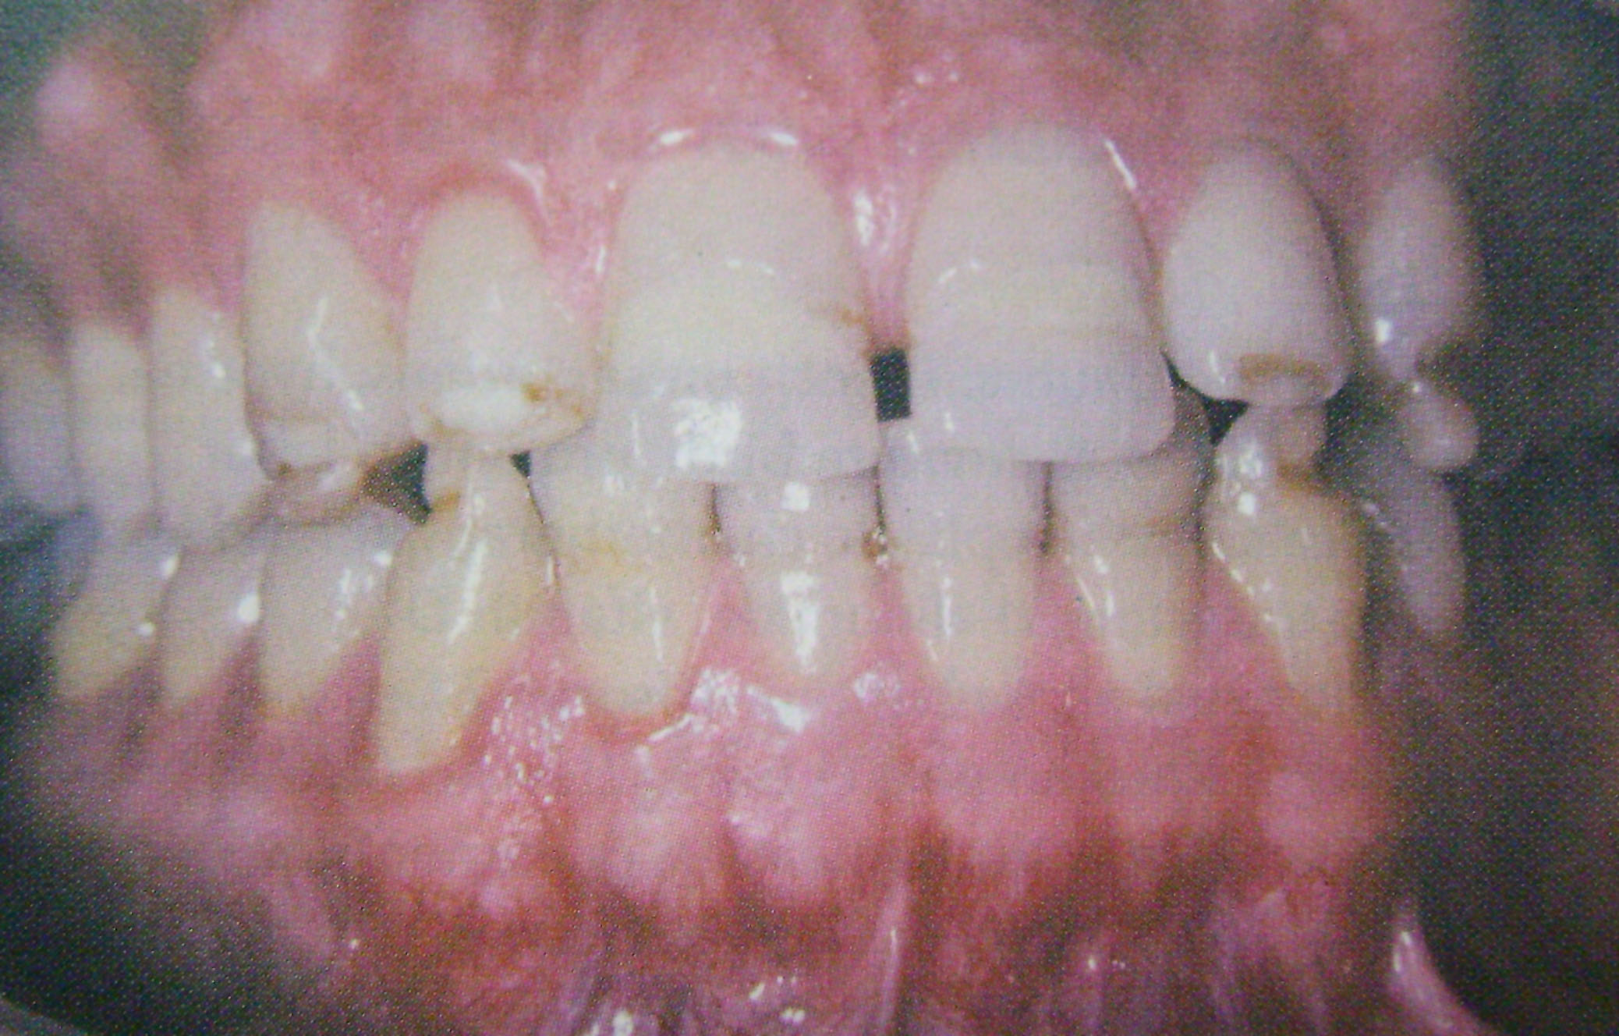

Slide 7
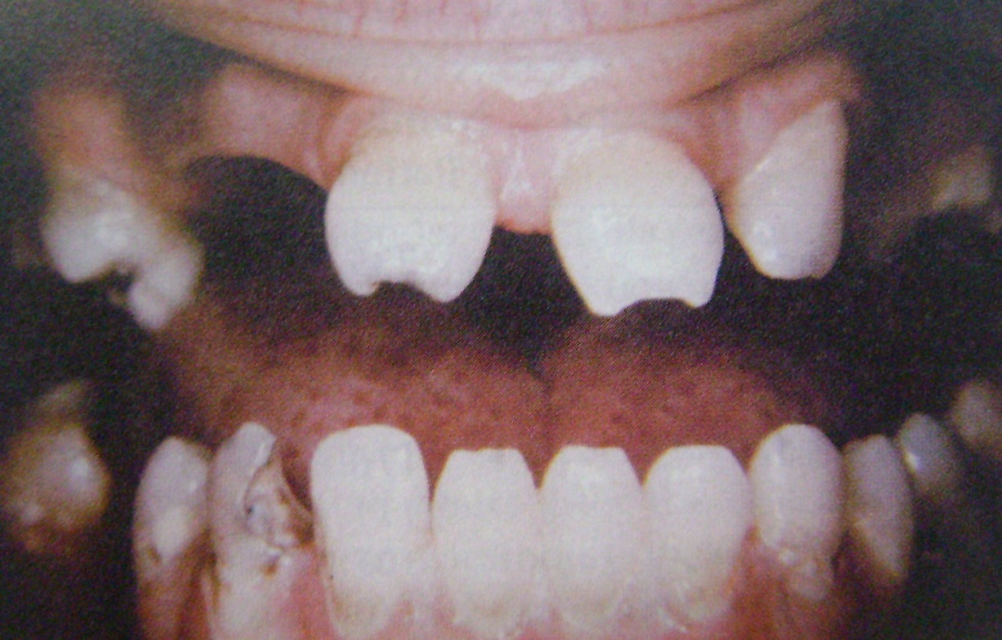
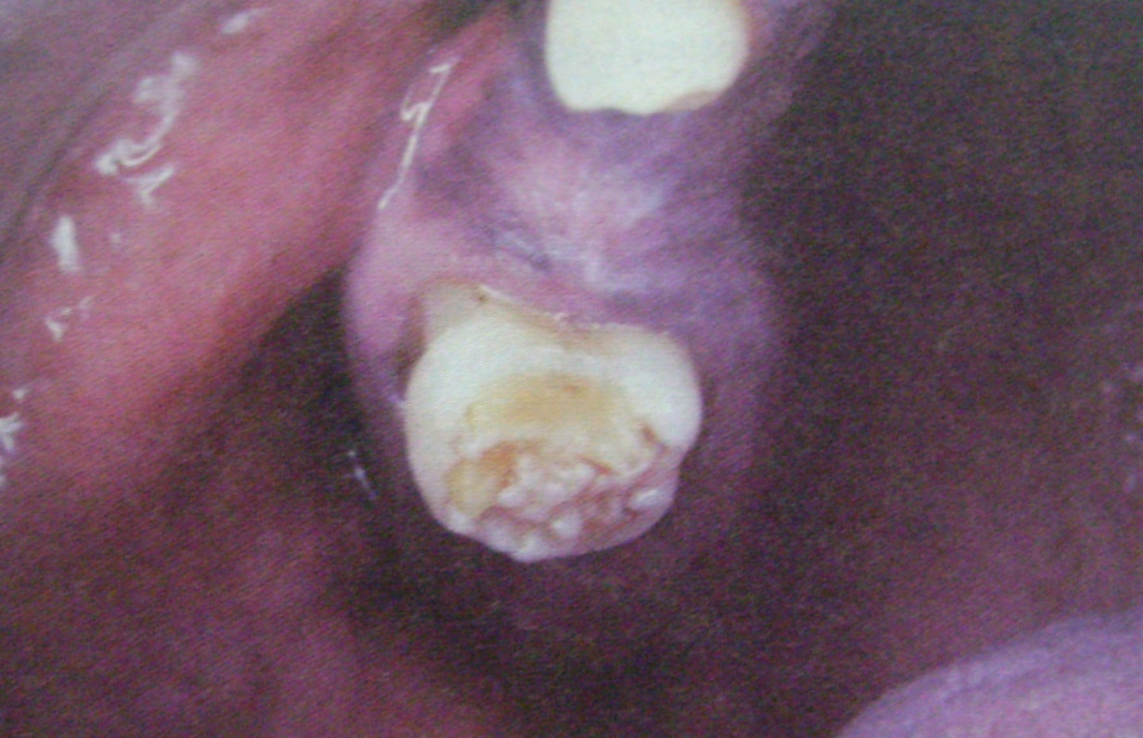

Slide 8
Due to hypocalcemia
When serum calcium level falls below 6mg/100ml, pitting variety of enamel hypoplasia is seen.
Due to birth injuries
Hypoplasia is common in prematurely born children.
Children suffering from Rh hemolytic diseases at birth showed recognized staining of teeth.
Generally seen in the enamel formed after deciduous dentition.
Due to local infections
Only single tooth is involved.
  Turner’s teeth-any degree of hypoplasia (mild, moderate, severe).
  Infection of periapical region of deciduous teeth affect the ameloblastic layer of secondary dentition resulting in hypoplasia.

Slide 9
Due to chemicals-
Mainly due to fluorides
  Mottled enamel - characterized by ingestion of fluoride in drinking water during the tooth formation.
  Disturbance of the ameloblasts during formative stage results in defective or deficient enamel matrix.
  Clinical features varies from occasional white flecking or spotting to white opaque areas involving more of tooth surface, pitting and brownish staining of surface and corroded appearance of the teeth.
Due to idiopathic factors-
Ameloblast being a sensitive cell gets affected easily by even illness or some mild systemic disturbances, which is not significantly remembered by the patients.

Slide 10
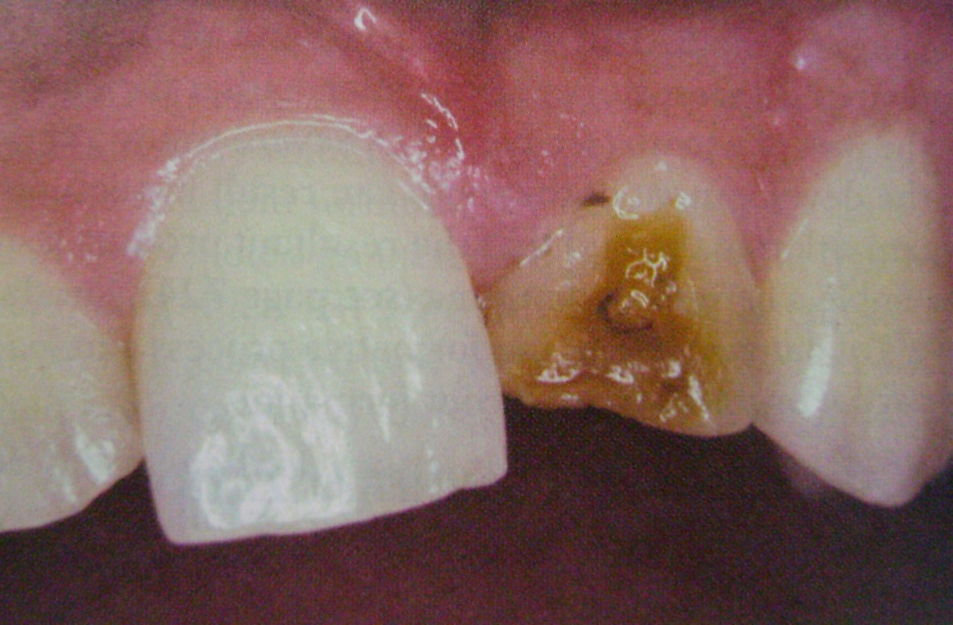
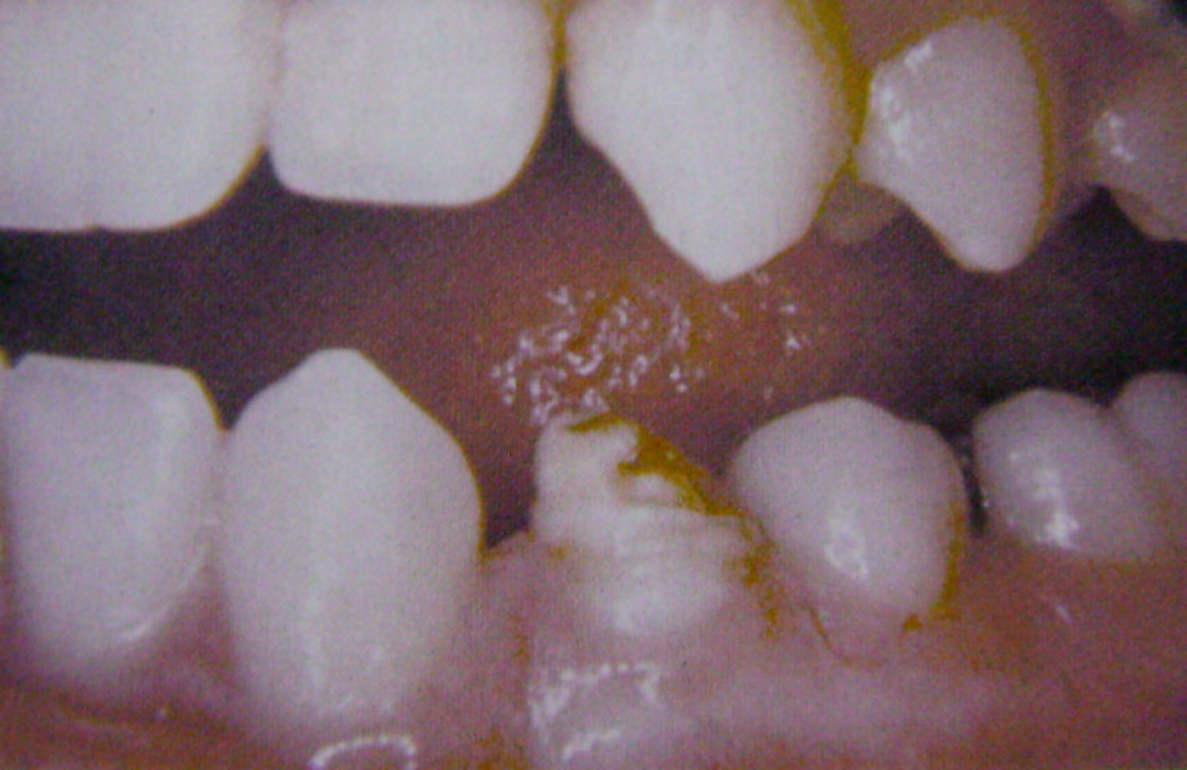

Slide 11
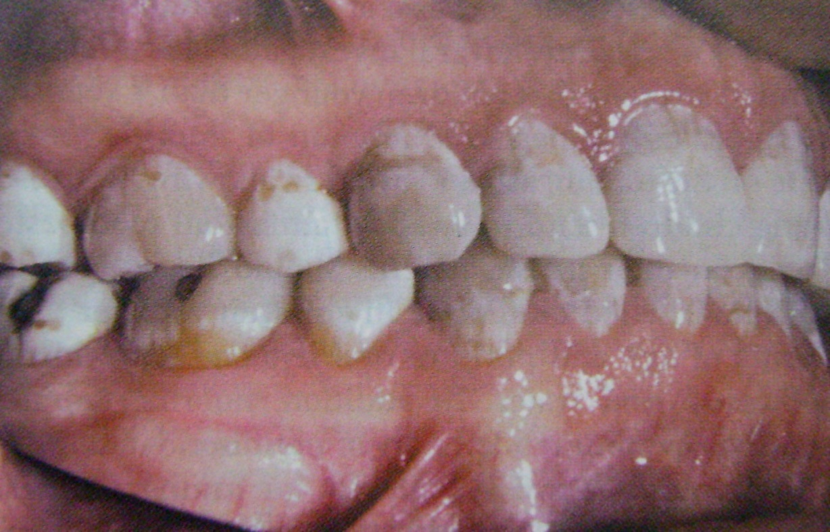
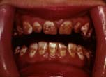

Slide 12
AMELOGENESIS IMPERFECTA
(Hereditary enamel dysplasia, hereditary brown enamel, hereditary brown opalescent teeth)
It is an ectodermal disturbance since the mesodermal components of the teeth are normal.
Three basic types of amelognesis imperfecta are recognized:
  Hypoplastic type in which there is defective formation of matrix.
  Hypocalcification (hypomineralization) in which there is defective mineralization of the formed matrix.
  Hypomaturation type in which enamel crystallites remain immature.

Slide 13
Clinical Features
1. Hypoplastic type
Enamel has not formed to full normal thickness on newly erupted teeth.
2. Hypocalcified type
Enamel is so soft that is can be removed by prophylaxis instrument.
3. Hypomaturation type.
Enamel can be pierced by an explorer point under firm pressure and can be lost by chipping away from the underlying normal appearing dentin.
Crowns of the teeth may or may not show discoloration. If present it varies between yellow to dark brown.
It may have a chalky texture or a cheesy consistency. It may be chipped or show depressions.

Slide 14
Histologic Feature
There is a disturbance in the differentitaion or viability of ameloblasts in the hypoplastic type and this is reflected in defects in matrix formation up to and including total absence of matrix.
In hypocalcification type there are defects of matrix structure and mineral deposition.
In hypomaturation type there are alterations in enamel rod and rod sheath structure.

Slide 15
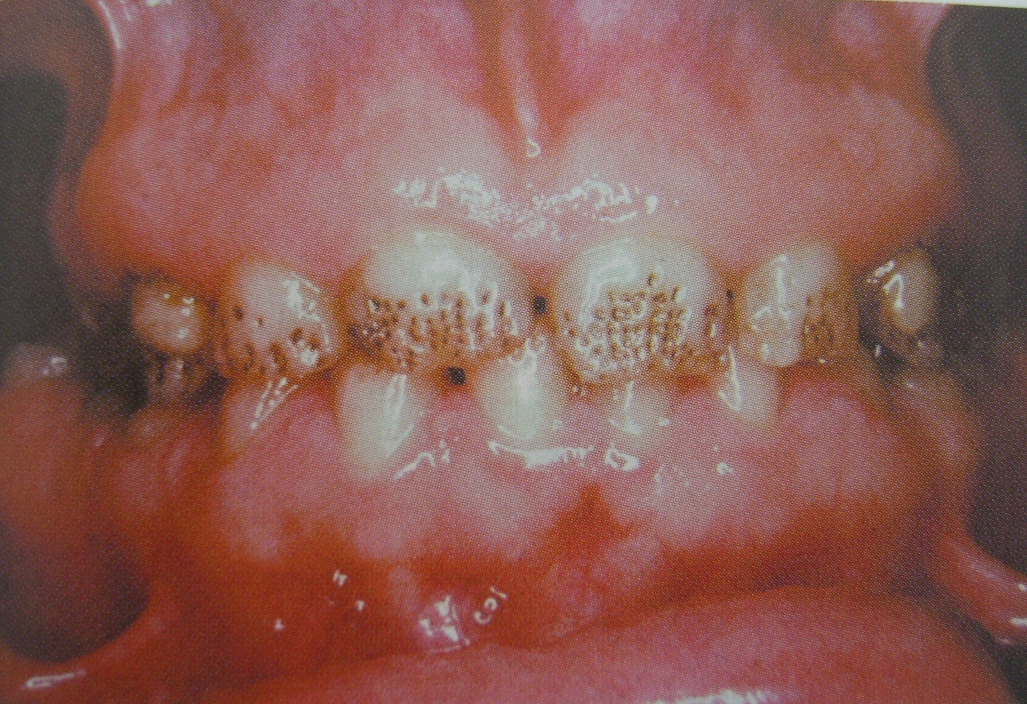

Slide 16
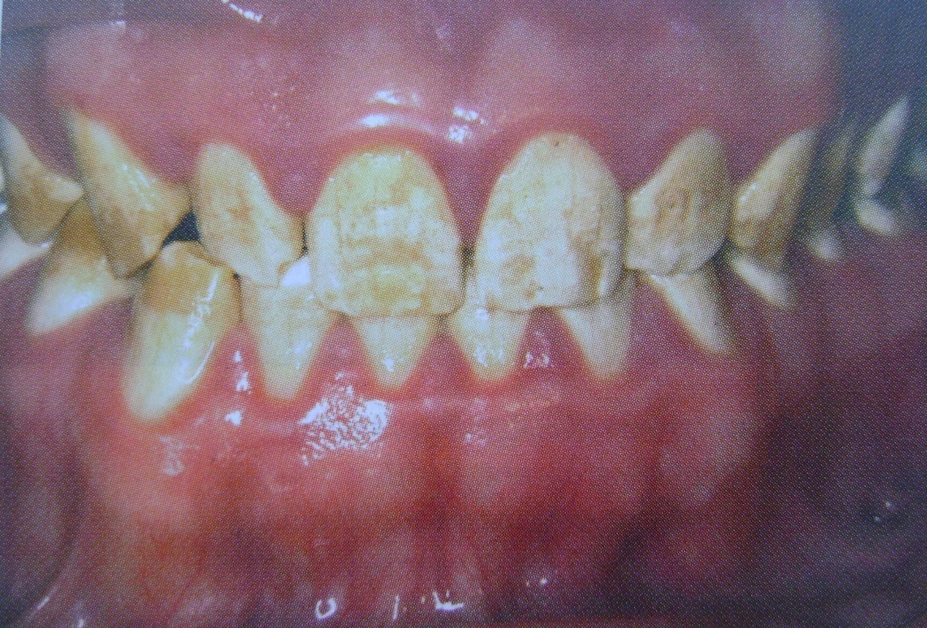

Slide 17
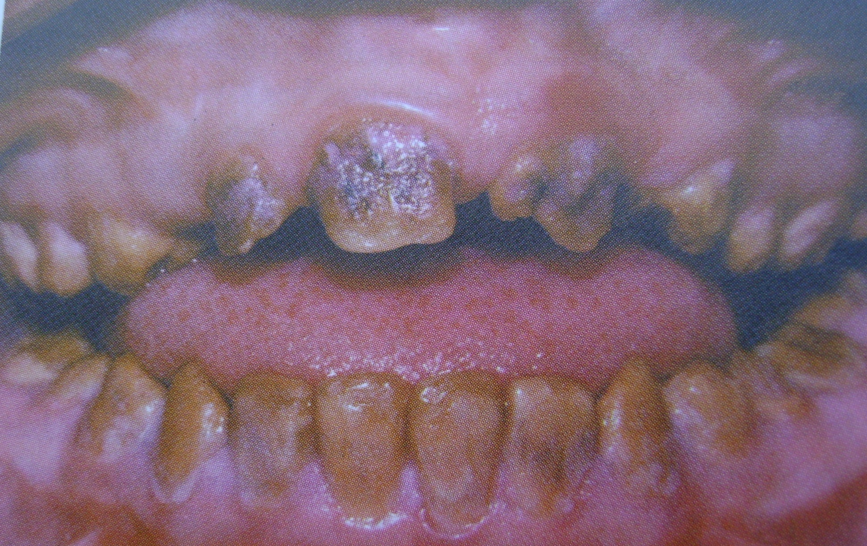

Slide 18
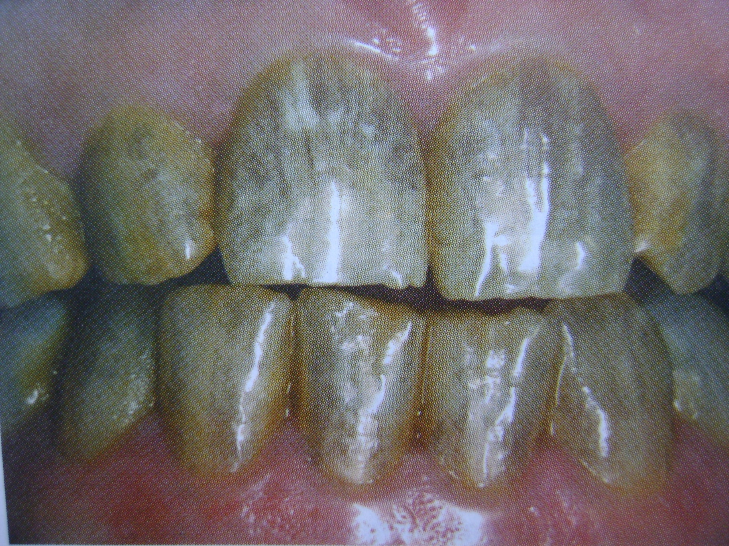

Slide 19
DENTINOGENESIS IMPERFECTA
(Hereditary opalescent dentin)
Here the mesodermal portion of the odontogenic apparatus is disturbed.
Classification
Type I : Occurs in families with osteogenesis imperfecta.
It is an autosomal dominant trait with variable expressivity.
Type II : Never occurs in association with osteogenesis imperfecta. Referred as hereditary opalescent dentin. Inherited as an autosomal dominant trait.
Type III : It is of brandywine type. This is a racial isolate in Maryland.
There is multiple pulp exposures in deciduous teeth.
It is an autosomal dominant disorder.

Slide 20
Clinical Features
Color of teeth may range from a gray to brownish-violet or yellowish-brown.
Exhibits a characteristic translucent or opalescent hue.
Abnormal dentin enamel junction and the scalloping is absent.
Dentin undergoes rapid attrition and occlusal surfaces are severely flattened.
Radiological Features
There is partial or total precocious obliteration of the pulp chambers and root canals by continued formation of dentin.
Enamel is normal while dentin is thin and pulp chambers are enormous. This is shell teeth.
Most of the teeth exhibit short roots.

Slide 21
Histologic Features-
This is purely a mesodermal disturbance.
Dentin is composed of irregular tubules often with large areas of uncalcified matrix.
Tubules tend to be larger in diameter.
Pulp chamber is obliterated by the continued deposition of dentin.
Odontoblasts degenerate readily becoming entrapped in the matrix.
Chemical and Physical Features-
Water content is greatly increased (60% above normal) Inorganic content is less than that of normal dentin.

Slide 22
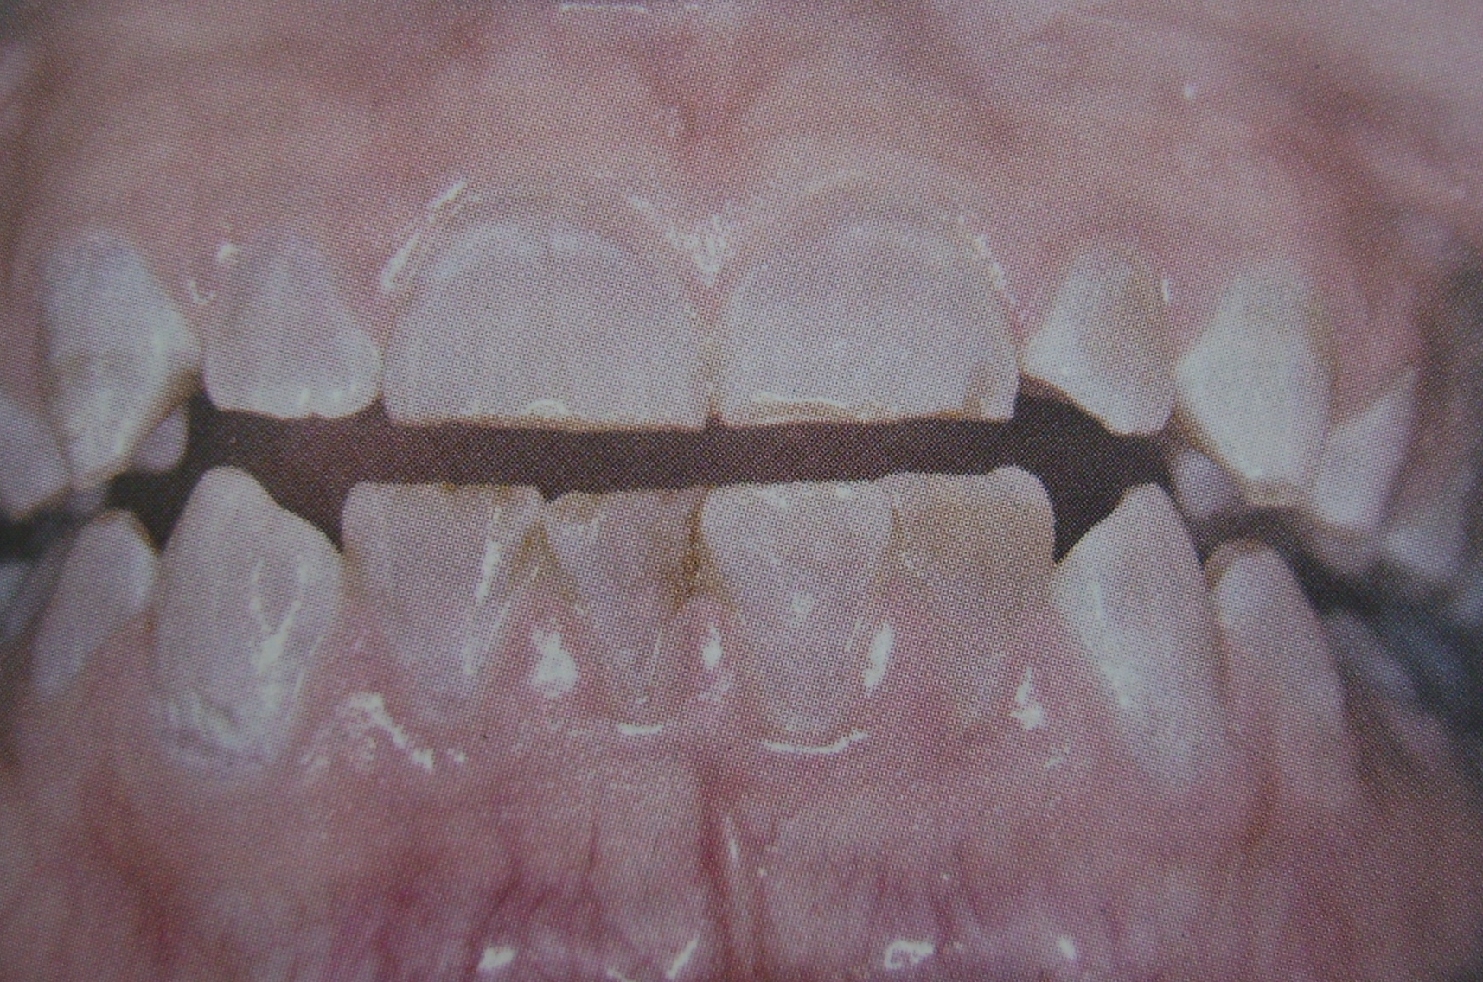

Slide 23
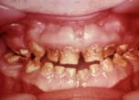
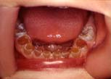

Slide 24
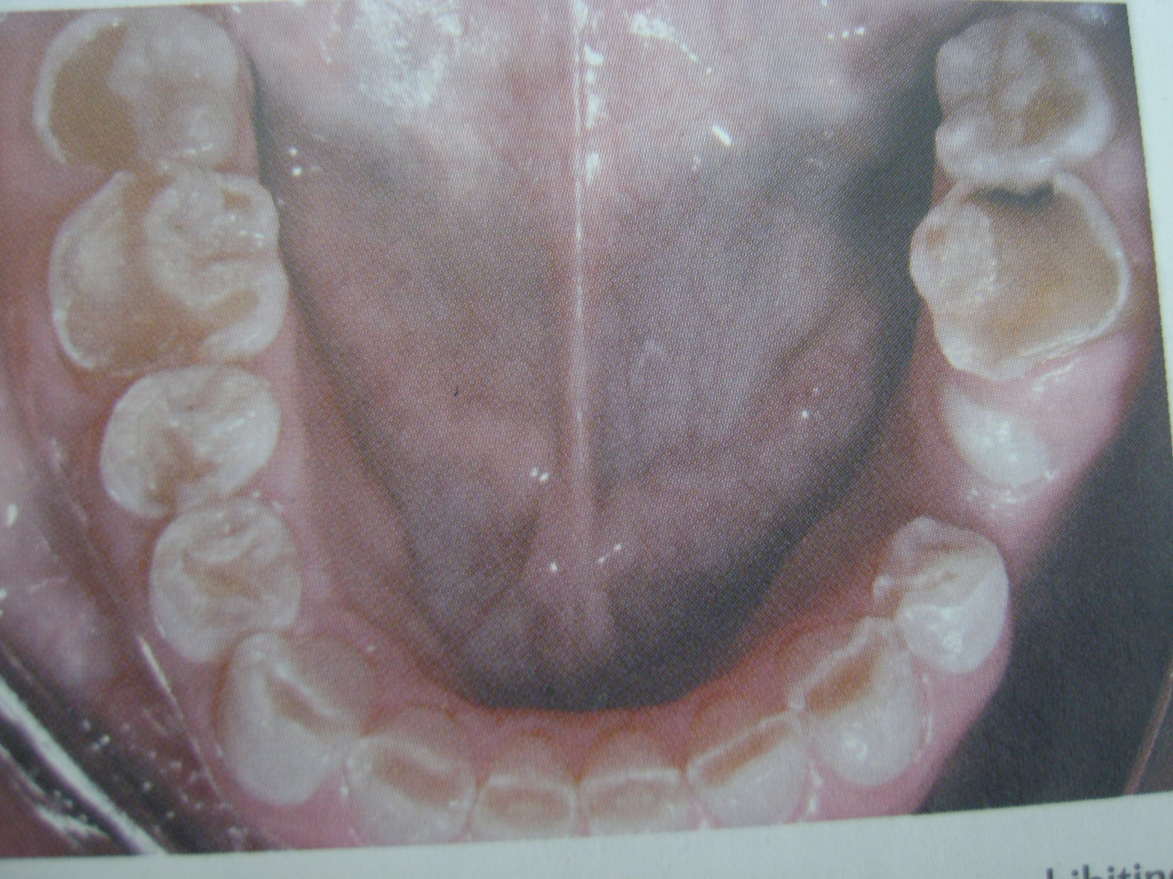

Slide 25
DENTIN DYSPLASIA
(Rootless teeth)
Rare disturbance of dentin formation characterized by normal pulpal morphology.
  Type I- Radicular dentin dysplasia.
  Type II- Coronal dentin dysplasia.
Etiology
Hereditary disease transmitted as an autosomal dominant characteristic.
Clinical Features
Type I (Radicular): Both dentitions are affected. Teeth exhibits extreme mobility and are commonly exfoliated prematurely or after minor trauma.
Type II (coronal) : Both dentitions are affected. Deciduous teeth have brown or bluish grey opalescent appearance.
Radiological Features
Type I (Radicular): In both dentitions roots are short, blunt, conical and malformed, root canals are obliterated. Crescent shaped pulpal remnants may be seen in pulp chamber.
Type II (coronal): Exhibit an abnormally large pulp chamber in the coronal portion of the tooth often described as thistle tube in shape.

Slide 26
Histologic Features
Type I (Radicular): Apical to the coronal dentin is tubular dentin, most of which obliterates the pulp and is calcified tubular dentin, osteodentin and fused denticles. New dentin forms around obstacles and shows a characteristic appearance as lava flowing around boulders.
Type II (Coronal): Deciduous teeth exhibit amorphous and a tubular dentin in the radicular portion. Coronal dentin is normal. Pulp has multiple pulp stones or denticles.

Slide 27
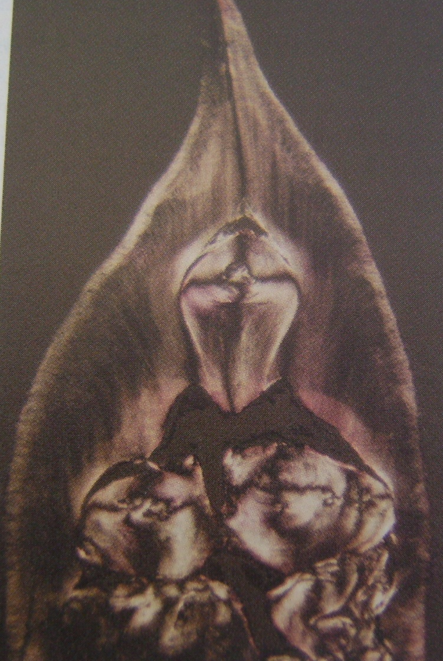

Slide 28
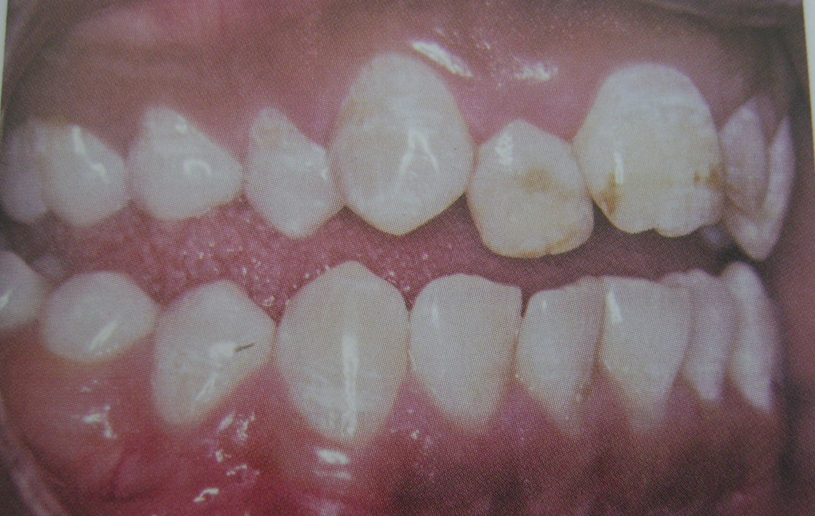

Slide 29
REGIONAL ODONTODYSPLASIA
(Odontogenesis inperfecta, ghost teeth, odontodysplasia, odontogenic dysplasia)
Etiology
Local vascular defects are involved in the pathogenesis of the condition.
Clinical Features
Delay or total failure in eruption.
Shape is markedly altered, irregular in appearance with evidence of defective mineralization.
Radiological Features
Marked Reduction in radiodensity so that the teeth assume “ghost appearance”.
Enamel and dentin are thin and pulp chamber is large.
Histologic Features
Marked reduction in amount of dentin, widening of predentin layer, presence of large areas of interglobular dentin and an irregular tubular pattern of dentin.

Slide 30
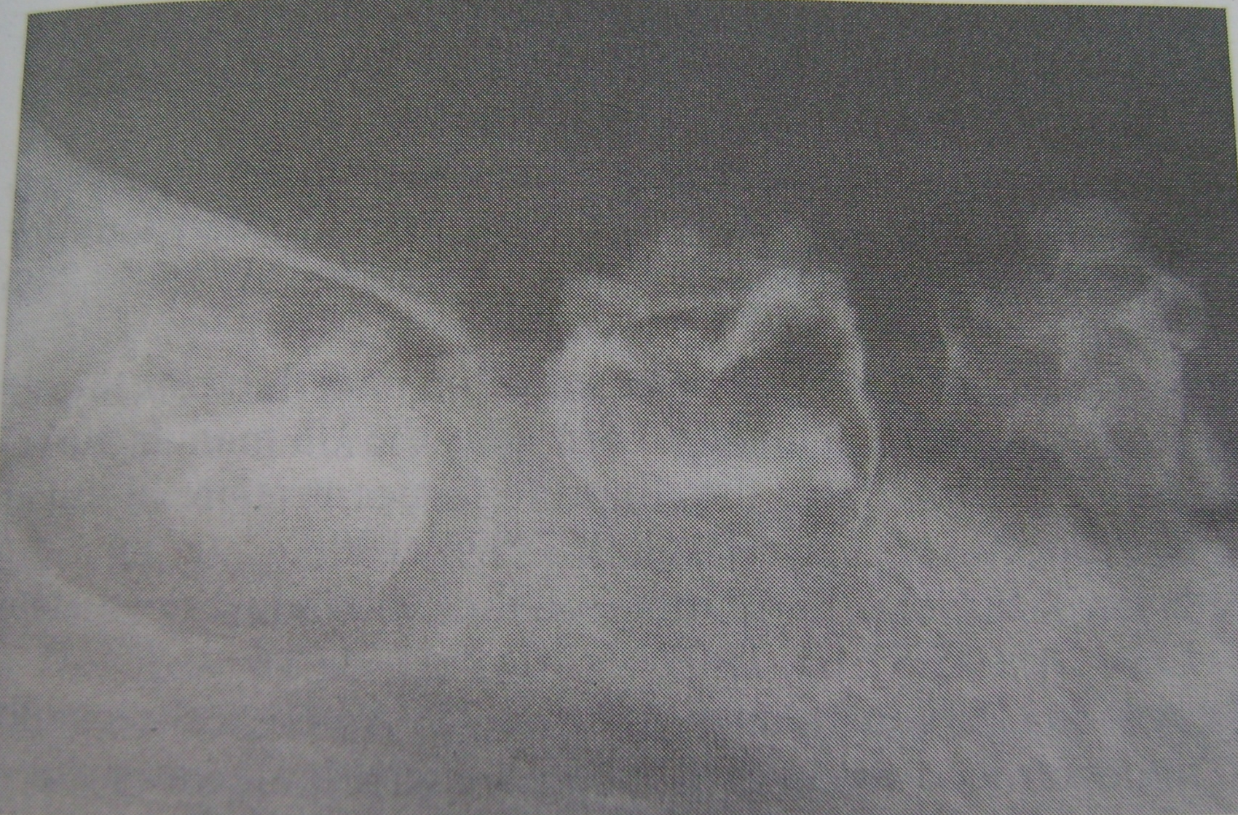

Slide 31
Thank you!!!

