Slide 1
DENTAL CARIES
Dept. of Oral Pathology

Slide 2
LEARNING OBJECTIVES
At the end of the lecture student should be able to
Describe & identify the zones of enamel caries

Slide 3
HISTOPATHOLOGY OF CARIES
ENAMEL CARIES
The small lesion had has been divided into zones based upon its histological appearance when longitudinal ground sections are examined with light microscope.

Slide 4
It is subdivided into 4 zones
Translucent zone at the inner advancing front of the lesion.
Dark zone lies superficial to the translucent zone.
The Body of the lesion is the third zone and lies between the dark zone and the apparently undamaged enamel surface..
Unaffected zone is the fourth zone and is superficial to the lesion .

Slide 5
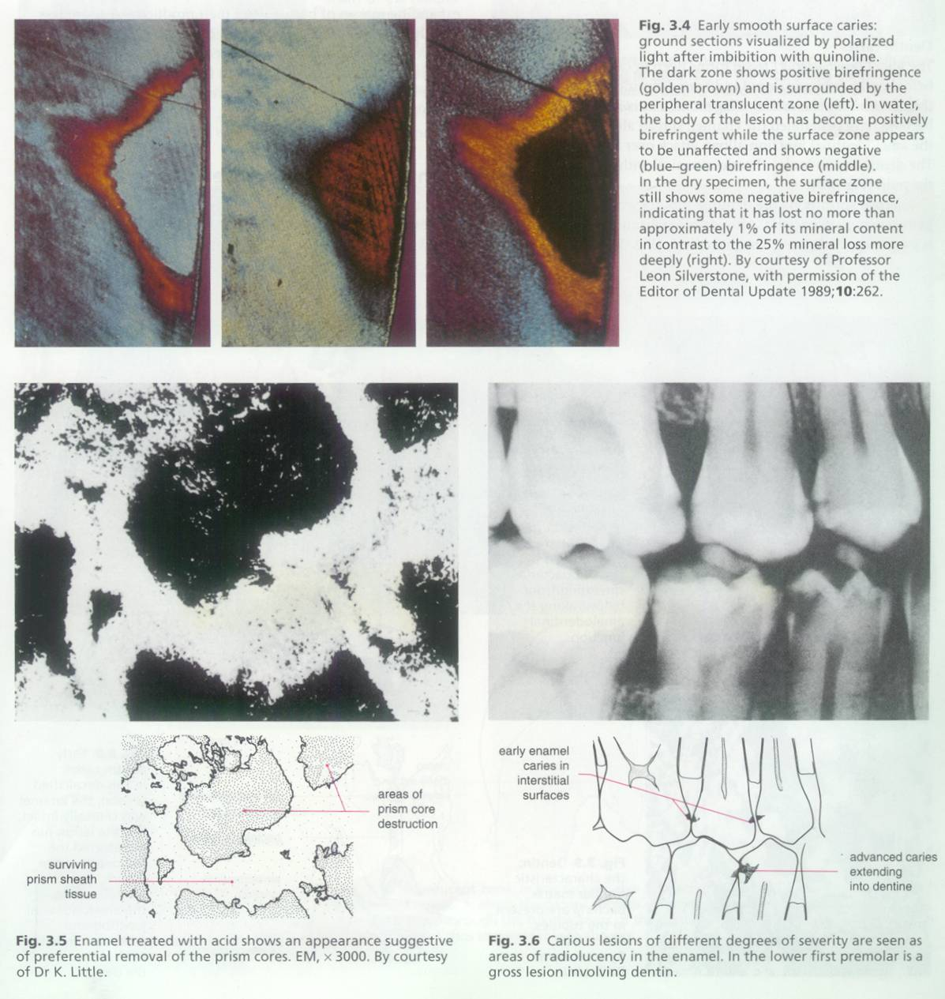
Zone 1: TRANSLUCENT ZONE
The deepest zone and represents the advancing front of the enamel lesion.
Has a structure less appearance when perfused with quinoline solution and examined with polarized light .
Pores or voids form along the enamel prism (rod) boundaries, presumably because of the ease of hydrogen ion penetration during the carious process.

Slide 6
When these boundary area voids are fitted with quinoline solution, (same R.I as enamel) the features of the area disappear.
The pore column of translucent enamel caries is 1%, 10 times greater than normal enamel.

Slide 7
Zone 2: Dark Zone
The next deepest zone is dark zone because it does not transmit polarized light. The light blockage is caused by the presence of many tiny pores too small to absorb quinoline.
These smaller air or vapor filled pores make the region opaque.

Slide 8
The total pore volume is 2% to 4% .
There is some speculation that the dark zone is not really a stage in the sequence of the breakdown of enamel, rather the may be formed by deposition of ions into an area previously only containing large pores.

Slide 9
ZONE 3 : Body of the lesion:
The body of the lesion is the largest portion of the incipient lesion. It has pore volume , varying from 5% at the periphery to 25% at the center.
The striae of Retzius are well marked in the body of the lesion indicating preferential mineral dissolution along the areas of relatively higher porosity.

Slide 10
The first penetration of caries enters the enamel surface via the striae of Retzius. The inter prismatic areas and these cross- striations provide access to the rod (prism) cores, which are then preferentially attacked.
Bacteria may be present in this zone if the pore size is large enough to permit their entry.

Slide 11
Zone 4: Surface Zone :
It has lower pore volume than the body of the lesion (less than 5%) and a radiopacity comparable to unaffected adjacent enamel.
It has been hypothesized that hyper mineralization and increased fluoride content of the superficial enamel are responsible for the relative immunity of the enamel surface.

Slide 12
However removal of the hyper mineralized surface by polishing fails to prevent the reformation of a typical well mineralized surface over the carious lesion. Thus , the intact surface over incipient caries is a phenomena of the caries demineralization process rather than any characteristics of the superficial enamel.

Slide 13
  1. The path of ingress of an advancing carious lesions is roughly parallel to the long axis of the enamel rods.
  2. The advanced smooth surface caries obtains a typical ‘V’ shaped/ cone shaped lesion whose base is towards the enamel and apex towards the dentin.
  3. Eventually there is a loss of continuity of the enamel surface.

Slide 14
-- zones of enamel caries
SUMMARY

Slide 15
BIBLIOGRAPHY
Text book of oral pathology Shafer's, 5 & 6th edition
Color Atlas of Oral Diseases Cawson, R. 2nd edition
Oral and Maxillofacial Pathology Neville, Brad W. 2nd
Lucas’s Pathology Of Tumor’s of the Oral Tissues Cawson, R. A., Bennie, W. H 5th edition

Slide 16
Thank you

