Slide 1
DEVELOPMENTAL DISTURBANCES OF ORAL & PARAORAL STRUCTURES

Slide 2
CRANIOFACIAL ANOMALIES
CRANIOFACIAL ANOMALIES:
Anomalies - different from normal
Congenital
Hereditary
Factors -
combination of genes
environmental
folic acid deficiency

Slide 3
TYPES OF CRANIOFACIAL ANOMALIES
CLEFT LIP / PALATE
CRANIOSYNOSTOSIS
HEMIFACIAL MICROSOMIA
VASCULAR MALFORMATION
HEMANGIOMA
DEFORMATIONAL PLAGIOCEPHALY

Slide 4
GENETICS
Genotype
Phenotype
Mode of inheritance
-multifactorial inheritance
-molecular genetics in tooth development
-control of tooth development

Slide 5
Causes Of Deformations
Intrinsic-
Malformation:
Functional:
Extrinsic
Mechanical:

Slide 6
Classification
Jaws
Dental arch relations
Teeth
  Size of teeth
  Shape of teeth
  Number of teeth
  Structure of teeth
  Growth (eruption) of teeth
IV. Fissural (inclusion, developmental) cysts of oral regions

Slide 7
Developmental Disturbances of Jaws
Agnathia (otocephaly, holoprosencephaly agnathia)
Micrognathia
Macrognathia
Facial hemihypertrophy (hyperplasia)
Facial hemiatrophy (Parry-Romberg syndrome, progressive facial hemiatrophy, progressive hemifacial atrophy)
Coronoid hyperplasia
Condylar hyperplasia
Condylar hypoplasia
Bifid condyle
Exostoses

Slide 8
Developmental Disturbances of lips & palate
Commissural lip pits
Paramedian lip pits
Double lip
Cleft lip and or cleft palate
Chelitis glandularis
Chelitis granulomatosa
Hereditary intestinal polyposis syndrome
Labial & Oral melanotic macules

Slide 9
Developmental Disturbances of oral mucosa
Fordyce granules
Focal epithelial hyperplasia

Slide 10
Developmental Disturbances of gingiva
Fibromatosis gingivae
Retrocuspid papilla

Slide 11
Developmental Disturbances of Tongue
Aglossia
Hypoglossia
Microglossia
Macroglossia
Ankyloglossia/tongue tie
Lingual thyroid nodule
Fissured tongue/ scrotal tongue
Hairy tongue
Median rhomboid glossitis
Lingual varices

Slide 12
Development disturbances of oral lymphoid tissue
Reactive lymphoid aggregates
Lymphoid harmartoma
Angiolymphoid hyperplasia with eosinophils
Lymphoepithelial cyst

Slide 13
Developmental disturbances of salivary glands
Aplasia
Hyperplasia of palatal gland
Atresia
Aberrancy
Developmental mandibular salivary gland depression

Slide 14
Developmental disturbances of size of teeth
Microdontia
Macrodontia

Slide 15
Developmental disturbances in shape of teeth
Gemination
Fusion
Concresence
Dilaceration
Talons cusp
Dense in dente
Dense evaginatus
Supernumery roots

Slide 16
Developmental disturbances in number of teeth
Oligodontia
Anodontia
Supernumerary teeth
Predeciduous dentition
Post permanent dentition

Slide 17
Developmental disturbances in structure of teeth
Amelogenesis imperfecta
Environmental defects of enamel
Dentinogenesis imperfecta
Dentin dysplasia
Regional odontodysplasia
Dentin hypocalcification

Slide 18
Developmental disturbances of growth(eruption) of teeth
Premature eruption
Delayed eruption
Multiple unerupted teeth
Embedded and impacted teeth
Ankyosed deciduous teeth

Slide 19
Developmental disturbances in colour of teeth
Exogenous stains
Endogenous stains

Slide 20
Developmental Disturbances of Jaws
Agnathia - absence of mandible
Micrognathia - small jaw: true & acquired
Macrognathia - abnormally large jaws
Facial hemihypertrophy(hyperplasia)
Facial hemiatropy (Parry-Romberg syndrome, progressive facial hemiatropy)

Slide 21
Agnathia
Hypoplasia or absence of the mandible with abnormally positioned ears
Autosomal recessive mode of inheritance
Commonly, only a portion of one jaw is missing
e.g. half mandible, condyle, ramus, one maxillary process, premaxilla

Slide 22
Micrognathia
Means a small jaw
Classification:
(1) True – due to abnormally small jaw
Congenital
Acquired
(2) Apparent- due to an abnormal positioning or an abnormal relation of one jaw to the other or to the skull

Slide 23
Micrognathia
Congenital:
Unknown etiology
Associated with other congenital abnormalities:
Pierre Robbin syndrome
Congenital syphilis
Trisomy 18
Turner’s syndrome
Noonan’s syndrome
Treacher Collins-Franceschetti syndrome

Slide 24
Micrognathia
True congenital mandibular micrognathia:
Due to posterior positioning of mandible with regard to skull, a steep mandibular angle, agenesis of condyles
Severe retrusion of chin
Acquired:
Post-natal origin, e.g. ankylosis

Slide 25
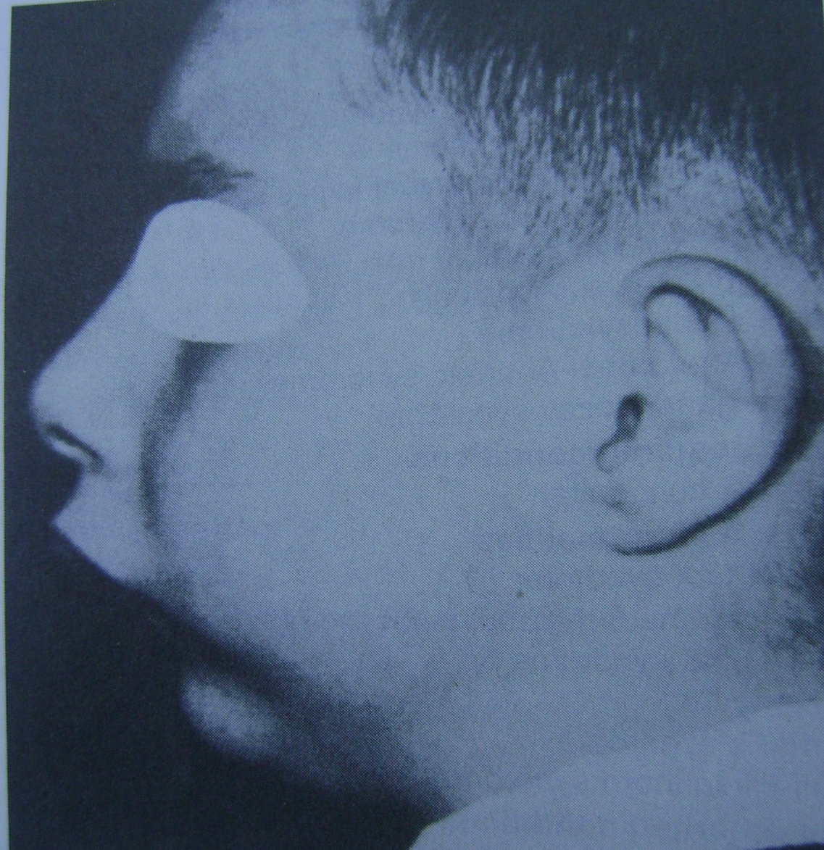
Micrognathia of mandible

Slide 26
Macrognathia
Refers to the condition of abnormally large jaws
Increase in size of both jaws is frequently proportional to a generalized increase in size of the entire skeleton, e.g. in pituitary gigantism
Commonly only the jaws affected
May be associated with other conditions:
Paget’s disease- overgrowth of the cranium & maxilla or occasionally mandible occurs
Acromegaly- progressive enlargement of the mandible owing to hyperpituitarism in adults
Leontiasis ossea- a form of fibrous dysplasia with enlargement of maxilla

Slide 27
Macrognathia
General factors which influence & tend to favor mandibular prognathism:
Increased height of the ramus
Increased mandibular body length
Increased gonial angle
Anterior positioning of the glenoid fossa
Decreased maxillary length
Posterior positioning of maxilla in relation to cranium
Prominent chin button
Varying soft tissue contours

Slide 28
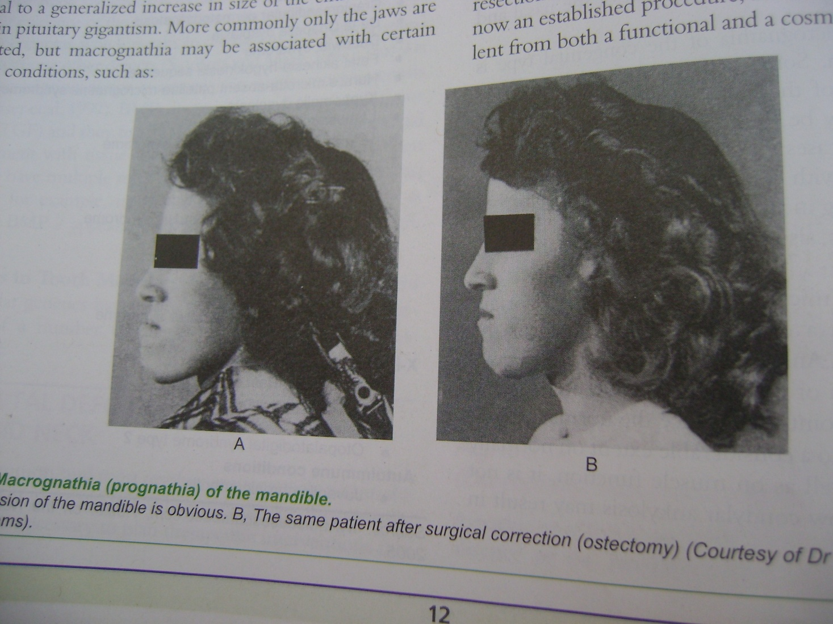
Macrognathia of mandible

Slide 29
Facial Hemihypertrophy
Hyperplasia of tissues rather than hypertrophy
Characterized by asymmetric overgrowth of one or more body parts
Can be an isolated finding or associated with a variety of conditions:
Beckwith-Wiedemann syndrome
Neurofibromatiosis
McCune-Albright syndrome
Multiple exostoses syndrome
Maffucci’s syndrome

Slide 30
Facial Hemihypertrophy
Hoyme et al. (1998) anatomic classification:
Complex hemihyperplasia - involvement of half of the body (at least one arm & one leg); affected parts may be contralateral or ipsilateral
Simple hemihyperplasia - involvement of a single limb
Hemifacial hyperplasia - involvement of one side of face

Slide 31
Facial Hemihypertrophy
Etiology- unknown;
The condition is ascribed to vascular or lymphatic abnormalities, CNS disturbances, chromosomal abnormalities

Slide 32
Facial Hemihypertrophy
Clinical features-
Enlargement confinement to one side of body
Unilateral macroglossia
Premature development & eruption of teeth
Increased size of dentition
Familial occurrence reported
Female predilection (63% vs 37%)
Equal involvement of both right & left sides

Slide 33
Facial Hemiatrophy
Originally described by Parry & Romberg
Slowly progressive atrophy of the soft tissues of essentially half the face
Characterized by progressive wasting of subcutaneous fat, sometimes accompanied by atrophy of skin, cartilage, bone, muscle
May spread to the neck & half side of the body, usually accompanied by contralateral Jacksonian epilepsy, trigeminal neuralgia & changes in the eyes & hair

Slide 34
Facial Hemiatrophy
May be a form of localized scleroderma
Majority cases are sporadic, familial distribution has been found
Etiology-
Cerebral disturbance leading to increased & unregulated activity of sympathetic nervous system produce the localized atrophy through its trophic functions
Extraction of teeth, local trauma, infection & genetic factors could also be a cause
Carotid flow abnormalities & vascular disruption

Slide 35
Facial Hemiatrophy
Clinical features-
Most common early sign is a painless cleft, the ‘coup de sabre’ near midline of the face or forehead. It marks boundary between normal & atrophic tissue
A bluish hue in the skin overlying atrophic fat.
Progressive atrophy of skin, subcutaneous tissue, muscles, bones, cartilages & soft palate
May include ipsilateral salivary glands, tongue, ear, larynx, esophagus, diaphragm, kidney and brain.
Female: male ratio= 3: 2
Slight predilection for left side

Slide 36
Facial Hemiatrophy
Appears in the 1st or 2nd decade & progresses for about 2 to 10 years before it becomes quiescent.
Follow the distribution of one or more divisions of trigeminal nerve and mistaken for Bell’s palsy.
Neurological disorders found in 15% patients; ocular findings occur in 10-40%, the most common being enophtholmos
Rarely half of the body affected, accompanied by pigmentation disorders, vitiligo, pigmented facial nevi, contralateral jacksonian epilepsy, contralateral trigeminal neuralgia & ocular complications

Slide 37
Facial Hemiatrophy
Oral manifestations-
Incomplete root formation, delayed eruption & severe facial asymmetry resulting in difficulty in mastication on affected side
Differential diagnosis-
Post-traumatic fat atrophy,
Hemifacial microsomia (first & second branchial arch syndrome),
Goldenhar’s syndrome &
Partial lipodystrophy, which is always bilateral

Slide 38
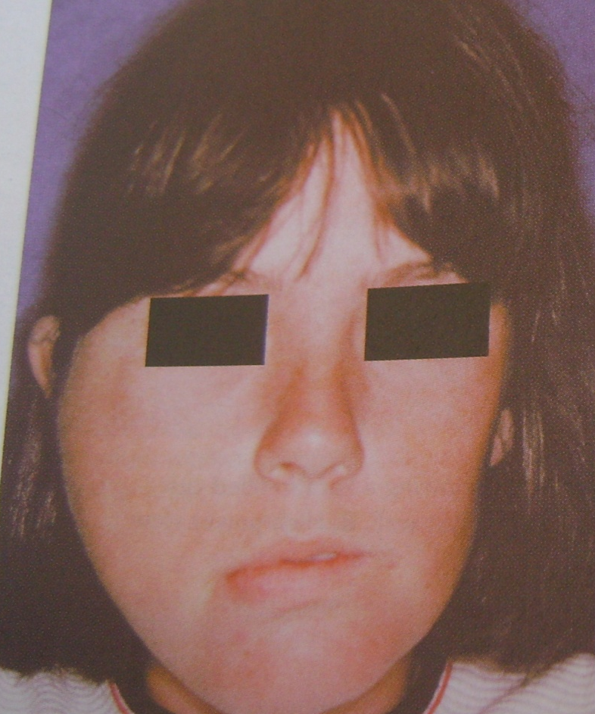
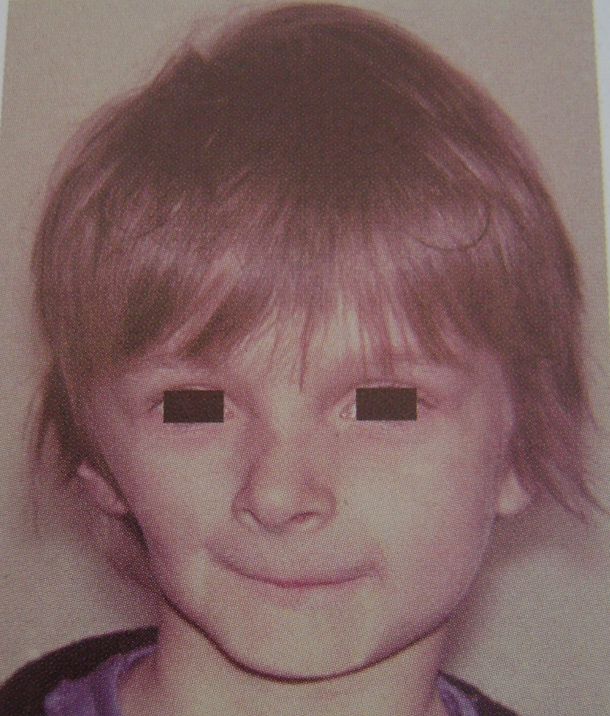
Facial hemihypertrophy
Facial hemiatropy

Slide 39



Facial hemihypertrophy

Slide 40
Abnormalities of dental arch relations
Class-1 – Normal relation
Class-2 – Maxillary prognathism
Class 2 Div.1 – Protruding lateral incisor
Class 2 Div.2 – Retruding lateral incisors
Class-3 – Mandibular prognathism

Slide 42
VAN DER WOUDE’S SYNDROME
(cleft lip syndrome, lip pit syndrome, dimpled papillae of the lip)
It is an autosomal dominant syndrome consisting of a cleft lip or cleft palate and distinctive pits of the lower lips.
Etiology :-
Prominent feature of this syndrome is orofacial anomalies.
This is due to abnormal fusion of palate and lips at days 30-50 post conception.

Slide 43
Clinical Features
Incidence is 1 in 100,000 people.
  Affects both generation equally.
  Cleft lip and cleft palate is commonly seen. Unilateral or bilateral involvement is seen.
  Hypernasal voice and cleft or bifid uvula is the clue for diagnosis.
  Lower lip pits are quite distinctive and medial on the vermilion portion of the lower lip.
  Extraoral manifestations
  Rare but include limb anomalies, popliteal webs, brain anomalies, accessory nipples, congenital heart diseases can be seen.

Slide 44
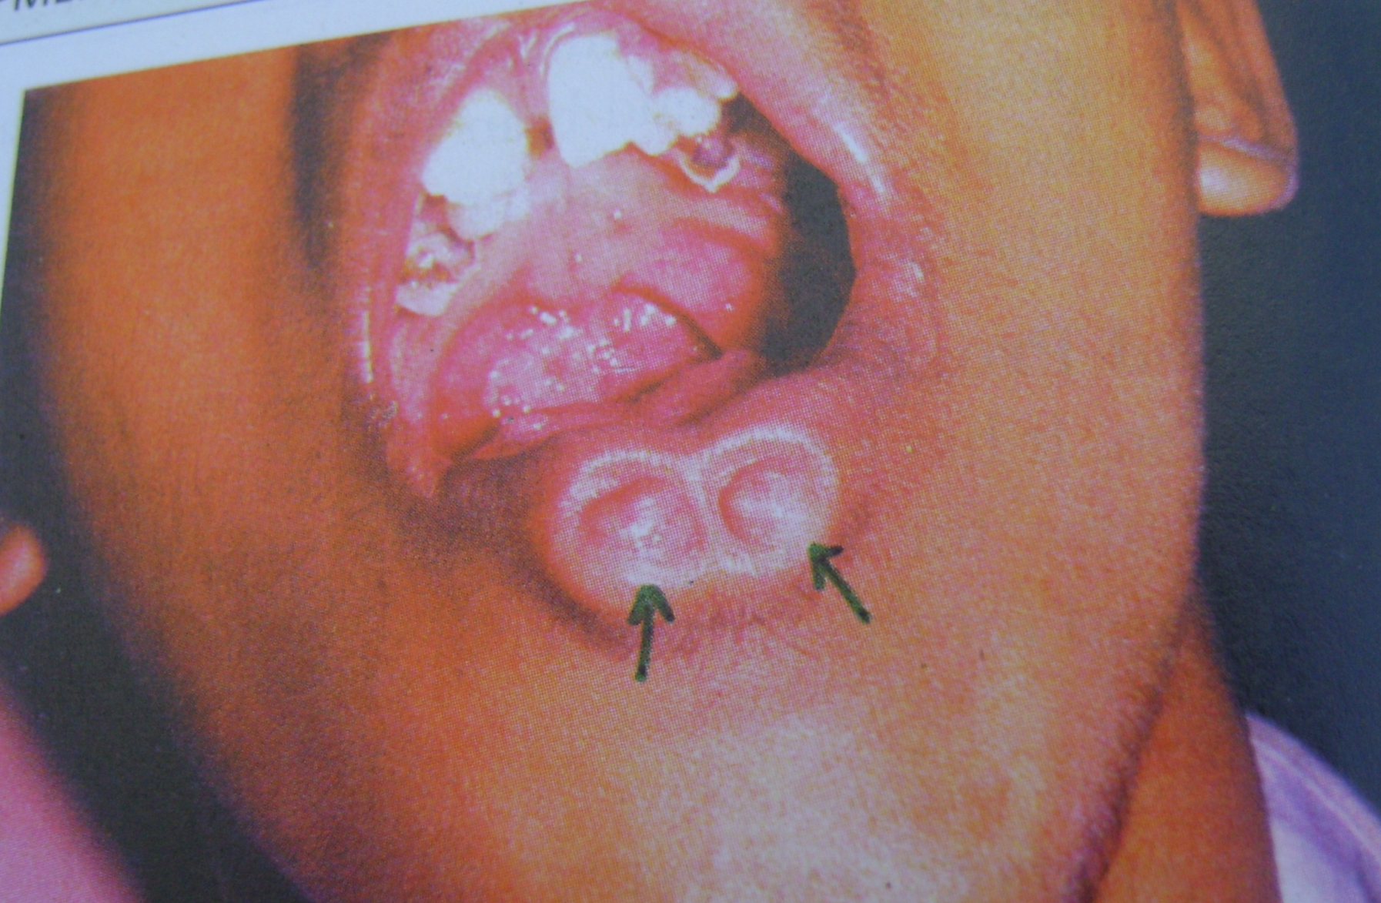

Slide 45
CONGENITAL LIP PITS AND COMMISSURAL PITS
Etiology
May result from notching of the lip at an early stage of development.
Fixation of the tissue at the base of the notch.
Failure of complete union of the embryonic lateral sulci of the lip.
Occur at the site of horizontal facial cleft and may represent defective development of the embryonic fissure.

Slide 46
Clinical Features
Unilateral or bilateral depression or pit that occurs on the vermilon surface of lip.
Sparse mucus seccretion may exude from the base of the pit.
Lip appears swollen, accentuating the appearance of the pits.

Slide 47
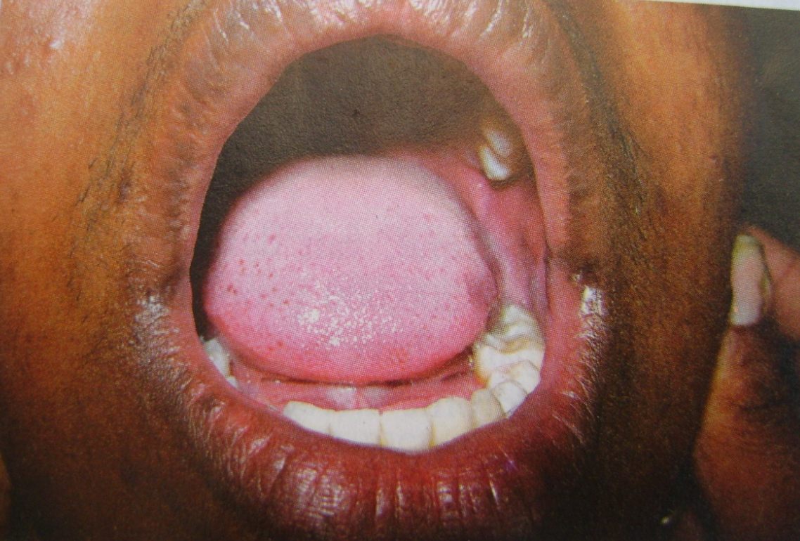
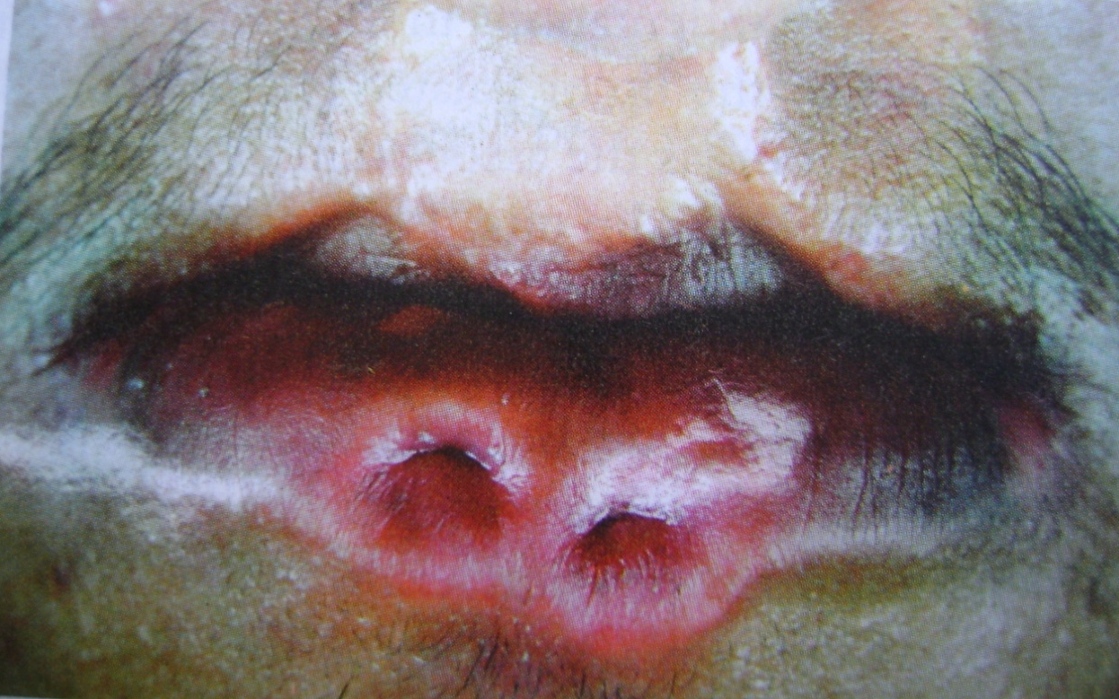

Slide 48
Double Lip
It is anomaly characterized by a fold of excess tissue on the inner mucosal aspect of the lip.

Slide 49
Clinical Features
Both upper and lower lips are involved.
When the upper lip is sensed, the double lip resembles a cupids bow.
Occurrence of acquired double lip inm association with blepharochalasis and nontoxic thyroid enlargement is known as “Ascher’s syndrome”.
Blepharochalasis is drooping of tissue between the eyebrow and the edge of upper eyelid so that it hangs loosely over margin of the lid.

Slide 50
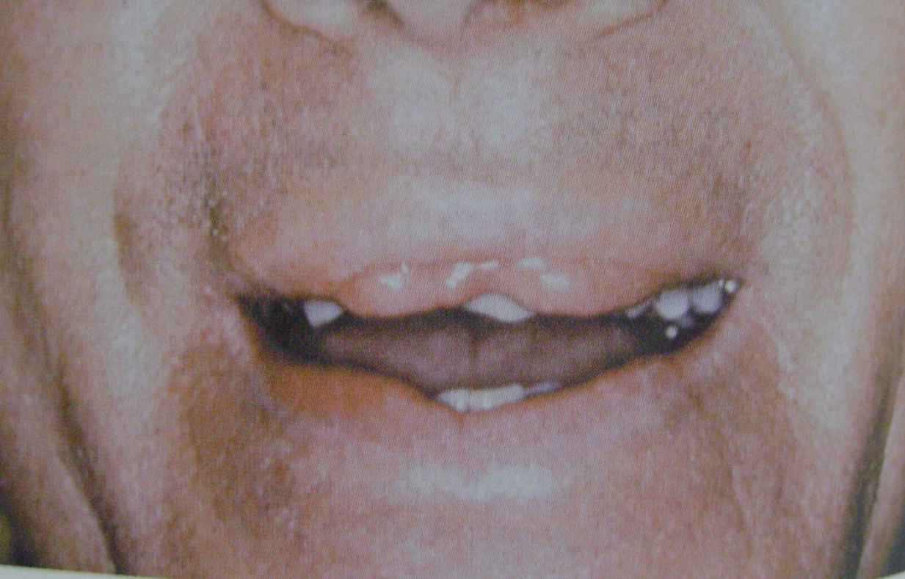
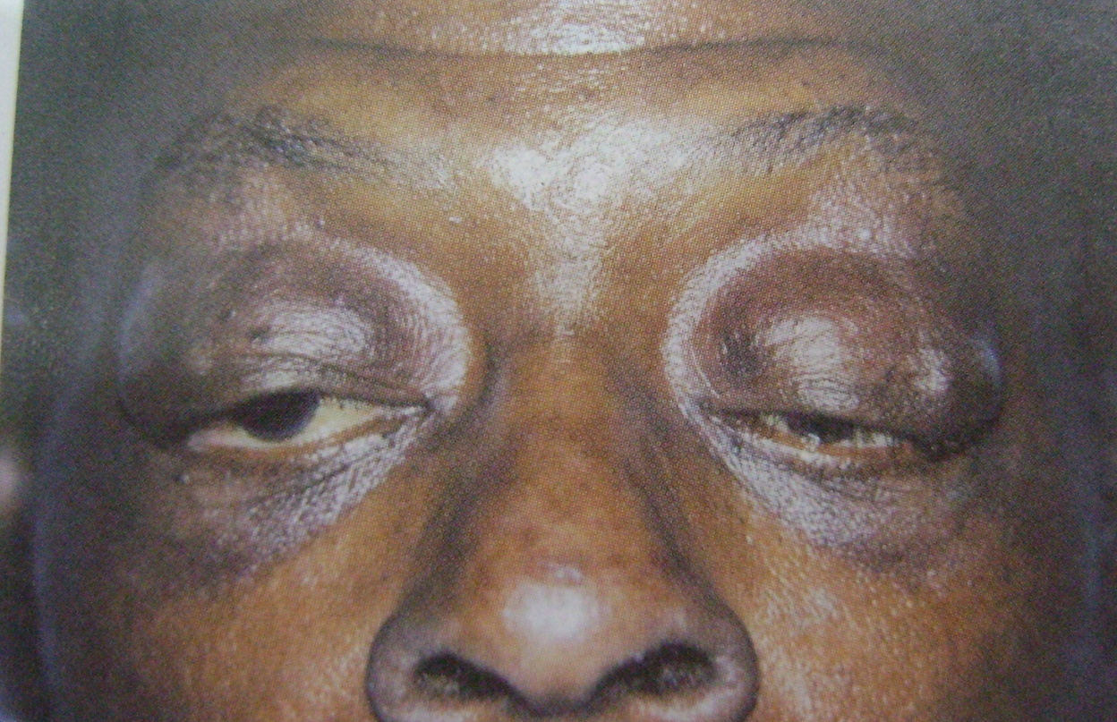

Slide 51
CLEFT LIP AND CLEFT PALATE
Classification of cleft lip
  Unilateral incomplete.
  Unilateral complete.
  Bilateral incomplete.
  Bilateral complete.
Mandibular cleft lip is an extremely rare condition that occurs in the midline of the lowerlip.
It is due either failure of the copula to give rise to mandibular arch or to persistence of the central groove of the mandibular process.
Maxillary cleft lip is thought to be due to failure of the globular portion of the median nasal process to unite properly with the lateral nasal and maxillary process.

Slide 52
Cleft may also be due not to an actual lack of union of the processes but rather to a failure of mesodermal penetration and the obliteration of the ectodermal grooves separating these mesodermal masses that actually constitute the facial processes.
Cleft palate appears to represent a disturbance in the normal fusion of the palatla shelves.
Failure to unite due to lack of forceful interference by the tongue, disparity in the size of the parts involved.
Etiology
Heredity is undoubtedly one of the most important factors to be considered.
Environmental factors
Genetic in origin.
Physiologic, emotional or traumatic stress may play a significant role.

Slide 53
Other Factors
A defective vascular supply to the area involved.
A mechanical disturbance in which the size of the tongue may present the union of parts.
Circulating substances such as alcohol and certain drugs.
Infections.
Lack of inherent developmental force.
Clinical Features
Unilateral cleft lip involves only one side of the lip or both sides of the lip.
The latter type has given rise to term harelip.
Cleft lip and cleft palate are somewhat more common in boys than in girls.
Cleft occurs about three times more frequently on the left side than on the right.

Slide 54
Cleft of the hard palate extends anteriorly through the alveolar ridge and lip, producing a complete cleft in the lip, ridge and palate.
Isolated cleft palate is associated with congenital heart diseases, polydactylism and syndactylism ear, hypospadias, spina bifida, hypertelorism and mental deficiency.
A median maxillary anterior alveolar cleft might be due to precocious limitation of the growth of the primary ossification centers on either side of the midline at the primary palate or to their subsequent failure to fuse.

Slide 55
Clinical significance
Eating and drinking are difficult because of regurgitation of food and liquid through nose.

Slide 56
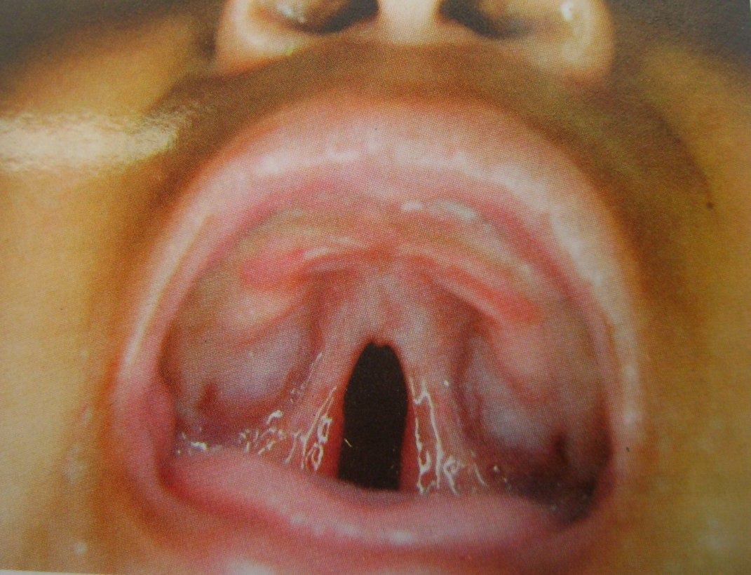
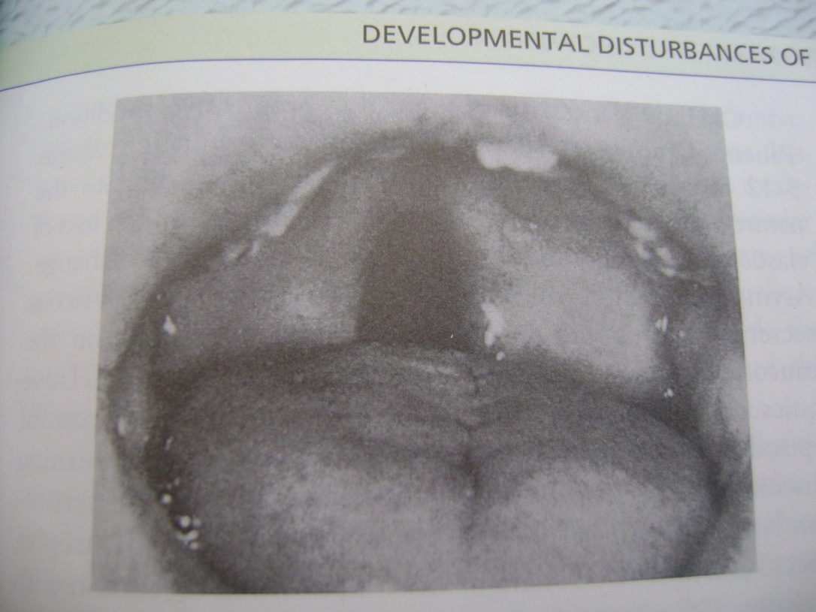

Slide 57
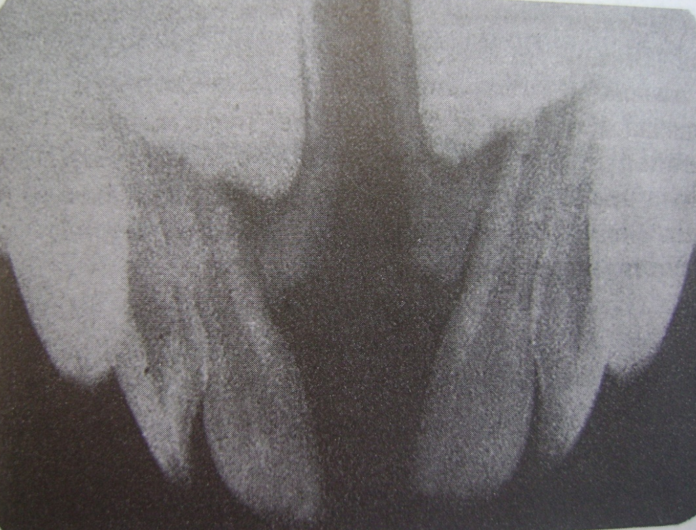
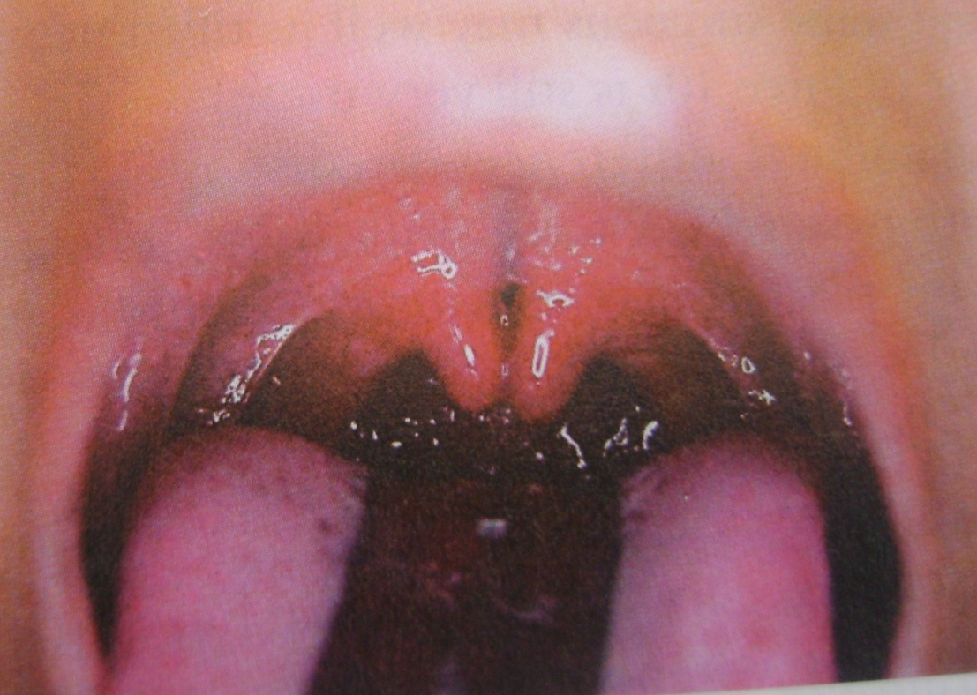

Slide 58
CHEILITIS GLANDULARIS
Occurs mostly in adult, the lower lip becomes enlarged, firm and finally everted.
Etiology
Unknown etiology, but it can be due to :
  Chronic exposure to sun, wind and dust.
  Use of tobacco.
Clinical Features
Labial salivary glands become enlarged and sometimes nodular.
Orifices of the secretory ducts are inflamed and dilated appearing as small red macules on the mucosa three basic types of cheilitis glandularis are seen:

Slide 59
  Simple type
  Superfical suppurative type
  Deep suppurative type.
Simple type is characterized by multiple painless pinhead sized lesions with central depressions and dilated canals.
This type may be transformed into superficial suppurative type characterized by painless swelling, induration, crusting, superficial and deep ulcerations of the lip. (Baelz’s disease.)
Deep suppurative type (Cheilitis glandularis apostematosa, myxadenitis labialis) is a deep seated infection with abscesses and fistulous tracts that eventually form scars.

Slide 60
CHEILITIS GRANULOMATOSA
(Mieschers-Melkersson-Rosenthal syndrome)
Clinical Features
There is diffuse swelling of the lips, especially lower lip. Swelling is usually soft and exhibits no pitting upon pressure.
Scaling, fissuring, erythematous vesicles or pustules present.
Appears in association with facial paralysis and scrotal tongue called melkersson-Reosenthal syndrome
Histologic features
Chronic inflammatory cell infiltrate particularly peri and paravascular aggregations of lymphocytes, plasma cells and histiocytes and focal noncaseating granuloma formation with epitheloid cells and langhans type of giant cells.

Slide 61
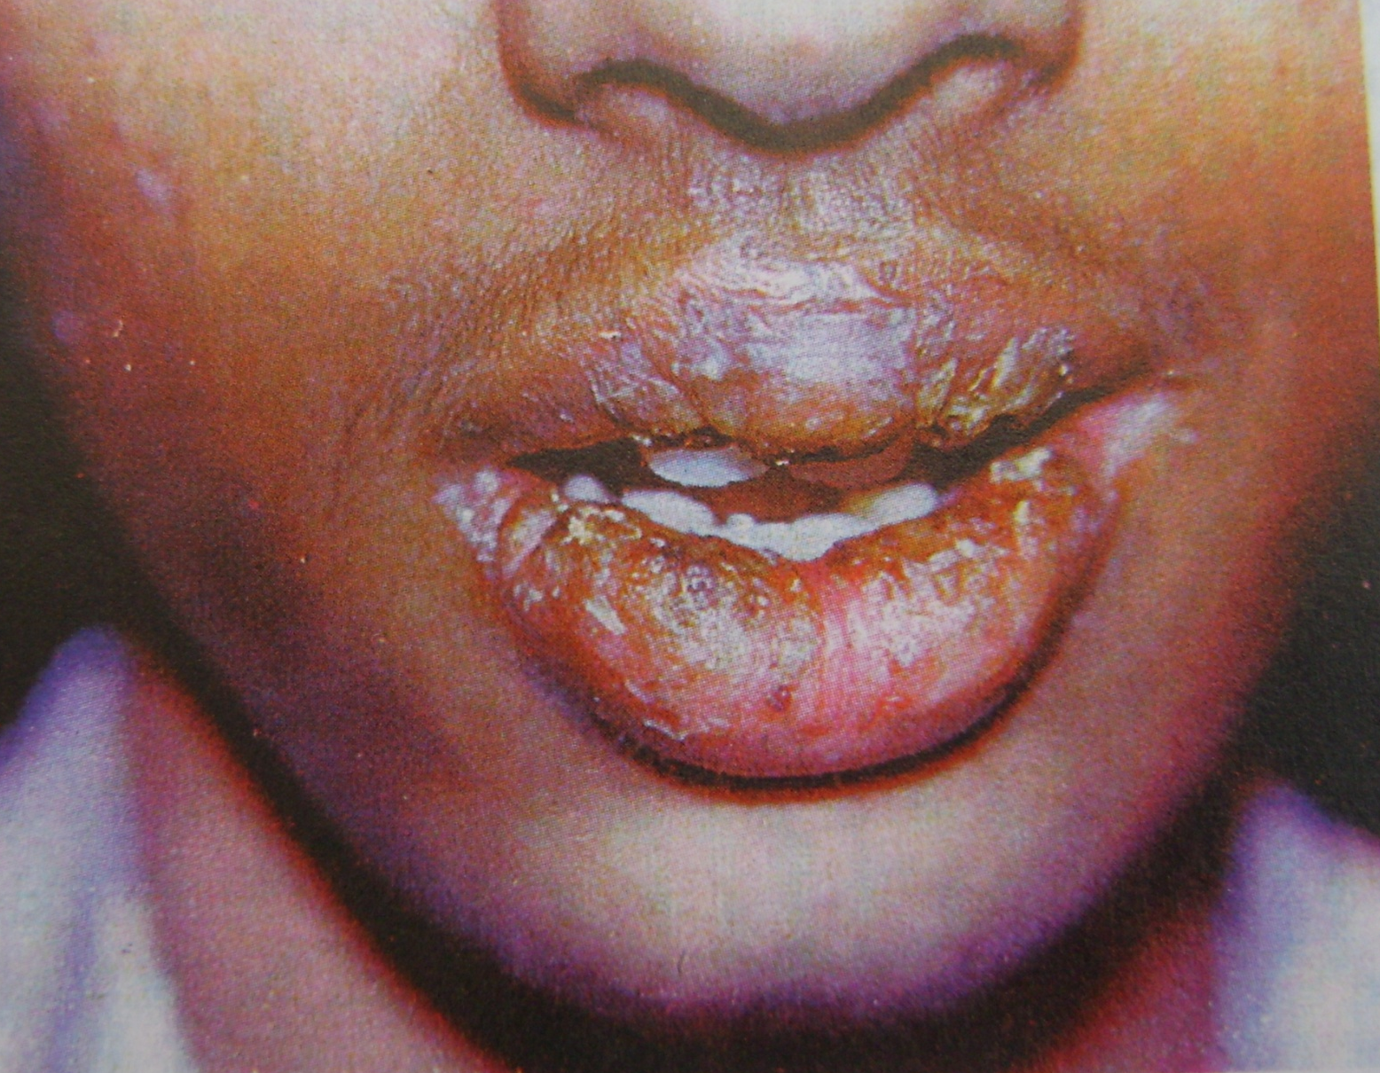

Slide 62
Hereditary intestinal polyposis syndrome
(Peutz-jeghers syndrome)
Pigmented spots on the face, oral cavity and sometimes the hands and sometimes the hands and feet.
Clinical Features
Melanin pigmentation of the lips and oral mucosa is present from birth and appears as small brown macules measuring 1-5 mm in diameter.
Buccal mucosa is frequently involved.
On the face the spots tend to be grouped arround the eyes, nostrils and lips,
Lower lip is almost involved.
Facial pigmentation tends to fade later in life.
Oromucosal pigmentation includes melanin pigmentation such as:

Slide 63
Local and ethnic pigmentation.
Oral pigmentary manifestations of systemic diseases.
Pigmentary disturbances associated with pharmaceuticals and other chemicals.
Benign and malignant pigmented neoplasms.
Interstinal polyps are distributed through the entire intestine.
Patients have frequent episodes of abdominal pain and signs of minor obstruction.
Role of dentist in detecting this syndrome is important through a tentative diagnosis based on the oral and paraoral manifestations.

Slide 64
Developmental disturbances of oral mucosa
Focal epithelial hyperplasia (Heck’s Disease)
It is the one of the most contagious oral papillary lesions caused by HPV (Human papilloma virus)
Clinical Features
Primarily occurs in children but may appear in young and middle aged adult.
No gender predilection.
Involves the labial, buccal and lingual mucosa mainly but gingiva and soft palate can be affected.
Characterized by broad based or slightly elevated, well demarcated palques. Frequently papillary in nature, relatively smooth surfaced, flat toped lesions.
Appears as cobblestone or fissured appearance.
Histologic Features
Considerable focal acanthosis of the oral epithelium.

Slide 65
Fordyce’s Granules
(Fordyce’s Disease)
Also called Fordyce’s disease and sebaceous nevi.
Not a disease of oral mucosa. It is a developmental anomaly characterized by heterotopic collections of sebaceous glands at various sites in the oral cavity.
This occurs due to inclusion of sebaceous glands in the oral cavity of ectoderm during development of the maxillary and mandibular processes of embryonic life.
Clinical Features
Appears as small yellow spots, either seen individually or forming a large plaques, often projecting slightly above the surface of the tissue.
Most frequently seen as a bilaterally symmetrical pattern. On the cheek mucosa, opposite the molar teeth.

Slide 66
Other sites
Inner surface of the lips.
Retromolar region lateral to the anterior faucial pillar.
Occasionally on the tongue, gingiva, frenum and palate.
Current research states that it can be seen in esophagus, the female genitalia including the uterine cervix, the nipples, the palms and soles, the parotid glands, the larynx and the orbit.
No significant difference in occurrence between the genders or races.

Slide 67
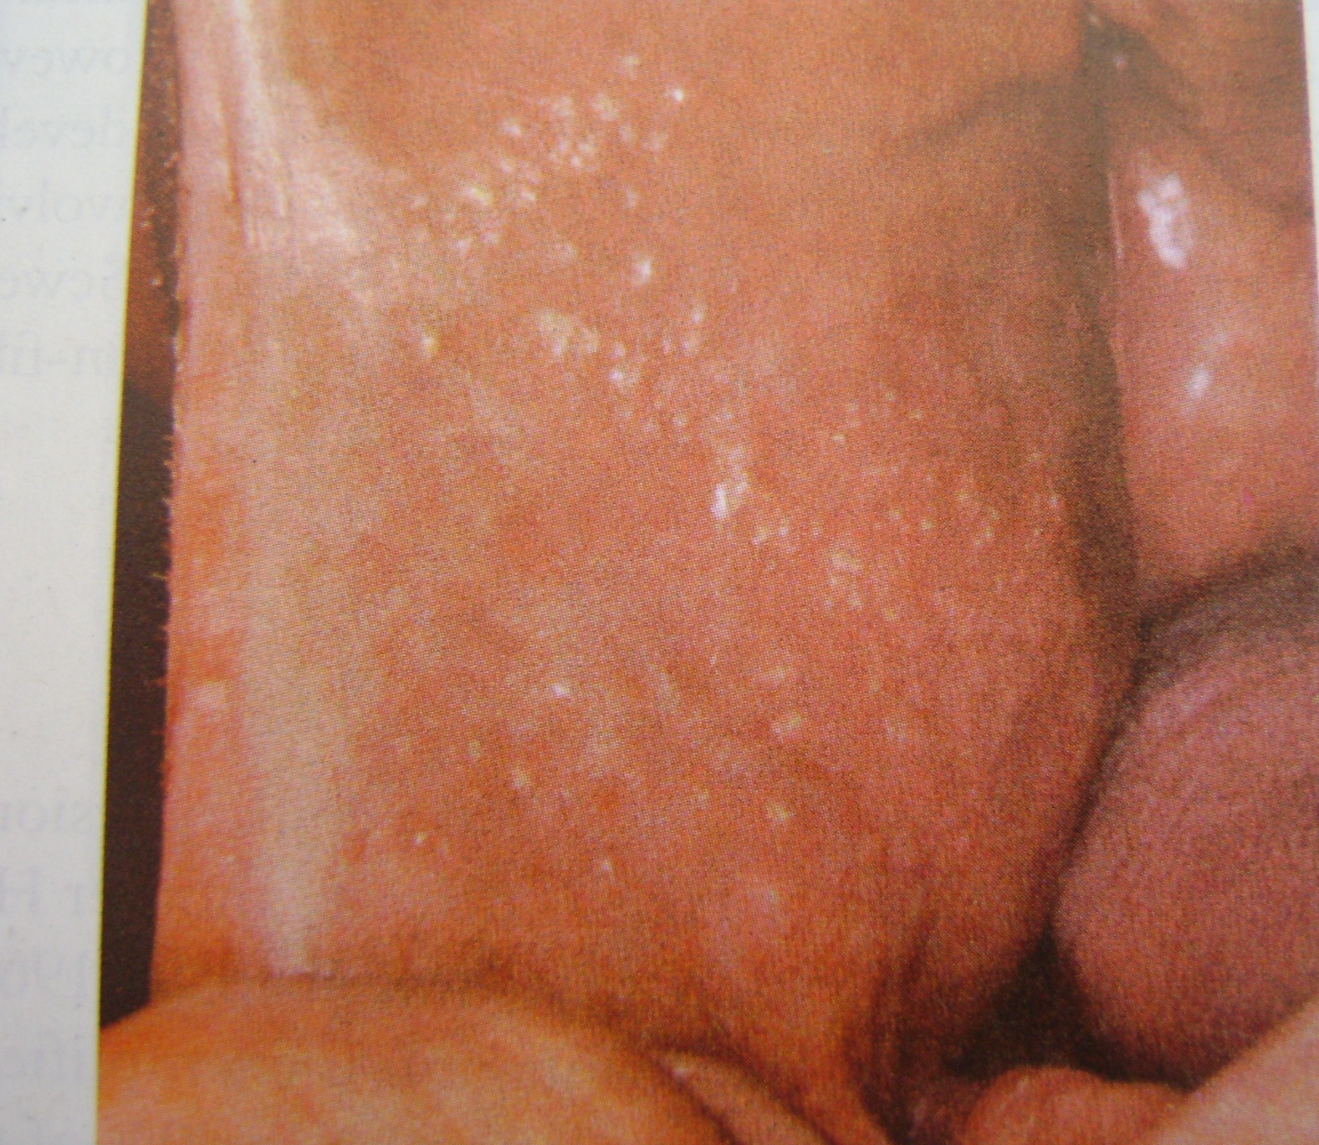

Slide 69
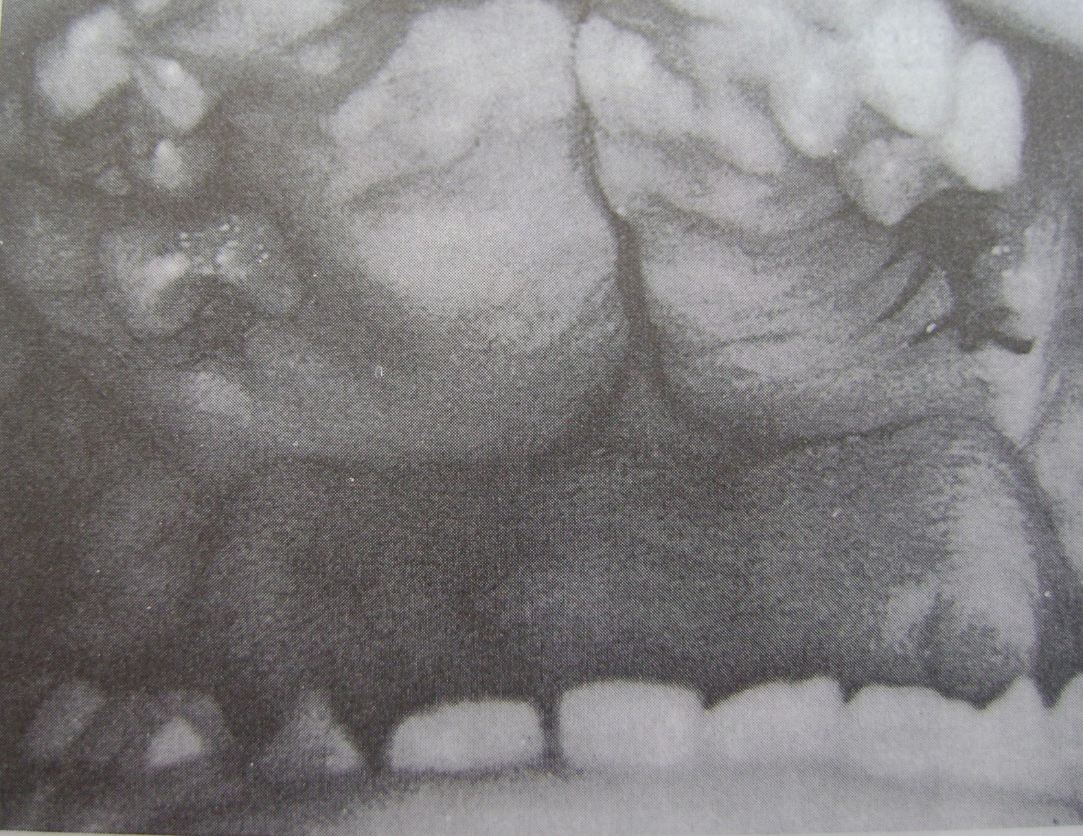
Fibromatosis Gingivae

Slide 70
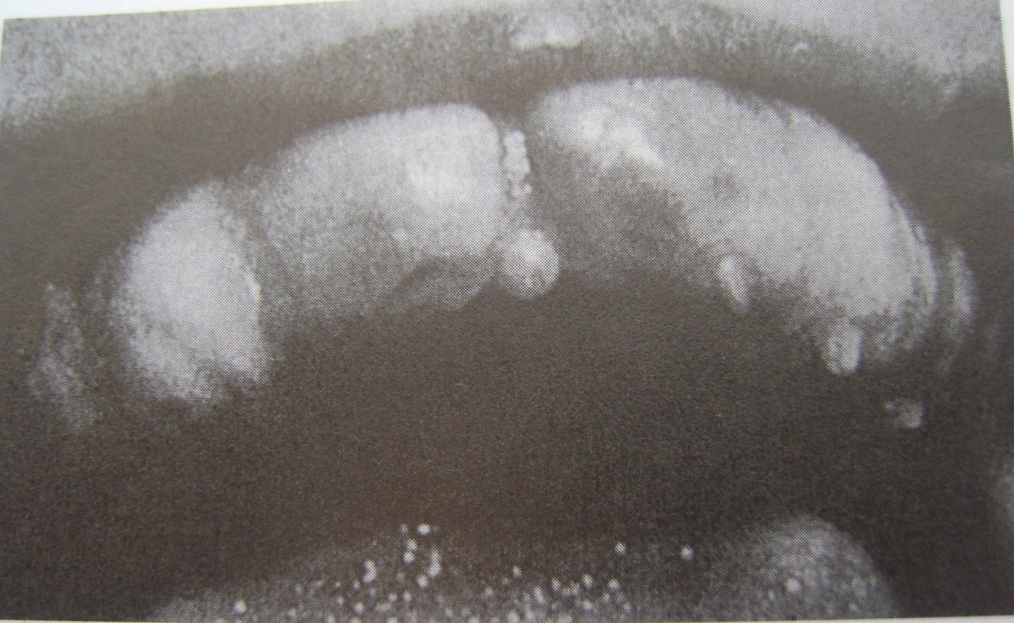
Fibromatosis Gingivae

Slide 71
MICROSTOMIA
Congenital
Agnathia
Cyclopia hypognathus
Acquired
Electrical burn
Chemical burn
Associated syndromes
Craniocarpotarsal dysplasia
Whistling face syndrome

Slide 72
Microglossia/Hypoglossia/Aglossia
Abnoramlly small tongue or entirely missing tongue
Asssociated with
Oro-mandibular limb hypogenesis syndrome

Slide 73
MACROGLOSSIA
Abnormal enlargement of tongue
Congenital
Lymphangioma
Hemangioma
Hemi-hyperplasia
Cretinism
Beckwith Wiedemann
syndrome
Down syndrome
Mucopolysaccharidosis
Neurofibromatosis
MEN type II
Acquired
Edentulous patient
Amyloidosis
Myxedema
Acromegaly
Angioedema
Carcinoma
Other tumors

Slide 74
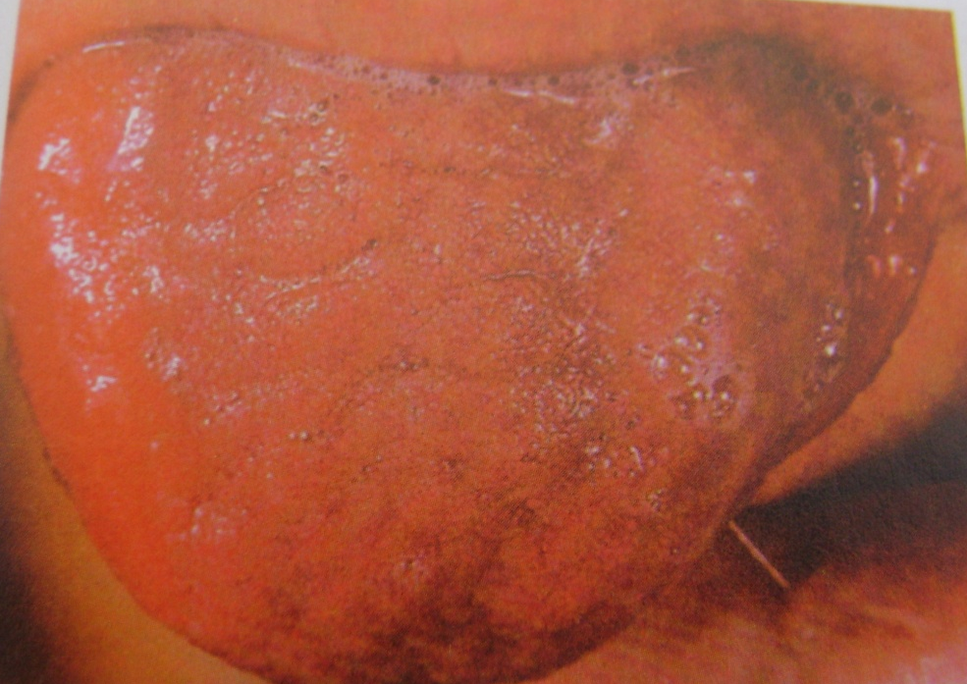
MACROGLOSSIA
Noisy breathing
Drooling
Difficulty in eating
Lisping speech
Crenated lateral border of tongue
Open bite
Mandibular prognathism

Slide 75
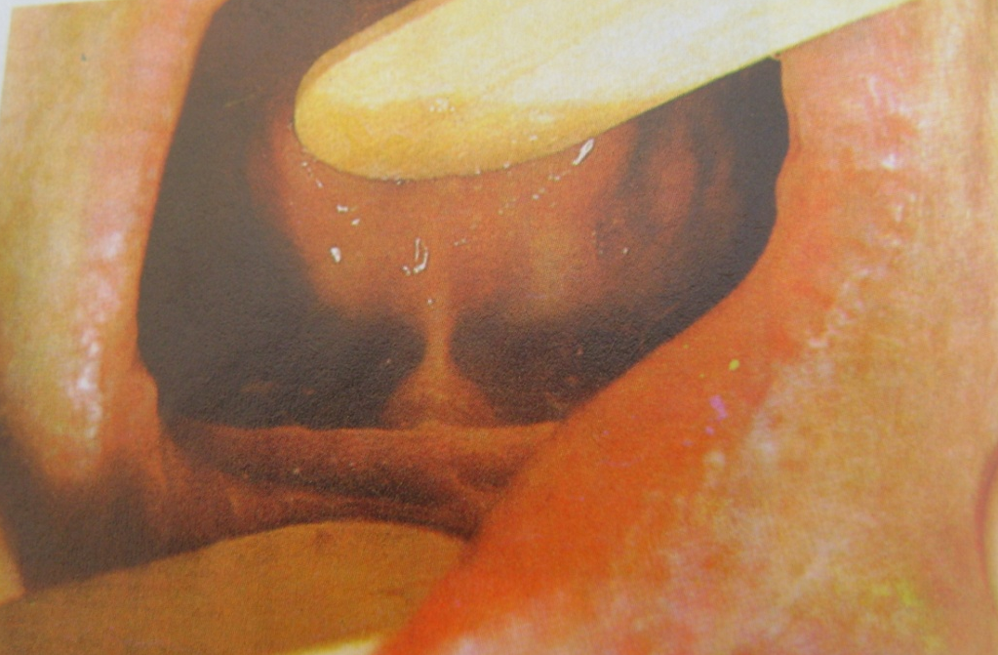
ANKYLOGLOSSIA/TONGUE TIE
Short, thick lingual frenum resulting in restricted tongue movement
High mucogingival attachment lead to periodontal problem
Speech defect
Associated syndromes
Neumann syndrome
Orofacial digital syndrome

Slide 76
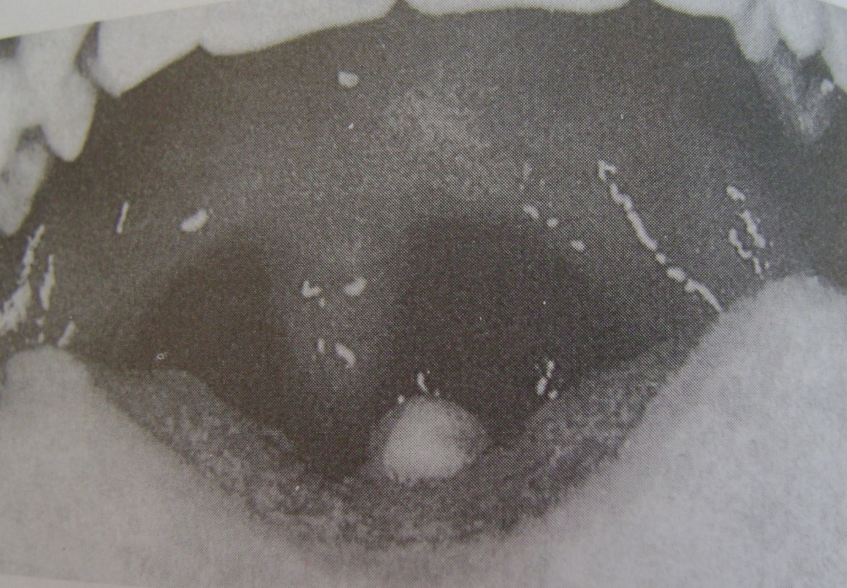
LINGUAL THYROID NODULE
Only thyroid tissue as primitive gland does not descend normally, or
Secondary to thyroid hypofunction
Most common on base of tongue at foramen ceacum
Dysphagia
Dysphonia
Dyspnea

Slide 77
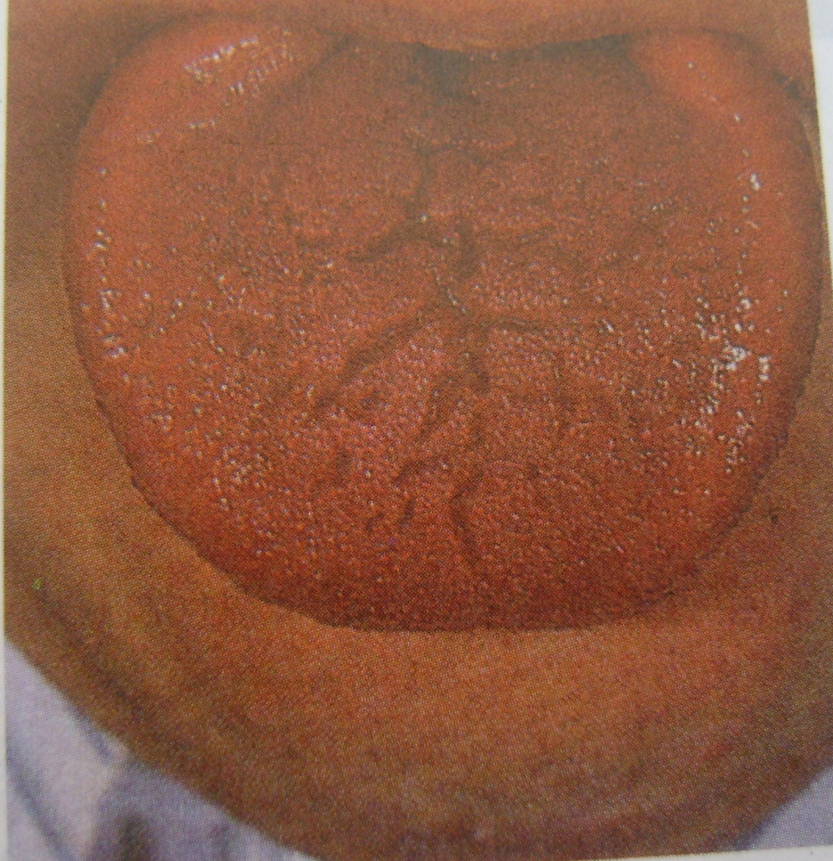
FISSURED TONGUE/ SCROTAL TONGUE
Grooves or fissures on dorsum of tongue
Asymptomatic or Mild burning sensation
Associated with
Geographic tongue
Melkerson Rosanthal syndrome
Fissured tongue
Chielitis granulosomata
Bells palsy
Trisomy 21

Slide 78
CLEFT TONGUE OR BIFID TONGUE
Is a rare condition that is apparently due to lack of merging of the lateral lingual swellings of this organ.
Manifested as a lay groove in the midline of the dorsal surface.
Results because of incomplete merging and failure of groove obliteration by underlying mesenchymal proliferation.
It is found in association with orofacial digital syndrome.

Slide 79
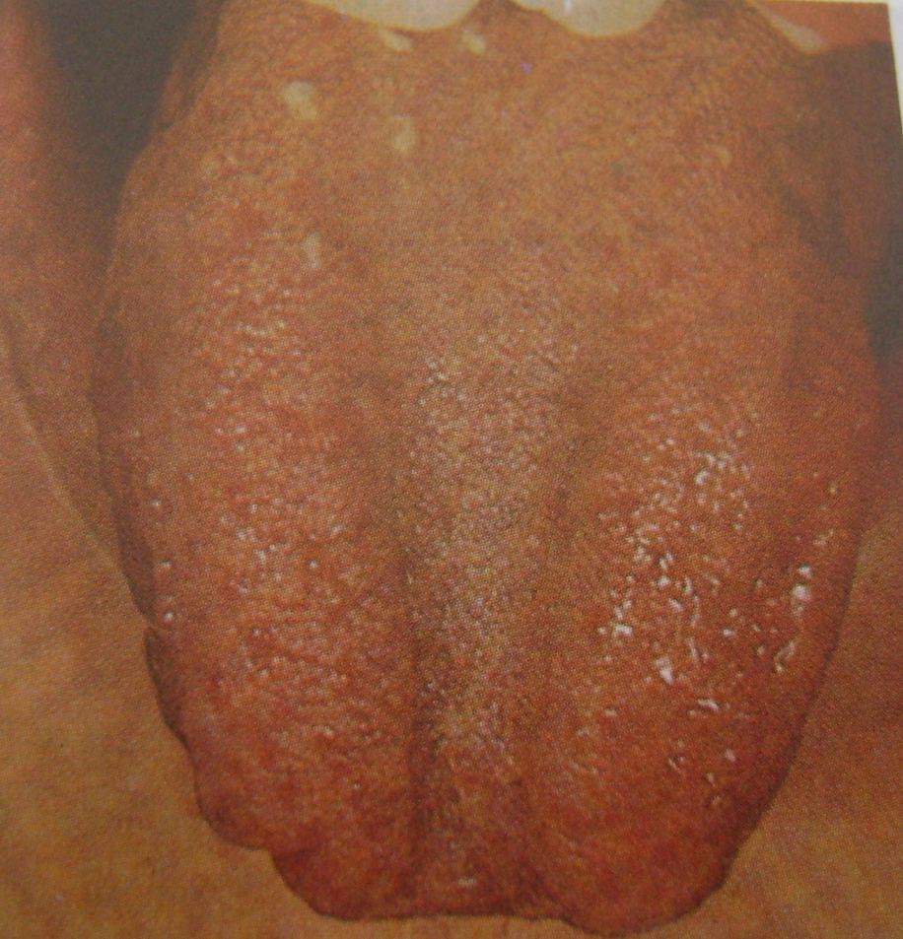
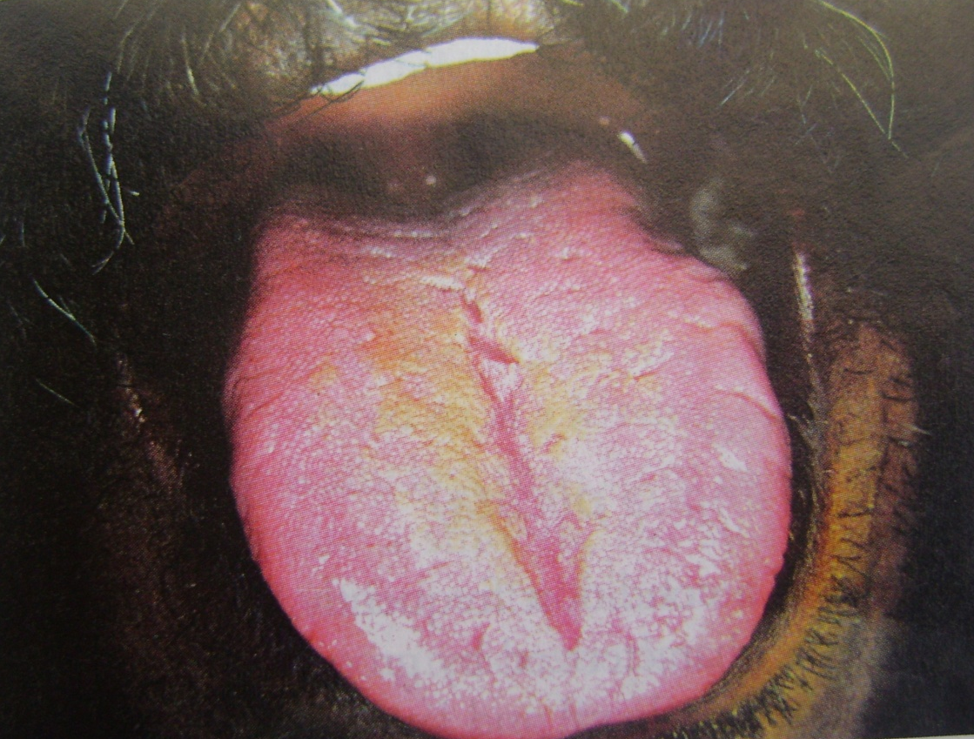

Slide 80
BENIGN MIGRATORY GLOSSITIS
May be related to emotional stress.
Clinical Features
Multiple areas of desquamation of the filiform papillae of the tongue in an irregular circinate pattern.
Central portion of the lesion appears inflamed while the borders is outlined by a thin, yellowish while line or band.
Fungiform papillae persist in the desquamated areas small, elevated red dots.
Areas of desquamation remains for a short time in one location and heal and appear in another thus giving rise to the idea of migration.

Slide 81
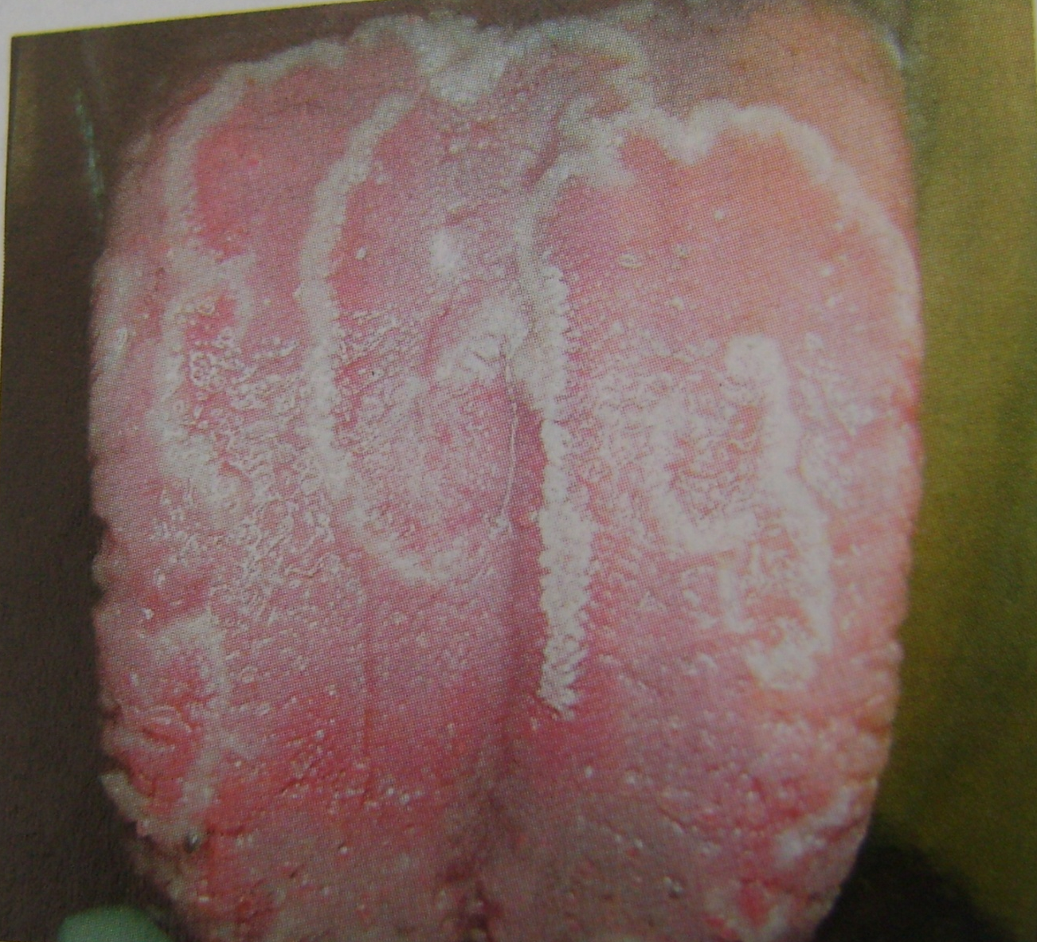

Slide 82
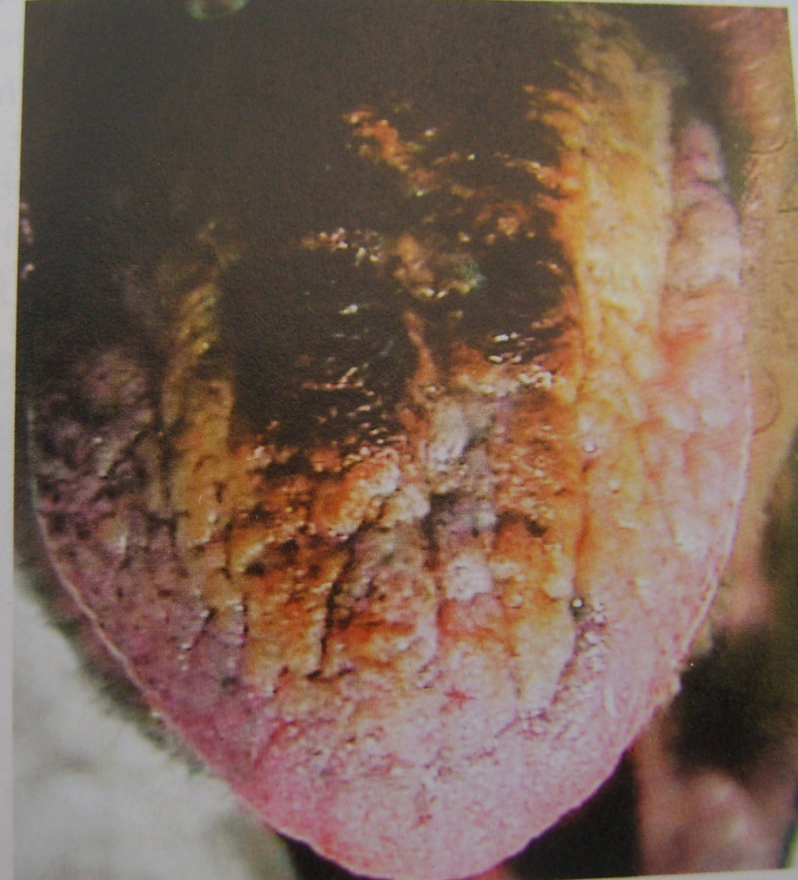
HAIRY TONGUE
Accumulation of keratin on filiform papillae of dorsum tongue
Cause
Heavy smoking
Antibiotic therapy
Poor oral hygiene
General debilitation
Radiation therapy
Use of oxidizing mouthwash or antacid
Overgrowth of fungal or bacterial organisms

Slide 83
HAIRY TONGUE
Midline - anterior to circumvallate papillae
Sparing anterior and lateral border
Elongated papillae are brown, yellow or black as a result of pigment producing bacteria or staining from tobacco or food
Elongated papillae brush palate lead to gagging
Bad taste

Slide 84
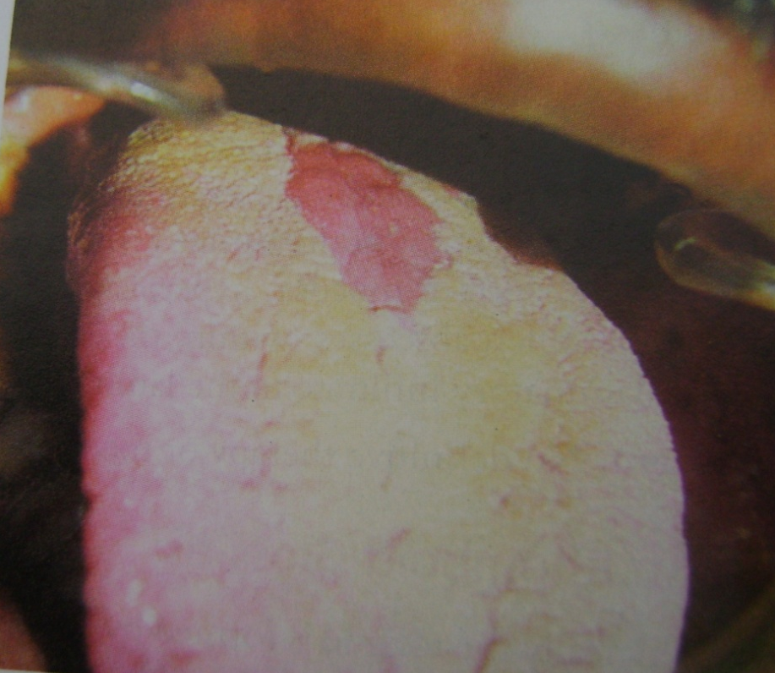
Median rhomboid glossitis
Romboid reddish area in midline of dorsum of tongue anterior to vallate papillae
Due to persistance of tuberculum impar
Absence of filiform papillae and taste buds

Slide 85
Salivary gland aplasia
One or group of salivary gland absent
Associated syndromes
Hemifacial microsomia
LADD (lacrimal, auricle, dental and digit)
Mandibulofacial dysostosis

Slide 86
Xerostomia
Reduced salivary secretion
Temporary
Psychological
Duct calculi
Sialoadenitis
Mumps
Postop. Parotitis
Nutritional deficiencies
Drug therapy
Anticholinergic
Sympathomimetic
Tricyclic antidepressant
Bronchodilators
Antihistaminics
Permanent
Salivary gland aplasia
Sjogrens syndrome
Dibetes mallitus
Parkinsons disease
Cystic fibrosis
Sarcoidosis
Radiotherapy
Surgical/physical trauma
Menapause

Slide 87
Hyperplasia of palatal glands
Endocrine disorder
Gout
Dibetes mallitus
Menopause
Hepatic disease
Starvation
Alcoholism
Inflammation
Benign lymphoepithelial lesion
Sjogrens syndrome
Adiposity
Aglosia aductyly syndrome
Waldenstroms macroglobuliemia
Uveoparotid fever
Felty’s syndrome
Drugs
Aging
Idiopathic

Slide 88
Atresia
Congenital occlusion or absence of one or more of major salivary gland duct
Leads to retention cyst or xerostomia
Aberrancy
Salivary glands found farthest from normal location

Slide 89
Static bone cavity
Asymptomatic
well circumscribed radiolucency with sclerotic borders
below mandibular canal between molar teeth and angle of mandible
Contains normal salivary gland tissue

Slide 90
Disturbances in Size of Teeth
MICRODONTIA
It is used to describe teeth which are smaller than normal.
In true generalized microdontia, all the teeth are smaller than normal. e.g.: pituitary dwarfism.
In relative generalized microdontia, normal or slightly smaller than normal teeth are present in jaws that are somewhat larger than normal.
Microdontia involving a single tooth, affects mostly the maxillary lateral incisor and the third molar, e.g. Peg lateral.

Slide 91
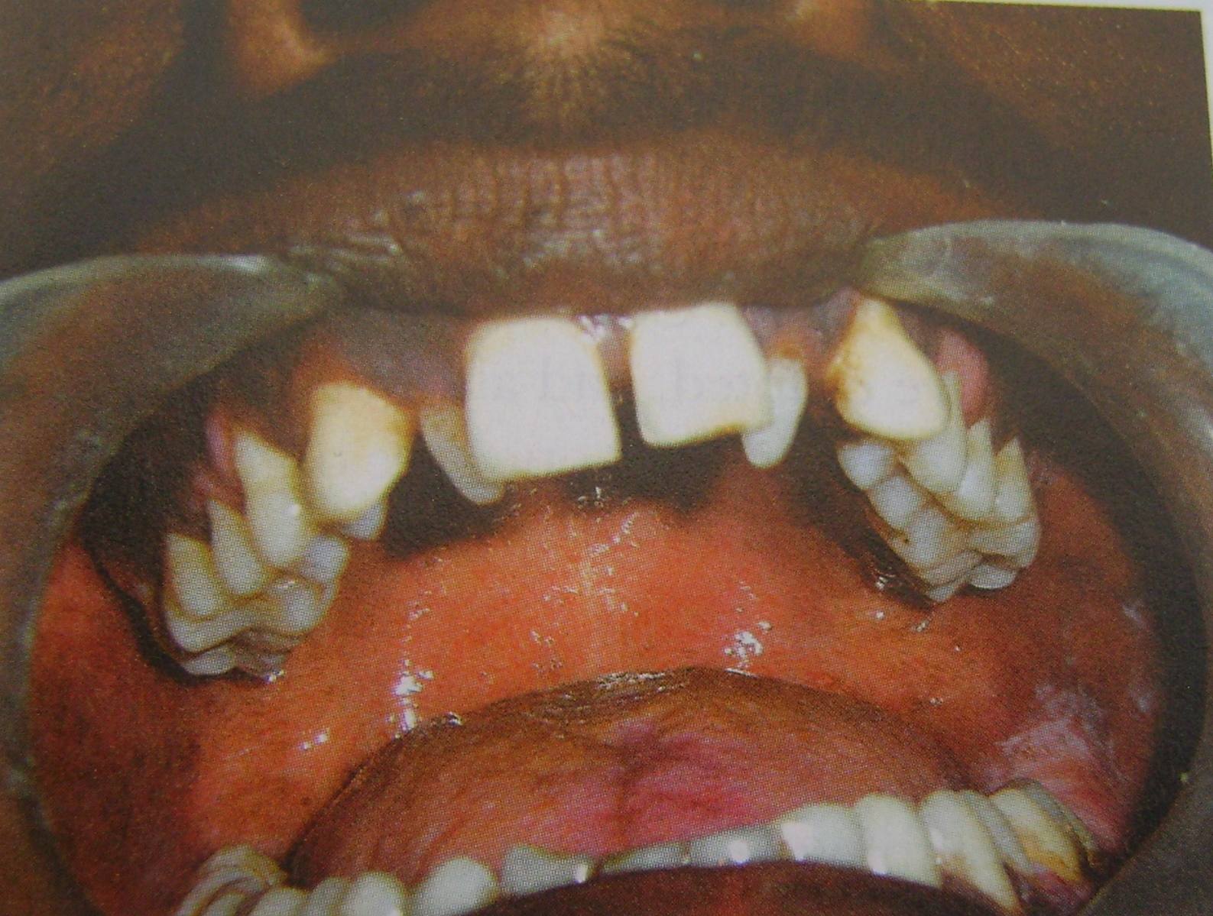

Slide 92
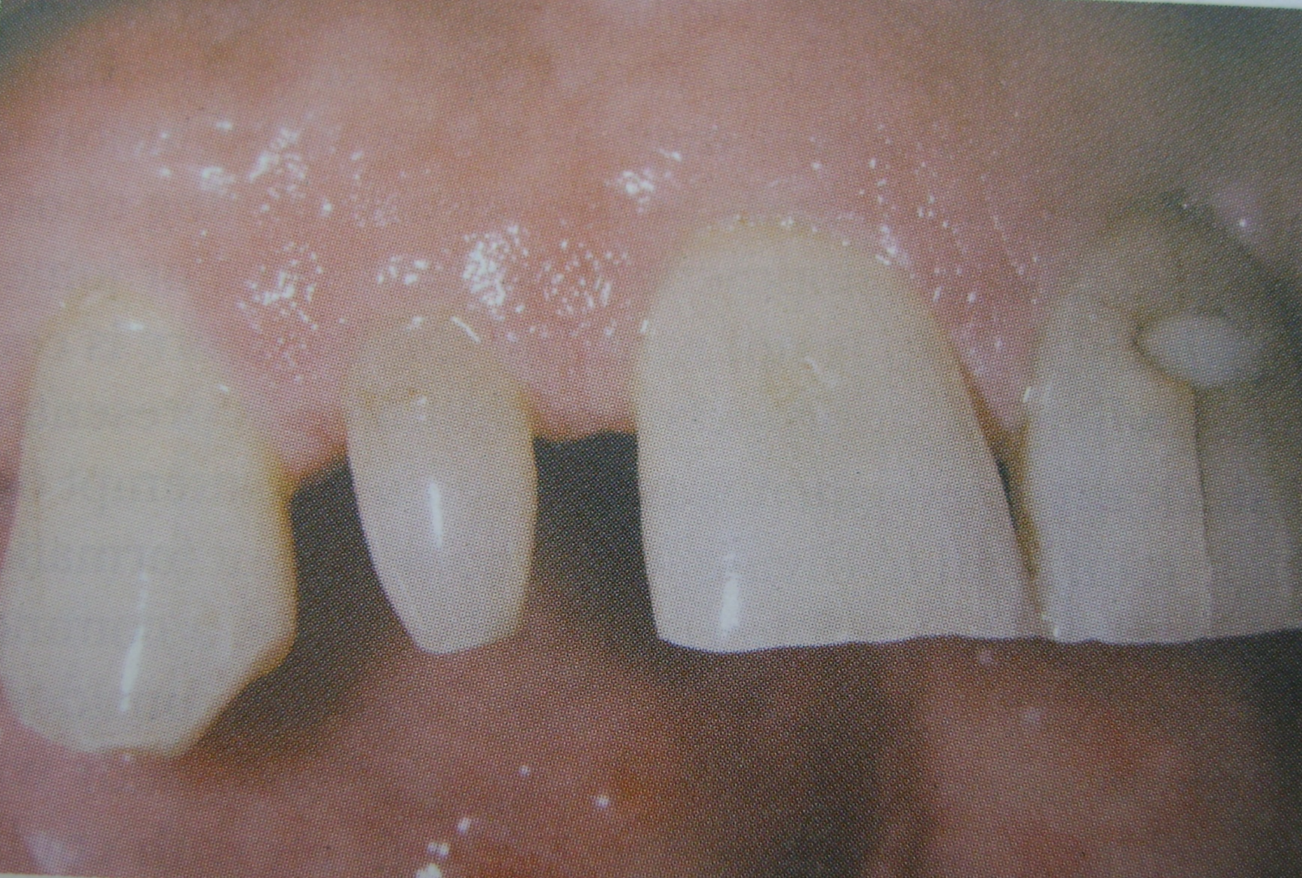

Slide 93
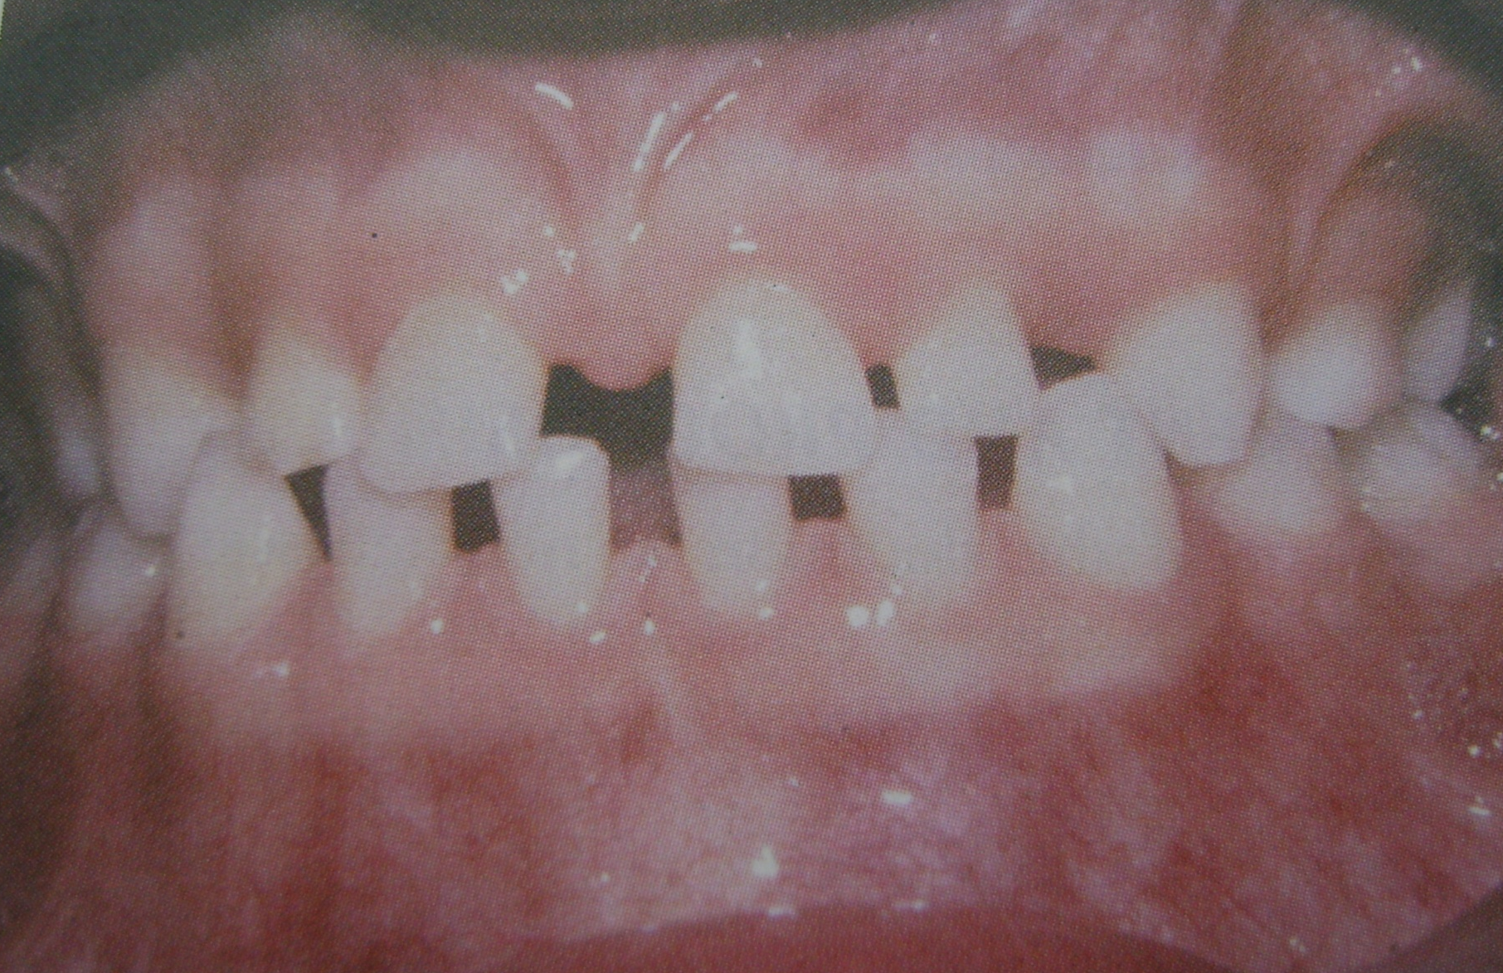

Slide 94
MACRODONTIA
Refers to teeth larger than normal.
True generalized: All teeth larger than normal, e.g.: pituitary gigantism.
Relative generalized: slightly larger teeth in small jaws
Microdontia involving a single tooth is common.
Hemihypertrophy of the face - can be seen but not a true type.

Slide 95
Developmental Disturbances in Shape of Teeth
GEMINATION
Anomalies which arise from an attempt at division of a single tooth germ by an invagination, with resultant incomplete formation of two teeth.
The structure is usually one with two completely or incompletely separated crowns that have a single root and root canal.
Seen in deciduous as well as permanent dentition.
The term “twinning” is used to designate the production of equal structures by division resulting in one normal and one supernumerary tooth.

Slide 96
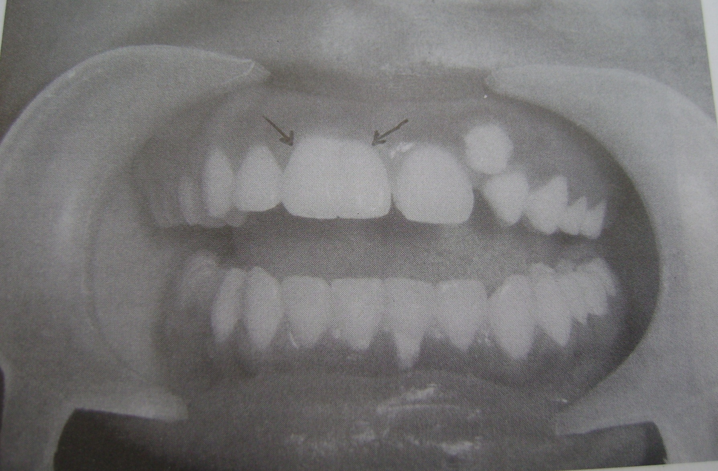

Slide 97
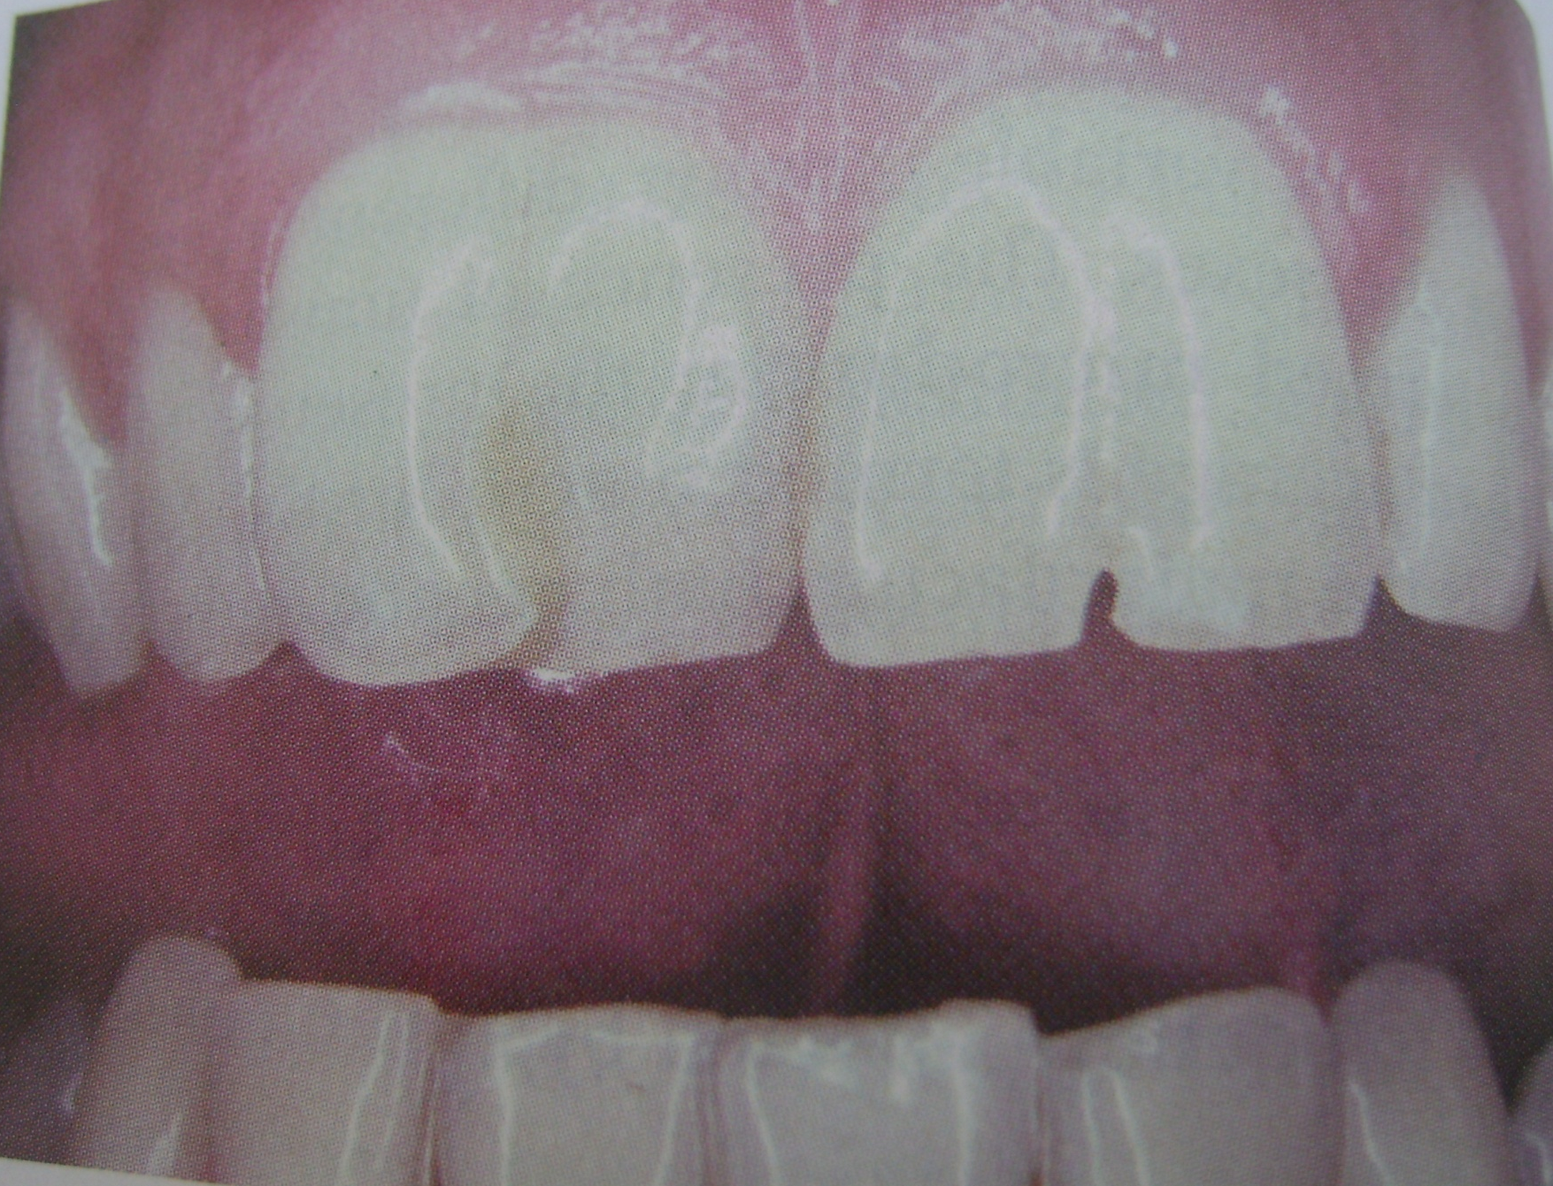

Slide 98
FUSION
Arise through union of two normally separated tooth germs.
Depending on stage of development of teeth at the time of union, fusion may be complete or incomplete.
Some physical force or pressure produces contact of the developing teeth and their subsequent fusion occurs.
If contact occurs early before calcification begins, the two teeth may be completely united to form a single large tooth.
If contact of teeth occur when a portion of the tooth crown has completed its formation there may be union of roots.
Tooth may have separate or fused root canals and the condition is common in deciduous as will as permanent dentition.
Possible clinical problems related to appearance, spacing and periodontal conditions have been noticed.

Slide 99
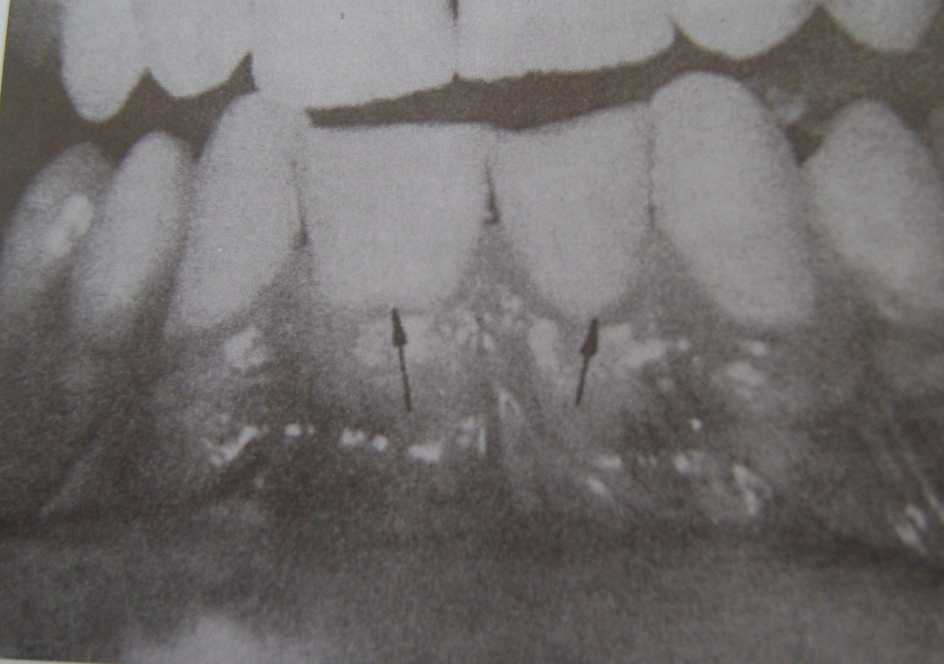

Slide 100
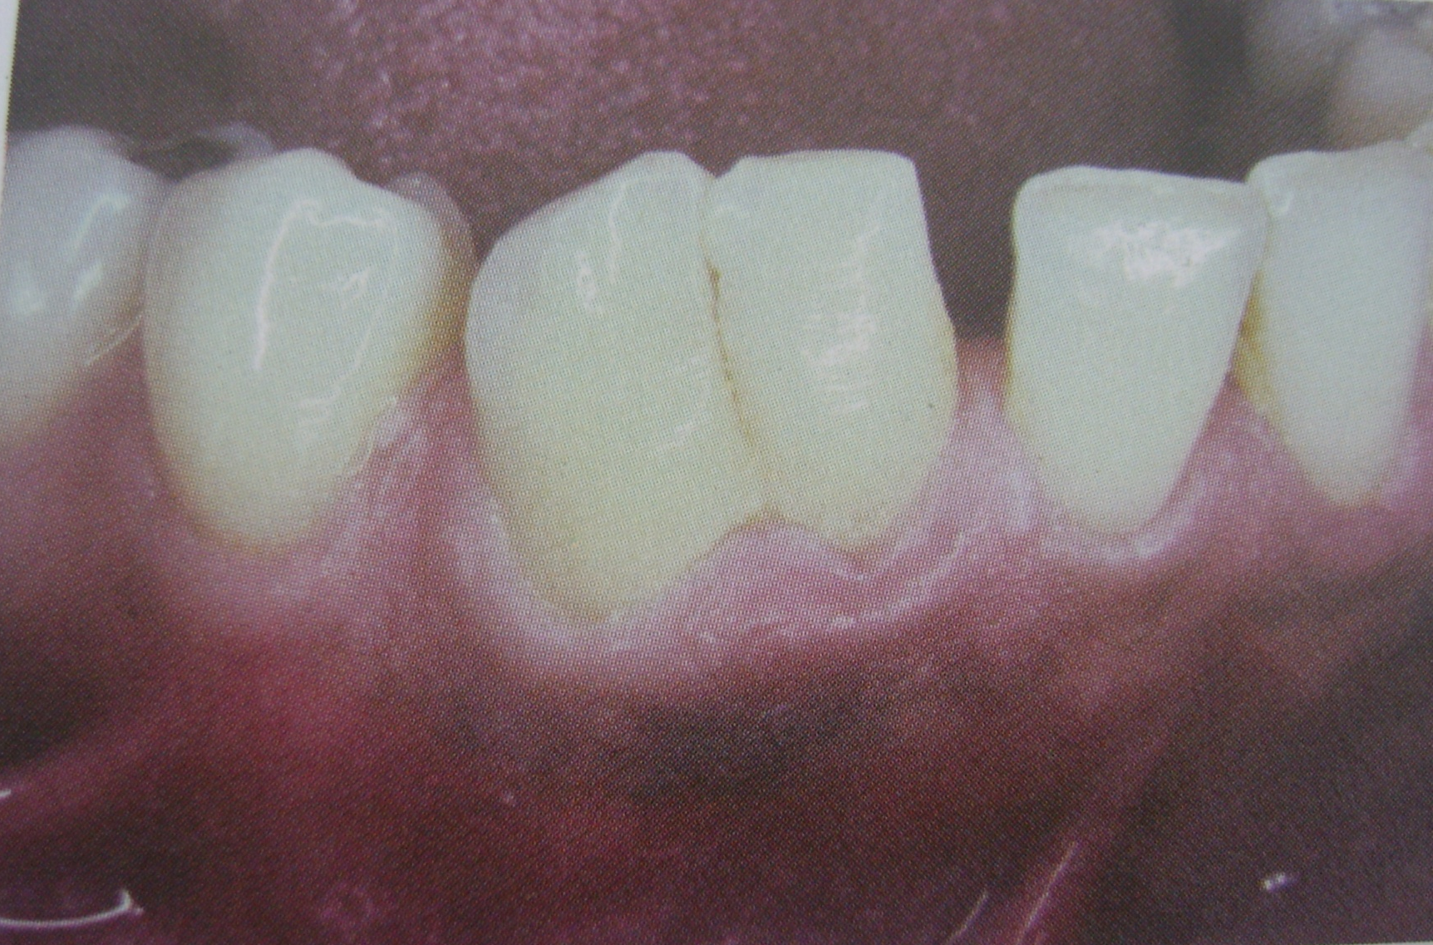

Slide 101
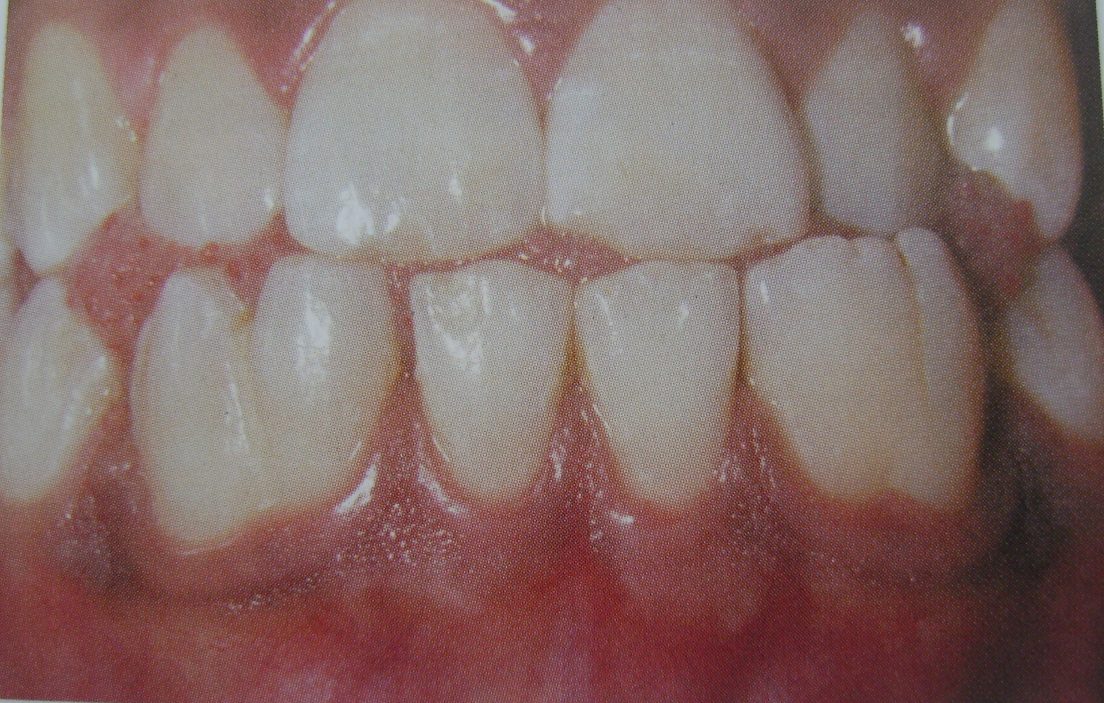

Slide 102
CONCRESCENCE
A form fusion which occurs after root formation has been completed.
The teeth are united by cementum only.
Thought to arise as a result of traumatic injury a crowding of teeth with resorption of interdental bone so that the two roots are in approximate contact and become pushed by deposition of cementum between them.
May occur before or after teeth have erupted.
Diagnosis is by roentgenographic examination.
With fused teeth the extraction of one may result in extraction of the other.

Slide 103
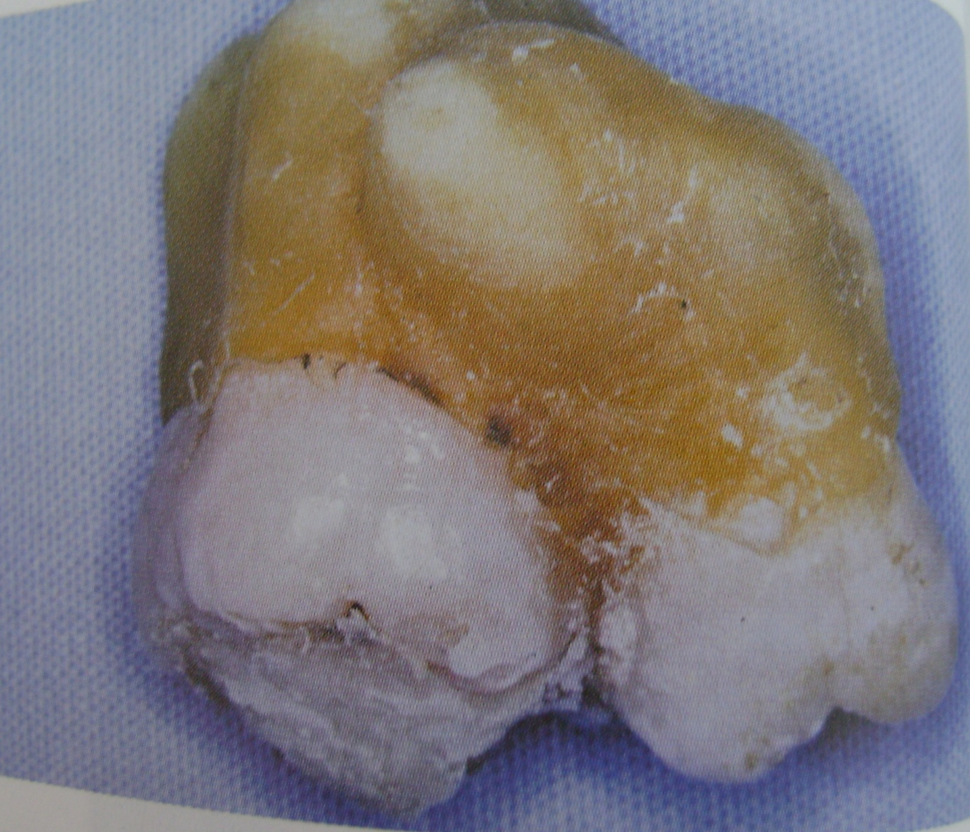

Slide 104
DILACERATION
Refers to an angulation or a sharp bend or curve in the root or crown of a formed tooth.
It is thought to be due to trauma during the period in which the tooth is forming with result that the position of calcified portion of the tooth is changed and the remainder of the tooth is formed at an angle.
Curve or bend may occur anywhere along the length of the tooth, at the cervical portion, at other midway along the root or own just at the apex of the root, depending upon the amount or root formed when the injury occurred.
Dilacerated teeth present difficult problems at the tie of extraction.

Slide 105
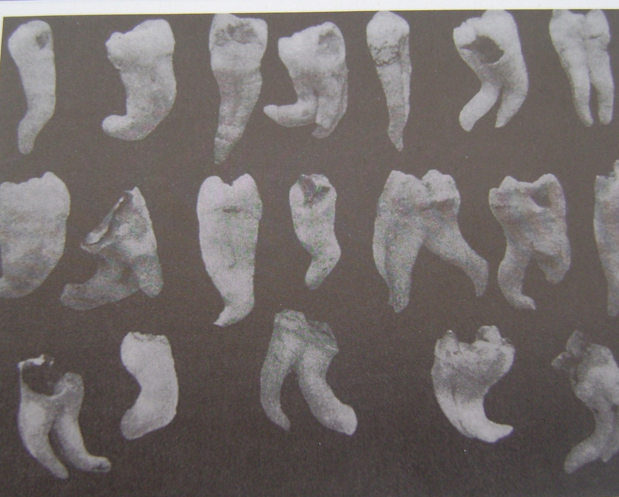
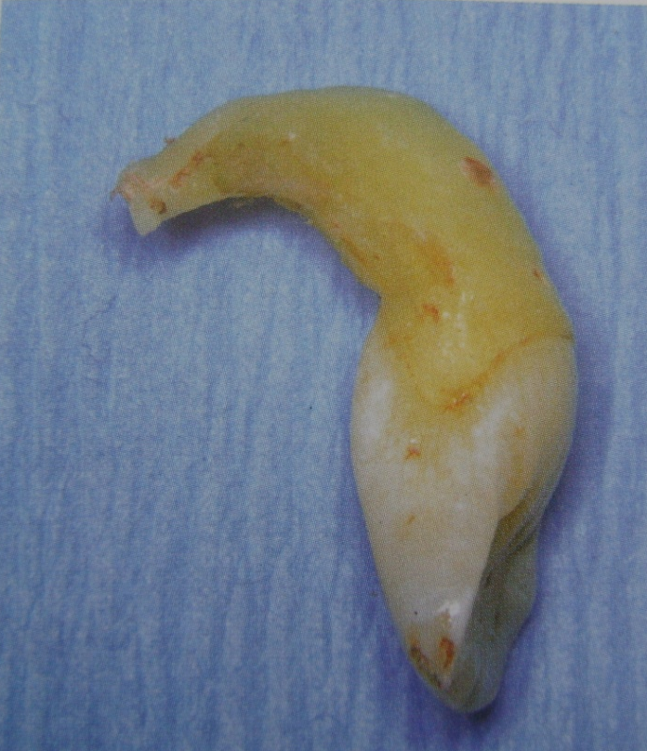

Slide 106
TALON CUSP
An anomalous structure resembling an eagles talon projects lingually from the cingulum areas of a maxillary and mandibular permanent incisor.
The cusp blends smoothy with the tooth except that there is a deep developmental groove where the cusp blends with the sloping lingual tooth surface.
It poses problems for the patient in terms of esthetics, caries control and occlusal accommodation.
Prevalent in persons with Rubintein-Taybi syndrome.

Slide 107
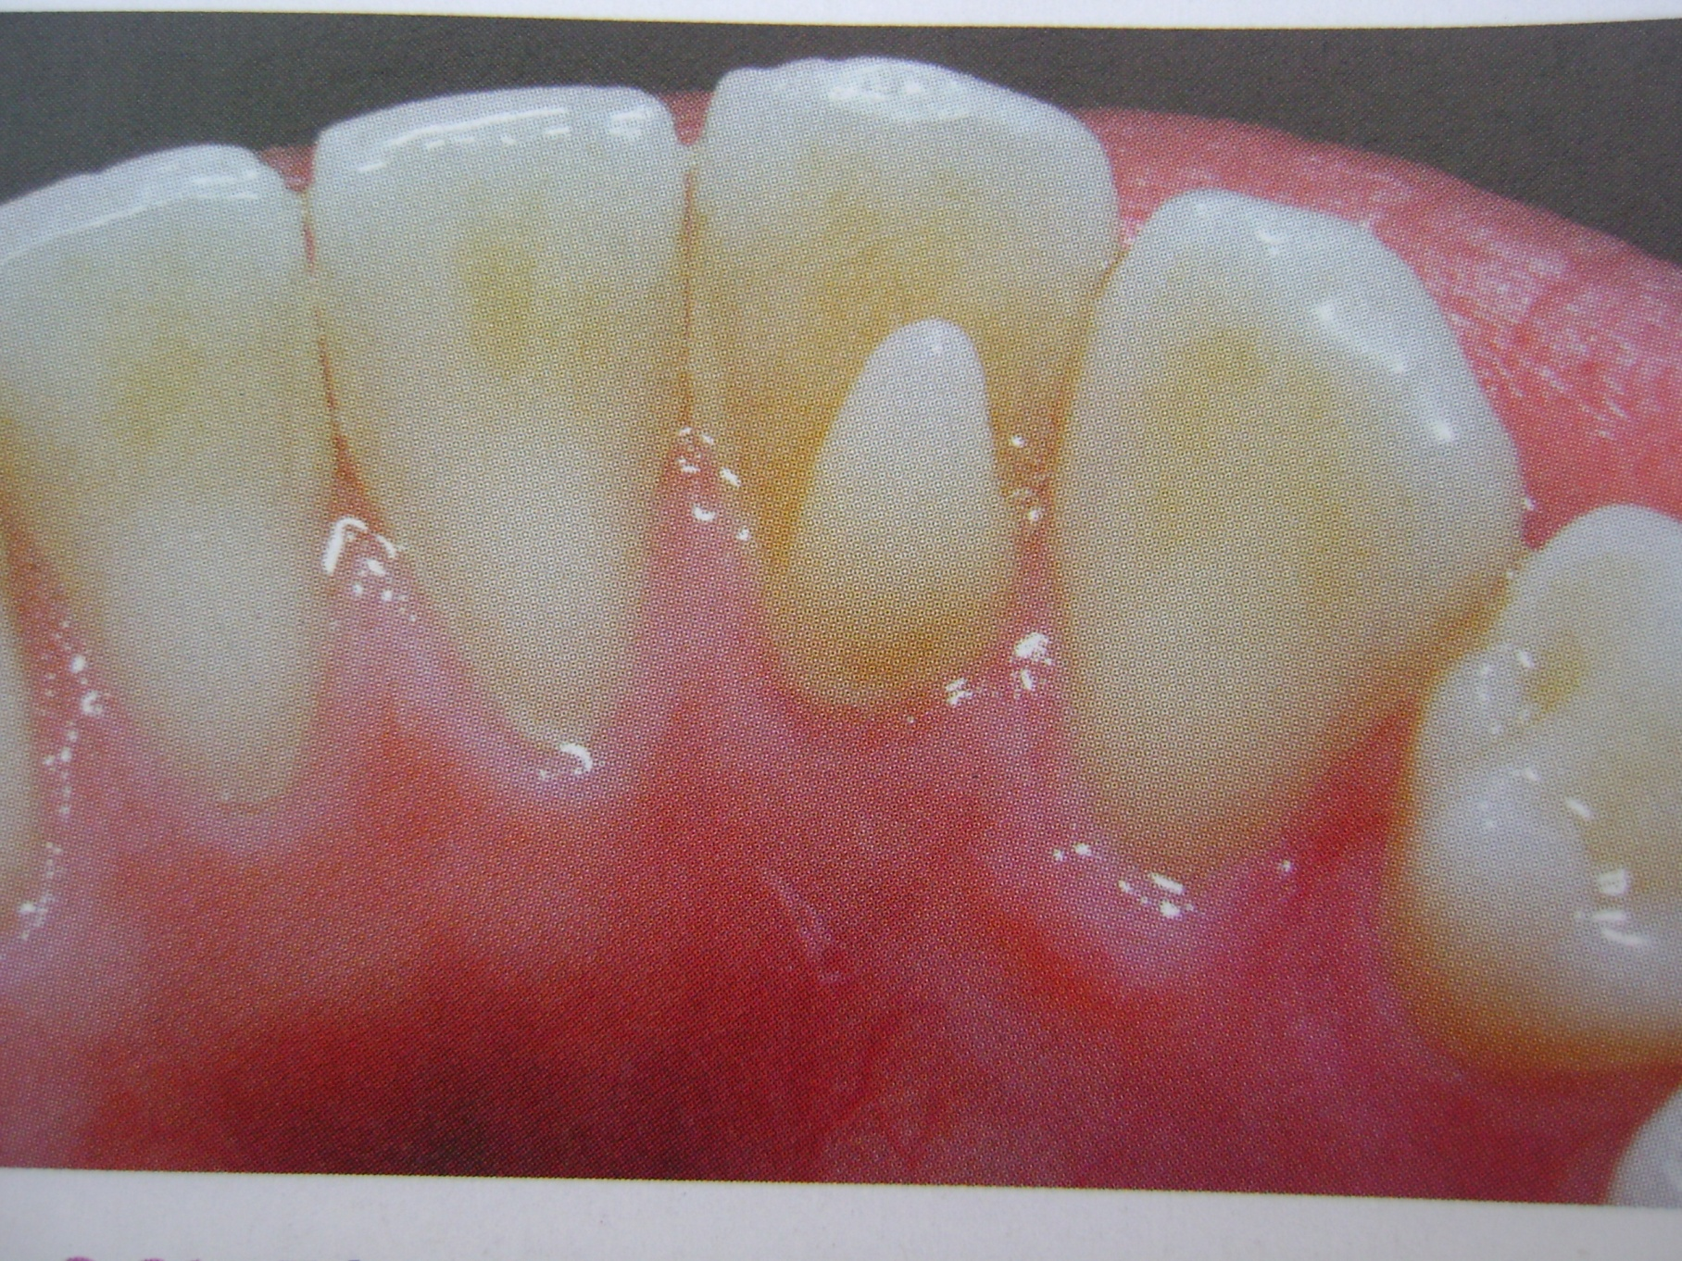

Slide 108
DENS IN DENTE
(Dens invaginatus, dilated composite odontome)
Is a developmental variation which is thought to arise as a result of an invagination in the surface of a tooth crown before calcification has occurred.
Causes
Increased localized external pressure, focal growth retardation and focal growth stimulation in certain areas of tooth bud.
Permanent maxillary laternal incisors are mostly involved.
Maxillary central incisor are sometimes involved.
Radiological Features
It is recognized as a pear shaped invagination of enamel and dentin with a narrow constriction at the opening on the surface of the tooth and closely approximating, the pulp in its depth. Food debris may become packed in this area with resultant caries and infection of the pulp.
Dens in dente may exhibit an invagination that extends nearly to the apex of the root.

Slide 109
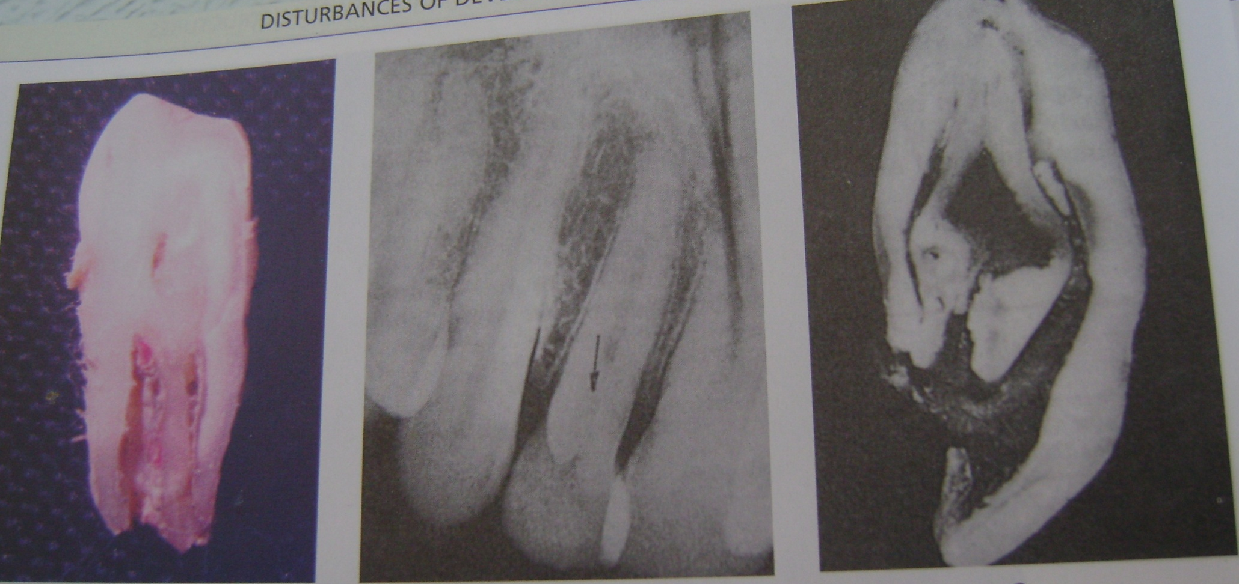

Slide 110
DENS EVAGINTUS
(Occlusal tuberculated premolar, leong’s premolar, evaginated odontome, occlusal enamel pearl)
Is a developmental condition that appears clinically as an accessor cusp or a globule of enamel on the occlusal surface between the buccal and lingual cusps of premolars, unilaterally or bilaterally.
Pathogenesis of the lesion is thought to be proliferation and evagination of an area of the inner enamel epithelium and subjacent odontogenic mesenchyme into the dental organ during early tooth development.
This extra cusp may contribute to incomplete eruption, displacement of teeth or pulp exposure with subsequent infection following occlusal wear off.

Slide 111
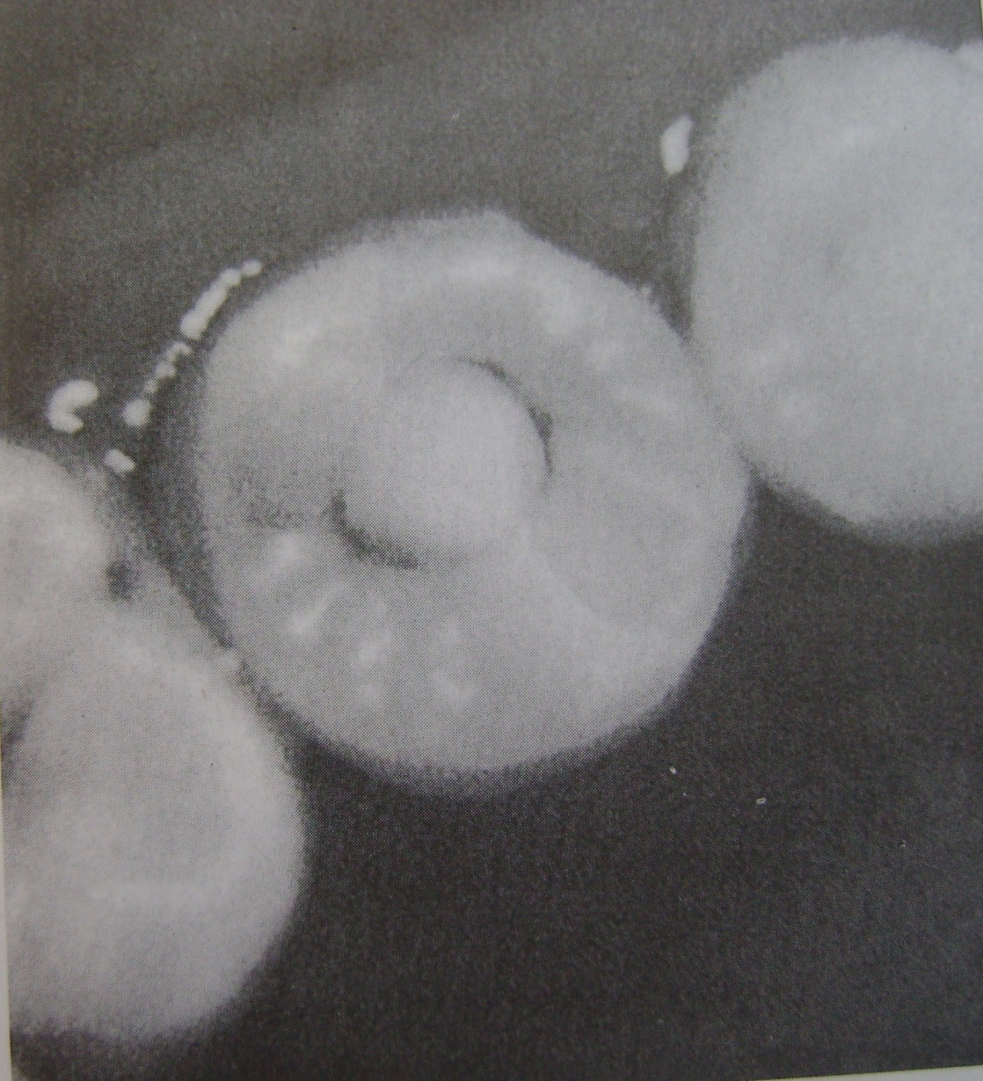

Slide 112
TAURODONTISM
(Bull like Teeth)
Dental anomaly in which the body of the tooth is enlarged at the expense of the roots.
Shaw classified taurodont into -Hypotaurodont
-Mesotaurodont
-Hypertaurodont
Causes of Taurodontism
Failure of epithelial sheath to invaginate at the proper horizontal level.
Specialized or retrograde character.
Primitive pattern.
Mendelian recessive trait.
Atavistic feature.
Mutation resulting from odontoblastic deficiency during dentinogenesis of the roots.
It is associated with klinefelter’s syndrome (males whose sex chromosome constitution includes one or more extra X chromosomes)

Slide 113
Clinical Features
May affect either deciduous for permanent dentition.
Teeth involved are molars.
In may be unilateral/bilaternal.
Radiological Features
Involved teeth are rectangular in shape.
Pulp chamber is extremely large with greater apico-occusal height.
Pulp lacks the usual constriction at the cervical of the tooth and roots are short.
Bifurcation or trifurcation is only a few mm above the apices of roots.

Slide 114
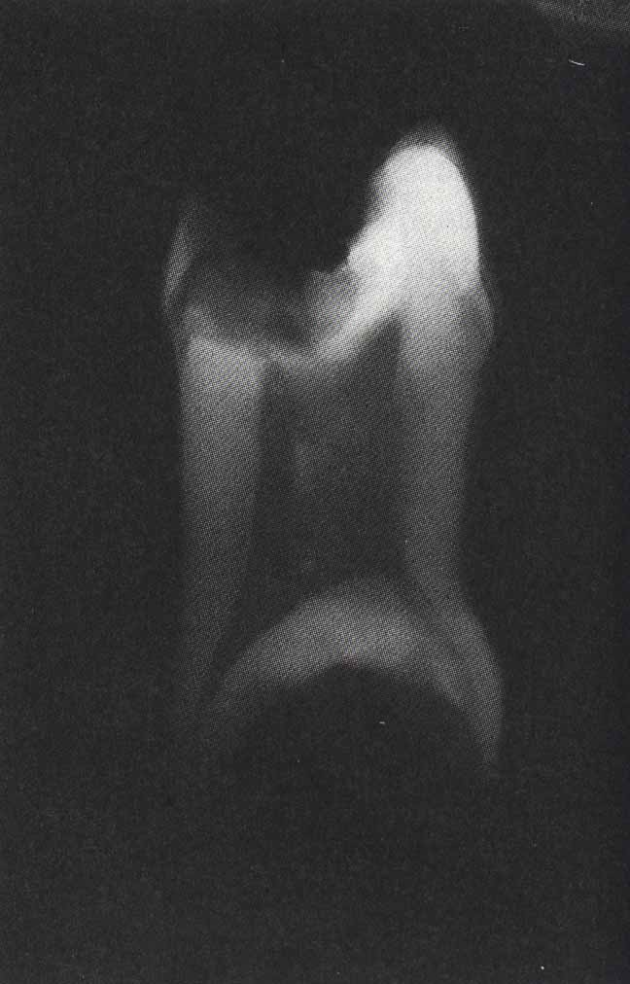
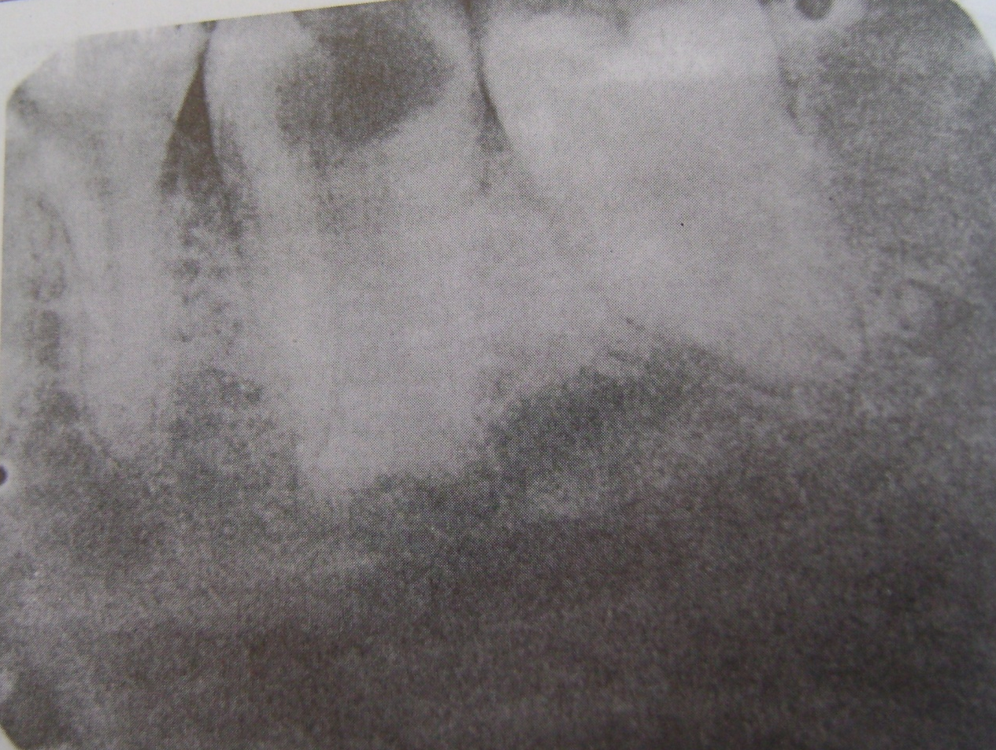

Slide 115
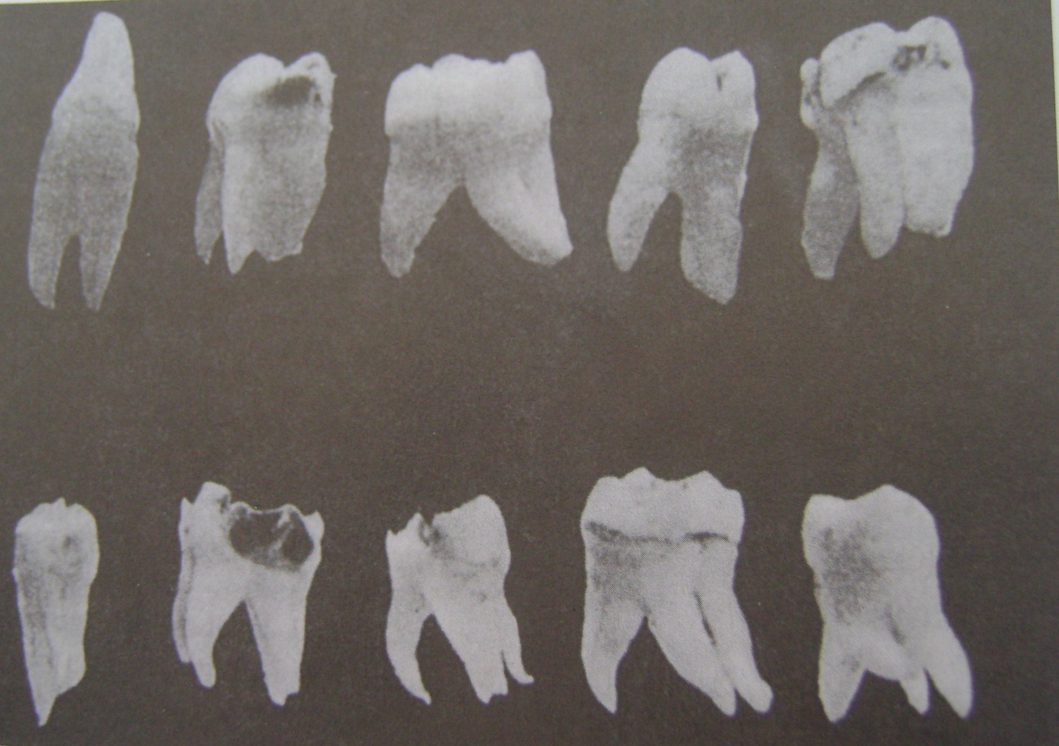
SUPERNUMERARY ROOTS

Slide 116
DEVELOPMENTAL DISTURBANCES IN NUMBER OF TEETH
ANODONTIA
Total anodontia in which all teeth are missing may involve both deciduous an permanent dentition. It is associated with hereditary ectodermal dysplasia.
Induced or false anodontia occurs as result of extraction of all teeth.
Pseudoanodontia is applied to multiple unerupted teeth.
True partial anodontia (hypodontia or oligodontia).
All four first molars are missing.
Maxillary lateral incisors, maxillary and mandibular second premolars are missing.
Congenitally missing deciduous teeth usually involve the maxillary lateral incisor.
The etiology of missing teeth is that it is actually the result of one or more point mutations in a closely linked polygenic system transmitted as an autosomal dominant pattern with incomplet penetrance and variable expressivity.

Slide 117
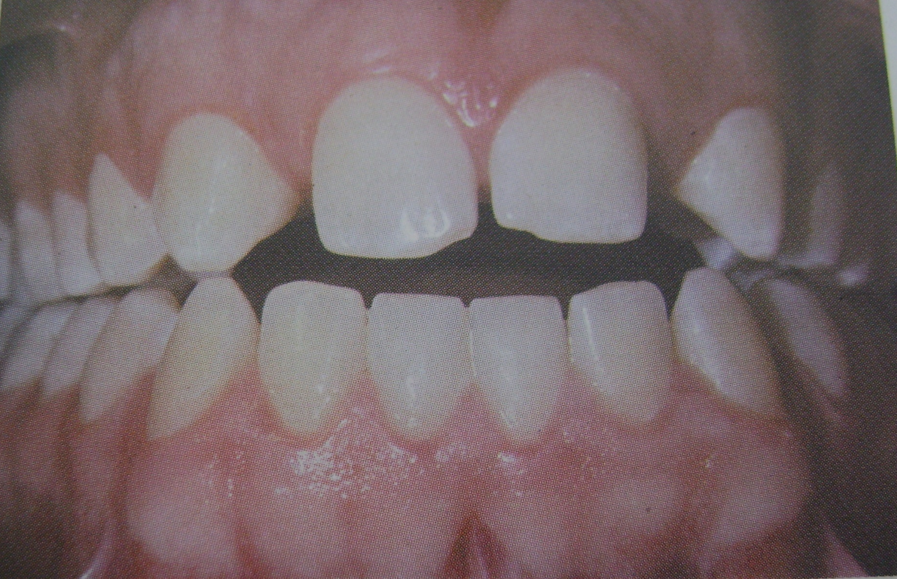

Slide 118
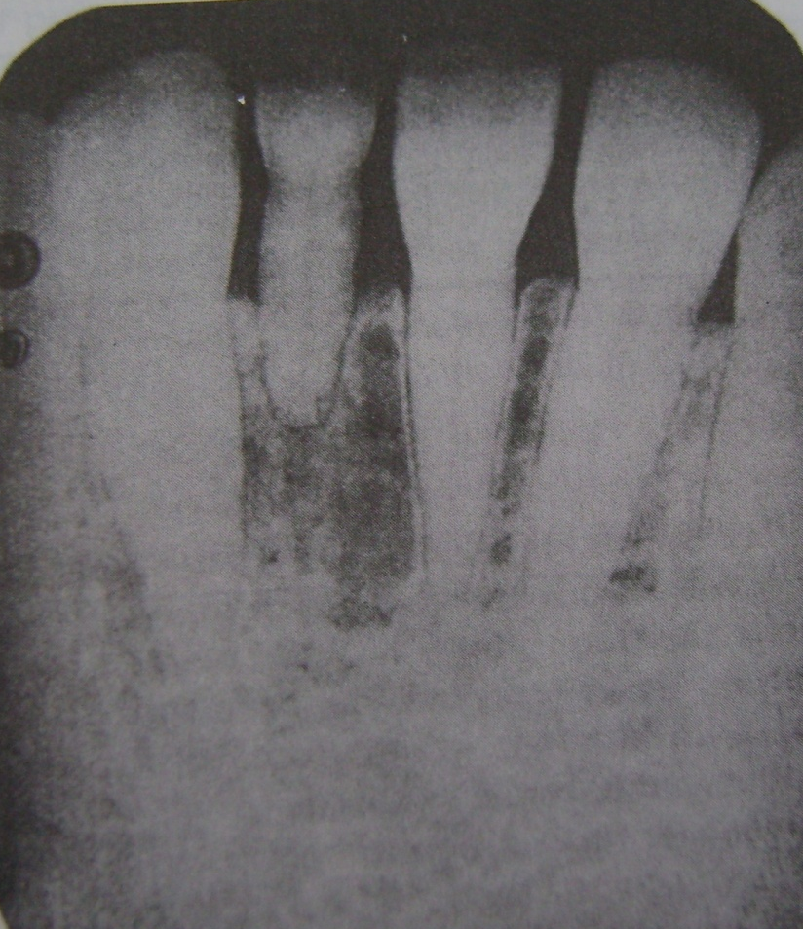
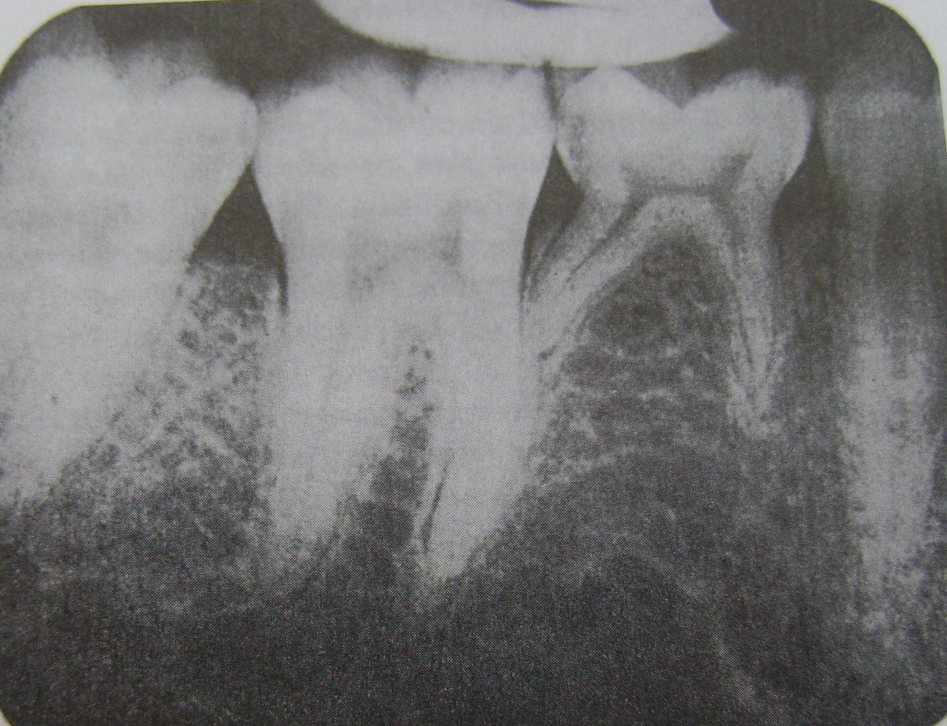

Slide 119
SUPERNUMERARY TEETH
Develop from a fluid tooth bud arising from the dental lamian near permanent tooth bud or from splitting of the permanent but itself.
Most common tooth is mesiodens.
Maxillary 4th molar is the second most supernumerary tooth.
Other supernumerary teeth are maxillary paramolars, mandibular premolars and maxillary lateral incisors.
It may be erupted or impacted.
Frequently cause malposition of adjacent teeth or present their eruption.
Found in cleidocranical dysplasia, Gardner syndrome.

Slide 120
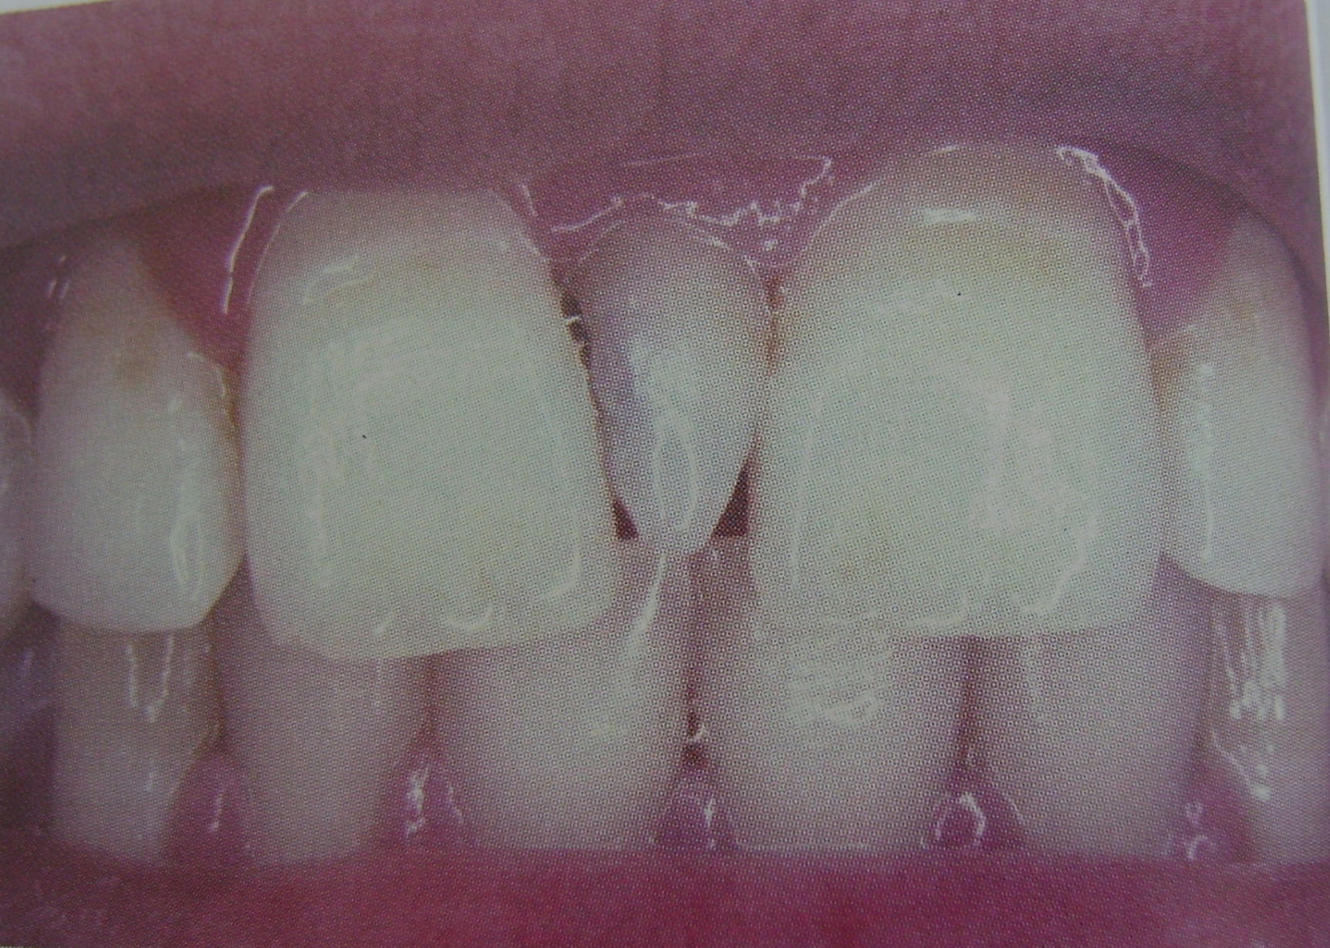

Slide 121
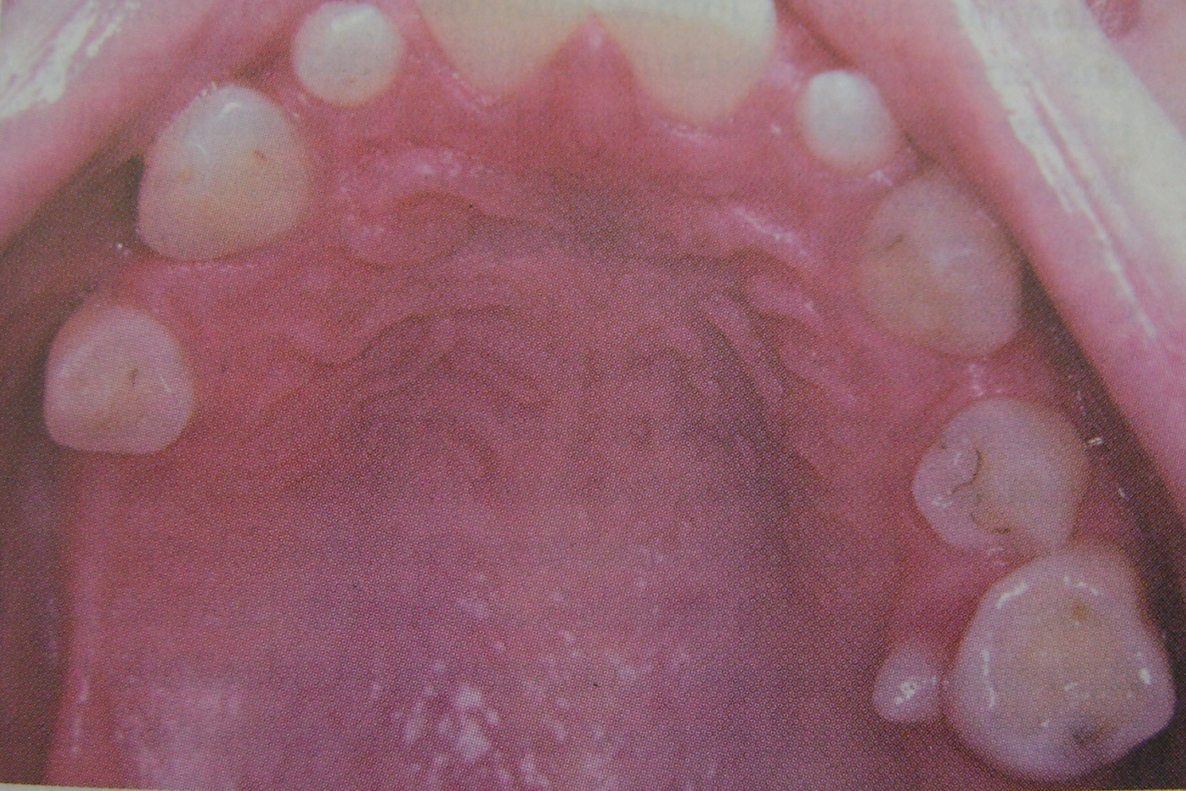

Slide 122
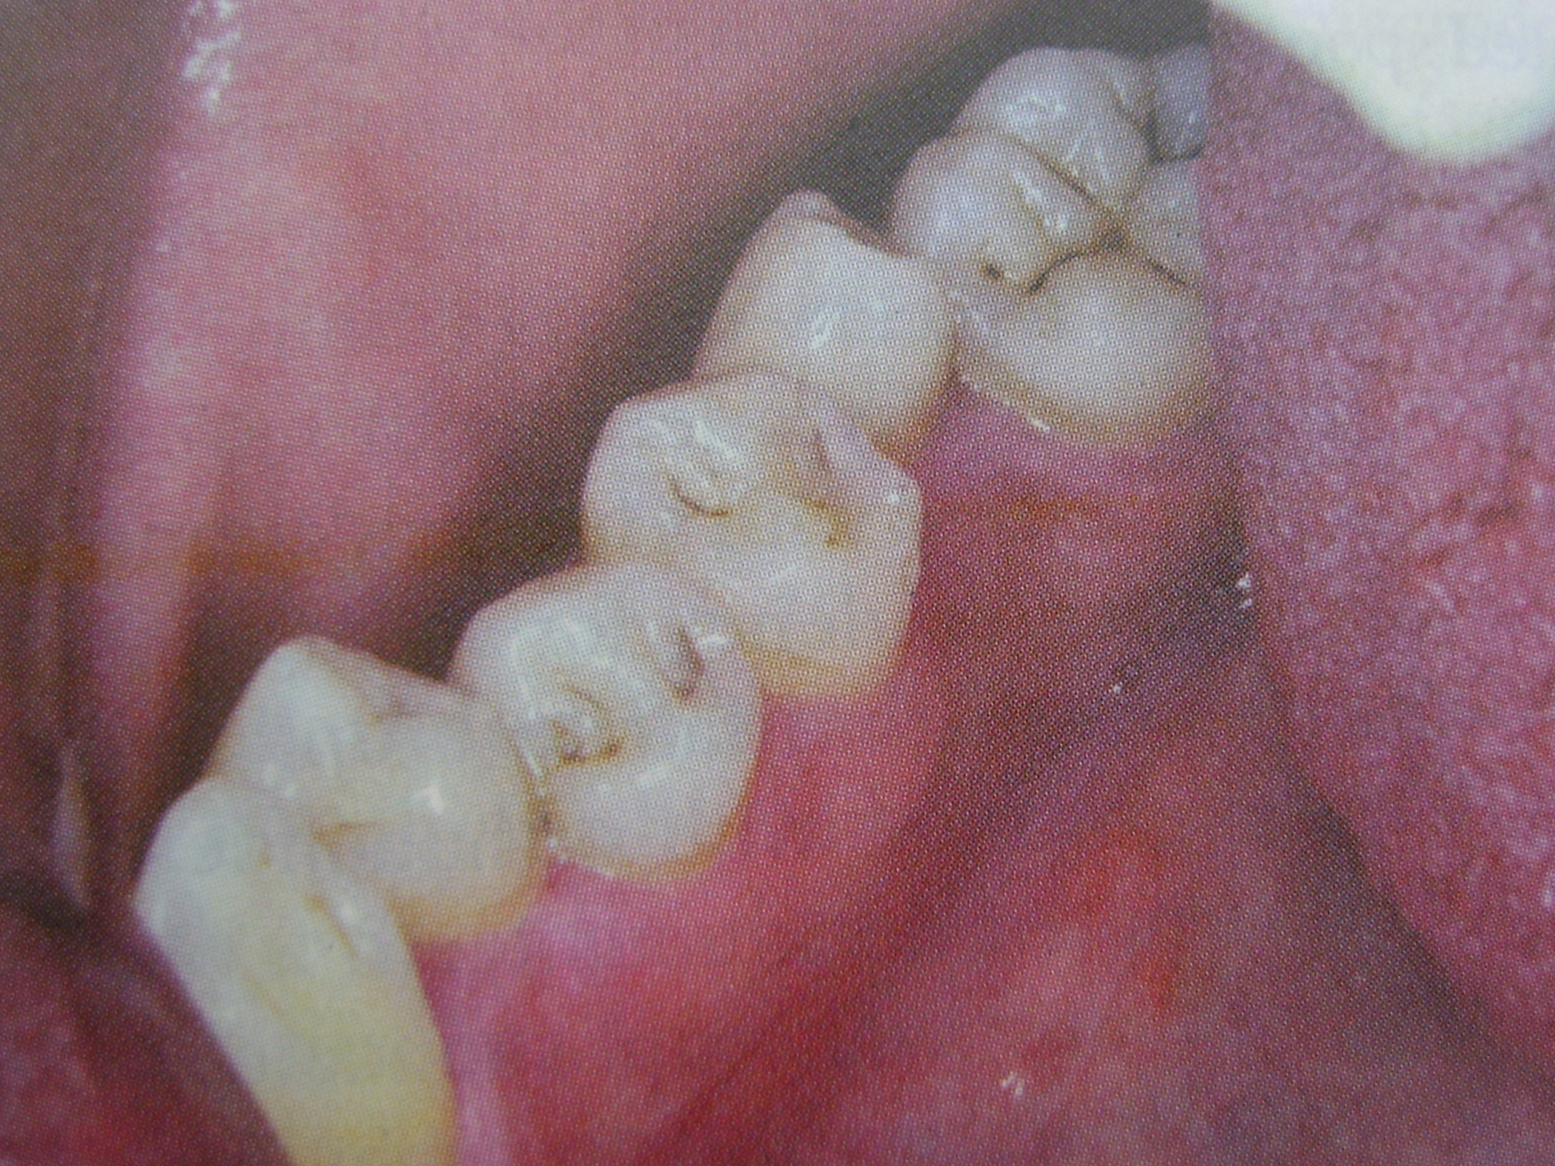

Slide 123
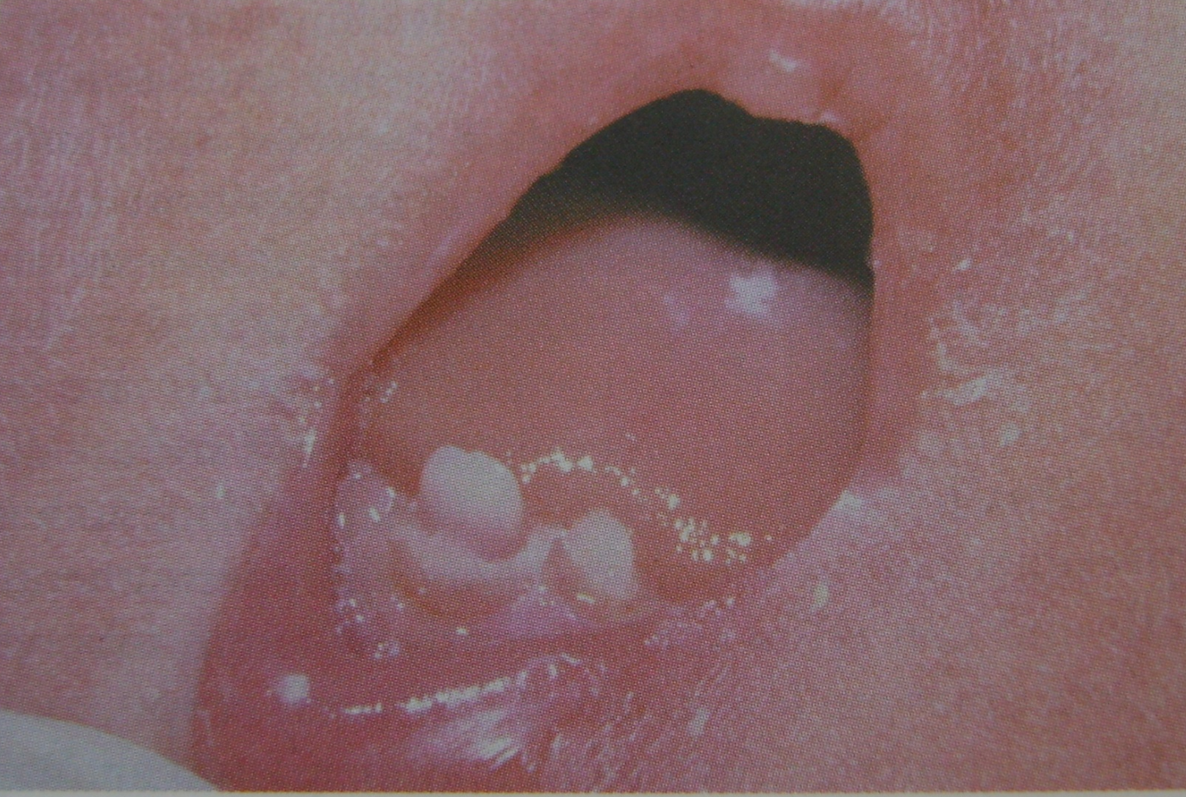
Predeciduous Dentition
Natal teeth

Slide 124
DEVELOPMENTAL DISTURBANCES IN TOOTH STRUCTURE
DEVELOPMENTAL ENAMEL HYPOPLASIA
Caused by environmental factors.
Either primary or permanent dentition is involved.
Both enamel and dentin are affected.
Causes
Nutritional deficiencies
Exanthematous diseases
Congenital syphilis
Hypocalcemia
Birth injury, prematurity, Rh incompatibility
Local infection / trauma
Ingestion of chemicals
Idiopathic

Slide 125
Types
Mild-few small grooves, pits or fissures in enamel surface.
Moderate-rows of deep pits arranged horizontally across the tooth.
Severe-considerable portion of enamel may by lost.
Clinical Features
Due to nutritional deficiency
Mainly deficiency of vitamin A, C and D during tooth formation, usually pitting type of hypoplasia is seen.
Involve those teeth that form within the 1st year after birth.

Slide 126
Due to exanthematous fevers
Measles, chickenpox, scarlet fever are the common causes. Ameloblasts being one of the most sensitive group of cells in terms of metabolic funcation are easily affected by any systemic diseases.
Due to congenital syphilis
Pathognomonic appearance is seen.
Involves maxillary and mandibular permanent incisors and 1st molars.
Incisors shown “Hutchinson’s teeth” characterized by screw driver shaped, mesial and distal surfaces of crown taper towards the notched incisal edge.
Molars show “mulberry molars” characterized by irrgular crowns and enamel of the occlusal 1/3rd arranged in an agglomerate mass.

Slide 127


Slide 128



Slide 129
Due to hypocalcemia
When serum calcium level falls below 6mg/100ml, pitting variety of enamel hypoplasia is seen.
Due to birth injuries
Hypoplasia is common in prematurely born children.
Children suffering from Rh hemolytic diseases at birth showed recognized staining of teeth.
Generally seen in the enamel formed after deciduous dentition.
Due to local infections
Only single tooth is involved.
  Turner’s teeth-any degree of hypoplasia (mild,moderate,severe).
  Infection of periapical region of deciduous teeth affect the ameloblastic layer of secondary dentition resulting in hypoplasia

Slide 130
Due to chemicals
Mainly due to fluorides
  Mottled enamel - characterized by ingestion of fluoride in drinking water during the tooth formation.
  Disturbance of the ameloblasts during formative stage results in defective or deficient enamel matrix.
  Clinical features varies from occasional white flecking or spotting to white opaque areas involving more of tooth surface, pitting and brownish staining of surface and corroded appearance of the teeth.
Due to idiopathic factors
Ameloblast being a sensitive cell gets affected easily by even illness or some mild systemic disturbances, which is not significantly remembered by the patients.

Slide 131



Slide 132



Slide 133
AMELOGENESIS IMPERFECTA
(Hereditary enamel dysplasia, hereditary brown enamel, hereditary brown opalescent teeth)
It is an ectodermal disturbance since the mesodermal components of the teeth are normal.
Three basic types of amelognesis imperfectaare recognized:
  Hypoplastic type in which there is defective formation of matrix.
  Hypocalcification (hypomineralization) in which there is defective mineralization of the formed matrix.
  Hypomaturation type in which enamel crystallites remain immature.

Slide 134
Clinical Features
1. Hypoplastic type
Enamel has not formed to full normal thickness on newly erupted teeth.
2. Hypocalcified type
Enamel is so soft that is can be removed by prophylaxis instrument.
3. Hypomaturation type.
Enamel can be pierced by an explorer point under firm pressure of can be lost by chipping away from the underlying normal appearing dentin.
Crowns of the teeth may or may not show discoloration. If present it varies between yellow to dark brown.
It may have a chalky texture or a cheesy consistency. It may be chipped or show depressions.

Slide 135
Histologic Feature
There is a disturbance in the differentitaion or viability of ameloblasts in the hypoplastic type and this is reflected in defects in matrix formation up to and including total absence of matrix.
In hypocalcification type there are defects of matrix structure and mineral deposition.
In hypomaturation type there are alterations in enamel rod and rod sheath structure.

Slide 136


Slide 137


Slide 138


Slide 139


Slide 140
DENTINOGENESIS IMPERFECTA
(Hereditary opalescent dentin)
Here the mesodermal portion of the odontogenic apparatus is disturbed.
Classification
Type I : Occurs in families with osteogenesis imperfecta.
It is an autosomal dominant trait with variable expressivity.
Type II : Never occurs in association with osteogenesis imperfecta. Referred do as hereditary opalescent dentin. Inherited as an autosomal dominant trait.
Type III : It is of brandywine type. This is a racial isolate in Maryland.
There is multiple pup exposures in deciduous teeth.
It is an autosomal dominant.

Slide 141
Clinical Features
Color of teeth may range from a gray to brownish-violet or yellowish-brown.
Exhibits a characteristic translucent or opalescent hue.
Abnormal dentin enamel junction and the scalloping is absent.
Dentin undergoes rapid attrition and occlusal surfaces are severally flattened.
Radiological Features
There is partial or total precocious obliteration of the pulp chambers and root canals by continued formation of dentin.
Enamel is normal while dentin is thin and pulp chambers are enormous. This is shell teeth.
Most of the teeth exhibit short roots.

Slide 142
Histologic Features
There is purely a mesodermal disturbance.
Dentin is composed of irregular tubules often with large areas of uncalcified matrix.
Tubules tend to be larger in diameter.
Pulp chamber is obliterated by the continued deposition of dentin.
Odontoblasts degenerate readily becoming entrapped in the matrix.
Chemical and Physical Features
Water content is greatly increased (60% above normal) Inorganic content is less than that of normal dentin.

Slide 143


Slide 144



Slide 145


Slide 146
DENTIN DYSPLASIA
(Rootless teeth)
Rare disturbance of dentin formation characterized by normal pulpal morphology.
  Type I- Redicular dentin dysplasia
  Type II- Coronal dentin dysplasia
Etiology
Hereditary disease transmitted as an autosomal dominant characteristic.
Clinical Features
Type I (Radicular): Both dentitions are affected. Teeth exhibits extreme mobility and are commonly exfoliated prematurely or after minor trauma.
Type II (coronal) : Both dentitions are affected. Deciduous teeth have brown or bluish grey opalescent appearance.
Radiological Features
Type I(Radicular): In both dentitions roots are short, blunt, conical and malformed, root canals are obliterated. Crescent shaped pulpal remnants may be seen in pulp chamber.
Type II (coronal): Exhibit an abnormally large pulp chamber in the coronal portion of the tooth offer described as thistle tube in shape.

Slide 147
Histologic Features
Type I (Radicular): Apical to the coronal dentin is tubular dentin, most of which obliterates the pulp is calcified tubular dentin, osteodentin and fused denticles. New dentin forms around obstacles and shows an characteristic appearance as lava flowing around boulders.
Type II (Coronal): Deciduous teeth exhibit amorphous and atubular dentin in the radicular portion. Coronal dentin is normal. Pulp has multiple pulp stones or denticles.

Slide 148


Slide 149


Slide 150
REGIONAL ODONTODYSPLASIA
(Odontogenesis inperfecta, ghost teeth, odontodysplasia, odontogenic dysplasia)
Etiology
Local vascular defects are involved in the pathogenesis of the condition.
Clinical Features
Delay or total failure in eruption.
Shape is markedly altered, irregular in appearance with evidence of defective mineralization.
Radiological Features
Marked Reduction in radiodensity so that the teeth assume” ghost appearance”.
Enamel and dentin are thin and pulp chamber is large.
Histologic Features
Marked reduction in amount of dentin, widening of predentin layer, presence of large areas of interglobular dentin and an irregular tubular pattern of dentin.

Slide 151


Slide 152
DISTURBANCES OF GROWTH OF TEETH
Deciduous teeth erupted into oral cavity seen in infants at birth. These are called natal teeth.
Neonatal teeth are those teeth erupting prematurely in the first 30 days of life.
Only 1 or 2 teeth erupt early most often deciduous and mandibular central incisors.
In cases of endocrine dysfunction (hyperthyroidism) cases it involves the entire dentition.

Slide 153
DISTURBANCES OF GROWTH OF TEETH
Premature Eruption
Deciduous teeth that have erupted into the oral cavity are occasionally seen in the infants at birth.
These are called natal teeth in contrast with neonatal teeth which have been defined as those teeth reputing prematurely in the first 30 days of life.
Most of the deciduous and mandibular central incisors are involved.
Etiology of this phenomenon is unknown, although in some instances it follows a familial pattern. In case of the adrenogenital syndrome developing early in life, premature eruption of teeth is sometime seen.
It has been pointed that premature erupted teeth are often well formed and normal in all respect except that they may by somewhat mobile.
The premature eruption of permanent teeth is usually sequelae of the premature loss of deciduous teeth this is best demonstrated in the situation of single deciduous tooth has been loss, with subsequent of permanent tooth.

Slide 155

Eruption Sequestrum

Slide 156

Delayed Eruption

Slide 157
EMBEDDED AND IMPACTED TEETH
Individual teeth which are unerupted usually because of lack of eruption force is called embedded teeth.
Impacted teeth are those prevented from erupting by some physical barrier in the eruption teeth.
Lack of space due to crowding of dental arches or the premature loss of deciduous teeth with subsequent partial closure of the area.
Maxillary and mandibular third molars and maxillary cuspides are frequently impacted.

Slide 158
Winter’s classification of mandibular third molars
Mesioangular impaction: Third molar lies obliquely in bone, crown pointing in a mesial direction, usually in contact with distal surface of the root or crown of the second molar.
Distoangular impaction : Third molar lies obliquely in bone, crown of the tooth pointing distally towards the ramus.
Vertical impcatin: There is lack of space for eruption. It is prevented from erupting by impingement on the distal surface of IInd molar or the anterior border of ramus.
Horzontal impaction: It is in horizontal position with respect to body of mandible.

Slide 159
Crown may or may not be in contact with the distal surface of second molar.
Completely impacted tooth is one which lies completely within the bone.
Partially impacted tooth is not completely encased in bone but lies partially in soft tissue.
This tooth creates an ideal situation for infection and even dental caries.

Slide 160


Slide 161
ANKYLOSED DECIDUOUS TEETH
(Submerged teeth)
Are deciduous teeth, most commonly mandibular second molars that have a variable degree of rooth resorption and then have become ankyloses to the bone.
This process presents exfoliation and subsequent replacement by permanent teeth.
After the adjacent permanent teeth have erupted, the ankylosed tooth appears to have submerged below level of occlusion.
Teeth affected lack mobility even though root resorption is far advanced.
Upon percussion ankylosed tooth imparts characteristic solid sound in comparison to dull cushioned sound of normal tooth.
Trauma, infection, disturbed local metabolism, or a genetic influence have been considered.

Slide 162


Slide 163
Anomalies of Color
— Discoloration of teeth
Etiology
Surface deposits (Extrinsic stains)
Changes in structure or thickness of dental tissues
Diffusion of pigments into dental tissues
Pigments incorporated during formation of
dental tissues.

Slide 164
Extrinsic stains
Substances in the diet
Habitual chewing, betel nut, tobacco
Tobacco smoking
Medicaments
Chromogenic bacteria

Slide 165
Changes in structure
Enamel hypoplasias, fluorosis
Amelogenesis imperfecta, hypocalcified,
hypomaturation, and hypoplastic types
Enamel opacities
Enamel caries
Dentinogenesis imperfecta
age changes in dental tissues

Slide 166
Pigments incorporation
Bile pigments
Porphyrins
Tetracycline
Rh-hump

Slide 167



Tetracycline stained teeth

Slide 168



