Slide 1

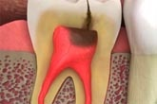
DIET AND DENTAL CARIES

Slide 2
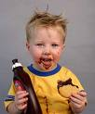
INTRODUCTION
There is a substantial evidence of relation between diet & dental caries.
Fermentable carbohydrates of dietary origin are a necessary component of the dental caries process.
The classic study conducted in Vipeholm, Sweden during the late 1940 suggested that the timing of consumption & retentive nature of carbohydrates were predictors of caries risk.
Sugar are the preferred substrate.

Slide 3
FOOD:-
“Food is A complex chemical mixture of organic & inorganic materials containing both diet & nutrition's.”
Diet is the total intake of substances that provide nutrition & energy.
NUTRITION
Nutrition is a science of how the body utilizes food to meet the requirements for development, growth, repairs & maintenance.
DIET

Slide 4
COMPONENTS OF FOOD
COMPONENTS
CARBOHYDDRATES
PROTEINS
FATS
VITAMINES
MINERALS
WATER

Slide 5
DIET:-
IT MAY BE
  Dairy Or Milk Group
  Meat Or Poultry Group
  Vegetable Or Fruit Group.
  Bread Or Cereal Group

Slide 6
NUTRITION
  Macro nutrients:
    Carbohydrates
    Fats
    Proteins
  Micro nutrients :
    Vitamins and
    Minerals

Slide 7
EVIDENCE LINKING DIET & DENTAL CARIES
HISTORICAL EVIDENCE
EPIDEMIOLOGICAL EVIDENCE
    OBSERVATIONAL EVIDENCE
    EXPERIMENTAL EVIDENCE

Slide 8
HISTORICAL EVIDENCE
It Was Found That Caries Was Present Since About 5 Million Years In South Africa In Hominids In Neolithics.
Interestingly Dietary Pattern Was Not Known.
Eskimos Skulls Were Free From Caries.

Slide 9
EPIDEMIOLOGICAL EVIDENCE
Tristan da Cunha study:-
    Before 1930 & 1940 onwards study showed no evidence of dental caries in Tristan da Cunha’s region because of consumption of raw diet.
    But after volcanic eruption in 1964, people living in this area moved to other areas where they developed dental caries because of change in dietary habits.

Slide 10
During World War II
  Due To Sugar Restriction In World War II (1939-1944), Dental Caries Reduced Among Civilians.
  At The Same Time Dental Caries Experience Among Army Personnel Was Increased Due To Increase In Sugar Consumption As More Quantity Of Ready Made Food Items Were Supplied During War Time.

Slide 11
HEREDITARY FRUCTOSE INTOLERANCE(1956)
  It is an autosomal recessive disorder of fructose metabolism.
  Patients having intolerance to fructose avoid fructose & fructose containing dietary factors, because consumption of fructose causes malaise, nausea, vomiting, sweating, tremors, convulsions, coma & finally death hence dental caries experience among these patients is very low

Slide 12
EXPERIMENTAL EVIDENCE
ANIMAL STUDIES:-
ORLAND(1954) DID A STUDY ON RATS HE SHOWED THAT GERM FREE RATS FED ON CARBOHYDRATES PRODUCED NO CARIES.
HUMAN STUDIES:-
  VIPEHOLM STUDY(1954):-
  HOPEWOOD HOUSE STUDY(1942-1957):-
  TURKU SUGAR STUDY(1972-1974):-

Slide 13
1]VIPEHOLM STUDY
This study was conducted in a mental institution in sweden.
Residents were adults and mentally retarded. Before starting this study ,they were under normal diet.
Later they divided into 7 groups depending on type of food consumed
Sucrose in solid forms were given in different frequency and quantity.

Slide 14
7 groups
Control: 60 males low carbohydrate
Sucrose group: 57 males 300gms after 2 yrs reduced to 75gms
A bread group: 41 males & 42 females
Chocolate: 47 males
Caramel: 62 males, 22 caramels daily
8 Toffee: 40 males
24 toffee: 48 males

Slide 15
Findings:
1]significant caries increase occurred when sucrose containing snacks were taken between meals –TIME FACTOR
2]more the number of times sucrose was ingested more increase in caries-FREQUENCY
3]sticky forms of sucrose foods ,which can retain high sugar levels ,were more cariogenic than those cleaned rapidly-CONSISTENCY AND FORM

Slide 16
Sugar consumption increases caries activity.
The risk of increased caries activity is greater if the sugar is in sticky form.
The risk is greatest if the sugar is taken between meals and in a sticky form.
The increase in caries under uniform conditions shows great individual variation.
The increase in caries disappears upon withdrawal of sticky foodstuffs from the diet.
Caries can still occur in the absence of refined sugar, natural sugars, and total dietary carbohydrates.

Slide 17
2]HOPEWOOD HOUSE STUDY
Study was conducted in south wales, Australia.
Hopewood House is an orphan house containing children from birth to 12 year s of age.
These subject were on lactovegetarian diet-rich in milk products and vegetables.
The drinking water was having low amount of fluoride . There oral hygiene practices were poor.

Slide 18
Their oral hygiene practices were poor.
their diet mainly consisted of whole wheat , soybeans, and nuts.
Cheese , sugar and refined carbohydrates were totally excluded.

Slide 19
Findings:
Significant caries reduction was seen in spite of poor oral hygiene and low level of fluoride in drinking water.
The children were on lactovegetarian diet right from the birth ,they did not have any special protection against dental caries when teeth were exposed to sugar.

Slide 20

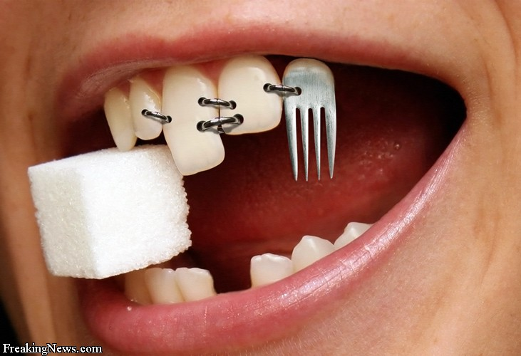
3]TURKU SUGAR STUDY
Scheinin and Makinin
In this study about 125 subjects of all age groups were included and they were divided into three groups.
Each groups was given different types of diet.

Slide 21
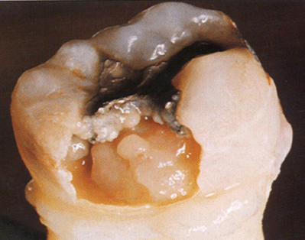
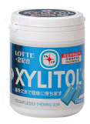
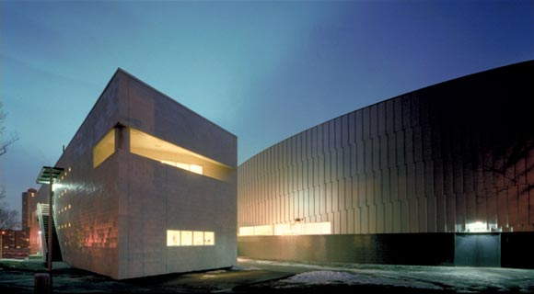
Findings:
Dramatic reduction of dental caries after 2 years among subjects of xylitol consumption.
Between meals chewing of xylitol was anticariogenic .

Slide 22
CARIOGENICITY OF SUCROSE
Sucrose Induces The Smooth Surface Lesion More Than Any Other Carbohydrates Especially When Treated With S. Mutans
Sucrose Is The Only Carbohydrate Diet Degraded To Glucans.
Cariogenicity Of Sucrose Does Not Relate To The Ability To Increase Plaque but Ability Of S. Mutans To Colonise Smooth Surface In The Presence Of Sucrose

Slide 23

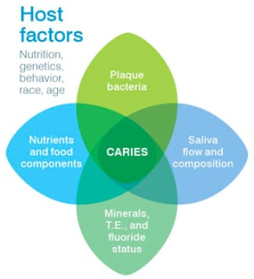
STEPHAN CURVE(1940)
Stephan By Using Antimony Microelectrodes Recorded The Ph Value Of Dental Plaque In Situ Before, During And After A Glucose Rinse.
Under Resting Conditions, ph Of Plaque Is Reasonably Constant 6.9-7.2
Exposure To Sugar The Ph Drops Very Rapidly To Its Lowest Level 5.5-5.2 And At This Ph The Tooh Surface Is At Risk .
Repeated Fall Of Ph Over A Period Of Time Leads To More And More Mineral Loss Resulting In Initiation Of Dental Caries
Later Slowly It Returns To Its Original Value Over A Period Of 30-60 Min.

Slide 24
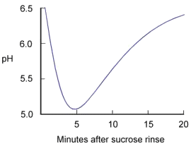
STEPHAN CURVE

Slide 25
ORAL CLEARANCE OF CARBOHYDRATES
ACID PRODUCTION IN THE PLAQUE DEPENDS ON
  RETENTIVE FACTORS.
  TIME
  CONCENTRATION OF SUGARS IN SALIVA

Slide 26
Clearance time for sugar is the time it takes to eliminate these either to level present before eating or below 0.1%
Clearance time may b prolonged by malocclusion, cavities, improper restorations, crowns, orthodontic and prosthetic appliances, low salivary flow n high viscosity.
Low sugar clearance is the risk factor for caries activity.
Cariogenicity of sucrose and its synthesis of glucose depend on high concentration of sugar.

Slide 27


TIME TAKEN FOR CLEARANCE OF VARIOUS FOOD ITEMS FROM THE ORAL CAVITY
FRESH FRUITS & VEGETABLES
TOFFEES & CHOCOLATES
SUGAR CHEWING GUM
RICE
POTATOES
MACARONI
BREAD
FOOD ITEMS
TIMES(IN MINS)
5
20-40
15
8
9
11
15-20

Slide 28
PREVENTIVE DIETARY PROGRAMME
Exclude fermentable sugars from diet
If child is fond of sweets give them all at meal time not between the meals.
Include vegetables & fruits, nuts & cheese as basic diet ( increases in salivation )
Avoid solid and sticky sugary foods.
Reduce the no of sugar exposure.

Slide 29
THANK YOU

