Slide 1
Dental Cements

Slide 2
CONTENTS
Introduction
Definition
History
Ideal properties
Classification
Silicate cement
Zinc phosphate cement
Modification
Fluoridated cement
Copper cement
Silicophosphate cement
Zinc polycarboxylate cement

Slide 3
Zinc Oxide Eugenol cement
Modification
Reinforced Zinc Oxide Eugenol
EBA
Calcium Hydroxide cement
Resin cements
Conclusions
References

Slide 4
INTRODUCTION
In last 20 years there has been an explosion of different types of dental cements that have become available to practicing dentist ,many of them tailored for specialized types of restoration.
Dental cements are employed to bond inlays, crowns, bridges, posts and facings in or on the tooth and to retain orthodontic bands and retainers.
Notes:
In fact ,there are so many products to choose from the task ,can become confusing. however secondary applications of these cements include cavity linings, bases and temporary fillings, endodontic sealer.

Slide 5
DEFINITIONS
Cement:
  A non metallic material , used for luting, filling permanent or temporary restorative purposes, made by mixing components into a plastic mass that sets or as an adherent sealer in attaching various dental restorations in or on the tooth
(CRAIG)

Slide 6
A substance that hardens to act as a Base, Liner, Filling material or Adhesive to Bind Devices and Prosthesis To Tooth Structure To each Other .
(Anusavice)
Dental cements are based on reactions between acidic liquids and basic powders to produce reaction product salts that form a solid matrix surrounding residual powder particles.
(Sturdevant)

Slide 7
History…
1873- Silicate cement by Fletcher
1873- Zinc oxide and clove oil by Chisolm
1879- Zinc phosphate cement by Dr Pierce
1930- Calcium hydroxide paste by Hermann
1968-Polycarboxilic cement by Dennis Smith
1971-Glass ionomer cement by Wilson and
Kent

Slide 8
Ideal properties of dental cements
Should be strong and hard.
Able to protect pulp
Should be insoluble in saliva & liquids taken in mouth.
Should be dimensionally stable.
Should be adhesive .
Should be non porous .
Should be biocompatible and non irritant.
Co-efficient of thermal expansion should be equal to the tooth structure.
Should not be affected by thermal changes and moisture.
Should be easy to manipulate.

Slide 9
CLASSIFICATION
Based on Ingredients & Application
(Craig 12th edition)
Water based cements
Glass & Resin modified glass ionomer
Zinc Polyacrylate
Zinc Phosphate
Resin based cements
Composite & adhesive resin
Compomers
Oil based cements
Zinc Oxide Eugenol
Non Eugenol -Zinc Oxide

Slide 10
Water based cements
1) Glass & Resin modified glass ionomer cement :
Class V restoration
- Retention of- Conventional alloy based restoration
Orthodontic bands
Alumina or zirconia based all ceramic restoration
- High strength bases
- Long term provisional restoration
2) Zinc Polyacrylate:
- Retention of -Conventional alloy restoration
-Orthodontic bands
-Pediatric stainless steel crown
- High strength bases
- Long term provisional restoration

Slide 11
3) Zinc phosphate :
- Retention of- Conventional alloy based restoration
-Orthodontic bands
- High strength bases
- Long term provisional restoration

Slide 12
Resin based cements
1. Composite & adhesive resin :
Bonding- Conventional alloy based restoration
-Ceramic crowns, bridges ,veneers, inlays,
onlays.
- Post & core
- Orthodontic bands
2. Compomers:
Bonding -Conventional alloy based restoration
- Alumina or zirconia based all ceramic restoration
- Orthodontic bands
- High strength bases

Slide 13
Oil Based Cements
Zinc Oxide Eugenol :
High strength bases
Provisional restoration
Root canal sealers
Gingival tissue packs
Surgical dressing
Non Eugenol -Zinc Oxide:
Provisional restoration
Root canal sealers
Gingival tissue packs
Surgical dressing

Slide 14
Classification based on setting reaction
( Skinners)
Acid Base Reaction –
Zinc phosphate
Zinc polycarboxylate
Zinc oxide eugenol
Glass ionomer cement
Polymerization and acid base reaction –
- Resin modified glass ionomer cement
Light activated polymerization –
-Compomer
-Resin cements

Slide 15
Classification (E.C. Combe 6th edition)
Acid base reaction cements.
Zinc phosphate
Zinc polycarboxylate
Zinc oxide eugenol
Silicate
Glass ionomer cement
Polymerising materials
    Acrylic polymer
    Cyanoacrylates
    Dimethacrylate polymers
    Polymer ceramic composites

Slide 16
Other materials
i) Calcium hydroxide
ii) Guttapercha
iii) Varnishes

Slide 17
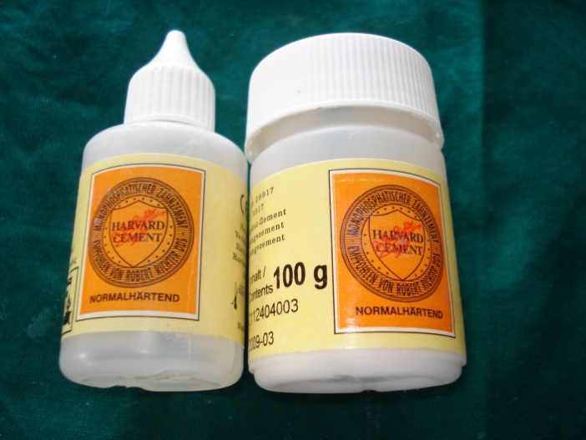
Zinc Phosphate cement
Introduced over a century ago.
It is the oldest luting cement
Synonyms `Crown and Bridge’ and “Zinc oxyphosphate’

Slide 18
Composition
POWDER
Zinc Oxide- 90.2% Principle Ingredient
Magnesium Oxide- 8.2% Reduces the temp. of calcification process and aids in sintering.
Oxides of
Bismuth, Calcium, Barium- 0.2% Impact a smoothness to freshly mixed cement mass.
In large quantities lengthen the S.T
Silicon Dioxide - 1.4%In active filler

Slide 19
LIQUID
Phosphoric acid-
  45-64% Reacts with ZnO
Water-
  30 – 55% Increases Rate of reaction
Aluminum-
  2.3% Essential to the cement forming reaction
Zinc-
  0.9% Moderates reaction between powder and liquid
  allows adequate working time

Slide 20
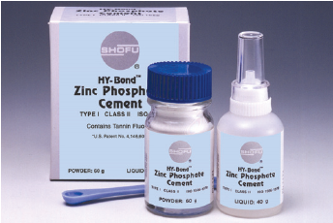
CLASSIFICATION
Anusavice
Type I
-Fine grained for luting
-Film thickness should
be less than 25 um
Type II -
- Medium grained for
luting and filling
- Film thickness
should be more than
40um

Slide 21
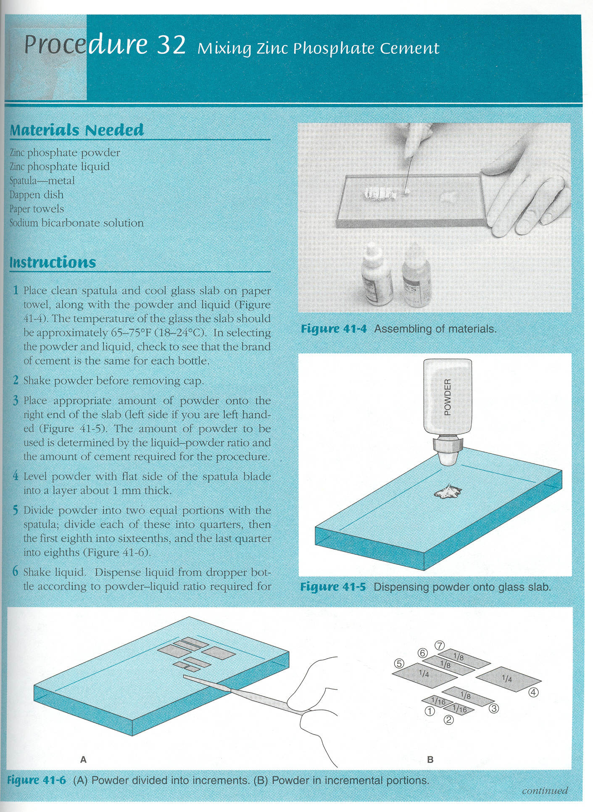

Manipulation
Dispense the cement P/L :1.4 gm / 0.5 ml.
Divide the powder in one corner of the glass slab into increments depending on product.
Dispense the correct amount of liquid, to other area of the slab away from the powder.
Add the powder to liquid in portions at 15 sec intervals for a mixing time 60-120 sec

Slide 22
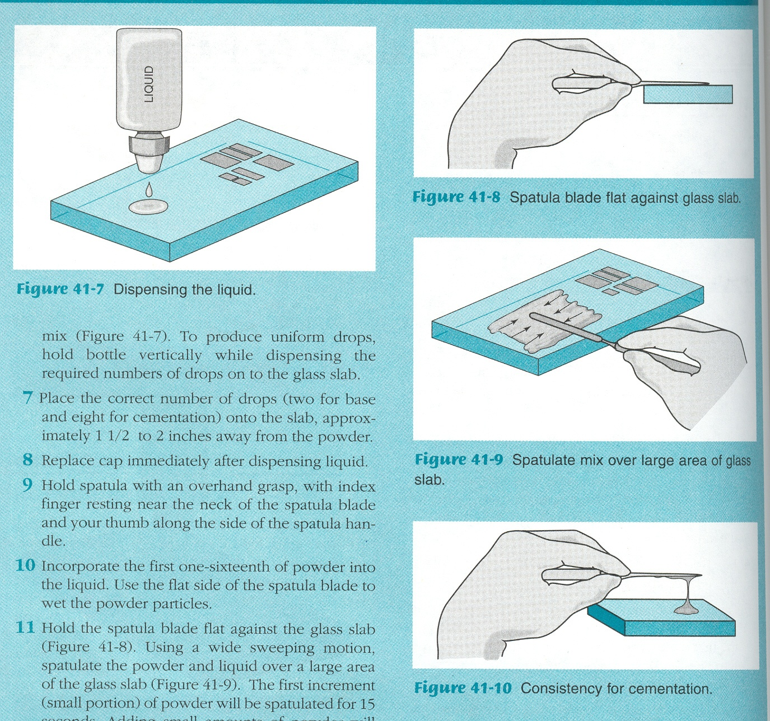
Mix it over a large area of the slab with a flexible metal spatula.
Test the consistency of the cement before adding the last portion of powder.
Only part of that portion of powder may be necessary to reach the desired consistency.
The cementing strings about one inch above the slab.

Slide 23
NOTE :
Powder liquid reactions accelerated by the presence of heat (exothermic reaction)
When this liquid is exposed to a humid atmosphere, it will absorb water.
Whereas exposure to dry air tends to result in a loss of water which will alter the property of cement.

Slide 24
Frozen Slab Technique
Practical way to increase the working time and reduce the setting time of zinc phosphate cement.
50% increased powder/liquid ratio.
Mixing in a frozen glass slab at 6⁰ C.
Effective when multiple castings are to be cemented.
Excess of cement is easy to clean up .
But decrease in compressive strength.

Slide 25
SETTING REACTION
Exothermic reaction
Powder & liquid mixed
Phosphoric acid attacks the surface
Release of zinc ions & reaction of Al with phosphoric acid
Al & Zn ions react with phosphoric acid
Zinc alumino phosphate gel
and surrounds with un reacted particle
.
Notes:
Thus the set cement is a cored structure consisting primarily of un-reacted Zinc Oxide particles embedded in a cohesive amorphous matrix of zinc aluminophosphate.
Water is critical to reaction

Slide 26
Properties
Compressive strength -104 Mpa
Tensile strength -55 Mpa
Modulus of elasticity – 13.7Gpa ( stiff & resistance to deformity )
Retention is mechanical
At insertion pH at 2 min – 2
at 24 hrs – 5.
ST
WT
5 min
2.5 -8 min
MT
1.5 -2 min

Slide 27
Advantages
Most popular for cast restorations
Adequate strength
Reasonable working time
Excess material can be easily removed
Acceptable effect over the dental pulp
Manipulation less critical than other cements.

Slide 28
Disadvantages
Pulp irritation
Lack of antibacterial action
Brittleness
Lack of adhesion
Solubility in acid fluids

Slide 29
Variations in Zinc Phosphate Cement
Fluoridated cement:
Small amt of stannous fluoride.
Lower strength & higher solubility than zinc phosphate.
Fluoride release continues over long period & uptake. reduces enamel solubility ,increases hardness.
This activity should reduce the incidence of enamel decalcification under orthodontic bands.
Used in orthodontic band cementation.

Slide 30
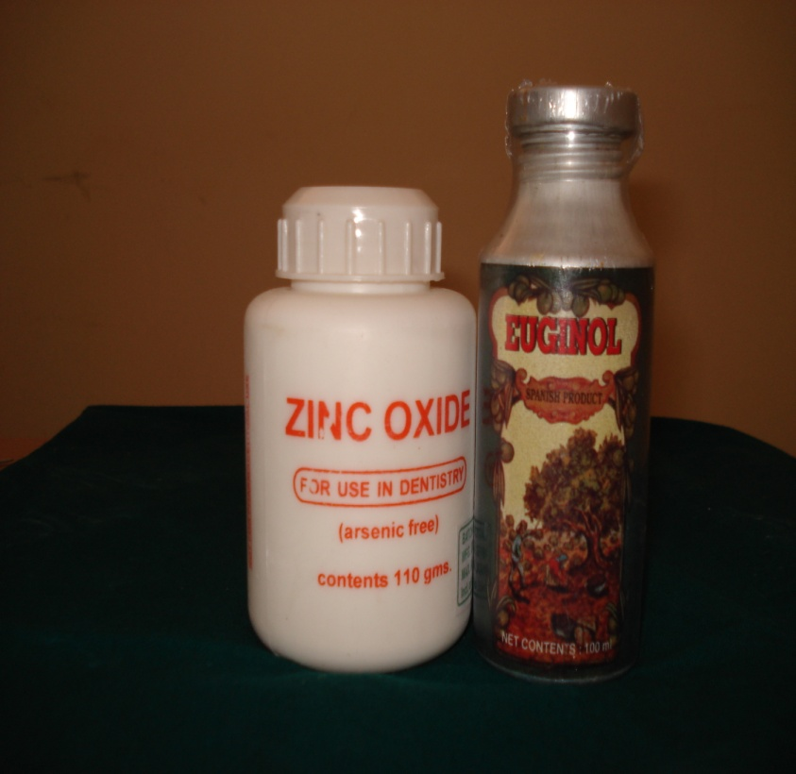
Zinc Oxide Eugenol
Extensively used in dentistry since 1890’s .
Least irritant of all the dental materials.
Poor strength when compared to zinc phosphate.
It has sedative effect on exposed dentin.

Slide 31
ZINC OXIDE EUGENOL
POWDER
LIQUID
ZnO | Principal Ingredient
White rosin | Brittleness of set cement
Zn acetate | Accelerator strength – up to 1%
MgO | Modifier
Zn stearate | Plasticizer
Eugenol | Reacts with ZnO
Olive Oil | Plasticizer (85% Eugenol)
Water | Initiator
Acetic acid/alcohol | To accelerate setting – about 1%
Notes:
POWDER

Slide 32
CLASSIFICATION (ADA Sp. No 30)
Type I | Used for Temporary cementation
Type II | Used for Long Term cementation of fixed prosthesis
Type III | Temporary Filling/ Thermal insulating base
Type IV | Intermediate Restorations and Cavity liners

Slide 33
ZINC OXIDE EUGENOL CEMENT
MANIPULATION
Temporary cements (Type I) & Liners (Type IV )
A typically two paste systems.
Dispense equal lengths of the accelerators and base pastes on a paper pad / glass slab
Continue mixing until a uniform colour is achieved.

Slide 34
Long term Zinc oxide Eugenol Cements (Type – II)
Shake the powder bottle gently, then dispense the powder with the supplied scoop and the liquid with a dropper.
Mix on a glass slab or treated paper pad with a metal spatula. Incorporate the powder into the liquid all at once and mix for 30 sec.
Oil of orange is a solvent useful in removing set cement

Slide 35
SETTING REACTION
Formulated as a powder-liquid or two-pastesystem.
•Powder or Base Paste: zinc oxide particles.
•Liquid or Accelerator Paste: eugenol.
•Water in the eugenol solution that hydrolyzes the zinc oxide to form zinc hydroxide.
•Zinc hydroxide and eugenol chelate and solidify to form zinc oxide eugenolate.
•Slow but proceeds more rapidly in a warm, humid environment
Notes:
The setting reaction is also accelerated by the presence of zinc chelate dehydrate.
Acetic acid is a more active catalyst for the setting reaction than is water because it increases the formation rate of zinc hydroxide. High atmospheric temperature also accelerates

Slide 36
Advantages:
Minimal pulp reaction.
Good sealing properties
Strength adequate for lining material & luting single restoration & retainers, with good retention form

Slide 37
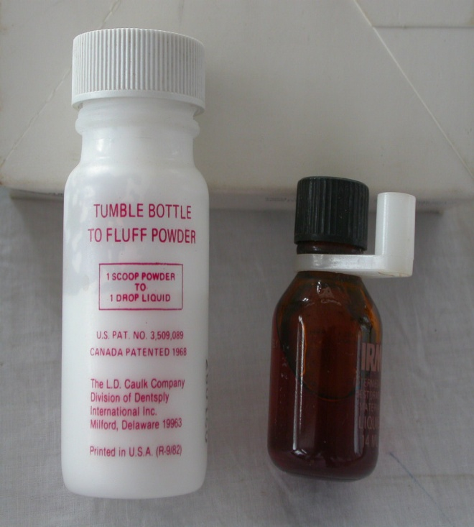
Modifications of ZOE :
Resin Reinforced Zinc Oxide Eugenol Cement
EBA and other Chelate Cements

Slide 38
Disadvantages:
Hydrolytic breakdown under exposure to oral fluids
Inflammatory reaction in soft tissue
potential allergic response
Minimal mechanical properties for luting
May soften & discolor

Slide 39
RESIN REINFORCED ZINC OXIDE
EUGENOL CEMENT
COMPOSITION :
POWDER :
Zinc powder – 80.0%
Poly methyl-methacrylate – 20.0%(bond to other components)
Zinc stearate - traces (accelerator)
Zinc acetate
Thymol & hydroxyquinoline – traces (antimicrobial agent)
LIQUID:
Eugenol – 85%
Olive oil – 15% -(as plasticizer ,masks irritating effect of eugenol).

Slide 40
PROPERTIES
Film thickness - 25-75 um
Compressive strength - 35-55 MPa
Tensile Strength - 4 Mpa
Modulus of elasticity - 2-3000 MPa
Water immersion reduces the mechanical properties due to loss of eugenol.
7-9 min
ST
WT
5 min
MT
2 min

Slide 41
Mechanical retention of crowns of ZOE cement is less than Zinc phosphate cements.
An 83.5% success rate was noted for polymer reinforced cement after 7 years.

Slide 43
Zinc Oxide Eugenol
Extensively used in dentistry since 1890’s .
Least irritant of all the dental materials.
Poor strength when compared to zinc phosphate.
It has sedative effect on exposed dentin.

Slide 44
ZINC OXIDE EUGENOL
POWDER
LIQUID
ZnO | Principal Ingredient
White rosin | Brittleness of set cement
Zn acetate | Accelerator strength – up to 1%
MgO | Modifier
Zn stearate | Plasticizer
Eugenol | Reacts with ZnO
Olive Oil | Plasticizer (85% Eugenol)
Water | Initiator
Acetic acid/alcohol | To accelerate setting – about 1%
Notes:
POWDER

Slide 45
CLASSIFICATION (ADA Sp. No 30)
Type I | Used for Temporary cementation
Type II | Used for Long Term cementation of fixed prosthesis
Type III | Temporary Filling/ Thermal insulating base
Type IV | Intermediate Restorations and Cavity liners

Slide 46
ZINC OXIDE EUGENOL CEMENT
MANIPULATION
Temporary cements (Type I) & Liners (Type IV )
A typically two paste systems.
Dispense equal lengths of the accelerators and base pastes on a paper pad / glass slab
Continue mixing until a uniform colour is achieved.

Slide 47
Long term Zinc oxide Eugenol Cements (Type – II)
Shake the powder bottle gently, then dispense the powder with the supplied scoop and the liquid with a dropper.
Mix on a glass slab or treated paper pad with a metal spatula. Incorporate the powder into the liquid all at once and mix for 30 sec.
Oil of orange is a solvent useful in removing set cement

Slide 48
SETTING REACTION
Formulated as a powder-liquid or two-pastesystem.
•Powder or Base Paste: zinc oxide particles.
•Liquid or Accelerator Paste: eugenol.
•Water in the eugenol solution that hydrolyzes the zinc oxide to form zinc hydroxide.
•Zinc hydroxide and eugenol chelate and solidify to form zinc oxide eugenolate.
•Slow but proceeds more rapidly in a warm, humid environment
Notes:
The setting reaction is also accelerated by the presence of zinc chelate dehydrate.
Acetic acid is a more active catalyst for the setting reaction than is water because it increases the formation rate of zinc hydroxide. High atmospheric temperature also accelerates

Slide 49
Advantages:
Minimal pulp reaction.
Good sealing properties
Strength adequate for lining material & luting single restoration & retainers, with good retention form

Slide 50
ZINC OXIDE EUGENOL
Modifications of ZOE :
Resin Reinforced Zinc Oxide Eugenol Cement
EBA and other Chelate Cements

Slide 51
Disadvantages:
Hydrolytic breakdown under exposure to oral fluids
Inflammatory reaction in soft tissue
potential allergic response
Minimal mechanical properties for luting
May soften & discolor

Slide 52
RESIN REINFORCED ZINC OXIDE
EUGENOL CEMENT
COMPOSITION :
POWDER :
Zinc powder – 80.0%
Poly methyl-methacrylate – 20.0%(bond to other components)
Zinc stearate - traces (accelerator)
Zinc acetate
Thymol & hydroxyquinoline – traces (antimicrobial agent)
LIQUID:
Eugenol – 85%
Olive oil – 15% -(as plasticizer ,masks irritating effect of eugenol).

Slide 53
PROPERTIES
Film thickness - 25-75 um
Compressive strength - 35-55 MPa
Tensile Strength - 4 Mpa
Modulus of elasticity - 2-3000 MPa
Water immersion reduces the mechanical properties due to loss of eugenol.
7-9 min
ST
WT
5 min
MT
2 min

Slide 54
Mechanical retention of crowns of ZOE cement is less than Zinc phosphate cements.
An 83.5% success rate was noted for polymer reinforced cement after 7 years.

Slide 55
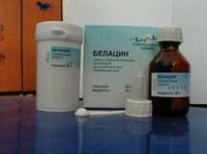
Silicates
Introduced in 1903 as anterior filling materials.
Silicates are attacked by oral fluids and in time degrade.
They may not be considered permanent restoration.
The uses of silicate cements diminished with the advent of composite resins and development of GIC.

Slide 56
Composition
Powder:
Silica
Alumina
Fluoride compounds
Calcium salts
Fluoride Flux -
To permit proper sintering
of the other ingredients.
Liquid :
Phosphoric acid
Water
Buffer salts

Slide 57
Setting Reaction
Powder mixed with liquid
Powder attacked by acid liquid releasing Ca, Al, Fl ions
Metal ions precipitate as phosphate along with silicic acid that form silica gel.
Set cement contain phosphate matrix containing unreacted powder particles surrounded by silic acid and fluoride ions.

Slide 58
Advantages
It exhibit good esthetic qualities .
Anticariogenic property.
Analogues to topical applied fluoride solution.
Disadvantages
  It lacks stability in oral fluids with loss of esthetic qualities
  Rubber dam is essential for successful silicate
  restoration.
  Irritant to pulp.

Slide 59
ZINC POLYCARBOXYLATE
MANIPULATION:-
Mixed at a P/L of 1.5 :1
The consistency is creamy compared with that of zinc phosphate cements.
Dispensing of the liquid should be done immediately before mixing to prevent evaporation of water and subsequent thickening.

Slide 60
Non absorptive surface, such as glass slab or treated paper, will keep all the liquid available for the reaction and facilitate spatulation.
Polyacrylate cements should be mixed within 30-60 sec, with half to all of the powder incorporated at once to provide the max thickness.
Notes:
The strength of the mixed cement is not compromised by this technique. The mixed cement should be used only till appears glossy on the surface. Once the surface becomes dull, the cement develops stringiness and the film thickness becomes too great to seat a casting completely.

Slide 61
Setting Reaction
Surface dissolution of particles by acid
Release of Zn, Mg ,Sn ions
Bind to polymer chain by OH group
Reacts with carboxylic group
Cross linking of polymer chain
Amorphous gel particle with unreacted particle dispersed

Slide 62
Properties
Compressive strength – 55 -67 Mpa
Tensile strength –slightly higher than ZnPO₄
Modulus of elasticity -2.4 – 4.4 Gpa
(less stiffer & less brittle thanZnPo₄ )
Low soluble in oral fluids than ZnPO₄
Excellent biocompatibility with pulp
ST
WT
2.5 min
6 -9 min
MT
30-60 sec

Slide 63
Advantages :
Low level of irritation
Good adhesion to tooth substances & alloys.
Good strength ,solubility & film thickness compare to zinc phosphate.

Slide 64
Disadvantage
Need for accurate proportion, more critical manipulation
Lower compressive strength & greater visco-elasticity than zinc phosphate.
Short working time & need clean surface to use adhesion potential (technique sensitive).

Slide 65
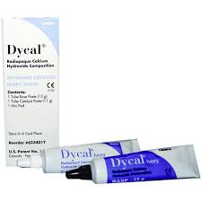
Calcium hydroxide
Hermann – 1920
  Calxyl induced dentinal bridging of the exposed pulpal surface
  In it pure form, this substance has a high pH and its dental use relates chiefly to its ability to stimulate mineralization and also its antimicrobial properties.

Slide 66
Calcium hydroxide is a strong alkali, which can be formed by the reaction of calcium oxide.
If the oxide is treated with only sufficient water to make it crumble to a fine, white, dry powder slaked lime is produced.

Slide 67
Composition
Base paste
  Calcium tungstate
  Zinc oxide
  1,3 butylene glycol
Catalyst paste
  Calcium hydroxide
  Zinc oxide
  Titanium dioxide

Slide 68
B/O Mechanism of setting
  Self curing – dycal
  Light curing – prisma VLC dycal
B/O Vehicle used
  Aqueous vehicle - Eg. Water, saline dental anesthetic, ringers solution, aqueous suspension of methylcellulose.
  Viscous vehicle – ex. glycerine, polyethylene glycol and propylene glycol.
  Oily vehicles – Olive oil, oleic acid, linoleic and isosteric acid.

Slide 69
It has low solubility in water (about 1.2 g /L at 25ºC), which decreases as the temperature rises.
It has a high pH (about 12.5-12.8) and is insoluble in alcohol.

Slide 70
Compressive Strength
  7 minutes : 3.8 to 7.6 MPa to 550 psi.
  30 minutes: 4.8 to 6.2 MPa to 750 – 900 psi
  24 hours: 8.3 to 10.3 MPa or 1200 – 1500 psi

Slide 71
Tensile strength: 10 MPa
Modulus of elasticity: low -0.37 Gpa/m²
pH: high alkaline: 9.2 to 11.7
Setting time: 2.5 – 5.5 minutes.
Solubility and disintegration: solubility is high 0.4 to 7.8%

Slide 72
The main actions of calcium hydroxide come from the ionic dissociation of Ca & OH ions and the action of these ions on vital tissue and bacteria generate the induction of hard tissue deposition and the antibacterial effect.

Slide 73
Ca ²⁺ and OH⁻ are rapidly released.
Direct contact with the tissue and the tissue fluids causing it to be rapidly solubilized and resorbed by the macrophages
USES
  Indirect pulp capping
  Direct pulp capping
  Pulpotomy
  Apexification subsequent to the apical curettage
  Treatment of large periapical lesions
  Inter-appointment dressing

Slide 74
Pulp tissue immediately in contact with CaOH is completely deranged and distorted because of the caustic effect of the drug.
This zone consists of debris, dentinal fragments, hemorrhage, blood clot, particles of Calcium hydroxide.

Slide 75
Calcium hydroxide induces the breakdown of ionic bonds that maintain the tertiary structure of proteins.
As a consequence, the enzyme maintains its covalent structure but the polypeptide chain is randomly unravelled in variable and irregular spatial conformation.
This results in the loss of biological activity of the enzyme and disruption of the cellular metabolism

Slide 76
Advantages
Initially bactericidal then bacteriostatic.
Promotes healing and repair.
High pH stimulates fibroblasts.
Neutralizes low pH of acids.
Stops internal resorption.
Inexpensive and easy to use.

Slide 77
Disadvantages
Does not exclusively stimulate dentinogenesis.
Does exclusively stimulate reparative dentin.
Associated with primary tooth resorption.
May dissolve after one year with cavosurface dissolution.
May degrade during acid etching.
Degrades upon tooth flexure.
Marginal failure with amalgam condensation.
Does not adhere to dentin or resin restoration

Slide 78
Glass ionomer cement
Glass ionomer cements are tooth-colored materials that bond chemically to dental hard tissues and release fluoride for a relatively long period.
They have therefore been suggested as the materials of choice for the restoration of carious primary teeth

Slide 79
Definition
Water based material that hardens following an acid base reaction between basic fluoroaluminosilicate glass and an aqueous solution of polyacids. (Anusavice)
Invented by Wilson and Kent 1969
1972 Wilson & Crisp found that tartaric acid improves manipulative properties
1974 Mc. Lean & Wilson proposed clinical use of GIC

Slide 80
Classification
A/C to clinical use
  Type I- Luting
  TYPE II- Restorative
  Type III- Liner/ Base
  Type IV- Pit & Fissure Sealant
  Type V- Luting for Orthodontic Purpose
  Type VI- Core build up material
  Type VII- High fluoride releasing command set
  Type VIII- ART
  Type IX- Geriatric & Paediatric GIC

Slide 81
A/C to Sturdevant
Conventional or Traditional
Metal Modified GIC
  Miracle Mix
  Cermet
Light Cured GIC
Hybrid (resin modified) GIC
Polyacid Modified Resin Composites

Slide 82
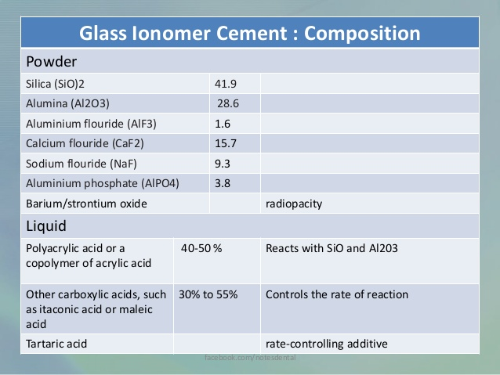

Slide 83
Silica
  It forms the skeletal structure of the glass. It also increases the transparency of the glass.
Alumina
  It forms the skeletal structure of the glass. It also increases the opacity of the glass.
Aluminium fluoride
  providing negative sites, which are vulnerable to acid attack by H+ leading to decomposition of glass

Slide 84
Fluoride
  It contributes to therapeutic value by releasing fluoride over a prolonged period of time.
  It helps to lower the fusion temperature.
  It enhances translucency and improves the working characteristics.
  It also helps to increase the strength of set cement.
Calcium fluoride
  It acts as a flux and provides opacity to the set cement

Slide 85
Phosphate
  It lowers the melting temperature and modifies the setting characteristics of the cement.
Lanthanum, Strontium, Barium :
  It provides radio - opacity to the cement
Aluminum phosphate :
  It helps to add body to cement and improve the translucency of the cement

Slide 86
Liquid
The liquid is an aqueous solution of polymers and copolymers of acrylic acid.
Polyacrylic acid is the most important acid contributing to formation of the cement matrix .

Slide 87
Itaconic acid
Promotes reactivity between the glass and the liquid.
Prevents gelation of the liquid which can result from hydrogen bonding between two polyacrylic acid chains

Slide 88
Polymaleic acid
Stronger acid than polyacrylic acid
Causes the cement to harden and lose its moisture sensitivity faster
More carboxyl (COOH) groups which lead to more rapid polycarboxylate crosslinking

Slide 89
Tartaric acid
A reaction controlling additive .
Extends the working time.
Promotes a snap set.
Strengthens and hardens the cement

Slide 90
Water
It is reaction medium.
It serves to hydrate the siliceous hydrogel and the metal salts formed.
It is essential part of the cement structure.
If water is lost from the cement by desiccation while it is setting, the cement- forming reactions will stop.

Slide 91
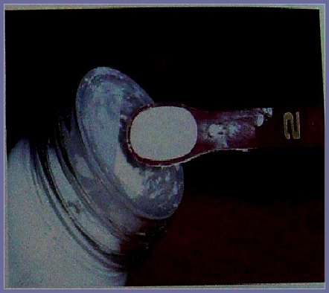
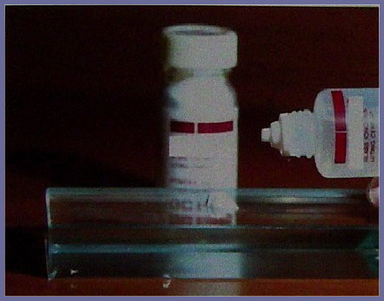
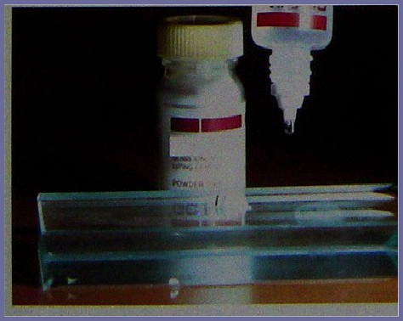
Dispensing

Slide 92
Mixing
Liquid should not stay on paper pad longer than 1minute (some of it may soak into it)
Don’t mix beyond 30 seconds
The objective is – only wet the particle – no dissolving it.
First half folded into liquid in 10-15seconds
Second half incorporated in 15 seconds Small mixing area

Slide 93
The surface of prepared tooth must be clean and dry
Consistency of mixed cement must allow complete coating of surface irregularities and complete sealing of prostheses.
Excess cement must be removed at appropriate time.
Surface must be finished without excessive drying
Protection of restoration be ensured.
These conditions are similar for luting applications except that no surface finishing is needed.

Slide 94
The powder and liquid should not be dispersed on slab until just before mixing procedure is begun; as prolonged exposure to office atmosphere alters the precise acid: water ratio of liquid.
The powder is incorporated into liquid with stiff, spatula. The mixing time should not exceed 45-60s. At this time mix should have a glossy appearance which indicates residual polyacid

Slide 95
Prolonged mixing leads to dull surface and adhesion will not be achieved.
GIC are also supplied in capsule containing preproportioned powder and liquid. Mixing is accomplished in an amalgamator after the seal that separates the powder and liquid is broken. Capsule also contains a nozzle for placement

Slide 96
Setting time
It sets rapidly in the mouth that is within 3-5 min and hardens to form a body having translucency that matches enamel
Setting time for type I –GIC – 5 -7 min
Setting time for type II–GIC -10 min
Film thickness should not exceed 20µm for luting agents

Slide 97
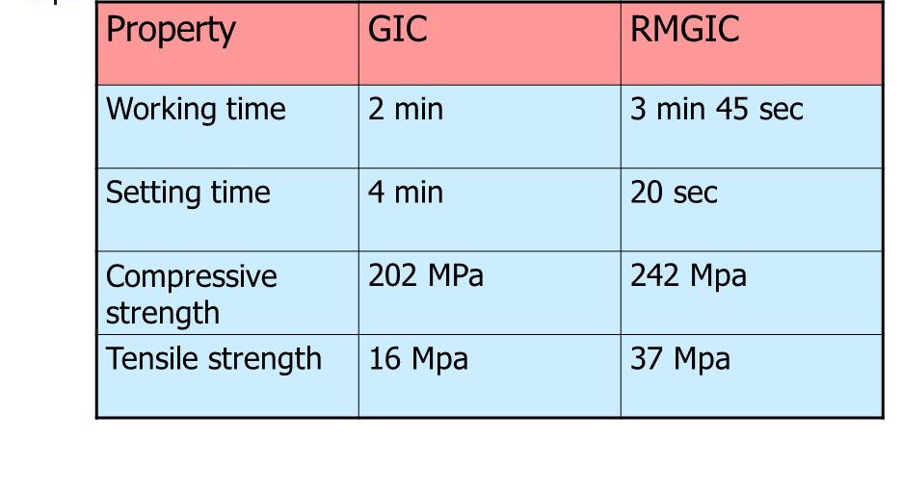

Slide 98
Dissolution
At the beginning of the reaction the surface of the glass particles is attacked by the polyacid.
This results in the dissolution of the glass particles releasing calcium and aluminium ions leading to the formination of the cement sol.

Slide 99
Precipitation
During this stage calcium and aluminum ions bind to polycarboxylate groups.
The initial set is achieved by cross-linking of the more readily available calcium ions with the carboxyl of the acid.

Slide 100
Gelation
This is the gelation phase and this reaction is relatively rapid, usually forming a clinically “hard” surface within 4-10 minutes from the start of mixing

Slide 101
Maturation
Maturation occurs over the next 24 hours as the less mobile aluminium ions become bound within the cement matrix, leading to more rigid cross lining between the poly (alkenoic acid) chains.
Fluoride and phosphate ions donot particpate in the crosslinking of the cement

Slide 102
Hydration
Associated with the maturation phase is a progressive hydration of the matrix salts, leading to sharp improvement in the physical properties

Slide 103
Factors affecting setting mechanism
Glass composition:
  Higher the alumima/Silica ratio, faster the set and shorter the W.T.
Powder particle size:
  The finer the powder, faster the set and shorter the W.T.
  Addition of Tartaric acid sharpens the set without reduction in W.T.

Slide 104
Temperature of mix:
  Increase the temperature, faster the set and shorter the W.T.
Relative proportion of constituent in the mix:
  The greater proportion of glass and lower the proportion of H₂O; faster the set and shorter the W.T

Slide 105
Indications
Restoration of erosive/abrasive lesions without cavity preparation.
Sealing and filling of occlusal pit and fissures
Restoration of primary teeth.
Restoration of Class V carious lesions.
Restoration of Class III carious lesions, preferably using lingual approach.
Repair of defective margins in restorations
Minimal cavity preparations in approximal lesions through buccal and occlusal approach (tunnel preparations)

Slide 106
Contraindications
Class IV carious lesions (or) fractured incisors
Lesions involving large areas of labial enamel where esthetics is of major importance.
Class II carious lesion where conventional cavities are prepared, for replacement of existing amalgam restorations.
Lost cusp areas.

Slide 107
Physical properties
Strength
  The strength of Glass Ionomer cement is increased as the filer content is increased and the water content is reduced.
  However increased strength is accompanied by an acceleration of setting and loss of workability.
Compressive strength
  Glass Ionomer compressive strength is 150-200 Mpa compressive strength is increased by increasing alumina content but this is achieved at the expense of translucency.
  The finer the particles the more will be the compressive strength.

Slide 108
Tensile strength
  Glass ionomers has a higher tensile strength when compared with silicates tensile strength 6.5 Mpa –17.4 Mpa.
Hardness:
  It is less than that of silicates the value is 48 KHN.
Fracture Toughness:
  Glass Ionomer cements are much inferior to composites in this aspect

Slide 109
Biocompatibility
  The adhesion to tooth material endures that they provide an excellent and enduring marginal seal, thus eliminating secondary caries.
  Sustained release of fluoride confers resistance to caries on adjacent tooth material.

Slide 110
Fluoride ions released from the restorative materials become incorporated in hydroxyapatite crystals of adjacent tooth structure to from to structure such as fluorapatite that is more resistant to acid mediated decalcification.
Thick mix – more glass – more fluoride

Slide 111
Large amounts of fluorides are released during the first few days after placement
It gradually declines during the first week
Stabilizes after 2-3 months
Continues for a long time that is 8 years after placement and certainly longer.

Slide 112
Atraumatic restorative technique
The ART technique consists of a simplified approach to caries management.
Hand instruments are used to excavate the soft caries followed by restoring the cavities with the autocure GIC.
Indications : occlusal pit and fissure cavities of small to moderate sizes with adequate tooth structure to surround the restoration

Slide 113
Modifications of GIC
CERMET
  This is formed by fusing the glass powder to the fine precious metal powders like silver or gold through sintering .
MIRACLE MIX
  Seed & Wilson (1980) invented miracle mix
  Spherical silver amalgam alloy + G I C in ratio 1:7 and mixing it with GIC liqiuid
  Improves strength and abrasion resistance of the cement

Slide 114
RESIN MODIFIED GIC
    To overcome low early strength and moisture sensitivity
    Defined as hybrid cement that sets partly by acid base reaction and partly by polymerisation reaction (Mc Lean)
    Powder – Ion leachable glass and initiators
    liquid – water, Poly acrylic acid, HEMA (15-25%), methacrylate monomers.
  Disadvantage
    More setting shrinkage

Slide 115
Advantages of RMGIC
Long working time due to photo curing
Improved setting characteristics
Decrease sensitivity towater
Increase early strength
Finishing & polishing can be done immediately
Improved tensile strength.
Better adhesion to composite restoration
Increase fluoride release.
Repairable.

Slide 116
COMPOMER
  Polyacid modified composite resin
  Defined as : material that contain both the essential components of GIC but in an amount insufficient to carry out acid base reaction in dark.
  They are developed to combine fluoride release of GIC and durability of composite

Slide 117
Powder
  Strontium, aluminium flurosilicate glass particles, metal oxides and intiators
Liquid
  Polymerizable methacrylate/caboxylic acidic monomers multi functional acrylate monomers and water

Slide 118
Setting reaction
  Initially light curing forms resin network around the glass
  After 2 to 3 month there is water uptake which initiates slow acid base reaction and fluoride release.

Slide 119
Thank you.

