Slide 1
DEVELOPMENT OF TONGUE

Slide 2
Purpose Statement
At the end of the lecture, the students should be able to describe in detail the-
  ,Development of tongue, Nerve Supply of tongue, Formation of frenum and papillae
  ,Development of musculature of tongue, Enlist clinical Considerations.

Slide 3
Learning Objectives
At the end of the lecture the student should be able to
S.N. | Learning Objectives | Domain | Level | Criteria | Condition
1 | Describe Development of tongue and Nerve Supply of tongue | Cognitive | Must Know | All
2 | Descibe Formation of frenum and papillae | Cognitive & Psychomotor | Must Know | All
3 | Development of musculature of tongue. | Cognitive | Must Know | All
4 | Enlist clinical Considerations | Cognitive | Must Know | All

Slide 4
CONTENTS
Pharyngeal Arch Contributions
DEVELOPMENT OF TONGUE
Nerve Supply
CLINICAL CONSIDERATIONS

Slide 5
INTRODUCTION
Tongue is a mass of striated muscle covered with mucous membrane.
It is a highly muscular organ of deglutition, taste and speech.

Slide 6
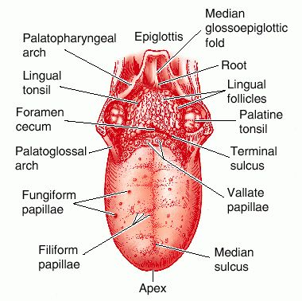

Slide 7
Overview Development of the Tongue
The tongue has contributions from all pharyngeal arches which changes with time.
The tongue initially begins as swelling rostral to foramen cecum, the median tongue bud.

Slide 8
Pharyngeal Arch Contributions
Arch 1 - oral part of tongue (anterior 2/3)
Arch 2 - initial contribution to surface is lost
Arch 3 - pharyngeal part of tongue
(posterior 1/3)
Arch 4 - epiglottis and adjacent regions

Slide 9
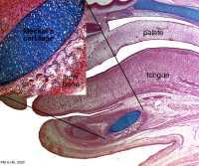
DEVELOPMENT OF TONGUE
It starts in the 4th month of the intrauterine life.
The tongue develops in relation to the pharyngeal arches in the floor of the developing mouth.

Slide 10
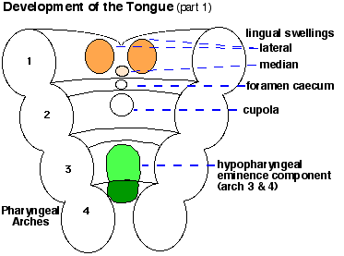

Slide 11
The medial most part of the mandibular arches proliferate to form 2 lingual swelling (derived from the anterior end of each first pharyngeal arch )

Slide 12
The lingual swelling are partially separated from each other by another swelling that appears in midline , at about 4th wk
The median swelling is called the tuberculum impar .

Slide 13
Immediately behind the tuberculum impar , the epithelium proliferates to form a down growth ( thyroglossal duct) from which thyroid gland develops.
The site of this downgrowth is subsequently marked by a depression called the foramen caecum .

Slide 14
The lateral swelling now enlarge,grow medially and fuse with each other and the tuberculum impar .
The lingual swelling thus form the anterior 2/3 or body of the tongue.

Slide 15
Another midline swelling is seen in relation to the medial ends of the 2nd, 3rd, and 4th arches.
This swelling is called the hypobrachial eminence.

Slide 16
The eminence soon shows a subdivision into a cranial part related to the 2nd and 3rd arches (called the copula) and a caudal part related to the 4th arch.
The caudal part forms the epiglottis.

Slide 17
The anterior 2/3 of the tongue is thus derived from the mandibular arch .
According to some the tuberculum impar does not make any significant contribution to the tongue.

Slide 18
The posterior 1/3 of the tongue is thus derived from the cranial part of the hypobrachial eminence (copula).
In this situation , the 2nd arch mesoderm gets buried below the surface .

Slide 19
The 3rd arch mesoderm grows over it to fuse with the mesoderm of the 1st arch.
The posterior 1/3 of the tongue is thus formed by 3rd arch mesoderm .
The posterior most part of the tongue is derived from the 4th arch.

Slide 20
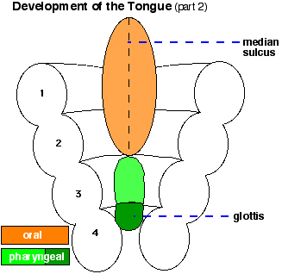

Slide 21
Nerve Supply
Anterior 2/3 of the tongue -lingual branch of the mandibular nerve, which is the post trematic nerve of the 1st arch and by the chorda tympani which is the pretrematic nerve .
Posterior 1/3 of the tongue -superior laryngeal nerve, which is the nerve of the 4th arch.

Slide 22
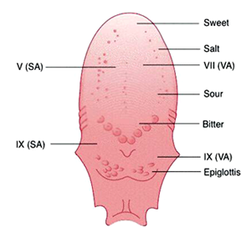

Slide 23
Formation of frenum and papillae
The sulcus terminalis represents the interval between the lingual swellings of the 1st pharyngeal arches & the anterior ends of the 3rd pharyngeal arches.
Around the edge of the anterior 2/3 rd of the tongue , the ectodermal cell proliferate & grow inferiorly into the underlying mesenchyme.

Slide 24
Later, these cells degenerate so that this part of the tongue becomes free. Some of the entodermal cells remain in the midline and help form the frenum of the tongue.

Slide 25
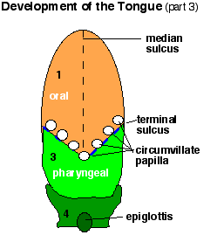

Slide 26
Development of musculature of tongue
It is derived from the occipital myotomes and is thus supplied by the hypoglossal nerve , which is the nerve of these myotomes.

Slide 27
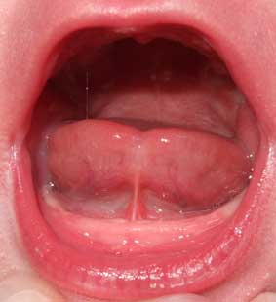
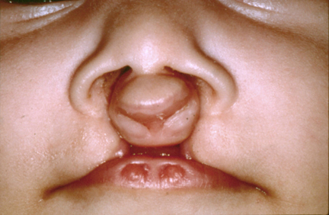
CLINICAL CONSIDERATIONS
Macroglossia or microglossia or aglossia
Bifid tongue because of non fusion of the lingual swellings
Ankyloglossia or tongue tie

Slide 28
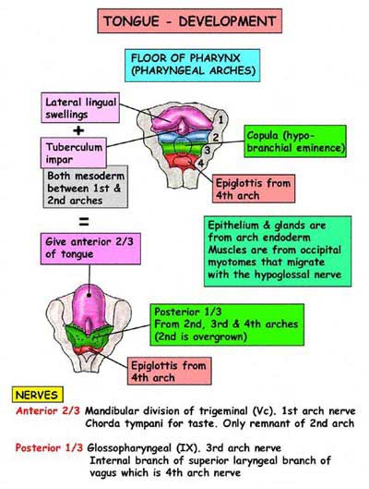

Slide 29
Summary
Development of tongue
Nerve Supply of tongue
Formation of frenum and papillae
Development of musculature of tongue
Clinical Considerations

Slide 30
BIBLIOGRAPHY
Color Atlas And Text Book Of Oral Anatomy, Histology Berkovitz, B. 1ST edition.
Oral Development and Histology Avery, j. K.1st edition.
Oral Histology : Development, Structure and Function Tencate, 4th edition.
Dental Embryology, Histology & Anatomy. Marry Bath- Balogh Inergaret. 2nd edition.

Slide 31
THANK YOU

