Slide 1
DEVELOPMENT OF FACE

Slide 2
Purpose Statement:
At the end of the lecture, the students should be able to describe the –Development of lips –upper and lower .,Anomalies of lip, Development of palate, Anomalies of palate

Slide 3
Learning Objectives
At the end of the lecture the student should be able to
S.N. | Learning Objectives | Domain | Level | Criteria | Condition
1 | Development of lips –upper and lower . Anomalies of lip | Cognitive | Must Know | All
2 | Development of palate Anomalies of palate | Cognitive | Must Know | All

Slide 4
CONTENTS
Development of lips
Development of lips
Anomalies of lips

Slide 5
Development of lips:
Lower lip:
Lower lip and lower jaw develop by the fusion of mandibular processes of two sides.
Lower lip forms the lower margin of the stomatodeum.

Slide 6
Upper lip:
Lateral part of the upper lip is formed by the proliferation of the mesoderm of the maxillary process.
Mesoderm of philtrum of the upper lip is derived from the frontonasal process.

Slide 7
However the ectoderm of maxillary process overgrows this mesoderm so as to meet the ectoderm of the opposite side in the midline.

Slide 8
Thus the skin of the entire upper lip is innervated by maxillary nerves.
The muscles of the lips and whole of the face are derived from the second branchial arch.

Slide 9
Anomalies of lips:
Hare lip – one or both of the maxillary processes fail to fuse with medial nasal process.
It may be unilateral or bilateral .

Slide 10
Unilateral Harelip:
Bilateral Harelip:

Slide 11
Commissural Labial pits:
Cleft of lower lip:

Slide 12
Development of palate:
Palatal shelves or palatal processes are outgrowths given from the medial edges of maxillary processes
Palate is formed by the fusion of two palatal processes with each other and with primary palate.

Slide 13
Medial edges of palatal processes fuse with lower edges of nasal septum thus separating two nasal cavities from each other and from mouth.

Slide 14
Three elements that make up the palate:-
a) Two lateral maxillary shelves
b) Primary palate of the frontonasal prominence
Initially they are widely separated.
Due to the vertical orientation of the lateral shelves on either side of the tongue.

Slide 15
Palatal development begins in week 5, but weeks 6-9 are most critical.
Formation of intermaxillary segment from merged medial nasal prominences.
Primary palate forms from median palatine process ossifies as the premaxillary portion of the maxilla.

Slide 16
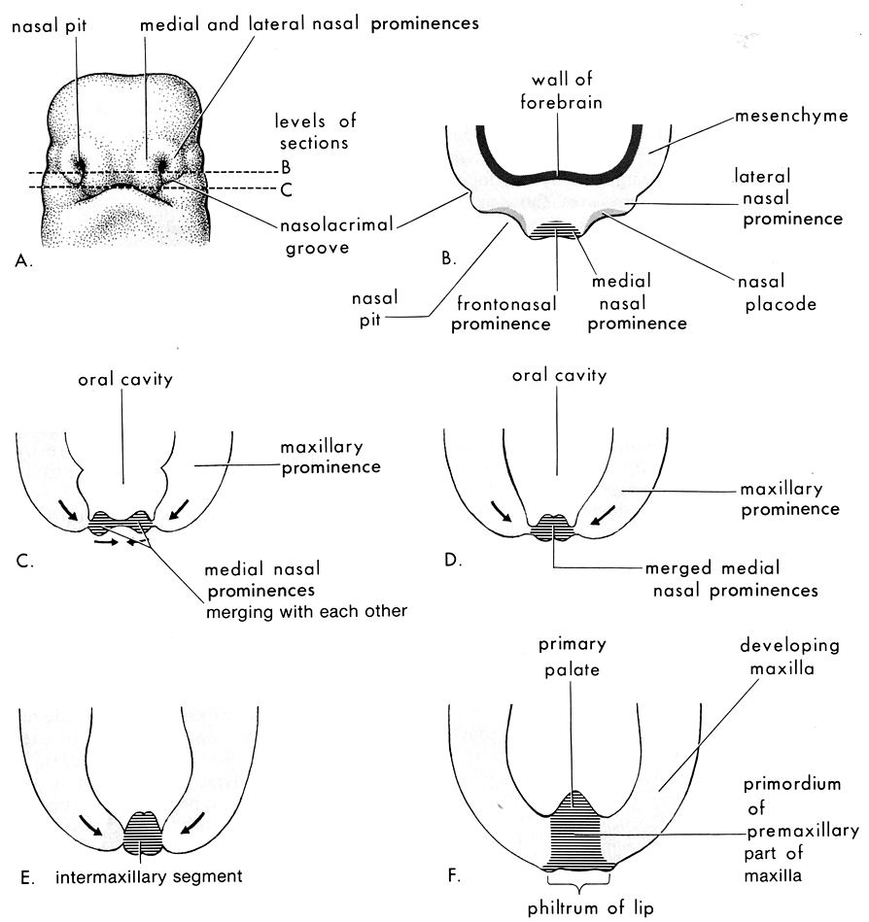

Slide 17
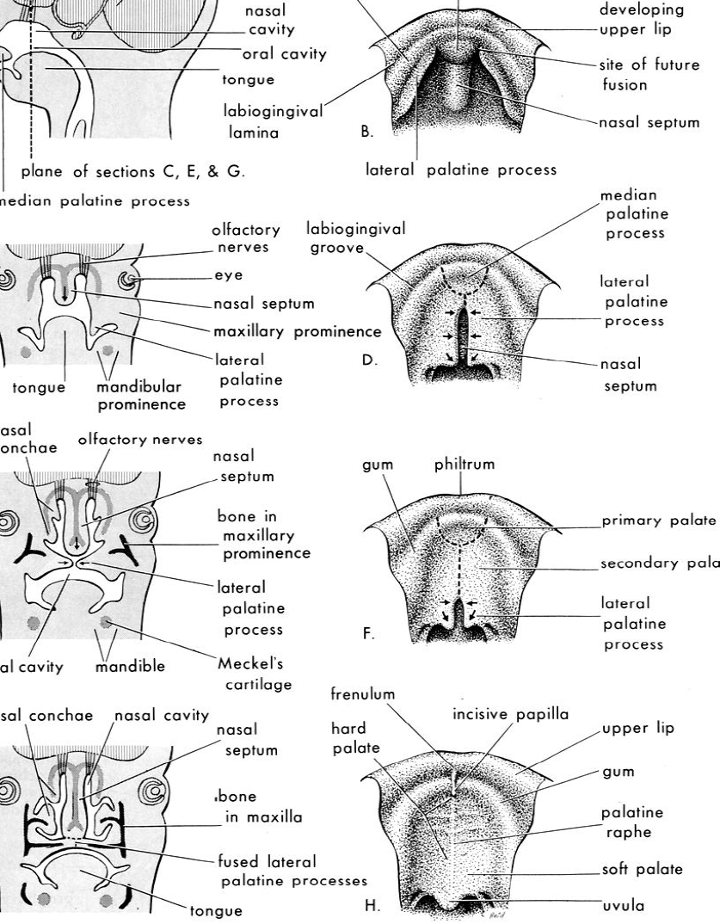

Slide 18
During 8th week intrauterine life a remarkable transformation in position of the lateral shelves takes place.
They alter from vertical to horizontal as a prelude to their fusion and partitioning the oronasal chamber.
The transition is completed within hours.

Slide 19
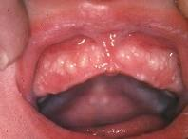
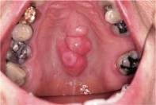
Bohn’s Nodules
Torus palatinus

Slide 20
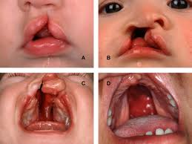
Anomalies of palate:
Cleft palate: caused due to non-fusion of palatal processes with primary palate.

Slide 21
Unilateral cleft lip and palate:
Bilateral cleft lip and palate:

Slide 22
Cleft palate:
Bifid uvula:

Slide 23
Summary:
Development of lips –upper and lower .
Anomalies of lip
Development of palate
Anomalies of palate

Slide 24
THANK YOU !!!

