Slide 1
DEVELOPMENT OF TOOTH

Slide 2
Purpose Statement
At the end of the lecture student should be able to describe the Successional lamina, Enamel Knot , cord , navel & septum, Gubernacular canal, Membrana preformativa, Enzymes of stellate reticulum

Slide 3
Learning Objectives
At the end of the lecture the student should be able to
S.N. | Learning Objectives | Domain | Level | Criteria | Condition
1 | Write about Successional lamina Gubernacular canal | Cognitive | Must Know | All
2 | Define Enamel Knot , cord , navel & septum | Cognitive | Must Know | All
3 | Define Membrana preformativa | Cognitive | Must Know | All
4 | Enumerate Enzymes of stellate reticulum | Cognitive | Must Know | All

Slide 4
CONTENTS
Successional lamina
Gubernacular canal
Enamel Knot
Enamel Cord
Membrana preformativa

Slide 5
Successional lamina
The lingual extension of the dental lamina is termed as successional lamina and it develops from the 5th month in utero (permanent central incisor) to the tenth month of age (second premolar).

Slide 6
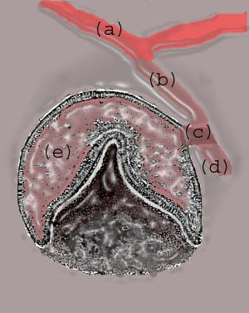
a) Oral epithelium; (b) dental lamina; (c) lateral lamina; (d) successional lamina; (e) tooth bud or enamel organ (future tooth).

Slide 7
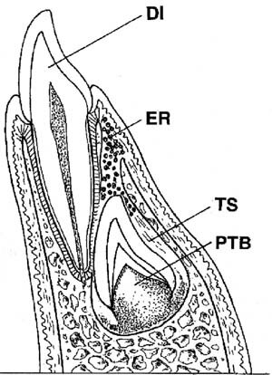
Epithelial remnants from the dental lamina (ER, shown as tiny circles) localized to the gubernacular canal that links the tooth sac (TS) around the developing permanent successor (PTB) with the lingual gingiva. DI: deciduous incisor.

Slide 8
Gubernacular canal
Although the permanent incisors, canines and premolars, eventually become isolated in their own bony crypts, they maintain continuity with the connective tissue of the lamina propria of the overlying gingiva.
This is achieved through the persistence of an intrabony canal or corridor called the gubernaculum dentis or gubernacular canal, which connects the two

Slide 9
Enamel Knot
The cells in the centre of the enamel organ are densely packed and form what is called enamel knot.

Slide 10
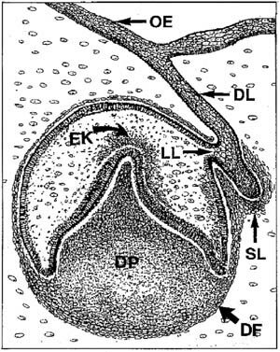
Fig. 2 Formation of the deciduous tooth germs occurs on the labial aspect of the dental lamina (DL). An epithelial bridge (lateral lamina, LL) is seen to connect DL with the bell-shaped tooth germ. EK: enamel knot. The free tip of DL proliferates into the ectomesenchyme as the successional lamina (SL) providing the anlage for a permanent tooth. Dental papilla (DP), dental follicle (DF).

Slide 11
Enamel Cord
The vertical projection of the enamel knot is called enamel cord.
Enamel Septum
When the enamel chord extends to meet the outer enamel epithelium it is termed as enamel septum, which divides the stellate reticulum into 2 parts

Slide 12
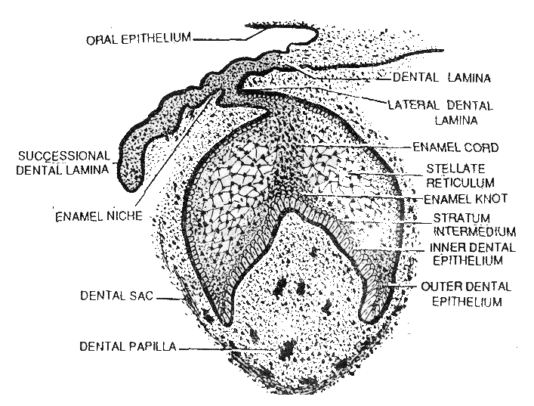

Slide 13
Function
The function of enamel knot and chord may be to act as a reservoir of dividing cells for the growing enamel organ.
Enamel knot also expresses many growth factors which are essential for determining the shape of the tooth.

Slide 14
Enamel Navel
The outer enamel epithelium at the point of the meeting shows a small depression called enamel navel , which resembles the umbilicus.

Slide 15
Membrana preformativa
The basement membrane that seperates the enamel organ and the dental papilla just prior to dentin formation is called membrana preformativa.

Slide 16
Enzymes of stellate reticulum
Alkaline phosphatase-In hard tissue it is implicated in the process of mineralization, in synthesis of organic matrix, osteogenesis and Dentinogenesis.
In developing in molar & incisor it is present in stratum intermedium, odontoblast and subadjacent Korff’s fibres and the ground substance.

Slide 17
Succinate dehyrogenase -It is closely related to cytochrome oxidase in the mitochondria.
Amino peptidase- are proteolytic enzymes that hydrolyse certain terminal peptide bond.
Demonstrated in odontoblast also during dentinogenesis

Slide 18
Summary
Successional lamina
Enamel Knot , cord , navel & septum
Gubernacular canal
Membrana preformativa
Enzymes of stellate reticulum

Slide 19
BIBLIOGRAPHY
Color Atlas And Text Book Of Oral Anatomy, Histology Berkovitz, B. 1ST edition.
Oral Development and Histology Avery, j. K.1st edition.
Orban's Oral Histology and Embryology Bhaskar, s. N.11th edition.
Oral Histology : Development, Structure and Funct Tencate, a. R. 4th edition.
Dental Embryology, Histology & Anatomy. Marry Bath- Balogh Inergaret. 2nd edition.

Slide 20
THANK YOU

