Slide 1
Eruption of Teeth

Slide 2
Purpose Statement
At the end of the lecture student should be able to describe the
Phases of tooth eruption &
Eruptive tooth movement

Slide 3
Learning Objectives
At the end of the lecture the student should be able to
S.N. | Learning Objectives | Domain | Level | Criteria | Condition
1 | Describe the mechanism of tooth eruption movement | Cognitive | Must Know | All
2 | Enlist and define types of tooth eruption | Cognitive | Must Know | All
3 | Describe clinical consideration of eruption | Cognitive | Must Know | All

Slide 4
Anterior compartment of occlusal force: An anteriorly directed force is generated when teeth are clenched, due to the mesial inclination of most teeth and the forward-directed force generated from inter-cuspal forces.

Slide 5
Active eruption: to compensate incisal and occlusal wear
Passive eruption: gradual recession of the gingiva and the underlying alveolar bone
Both active and passive eruption leads to lengthening of clinical crown

Slide 6
Mechanisms of Eruptive Tooth Movement
Root formation
Bone remodeling
Dental Follicle
Periodontal ligament traction
Vascular pressure -the teeth 'jiggle' up and down in synchrony with the arterial pulse. A logical test, therefore is to surgically remove the growing root. When this is done, the tooth continues to erupt.

Slide 7
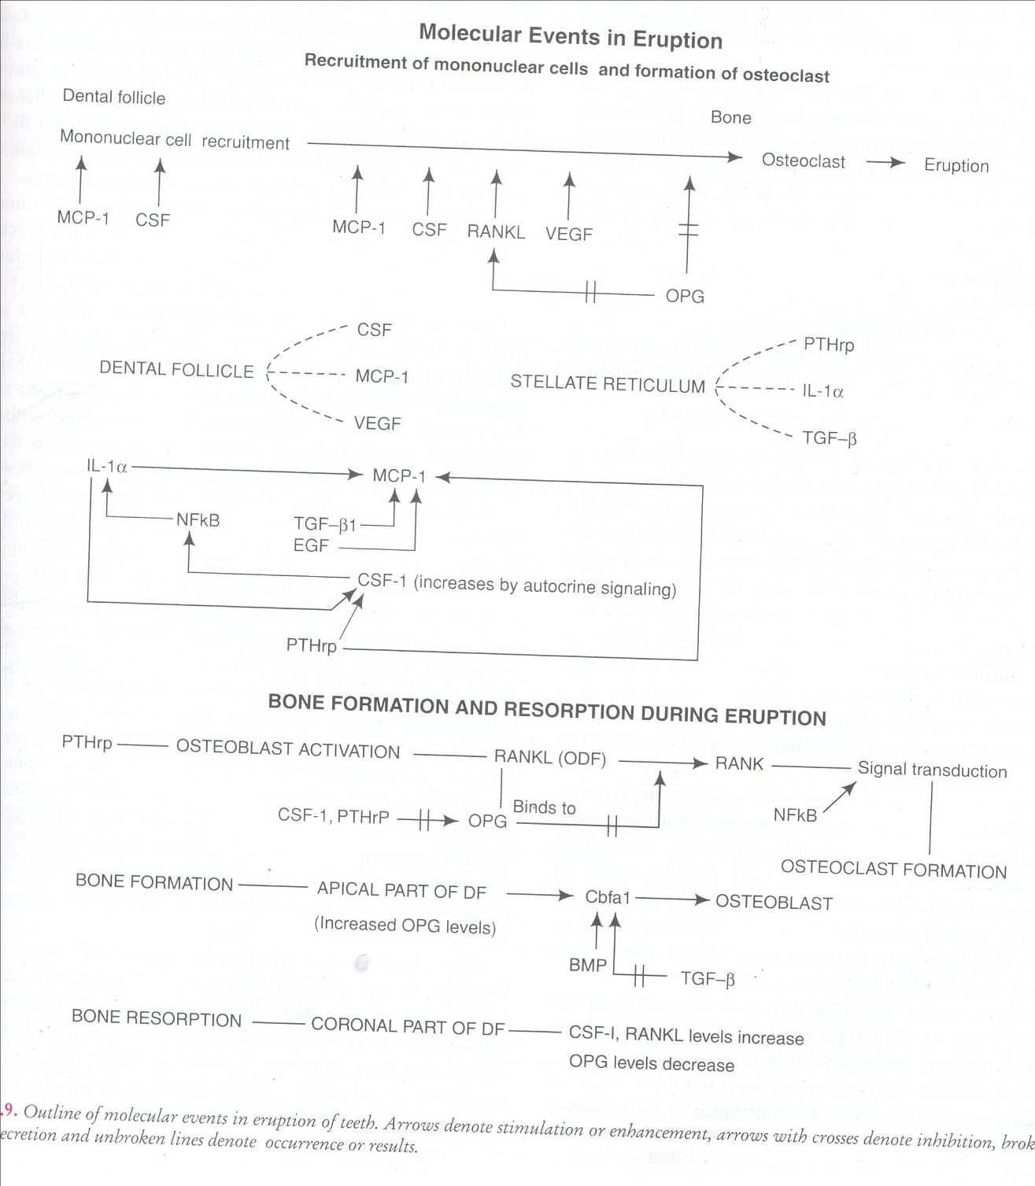

Slide 8
Clinical consideration
Orthodontic tooth movements
Premature eruption of teeth
Tooth ankylosis
Missing tooth
Impaction - failure to erupt e.g., from too little gap after premature loss of deciduous tooth

Slide 9
Malocclusion
Infra-occlusion (not high enough)
Excessive drift
Tilting (can occur early from germ rotation)

Slide 10
Deciduous
Months | CI | LI | C | First Molar | Second Molar
Maxillary | 7 1/2 | 9 | 18 | 14 | 24
Mandibular | 6 | 7 | 16 | 12 | 20
Permanent
Years | CI | LI | C | First Pre-molar | Second Pre-molar | First molar | Second molar | Third molar
Maxillary | 7-8 | 8-9 | 11-12 | 10-12 | 10-12 | 6-7 | 12-13 | 17-21
Mandibular | 6-7 | 7-8 | 9-10 | 10-12 | 11-12 | 6-7 | 11-13 | 17-21

Slide 11
Summary
Mixed dentition: presence of both dentitions
Definition
Phases of tooth eruption
Eruptive tooth movement

Slide 12
BIBLIOGRAPHY
Color Atlas And Text Book Of Oral Anatomy, Histology Berkovitz, B. 1ST edition.
Oral Development and Histology Avery, j. K.1st edition.
Orban's Oral Histology and Embryology Bhaskar, s. N.11th edition.
Oral Histology : Development, Structure and Funct Tencate, a. R. 4th edition.
Dental Embryology, Histology & Anatomy. Marry Bath- Balogh Inergaret. 2nd edition.

Slide 13
Thank you

