Slide 1
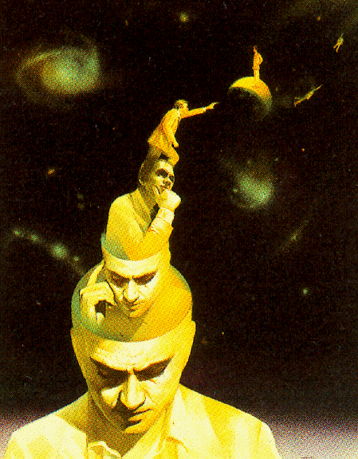
GOOD AFTERNOON
Notes:
Anand sir class

Slide 2
COMMUNICATION
for
HEALTH EDUCATION

Slide 3
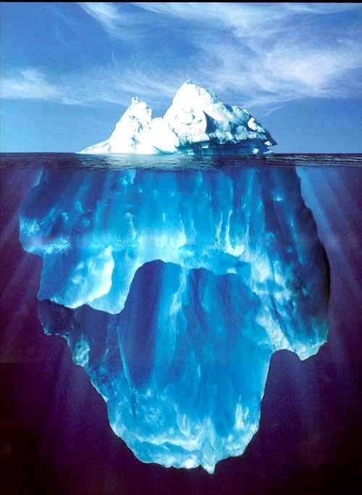

Slide 4
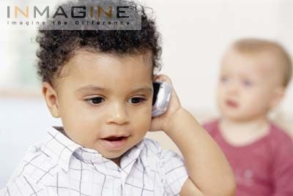
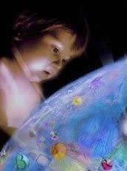

Slide 5
Cognitive level – Increase in knowledge
Affective level – Changing existing patterns of behavior.
Psychomotor level – Acquisition of new skills

Slide 6
Process Of Communication In
Health Education
Sender
Message
Channel
Feed back
Receiver
Awareness Interest Evaluation Adoption

Slide 7
Process Of Communication In
Health Education
Sender
  His objectives clearly defined
  His audience: it’s interests & needs
  His message
  Channels of communication
  His abilities & limitations
Receiver
  Controlled – common interest
  Uncontrolled/ free - curiosity

Slide 8
Process Of Communication In
Health Education
Message
  In line with the objectives
  Meaningful
  Based on felt needs
  Clear & understandable
  Specific & accurate
  Timely & adequate
  Fitting the audience
  Interesting
  Culturally & socially appropriate

Slide 9
Process Of Communication In
Health Education
Channels of communication
  Interpersonal communication
  Mass media
  Traditional/folk media
Feedback
  Reaction of the audience
  Provides opportunity to modify the message

Slide 10
Types Of Communication
One- way communication (Didactic method)
  Knowledge is imposed
  Learning is authoritative
  Little audience participation
  No feedback
  Doesn’t influence human behavior
Two – way communication (Socratic Method)
  Learning is active & democratic
  More likely to influence behavior

Slide 11
Types Of Communication
Verbal communication
  Loaded with hidden meanings
  Persuasive
Non-verbal communication
Formal (lines of authority) & informal (grape vine) communication
Visual communication
  Charts, graphs, pictograms, tables, maps, posters etc.
Telecommunication & internet

Slide 12
Barriers Of Communication
Physiological | Difficulties in hearing, expression
Psychological | Emotional disturbances, neurosis, level of intelligence, language or comprehension difficulties
Environmental | Noise, invisibility, congestion
Cultural | Illiteracy, levels of knowledge & understanding, customs, beliefs, religion, attitudes, economic & social class differences, cultural difficulties b/w foreigners, b/w urban & rural population

Slide 13
HEALTH EDUCATION

Slide 14
Definitions
Health:
  It is a state of complete physical, mental and social well being and not merely the absence of disease or infirmity
  - WHO, 1948
Health Education:
  Health education, like general education, is concerned with changes in knowledge, feelings & behavior of people. In its most usual forms, it concentrates on developing such health practices as are believed to bring about the best possible state of well being
  - WHO, 1969

Slide 15
Definitions
  Is a process which informs, motivates and helps people to adopt and maintain healthy practices and lifestyles, advocates environmental changes as needed to facilitate this goal and conducts professional training and research to the same end.
  - National conference on preventive medicine in USA
  Any combination of learning experiences designed to facilitate voluntary adaptations of behavior conducive to health.
  - Green
  The sum experience which favorably influences habits, attitudes and knowledge relating to individual, community & racial health.
  - Wood

Slide 16
Aims & Objectives
  Encourage people to adopt and sustain health promoting life style and practices
  Promote proper use of health services
  Arouse interest, provide knowledge, improve skills and change attitude
  Stimulate individual & community participation

Slide 17
Process Of Communication In
Health Education
  Ability to influence others depends on communication Skill
  “without communication an individual could never become a human being, without mass communication, he never becomes a part of modern society”

Slide 18
Approach To Health Promotion
Legal / Regulatory/ Coercive approach
  Eg: -The child marriage restraint Act
  Simplest & quickest method
  Can't eradicate the cause
  Can’t regulate the areas of personal choice
  Require vast administrative infrastructure & expenditure
  Counter to the basic tenet of health education

Slide 19
Approach To Health Promotion
Service approach
  Basic Health Services 1960
  Providing all the health services at their door step
  Failure: Not based on felt – needs
Health education approach
  People will be better off if they have autonomy over their lives
  Informed, educated & encouraged to make their own choice
  Consistent with the democratic philosophy
  Results are slow, but enduring
  Behavior is easily controlled / developed in young population

Slide 20
Approach To Health Promotion
Primary health care approach
  New approach
  Participation & active involvement of people
  Necessary guidance in identifying health problem & finding a workable solution
  Objective – making people self reliant

Slide 21
Health education Vs Propaganda
Education | Propaganda
Knowledge & skills actively acquired | Knowledge instilled in the minds of people
Makes people think for themselves | Prevents thinking
Disciplines primitive desires | Arouses & stimulates primitive desires
Develops reflective behavior | Develops reflexive behavior
Appeals to reason | Appeals to emotion
Develops individuality, personality & self expression | Develops a standard pattern of attitude & behavior
The process is behavior centered | Information centered

Slide 22
Models Of Health Education
Medical Model
  Transfer of Knowledge to achieve behavioral change
  Recognition & treatment of disease
  Technical advancement
  Social, cultural & psychological factors were ignored
Motivation Model
  Stage of un - awareness
  Stage of awareness
  Stage of motivation
    Stage of interest
    Stage of evaluation
    Stage of decision making
  Stage of action
    Stage of trial
    Stage of adoption

Slide 23
Models Of Health Education
Social intervention Model
  Considered the importance of social environment in shaping the behavior
  Highlights the importance of group support
  Knowledge of sociology & understanding of cultural, biological, social environment

Slide 24
Stages in the adoption of new ideas
Adoption
Trial
Evaluation
Interest
Awareness
Unawareness
STEP LADDER PATTERN

Slide 25
Content Of Health Education
Human Biology
  Understanding
    Structure & function of the body
    Need of exercise, rest, sleep
    Effect of deviation from healthy life style
  UNICEF 1989
    Child spacing
    Breast feeding
    Safe motherhood
    Immunization
    Weaning
    Child growth
    House hygiene

Slide 26
Content Of Health Education
Nutrition
  Guide people to choose healthy & balanced diet
  Remove prejudices
  Promote good dietary habits
    Value of breast feeding
    Misconception about weaning
    Ignorance of appropriate diet
  Intervention for the prevention of malnutrition
  Promotion of health
  Improve quality of life

Slide 27
Content Of Health Education
Hygiene
  Personal
    Bathing, clothing, washing hands, dental care
    Should start in early age
  Environmental
    Domestic
      Fresh air, light, ventilation, hygienic storage of food , disposal of wastes, need to avoid pests
    Community
      Water supply, disposal of wastes, vector control, food sanitation & housing

Slide 28
Content Of Health Education
Family Health
  Strengthen and improve family health as a unit
    Maternal & child health care, family planning, immunization, nutrition
Disease prevention and control
  Provide elementary knowledge about the nature of disease & method of prevention
  Encouraged to participate in disease control
Mental Health
  Help people keep mentally healthy
  Enjoy relationship with others
  Live & work without mental break down
    Mother after child birth, child at entry into school, decision about future, starting new family, widowhood

Slide 29
Content Of Health Education
Prevention of accidents
  Home, road, work place
  Enforce certain rules
  Provide safe environment
Use of health services
  Inform people about health services available
    Screening programmes, Immunization. Family planning

Slide 30
Principles

Slide 31
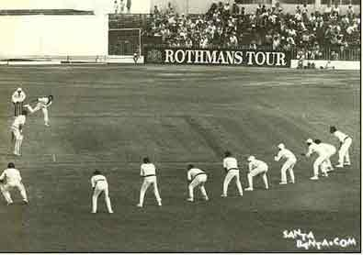
1. Interest
Felt
Needs

Slide 32
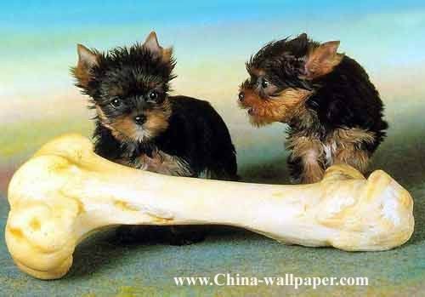
2. Participation
Active learning

Slide 33
3. Known to unknown
From where the people are to new knowledge
From particular to general
From easy to more difficult
Obstacles

Slide 34
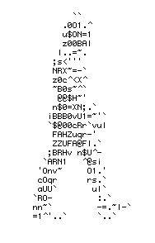
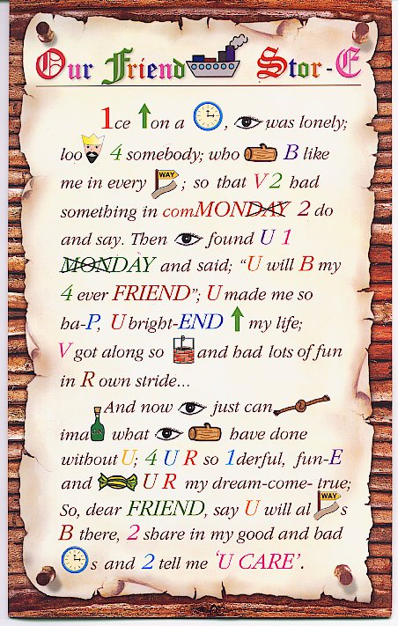
4. Comprehension
Knowledge
Education,literacy
Within mental capacity
Language

Slide 35
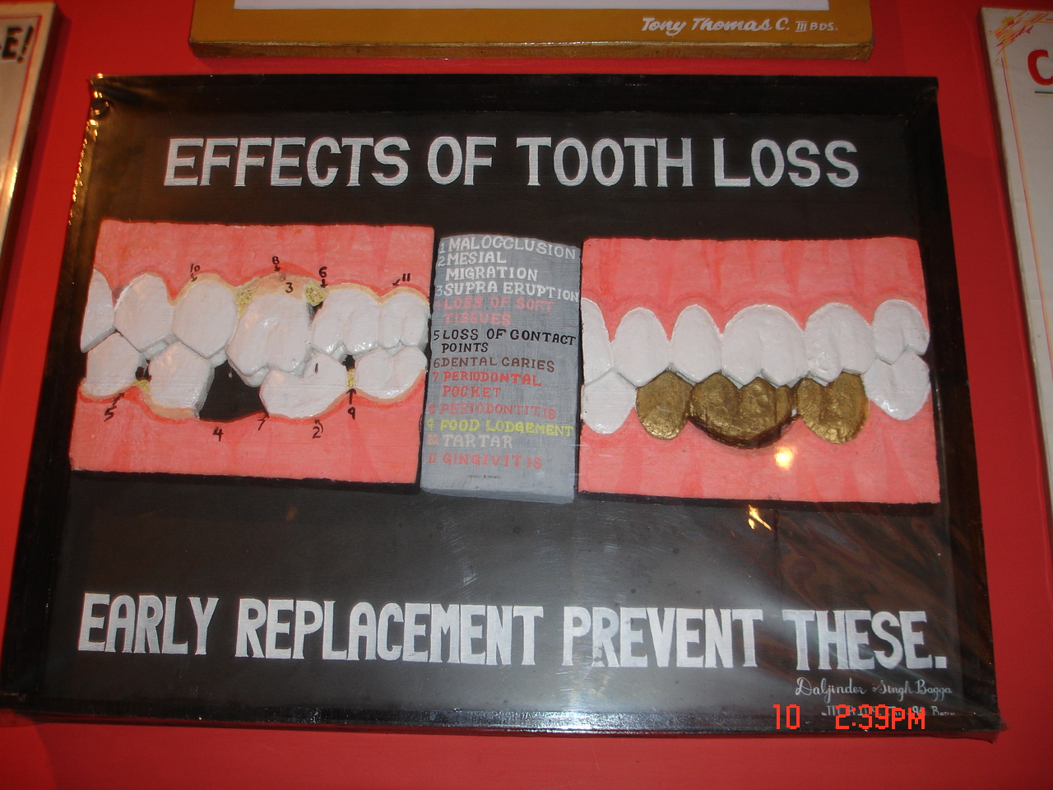

Slide 36

5. Reinforcement
Inoculation
based
prevention
Booster dose

Slide 37

6. Motivation
Primary motives
Secondary motives
Physiological
Learned

Slide 38
The need or drive
Action
A goal or incentive to be achieved
Some form of satisfaction

Slide 39
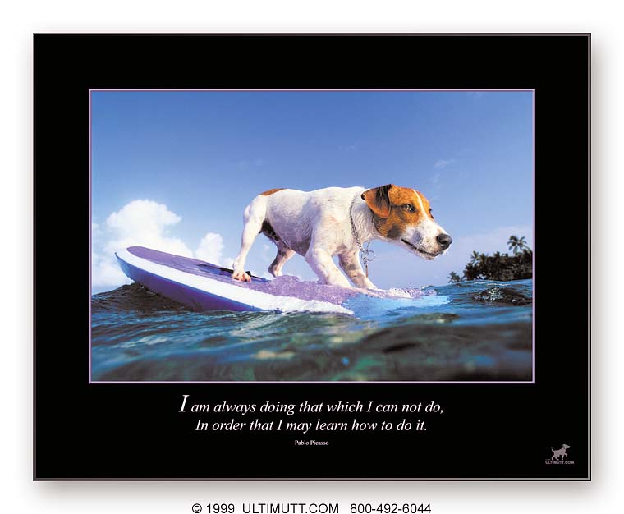
7. Learning by doing

Slide 40
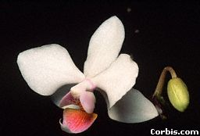

8. Soil, seed and sower
People
Media
Health facts

Slide 41
9. Credibility
Degree to which the message to be communicated is perceived as trustworthy by the receiver
  based on facts & scientific knowledge
  should consider local culture, education system & social goals
Unless people have trust & confidence in communicator – no desired effect ensures

Slide 42
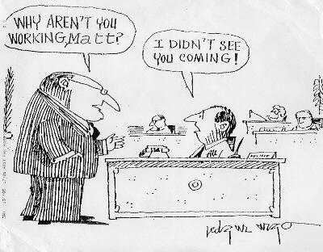
10. Setting an example

Slide 43
11. Feedback

Slide 44
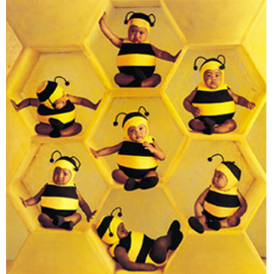
12. Good human relations

Slide 45
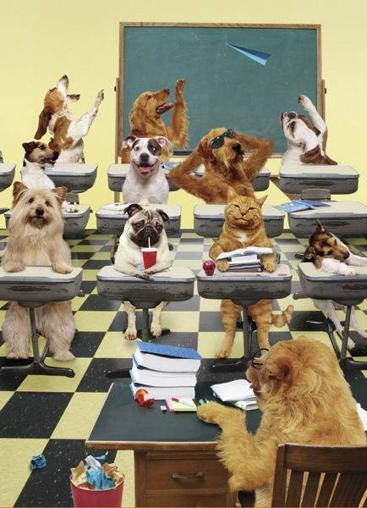
13.Leaders
Village head men
School teachers
Community leaders

Slide 46
Aids used in Health Education
AUDIO AIDS :
- based on principles of sound, electricity and
magnetism.
- can reproduce sound or words spoken
- can be repeated
Auditory aids – radio, tape-recorder, microphones , sound amplifiers, gramophones, etc,.

Slide 47
2) Visual aids –
- principles of projection
a) not requiring projection – Black board , leaflets, posters exhibits, photographs, flashcards, pamphlets, models, brochures etc,.
b) requiring projection – slides, film strip, Overhead projectors, Bioscopes, Video cassettes,
c) Other aids used – folk dances, folk songs, puppet shows , dramas
3) Combined AV aids – TV, sound films(cinema), slide
-tape combination , motion pictures, multimedia computers etc.,
AV aids are the means to an end, not an end in
themselves

Slide 48
ii) methods in health education/ communication
Health communication
Individual
approach
Personal contact
Home visit
Personal letters
Group approach
Lectures
Demonstrations
Discussion methods
  group discussion
  panel discussion
  Symposium
  Workshop &
  conferences
  Seminars
  Role play
Mass approach
Television
Radio
News papers
Printed materials
Direct mailing
Posters
Health museum &
exhibition
Folk methods
Internet

Slide 49
Chalk & Talk (Lecture)
may be defined as – carefully prepared oral presentation of facts, organized thoughts and ideas by the qualified person
- effectiveness depends on speakers ability to
write legibly & draw on black board
- group should not be more than 30 & talk
should not exceed 15-20 minutes

Slide 50
The lecture method can be more effective by combining with suitable AV aids as –
Flip charts – series of charts (or posters) 25x30 cms or more flashed or displayed - chart
should be
  brief and to the point
  hold attention
  help lecture to proceed

Slide 51
b) Flannel graph – rough flannel or khadi fixed over a wooden board - background - cutout pictures, graphs, drawing etc,.
Pictures - made rough on back side by pasting a piece of sand paper – adhere at once when put on flannel
Advantages
  – prearranged sequence of pictures – maintain continuity
  - cheap medium & easy to transport
  - promotes thoughts & criticism

Slide 52
c) Exhibits – objects, models, specimens
d) Films and charts
Disadvantages of lectures –
  students are involved to a minimum extent
  learning is passive
  do not stimulate thinking or problem solving capacity
  the health behavior of listeners are not necessarily
  affected

Slide 53
2) DEMONSTRATION
is carefully prepared presentation to show how to perform a skill or procedure
- performed step by step making the audience understand & involve in discussion
upholds principle – ‘seeing is believing’ &
‘ learning by doing’
has high motivational value

Slide 54
3) GROUP DISCUSSIONS
Is very effective method that permit to learn by freely exchanging their ideas, knowledge & opinions
for effective group discussions
  group – not less than 6 & not more than 12 members
  participants are all seated in a circle
  there should be a leader – initiates, avoids side
  conversations, encourages everyone to participate
  & sums up the discussion in the end

Slide 55
In group discussion, members should follow certain rules as
  Express ideas clearly and concisely
  Listen to what others say
  Do not interrupt when others are speaking
  Accept criticism gracefully
  Help to reach conclusions
Limitations - unequal participation of members
- some may deviate from the subject

Slide 56
4) PANEL DISCUSSION
4-8 persons - qualified to talk about topic - discuss a given problem in front of a large group or audience
- comprises of a chairman or moderator &
4-8 speakers
- there is no specific agenda, no order of speaking
& no set speeches

Slide 57
- after speakers discussion, the audience are invited to take part
- the discussion should be spontaneous & natural
- can be extremely useful method of education, provided it is properly planned & guided

Slide 58
5) SYMPOSIUM
- Is a series of speeches on a selected subjects
- each person or expert presents an aspect of the subject briefly
  - no discussion among speakers
  - audience may raise questions
  - chairman makes a comprehensive summary at the end

Slide 59
6) WORKSHOP
- Consists of a series of meeting (4 or more) with emphasis on individual work, within the group, with the help of consultants & resource personnel
- it provides opportunities to improve his effectiveness as a professional worker

Slide 60
7) ROLE - PLAYING (Socio-Drama)
- Based on assumption that many values in situation cannot be expressed in words and the communication can be more effective if dramatized by the group
- size of group best at 25
- is followed by discussion of the problem

Slide 61
8) CONFERENCES & SEMINARS
- Usually held on a regional, state or national level
- ranges from half a day to a week length
- may cover single topic in depth or be broadly
comprehensive
- use variety of aids from self instruction – multimedia

Slide 62
9) Colloquy
- Audience gets the opportunity for direct participation
- A group of experts on particular topic of discussion
are selected & they listen to the problems or
questions raised by the members of the audience.
- The experts give answers & comments on the
particular problem

Slide 63
3) MASS APPROACH (education of general public)
- are one way communication
- are useful in transmitting messages to the people even in remotest places
- numbers reached are usually millions
- can give high returns for the time & money involved

Slide 64
TELEVISION
Most popular of all media
Effective in ;
  creating awareness
  influencing public opinion and introducing new way of life
  raising levels of understanding
  helping people familiarize with things not seen before
TV can only be a aid of teaching & cannot cover
all areas of learning

Slide 65
2) RADIO
In many developing countries radio has broader audience than TV
  Purely didactic medium
  radio is cheaper than TV
  Doctors & health workers may discuss the local health issues & increase general awareness
- Both TV & Radio can reach illiterate population
not accessible thro’ printed word

Slide 66
3) INTERNET
- This is a fast growing media – a major health educational tool
- large number of Indians are using this media & the number is growing every day
Health related literature from WHO & other
health agencies & Ministry of Health & Family
Welfare, Govt of India is available on their websites.

Slide 67
4) NEWSPAPERS
- Most widely disseminated of all forms of literature
- news must be newsworthy before it is printed – provide more factual detailed and even statistical materials
Limitations – low readership in rural areas because
of illiteracy

Slide 68
5) POSTERS, BILLBOARDS AND SIGNS
- Are intended to catch the eyes & create awareness
- must be simple & artistic
- should hold the attention of the public
- the message on the poster should be short,
simple, direct & easy to understand
- the life of the poster is usually short; should be
changed frequently

Slide 69
6) HEALTH MUSEUM & EXHIBITION
- If properly organized – attract large numbers of people
- by presenting variety of ideas – they do increase knowledge & awareness
- photographic panels give humanized touch to the
communication
- three dimensional models are more effective
than photos

Slide 70
in exhibitions, you can communicate by explaining each item on the exhibit
printed literature explaining exhibits is often freely distributed,
thus it is both personal and impersonal method of communication

Slide 71
7) PRINTED MATERIALS – magazines, pamphlets, booklets & hand-outs
8) DIRECT MAILING
- these are sent directly to the village leaders, literates, panchayats & others for creating awareness
9) FOLK MEDIA – keerthan, Katha, Folk songs, dances & dramas, puppet shows

Slide 72
Practice Of Health Education
Educational material
  Focus attention
  Facilitate interpersonal & group discussion
  Reinforce/ clarify prior knowledge & behavior

Slide 73
Practice Of Health Education
  Auditory Aids
    Radio, tape-recorder, microphones, amplifiers, earphones
  Visual Aids
    Not requiring projection: Chalk –board, leaflets, posters, charts, flannelgraph, exhibits, models, specimens
    Requiring projection : slides, film strips
  Combined
    Television, sound films, slide-tape combination

Slide 74
Methods Of Health Communication

Slide 75
Methods Of Health Communication
Individual approach
  On individuals visit to health center
  On health visitor’s home visit
  Advantage
    Discuss, argue & persuade the individual
    Specific interest can be discussed
  Disadvantage
    Reaches small number

Slide 76
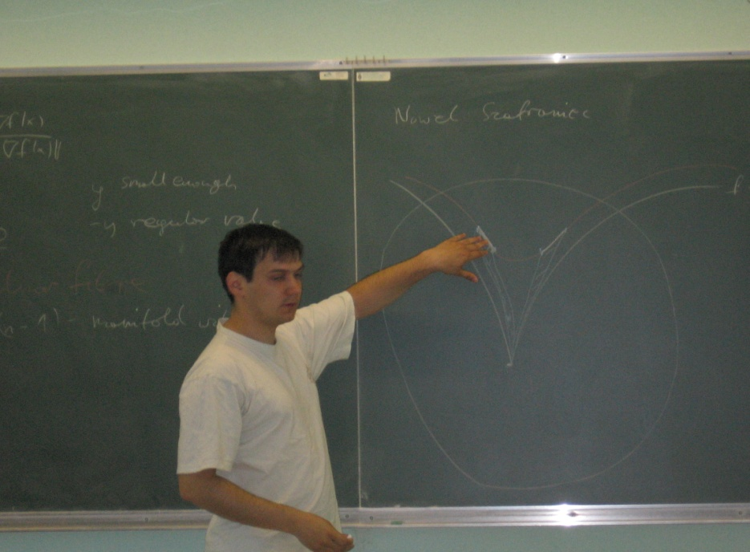
Methods Of Health Communication
Group Approach
Group approach
  Choice of subject
Chalk & talk (lecture)
  Carefully prepared oral presentation of facts, organized thoughts and ideas by a qualified person
  Not > 30
  15-20min

Slide 77
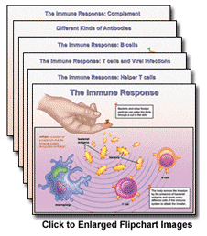
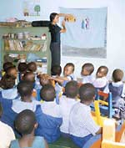
Methods Of Health Communication
Group Approach
Flipcharts – 25×30cms
  Message on chart must be brief
  Help to hold the attention of the group
Flannel graph
  Maintain continuity
  A very cheap medium
  Easy to transport
  Promotes thought & critcism

Slide 78
Methods Of Health Communication
Group Approach
Exhibits
  Objects, models, specimens etc
Films & charts
Disadvantages of lectures
  Minimal involvement of audience
  Learning is passive
  Don not stimulate thinking/problem solving capacity
  Comprehension varies with audience
  Behavior not necessarily affected

Slide 79
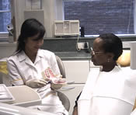
Methods Of Health Communication
Group Approach
Demonstrations
  Arouses interest
  Persuades

Slide 80
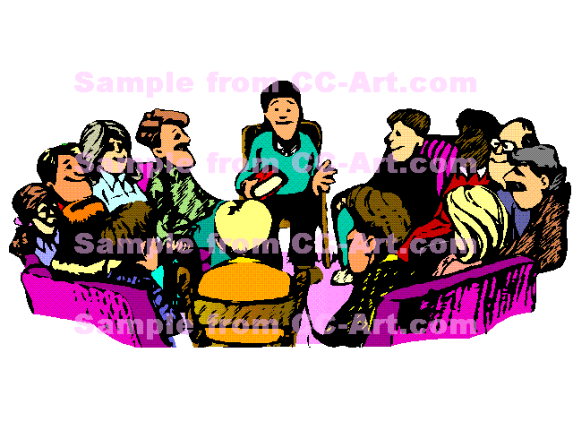
Methods Of Health Communication
Group Approach
Group discussion
  Free exchange of ideas, opinion & knowledge
  Group - >6, <12
    Express ideas clearly & consistently
    Listen what others say
    Do not interrupt
    Make only relevant remarks
    Accept criticism gracefully
    Help to reach conclusion

Slide 81
Methods Of Health Communication
Group Approach
Group discussion
  Adv :
    Decision is accepted easily
  Limitations

Slide 82
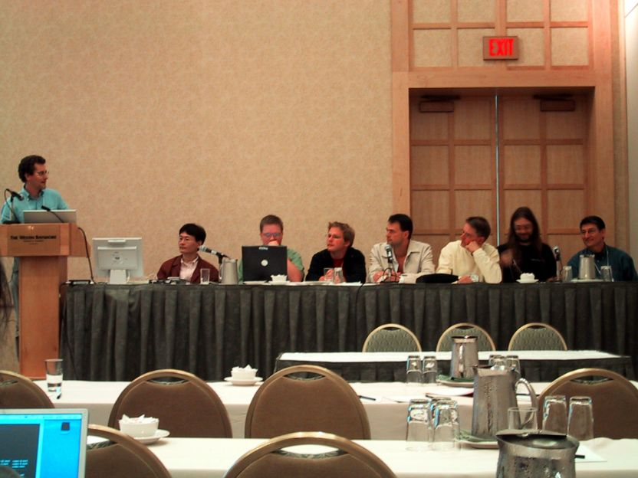
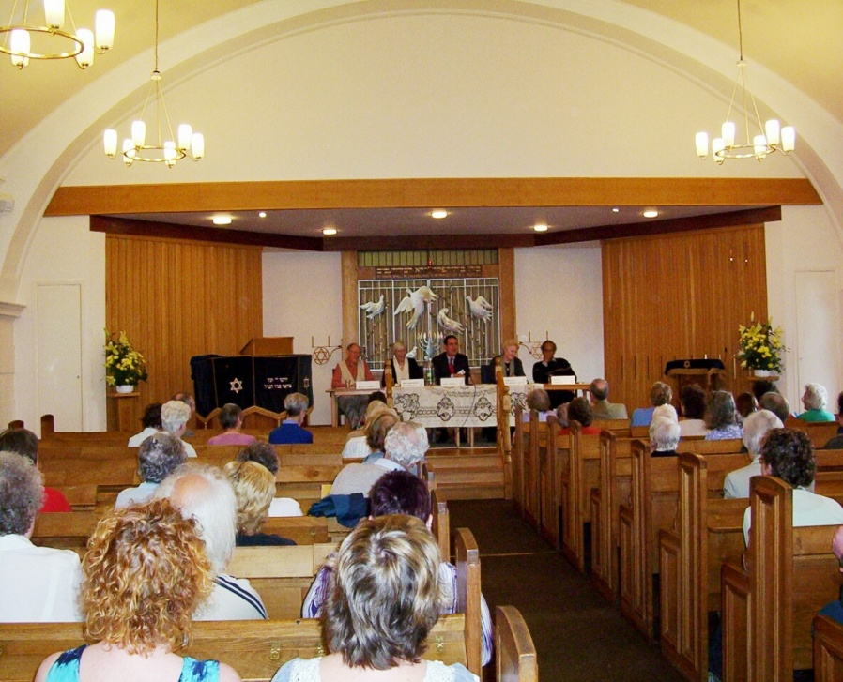
Methods Of Health Communication
Group Approach
Panel discussion

Slide 83
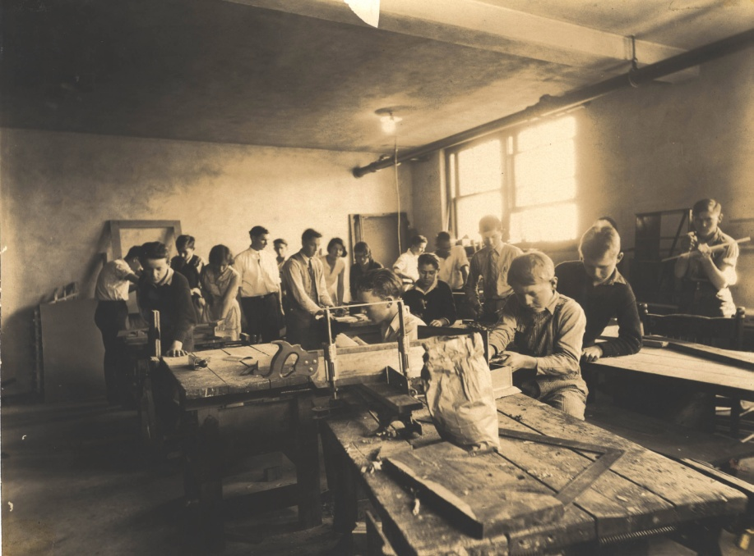
Methods Of Health Communication
Group Approach
Symposium
Workshop

Slide 84
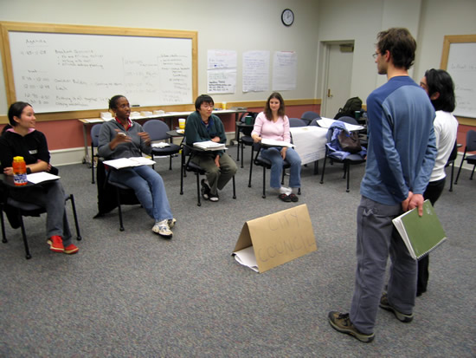
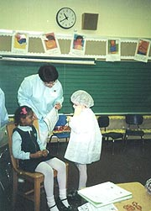
Methods Of Health Communication
Group Approach
Role playing/Socio-drama

Slide 85
Methods Of Health Communication
Mass approach
  1920- printed matter
  Reach remotest places, large number
  Raising health conscious
  Delivering technical messages
  Popularizing health knowledge
  One –way communication
  Not effective in changing human behavior

Slide 86
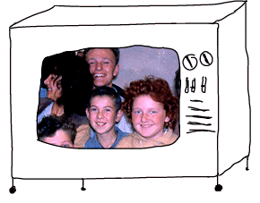
Methods Of Health Communication
Mass Approach
Television
  The most popular media
  Influence public opinion
  Introduce new ways of life
  Raise level of understanding
  Familiarize with unknown
Radio
  Much cheaper

Slide 87
Methods Of Health Communication
Mass Approach
Internet
  Direct & instant communication
  Major health education tool in the future
News paper
  Factual, detailed & statistical material
  Reach only limited group
Printed materials
  Magazines, pamphlets, booklets & hand outs
  Convey detailed information

Slide 88
Methods Of Health Communication
Mass Approach
Direct mailing
  Folders, newsletters & booklets
  Reach remote areas
  The most personal of mass communication

Slide 89

Methods Of Health Communication
Mass Approach
Posters, billboards & signs
  Catch eye & create awareness
  Not expensive
  Humor & fear are introduced
  Message should be simple, short, direct
  Right place & right time
  Changed frequently

Slide 90
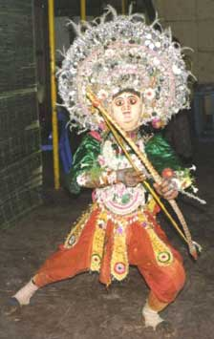
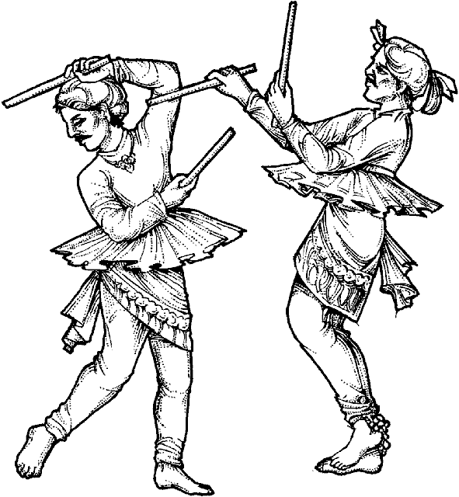
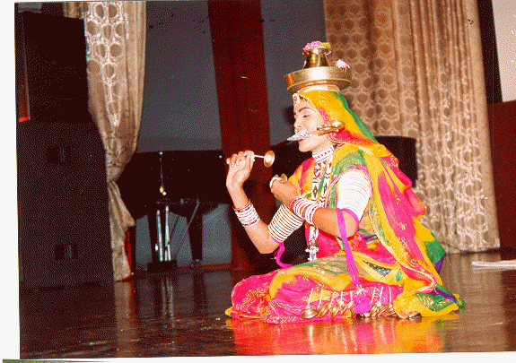
Methods Of Health Communication
Mass Approach
Health museum & Exhibition
  Can attract large number of people
Folk media

Slide 91
Essentials Of Health Education
The aim of health education is to bring about a change in health behavior
Health education should be factual
Tell only what is needed
Do not give conflicting information
Try to change only what needs to be changed

Slide 92
Essentials Of Health Education
The educator should make himself acceptable
  He should be friendly & be sympathetic
  He should be knowledgeable
  He should talk the language of the people
Choose a proper medium of communication
Use audiovisual aids whenever possible
Health education should be provided in graded dosages

Slide 93
Obstacles For Positive Dental Health
Chronic, recurrent, irreversible, cumulative and prevalent
Attitude of people towards teeth
Artificial replacement is well accepted
Undramatic nature of dental diseases
Anxiety & fear towards dentistry

Slide 94
Health Education Implications
In Dental Diseases
Dental caries & periodontal diseases
  Adoption & continuation of prescribed oral hygiene & nutritional practice
  Periodic dental care
  Application of community wide measure
  Receive top priority
  Epidemiological differences should be borne in mind

