Slide 1
CLASS II INLAY PREPARATION

Slide 2
Contents
Definitions
Initial procedures
Preparation
occlusal outline
proximal preparation
bevels & flares
Modifications of proximal box designs Special Considerations in specific situations

Slide 3
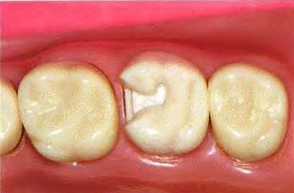
CLASS II INLAY PREPARATION
INLAYS:
Entirely intracoronal restorations, most commonly with occlusal and proximal extensions
Indirect intracoronal restoration fabricated using the lost wax
technique.
Class II Inlay: An indirect restoration that caps one or more cusps
of a posterior tooth but not all the cusps
technique
ONLAY: An indirect restoration, which is partly intracoronal and partly extracoronal that covers
all the cusps of a posterior tooth.

Slide 4
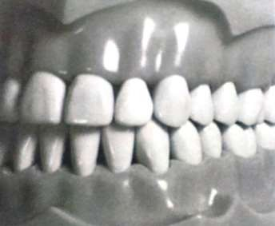
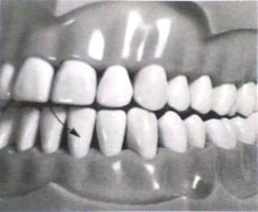
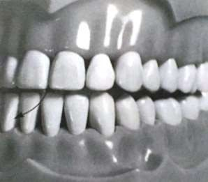
INITIAL PROCEDURES
OCCLUSION:
Occlusal contacts evaluated
Existing contacts: improved with the restoration
Maximum intercuspation where the teeth are in full interdigitation
During mandibular movements

Slide 5
INITIAL PROCEDURES
ANESTHESIA
Tooth to be prepared on & the adjacent soft tissues
Eliminates pain Reduces salivation
More pleasant operation

Slide 6
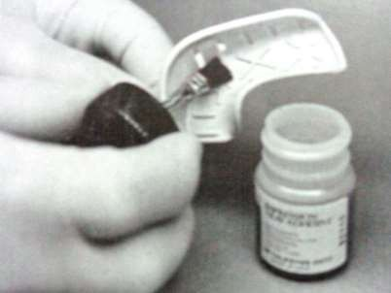
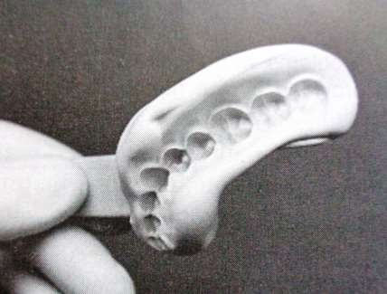
INITIAL PROCEDURES
CONSIDERATIONS FOR TEMPORARY RESTORATIONS
Method of fabrication of temporary restoration
Use of a preoperative impression : occlusal, facial &
lingual surfaces of the temporary restoration to the preoperative contours Elastic impression material: Alginate
Polyvinyl siloxane: additional accuracy, stability & durability

Slide 7
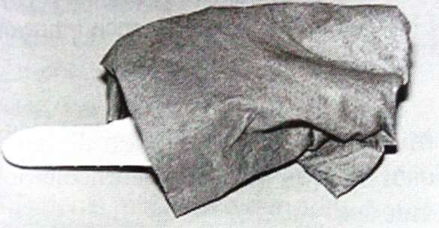
INITIAL PROCEDURES
Tooth to be reproduced: large defects; 2 methods to reproduce the missing area
Remove impression material in the area of the missing tooth structure to simulate the desired
form of the temporary
Wax added to the tooth before the impression
Alginate impressions: wrapped in wet paper towels
to serve as a humidor

Slide 8
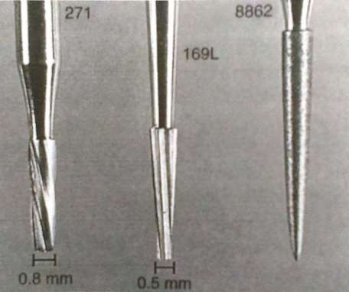
TOOTH PREPARATIONS FOR CLASS II CAST METAL RESTORATIONS
Plane cut tapered fissure carbide burs: vertical internal walls
Side & end surfaces: straight
Uniformly tapered walls; smooth pulpal & gingival walls No. 271: sides & ends meet in a slightly rounded manner No. 169L
No. 8862: Slender fine grit flame shaped diamond

Slide 9
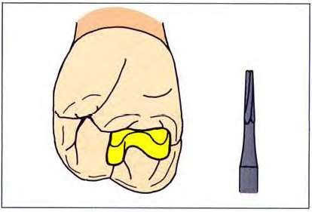
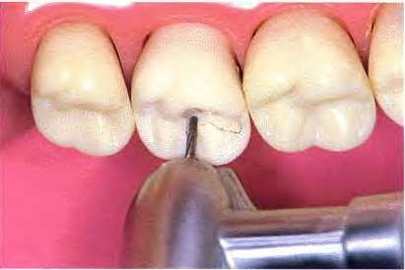
Occlusal Outline :No.170
Initial penetration: Fossa with the edge of the tip of non dentate tapered fissure bur
Drag the bur through the central groove of the occlusal surface- leaning the instrument in the direction the hand piece is moving.

Slide 10
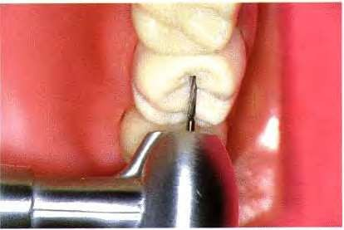
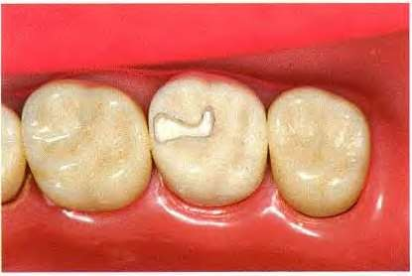
Isthmus: 1.5mm deep- following developmental grooves
Penetration end at least 1mm from the nearest occlusal contact
Completed occlusal outline: narrow
Distinct dovetail: enhanced retention &
resistance
Pulpal floor: Flat, even depth & perpendicular to the path of insertion

Slide 11
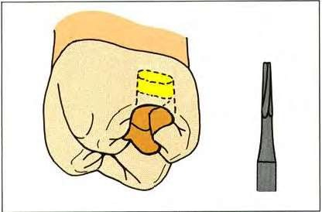
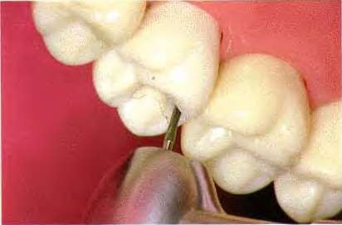
Undermining the Marginal ridge-
No.169L bur
Begin proximal box : 169L bur inside the CEJ
interproximally

Slide 12
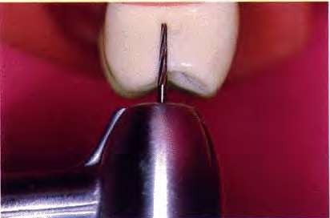
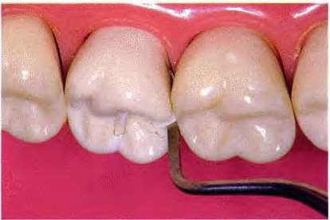
Bur removed from the preparation & superimposed over the proximal surface: full gingival length of the preparation
Gingival extension: not too conservative-
important for retention
Sharp enamel chisel- Hatchet: breaks out undermined enamel & expedite the preparation of the proximal box

Slide 13
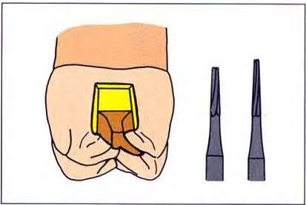
Proximal box: Nos. 169L & 170

Slide 14
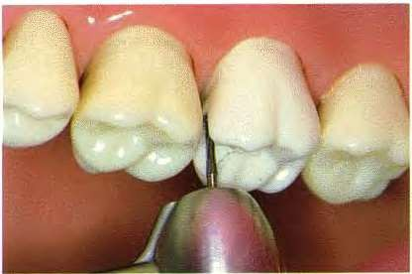
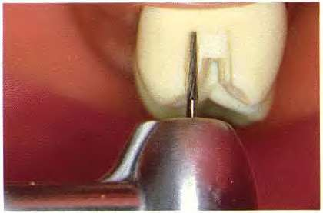
169L: Extend the box facially & lingually- box breaks contact with adjacent tooth
Facial & lingual line angles: defines the box
169L : Facial & lingual walls of the box- nearly parallel walls
Ward: 3 to 12 degrees
Gillett: 3 degrees
Gilmore: 8 to 12 degrees

Slide 15
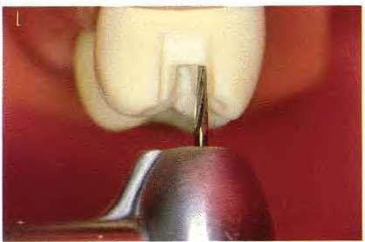
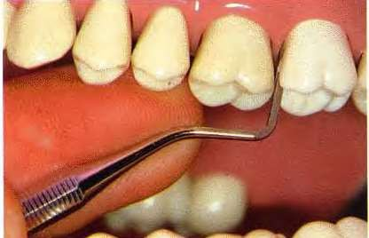
Widen the isthmus where it joins the proximal box
Round off any angle that has formed between them
Use hatchet/ binangle chisel to smooth &
define facial & lingual walls of the box
Walls: good resistance

Slide 16
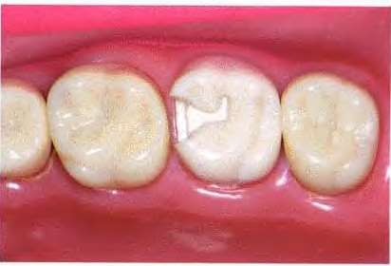
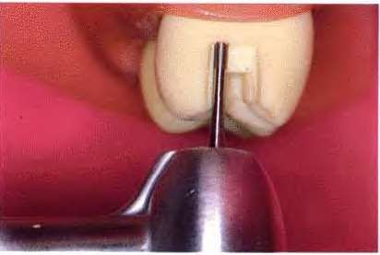
Completed proximal walls: just barely break contact with the adjacent proximal surface
Pulpal floor of the isthmus & gingival floor of the proximal box: planed No. 957 end- cutting bur

Slide 17
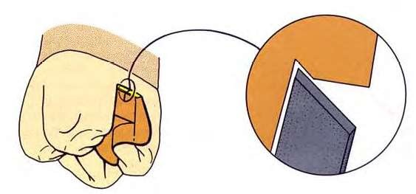
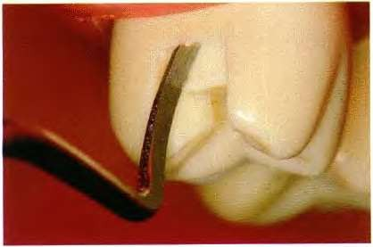
Gingivo- axial groove:
GMT
V- shaped groove: junction of the axial wall & gingival floor of the box
Enhances retention
‘Minnesota ditch’

Slide 18
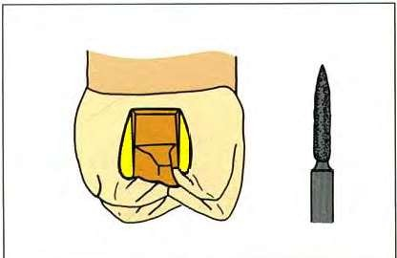
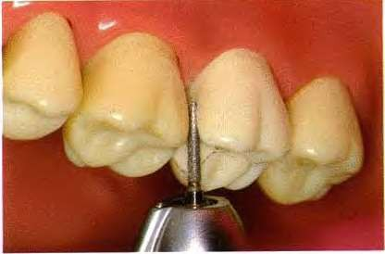
Flares: Flame shaped
Diamond
Flat plane cut across the curving proximal surface equally at the expense of the facial/ lingual wall of the proximal box & the outer enamel surface
Narrow at the gingival end
Sharp tipped flamed diamond in the proximal box & the small diameter tip cuts the cavosurface angle of the box from the gingival floor up

Slide 19
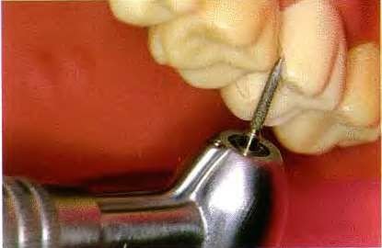
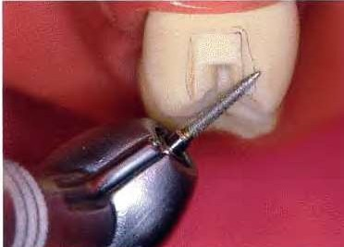
Continue occlusalward sweep of the diamond without changing the instrument’s direction
Only the tip used with the diamond cutting when it is moving towards the occlusal end
With the space created by the first passes of the diamond tip: larger portion of the instrument can be used to remove tooth structure more efficiently

Slide 20
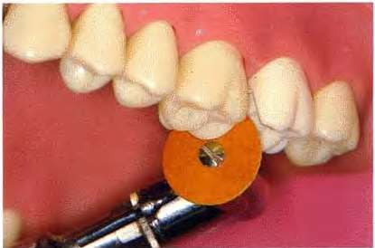
Sand paper disk: shaping the flares
Extreme caution: Avoid laceration to the soft tissues
Better done only for preparations made under rubber dam isolation

Slide 21
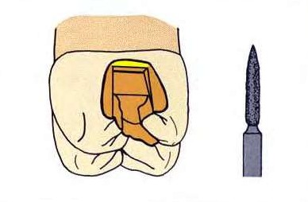
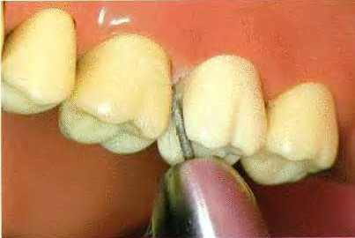
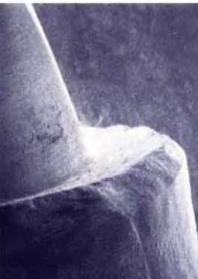
Gingival bevel: Flame shaped Diamond
Lean the flame diamond against the pulpal axial line angle : proper gingival bevel
Marginal bevel:30 to 45 degrees- optimal blend of strength & marginal fit
GMT: ragged finish line Unacceptably rough

Slide 22
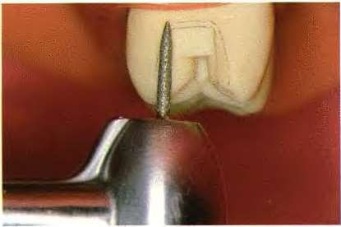
Gingival bevel: blended with the proximal
flares: avoid scooped- out area undercut

Slide 23
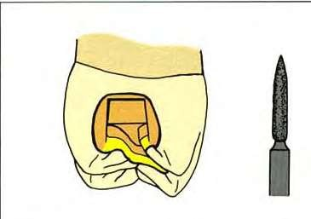
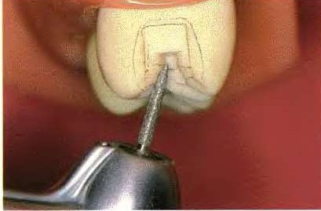
Occlusal bevel: Flame diamond
Bevel: along the entire periphery of the occlusal portion of the preparation
Bevel of 15 to 20 degrees beginning at the junction of the occlusal 1/3rd & pulpal 2/3rds of the isthmus wall- Ingraham et al
Convex part of the diamond used- hollow ground bevel or slightly concave bevel- Tucker more easily read finish line

Slide 24
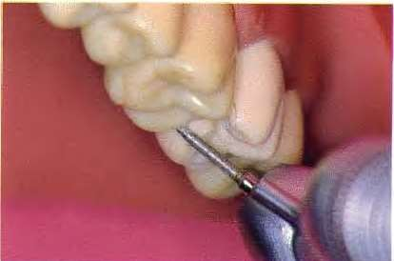
Proximal flares blended with the occlusal bevels carefully
Smooth continuous finish line

Slide 25
Bevel & Flare finishing: Flame bur
Flame shaped carbide bur: the most consistent bevels & gives smooth finish lines
Smoothness diminishes vulnerability of the
finish line
Refining the occlusal bevel: concave bevel with distinct finish line- easily identified in the impression
Inlay easily waxed & finished against it

Slide 26
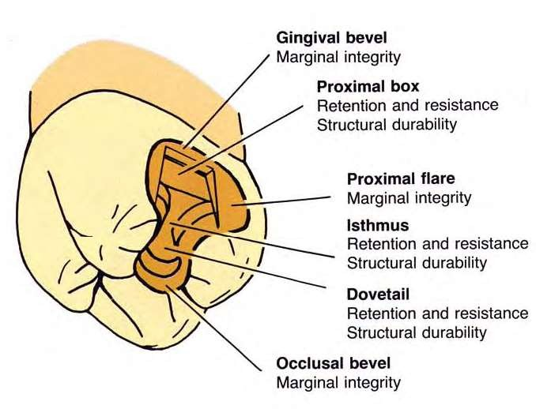

Slide 27
VARIATIONS IN PROXIMAL MARGIN DESIGN
Principal Determinants of Positions of Proximal Margin:
Extent of hard tissue injury
Convenience required for finishing the preparation Convenience for finishing the casting
Several basic designs: finish & extend the walls and margins of proximal box resulting from caries removal
Box
Full tapered Slice
Modified Slice Auxiliary Slice
Modified Flare

Slide 28
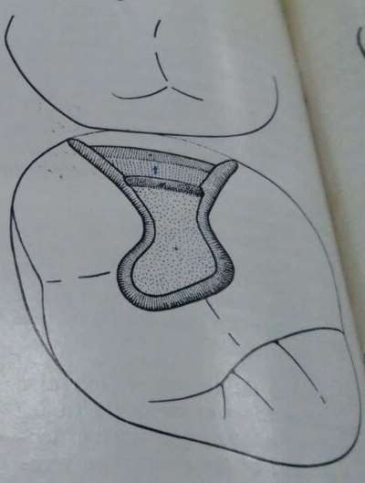
BOX PREPARATION
The direct wax technique requires margins which allow easy manipulation of the wax
Bulk of wax consistent with subsequent finishing procedures: allowed
Buccal & lingual proximal walls finished at nearly 90 degrees to the outer tooth surface
Cervical bevel: hand instruments providing a lap joint with a bulk of
wax suitable for carving
Type I gold alloy: suitable for easy manipulation of castings formed from a well- formed well adapted wax pattern
of

Slide 29
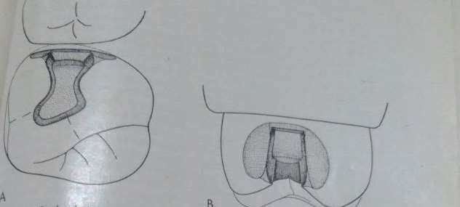
SLICE PREPARATIONS
Involves full proximal disking & was used for indirect technique of wax pattern fabrication
Taking impressions with a non elastic material: compound facilitated by reducing the proximal
contour with a full slice
Accurate elastic impression materials: generalized reduction of the contour not required

Slide 30
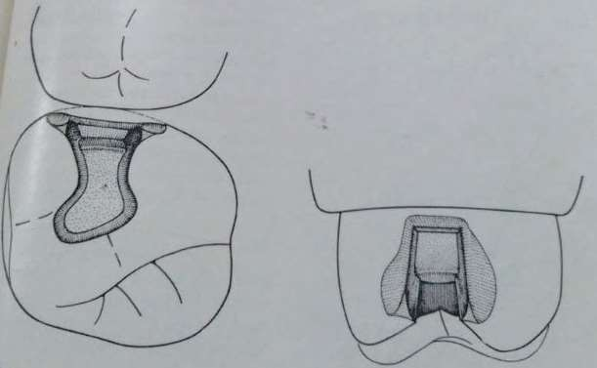
SLICE PREPARATIONS
Decision whether a full- tapered slice or modified slice preparation :
Careful analysis of all factors related to operation: tooth position, form, extent of hard tissue
injury
Slice indicated: Proximal extension can be gained with limited bucco- lingual width of the proximal box
Depth of the proximal box is best kept conservative:
danger of pulp encroachment as in young patients
Tooth form: intraoral/ radiographic

Slide 31
SLICE PREPARATIONS
Broad proximal contact: buccolingually & cervico incisally
Convenient external outline forms with minimal loss of tooth tissue when flattened contacts are
disked
Narrow occlusally positioned proximal contact: Modified slice
Removal of less tooth tissue from the cervical floor to the occlusal surface

Slide 32
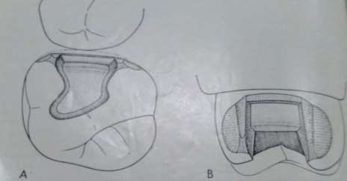
SLICE PREPARATIONS
External support of weakened tooth structure & areas subjected to high stress
Auxiliary Slice: wraps partially around the proximal line angles & provide additional tooth
support
Resistance is enhanced with minimal loss of tooth tissue Excellent definition of finishing line, sound enamel margin Enables good adaptation & finishing of margins of the casting

Slide 33
SLICE PREPARATIONS
External retention form around the lingual proximal line angle when the buccal wall is not sound for providing retention
Prevents lingual displacement when given around the buccal line angle
Conservatively include the margins of a previous amalgam cavity/ cement base/ areas of
demineralized enamel

Slide 34
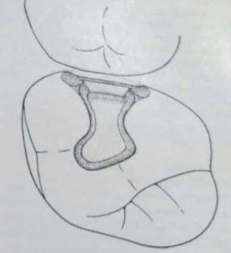
MODIFIED FLARE PREPARATION
Hybrid between box & slice preparations
Buccal & lingual proximal walls formed initially with minimal extension Disked in a plane that only slightly reduces the proximal wall dimension Enhances the obtuseness of the cavosurface angles
Excessive disking reduces retention

Slide 35
Selection of box/ slice/ modified flare preparations: mechanical, biologic or esthetic considerations
Mesial buccal proximal margins of maxillary premolars & molars: slice preparation avoided for better esthetics
Decision made at the specific time of treatment planning for individual case

Slide 36
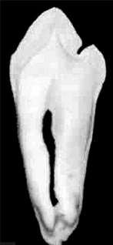
SPECIAL MODIFICATIONS FOR CLASS II CAVITY PREPARATIONS
Exceptions : Mandibular bicuspids
Mandibular first premolar: Occlusal preparation needs two thirds of the occlusal width prepared by removal of structure situated buccally to the central groove & one third from the lingual aspect
Pulpal floor slanted to the lingual side
Cervical floor may or may not follow the pulpal floor

Slide 37
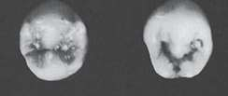
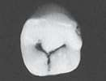
SPECIAL MODIFICATIONS FOR CLASS II CAVITY PREPARATIONS
Mandibular second Bicuspid:
Central groove forms : H, Y or U patterns
H type: protection of the integrity o the lingual cusp
U and Y types: 2/3rds- 1/3rds relationship & requires operation with great care to avoid undue weakening of the lingual cusp
Extension to include the lingual groove

Slide 38
MODIFICATIONS IN INLAY TOOTH PREPARATIONS
-Mesio-occlusodistal preparation
-Modifications or esthetics
-Facial or lingual groove extension
-Abutment teeth & extension gingivally to include root- surface lesions
-Maxillary first molar with unaffected, strong oblique ridge
-Fissures in the Facial and Lingual Cusp Ridges & Marginal Ridges
-Capping cusps
-Including Portions of the Facial & Lingual Smooth Surfaces Affected by Caries or Other Injury

Slide 39
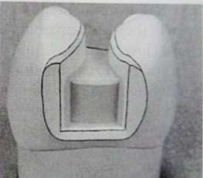
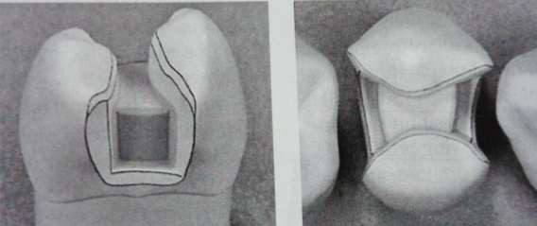
MESIO-OCCLUSODISTAL PREPARATION
Excessive weakening of the marginal ridge
Preparation outline is altered to include the proximal surface DO → MOD

Slide 40
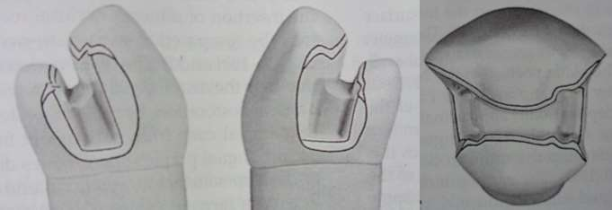
Whether the remaining marginal ridge would withstand occlusal forces without fracture
Ridge enamel: Gnarled enamel- stronger
Caries on both proximal surfaces: definite indication for MOD

Slide 41
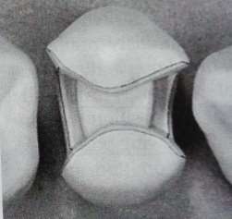
ESTHETICS
Mesiofacial proximal wall – maxillary premolars & first molars: minimal flare
Margin barely visible from a facial viewing position
Secondary flare omitted Wall & margin developed
: chisel or enamel hatchet & final smoothing with a fine- grit paper disk
: narrow diamond / bur when access permits

Slide 42
FACIAL & LINGUAL SURFACE GROOVE EXTENSION
Faulty facial grove on the occlusal surface- continuous with the faulty facial surface groove:
Mandibular molar
faulty distal oblique groove on the occlusal surface continuous with faulty lingual surface groove:
Maxillary molar
Preparation outline extended to include the fissure to its termination
Further gingivally to improve retention form.
Sufficient retention form – though the facial or lingual surface grooves are not fissured.

Slide 43


No. 271 carbide bur held parallel to the line of draw, extend through the facial ridge
The depth of the cut: 1.5 mm.
The floor (pulpal wall) should be continuous with the pulpal wall of the occlusal portion

Slide 44

With the bur still aligned with the path of draw, the side of the bur is used to cut the facial surface portion of this extension
The diameter of the bur serves as a depth gauge for the axial wall, which is in dentin.
The blade portion of the No. 271 bur is 0.8 mm in diameter at its tip end and 1 mm at the neck
The axial wall depth should approximate 1 mm or slightly more
The bur should be tilted lingually as it is drawn occlusally, to develop the uniform depth of the axial wall

Slide 45


Included facial or lingual groove- beveled
With the flame-shaped, fine-grit diamond- provide for 30-degree marginal metal Light bevel on
the mesial and distal margins-
continuous with the occlusal and gingival bevels 40-degree metal at these margins
The bevel width- approximately 0.5 mm

Slide 46
ABUTMENT TEETH
Facial, lingual, and gingival margins- the proximal surfaces of abutments for RPDs
Increase the surface area for development of guiding planes
Occlusal outline form wide faciolingually- accommodate any contemplated rest preparation(s) without involving the margins of the restoration
Accomplished by simply increasing the width of the bevels

Slide 47

EXTENSION
GINGIVALLY TO INCLUDE ROOT-SURFACE LESIONS
Primarily by lengthening the gingival bevel- a longer clinical crown due to gingival recession Slightly extend (gingivally) the gingival floor, and although
Minimal movement of the axial wall pulpally
Additional extension of the gingival floor if necessary, narrower pulpally the floor level is at a normal position
than when
Extending the preparation gingivally without these modifications- dangerous encroachment of the axial wall on the pulp

Slide 48


MAXILLARY FIRST MOLAR WITH UNAFFECTED, STRONG OBLIQUE RIDGE
Strong oblique ridge preserved
Distal surface lesion – after the insertion of a MO restoration
Prepared for a distoocclusolingual inlay
Distolingual cusp capping-prevents subsequent fracture

Slide 49

MAXILLARY FIRST MOLAR WITH UNAFFECTED, STRONG OBLIQUE RIDGE
Retention form
creating a maximum of 2-degree occlusal divergence of the vertical walls
accentuating some line angles
extending the lingual surface groove to create an axial wall height in this extension of at least
2.5 mm occlusogingivally

Slide 50
MAXILLARY FIRST MOLAR WITH UNAFFECTED, STRONG OBLIQUE RIDGE
Resistance form
routine capping of the distolingual cusp and
maintaining sound tooth structure between the lingual surface groove extension and the distolingual wall of the proximal boxing

Slide 51
Distolingual preparation
Distolingual cusp reduced with the side of the No. 271 carbide bur- uniform 1.5 mm
Remaining occlusal step prepared with the No. 271 carbide bur., followed by the proximal box portion
The lingual groove extension only after the position of the distolingual wall of the proximal boxing is established.
Maintain a minimum of 3 mm of sound tooth structure between this extension and the distolingual wall.
Use the side of the No. 271 carbide bur
If not possible- then a more extensive type of preparation indicated

Slide 52
Distolingual preparation
The diameter of the bur – gauge for the axial depth Occlusogingival dimension of this axial wall- minimum of 2.5 mm
2-mm depth- portion of the pulpal floor that connects the proximal boxing to the lingual surface groove extension.
Strengthens the wax pattern and casting in later steps of fabrication.
Creates a definite 0.5-mm step from the reduced distolingual cusp to the pulpal floor.

Slide 53


No. 169L carbide bur, increase retention form in the distoocclusolingual preparation by:
(1) Creating mesioaxial and distoaxial grooves
in the lingual surface groove extension
(2) Preparing facial and lingual retention grooves in the distal boxing

Slide 54

Flame-shaped, fine-grit diamond instrument-
bevel the proximal gingival margin, prepare the secondary flares on the
proximal enamel walls, bevel the lingual margins
A lingual counterbevel- distolingual cusp wide enough for a 30-degree metal at the margin
Beyond any occlusal contacts

Slide 55

Bevel on the gingival margin of the lingual extension - 0.5 mm wide and provide for a 30-degree metal angle
Bevels on the mesial and distal margins of the lingual extension are also approximately
0.5 mm wide and result in 40-degree marginal metal

Slide 56

FISSURES IN THE FACIAL AND LINGUAL CUSP RIDGES & MARGINAL RIDGES
Facial and lingual occlusal fissures may extend nearly to, or through
the respective facial and lingual cusp ridges, but not onto the facial or lingual surface
The preparation margin should not cross such fissures, but should be extended to include them When the occlusal step is prepared, initially extend along the lingual fissure
until only 2 mm of tooth structure remains between the bur and the lingual surface
Additional lingual extension at this time is incorrect because it may remove the supporting
dentin unnecessarily

Slide 57


FISSURES IN THE FACIAL AND LINGUAL CUSP RIDGES & MARGINAL RIDGES
Additional extension is achieved later by virtue of the occlusal bevel Wider than conventional if the remaining fissure can be eliminated
Enameloplasty sometimes may eliminate the end portion of the fissure
and provide a smooth enamel surface
Include the fissure in the preparation outline without extending the margin to the height of the
ridge

Slide 58


FISSURES IN THE FACIAL AND LINGUAL CUSP RIDGES & MARGINAL RIDGES
Preparation outline should be extended just onto the facial or lingual surface →
Occlusal bevel places the margin on the height of the ridge, then the marginal enamel likely is
weak because of both its sharpness and the inclination of the enamel rods in this region.
If the fissure still remains through the ridge after enameloplasty

Slide 59



Extension- cutting through the ridge at a depth of 1 mm with the No. 271 carbide bur
Bevels placed- flame shaped, fine-grit diamond instrument
40-degree marginal metal on the occlusal, mesial, and distal margins 30-degree marginal

Slide 60

Fissures that may extend into or through a proximal marginal ridge- similarly managed
Does not extend the preparation outline near the adjacent tooth contact
Particularly applies to a mesial fissure of the maxillary first premolar

Slide 61


CAPPING CUSPS
The facial and lingual margins on the occlusal surface
frequently must be extended toward
the cusp tips to the extent of existing restorative materials and to uncover caries
When the occlusal outline is extended up the cusp slopes more than half the distance from any primary occlusal groove to the cusp tip, capping the cusp should be considered
If the preparation outline is extended two thirds of this distance or more, capping the cusp is usually necessary to:
protect the weak, underlying cuspal structure from fracture caused by masticatory force
remove the occlusal margin from a region subjected to heavy stress and wear

Slide 62
CAPPING CUSPS
At this point in preparation the pulpal floor, depth can be increased from 1.5 mm to 2 mm.
Sufficient reduction in an area that is often underreduced
Result in greater strength and rigidity to the wax pattern and cast restoration.

Slide 63

Technique of capping less than all of the cusps
Reduce the Cusps for Capping as Soon as the Indication for Such Capping Is Determined Because This Improves Access and Visibility for Subsequent Steps in Preparation.
Cusp in infraocclusion of the desired occlusal plane before reduction- - The amount of cusp reduction is less
Only to provide the required clearance with the desired occlusal plane.
Depth gauge grooves (depth cuts) prepared with the side of the
No. 271 carbide bur
Prevent thin spots in the restoration

Slide 64


With the depth cuts serving as guides, complete the cusp reduction with the side of the carbide bur
The reduction should provide for a uniform 1.5 mm of metal thickness over the reduced cusp. On maxillary premolars and first molars, the reduction should be minimal (i.e., 0.75 to 1 mm) on
the facial cusp ridge to decrease the display of metal.
Reduction should increase progressively to 1.5 mm toward the center of the tooth to help provide rigidity to the capping metal

Slide 65



If only one of the two lingual cusps of a molar is reduced for capping, the reduction must extend to just include the lingual groove between the reduced and unreduced cusps.
This reduction should terminate with a distinct vertical wall that has a height that is the same as the prescribed cusp reduction.
Applying the bur vertically, as shown, should help establish a vertical wall of proper depth and direction.
Similar principles apply when only one of the facial cusps is to be reduced

Slide 66

A bevel of generous width is prepared on the facial (lingual) margin of a reduced cusp with the
flame shaped, fine-grit diamond instrument
Avoided in esthetically prominent areas
Reverse bevel or counterbevel. Beyond any occlusal contact 30-degree marginal metal

Slide 67

Esthetic requirements- facial margin on maxillary premolars & first molar
Blunting and smoothing of the enamel margin (a stub margin) by the light application of a fine-
grit sandpaper disc or the fine-grit diamond instrument (flame-shaped) held at a right angle to the facial surface
Slightly round any sharp external corners to strengthen them and reduce the problems they may generate in future steps

Slide 68

Cusp reduction appreciably decreases retention form because of decreasing the height of the vertical walls
Proximal retention grooves usually are recommended
For additional retention
Extending facial and lingual groove regions of the respective surfaces,
Secondary retention features- collar and skirt

Slide 69


Treatment of the distal cusp of the mandibular first molar -MOD preparation
Satisfactory treatment usually dictates either
extending the distofacial margin (and wall) slightly mesial of the distofacial groove
capping the remaining portion of the distal cusp

Slide 70

After cusp reduction, visually verify that the occlusal clearances are sufficient.
A wax interocclusal record- especially in areas difficult to visualize
Central groove/lingual cusp region
First dry the preparation(s) free of visible moisture but not desiccate the dentin.

Slide 71



Next lightly press a portion of softened, low-fusing inlay wax over the prepared tooth (teeth); then immediately request the patient to close into the soft wax and slide the teeth in all directions

Slide 72
During the mandibular movements, observe to verify that
the patient moves in right lateral, left lateral, and protrusive movements
the adjacent unprepared teeth are in contact with the opposing teeth
the wax in the preparation is stable (not loose and rocking)
the wax is not in infraocclusion.
Cool and carefully remove the wax
Hold it up to a light, and note the degree of light transmittedAlternatives Use wax calipers
Section the wax to verify its thickness
Insufficient thickness calls for more reduction in the indicated area before proceeding.

Slide 73


INCLUDING PORTIONS OF THE FACIAL & LINGUAL SMOOTH SURFACES AFFECTED BY CARIES OR OTHER INJURY
Portion of both a facial/ lingual smooth surface & a proximal surface are affected by caries or some other factor
A large inlay, an onlay, a three-quarter crown, a full crown, or multiple amalgam or composite restorations

Slide 74
Choice of treatment- degree of tooth circumference involved
Full crown- both the lingual and facial smooth surfaces are defective, especially if the tooth is a
second or third molar.
MODFL inlay or onlay with a lingual groove extension-
When only a portion of the facial smooth surface is carious and the lingual surfaces of the teeth
are conspicuously free of caries
More favorable to the health of the gingival tissues More conservative in the removal of tooth structure
Treatment choice for the maxillary second molar- caries or decalcification on the distofacial
surface

Slide 75

Mesiofacial, distolingual cusps & the distofacial cusp- reduced for capping
If the distofacial cusp defect is primarily shallow decalcification- the flame-shaped diamond instrument is used to both reduce the involved facial surface and distofacial corner approximately the depth of the enamel and to establish the gingival margin

Slide 76

If an effective distal box or groove & a facial wall is not possible, then the No. 271 carbide bur should be used to cut a gingival shoulder extending from the distal gingival floor around to include the affected facial surface
This shoulder partially provides the desired resistance form Use the No.271 bur to also create a nearly vertical wall
in the remaining facial enamel

Slide 77

Width of the shoulder- diameter of the end of the cutting instrument
Vertical walls - appropriate degree of draft to contribute to retention form.
Faciogingival and facial margins are beveled with the flame-shaped, fine-grit diamond instrument- 30-degree metal at the gingival margin and 40-degree metal along the facial margin

Slide 78

Two bevels should blend together, the faciogingival bevel should be continuous with the gingival bevel on the distal surface.

Slide 79


Additional Retention & Resistance features
Arbitrary lingual groove extension
Distolingual skirt extension
Resist forces normally opposed by the missing distofacial wall Protect the restored tooth from fracture injury

Slide 80
Thank you.

