Slide 1
Malignant connective tissue tumours-
Dr. Varsha Sangle

Slide 2
Classification
Fibroblastic Tumors
  Benign
    Fibroma
    Nodular Fascitis
    Fibromatosis
    Myofibroma
  Malignant
    Fibrosarcoma

Slide 3
Classification ….
Fibrohistocytic Tumors
  Benign
    Fibrous Histiocytoma
  Malignant
    Malignant Fibrous Histiocytoma

Slide 4
Classification ….
Lipomatous Tumors
  Benign
    Lipoma
      Spindle cell lipoma
      Pleomorphic lipoma
  Malignant
    Liposarcoma
      Dediffrentiated liposarcoma

Slide 5
Classification ….
Smooth Muscle Tumors
  Benign
    Leiomyoma
      Angiomyoma
  Malignant
    Leiomyosarcoma

Slide 6
Classification ….
Skeletal Muscle Tumors
  Benign
    Rhabdomyoma
      Cellular rhabdomyoma
  Malignant
    Rhabdomyosarcoma
      Spindle Cell rhabdomyosarcoma

Slide 7
Classification ….
Vascular Tumors
  Intermediate
    Hemangioendothelioma
      Spindle Cell
  Malignant
    Angiosarcoma
    Kaposi Sarcoma

Slide 8
Classification ….
Neural Tumors
  Benign
    Traumatic Neuroma
    Neurofibroma
    Neurofibromatosis
    Schwannoma
      Cellular Schwannoma
      Ancient Schwannoma
  Malignant
    Neurofibrosarcoma

Slide 9
Introduction:
Malignant soft tissue tumors are uncommon malignancies.
Represents 4-8% malignancies of maxillofacial region.
Associated with considerable morbidity and mortality.
Rhabdomyosarcoma –most common in children.
Most common in adults- osteogenic sarcoma.

Slide 10
Etiology:
Etiology of most of the sarcomas are unknown.
Mutation in the mesenchymal progenitor cells.
Chemical carcinogens: Phenoxyacetic herbicides, Chlorphenol.
Radiation: 50 gy radiation causes germ line mutation of RB gene.
Viral : HHV-8, EB virus- Kaposi’s sarcoma.
Genetic susceptibility:
Mutation of NF-1 and NF-2 in neurofibromatosis.
Li-Fraumanni syndrome- mutation of TP53.

Slide 11
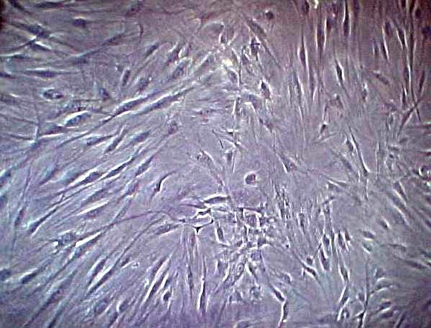
Fibrosarcoma:
Malignant tumor of fibroblast origin.
Seen in soft tissue and bone.
Bone lesions- primary or secondary.
Arise in bone marrow or periosteum.
Associated with genetic mutation.
Translocation t(12;15)(p13;q25) giving rise to ETV6NTRK3

Slide 12
Predisposing factors:
Radiation exposure.
Trauma.
Paget’s disease.
Fibrous dysplasia.
Chronic osteomyelitis

Slide 13
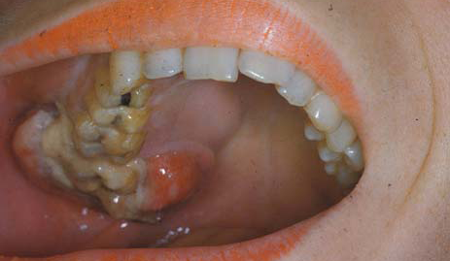
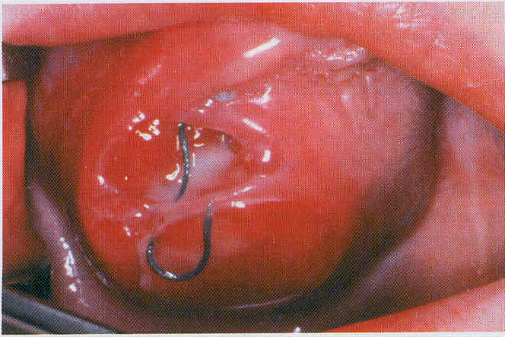
Clinical features:
Rare tumor.
More common in 4th decade.
Male predilection.
Painless, deep mass with ill defined margins.
Bone lesion- Pain and swelling.

Slide 14
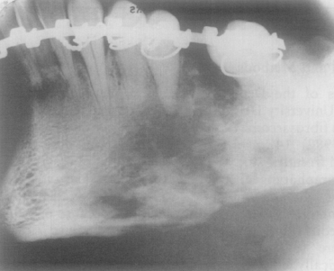
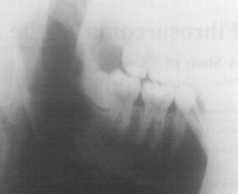
Radiographic features:
Osteolytic lesions.
Ill defined boarders.
Hanging in the air appearance of involved teeth.
Moth eaten bone destruction.

Slide 15
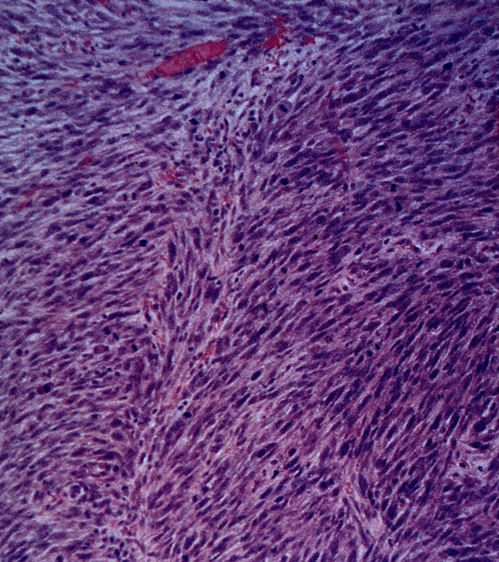
Histopathology:
Malignant fibroblasts in a collagenous background.
Plump fibroblasts showing Herring bone pattern.
Deeply stained spindle shaped nuclei.
Varying degree of cellularity.
Cellular atypia.
Bizarre nuclei.

Slide 16
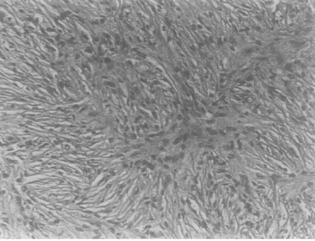
Whorling of tumor fascicles.
Storiform or cartwheel pattern.

Slide 17
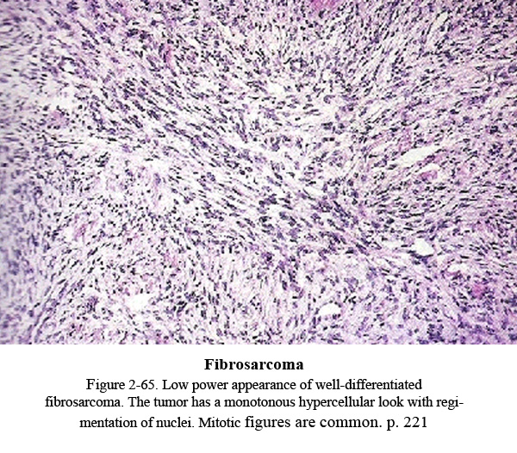
Well-differentiated:
Rich collagen background.
Normal mitosis and no cellular and nuclear pleomorphism.
Intermediate grade:
Quite cellular with moderate amount of collagen.
Slight cellular pleomorphism.
High grade:
Highly cellular.
Marked cellular atypia.

Slide 18
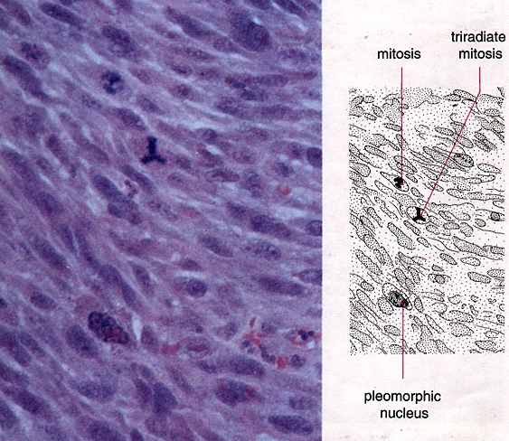

Slide 19
Treatment and prognosis:
Show blood born metastasis late in it’s clinical course.
Soft tissue tumors has better prognosis.
5 year survival rate for soft tissue tumor is 61%.
For bone lesions it is 4.2-31.7%.
Treatment of choice is radical surgery.

Slide 20
Malignant fibrous histiocytoma:
The most common sarcoma of adults.
Exhibit fibroblastic and histiocytic differentiation.
Pathogenesis:
Histiocytes may act as a facultative fibroblast.
Histiocytes originate from blood monocytes.
Histiocytes are also derived from fibroblasts.
Primitive mesenchymal elements give rise to histiocytes and fibroblasts.
Malignant fibrous histiocytoma,- review Pablo R Ros et al, Amr Jnl Radl 1984: april: 142

Slide 21
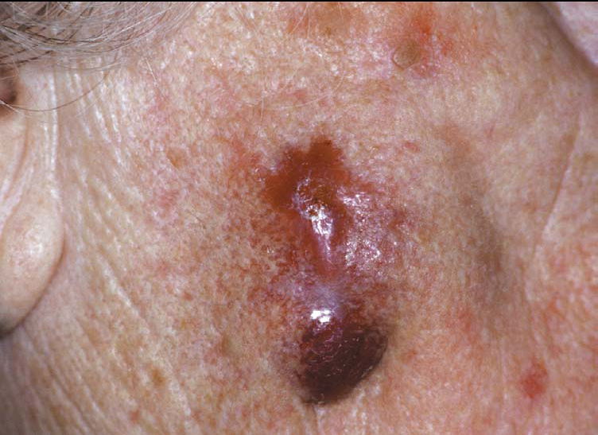
Clinical features:
Irregular nodular lesion.
Unencapsulated.
Presents as moderately growing submucosal mass.
Occasional pain.
Male predilection.
Peak age- 50-70 years.

Slide 22
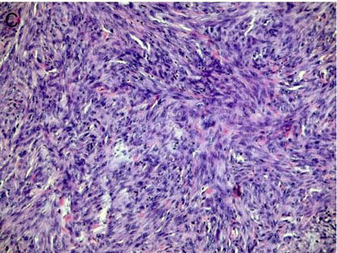
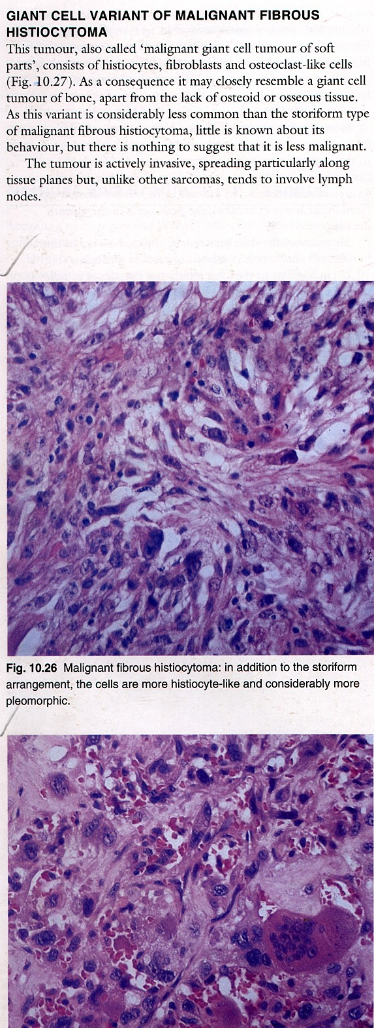
Histopathology:
Admixture of fibroblasts and histiocytes.
Fibroblasts form fascicles or bundles.
Plump cells with hyperchromatic nuclei.
Round to polygonal histiocytes.
Storiform or cartwheel pattern.

Slide 23
Mostly fibroblast like cells.
Pleomorphic giant cells.
Chronic inflammatory cells.
Varying density of fibrous stroma.
Subtypes:
Pleomorphic storiform
myxoid
angiomatoid.
Giant cell type.

Slide 24
Treatment and prognosis:
Radical surgical excision.
40% cases recur locally.
5 year survival rate 30%.

Slide 25
Hemangioendothelioma:
Proliferative, neoplastic vascular lesion.
Intermediate or low malignant potential.
Borrmann first introduced the concept.
Three histological types:
Epitheloid hemangioendothelioma.
Spindle cell hemangioendothelioma.
Kaposiform hemangioendothelioma.

Slide 26
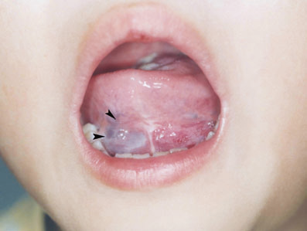
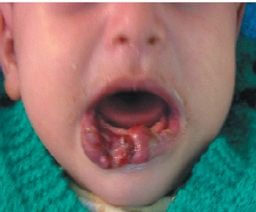
Clinical features:
Flat and slightly raised lesion.
Localized swelling with occasional pain.
Involves lip, palate and gingivae.
Predilection for female of 2nd-3rd decade.
Malignant- tendency to bleed.

Slide 27
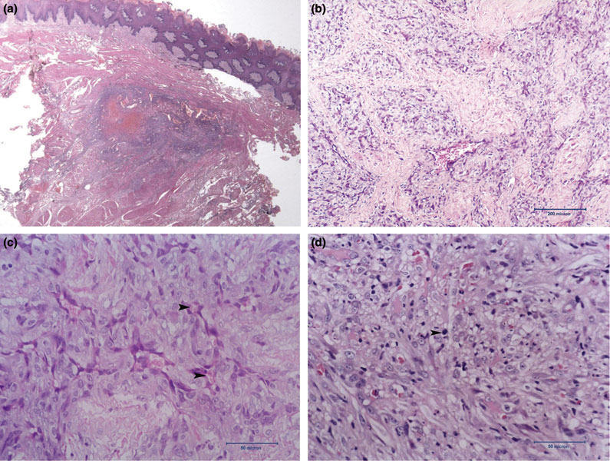
Histopathology:
Poorly circumscribed lesion.
proliferation of vain and capillaries.
Occasional thrombi and phlebolith.
Intermixed epitheloid and spindle shaped cells.
IHC positive for CD 31 and 34.

Slide 28
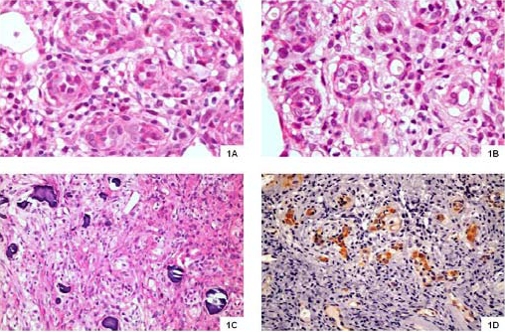
Epitheloid hemangioendothelioma:
Poorly marinated infiltrative lesion.
Epitheloid cells- eosinophilic cytoplasm.
Prominent cytoplasmic vacuoles.
Metaplastic bone formation.
Cellular atypia and mitotic activity.

Slide 29
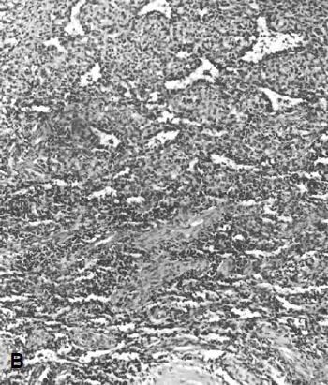
Spindle cell hemangioendothelioma:
Bland bipolar mesenchymal cells.
Contain vacuoles or primitive lumen.
Solid tumor cells in between.
Epitheloid cells are less.

Slide 30
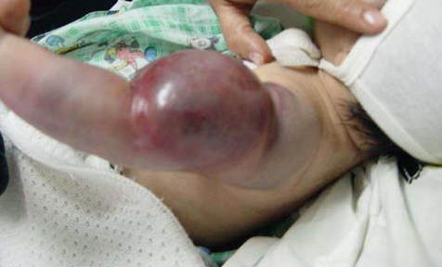
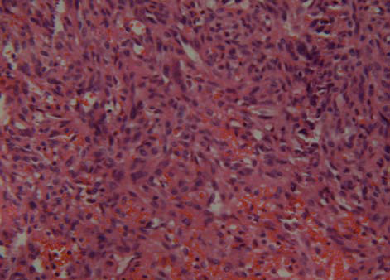
Kaposiform hemangiopericytoma:
Uniform spindle cells.
Pale eosinophilic cytoplasm.
Elongated nuclei.
Slit like vascular channel.
RBC extravasation.

Slide 31
Treatment and prognosis:
Wide surgical excision.
High rate of recurrence.
One third of the cases develop metastases.

Slide 32
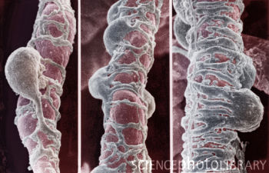
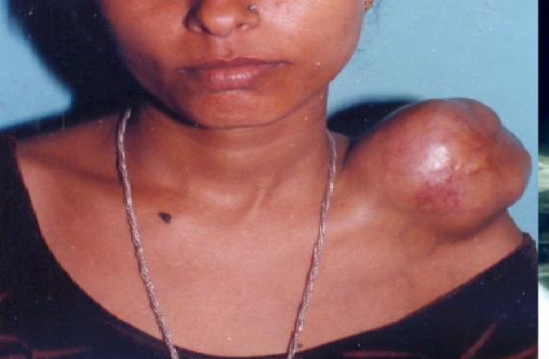
Hemangiopericytoma:
Tumor derived from pericytes.
Benign tumor with a malignant counterpart.
Suggested as solitary fibrous tumor.
Rapidly enlarging red- bluish mass.
Soft, rubbery and painless.
Common in oral and pharyngeal mucosa.

Slide 33
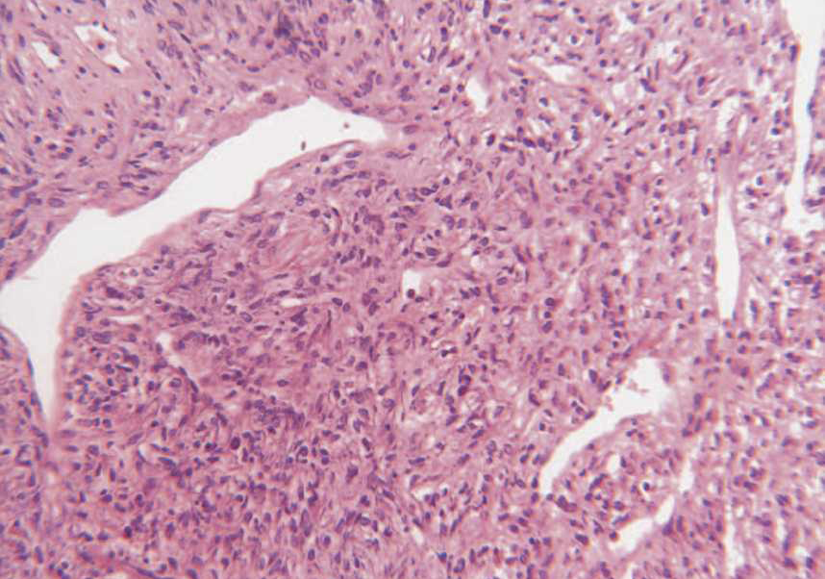
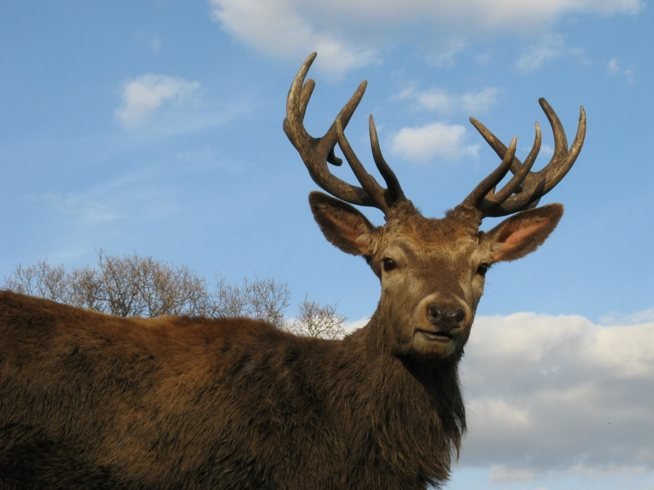
Histopathology:
Numerous vascular channels.
Branching channels give a staghorn pattern.
Proliferation of oval hyperchromatic cells.
Plump endothelial cells.

Slide 34
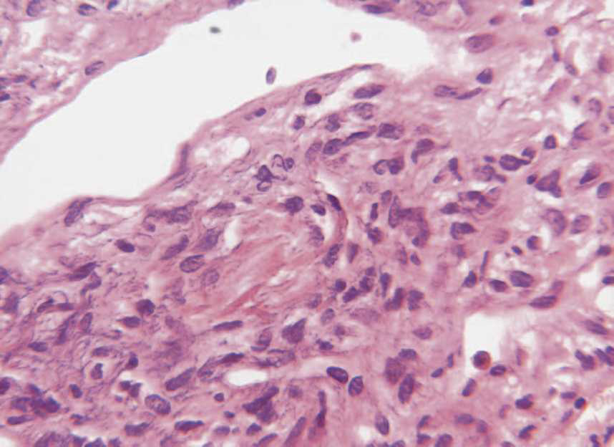
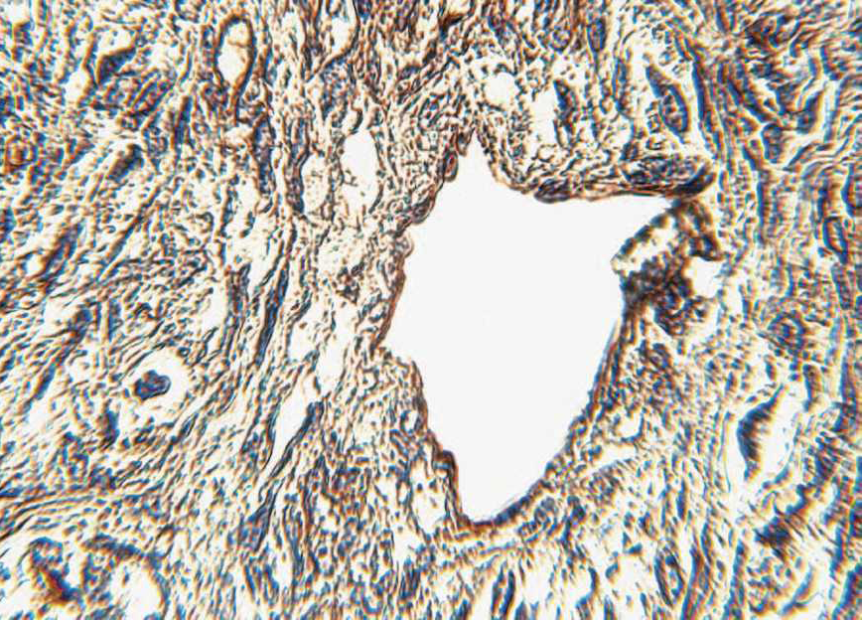
Tightly packed cells.
Haphazardly arranged.
Indistinct cell boarder.
Round to ovoid nucleus.
IHC positive for CD 34.
Malignancy is suggested when-
Necrosis, frequent mitosis.

Slide 35
Treatment and prognosis:
Depends on cellular dysplasia and mitotic activity.
Benign tumors- local excision.
Malignant tumors- extensive surgery.
5 Year survival rate 86%.
Sinonasal lesions have a batter prognosis.

Slide 36
Osteosarcoma:
Malignancy of mesenchymal cells characterized by production of osteoid.
Third most common malignancy of adolescene.
Etiology:
Inactivation of retinoblastoma gene. (deletion of 13q14).
Bone dysplasia.
Li-Fraumani syndrome- TP-53 mutation.
Exposure to radiation.

Slide 37
Variants of steosarcoma:
Conventional types.
Multifocal OS.
Telangiectatic OS.
Small cell OS.
Intra-osseous well differentiated OS.
Intracortical OS.
Periosteal OS.
Paraosteal OS.
High grade surface OS.
Extraosseous OS.

Slide 38
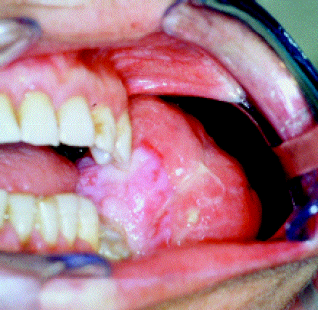
Clinical features:
Mostly seen in 10-25 years of age.
Jaw lesions occurs at age of 27-33years.
Swelling and pain with activity.
Facial deformity.
Tooth ache and loosening.
Paresthesia.
Mandibular predilection.

Slide 39
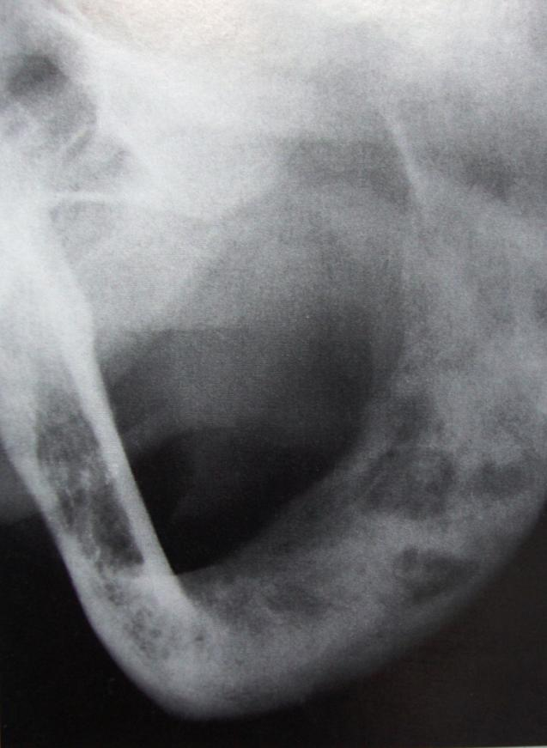
Radiographic features:
Varies according to amount of tumor bone synthesis.
From radiolucent to radio-opaque.
Cumulus cloud density for intramedullary.

Slide 40
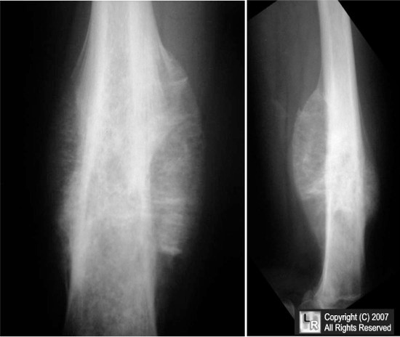
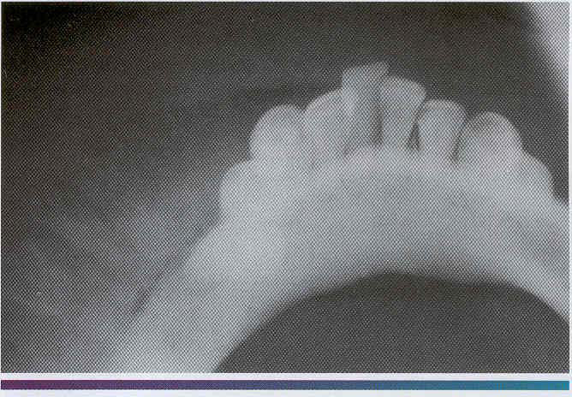
Three classic features of osteosarcoma:
A. Sunburst pattern.
Small streaks of bone radiate.
Seen in 25% cases.

Slide 41
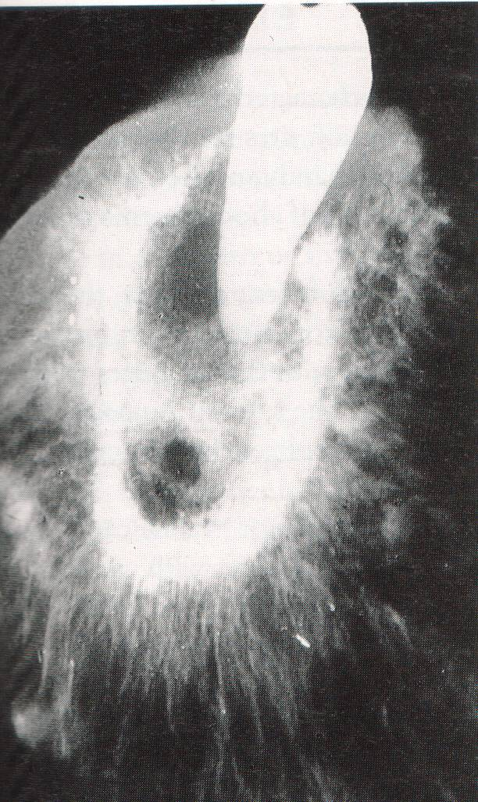
Radiograph of a resected mandible showing the classic sunray spiculation of an osteosarcoma

Slide 42
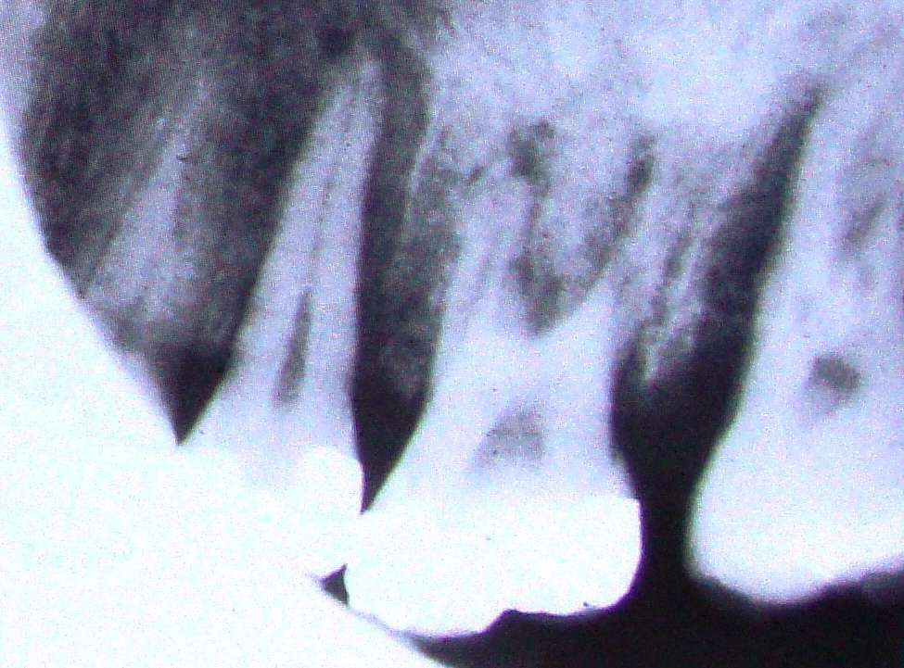
B. Widening of the PDL space
Resorption of adjacent bone.

Slide 43
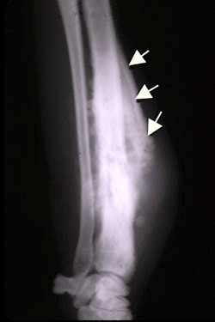
C. Codman’s triangle.
Elevated periosteum over the tumor.
Tent like fashion.

Slide 44
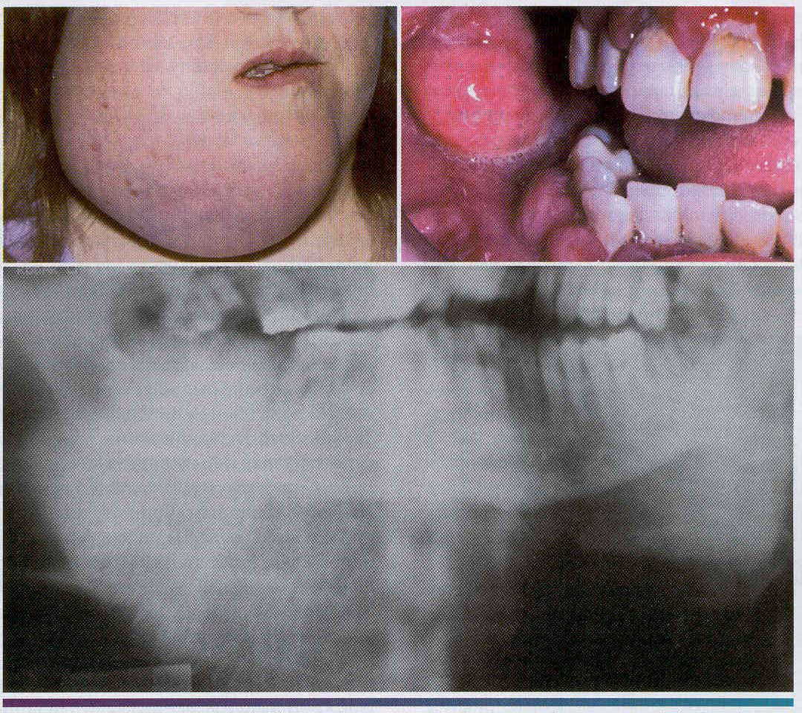
A, This massive tumor had been present for many months before the patient sought treatment. S, Intraoral photograph of the tumor mass. C. The panoramic radiograph shows a "sunburst" pattern of trabeculation within the tumor.

Slide 45
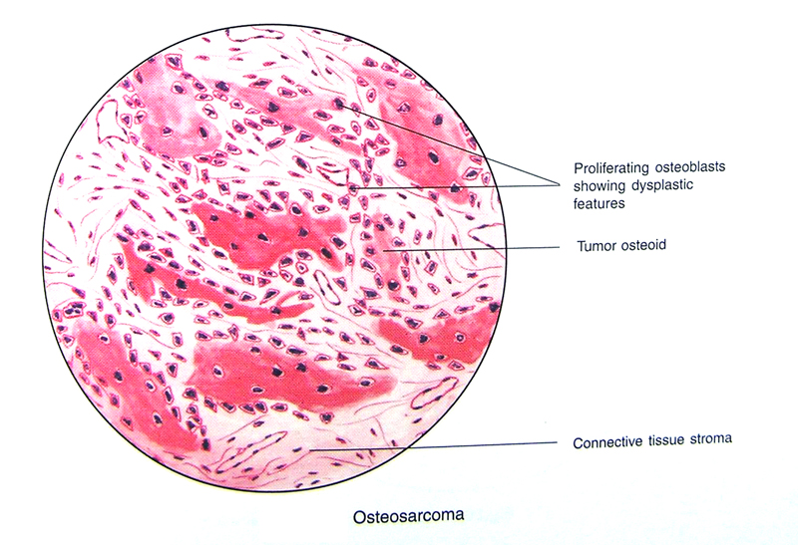

Slide 46
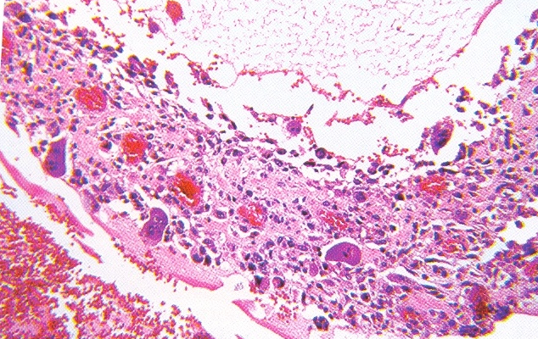
H/F:-
Characterized by proliferation of both atypical osteoblasts and their less differentiated precursors.
Presence of osteiod formed by malignant osteoblasts
Stromal cells are spindle shaped and atypical with irregularly shaped nuclei.

Slide 47
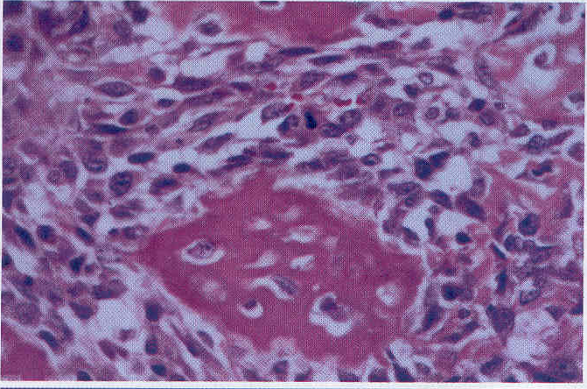
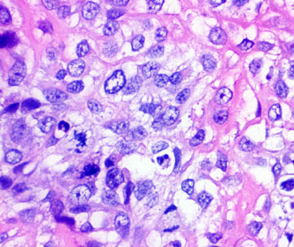
Histopathology:
Proliferation of atypical osteoblasts.
Less differentiated precursors.
Osteoid formation.

Slide 48
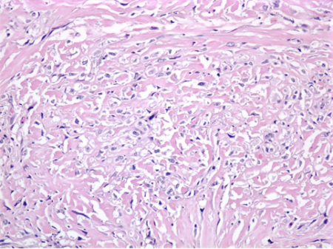
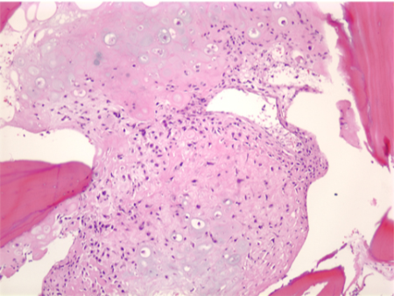
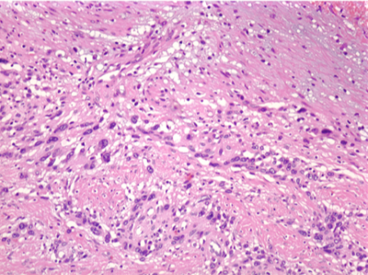
Osteoblastic OS
Chonroblastic OS
Fibroblastic OS

Slide 49
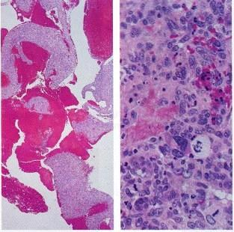
Telangiectatic osteosarcoma- blood filled spaces.

Slide 50
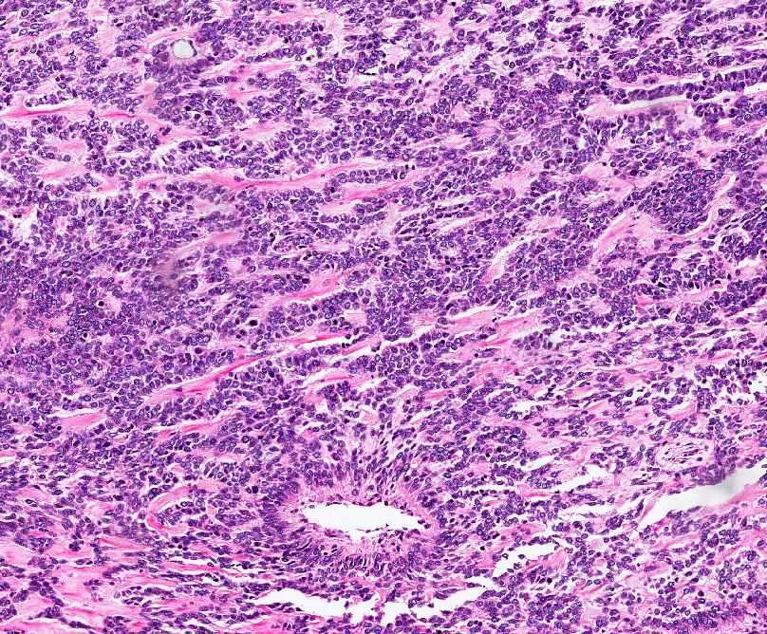
Small cell osteosarcoma- small round cells, focal osteoid

Slide 51
Staging of osteosarcoma:
Stages:
Stage-I low grade.
Stage –II- High grade.
Stage-III- Metastatic lesion.
Substages:
A- Intramedullary lesion.
B- Local extramedullary lesion.
Site of primary:
Distal extremity- Best prognosis.
Distal femur- Intermediate prognosis.
Axial skeleton- Worst prognosis

Slide 52
Treatment:
Surgical resection is primary resection.
Adjuvant chemotherapy.
Overall 5 year survival for:
Maxillary osteosarcoma 25%.
Mandibular osteosarcoma 41%

Slide 53
Leiomyosarcoma:
Malignant tumor of smooth muscle origin.
They arises from:
Smooth muscle cells.
Undifferentiated mesenchymal cells.
Painfull, lobulated, fixed mass of submucosal tissue.
Commonly affect cheek and floor of the mouth.

Slide 54
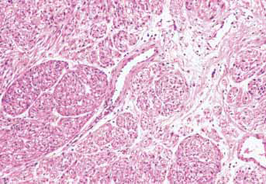
Histopathology:
Fascicles of interlacing spindle cells.
Eosinophilic cytoplasm with glycogen granules.
Large cigar shaped nuclei.
Nuclear palisading.
Areas of fibrosis and hyalinization.
Epitheloid variants contain numerous round cells.

Slide 55
Rhabdomyosarcoma:
Malignant tumor of striated muscle.
Derived from primitive mesenchyme.
Four types:
Embryonic rhabdomyosarcoma.
Botryoid rhabdomyosarcoma.
Alveolar rhabdomyosarcoma.
Pleomorphic Rhabdomyosarcoma.

Slide 56
Histogenesis:
Arises from undifferentiated mesoderm.
Recapitulate embryonic process.
3rd and 4th brachial arch.
Loss of heterogenesity of ch 11p15.
PAX3 or PAX7 gene involves.

Slide 57
Clinical features:
Head and neck is the most common site of presentation.
Mostly seen in first decade of life.
Solitary or polypoid mass..
Swelling and deviation of jaw.
Pain, is nerve is involved.

Slide 58
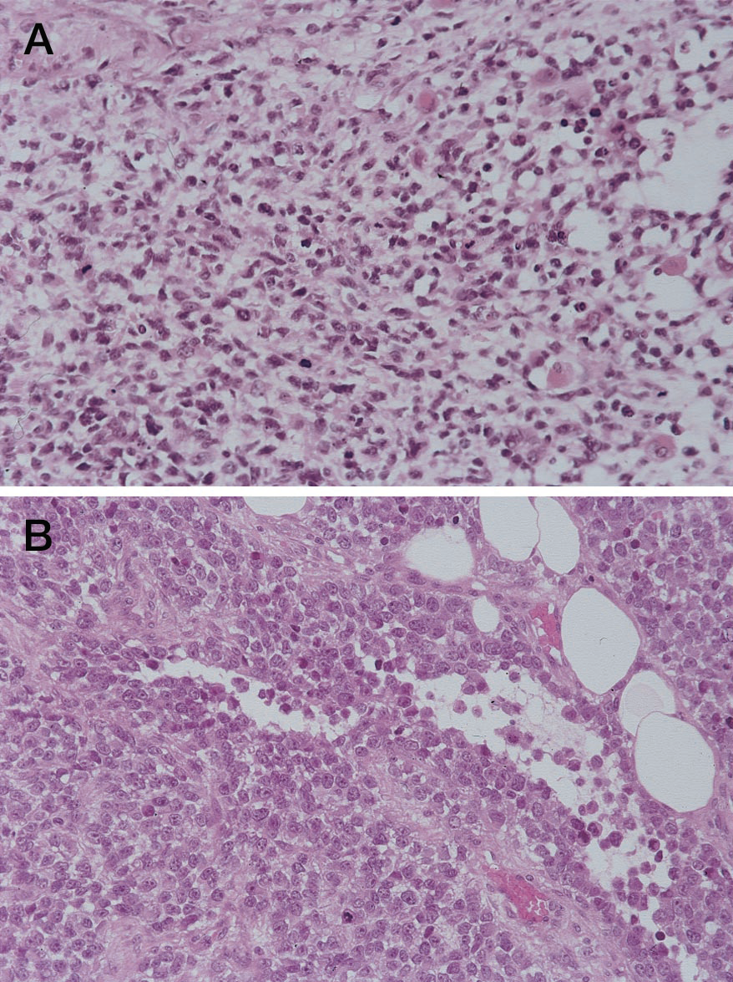
Histopathology:
Embryonic rhebdomyosarcoma:
Mixture of four cell types-
Eosinophilic spindle cells.
Round eosinophilic cells.
Broad elongated eosinophilic cells.
Small dark staining round or spindle cells.

Slide 59
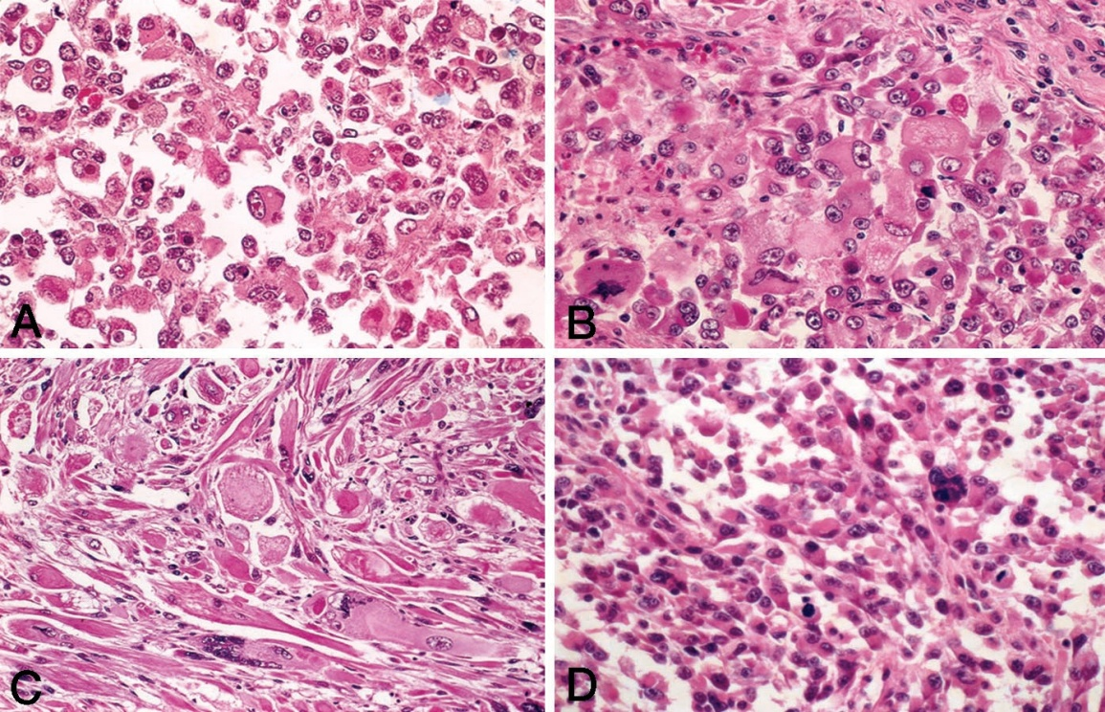
Pleomorphic rhabdomyosarcoma:
Haphazard arrangement of spindle cells.
Racket cells and ribbon cells.
Cytoplasmic vacuoles.
Ovoid or elongated nuclei.
Atypical mitosis

Slide 60
Alveolar rhabdomyosarcoma:
Cluster of poorly differentiated oval cells.
Degenerated cells in the centre.
Multinucleated giant cells.
Bizare mitotic figures.
Irregular pattern.

Slide 61
Botryoid rhabdomyosarcoma:
Diffuse myxoid matrix.
Primitive mesenchymal cells.
Increased cellularity.
Positive for mucopolysaccharide staining.
Take bright red colour with trichrome stain.

Slide 62
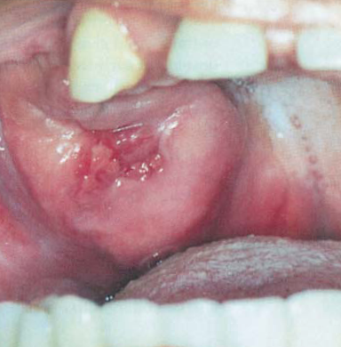
Malignant peripheral nerve sheath tumor:
Spindle cell malignancy of Schwann cells.
Half of the cases are associate with neurofibromatosis-I.
More common in lower extremities.
Involves neck, tongue, soft palate.
Central lesion involves mandibular nerve.
Manifest diffuse radiolucency.

Slide 63
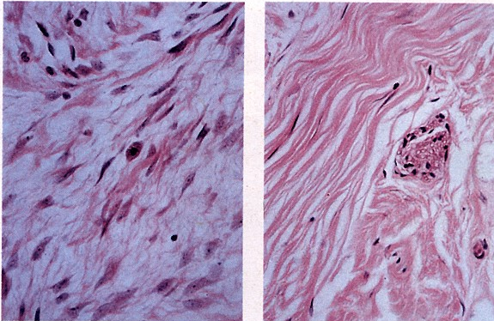
Histopathology:
Spindle cells arranged in fascicles.
Hypocellular and myxoid regions.
Eosinophilic cytoplasm.
Cellular and nuclear pleomorphism.
High mitotic activity.
Three categories: epitheloid, mesenchymal and glandular.

Slide 64
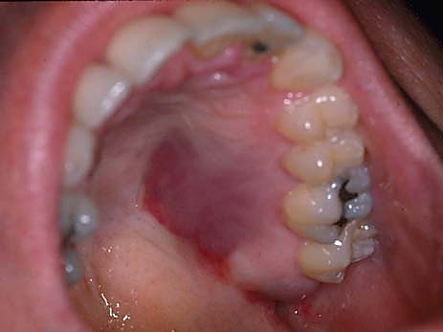
Kaposi’s sarcoma:
Multicentric proliferation of vascular and spindle cells.
Blue-red plaque.
Nodules, ulceration, exophytic.
Involves gingiva and palate.
Cervical lympadenopathy.
Clinical forms: classic, andemic, immunosupression associated and AIDS related.

Slide 65
Etiology:
Neoplasm or hyperplasia- debatable.
Cofactor model- infectious agents, host factor and environmental factors. ( Wahman et al 1991).
Human herpes virus 8 is associated.
Circulating growth factors plays a major role.
HIV-1 tat protein, IL-1, IL-6, TNF, FGF.
Increased incidence of HLA-DR5

Slide 66
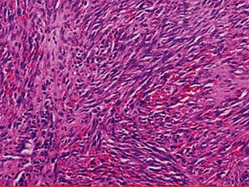
Histopathology:
Patch stage:
Venules and capillaries proliferate.
Mononuclear infiltrate.
Minimum cellular atypia.
Plaque stage:
Further vessel proliferation.
Atypical spindle cells.
Nodular stage:
Hyperchromatic spindle cells.
Moderate pleomorphism

Slide 67
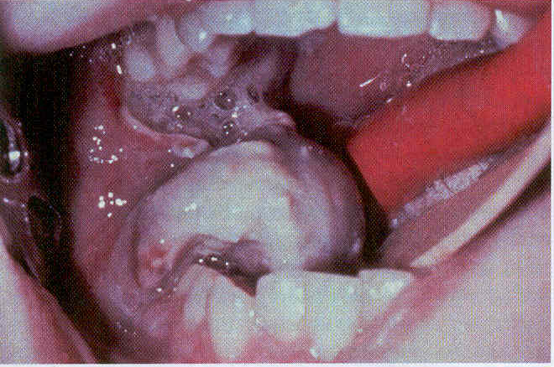
Ewing’s sarcoma:
Round cell sarcoma of bone.
Overlapping features with PNET.
Peak incidence 13 years.
Preceded by trauma.
Intermittent pain with swelling.
Facial neuralgia and paresthesia.

Slide 68
Radographic features:
Irregular diffuse radiolucency.
Some osteophyte formation.
Onion skin appearance.
Sun ray appearance.

Slide 69

Histological features:
Solid sheets of small round cells.
Oval hyperchromatic nucleus.
Filigree pattern of arrangement.
Mitotic figures are common.
Cellular pleomorphism and giant cells.
Geographic necrosis and perivascular sparring.

