Slide 1
MANDIBULAR LATERAL INCISORS
Dept Of Dental Anatomy, Embryology & Histology

Slide 2
Purpose Statement
At the end of the lecture student should be able to describe various aspects of mandibular lateral incisors, enumerate identifying features of mandibular lateral incisors, enlist differentiating features between right and left Mandibular lateral incisors

Slide 3
Learning Objectives
At the end of the lecture the student should be able to
S.N. | Learning Objectives | Domain | Level | Criteria | Condition
1 | Enlist the chronological features of mandibular lateral incisors | Cognitive | Must Know | All
2 | Describe Various aspects of mandibular lateral incisors | Cognitive | Must Know | All
3 | Enumerate Identifying features of mandibular lateral incisors | Cognitive | Must Know | All
4 | Enumerate Differentiating features between right and left mandibular lateral incisors | Cognitive | Must Know | All
5 | To carve permanent mandibular lateral incisors | Cognitive & Psychomotor | Must Know | All

Slide 4
CONTENTS
Enlist the chronological features of mandibular lateral incisors
Describe Various aspects of mandibular lateral incisors
Enumerate Identifying features of mandibular lateral incisors
Enumerate Differentiating features between right and left mandibular lateral incisors
To carve permanent mandibular lateral incisors

Slide 5
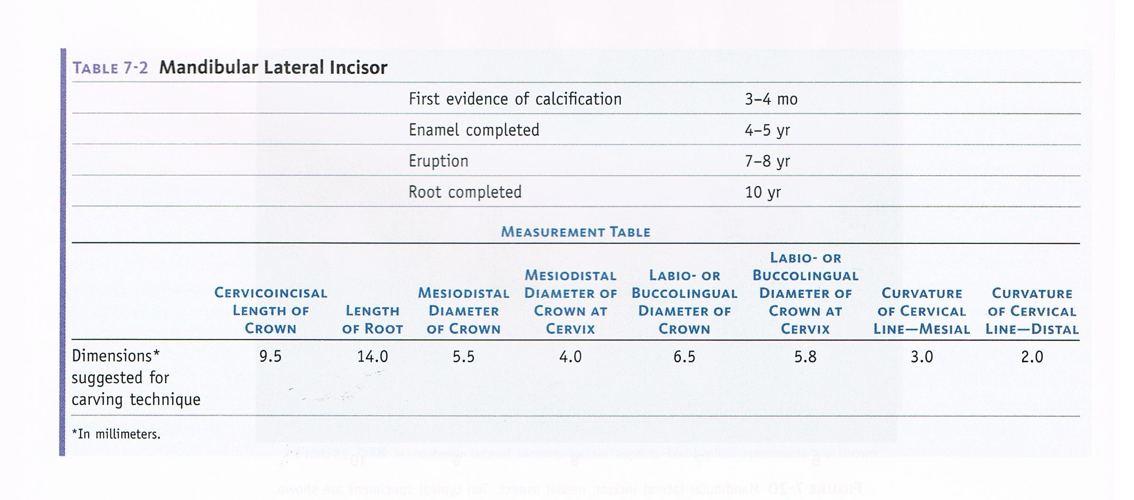

Slide 6
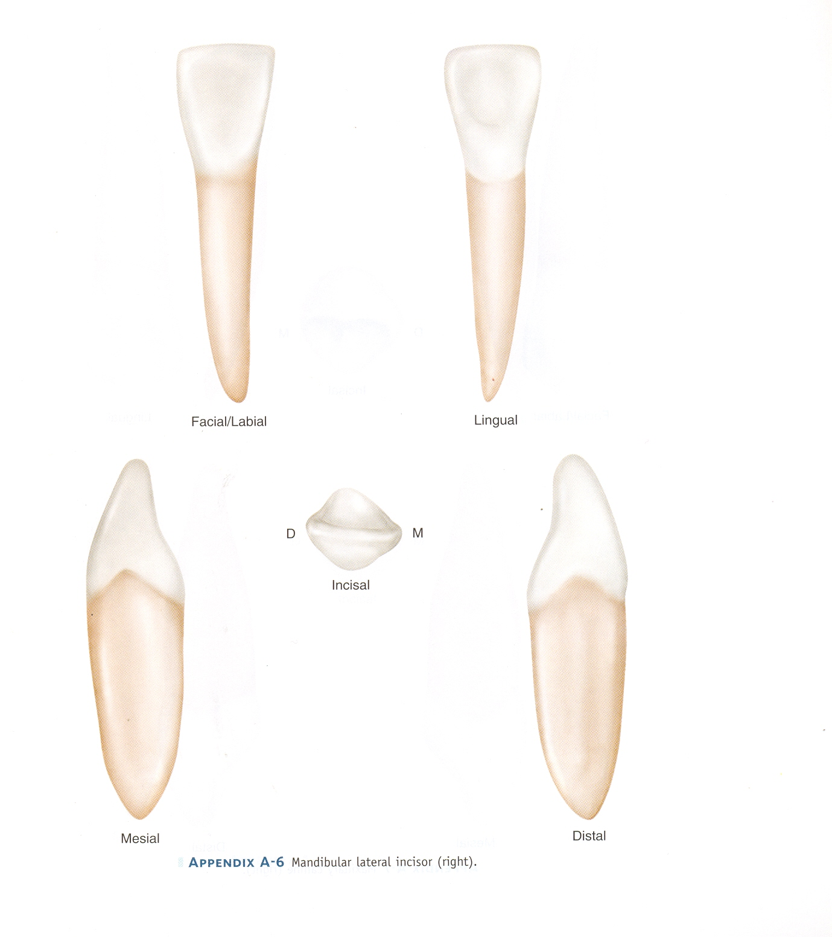
LABIAL & LINGUAL ASPECTS

Slide 7
MESIAL AND DISTAL ASPECTS.
Mesial side of the crown is often longer than the distal side, causing the incisal ridge which is straight to slope downwards in a distal direction.
The distal contact area is more towards the cervical than the mesial contact areas.

Slide 9
INCISAL ASPECT
The incisal edge follows the curvature of the mandibular dental arch giving the crown of the mandibular lateral incisor the appearance of being twisted slightly on its root base.

Slide 11
Summary
Various aspects of mandibular lateral incisors
Identifying features of mandibular lateral incisors
Differentiating features between right and left maxillary lateral incisors

Slide 12
BIBLIOGRAPHY
Wheeler’s Dental Anatomy, Physiology and Occlusion Ash, M. M. 6th edition.
Oral Development and Histology Avery, j. K.1st edition.
Color Atlas And Text Book Of Oral Anatomy, Histology Berkovitz, B. 1ST edition.
Orban's Oral Histology and Embryology Bhaskar, s. N.11th edition.
Oral Histology : Development, Structure and Funct Tencate, a. R. 4th edition.
Dental Embryology, Histology & Anatomy. Marry Bath- Balogh Inergaret. 2nd edition.

Slide 13
Thank You

