Slide 1
MASTICATION

Slide 2
Purpose Statement-
At the end of lecture student should be able to –
  Describe in detail the muscles of mastication
  Enumerate muscle activity

Slide 3
Learning Objectives
At the end of the lecture the student should be able to
S.N. | Learning Objectives | Domain | Level | Criteria | Condition
1 | Describe in detail the muscles of mastication | Cognitive | Must Know | All
2 | Enumerate muscle activity | Cognitive | Must Know | All

Slide 4
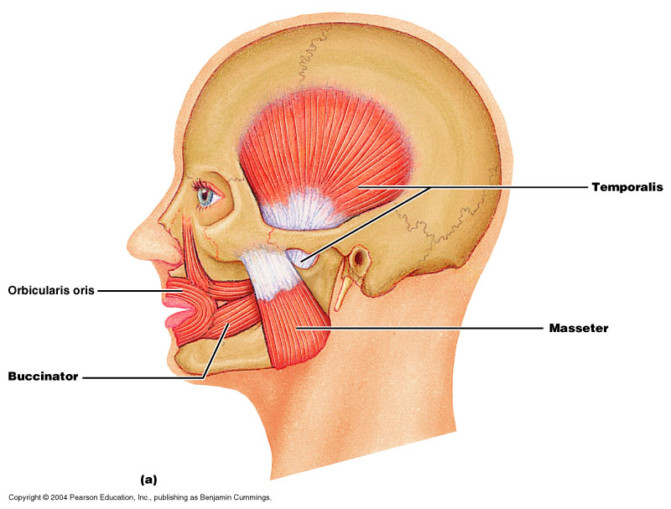
Muscles of Mastication

Slide 5
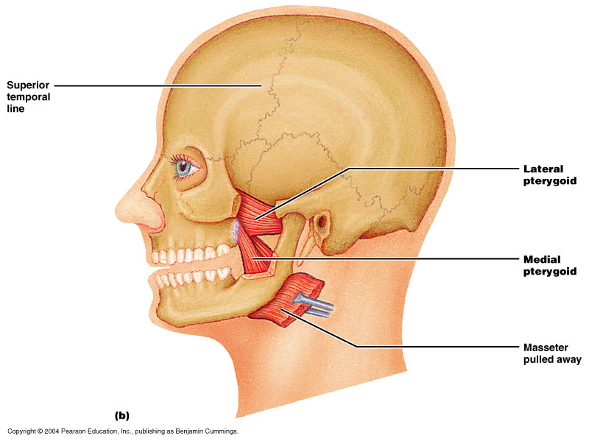

Slide 6
MUSCLES THAT OPEN JAW / DEPRESSOR JAW MUSCLES
Anterior belly of the digastric
Geniohyoid
Mylohyoid
Lateral pterygoid

Slide 7
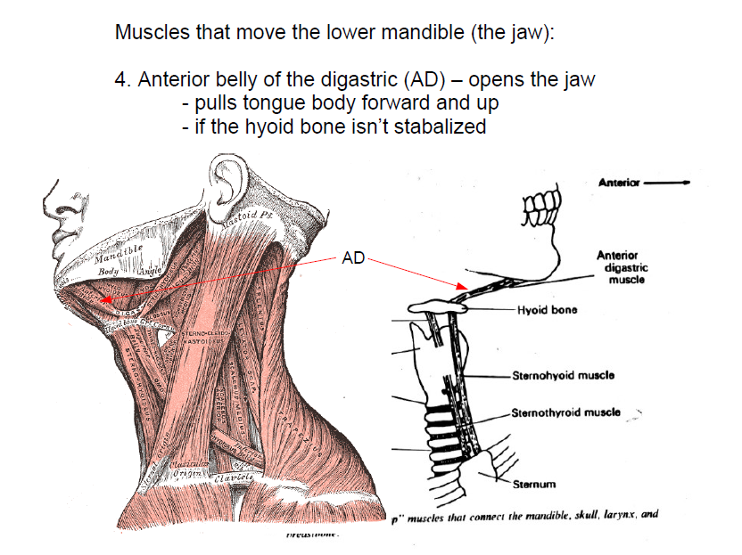

Slide 8
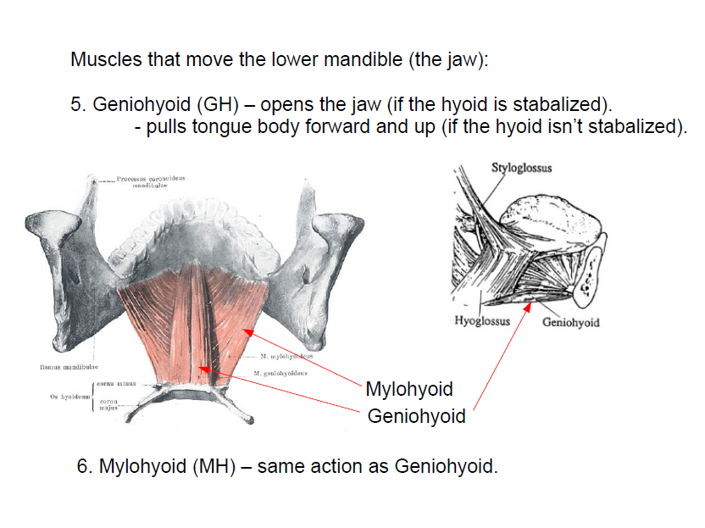

Slide 9
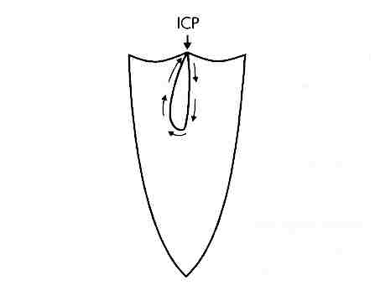
Opening
Start from static intercuspal position, where jaw movement pauses for 194 ms in chewing cycle,
muscle activity begins in the ipsilateral inferior head of the lateral pterygoid muscle approximately half way through the period of tooth contact.

Slide 10
Follow closely by the action of the contralateral inferior lateral pterygoid muscles.
Both superior and inferior head of the lateral pterygoid muscle are active during the opening phase.

Slide 11
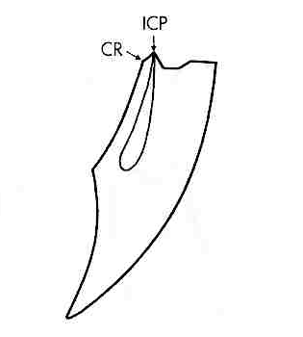
Opening
Early in the opening phase,
digastric muscles become active and remain until maximum opening position
During the opening phase,
masseter, temporalis, medial
pterygoid, and superior head
of lateral pterygoid muscles
are inactive.

Slide 12
MUSCLES THAT CLOSES JAW /
ELEVATOR JAW MUSCLES
Medial pterygoid
Masseter
Temporalis

Slide 13
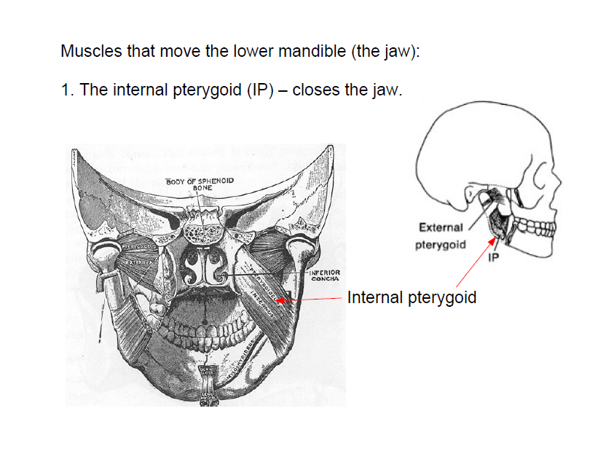

Slide 14
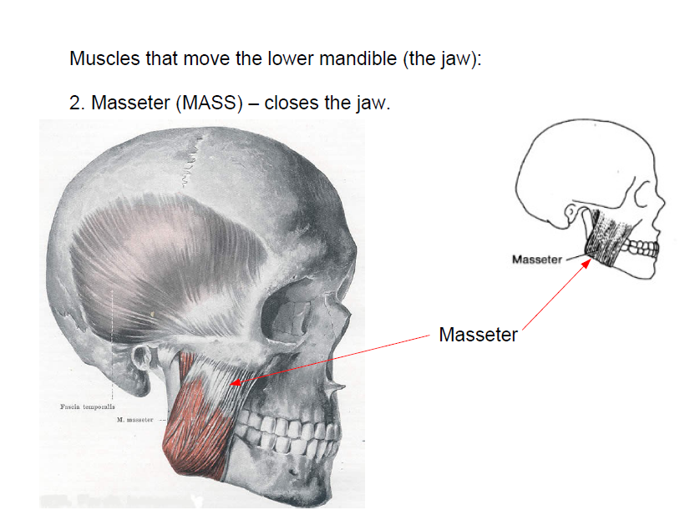

Slide 15
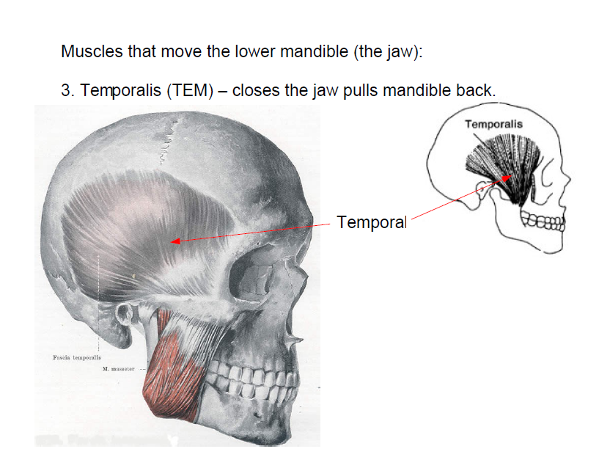

Slide 16
Closing
During early closing, contralateral medial pterygoid muscle
  more active in wider strokes,
  ceases activity during the intercuspal phase.
contralateral medial pterygoid controls the upward and lateral positions of the mandible

Slide 17
Closing
Activity increases in the anterior and posterior temporalis muscle, in the deep and superficial masseter muscles, and in the ipsilateral medial pterygoid muscle up to the peak 20 to 30 ms before the onset of the intercuspal position

Slide 18
Clenching
Muscle activity decreases when
  less posterior teeth
  only the incisors in contact

Slide 19
MUSCLE ACTIVITY
Closing muscles are usually inactive during jaw opening , when the jaw opening muscles are very active.
Activity in jaw closing muscles starts at the beginning of jaw closing.

Slide 20
Activity of jaw closing muscles increases slowly as the teeth begin to interdigitate.
The closing muscles on the side where food is being crushed are more active than the contralateral jaw closing muscles.

Slide 21
Neurological control during mastication
Coordination between
  sensory feed back from peripheral organ
  CPG :Central Pattern Generator neuron in brain stem
  higher center
  jaw reflexes

Slide 22
Summary
Muscles of mastication
Muscle activity

Slide 23
BIBLIOGRAPHY
Wheeler’s Dental Anatomy, Physiology and Occlusion Ash, M. M. 6th edition.
Oral Development and Histology Avery, j. K.1st edition.
Color Atlas And Text Book Of Oral Anatomy, Histology Berkovitz, B. 1ST edition.
Dental Embryology, Histology & Anatomy. Marry Bath- Balogh Inergaret. 2nd edition.

Slide 24
THANK YOU !!

