Slide 1
MORPHOLOGY OF DECIDUOUS TEETH - 1
Dept Of Dental Anatomy, Embryology & Histology

Slide 2
Purpose Statement
At the end of the lecture, learners should be able to Describe the morphology of :
a) Maxillary central incisor
b) Maxillary lateral incisor
c) Maxillary canine

Slide 3
Learning Objectives
At the end of the lecture the student should be able to
S.N. | Learning Objectives | Domain | Level | Criteria | Condition
1 | Definition of deciduous tooth | Cognitive | Must Know | All
2 | Describe morphology of Maxillary central incisor | Cognitive | Must Know | All
3 | Describe morphology of Maxillary lateral incisor | Cognitive | Must Know | All
4 | Describe morphology of Maxillary canine | Cognitive | Must Know | All
5 | To Carve Maxillary central, Lateral, and canine | Cognitive & Psychomotor | Must Know | All

Slide 4
INTRODUCTION
Deciduous teeth, otherwise known as reborner teeth, baby teeth, temporary teeth and primary teeth, are the first set of teeth in the growth development of humans and many other mammals.

Slide 5
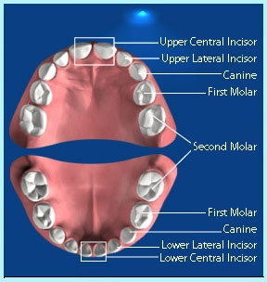

Slide 6
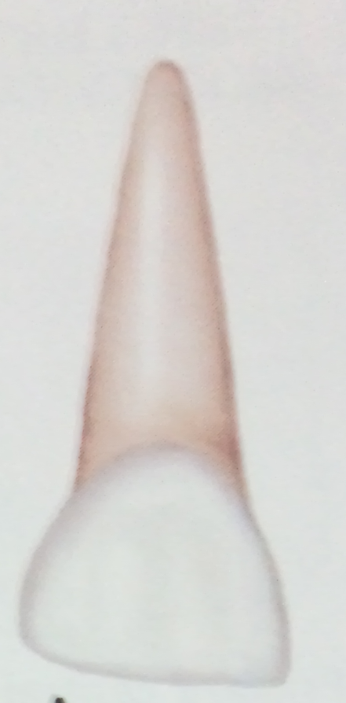
MAXILLARY CENTRAL INCISOR
LABIAL ASPECT
Mesiodistal diameter is greater than
the cervicoincisal length.
Labial surface is very smooth.
Incisal edge is nearly straight.
Developmental lines are usually not seen.

Slide 7
Root is cone shaped with even ,tapered sides.
Root length is greater in comparison with the crown length than that of the permanent central incisor.

Slide 8
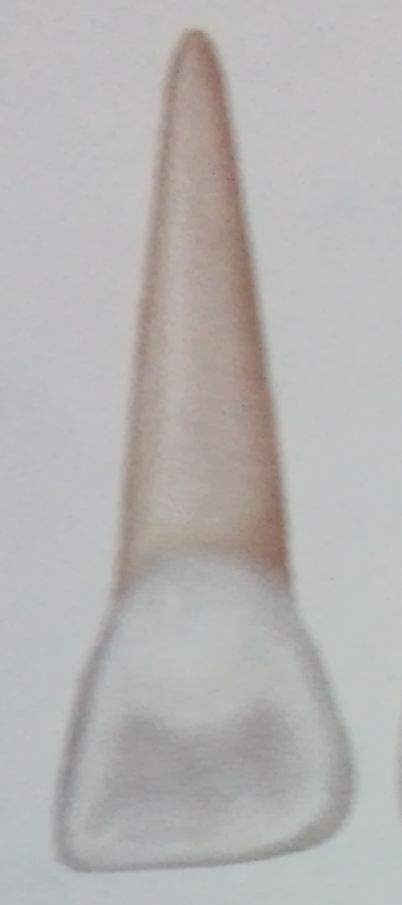
LINGUAL ASPECT
Shows well developed marginal
ridges and a highly developed cingulum.
The cingulum extends up towards the incisal ridge far enough to make a partial divison of the concavity on the lingual surface below the incisal edge, dividing it into a mesial and distal fossa.

Slide 9
The root narrows lingually and presents a ridge for its full length in comparison with a flatter surface labially.
Cross section of the root - triangular in shape , with the labial surface making one side of the triangle and mesial and distal surfaces making up the other two sides.

Slide 10
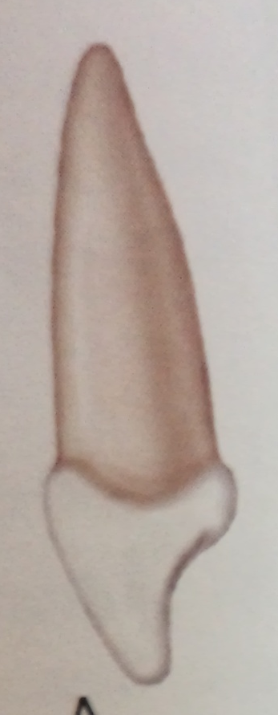
MESIAL AND DISTAL SURFACES
Mesial and distal aspects are similar.
Measurement of the crown at the cervical
third shows the crown from this aspect to
be wide in relation to its total length.

Slide 11
The crown appears thick at the middle third and even down towards the incisal third because of the short crown and its labiolingual measurement
The curvature of the cervical line ,which represents the cementoenamel junction, is distinct curving toward the incisal ridge.

Slide 12
Cervical curvature distally is less than the curvature mesially
Root appears more blunt from this aspect.
Mesial surface of the root will have a developmental groove or concavity and distally the surface is convex.

Slide 13
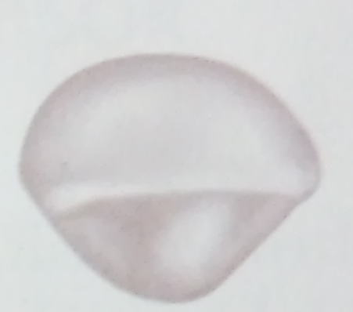
INCISAL ASPECT
The incisal edge is centered over the
main bulk of the crown and is relatively straight.
Looking down on the incisal edge, the labial surface is much broader and also smoother than the lingual surface.

Slide 14
The lingual surface tapers towards the cingulum .
Mesial and distal surfaces toward the incisal ridge or at the incisal third make good contact areas with the adjoining teeth.

Slide 15
MAXILLARY LATERAL INCISOR
Similar to maxillary central incisor.
Crown is smaller in all directions.
Cervicoincisal length of lateral crown is greater than its mesiodistal width.

Slide 16
Distoincisal angles of the crown are more rounded than those of central incisor.
Root is much longer in proportion to its crown .

Slide 17



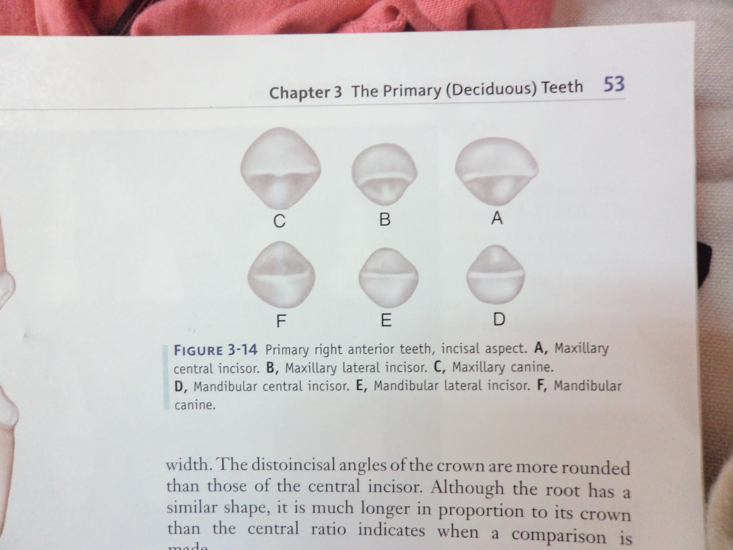
LABIAL
ASPECT
MESIAL
ASPECT
INCISAL
ASPECT
LINGUAL
ASPECT

Slide 18

MAXILLARY CANINE
LABIAL ASPECT
Crown is more constricted at the cervix
in relation to its mesiodistal width and
the mesial and distal surfaces are more convex.
Instead of an incisal edge that is relatively straight , it has a long, well developed, sharp cusp.

Slide 19
Cusp of primary canine is much longer and sharper.
When the cusp is intact , the mesial slope of the cusp is longer than the distal slope.
The root of the primary canine is long, slender and tapering and is more than twice the crown length.

Slide 20

LINGUAL ASPECT
Shows pronounced enamel ridges
that merge with eachother.
They are the cingulum , mesial and distal
marginal ridges and the incisal cusp ridges.
The root of this tooth tapers lingually.

Slide 21

MESIAL ASPECT
Measurement labiolingually at the
cervical third is much greater.
Increase in crown dimension in conjunction with the root width and length, permits resistance against the forces the tooth must withstand during function.

Slide 22
DISTAL ASPECT
The distal outline of this tooth is the reverse of the mesial aspect.
The curvature of the cervical line toward the cusp ridge is less than on the mesial surface.

Slide 23
INCISAL ASPECT
The crown is essentially diamond shaped.
The angles that are found at the contact areas mesially and distally ; the cingulum on the lingual surface and the cervical third or the enamel ridge ,

Slide 24
On the labial surface are more pronounced and less rounded in effect than those found on the permanent canines.
Tip of the cusp is distal to the center of the crown and the mesial cusp slope is longer than the distal cusp slope.

Slide 25
Summary
The morphology of :
a) Maxillary central incisor
b) Maxillary lateral incisor
c) Maxillary canine

Slide 26
Bibliography
Color Atlas And Text Book Of Oral Anatomy, Histology Berkovitz, B. 1ST edition.
Oral Development and Histology Avery, j. K.1st edition.
Orban's Oral Histology and Embryology Bhaskar, s. N.11th edition.
Oral Histology : Development, Structure and Funct Tencate, a. R. 4th edition.
Dental Embryology, Histology & Anatomy. Marry Bath- Balogh Inergaret. 2nd edition.

Slide 27
THANK YOU…

