Slide 1
MORPHOLOGY OF DECIDUOUS TEETH - 1
Dept Of Dental Anatomy, Embryology & Histology

Slide 2
Purpose Statement
At the end of the lecture, learners should be able to describe the morphology i.e. buccal , lingual , mesial, distal and occlusal aspects of :
Maxillary second molar
Mandibular first molar
Mandibular second molar

Slide 3
Learning Objectives
At the end of the lecture the student should be able to
S.N. | Learning Objectives | Domain | Level | Criteria | Condition
1 | Describe morphology of Maxillary second molar | Cognitive | Must Know | All
2 | Describe morphology of Mandibular first molar | Cognitive | Must Know | All
3 | Describe morphology of Mandibular second molar | Cognitive | Must Know | All
5 | To carve Mandibular first and second molar, maxillary second molar | Cognitive & Psychomotor | Must Know | All

Slide 4
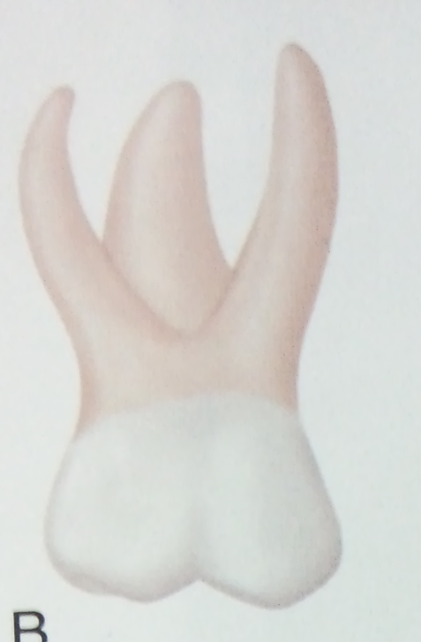
MAXILLARY SECOND MOLAR
BUCCAL ASPECT
Shows two well defined buccal cusps
with a developmental groove between them.
The crown is narrow at the cervix in
comparison with its mesiodistal
measurement at the contact areas.

Slide 5
Crown is much larger than first primary molar.
From this aspect, the roots appear slender ,they are much longer and heavier .

Slide 6
The point of bifurcation between the buccal roots is close to the cervical line of the crown.
The two buccal cusps are more nearly equal in size and development than those of the primary maxillary first molar.

Slide 7
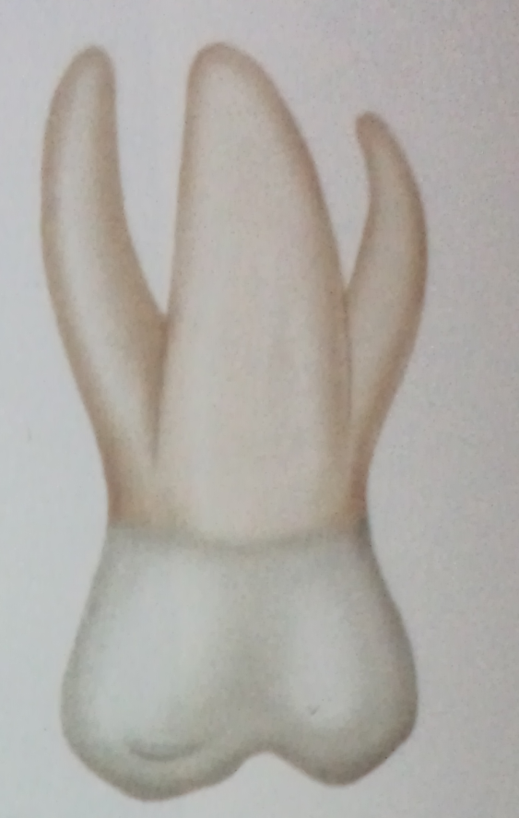
LINGUAL ASPECT
Lingually the crown shows the following three cusps :
- Mesiolingual cusp
- Distolingual cusp
- Supplemental cusp called
tubercle of carbelli
All three roots are visible from this
aspect, the lingual root is large and
thick in comparison with the other
two roots.

Slide 8
MESIAL ASPECT
The crown is usually short.
The mesiolingual cusp of the crown with its supplementary fifth cusp appears large in comparison with the mesiobuccal cusp.
Mesiobuccal root is broad and flat

Slide 9
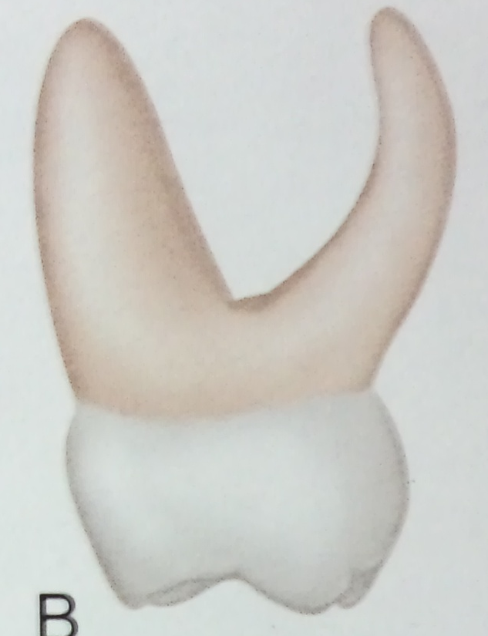
The point of bifurcation between the mesiobuccal root and the lingual root is 2 or 3mm apical to the cervical line of the crown.
Mesiolingual cusp is directly below the bifurcation

Slide 10
DISTAL ASPECT
The distal calibration of the crown is less than the mesial measurement.
The distobuccal cusp and the distolingual cusp are about the same length.
Cervical line was approx. straight.

Slide 11
Distobuccal root is shorter and narrower than the other roots.
Point of bifurcation between these two roots on the distal is more nearly centered above the crown than that on the mesial .

Slide 12
OCCLUSAL ASPECT
It is rhomboidal and has 4 well developed cusps and one supplemental cusp.
Occlusal surface has a central fossa with a central pit, well defined mesial triangular fossa just distal to mesial marginal ridge.

Slide 13
Well defined developmental groove is also present called the central groove.
The buccal developmental groove extends buccaly from the central pit , separating the triangular ridges.

Slide 14
The oblique ridge is prominent and connects the mesiolingual cusp with the distobuccal cusp.
Distal to the oblique ridge , distal fossa is found.
Distal marginal ridge is as well developed as the mesial marginal ridge.

Slide 15

MANDIBULAR FIRST MOLAR
BUCCAL ASPECT
Mesial outline of the crown is almost
straight from the contact area to the cervix.
Distal portion of the crown is shorter than
the mesial portion.
Mesial cusp is larger than the distal cusp.
Roots are long and slender.

Slide 16

LINGUAL ASPECT
The crown and root converge lingually to
a marked degree on the mesial surface.
Distolingual cusp is rounded and suggests a developmental groove between this cusp and the mesiolingual cusp.

Slide 17
The mesiolingual cusp is long and sharp at the tip.
From the lingual aspect, the crown length mesially and distally more uniform than from buccal aspect.

Slide 18
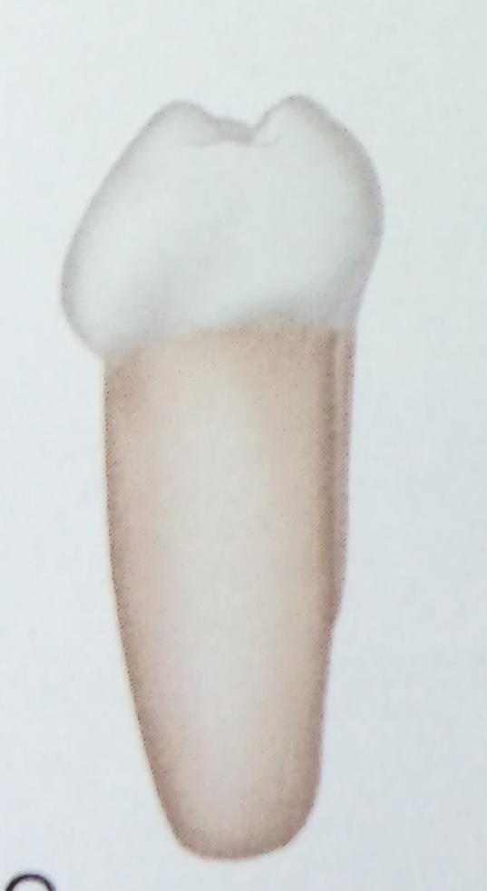
MESIAL ASPECT
This aspect resembles mesial aspect
of permanent mandibular molars.
Only noticeable difference is extreme
curvature buccally at the cervical line .

Slide 19
The cervical line slants upwards buccolingually.
Mesial root does not resemble any other primary tooth root from this aspect.

Slide 20
OCCLUSAL ASPECT
The general outline is rhomboidal.
The mesiolingual cusp is the largest and best developed of all the cusps and it has a broad, flattened surface lingually.

Slide 21
Buccal developmental groove of occlusal surface divides the two buccal cusps evenly.
Mesiobuccal cusp exhibits a well defined triangular ridge on the occlusal surface.

Slide 22
MANDIBULAR SECOND MOLAR
BUCCAL ASPECT
Has narrow mesiodistal calibration at the cervical portion of the crown compared with the calibration mesiodistally on the crown at contact level.

Slide 23
From this aspect also, mesiobuccal and distobuccal developmental grooves divide the buccal surface of the crown occlusally into 3 cuspal portionsalmost equal in size.

Slide 24

The roots of the primary second molar from this angle are slender and long.
Roots of the tooth may be twice as long as the crown.
The point of bifurcation of the roots start immediately below the CEJ of crown and root.

Slide 25
LINGUAL ASPECT
From the lingual aspect , two cusps of
almost equal dimensions can be observed
A short lingual groove is between them.

Slide 26

MESIAL ASPECT
The marginal ridge is high , a characteristic
that makes the mesiobuccal cusp and
the mesiolingual cusp appear rather short.
The lingual cusp is longer or higher than the buccal cusp.

Slide 27
DISTAL ASPECT
The crown is not as wide distally as it is mesially.
The distolingual cusp appears well developed and the triangular ridge from the tip of this cusp extending down into the occlusal surface is seen over the distal marginal ridge.

Slide 28
The cervical line of the crown is regular .
The distal root is as broad as mesial root and is flattened on the distal surface.
The distal root tapers more at the apical end than does the mesial root.

Slide 29
OCCLUSAL ASPECT
The occlusal aspect is rectangular.
The total mesiodistal width of the lingual cusps is less than the total mesiodistal width of the three buccal cusps.

Slide 30
Well defined triangular ridges extend from each one of these cusp tips.
Distal triangular fossa is not well defined as mesial triangular fossa.
Mesial marginal ridge is better developed and more pronounced than the distal marginal ridge.

Slide 31
Summary
The morphology i.e. buccal , lingual , mesial, distal and occlusal aspects of :
Maxillary second molar
Mandibular first molar
Mandibular second molar

Slide 32
Bibliography
Color Atlas And Text Book Of Oral Anatomy, Histology Berkovitz, B. 1ST edition.
Oral Development and Histology Avery, j. K.1st edition.
Orban's Oral Histology and Embryology Bhaskar, s. N.11th edition.
Oral Histology : Development, Structure and Funct Tencate, a. R. 4th edition.
Dental Embryology, Histology & Anatomy. Marry Bath- Balogh Inergaret. 2nd edition.

Slide 33
THANK YOU…

