Slide 1

AFTERNOON

Slide 2
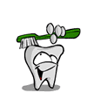
CARIES ACTIVITY TESTS

Slide 3
Lesson plan
Topic: Caries Activity tests
Date: 20-04-13
Class: 4th B D S
Duration: 1 hour
Setting: Classroom
At the end of the session, the learners should know
need of caries activity tests,
Characteristics of ideal test and
Various types of caries activity tests

Slide 4
Contents
Introduction
Caries activity
Need for caries activity test
Ideal caries activity test
Caries activity tests
Summary

Slide 5
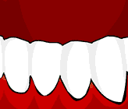
Introduction
Dental caries is an infectious microbial disease that begins as demineralization of inorganic portion of the tooth followed by destruction of organic portion leading to cavity formation.
Dental caries is a multifactorial disease.

Slide 6
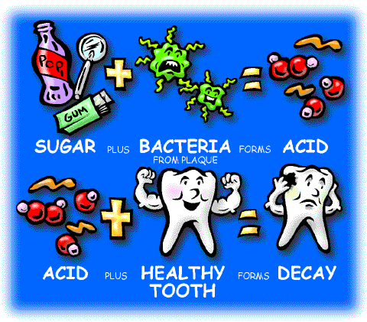

Slide 7
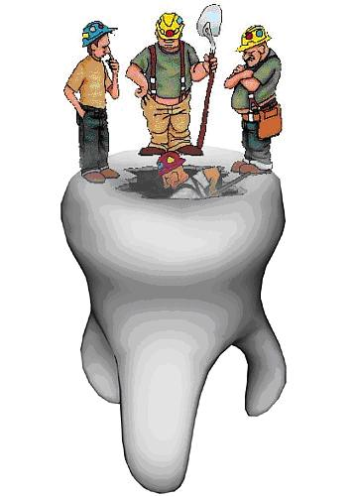
Caries risk assessment
Caries risk assessment determines the probability of caries incidence, i.e., the number of new cavities or incipient lesions over a given period of time.
Notes:
Caries risk assessment is the estimation of the probability of developing a new dental caries lesion within a specific timeframe and also the estimation of the probability of a change in the size or activity of existing lesions in the mouth.
The Caries Risk Assessment (CRA) measures the caries balance of a patient at a point in time, and information that is gathered drives the decision-making process in clinical treatment. Treatment is evidence-based and individual patients are treated according to their oral environment rather than treating all patients similarly. Treatment involves strategies that put the patient into a healthy balance.
National Institutes of Health. Diagnosis and management of dental caries throughout life. 2001; Bethesda, Md: National Institutes of Health.17. Reich E, Lussi A, Newbrun E. Caries-risk assessment. Int Dent J. 1999;49(1):15-26.

Slide 8
Caries susceptibility
Inherent tendency of the host and the target tissue, the tooth, to be afflicted by the caries process. This is the susceptibility (or resistance) of a tooth to a caries – producing environment.

Slide 9
Caries activity
Increment of active lesions (new or recurrent) over a stated period of time. Caries activity is a measure of the speed of progression of a carious lesion.

Slide 10
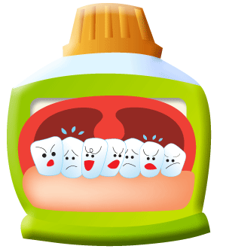
Caries activity tests
Measure the degree to which the local environmental challenge favours the probability of occurrence of carious lesions.
Degree of caries activity
Caries activity tests

Slide 11
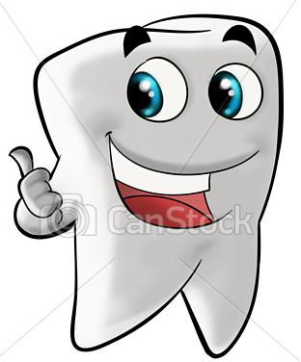
Caries activity test helps to:
Identify high risk groups and individuals
Determine the need for personalized preventive measures and motivate the individual
Ensure a low level of caries activity before starting any extensive restorative procedure.

Slide 12
Monitor effectiveness of oral health education programs by establishing an initial baseline level of cariogenic pathogens as a basis for future evaluation.
Serve as an index of success of therapeutic measures: reduction in the number of Strep mutans and Lactobacilli as a part of counselling to decrease sucrose intake.
Notes:
by monitoring patient behaviour towards reducing the number of Strep mutans and Lactobacilli as a part of counselling to curtail sucrose intake.

Slide 13
Ideal requisites
Sound theoretical basis
Maximum correlation with clinical status
Accurate duplication of results
Simple
Inexpensive
Less time consuming
Notes:
Mechanisms of caries process

Slide 14
Caries activity tests
Lactobacilli colony count test
Colorimetric Snyder test
Salivary reductase test
Salivary buffer capacity test
Fosdick calcium dissolution test
Streptococcus mutans screening tests

Slide 15
Streptococcus mutans screening tests
    Plaque / tooth pick method
    Saliva / tongue blade method
    Dip slide method
    Adherence test
    Replicate test

Slide 16
1. Lactobacillus Colony Count Test
(Hadley – 1933)
Principle:
Estimates the number of acidogenic and aciduric bacteria in the patient’s saliva by counting the number of colonies appearing on tomato peptone agar plates (pH 5.0) after inoculation with a sample of saliva.
Notes:
A selective media favouring the growth of aciduric lactobacilli is the basis for the test.

Slide 17
Procedure:
Saliva is collected by asking the subject to chew paraffin before breakfast and then collecting saliva in a bottle.
The specimen is shaken to mix it. The dilution of 1:10 and 1:100 are prepared by mixing with sterile salt solution.

Slide 18
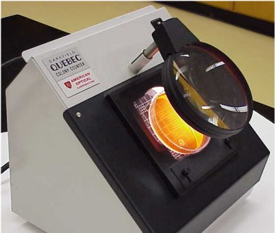
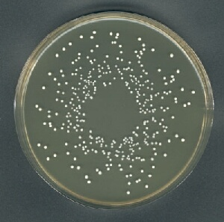
Then 0.4ml of 1:100 diluted saliva is spread on the surface of agar plate with a bent glass rod.
The plates are labelled and incubated at 37°C for 3-4 days.
Then numbers of colonies are counted using Quebec counter.

Slide 19
It takes only few minutes to do the test, but the results are not available for several days.
Counting the number colonies is a very tedious process.

Slide 20
Lactobacillus test
Number of organisms per cubic cm | Symbolic designation | Degree of caries activity suggested
0 – 1000 | + | Little or none
1000 – 5000 | + | Slight
5000 – 10,000 | ++ | Moderate
More than 10,000 | +++ | Marked

Slide 21
Limitations
Not simple
Needs professional training
Requires complex equipment and hence costly
Lactobacillus count varies in the same individual.
Does not completely exclude growth of other relatively aciduric organisms.
Notes:
For example,eating cheese can raise the Lactobacillus count of the patient who has less caries activity. Lactobacillus levels are highly influenced by the intake of dietary carbohydrates, reflecting the amount of bacterial substrate and indicating an acid environment within the oral cavity. prevalence of lactobacilli is lower compared mutans streptococci.

Slide 22
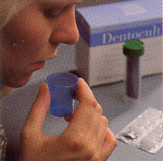
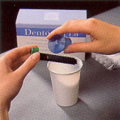
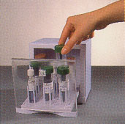
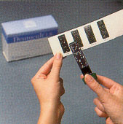
Dentocult-LB Dip-slide culture method
Collecting and pouring stimulated saliva over a Dentocult dip-slide. The slide is covered on both sides with modified Rogosa medium for culture of lactobacilli.
Incubated at 37 degrees for 4 days. Shows lactobacilli as white to transparent
colonies on the agar surface.

Slide 23
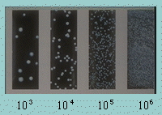
Lactobacilli per ml. of saliva
Model chart for comparison of colony density.
Lactobacilli per ml saliva
more than 100.000 (10⁵) | high risk value
less than 10.000 (10⁴) | low

Slide 24
2. Snyder Test
(1951)
Principle:
Measures the rapidity of acid formation when sample of stimulated saliva is inoculated into glucose agar adjusted to pH 4.7 to 5 and with bromocresol green as colour indicator.

Slide 25
Procedure
Saliva is collected before breakfast by having the subject chew paraffin.
A tube of Snyder glucose agar is melted and then cooled to 50°c.
Then 0.2ml of saliva is pipetted into the tube of agar and immediately mixed by rotating the tube.
Notes:
The saliva specimen is shaken vigorously for 3 minutes.

Slide 26
The agar is allowed to solidify in the tube and is incubated at 37°C.
The colour change of the indicator is observed for 24, 48 and 72 hours of incubation.

Slide 27
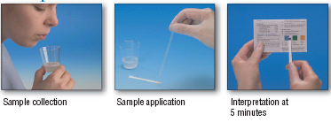
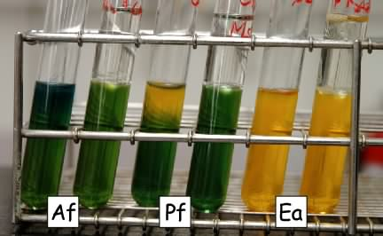

Slide 28
Snyder test
 | Time (hours)
 | 24 | 48 | 72
Colour | Yellow | Yellow | Yellow
Caries activity | Marked | Definite | Limited
Colour | Green | Green | Green
Caries activity | Continue test | Continue test | Inactive

Slide 29
Advantages
Limitations
Simple
Requires only simple equipment. Some training is needed and the cost is moderate
Correlation with clinical trials.
Time consumed is more. (24 – 48 hours)
Sometimes colour changes are not so clear.

Slide 30
Albans test
It is a simplified substitute for the Snyder test.
The depth of colour change in the medium.
Level of colour change | Scoring
No change | ¾
Beginning of colour change (from top) | +
One half colour change (from top) | + +
Three forth colour change (from top) | + + +
Total colour change to yellow | + + + +

Slide 31
3. Salivary Reductase Test
(Susceptibility test)
Principle:
Measures the rate at which an indicator diazo resorcinol, changes from blue to red to colourless on reduction by mixed salivary flora.
This test measures the activity of enzyme reductase - secreted by salivary bacteria.

Slide 32
Saliva is collected before breakfast having subject chew paraffin and expectorating directly into the collection tube.
When the saliva reaches the calibration mark (5ml) the reagent cap is replaced.

Slide 33
The sample is mixed with a fixed amount of diazo resorcinol, the reagent upon which the reductase enzyme is to react.
The change in colour after 30 seconds and after 15 minutes is taken as a measure of caries activity.

Slide 34
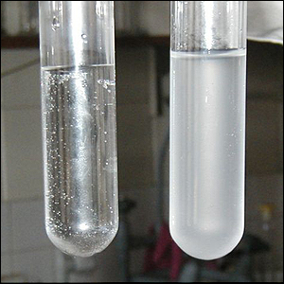
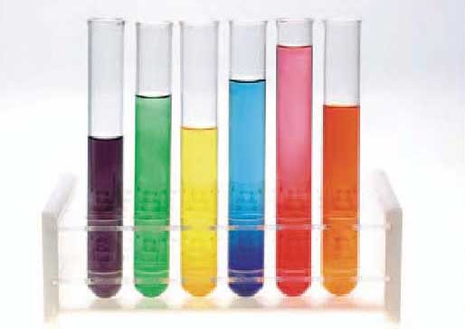
Diazo
Resorcinol
dye
30s.
15 min.
Stimulated saliva

Slide 35
Salivary Reductase test
Colour | Time | Score | Caries Activity
Blue | 15 minutes | 1 | Non conducive
Orchid | 15 minutes | 2 | Slightly conducive
Red | 15 minutes | 3 | Moderately conducive
Red | Immediately | 4 | Highly conducive
Pink or white | Immediately | 5 | Extremely conducive

Slide 36
Advantages
Good correlation with clinical experience.
Measure of oral hygiene status of an individual.
Caries-free adults exhibit low or negative scores on reductase test.

Slide 37
4. Salivary Buffer Capacity test
Principle:
Measures the number of ml of acid required to lower the pH of the saliva through an arbitrary pH interval, such as from pH 7 to 6 or amount of acid or base necessary to bring colour indicators to their end point.
Notes:
Buffer capacity can be quantified by using a pH meter or colour indicators.

Slide 38
Procedure
Ten ml of stimulated saliva is collected at least one hour after eating; 5 ml of this are measured into a beaker.
After correcting the pH meter to room temperature, the pH of saliva is adjusted to 7 by addition of acid or base.
Notes:
The level of lactic acid in the measuring cylinder is re-recorded.

Slide 39
Lactic acid is then added to the sample until a pH of 6 is reached.
The number of ml of lactic acid needed to reduce pH from 7 to 6 is a measure of buffer capacity.
This number can be converted to milliequivalents (mEq) per litre.

Slide 40
This test gives inverse relationship between buffering capacity of saliva and caries activity.
The saliva of individuals whose mouths contain a considerable number of carious lesions frequently has a lower acid-buffering capacity than the saliva of those who are relatively caries-free.

Slide 41
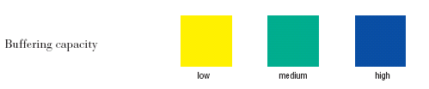
Interpretation
The yellow color indicates a final pH of 4 or less, meaning that the saliva was unable to raise the pH.
There is an inverse relationship between buffering capacity of saliva and caries activity.
Caries activity
Buffering capacity of saliva

Slide 42
Advantages
Disadvantages
Simple to carry out
Does not correlate adequately with caries activity.

Slide 43
5. Fosdick Calcium Dissolution Test
Principle:
Measures milligrams of powdered enamel dissolved in 4 hours by the acid produced by mixing patient’s saliva with glucose and powdered enamel.

Slide 44
Procedure
25 ml of gum stimulated saliva is collected and this is analysed for calcium content.
The rest is placed in a sterile tube with about 0.1g of powdered enamel.
The tube is sealed and shaken for 4 hours at body temperature.

Slide 45
Then again it is analysed for calcium content.
The amount of enamel dissolution increases as the activity increases.
Notes:
The chewing of gum is used to stimulate saliva or if paraffin is used, a concentration of about 5% glucose is added.

Slide 46
Limitations
Not simple
Costly equipment
High cost
Require trained personnel.

Slide 47
6. MUTANS STREPTOCOCCI
SCREENING TESTS

Slide 48
Streptococcus mutans screening tests
    Plaque / tooth pick method
    Saliva / tongue blade method
    Dip slide method
    Adherence test
    Replicate test

Slide 49
a. Plaque – toothpick method:
Plaque samples are collected from the gingival third of buccal tooth surfaces (one from each quadrant)and placed in Ringer's solution.
Then the plaque suspension is streaked across a mitis - salivarius agar plate.
Notes:
The sample is shaken until homogenised.

Slide 50
Incubated at 37°C for 72 hours, the cultures are examined under a low-power microscope and the total colonies in 10 fields are recorded.
This test is an attempt to semiquantitatively screen the dental plaque for a specific group of caries inducing streptococci, Streptococcus mutans.

Slide 51
Plaque toothpick method
Grade | Colonies / 10 fields
1 | None
2 | < 8
3 | ≥8

Slide 52
b. Saliva/Tongue Blade Method:
Saliva/ tongue blade method estimates the numbers of S. mutans in mixed paraffin-stimulated saliva when cultured on mitis - salivarius bacitracin (MSB)agar.

Slide 53
Procedure
The subjects chew paraffin for one minute to displace plaque microorganisms, thereby increasing the proportion of plaque microorganisms in the saliva.

Slide 54
The subjects are given a sterile tongue blade, which they rotate in their mouth 10 times, so that both sides of the tongue blade are thoroughly inoculated by the subject's flora.

Slide 55
Excess of saliva is removed by withdrawing the tongue blade through closed lips.
Both sides of the tongue blade are then pressed onto an MSB agar in petri dish, and then incubated at 37°C for 48 hours.

Slide 56
c. Strep mutans Adherence Method:
Developed for use with large number of school children and avoids necessary collection of saliva.
This test categorises salivary samples based on the ability of S.mutans to adhere to glass surfaces when grown in sucrose- containing broth.

Slide 57
Procedure:
Unstimulated(0.1ml) saliva is inoculated in MSB broth.
Inoculated tubes are set at 6° angle and incubated at 37°C for 24 hours.
After growth has been observed, the supernatant medium is removed and the cells adhering to the glass surface are examined macroscopically.

Slide 58
Strep mutans Adherence Method
Symbol | Interpretation
_ | No growth expressed
+ | A few deposits ranging from 1 – 10 X 10 ⁴ CFU / ml
++ | Scattered deposits of small size
+++ | > 20 X 10 ⁴ CFU / ml deposits

Slide 59
d. Strep mutans Dip-slide Method
Classify salivary samples according to estimates of S. mutans colonies growing on modified miitis - salivarius agar.
Notes:
(Dentocult SM, Orion Diagnostica, Caries- Screen SM, Apo Diagnostics)

Slide 60
Procedure: Dentocult SM
The subject chews the paraffin wax, and stimulated saliva is collected for 5 minutes.
The saliva is poured over a agar-coated slide, totally wetting the surface and the excess is allowed to drain off.

Slide 61
After the slide dries for 10-15 minutes, the bacitracin disc are placed in the middle of the inoculated agar about 1cm from each other.
If present, S. mutans appears as small colonies growing within the zone of inhibition.
Notes:
A zone of inhibition of 10-20 mm in diameter is formed around each disc.
A carbon dioxide tablet is inserted in the tube containing the slide, which is incubated for 48hours.

Slide 62
Grade | Interpretation
0 | Negligible
1 | < 1,00,000
2 | 1,00,000 – 10,00,000
3 | > 10,00,000 Strep mutans CFU/ml
Notes:
The colony density is compared with a model chart and classified as:

Slide 63
e. Strep mutans Replicate Technique:
Principle:
Localises S. mutans colonies on tooth surfaces, using a solid impression matrix comprised primarily of sucrose and a commercial gum base.

Slide 64
Procedure
An imprint of the tooth surfaces to be sampled is obtained by pressing the matrix against it, after which the matrix is washed for several seconds in water to remove non-adherent cells and saliva.

Slide 65
The matrices are placed in the liquid broth, incubated at 37°C, then removed and examined directly for overgrowth of S. mutans colonies at specific sites (e.g. occlusal and root surfaces).

Slide 66
Uses of Caries activity tests for clinicians
To determine the need for caries control measures
As an indicator of patient co-operation
To act as an aid in timing of recall appointments
As a guide to insertion of expensive restorations
To aid in determination of prognosis
As a precautionary signal to the orthodontist in placing bands.

Slide 67
Uses of Caries activity tests for researcher
As an aid in the selection of patients for caries study.
To help in the screening of potential therapeutic agents.
To serve as an indicator for periods of exacerbation and remission.

Slide 68
Conclusion
Microbiological tests should be regarded as monitors of oral ecology. Any increase in the challenge factors or decrease in defence, protective and repairing factors at any time should be considered as a warning sign.

Slide 69


Slide 70
ANSWER THESE QUESTIONS
Need for caries activity tests?
Ideal requirements of Caries activity tests?
Caries activity tests- name?
Results of caries activity in Lactobacillus colony test?
Name mutans Streptococcus screening tests?

Slide 71
MCQs
Color indicator in Snyder test?
i. Bromocresol green
ii. Diazoresorcinol
iii. Malachite green
iv. Acridine
Which color does show extremely conducive caries activity in reductase test?
i. Orchid
ii. Red
iii. Blue
iv. Pink

Slide 72
Who did introduce Lactobacillus colony test?
i. Alban
ii. Hadley
iii. Fosdick
iv. None
Culture media for lactobacillus test?
i. Glucose agar
ii. Tomato peptone agar
iii. Mitis salivarius bacitracin agar
iv. Blood agar

Slide 73


