Slide 1
NEURAL TUMORS
DR. VARSHA SANGLE

Slide 2
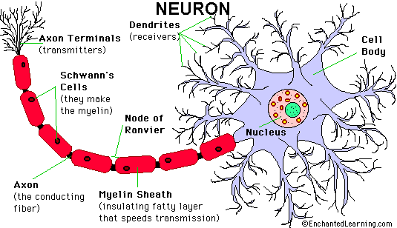
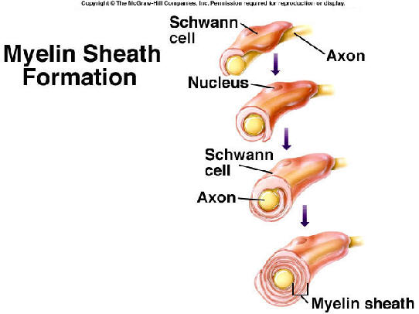
Structure of a neuron

Slide 3
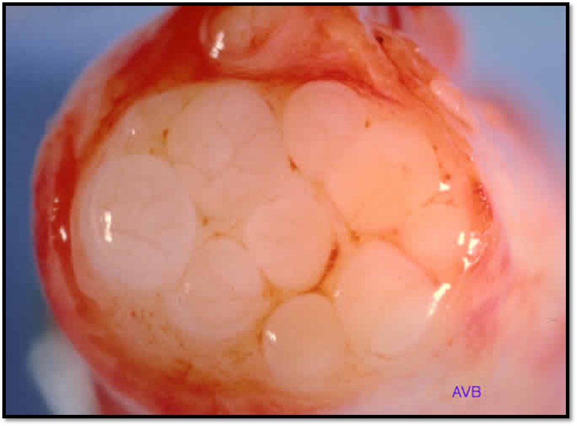
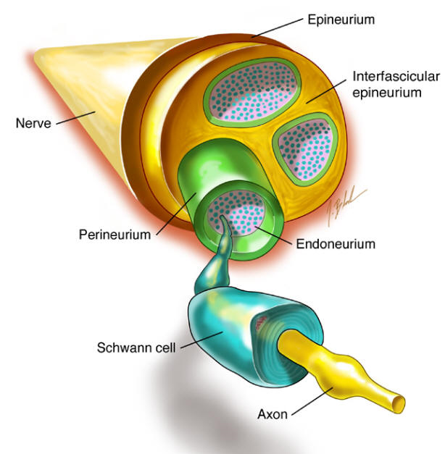
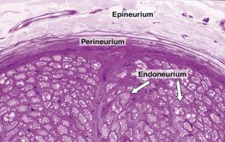
Structure of a nerve

Slide 4
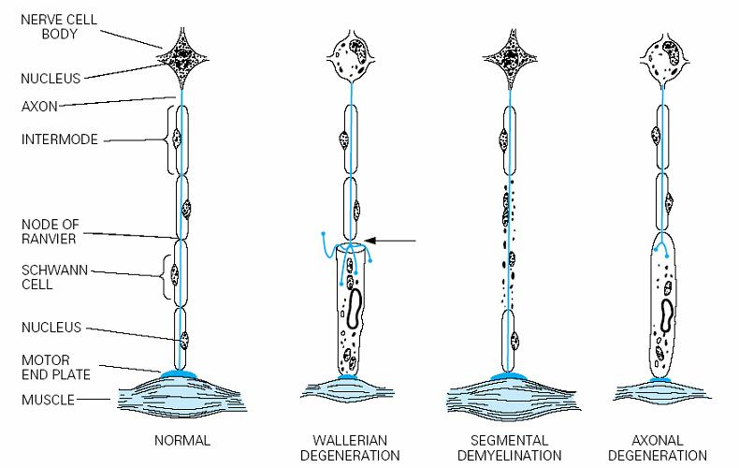
Types of degeneration

Slide 5
BENIGN TUMORS OF NERVE TISSUE ORIGIN
1)Traumatic neuroma
2)Multiple endocrine neoplasia syndrome
3)Neurilemmoma
4)Neurofibroma
5)Neurofibromatosis

Slide 6
Traumatic Neuroma
Also called Amputation Neuroma. It is not a true tumor but a reactive proliferation of neural tissue after transection or other damage of a nerve bundle.
H\O of trauma is found like extraction or other surgical procedure.
Occur at any age but common in middle aged, & females,
Pain is intermittent or constant & ranges from mild tenderness to burning to severe radiating pain.
Neuromas of mental nerve are very painful if impinged by denture or palpated.

Slide 7
Traumatic neuroma
Exuberant attempt to repair damaged nerve trunk.
Repair of damaged nerve:
Proliferation of axon, Schwann cells.
Proliferation meet some obstruction.
Unorganized bulbous proliferation.

Slide 8
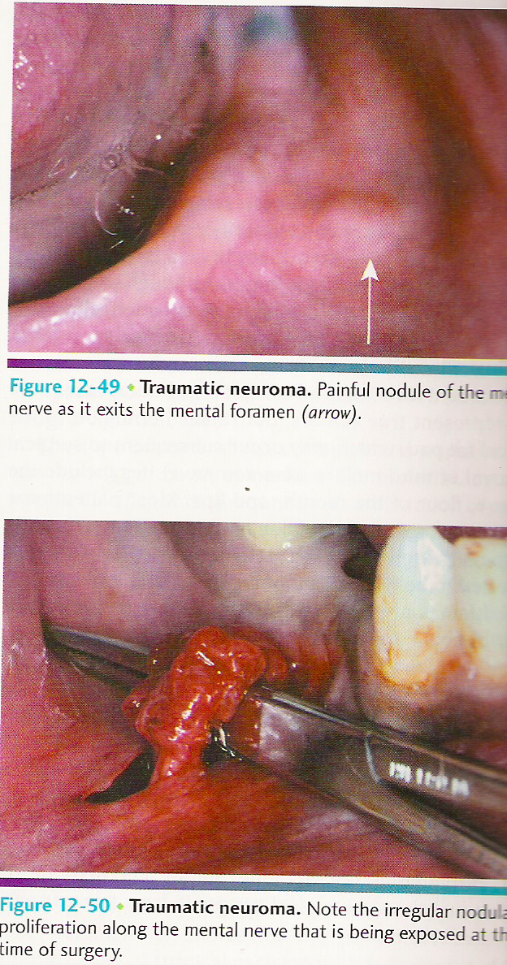
Clinical Features– are typically smooth nodules, common at mental foramen area, tongue, lower lip. Other sites like T\N of greater auricular nerve in 5-10% of pt’s undergoing surgery for Pleomorphic Adenoma.

Slide 9
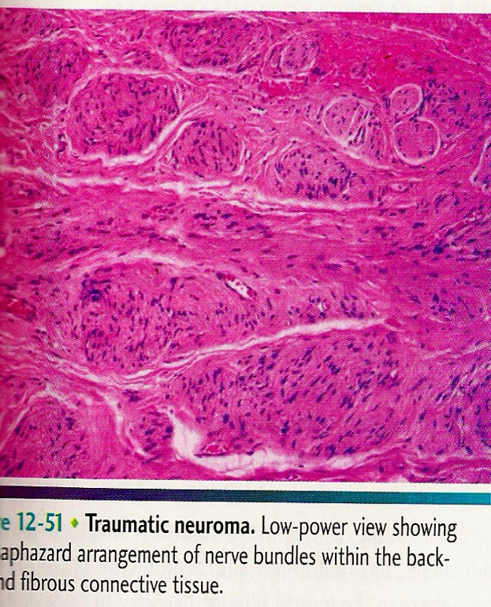
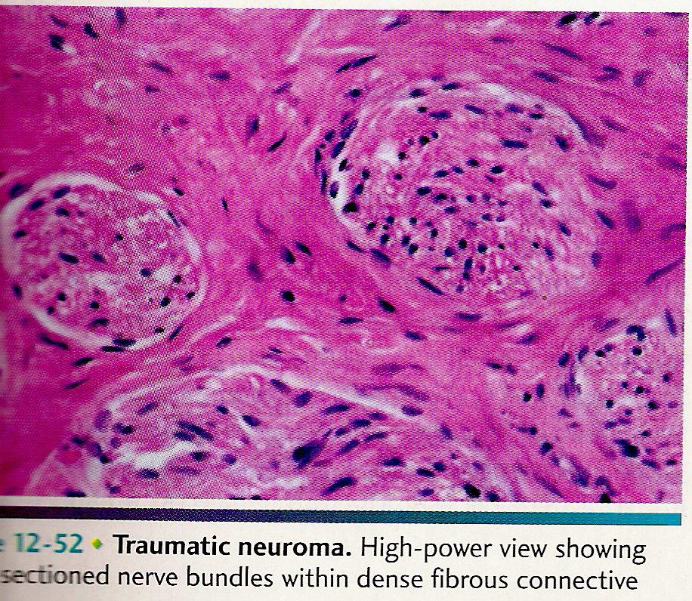

Slide 10
Schwannoma
Synonyms: Neurilemmoma
Perineural Fibroblastoma
Neurinoma
Lemmoma

Slide 11
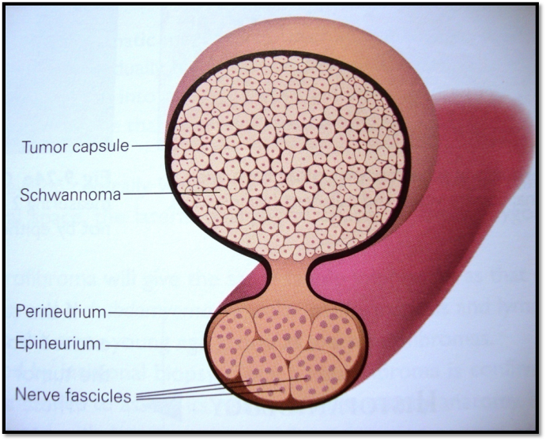
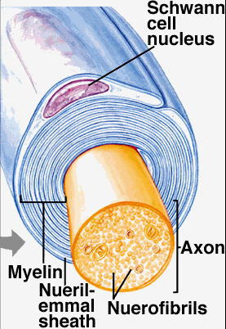
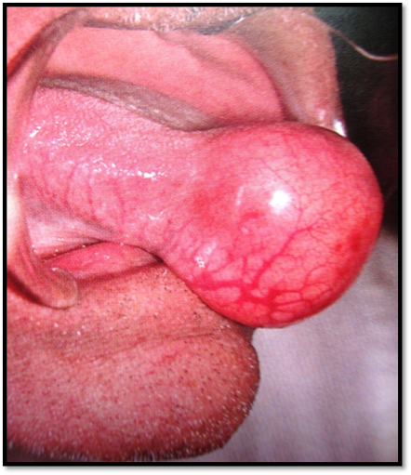
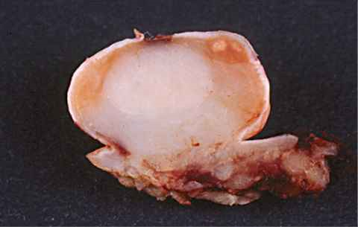
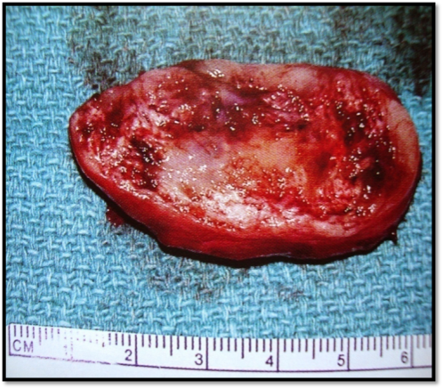
Schwannoma
Composed exclusively of--------------
Age predilection: 30-50 years
Site: Tongue, floor of the mouth------------
Gross Pathology
Notes:
Slow growing, Painless

Slide 12
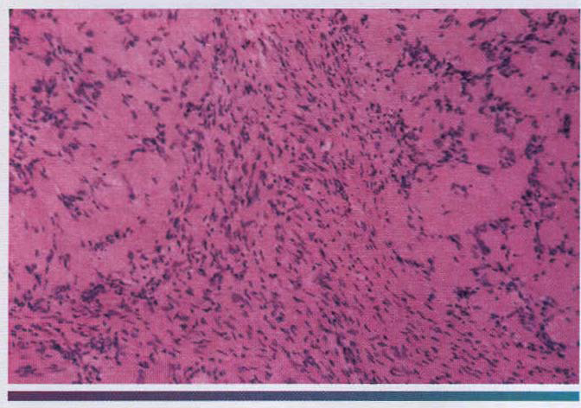
Neurilemoma. showing a central zone of Antoni B tissue that is bordered on both sides by better-organized Antoni A tissue. The Schwann cells of the Antoni A tissue form a palisaded arrangement around acellular zones known as Verocay bodies.

Slide 13
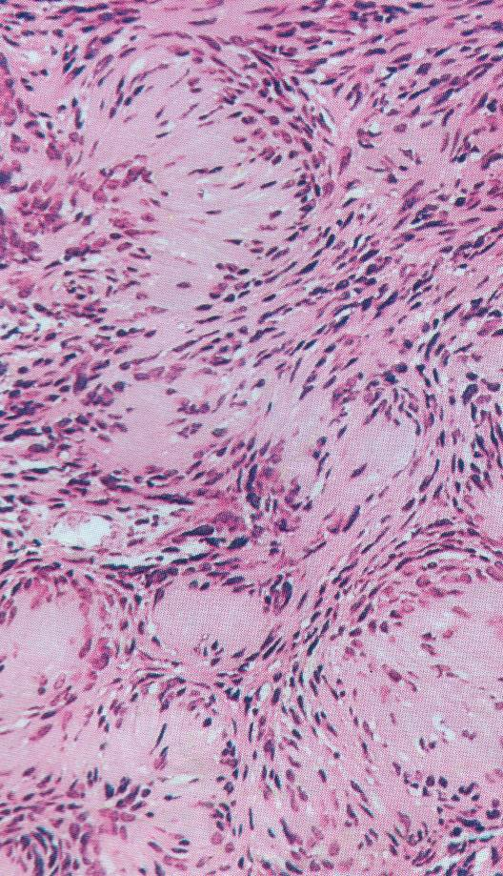
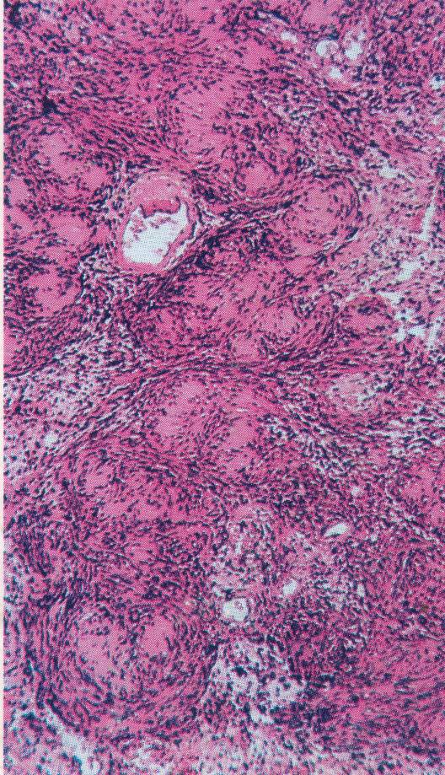

Slide 14
Clinical Differential Diagnosis
Granular cell tumor
Lipoma
Neurofibroma
Notes:
Refer to marx

Slide 15
Neurofibroma
Common type of peripheral nerve neoplasm .
Arises from a mixture of cell types like Schwann cell, perineural fibroblasts.
Malignant transformation can occur but risks are high in neurofibromatosis

Slide 16
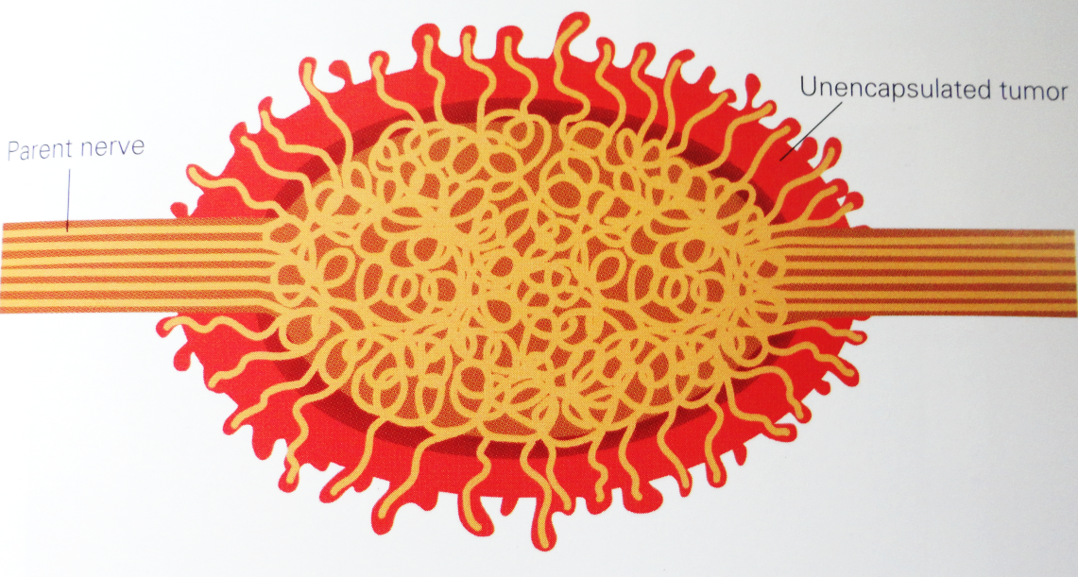
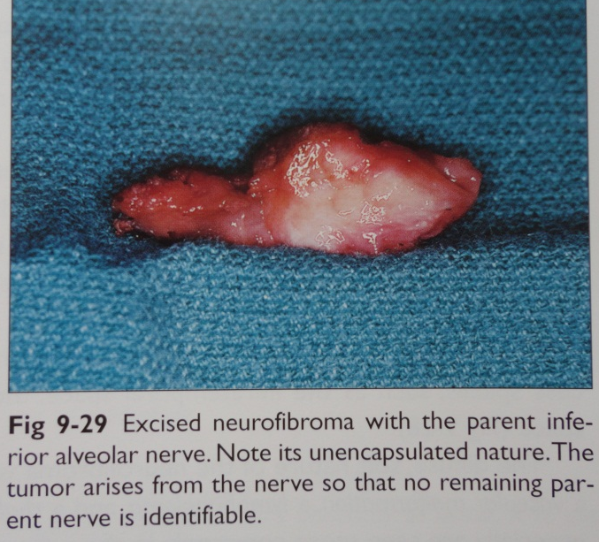
Solitary Neurofibroma
Account for 90% cases of neurofibroma
Asymptomatic, diffuse mass within subcutaneous or sub-mucosal tissue
Characteristic bag or worms appearance

Slide 17
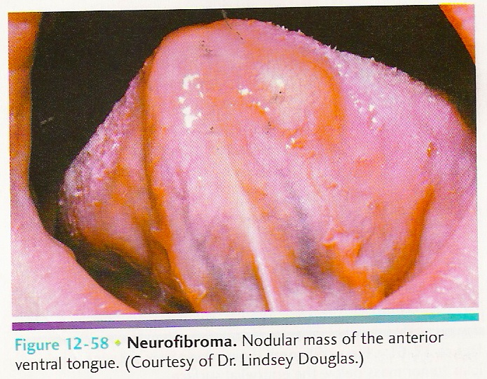
Clinical Features– arises as solitary tumor or component of neurofibromatosis.
Solitary – common in young adults, slow growing soft nodular mass
Common on skin, oral lesions are not uncommon.
Tongue, buccal mucosa, bone

Slide 18
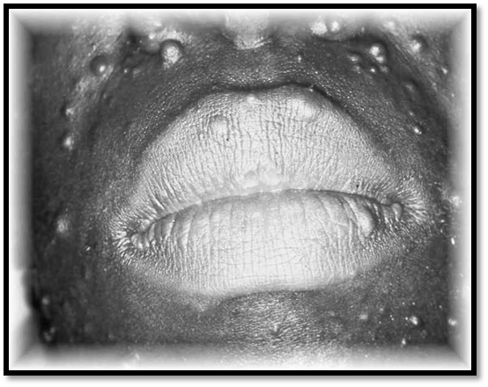
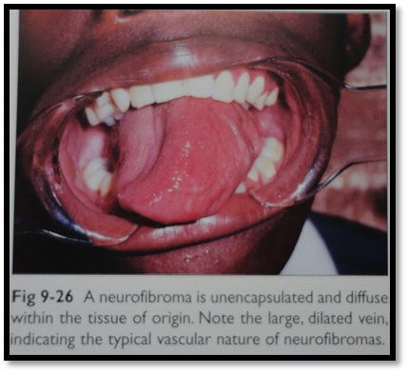
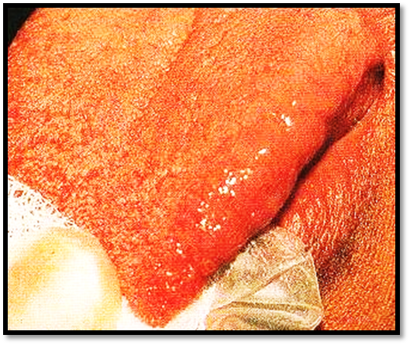

Slide 19
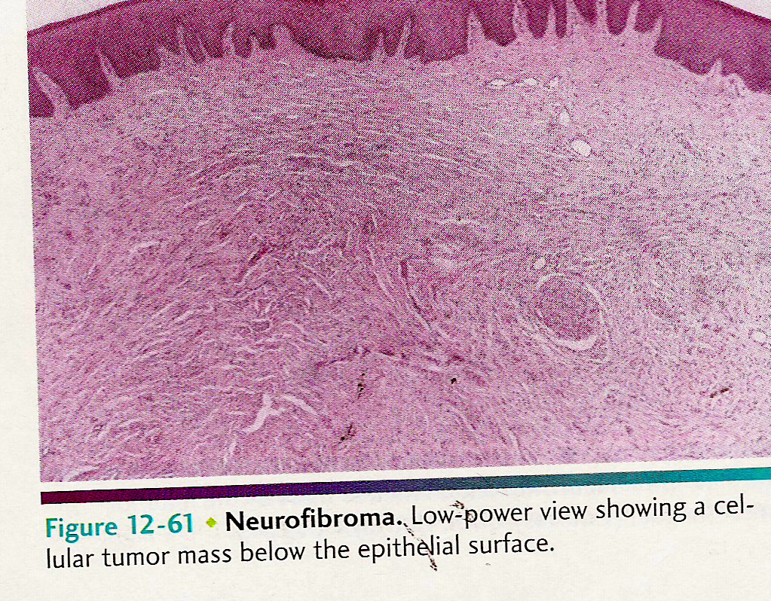
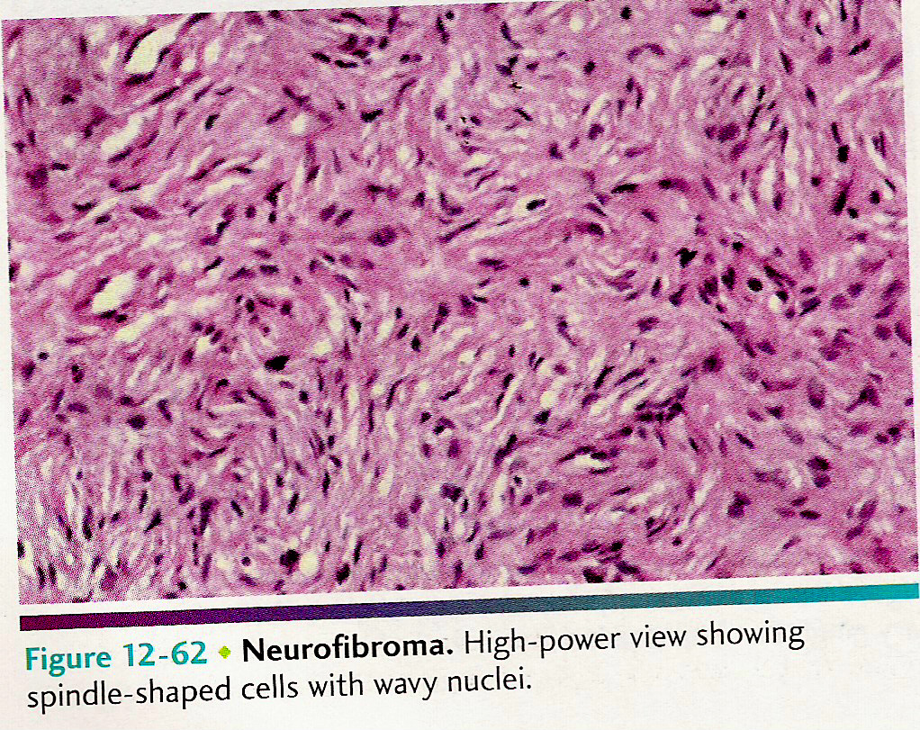

Slide 20
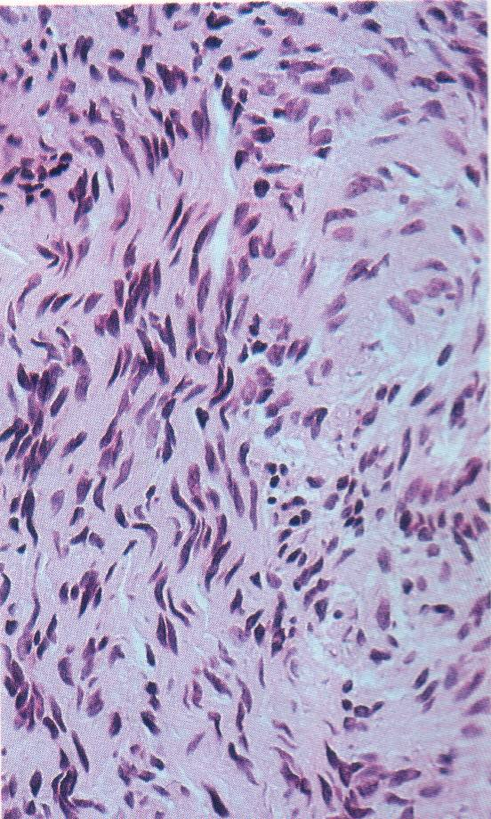
Composed of interlacing bundles of spindle shaped cells with wavy nuclei, along with collagen bundles, myxoid matrix, mast cells are numerous .

Slide 21
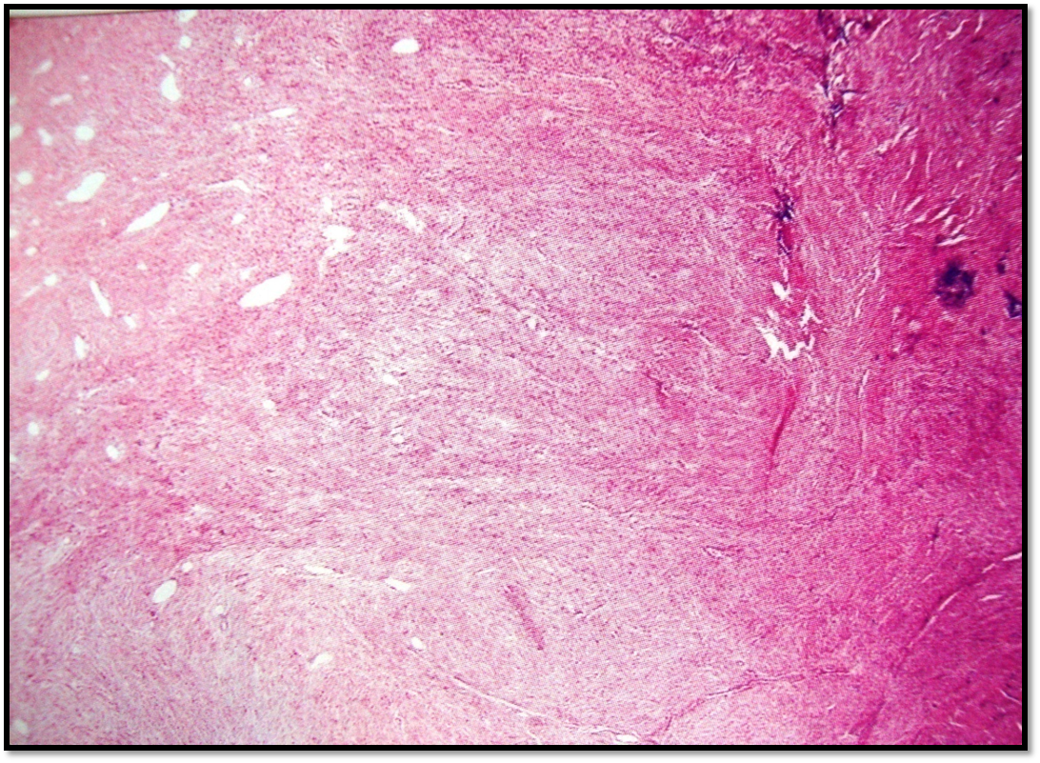
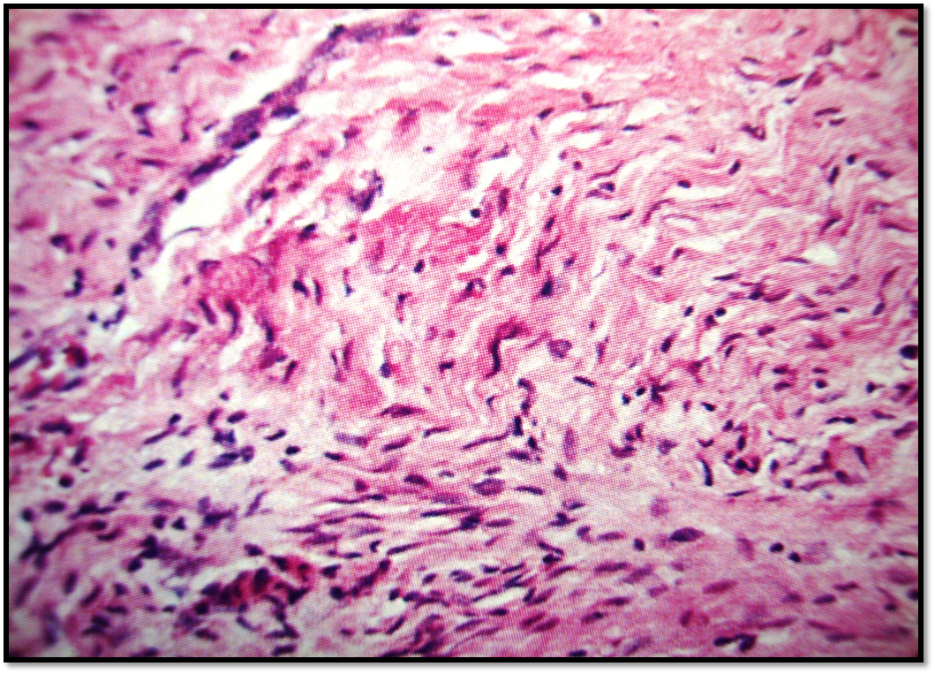
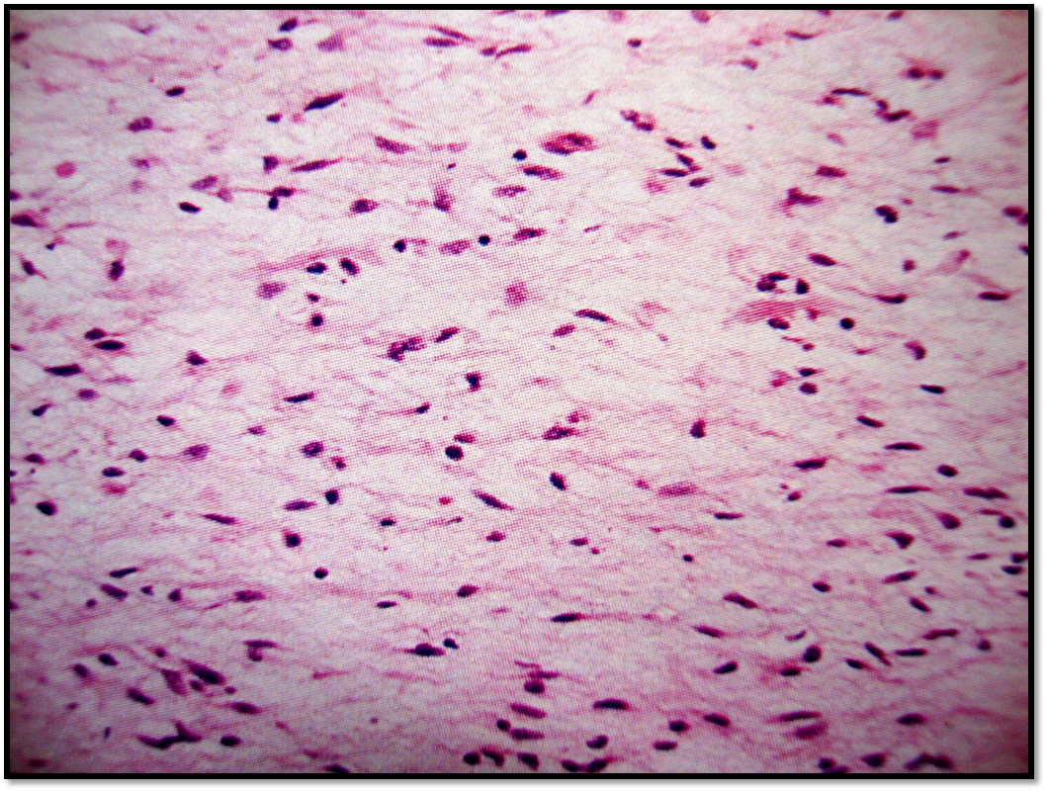

Slide 22
Clinical Differential Diagnosis
Vascular malformation
Rhabdomyoma
Lipoma
Notes:
Refer to Marx and Stern

Slide 23
 | Neurilemoma | Neurofibroma
Peak age | 20-50 years | 20-40 years
Location Cell origin | Any, especially tongue Schwann cell | Any. Especially tongue, buccal mucosa Schwann cell and peripheral fibroblast
Histological appearence | Encapsulated tumor composed of Antoni A and B; rarely plexiform growth | Localized , diffuse, or plexiform tumor that is usallly not encapsulated
Degenerative changes | common | occasional
S-100 protein immunostaining | Intense and relatively uniform | Variable staining of cells
Occurrence in NF-I | Uncommon | Plexiform neurofibroma or multiple neurofibromas are characteristics
Malignant trasformation | Extremely rare | Rare in solitary form; more common in neurofibromatosis

Slide 24
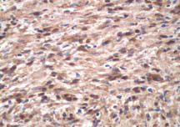
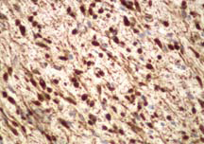
Neurilemoma
Neurofibroma
S-100 protein ++++
(nearly every cell +)
S-100 protein ++ to ++++
Immunohistochemistry in the Differential Diagnosis of Schwannoma and Neurofibroma; 2004

Slide 25
Neurofibromatosis
Peripheral form-type I / Neurofibromatosis Type-I (Von Recklinghausen’s Neurofibromatosis) associated with changes in chromosome 17, accounts for 90% of the cases
Central form-type II / Neurofibromatosis Type-II - long arm of chromosome 22, accounts for bilateral acoustic neuromas

Slide 26
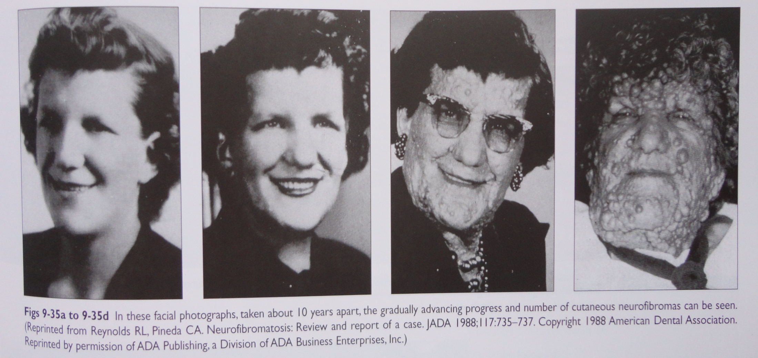

Slide 27
Neurofibromatoses type 1
Von Recklinghausen’s Neurofibromatoses
Inherited as an autosomal dominant trait.
Gene responsible for neurofibromatosis type I has been mapped to chromosome 17.
Multiple neurofibromas and Café au lait spots-PRIME CHARACTERISTICS

Slide 28
Clinical Features—
1)multiple neurofibromas, anywhere on skin. Appearance varies from small papules to large nodules or massive baggy pendulous masses called Elephantiasis Neuromatosa.
Presents at birth or later in life.
2)Café au lait ( coffee with milk) spots- smooth yellow to brown macules vary in size from 1-2 mm or cms. Present at birth or develop during 1st year of life.
3)Axillary freckling ( Crowe’s sign)
4)Lisch nodules translucent brown pigmented spots on iris, in nearly , all patients.
Other abnormalities– CNS tumors, mental retardation, seizures, short stature, scoliosis
Oral lesions-- common - enlargement of fungiform papillae( 50%)

Slide 29
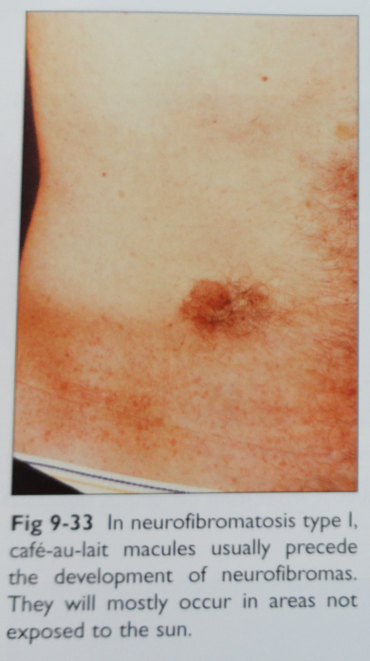

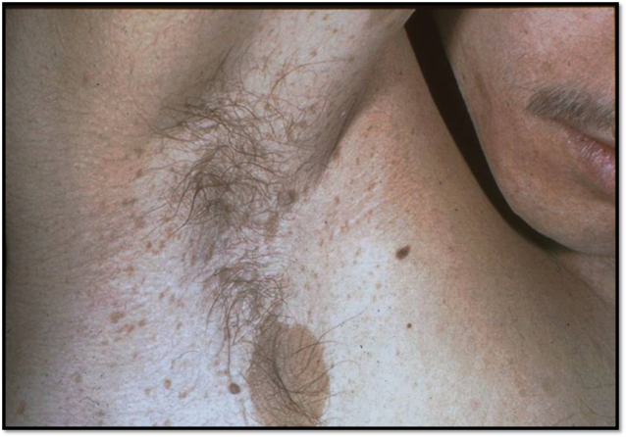
Clinical presentation
Development of café au lait spots, years before neurofibromas
Occur on areas not exposed to sun-differentiated from freckle
Axillary freckle’s sign or Crowe’s sign
Can be diagnosed early from a biopsy of the café au lait macule
Notes:
Talk abt melanosomes from Marx and Stern…….

Slide 30
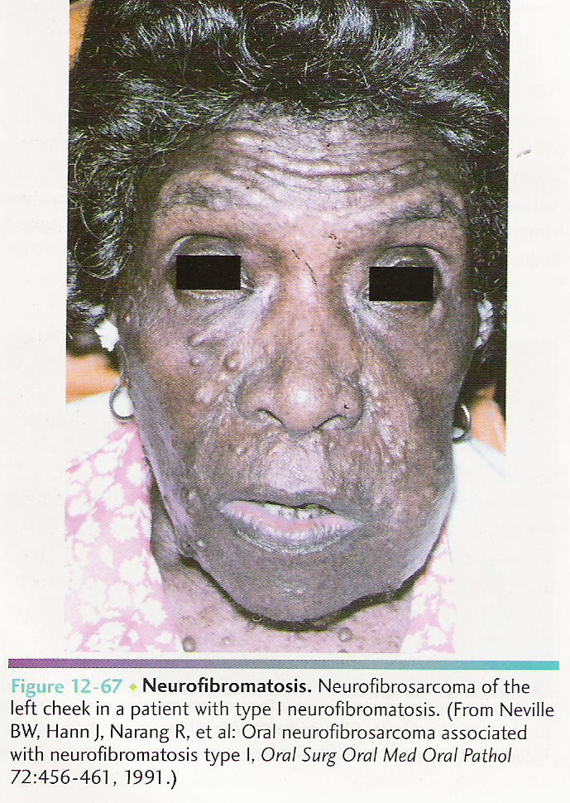
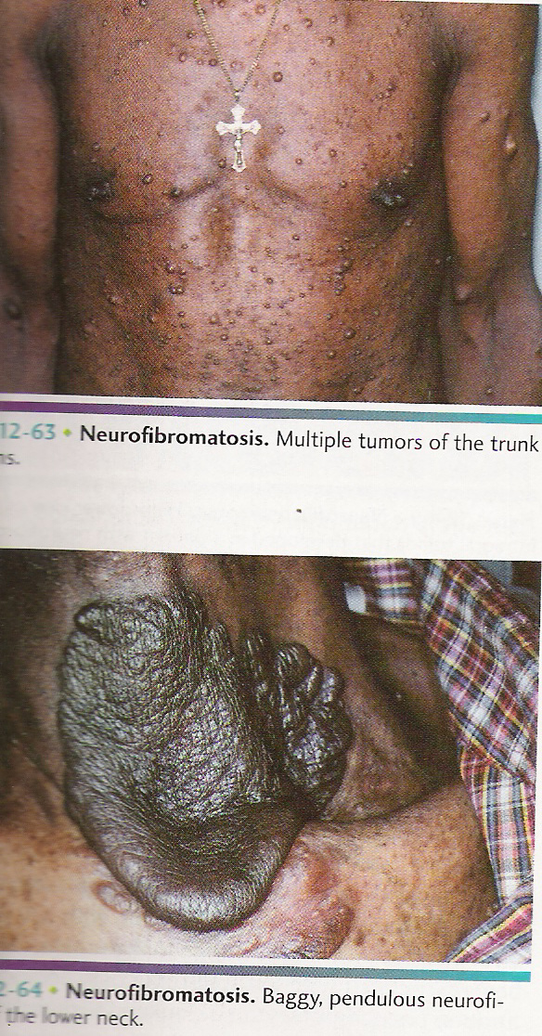
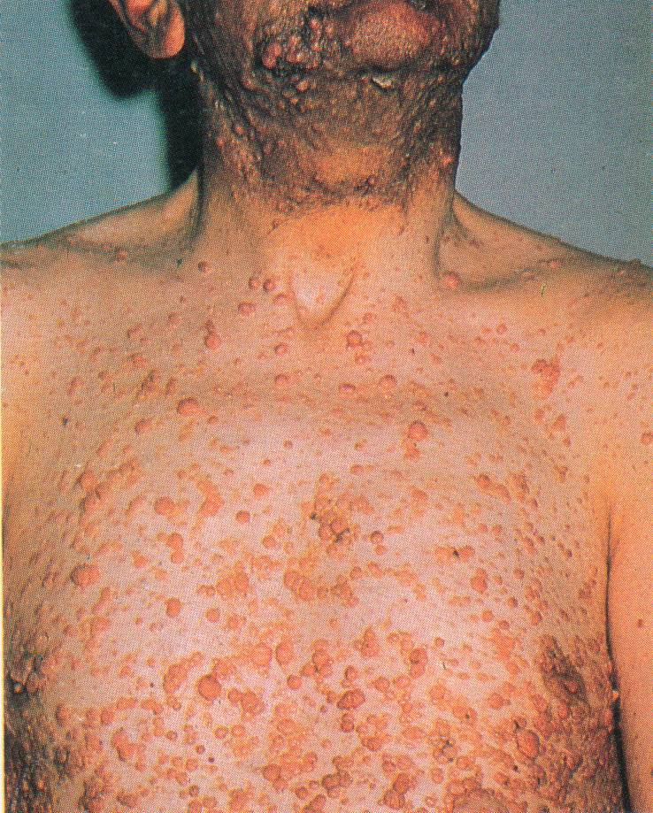

Slide 31
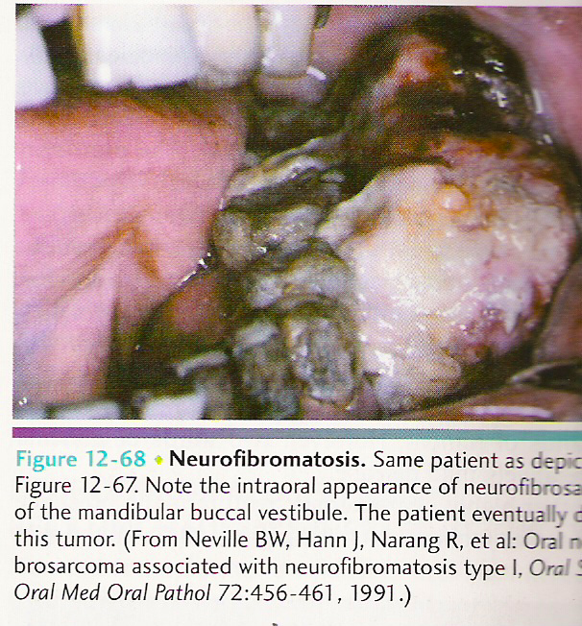
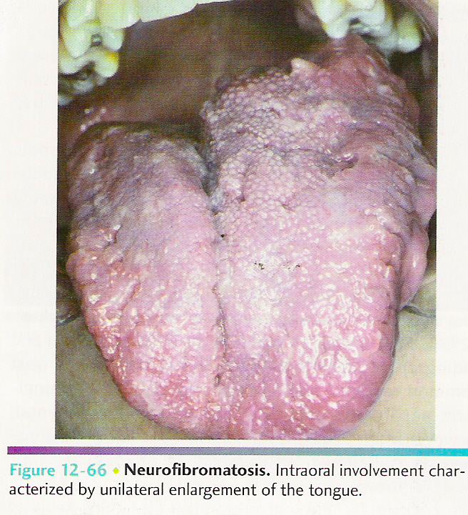
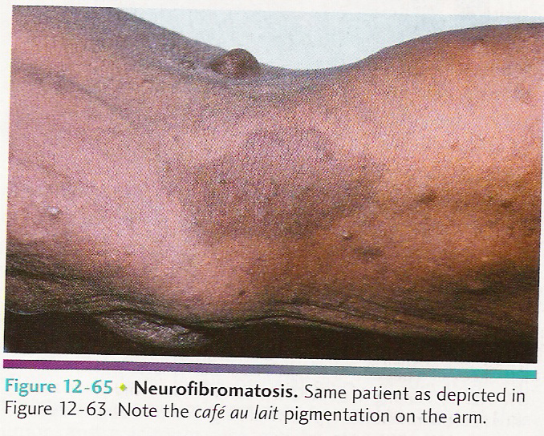

Slide 32
Diagnostic Criteria for NF-I
Individual with any of these two criteria
6 café au lait macules, >5mm diameter in pre-pubertal and >15mm diameter in post-pubertal patients
At least 2 neurofibromas of any type, or one plexiform neurofibroma
Axillary or inguinal freckling
Optic nerve glioma
A first degree relative of NF- I
Lisch nodules-2 or more
Distinct osseous lesion

Slide 33
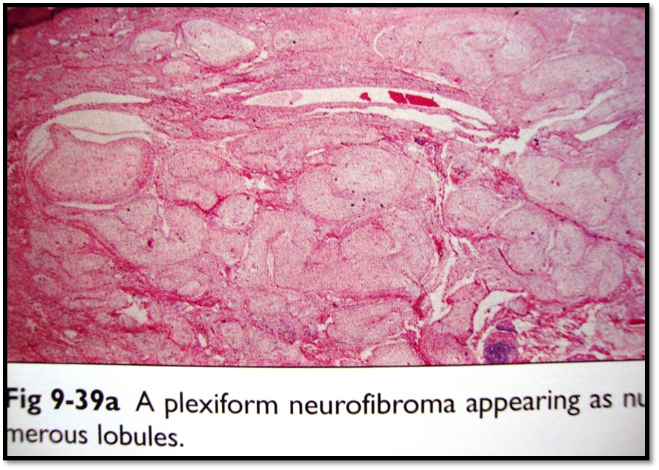
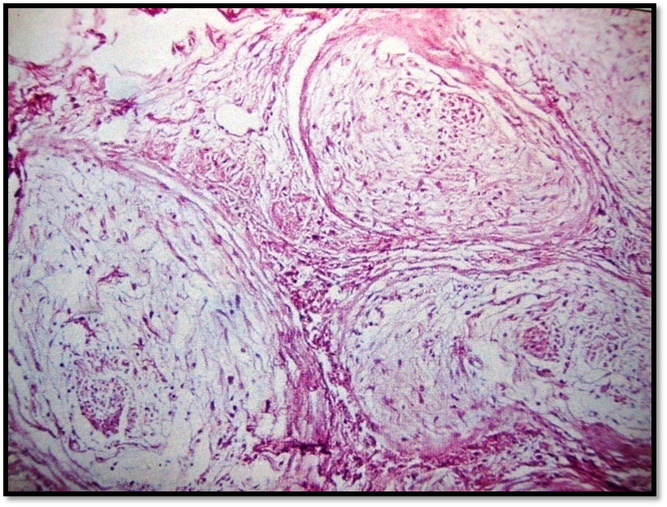

Slide 34
Neurofibromatoses type II
Less common than NF- I
Intracranial or intra spinal neural tumors
Most frequently produce Schwannoma – as acoustic neuroma
Hearing loss

Slide 35
Diagnostic Criteria for NF-II
Bilateral 8th nerve tumor or First degree
relative of NF-II
Unilateral 8th nerve tumor, or two of the
following
Dermal or subcutaneous neurofibromas
Plexiform neurofibromas
Schwannoma
Meningioma
Juvenile posterior capsular lenticular
opacity

Slide 36
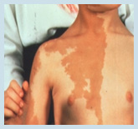
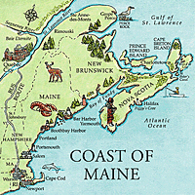
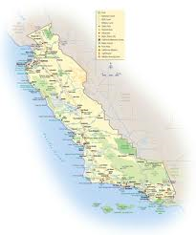
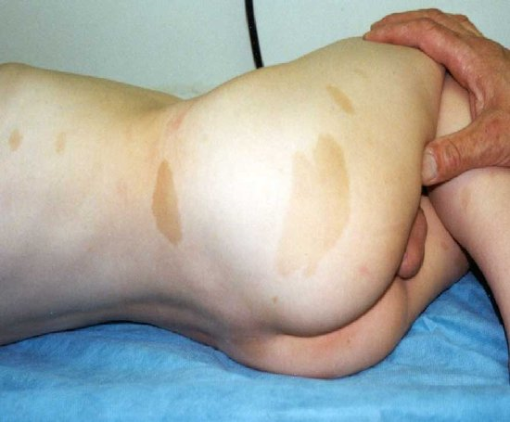
Clinical Differential Diagnosis
Jaffe type of fibrous dysplasia
Albright syndrome
Notes:
Put picture of coast of california and coast of Maine

Slide 37
Palisaded Encapsulated Neuroma
Predilection for peri-oral facial skin and palate
Non-painful sub-mucosal or intradermal mass
Result of reactive axonal regeneration attempts
Considered a hyperplasia rather than a neoplasm

Slide 38
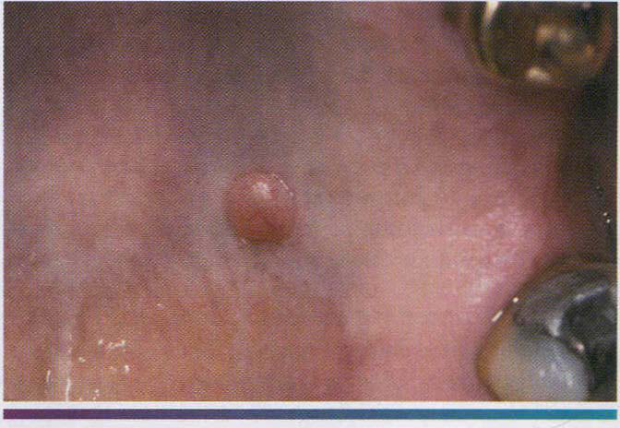
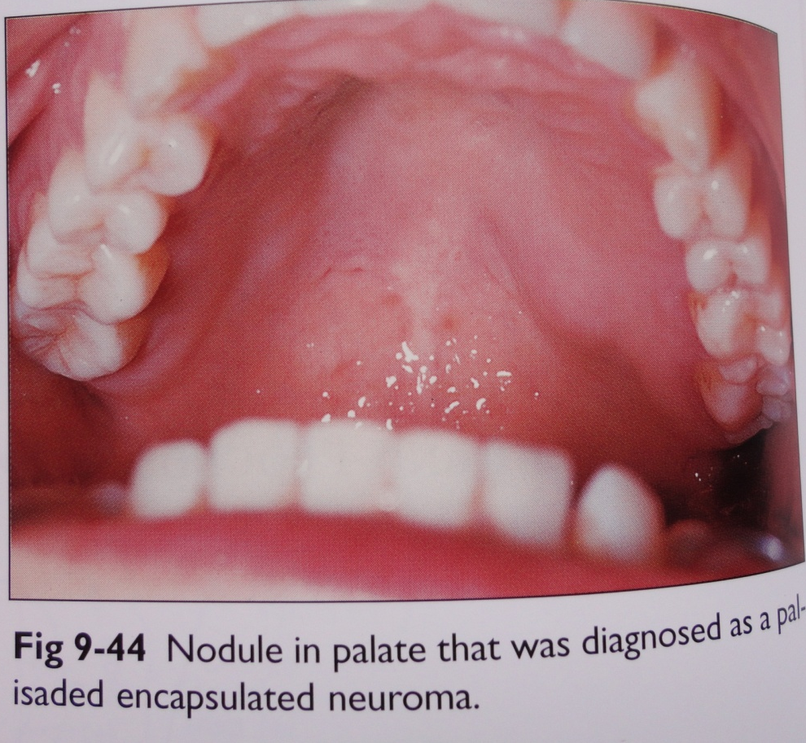
Palisaded encapsulated neuroma. Small. Painless nodule of the lateral hard palate.

Slide 39
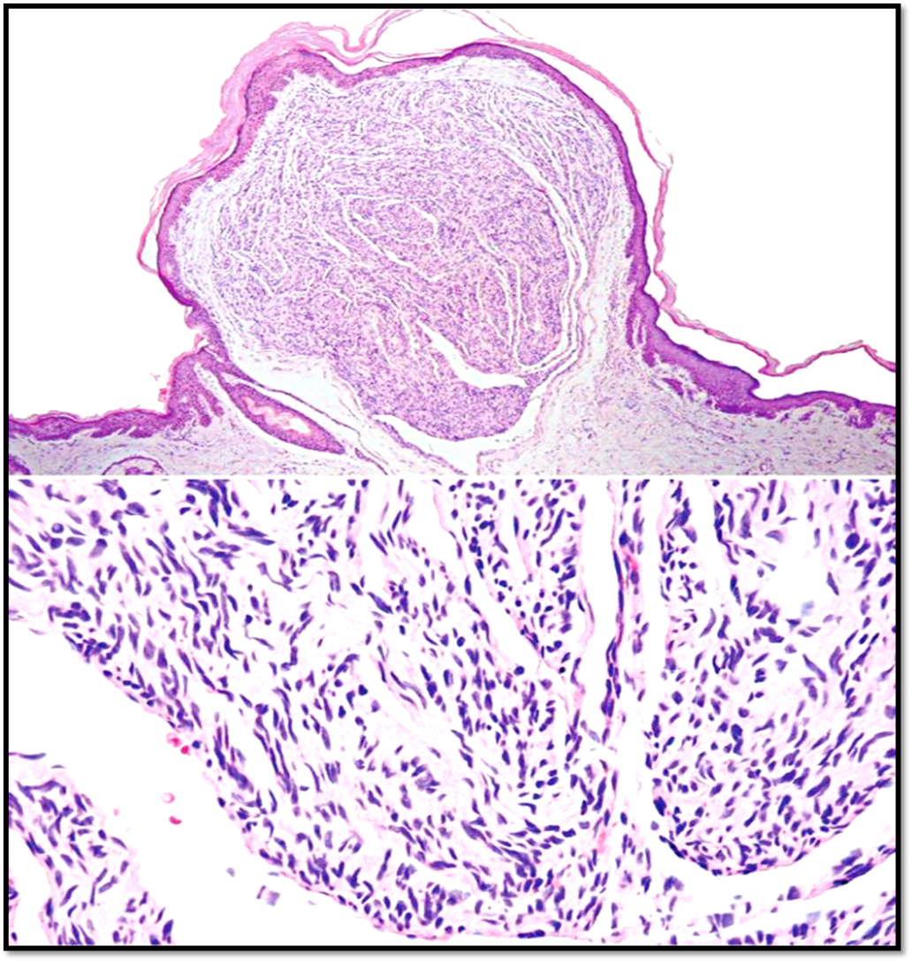
Palisaded encapsulated neuroma. low-power view showinga well-circumscribed, nodular proliferation of neural tissue.

Slide 40
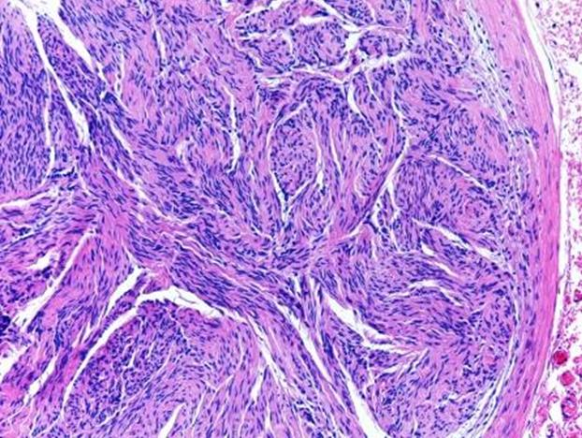

Slide 41
Clinical Differential Diagnosis
Schwannoma
Sebaceous or epidermal cyst
Nasolabial cyst
Notes:
Refer to Marx

Slide 42
MUlTIPLE ENDOCRINE NEOPLASIA TYPE 2B
The multiple endocrine neoplasia (MEN) syndromes are a group of rare conditions characterized by tumors or hyperplasias of neuroendocrine tissues.
MEN type 2B- pheochromocytomas and medullary thyroid carcinoma
Patients with MEN type 2B have mucosal neuromas that especially involve the oral mucous membranes

Slide 43


Multiple endocrine neoplasia (MEN) type 2B.
Note the narrow face and eversion of the upper eyelids.
Multiple endocrine neoplasia (MEN) type 2B.
Multiple neuromas along the anterior margin of the tongue and bilaterally at the commissures

Slide 44


Multiple endocrine neoplasia (MEN)type 2B.
low-power view of an oral mucosal neuroma showing marked hyperplasia of nerve bundles.
Multiple endocrine neoplasia (MEN) type 2B. Note the prominent thickening of the perineurium.

Slide 45
MALIGNANT TUMORS OF NERVE TISSUE ORIGIN
    MALIGNANT PERIPHERAL NERVE SHEATH TUMOR
    OLFACTORY NEUROBLASTOMA

Slide 46
Malignant Peripheral Nerve Sheath Tumor
Also called as neurofibrosarcoma; malignant neurilemmoma; malignant schwannoma; neurogenic sarcoma.
Malignant transformation of a neuro-fibroma in hereditary neurofibromatosis with a latency of 15 to 20 years
Centrally within the jaws or as a deep soft tissue malignancy
M: F- (3:2) , 20 to 60 years

Slide 47

Spindle cell malignancy of Schwann cells.
Half of the cases are associate with neurofibromatosis-I.
More common in lower extremities.
Involves neck, tongue, soft palate.
Central lesion involves mandibular nerve.
Manifest diffuse radiolucency.

Slide 48


Slide 49

Spindle cells arranged in fascicles.
myxoid regions.
Cellular and nuclear pleomorphism
Eosinophilic cytoplasm.
High mitotic activity.

Slide 50

Spindle cells arranged in fascicles.
and myxoid regions.
Cellular and nuclear pleomorphism
Eosinophilic cytoplasm.
High mitotic activity.
Notes:
Add histopath from Lucas …..add photos

Slide 51
Three categories:
Epitheloid: plump, rounded or ovoid epitheloid cells scattered throughout the spindled lesional cells
Mesenchymal
Glandular: contains areas with usually well differentiated ductal structures lined by simple, stratified, cuboidal or columnar epithelial cells with occasional goblet cells.
Malignant Triton Tumor: Malignant nerve sheath tumors with rhabdo-myoblastic differentiation
.

Slide 52
Differential diagnosis:
Leiomyosarcoma
Fibrosarcoma
Benign nerve sheath tumor- neurofibroma

Slide 53
Olfactory Neuroblastoma or Esthesioneuroblastoma
Malignant tumors of neuroectodermal cell origin arising from olfactory placode high in the nasal cavity
Production of norepinephrine and dopamine beta‐hydroxylase, the enzyme that catalyzes the conversion of dopamine to norepinephrine
Infancy up to the age of 3 years and are a common malignancy in children, 90% occur after the age of 10 years.

Slide 54
Lesion- unilateral nasal obstruction and epistaxis
Large lesions that erode into paranasal sinuses or the orbits may obstruct the nasolacrimal duct - nasal speculum examination will identify a gray fleshy mass in the superior meatus of the nasal cavity
Symptoms -epiphora, headaches, or anosmia

Slide 55

Olfactory neuroblastoma.
A Tl-weighted sagittal magnetic resonance image (MRI) showing a tumor filling the superior nasal cavity and ethmoid sinus, with extension into the anterior cranial fossa

Slide 56




Slide 57
Differential Diagnosis
Nasal obstruction, epistaxis, and periorbital expansion in a teenager or young adult suggestive of a nasopharyngeal angiofibroma or a rhabdomyosarcoma
Malignant fibrous histiocytoma or fibrosarcoma- A transnasal incisional biopsy done
Meningioceoles that have perforated the cribriform plate to present in the superior aspect of the nasal cavity- Meningioceole would leak cerebrospinal fluid if it were biopsied

Slide 58


