Slide 1
ORAL MUCOUS
MEMBRANE
Dept Of Dental Anatomy, Embryology & Histology

Slide 2
DEFINITION
Term mucous membrane is used to describe the moist lining of the gastrointestinal tract, nasal passage and other body cavities that communicate with the exterior.
In the oral cavity this lining is called
ORAL MUCOUS MEMBRANE
OR
ORAL MUCOSA

Slide 3
At the lips it is continuous with the skin. At the pharynx it is continuous with the mucosa lining the rest of the gastrointestinal tract
Thus the oral mucous membrane is situated anatomically between skin and gastrointestinal tract.

Slide 4
FUNCTIONS OF ORAL MUCOSA
Protection
- Separates and protects the deeper tissues.
- Mechanical forces such as compression, stretching,
shearing and surface abrasion (from hard particles in the diet).
- Major barrier from microorganisms causing
infection, toxins & various antigens.
Sensation
- Touch, pain, pressure & temperature
- Taste-anterior 2/3rd of dorsum of tongue

Slide 5
Lubrication
- Major secretion of oral mucosa is saliva secreted
by salivary gland which maintains mucosa moist,& also helps in speech, mastication, swallowing & in perception of taste.
Thermal Regulation
-Heat is dissipated through the oral mucosa by
panting (in some animals such as dog) which
maintains body temperature.

Slide 6
CLASSIFICATON
A . Based on Functional criteria
1. Masticatory mucosa
- Gingiva
- Hard Palate
2. Lining or reflecting mucosa
- Lip, cheek
- Soft palate
- Vestibular fornix
- Alveolar mucosa
- Floor of mouth

Slide 7
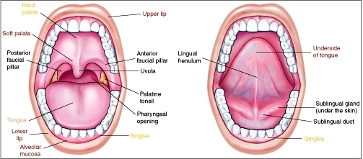
3.Specialised or sensory mucosa
- Dorsum of tongue
- Taste buds
.

Slide 8
B . Based on Keratinization
1. Keratinized Areas
- Masticatory mucosa
- Vermillion border of lip
2. Non-Keratinized Areas
- Lining or reflecting mucosa
The comparable part of skin is termed as epidermis and dermis or corium.

Slide 9
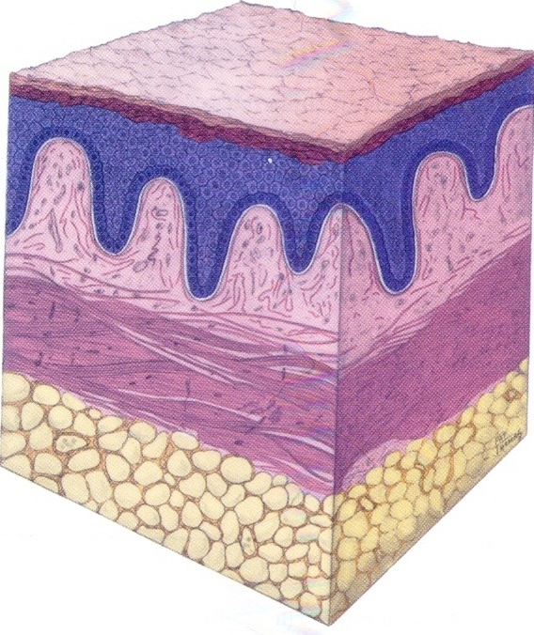

Slide 10
The interface between epithelium and connective tissue is usually irregular and upward projections of connective called connective tissue papillae, interdigitate with epithelial ridges or pegs called the rete ridges or pegs.

Slide 11
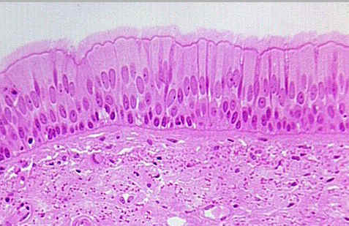
BASAL LAMINA OR
BASEMENT MEMBRANE
Basement membrane is present at the interface of epithelium and connective tissue,which appears as structure less layer

Slide 12
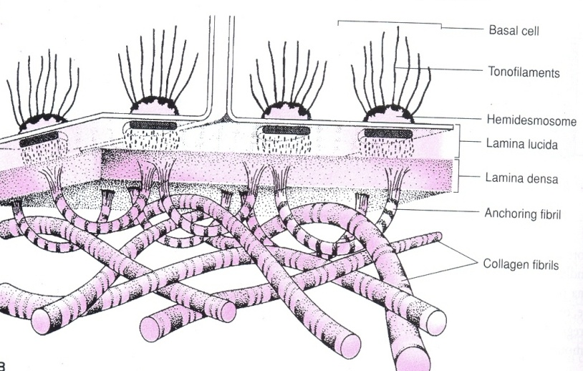
The Basal lamina is evident at electron microscope level.
The Basement Membrane is evident at the light microscopic level, 1 to 4µm wide and is relatively cell free

Slide 13
BASAL LAMINA
Consist of a layer of finely granular or filamentous material about 50 nm thick called LAMINA DENSA, runs parallel to the basal cell membrane
Lamina densa separated from the basal cell membrane by an apparently clear zone 45 nm wide called the LAMINA LUCIDA.

Slide 14
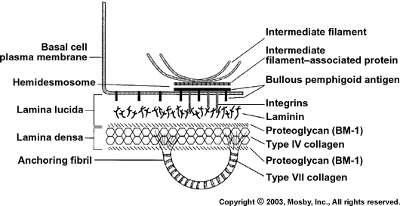

Slide 15
The layer represents the SUBMUCOSA in the oral cavity and determine the flexibility of oral mucosa to underlying structure.
The minor salivary glands are situated in the submucosa of the oral mucosa.

Slide 16
Associated with the lamina densa are striated fibrils called anchoring fibrils (type VII collagen) which form the loop through which run the collagen fibrils of the connective tissue.
Each end of the loop enter the lamina densa and fans out to form a spray of finer filament.

Slide 17
Network of anchoring fibrils provides interlocking between larger collagen fibers of connective tissue and the lamina densa.
The lamina densa contains type IV collagen arranged in “chicken wire” configuration.

Slide 18
ORAL EPITHELIUM
The oral epithelium is a stratified squamous epithelium consisting of cells tightly attached to each other and arranged in a number of distinct layers or strata.
The oral epithelium may be keratinized, parakeratinized or nonkeratinized, depending on location.

Slide 19
A common feature of all epithelial cells is keratin intermediate filaments (tonofilaments or cytokeratins ) as a component of their cytoplasm.
The cells of epithelium consists of two functional population
Progenitor population (divide & provide new cells)
Maturing population (differentiation or maturation to form a protective surface layer)

Slide 20
The cells arises by division in the basal or parabasal layers of the epithelium and undergoes maturation as they move to the surface.
Maturation in the oral cavity follows two main patterns.
- Keratinization
- Nonkeratinization

Slide 21
KERATINIZED EPITHELIUM
The epithelial surface of the masticatory mucosa is inflexible, tough, resistant to abrasion and tightly bound to lamina propria.
The mucosal surface result from the formation of a surface layer of keratin and the process of maturation is called keratinization or cornification.

Slide 22
The time taken for a cell to divide & pass through the entire epithelium is termed as Turnover time /Turnover rate
There are four layers of keratinized epithelium.
1. Basal ( Stratum basale)
2. Spinous (Stratum spinosum)
3. Granular (Stratum granulosum)
4. Cornified (Stratum corneum)

Slide 23
Basal cell
Basal cell (Maturing population)
Spinous cell
Granular cell
Surface squama
Basal cell (progenitor population)
Mitosis
Desquamates
Differentiation

Slide 24
NON-KERATINIZED EPITHELIUM
They do not produce cornified surface layer.
There are four layers of non- keratinized epithelium.
1. Basal ( Stratum basale)
2. Prickle cell
3. Intermediate (Stratum intermedium)
4. Superficial (Stratum superficiale)

Slide 25
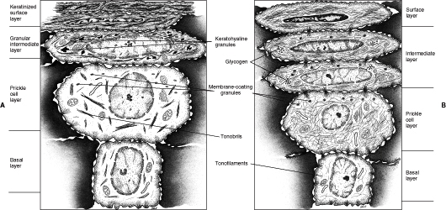
Principal structure of oral epithelium in successive layers
Orthokeratinized B. Non- keratinized
oral epithelium oral epithelium

Slide 26
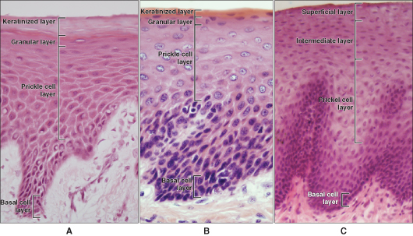
Histologic section
A. Orthokeratinization B. Parakeratinization C. Non- keratinization

Slide 27
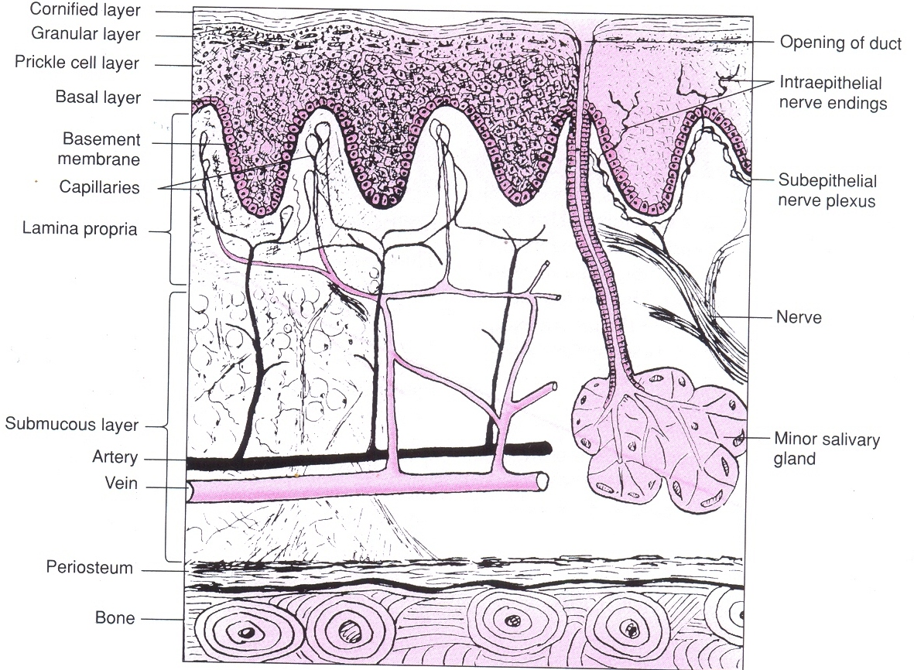
LAMINA PROPRIA
The connective tissue supporting the oral epithelium is termed LAMINA PROPRIA.
It can be divided into two layers.
- Superficial papillary layer
- Deeper reticular layer

Slide 28
In papillary layer, collagen fibers are thin and loosely arranged and many capillary loops are present.
In reticular layer, collagen fibers are arranged in thick bundles and lie parallel to surface plane.
The lamina propria may be attached to the periosteum of the alveolar bone.

Slide 29
SUBMUCOSA
The submucosa consists of connective tissue of varying thickness and density. It attaches the mucous membrane to the underlying structures.

Slide 30
Glands, blood vessels, nerves, lymph vessels and adipose tissue are present in this layer.
It is in the submucosa that larger arteries divide into smaller branches which then enter the lamina propria.

Slide 31
SUBDIVISIONS OF ORAL MUCOSA
For descriptive purposes, the oral mucosa can be divided into following areas :
1. Keratinized Areas
- Masticatory mucosa ( gingiva and hard palate)
- Vermillion border of lip
2. Non-Keratinized Areas
- Lining or reflecting mucosa
3. Specialised or sensory mucosa

Slide 32

KERATINIZED AREAS
MASTICATORY MUCOSA
1. Hard palate
2. Gingiva
HARD PALATE
It is divided in two regions, anterior hard palate and posterior soft palate.

Slide 33
Both are distinguished from one another by color and palpation.
The hard palate is light pink while soft palate is red.
The hard palate is firm and less movable than soft palate because the mucous membrane of hard palate is tightly fixed to underlying periosteum.

Slide 34
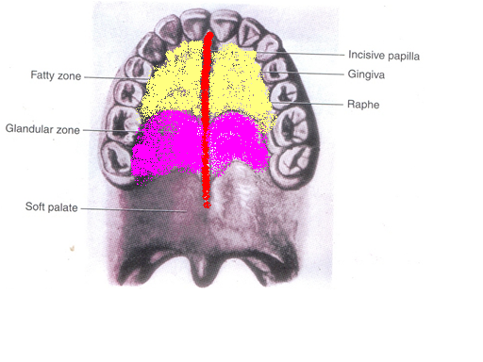
The hard palate is further divided into three regions –
1. The raphe
2. The fatty zone
3. The glandular zone

Slide 35
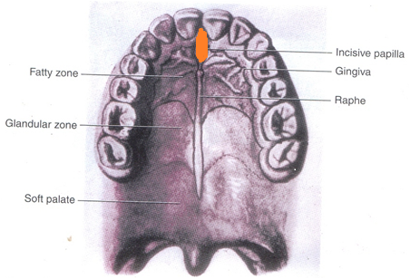
Incisive papilla
The oral incisive papilla is formed of dense connective tissue.
It contains the oral part of the vestigial Nasopalatine ducts.

Slide 36
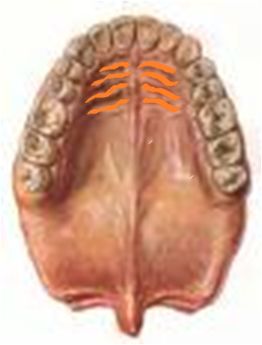
Palatine rugae (Transverse palatine ridges)
Irregular and often asymmetric in humans are ridges of mucous membrane extending laterally from the incisive papilla and the anterior part of the raphe
Made up of dense connective tissue layer with the interwoven fibers.

Slide 37
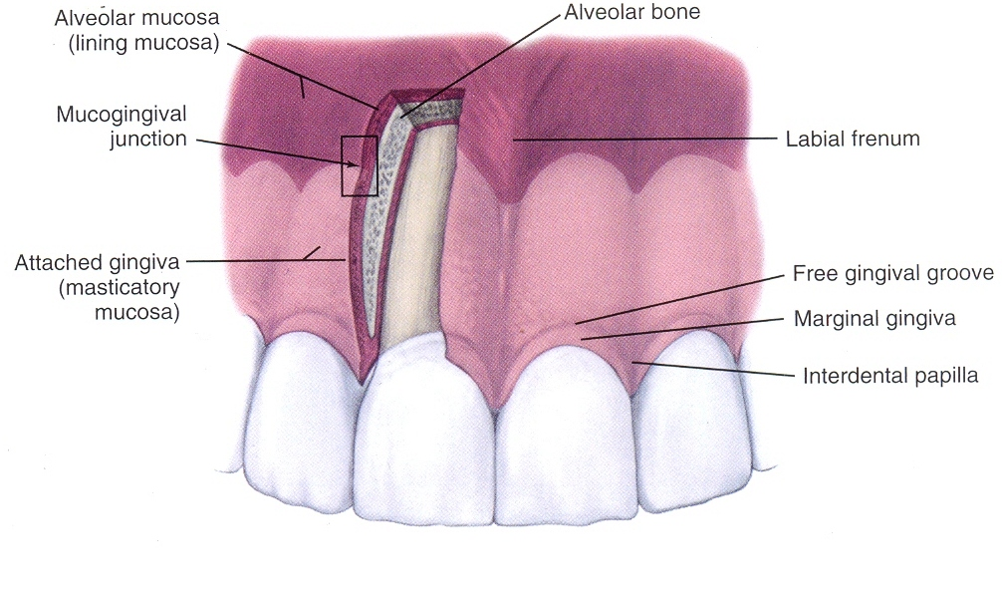
GINGIVA
The gingiva is that portion of the oral mucosa that surrounds and is attached to the teeth and the alveolar bone.
The gingiva extends from the dentogingival junction to the alveolar mucosa.

Slide 38
Gingiva can be divided into
i) Free gingiva
ii) Attached gingiva
iii) Interdental gingiva.

Slide 39
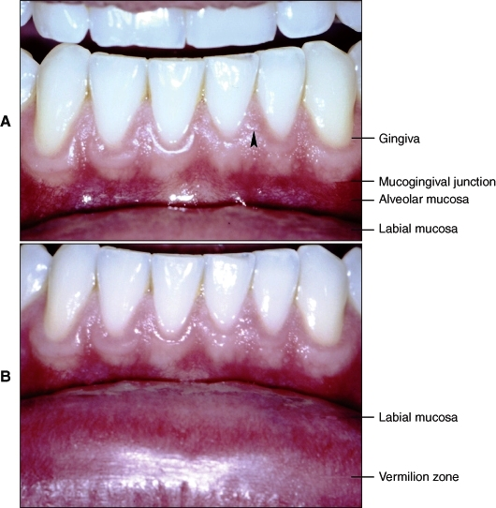
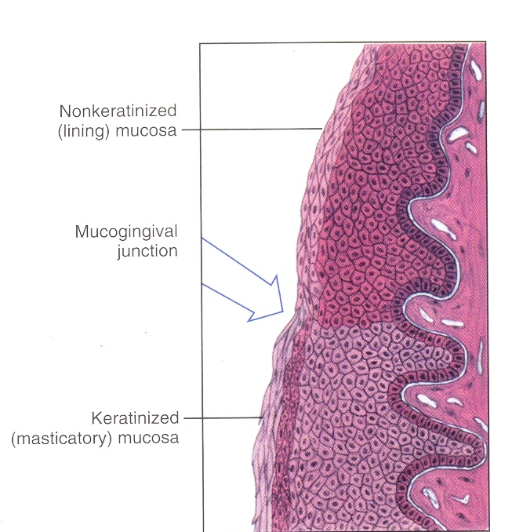

Slide 40
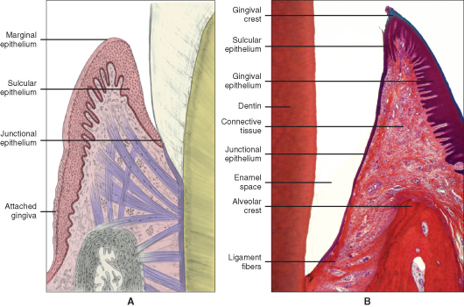
A. Different types of epithelium
B. Histologic section showing tissues

Slide 41
Gingiva and alveolar mucosa are separated by the mucogingival junction.
The alveolar mucosa is thin and loosely attached to the periosteum by a well-defined submucous layer of loose connective tissue , and it may contain small mixed glands.

Slide 42
The depression corresponds to the center of heavier epithelial ridges
Functional adaptations to mechanical impacts.
Disappearance of stippling- an indication of edema.
The degree of stippling and the texture of collagenous fibers vary with the different individuals, according to age and sex.

Slide 43
Interdental papilla
Part of gingiva that fills the space between two adjacent teeth.
The interdental papilla when viewed from the oral or vestibular aspect, the surface is triangular.
In a 3 dimensional view the interdental papilla of the posterior teeth is tent shaped, where as pyramidal between the anterior teeth.

Slide 44
Col: It is the central concave area which fits below the contact point seen in the tent shaped interdental papilla of the posterior teeth.
It is covered by non-keratinized epithelium and is more vulnerable to periodontal diseases.

Slide 45
BLOOD SUPPLY
It is chiefly from the branches of the alveolar arteries.
The lymph vessels of gingiva lead to submental and submandibular lymph nodes.
It is also well innervated by various nerve endings.

Slide 46
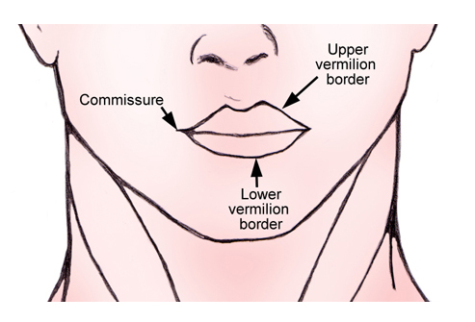
Vermilion border of lip

Slide 47
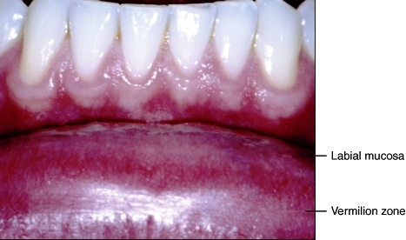
Vermilion zone of lip
It is the red/transitional zone between the skin and mucous membrane of the lip.
Only in humans
Skin on outer surface of the lip is covered by moderately thick, keratinized epithelium.

Slide 48
Papillae of connective tissue are few and short.
Sebaceous & sweat glands are seen, along with hair follicles
The epithelium of the mucous membrane of the lip is not keratinized.

Slide 49
The vermilion/transitional zone is characterized by
Mildly keratinised epithelium
Numerous, densely arranged, long papillae of the lamina propria, carrying large capillary loops close to the surface.

Slide 50
Pink/Red color of lip -Blood is visible through thin parts of translucent epithelium
No mucous glands present.
Like the skin, the transitional zone is exposed to atmosphere, but no glands present to keep it moist or preventing it from drying
So lips become dry easily and we lick our lips to moisten it.

Slide 51
NON KERATINIZED AREAS
Lining mucosa is found on lip, cheek, vestibular fornix and alveolar mucosa. They have thick non keratinized epithelium and thin lamina propria.
The reflectory mucosa found in fornix vestibule and in the sublingual sulcus at the floor of oral cavity has a submucosa that is loose and of considerable volume.

Slide 52
The mucous membrane is movably attached to deep structures and does not restrict the movement of lips, cheek and tongue.
The mucosa of the soft palate is intermediate between this type of lining mucosa and the reflecting mucosa.

Slide 53
LIP AND CHEEK
The epithelium of mucosa of lips and cheeks is stratified squamous nonkeratinized epithelium.
The lamina propria consists of dense connective tissue and has short, irregular papillae.

Slide 54
Submucous layer consists of strands of densely grouped collagen fibers. These strands limit the mobility of the mucous membrane, holding it to the musculature and preventing its elevation into folds and preventing from lodging between the teeth.

Slide 55
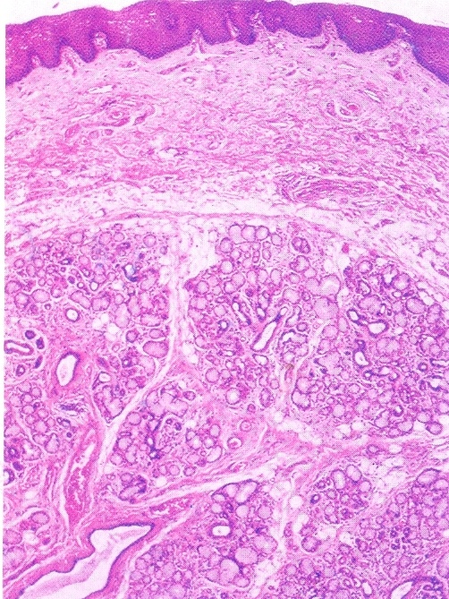
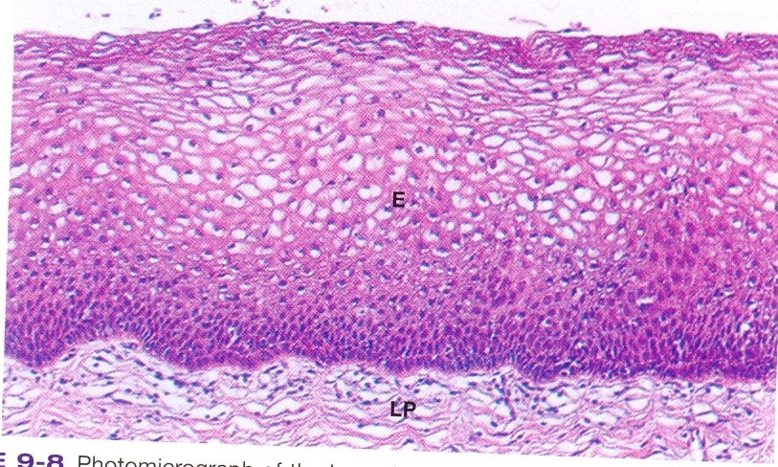
Labial mucosa
Buccal mucosa

Slide 56
The mixed minor salivary glands of the lips are situated in the submucosa whereas in the cheek glands are larger and are found between bundles of buccinator muscle and sometimes on its outer surface.
Some isolated sebaceous glands called Fordyce’s spot may occur lateral to the corner of mouth and are often seen opposite to molars.
A comparison of masticatory and buccal mucosa shows that in keratinized tissue epithelium is thinner.

Slide 57
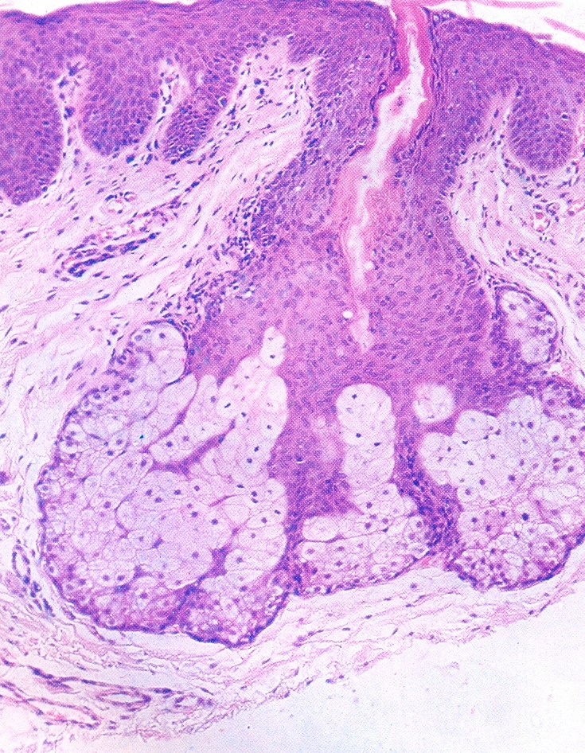
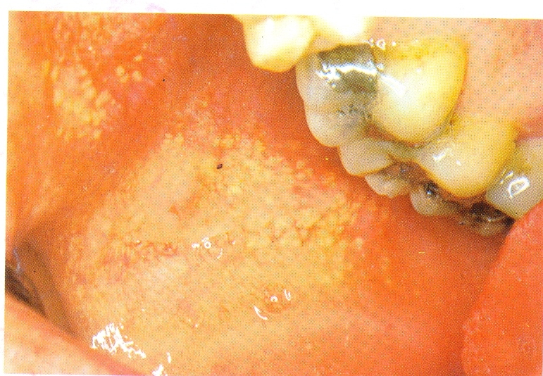
Fordyce’s spot

Slide 58
Vestibular fornix and alveolar mucosa
The mucosa of the lips and cheeks reflects from the vestibular fornix to the alveolar mucosa covering the bone.
The median and lateral labial frenula are folds of the mucous membrane containing loose connective tissue. No muscle fibers are found in these folds.

Slide 59
Inferior surface of tongue; floor of oral cavity
The mucous membrane on the floor of the oral cavity is thin and loosely attached to the underlying structures to allow for the free mobility of the tongue.
The epithelium is nonkeratinized, and the papillae of the lamina propria are short.
The submucosa contains adipose tissue. The sublingual glands lie close to the covering mucosa in the sublingual fold.

Slide 60
The mucous membrane of the inferior surface of the tongue is smooth and relatively thin. The epithelium is nonkeratinized.
The papillae of the connective tissue are numerous but short. Here the submucosa cannot be identified as a separate layer. It binds the mucous membrane tightly to the connective tissue surrounding the bundles of the muscles of the tongue.

Slide 61
Soft palate
The mucous membrane on the oral surface of the soft palate is highly vascularized and reddish in color, noticeably differing from the pale color of the hard palate.
The papillae of the connective tissue are few and short. The stratified squamous epithelium is nonkeratinized. The lamina propria shows a distinct layer of elastic fibers separating it from the submucosa.

Slide 62
It also contains taste buds.
Typical oral mucosa continues around the free border of the soft palate for a variable distance and is then replaced by nasal mucosa with its pseudo stratified ciliated columnar epithelium.

Slide 63

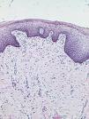

Slide 64
 | Lips and cheeks | Vestibule | Alveolar mucosa | Inferior surface of tongue | Floor of mouth | Soft palate
Epithelium | Non –keratinized Lip –thin Cheeks-thick | Thick non keratinized mucosa loosely connected to under lying structure | Thin non keratinized Epithelial ridges and papillae low and often missing. Mucous membrane is loosely attached to periosteum | Non keratinized epithelium Smooth and thin mucous membrane | Non keratinized epithelium, thin , loosely attached to under lying structure | Non keratinized epithelium Highly vascular mucous membrane

Slide 65
 | Lips and cheeks | Vestibule | Alveolar mucosa | Inferior surface of tongue | Floor of mouth | Soft palate
Lamina propria | Dense connective tissue Short irregular papillae | Loose connective tissue Thin lamina propria | Papillae low & often absent. Blood vessels present close to surface. | Papillae short & numerous | Papillae are short | Papillae few and short. Distinct fibers separate it from submucosa

Slide 66
 | Lips and cheeks | Vestibule | Alveolar mucosa | Inferior surface of tongue | Floor of mouth | Soft palate
Sub mucosa | Dense collagen fibers. Loose connective tissue with fat and small mixed glands present in between glands of lips—in sub mucosa glands of cheek in—between bundles of buccinator or on outer surface | Loosely textured sub mucosa large in volume | Well defined small mixed glands may be present | Cannot be identified as a separate layer | Adipose tissue present reflects to inferior surface of tongue and continues as ventro lingual mucosa | Contains a continuous layer of mucous glands taste buds present.

Slide 67
Differences between Masticatory and Lining mucosa
 | Masticatory mucosa | Lining mucosa
Colour | Light pink | Dark red
Surface | Stippled | Only areas
Attachment | Firmly attached to underlying periosteum | Loose attachment
Epithelium | Thin and keratinized | Thick and non keratinized
Intercellular bridges | Wider and prominent | Small and not prominent
Epithelium rete ridges | Numerous | Less in number
Connective tissue papillae | Numerous and high | Few and short
Lamina propria | Shows only presence of collagen fibers | Both collagen and elastic fibers are seen
Submucosa | Not recognized | Very distinct
Underlying tissue | Bone | Muscle fibers

Slide 68
SPECIALIZED MUCOSA
Dorsal lingual mucosa
Taste buds
The specialized (sensory) mucosa is so called
because it bears taste buds, which have sensory function.

Slide 69
DORSAL SURFACE OF TONGUE
The mucous membrane of the tongue is composed of
two parts, with different embryologic origins and is
divided by the V-shaped groove, the sulcus terminalis
(terminal groove).

Slide 70
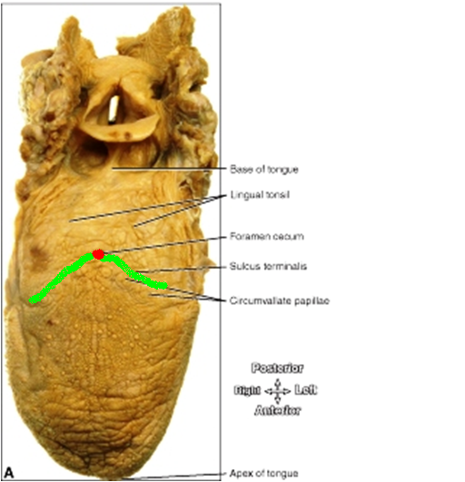
The anterior two thirds of the tongue, where the mucosa is derived from the first pharyngeal arch, often is called the body or papillary part.
The posterior third, where the mucosa is derived from the third pharyngeal arch, called the base

Slide 71
The mucosa covering the base of the tongue contains extensive nodules of lymphoid tissue, the lingual tonsils.
On anterior part:- Numerous papillae are seen-
Filiform papillae
Fungiform papillae
Circumvallate papillae
Foliate papillae

Slide 72
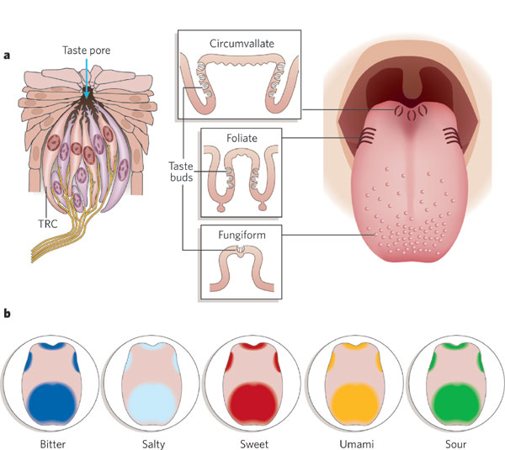
TONGUE SHOWING DIFFERENT PAPILLAE

Slide 73
Filliform papillae
Pointed, thread shaped, cone shaped, these are epithelial structures containing connective tissue from which secondary papillae protrude towards epithelium.
Responsible for velvety appearance of tongue and are most numerous.

Slide 74
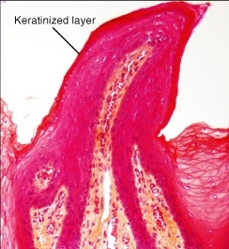
About 2 mm long arranged in rows parallel to sulcus terminalis, are conical or flame shaped with tips often showing several points.
Epithelium covering the papillae are relatively thick and keratinized.
Taste buds are absent

Slide 75
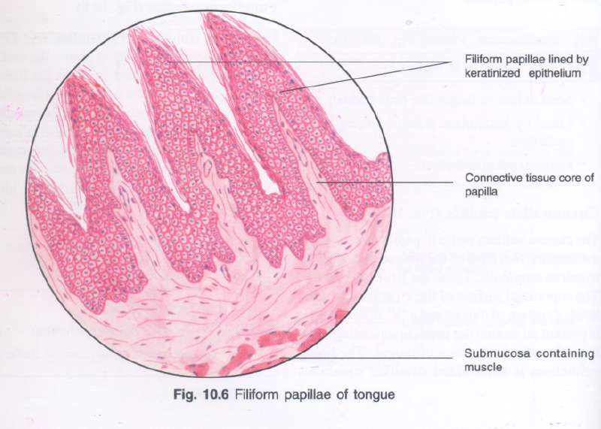

Slide 76
Fungiform papillae
Randomly dispersed among the Filiform papillae.
They may attain a height up to 2 mm and are mushroom shaped, round and reddish prominence.
Surface epithelium is nonkeratinized & somewhat thinner than that of Filiform papillae.

Slide 77
The domed surface of the fungiform papillae may bear one or more taste buds
The connective tissue is very vascular, decreased thickness of epithelium coupled with an increase in vascularity enables them to be identified because of their intense pink color.

Slide 78
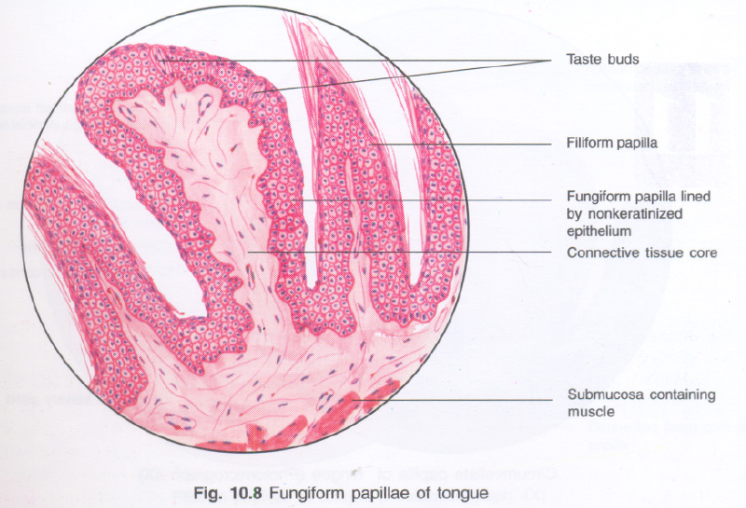

Slide 79
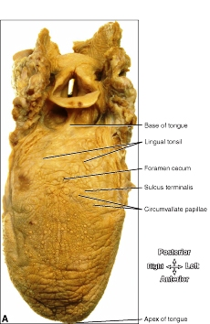
Circumvallate papillae
They are 8 to 10 in number, vallate(walled) papillae.
Present just anterior to sulcus terminalis.
They are largest of the lingual papillae, may be over 1 mm in length and up to 3mm in diameter.

Slide 80
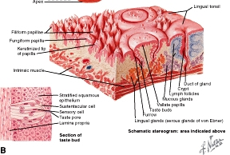
They are not a result of mucosal evagination, rather they are epithelial invagination i.e. don’t protrude above the surface of the tongue but are bounded by a deep circular furrow, only connection to the substance of the tongue is at their narrow base.
On lateral surface – numerous taste buds seen.

Slide 81
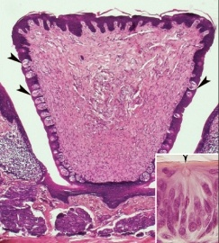

Slide 82
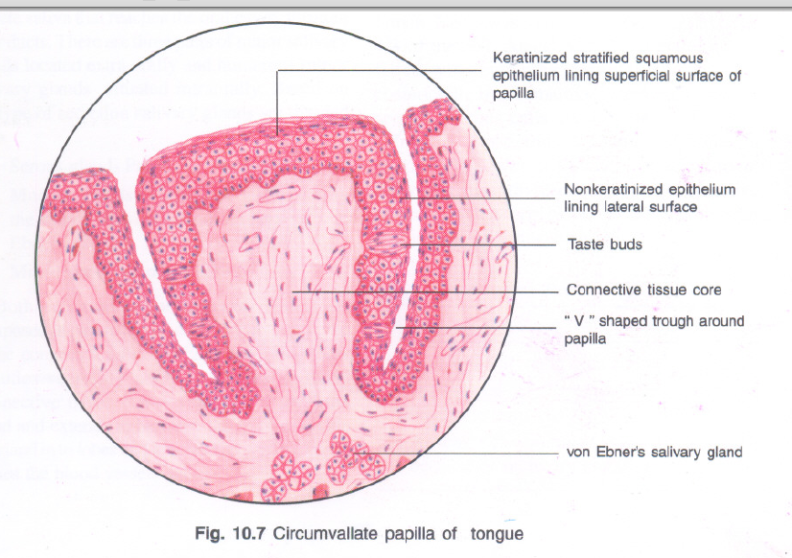

Slide 83
The ducts of small serous glands called von Ebner’s glands open into the trough, serve to wash out the soluble elements of food and are source of salivary lipase.

Slide 84
Foliate papillae
Foliate papillae are parallel mucosal folds at posterior lateral border of the tongue.
These mucosal clefts are well developed at birth, however with growth and maturation they undergo atrophic changes. So that at maturity they get reduced to rudimentary structures, 3 to 8 in numbers.
Taste buds are contained along the walls of the fold.

Slide 85
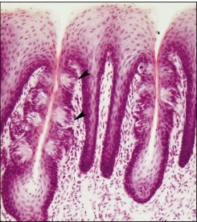
TASTE BUDS
Small ovoid or barrel-shaped intraepithelial organs about 80µm high and 40µm thick.
Extend from basal lamina to surface of the epithelium.

Slide 86
Outer surface –covered by few flat epithelial cells, that surround a small opening, taste pore – leads into a narrow space lined by supporting cells of the taste bud.
Outer supporting cells are arranged like staves of a barrel .

Slide 87
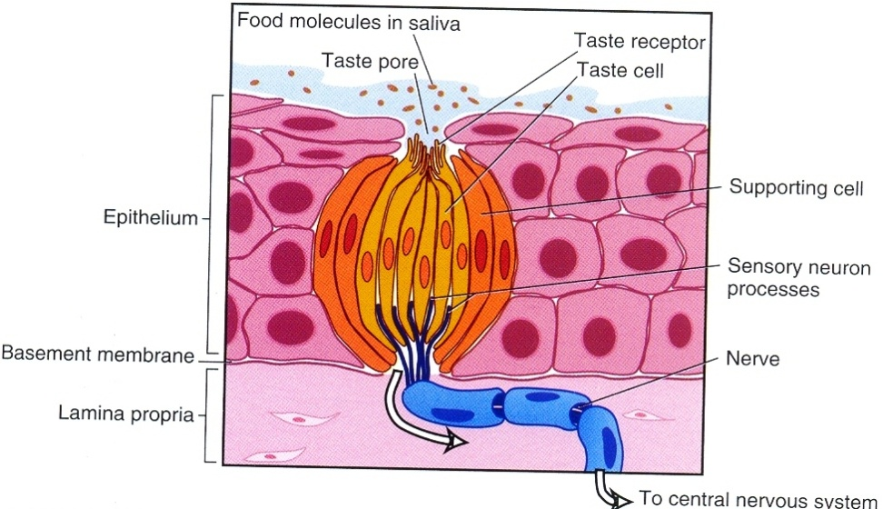
Inner cells-shorter and spindle shaped-between them are arranged 10-12 neuroepithelial cells, the receptors of taste stimuli, are slender, dark-staining cells that carry fingerlike processes at their superficial end.
A rich plexus of nerves is found below
the taste buds.
Taste buds also present on surface of
epiglottis

Slide 88
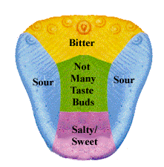
Primary taste sensations
Sweet- at tip of tongue.
Salty-lateral border of tongue.
Bitter-posteromiddle part of tongue.
Sour-posterolateral part of tongue.
Bitter and sour on palate also.

Slide 89
Fungiform papillae -: at tip- sweet,
at borders –salty
Circumvallate papillae -: Bitter
Foliate papillae -: Sour

Slide 90
Bibliography
Color Atlas And Text Book Of Oral Anatomy, Histology Berkovitz, B. 1ST edition.
Oral Development and Histology Avery, j. K.1st edition.
Orban's Oral Histology and Embryology Bhaskar, s. N.11th edition.
Oral Histology : Development, Structure and Funct Tencate, a. R. 4th edition.
Dental Embryology, Histology & Anatomy. Marry Bath- Balogh Inergaret. 2nd edition.

Slide 91
Thank you☺

