Slide 1
ORAL MUCOUS MEMBRANE
Dept Of Dental Anatomy, Embryology & Histology

Slide 2
Epithelial cells that ultimately keratinize are called keratinocytes.
The epithelium contains a smaller group of cells that do not possess cytokeratin filaments & so they do not have the ability to keratinize. They are known as non-keratinocytes.

Slide 3
At ultrastructural level they have been identified as
Melanocytes
Langerhans cells
Merkel cells
Inflammatory cells
- All Except Merkel cells lack desmosomal attachment, lack tonofilaments too and don’t take part in maturation.

Slide 4
Non Keratinocytes
Do not show mitotic activity
Do not undergrow maturation
Do not arrange in layers
Do not attach with adjacent keratinocytes by desmosomes
Dendritic & appear clear in routine H& E stained section
Migrate from neural crest cells

Slide 5
Melanocytes & Pigmentation
Endogenous pigmentation by Hemoglobin & Melanin.
Melanin produced by melanocytes situated in basal layer.
Arise from neural crest ectoderm & enter the epithelium at about 11 wks of gestation.
Melanin synthesized by melanocytes in the form of melanosomes.

Slide 6
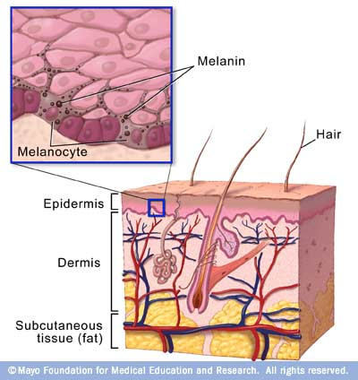

Slide 7
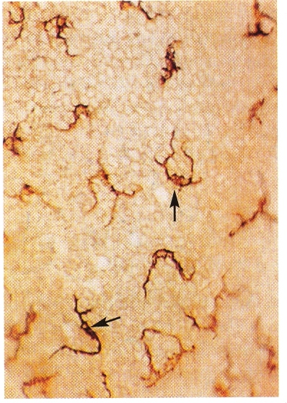
Melanophages may be seen in CT
Commonly pigmented areas gingiva, buccal mucosa, palate.
Nevus, Melanoma.
Exogenous pigmentation by Amalgam, lead, bismuth etc.
Burtonian’s line

Slide 8
Langerhans cells
Dendritic cell seen in suprabasal layer.
Lacks desmosomal attachment.
Ultrastructurally, presence of rod or flask shaped granule known as Birbeck granule.

Slide 9
Appear at same time as melanocytes
Move in & out of epithelium
Source is bone marrow.
Immunologic function.

Slide 10
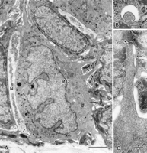
Merkel Cell
Situated in basal layer
Non dendritic
Few tonofilaments & occasional desmosomes
Characteristic presence of membrane bound vesicle in the cytoplasm.
Have a sensory function &
respond to touch.

Slide 11
Inflammatory cells
Lymphocyte most frequently found cell.
PMN’s & Mast cells may also be present.
Associated with langerhans cells and responsible for activation of T lymphocytes.

Slide 12
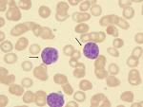

Slide 13
Junction of the epithelium and lamina propria
The region where C.T. of the lamina propria meets the overlying Epithelium is an undulating interface at which papillae of the CT interdigitate with epithelial ridges.
This arrangement provide large interface area and better attachment.

Slide 14
Masticatory mucosa has greater number of papillae per unit area.
In lining mucosa papillae are fewer and shorter.
Also represent a major interface for metabolic exchange as there are no blood vessels in epithelium.

Slide 15
GINGIVAL SULCUS AND DENTOGINGIVAL JUNCTION

Slide 16
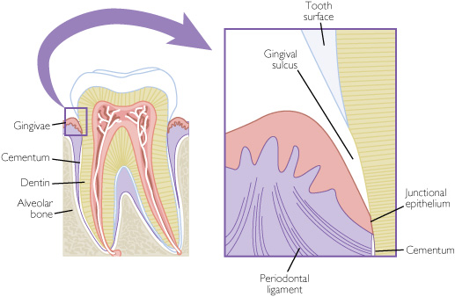

Slide 17
Gingival sulcus
It is a crevice or invagination made by gingiva as it joins with tooth surface .
Gingiva at its margin remains free i.e. doesn’t join the tooth called Free gingival margin.
Sulcus extends from free gingival margin to dentogingival junction (junction between tooth surface and gingival tissues)

Slide 18
Depth of healthy gingival sulcus varies from
0.5 to 3mm with an average of 1.8 mm
Sulcus is filled with crevicular fluid (GCF) which passes into oral cavity and mixes with saliva.
GCF contains immunological components and cells of blood eg. WBCs ,PMNLs, IgG, IgM, & IgA.

Slide 19
JUNCTIONS IN ORAL MUCOUS MEMBRANE
Mucocutaneous junction
Mucogingival junction
Dentogingival junction

Slide 20
DENTOGINGIVAL JUNCTION
The junction between gingiva & tooth -
DENTOGINGIVAL JUNCTION.
The epithelium of gingiva which gets attached to the tooth –Junctional /Attachment epithelium
The union between this epithelium & tooth -
- Epithelial Attachment

Slide 21
Resembles RER in structure ( a basal layer & few layers of flattened cells)
Nondifferentiating, nonkeratinizing tissue.
It extends upto 2 mm on the surface of the tooth
Has highest turnover rate of 5-6 days, so regenerates readily.

Slide 22
Highly permeable
It is a point of least resistance to mechanical forces and bacterial attack.

Slide 23
Firmness of this junction is maintained by gingival division of periodontal ligament.
Deeper extention of sulcular epithelium is junctional (attachment) epithelium, which lines floor of gingival sulcus and is attached to tooth surface by way of epithelial attachment.

Slide 24
Development of junctional (attachment) epithelium
When the ameloblasts finish formation of the enamel matrix, they leave a thin membrane on the surface of the enamel, the primary enamel cuticle
This cuticle is connected with the interprismatic enamel substance and the ameloblasts.

Slide 25
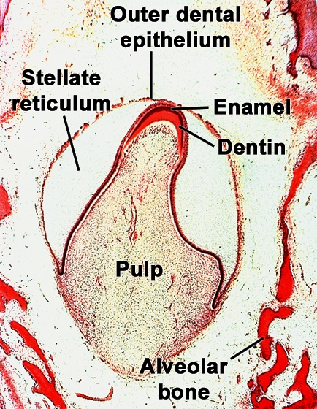

Slide 26
Reduced Enamel Epithelium(RER)
The ameloblasts shorten after the primary enamel cuticle has been formed, and the epithelial enamel organ is reduced to a few layers of flat cuboidal cells, which are then called Reduced Enamel Epithelium (RER).
Under normal conditions RER covers the entire enamel surface, extending to the cementoenamel junction, and remains attached to the primary enamel cuticle.

Slide 27
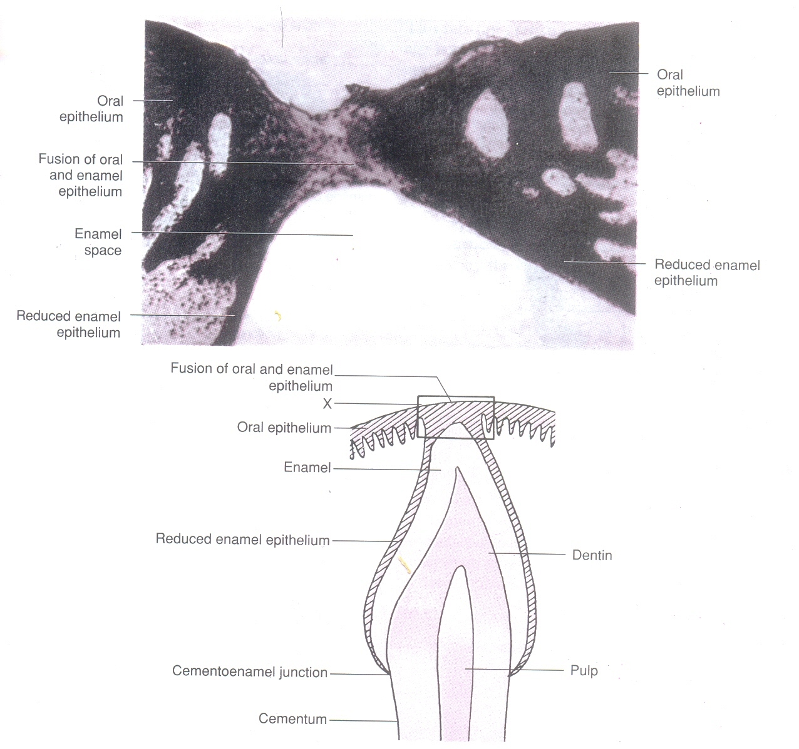

Slide 28
During eruption, the tip of the tooth approaches the oral mucosa, and the reduced enamel epithelium and the oral epithelium meet and fuse.
The remnant of the primary enamel cuticle after eruption is referred to as Nasmyth's membrane.

Slide 29
The epithelium that covers the tip of the crown degenerates in its center, and the crown emerges through this perforation into the oral cavity.

Slide 30
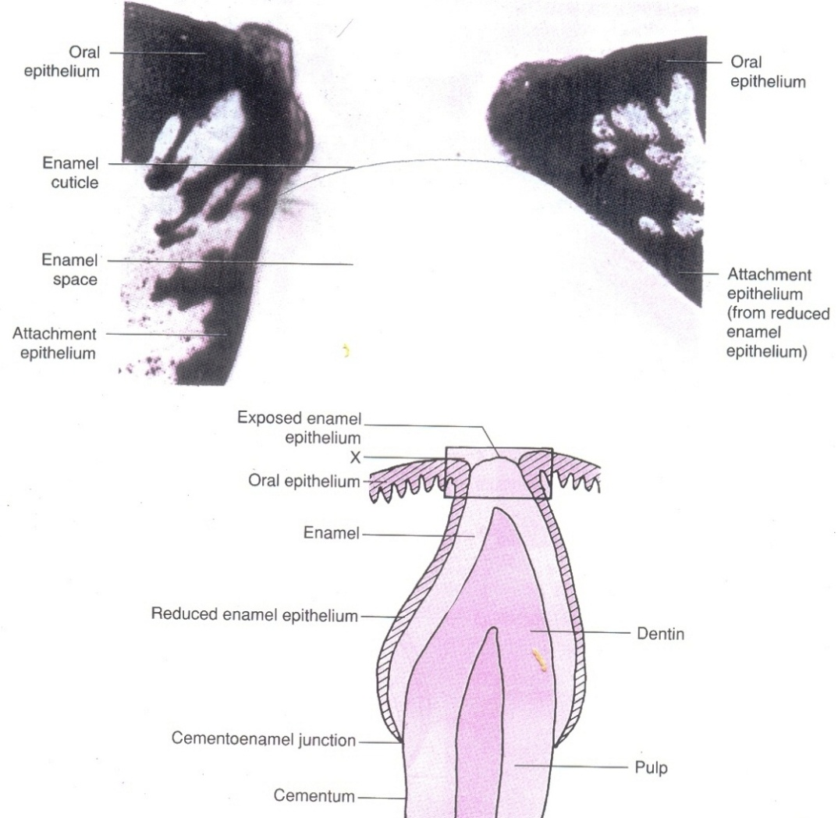

Slide 31
The reduced enamel epithelium, remains organically attached to the part of the enamel that has not yet erupted.
Once the tip of the crown has emerged, the reduced enamel epithelium is termed the primary attachment epithelium.

Slide 32
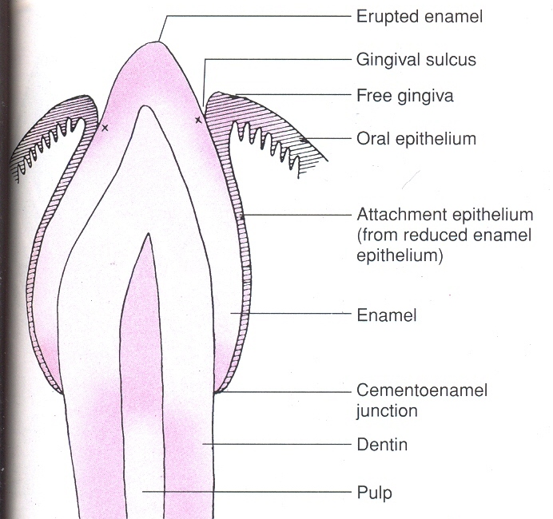
At the margin of the gingiva the attachment epithelium is continuous with the oral epithelium.
As tooth erupts, the reduced enamel epithelium grows gradually shorter.

Slide 33
Shift of dentogingival junction
The position of the gingiva on the surface of the tooth changes with time.
When the tip of the enamel first emerges through the mucous membrane of the oral cavity, the epithelium covers almost the entire enamel.
The attachment epithelium separates from the enamel surface gradually while the crown emerges into the oral cavity.

Slide 34
When the tooth first reaches the plane of occlusion one third to one fourth of the enamel still remains covered by the gingiva. A gradual exposure of the crown follows.
Active Eruption.
Passive Eruption.

Slide 35
Further recession exposing the cementum may ultimately occur. At that stage the reduced enamel epithelium has disappeared and the primary attachment epithelium is replaced by a Secondary Attachment Epithelium derived from the gingival epithelium.

Slide 36

Anatomical crown :- The enamel-covered part of a tooth.
Clinical crown :- The exposed part of a tooth within the oral cavity.

Slide 37
Crown exposure involving passive eruption and further recession has been described in four stages.
The first two may be physiologic.
Many conceive of the last two as normal also, but there is a strong possibility that they are pathologic.

Slide 38
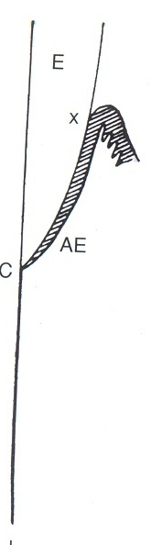
FIRST STAGE
The bottom of the gingival sulcus remains in the region of the enamel-covered crown for some time
The apical end of the attachment epithelium (reduced enamel epithelium) stays at the Cemento-enamel junction.
This relation persists in primary before shedding and, in permanent teeth, usually to the, age of 20 or 30 years.

Slide 39
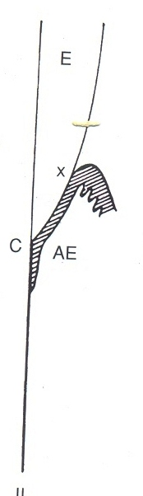
SECOND STAGE
The bottom of gingival sulcus is still on enamel, and the apical end of the attachment epithelium has shifted to the surface of the cementum.
This entails dissolution of fiber bundles that were anchored in the cervical parts of the cementum, now covered by the epithelium, and an apical shift of the gingival and transseptal fibers.

Slide 40
The destruction of the fibers may be caused by enzymes formed by the epithelial cells, by plaque metabolites or enzyme or by immunologic reactions as manifestations of periodontal disease.
This stage of tooth exposure may persist to the age of 40 years or later.

Slide 41
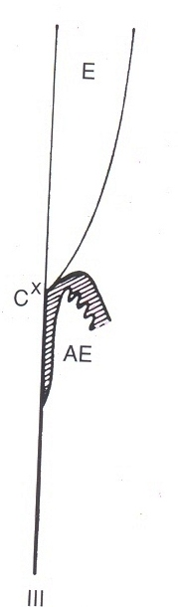
THIRD STAGE
When the bottom of the gingival sulcus is at the cementoenamel junction, the epithelium attachment is entirely on the cementum, and the enamel-covered crown is fully exposed.
This stage in the exposure of a tooth no longer is a passive manifestation. The epithelium shifts gradually along the surface of the tooth and does not remain at the cementoenamel junction.

Slide 42
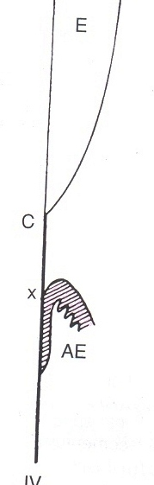
FOURTH STAGE
Fourth Stage
The fourth stage represents recession of the gingiva. When the entire attachment is on cementum, the gingiva may appear normal, but the process is regarded as pathologic.
In some cases the fourth stage is observed in persons during their twenties. In others, even at 50 years of age or older the teeth are still in the first or second stage.

Slide 43
The rate varies also in different teeth of the same jaw and on different surfaces of the same tooth. One side may be in the first stage and the other in the second or even the fourth stage.
Gradual exposure of the tooth makes it necessary to distinguish between the anatomic and the clinical crowns of the tooth.

Slide 44
That part of the tooth covered by enamel is the anatomic crown. The clinical crown is the part of the tooth exposed in the oral cavity.
In the first and second stages the clinical crown is smaller than the anatomic crown.

Slide 45
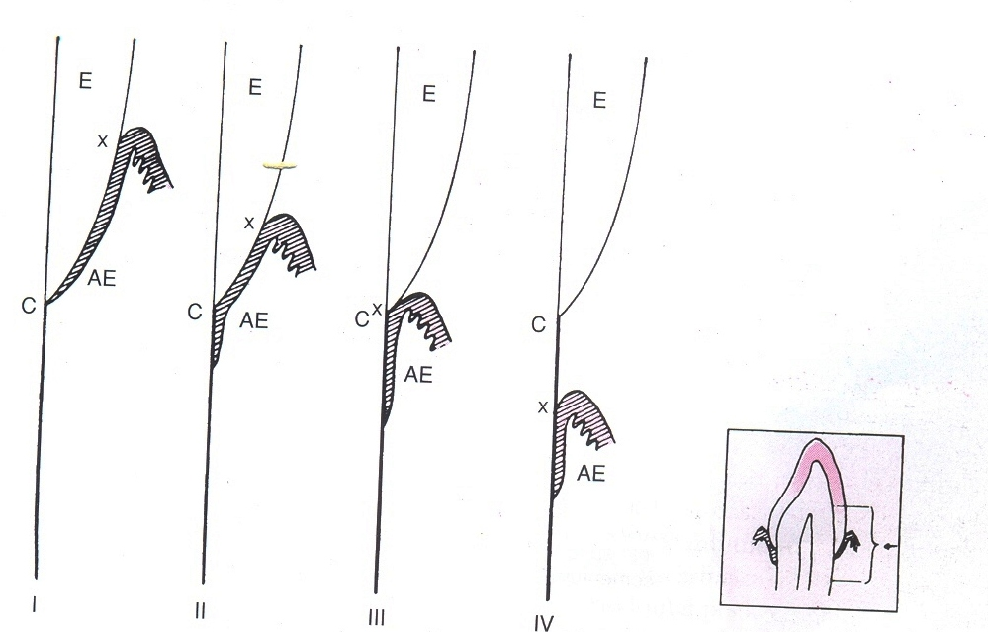
With recession (third stage) the entire enamel-covered part of the tooth is exposed, and the clinical crown is equal to the anatomic crown.
Later the clinical crown is larger than the anatomic crown because parts of the root have been exposed (fourth stage).

Slide 46
SULCUS AND CUTICLES
The primary cuticle mediating an organic union between ameloblasts and the enamel.
When the ameloblasts are replaced by the oral epithelium, a secondary cuticle is formed.

Slide 47
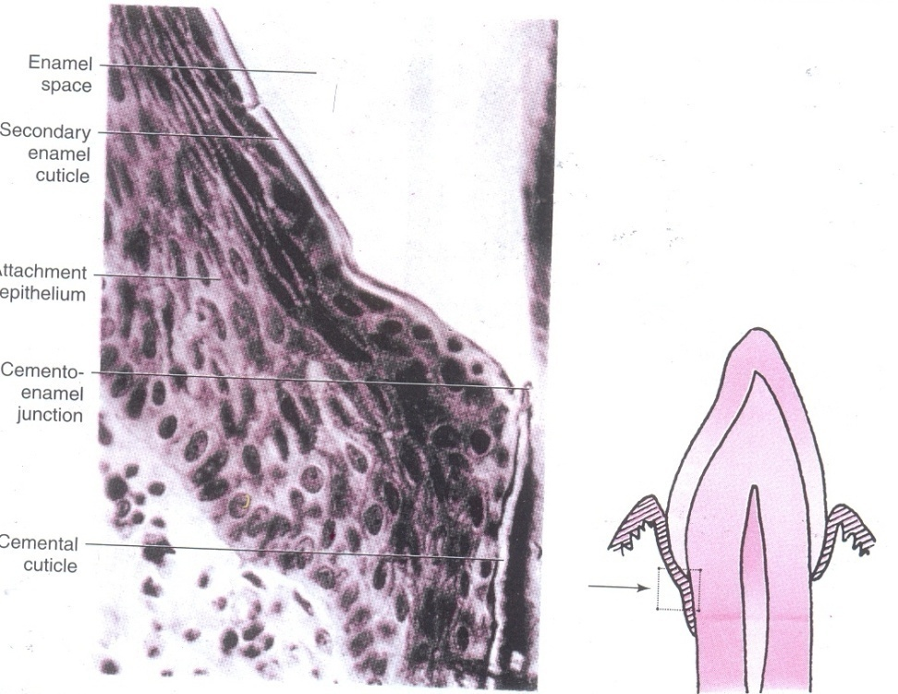
Secondary enamel cuticle and the cemental cuticle are referred to as Dental Cuticle.
These cuticles are microscopically ----an amorphous material between the attachment epithelium and the tooth.

Slide 48
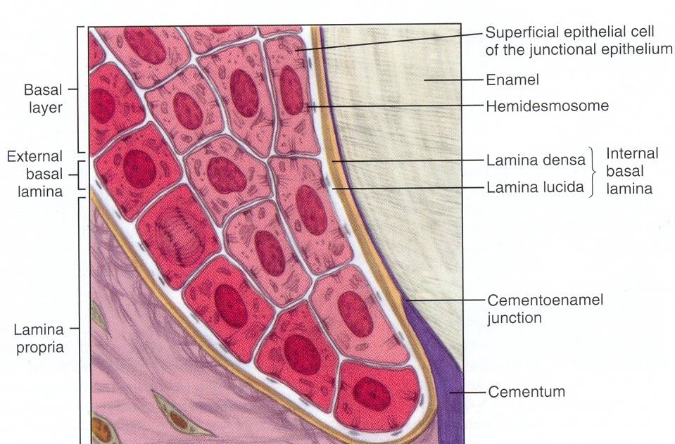

Slide 49
EPITHELIAL ATTACHMENT
The ultrastructural attachment of the primary attachment epithelium to the tooth was first shown by Stern and confirmed by Listgarten and Schroeder, to be basal lamina to which hemidesmosomes are attached.
This mode of attachment is referred to as the epithelial attachment.

Slide 50
The secondary attachment epithelium composed of cells derived from the oral epithelium forms an epithelial attachment identical with that of the primary attachment epithelium, that is a basal lamina and hemidesmosomes.
It is submicroscopic, approximately 40nm wide, and formed by the attachment epithelium.

Slide 51
Internal basal lamina-attaches the cells of attachment epithelium to the tooth via hemidesmosomes
External basal lamina- attaches the basal cells of attachment epithelium to lamina propria

Slide 52
Migration of attachment epithelium
The deepest /basal layer of AE undergoes constant & rapid cell division.
The cells migrate in coronal direction.
They do not undergo differentiation as other cells of keratinised/non keratinised epithelium.

Slide 53
They synthesize basal lamina & so the attachment is maintained by the hemidesmosomes while migration towards coronal direction.
The apical migration of the sulcus –due to detachment of basal cells & a reestablishment of their epithelial attachment at a more apical level.

Slide 54
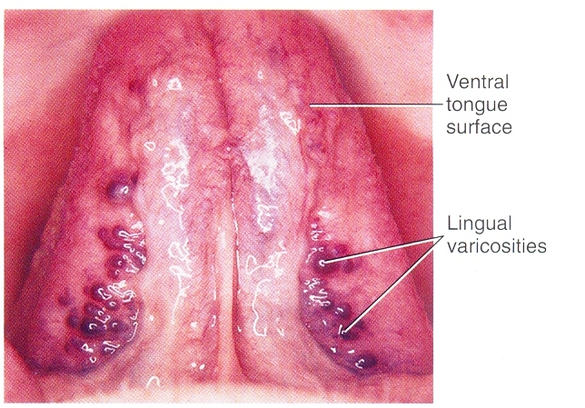
Age changes
With age mucosa becomes smooth & dry
Filiform papillae reduced-tongue appears smooth
Varicose veins on ventral surface of tongue
Ectopic sebaceous glands (Fordyce’s spot)

Slide 55
Turnover rate
The time taken for a cell to divide & pass through the entire epithelium –Turnover rate/Turnover time
Turnover time for oral mucosa –higher than skin
Amongst oral mucosa-junctional epithelium-highest Turnover rate (4-6 days)
Nonkeratinized mucosa -Faster Turnover rate than keratinized

Slide 56
BIBLIOGRAPHY
Color Atlas And Text Book Of Oral Anatomy, Histology Berkovitz, B. 1ST edition.
Oral Development and Histology Avery, j. K.1st edition.
Orban's Oral Histology and Embryology Bhaskar, s. N.11th edition.
Oral Histology : Development, Structure and Funct Tencate, a. R. 4th edition.
Dental Embryology, Histology & Anatomy. Marry Bath- Balogh Inergaret. 2nd edition.

Slide 57
Thank you☺☺☺

